Slide 1
COURSE: PRINCIPLES OF HUMAN RESOURCE MANAGEMENT
LECTURE 7: TRAINING AND DEVELOPMENT
LECTURER: DR LUCY KARIMI KIRIMA
Lecture learning outcomes:
At the end of the lecture, you will be able to:
Explain and discuss the concept of training and development
Understand the difference between training and development
Examine the importance in the organization

Slide 2
EMPLOYEE TRAINING
Training refers to a planned effort by a company to facilitate employees’ learning of job-related competencies. These competencies include knowledge, skills, or behaviors that are critical for successful job performance
Today, training is being evaluated not on the basis of the number of programs offered and training activity in the company but on how training addresses business needs related to learning, behavior change, and performance improvement

Slide 3
EMPLOYEE TRAINING
Training is becoming more performance-focused. That is, training is used to improve employee performance, which leads to improved business results.
Providing educational opportunities for all employees. These educational opportunities may include training programs, but they also include support for taking courses offered outside the company, self-study, and learning through job rotation.
Training being used to help attain strategic business objectives, which help companies gain a competitive advantage.
Training is about developing employees as an individual to make them capable and confident in their jobs, and consequently in their life.

Slide 4
EMPLOYEE TRAINING
Training consists of planned programme designed to improve performance at the individual, group, and /or organizational levels
Training is about developing people as an individual and helping them to become more confident and competent in their lives and in their jobs. The learning process is at the core of training and the ways of and opportunities for learning are numerous and varied
Training is a process of learning a sequence of programmed behavior. It is application of knowledge and it attempts to improve the performance of employee on the current job and prepares them for the intended job

Slide 5
TRAINING OBJECTIVES
The basic objective of training, however, is to establish a match between man and his job. This training is designated to improve the knowledge, skills and attitude and thus, equip the individual to be more effective in his present job or prepare him for future assignment.
Individual Objectives – They help employees in achieving their personal goals, which in turn, enhances the individual contribution to an organization.

Slide 6
TRAINING OBJECTIVES
Organizational Objectives – They assist the organization with its primary objective by bringing individual effectiveness
Functional Objectives – They maintain the department‘s contribution at a level suitable to the organization‘s needs
Societal Objectives – They ensure that an organization is ethically and socially responsible to the needs and challenges of the society.

Slide 7
TRAINING OBJECTIVES
To create constant awareness in the minds of all sections of employees of the mission of the industry, its objective and goals.
To encourage self-development to achieve organization goals with a sense of belonging and commitment to organization and thereby ensuring development of a proper work ethos in the Industry and fostering of team spirit.
To identify the training needs of the entire personnel in industry in keeping with the corporate plans and in consultation with the user departments.

Slide 8
TRAINING OBJECTIVES
To organize training activities as aids to: Career Planning and growth of Succession planning.
To educate and equip the employees to respond to the expectations of customers, and to accept responsibilities to attain a sense of achievement.
To achieve effectiveness of training through tapping the in-house training facilities as well as sources available externally in a balanced manner so as to develop internal faculty support at all levels and disciplines.
To promote research and development activities and to establish linkages with the operational front.

Slide 9
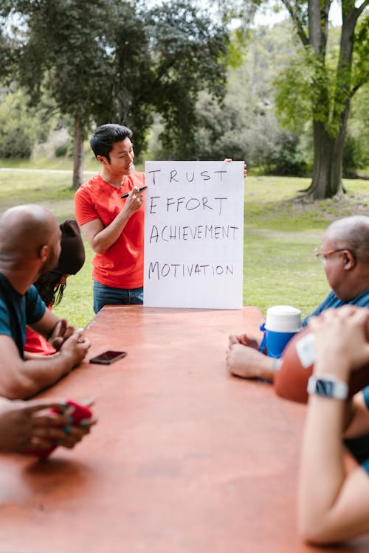
TRAINING OBJECTIVES
To increase productivity and quality
To promote versatility and adaptability to new methods
To reduce the number of accidents
To reduce labour turnover
To increase job satisfaction displaying itself in lower labour turn-over and less absenteeism
To increase efficiency
https://www.pexels.com/photo/man-speaking-to-a-group-on-team-building-7551454/

Slide 10
Advantages of training
Leads to improved profitability and/or more positive attitudes toward profits orientation.
Improves the job knowledge and skills at all levels of the organization.
Improves the morale of the workforce.
Improves the relationship between boss and subordinate.
. Aids in organizational development.
Helps people identify with organizational goals.
Helps create a better corporate image.
Fasters authentically, openness and trust

Slide 11
Advantages of training
Helps prepare guidelines for work.
Aids in understanding and carrying out organizational policies.
Provides information for future needs in all areas of the organization.
Organization gets more effective decision-making and problem solving.
Aids in development for promotion from within.

Slide 12
Advantages of training
Aids in developing leadership skill, motivation, loyalty, better attitudes, and other aspects that successful workers and managers usually display.
Aids in increasing productivity and/or quality of work.
Helps keep costs down in many areas, e.g. production, personnel. Administration, etc.
Develops a sense of responsibility to the organization for being competent and knowledgeable.

Slide 13

Advantages of training
Improves labor-management relations.
Reduces outside consulting costs by utilizing competent internal consulting.
https://www.pexels.com/photo/man-and-woman-pulling-a-rope-7551734/

Slide 14
Disadvantages of training
Can be a financial drain on resources; expensive development and testing, expensive to operate?
Often takes people away from their job for varying periods of time;
Equips staff to leave for a better job
Bad habits passed on
Narrow experience

Slide 15
ORGANIZATIONAL CHARACTERISTICS THAT INFLUENCE TRAINING
Top Management Support The CEO
The top manager in the company, plays a key role in determining the importance of training and learning in the company. The CEO is responsible for:
• A clear direction for learning (vision).
• Encouragement, resources, and commitment for strategic learning (sponsor).
• Taking an active role in governing learning, including reviewing goals and objectives and providing insight on how to measure training effectiveness (governor).

Slide 16
ORGANIZATIONAL CHARACTERISTICS THAT INFLUENCE TRAINING
Integration of Business Units -The degree to which a company’s units or businesses are integrated affects the kind of training that takes place. In a highly integrated business, employees need to understand other units, services, and products in the company
Global presence .For companies with global operations, training is used to prepare employees for temporary or long-term overseas assignments.

Slide 17

ORGANIZATIONAL CHARACTERISTICS THAT INFLUENCE TRAINING
Business Conditions When unemployment is low and/or businesses are growing at a high rate and need more employees, companies often find it difficult to attract new employees, find employees with necessary skills, and retain current employees. Companies may find themselves in the position of hiring employees who might not be qualified for the job
https://www.pexels.com/photo/group-of-people-sitting-inside-train-2372943/

Slide 18
HUMAN RESOURCE DEVELOPMENT
Human Resources Development is the process of improving, moulding and changing the skills, knowledge, creative ability, aptitude, attitude, values and commitment, based on present and future job and organisational requirements

Slide 19
Development
According to Nadler: Development is concerned with providing learning experiences to employees so that they may be ready to move in new directions that organisational change may require. Development is the need to enhance competencies beyond those required by the immediate job.
According to Peter F. Druker, "the prosperity, if not the survival of any business depends on the performance of its managers of tomorrow." The human resource should be nurtured and used for the benefit of the organisation.

Slide 20
Human Resource Development
Human Resource Development in the organization context refers to the process whereby the workers are continuously helped in a planned way to:
a) Acquire or sharpen capabilities required to perform various tasks and functions associated with their present or future expected roles.
b) Develop general enabling capabilities as individuals so that they are able to discover and exploit their own inner potential for their own and/ or organizational development purposes.

Slide 21
Human Resource Development
c) Develop an organizational culture where ‘superior/ subordinate’ relationships, ‘teamwork’ and ‘collaboration’ among different sub-units, which are strong and contribute to the professional well-being, motivation and pride of work
HRD is developing people so that, they are competent managers and competent workers and committed to the organizational goals.

Slide 22
HRD objectives
To develop the skills and knowledge of employees to enhance performance.
To improve the quality of work -life in the organization
To create a learning culture in the organization
To promote teamwork and collaboration among employees
To enhance employee motivation and engagement
To ensure the availability of a skilled workforce to meet future organizational needs

Slide 23
Nature of human resources development
Inherent part of Management: Human Resource Management is inherent part of management because if the manager wants to draw best out of his people, he must do the basic responsibility of selecting people who will work under him along with he must train, motivate appraise them from time to time
Inherent part of Management: Human Resource Management is inherent part of management because if the manager wants to draw best out of his people, he must do the basic responsibility of selecting people who will work under him along with he must train, motivate appraise them from time to time

Slide 24
Nature of human resources development
Personnel Function: It involves various functions concerned with managing people from man power planning recruitment, selection , placement, training, appraisal to compensation of employees.
Continuous Process: It is not a one step function rather it is a continuous process

Slide 25
Success factors of HRD
The organization believes that development of employee is in its own interest.
The organizations will provide opportunities and conditions for the development and optimization of human resources.
The management is willing to invest adequate time and resources for the development of the workers and to personally participate in the development
Managers have concern for growth of subordinates
Workers are willing to avail of given opportunities for growth and receive such help from the managers as may be necessary for the development and improving performance.
Training is one of the most important elements of HRD process.

Slide 26
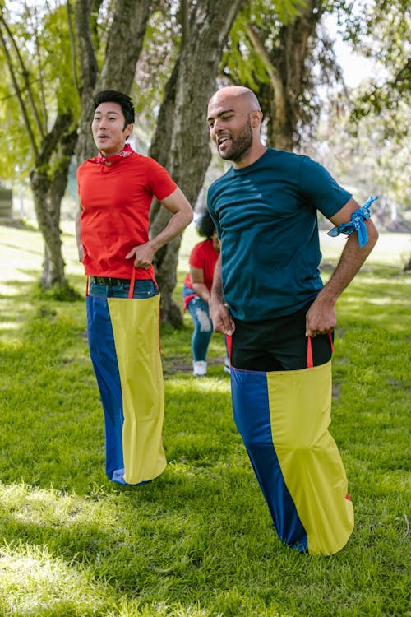
Significance of HRD activities
Human resource development is crucial for today’s companies. Having an edge over the competition is vital in the marketplace
It helps in the integrated growth of workers.
It helps workers to know their strength and weaknesses and enablethem to improve their performance and that of organizations. There is pressure to produce quality products and provide quality services. With increased competition, there is a need to become cost effective and efficient
https://www.pexels.com/photo/two-men-doing-the-sack-race-7551722/

Slide 27
Significance of HRD activities
Every organization consists of man, material, machines or infrastructure and many of all these factors human beings are of special category not only because they have their own needs, ideas, feelings, hopes, aspirations, but also because they are the prime movers behind the other factors. ‘People are human resource and hence valuable to the organization’.
They are important contributors to the achievement of organizational goals. People as assets have unlimited potential. It is only important to tap this potential and invest for increasing this resource to yield rich harvest.

Slide 28
Significance of HRD activities
HRD is pursuing excellence of people through enhancing knowledge, skill, attitudes and thereby seeking committed and motivated resources for their intense participation.
HRD activities, therefore, plays vital role in creating an atmosphere for sustained high quality. HRD activities are essential and significant for any growth oriented and dynamic organization which wants to succeed in a fast changing and competitive environment
Enhanced employee satisfaction: HRD activities such as training, career development and mentoring can improve employee satisfaction and motivation

Slide 29
Significance of HRD activities
Reduced employee turnover: HRD activities can increase employee engagement and loyalty, reducing the turnover rate
Increased employee engagement: HRD can increase employee engagement by providing employees with opportunities for professional development and career growth.

Slide 30
HRD challenges
Rapid technological advancements. Technology is constantly changing, and organizations need to keep up with the latest advancements to remain competitive
Managing diversity: The workforce is becoming increasingly diverse, which can create unique challenges for HRD professionals
Changing demographics: The demographics of the workforce are changing with more employees working remotely or on apart -time basis.
Budget constraints: HRD initiatives require resources, including financial resources, which can create challenges for organizations with limited budgets

Slide 31
HRD challenges
Culture or attitude: Different countries have different culture and as the world has become a global village HRD Professionals have to face the cultural challenges in different countries or with the employees belonging to the different countries.
Values of behaviour: The HRD professionals have to adjust themselves to the emerging new values as principle centric leadership is becoming trend in the corporate world
Lifestyle or habits: The life style of an employee is also important for HRD professionals because they have to understand the habits of the employees and then decide the training that needs to be imparted for bringing a change in the habits of the employees

Slide 32
References
Handbook of HR Management practice,Armstrong M,Kogan,London,10th Edition, 2008
Human Resource Contemporary Perspective,Beard Well Ian &Hlen,Prentice Hall London ,2008
Human Resource Management,Legge karen,Palgrave Macmillan London,1995
Managing Human Resources, Molaner C,London,Routledge,1994
Human Resource Mangemngent,Chandra,M,Chadalawada Engineering College,2018-2019

Slide 33
References
Introduction to HRM,Stredwick,J,British Cataloguing in Publication Data,2005
Human Resource Management,Guru Jambheshwar University,Hisar-125001
Human Resource Management,Smt.Shyamala etl,Calicut University,Computer Section,SDE,2014
Human Resource and Personnel Management ,Aswathapa, McGraw-Hill Publishing Company Ltd., New Delhi,2008
Human Resource Management, Biswajeet Pattanayak, Prentice Hall of India Pvt. Ltd., New Delhi,2001
Mamoria C.B., Rao, VSP, Personnal Management (Text and cases), Himalays Publishing, Mumbai( 2012)

Slide 34
References
Human Resource Management, Lloyed L. Byers and Leslie W. Rue (5th edition),The McGraw-Hill Companies, USA,1997.
Michael Armstrong (1999), A Handbook of Human Resource Management Practice (7th
edition), Michael Armstrong, Kogan Page Limited, 120 Pentonvelle Road, London,1999
Mamoria C.B., Gankar S.V. “A Textbook of Human Resource Management”, Himalaya Publishing House, New Delhi,(20060
Prentice Hall, Englewood Cliffs, New Jersey,(1999)

Slide 35
References
Dwivedi R.S., “Personnel Management in Indian Enterprises”, Galgotia Publising Company, New Delhi (1997)
Devid A. Decenzo, Stephen P. Robbins, “Personnel/Human Resource Management”, Prentice Hall of India, New Delhi (2002)
Prasad L.M., Human Resource Management,” Sultan Chand & Sons, New Delhi (2005)
Dessler Gary, “Personnel Management”, Prentice Hall International Editions, New Jersey (2001)

Slide 36
References
Carrell Michael R., Elbert Norbert F., Hatfield Robert D., “Human Resource Management,
RDNE Stock Project,2021. https://www.pexels.com/photo/man-speaking-to-a-group-on-team-building-7551454/
RDNE Stock Project,2021. https://www.pexels.com/photo/man-and-woman-pulling-a-rope-7551734/
Matheus Viana,2019. https://www.pexels.com/photo/group-of-people-sitting-inside-train-2372943/

Slide 37
References
RDNE Stock Project,2021 . https://www.pexels.com/photo/two-men-doing-the-sack-race-7551722/

