Slide 1
Course: Financial Analysis
Lecture 4- Comparative, Common Size and Dupont Analysis
Course Instructor: Dr. Charity Njoka (PhD)

Slide 2
Intended Learning Outcomes
By the end of this lesson , you should be able to,
Discuss the difference between Comparative
Statement Analysis and Common Size Analysis.
2. Evaluate a firms performance using common
Size analysis techniques
3. Apply Du Pont analysis in evaluating firms performance

Slide 3
Introduction
Ratio analysis provided us with some insight into the functioning of a firm and complexities of a business enterprise.
However ratios have limited usage as conclusive comments cannot be made.
Further analysis is therefore required to be made in order to reach to some definitive conclusions
For example, comparing ratios over time and with those of other similar companies.

Slide 4
Further Tools and Techniques
There are various tools and techniques that can help to understand businesses more
These are
comparative financial statements,
common size analysis, and
Dupont analysis.

Slide 5
Comparative Financial Statements
It is a tool of financial analysis that shows changes in each item of the financial statement
Changes are shown in absolute amount and in percentage,
Amounts of the preceding accounting period as the base, for comparison purposes.

Slide 6
Types of Comparative Statements
1. Comparative statement of financial position
This is also sometimes referred to as Balance Sheet; and
2. Comparative income statement
This is also sometimes referred to as Statement of Profit and Loss.

Slide 7
. Techniques of Comparative Analysis
There are two techniques of comparative analysis are especially popular:
i) Year-to-year change analysis and
ii) Index-number trend analysis.
.

Slide 8
Year-to-Year Change Analysis
This is comparing financial statements over relatively short time periods, usually two to three year
A year-to-year change analysis for short time periods is manageable and understandable.
It has the advantage of presenting changes in absolute dollar amounts as well as in percentages.

Slide 9
Challenges of Year-to-year Changes
When a negative amount appears in the base and a positive amount in the next period (or vice versa), it is hard to compute a meaningful percentage change.
2) When there is no amount for the base period, no percentage change is computable.
3) When the base period amount is small, a percentage change can be computed but the number must be interpreted with caution.
4) When an item has a value in the base period and none in the next period, the decrease is 100%.

Slide 10
Index-number Trend Analysis.
Trend analysis takes into account several years to look at the past to assess the present situation and to forecast the future.
It may also be applied to projected financial statements prepared by the company.
Trend Analysis is a statement in vertical form where the earliest year is taken as base year and the value of all the items in the financial statements will be related to the base year in terms of %

Slide 11
Illustration: Comparative Statement of Financial Position
  From the following statement of financial position of Kanta Ltd. as at 31 December 2023 and 2022, prepare a comparative statement of financial position

Slide 12
Kanta Ltd statement
Particulars | Dec 2023 | Dec 2022
1 Equity & Liabilities: Shareholder’s funds (a) Share Capital (b) Reserves & Surplus Non-current Liabilities Long term borrowings Current liabilities Trade payables Total | I 2,000,000 400,000 1,600,000 800,000 | II 1,000,000 600,000 1,000,000 400,000
 | 4,800,000 | 3,000,000
II Assets: Fixed Assets: i. Tangible Assets ii. Intangible Assets Current Assets (a) Inventories (b) Cash & Cash equivalents Total | 2,800,000 600,000 1,000,000 400,000 | 16,00,000 400,000 800,000 200,000
 | 4,800,000 | 3,000,000

Slide 13
Solution: Comparative Financial statement
Particulars | Dec 2023 | Dec 2022 | Abs Change | % Change
Equity & Liabilities: Shareholder’s funds (a) Share Capital (b) Reserves & Surplus Non-current Liabilities Long term borrowings Current liabilities Trade payables Total | I 2,000,000 400,000 1,600,000 800,000 | II 1,000,000 600,000 1,000,000 400,000 | II-I= III 10,00,000 (2,00,000) 6,00,000 4,00,000 | III/I x 100 100% (33.33%) 60% 100%
 | 4,800,000 3,000,000 1,800,000 60%
II Assets: Fixed Assets: i. Tangible Assets ii. Intangible Assets Current Assets (a) Inventories (b) Cash & Cash equivalents Total | 2,800,000 600,000 1,000,000 400,000 4,800,000 | 16,00,000 400,000 800,000 200,000 3,000,000 | 1,200,000 200,000 200,000 200,000 1,800,000 | 75% 50% 25% 100% 60%

Slide 14
Steps for Capital Calculations
Absolute amount of share capital for 31st Dec 2022 = 1000,000
& for 31st Dec 2023 = 20,00,0000
Absolute change in share capital = Current year figure – Previous year figure
= 20, 00,000 – 10, 00,000 = 10, 00,000
% change = (absolute change/Previous year figure ) × 100 = 10,00,000/10,00,000
= 100%
2. For Reserves & Surplus = (200,000/600,000) × 100 = 33.33%
Here absolute change is in negative figure ∴ % change will also be in bracket indicating -ve%

Slide 15
Illustration Comparative income statement
From the following information for the years ended
31st December 2023 and 2022 prepare
a comparative income statement of Kanta Limited
NB: Rate of Income Tax 50%
Particulars | Dec 2023 | Dec 2022
Revenue operations Expenses Other income | 700,000 450,000 75,000 | 500,000 375,000 100,000

Slide 16
Solution
Particulars | Dec 2022 | Dec 2023 | Absolute Change | Change %
Revenue from operations Add: Other income Total revenue Less: Expenses Profit before tax Less: Tax 50% Profit after tax | 500,000 100,000 600,000 375,000 225,000 112,500 112,500 | 700,000 75,000 775,000 450,000 325,000 162,500 162,500 | 200,000 (25,000) 175,000 75,000 100,000 50,000 50,000 | 40% (25%) 29.17% 20% 44.4% 44.4% 44.4%

Slide 17
Importance of Comparative Financial Statement
1. To make the data simple and more understandable.
2. To indicate the trend with respect to the previous year.
3. To compare the firm’s performance with the performance of other firm in the same business.

Slide 18
Disadvantages of Comparative Financial Statements
Misleading picture, if consistency in accounting principle not followed.
2. Constant change in price level tender accounting statement useless for comparison.

Slide 19
Disadvantages of Comparative Financial Statements Ctd
3. Inter firm comparison (comparison of the financial performance of the firm with its close competitors or the industry averages) is useless, unless all the firms are of the same age, size and follow the same principles.
4.If there exists any Abnormal Period between 2 successive accounting period then it will prove to be a pointless analysis.

Slide 20
Common Size Financial Statements
Common-size analysis is the restatement of financial statement information in a standardized form.
Common Size Financial Statements are the statements in which every item of the Financial Statement is reduced to a common base.
This was introduced with a view to overcome the limitation of Comparative Statement.
Here amounts of the various items of financial statements are converted into percentages to a common base.

Slide 21
Types of Common Size Statements:
Common Size Statement of Financial Position (Balance Sheet);
2.. Common Size Income Statement (Statement of Profit and Loss).

Slide 22
Steps for formation of common size financial statement
Step 1: Take the figure of previous year
Step 2: Take the figure of current year
Step 3: Calculate % total of each item to total of base which is 100 for previous year.
Step 4: Calculate % total of each item to total of base which is 100 for current year.

Slide 23
Common Size Statement of Financial Position (Balance Sheet)
This is a statement in which every item of assets, equity and liabilities is expressed as a percentage to the total of all assets or to the total of Equity and Liabilities.
Total Assets or Total Equity and Liabilities are taken as Common base. Specifically, in analyzing a statement of financial position, it is common to express total assets (or liabilities plus equity) as 100%.
Then, accounts within these groupings are expressed as a percentage of their respective total.

Slide 24
Illustration
Prepare a ‘Common Size statement of financial position on the basis of the information
Particulars | Dec 2022
Shareholders’ Funds Share Capital Reserves & Surplus Liabilities Long term loans Trade Payables TOTAL Assets Tangible Assets Non-current investiments Inventories Trade Receivables Cash& cash equivalents TOTAL | 600,000 100,000 250,000 50,000 1,000,000 650,000 150,000 70,000 50,000 80,000 1,000,000

Slide 25
Solution
Particulars | Dec 2022 | % of total assets
Shareholders’ Funds Share Capital Reserves & Surplus Liabilities a)Long term loans b)Trade Payables TOTAL Assets a)Tangible Assets b)Non-current investments c)Inventories d)Trade Receivables e)Cash& cash equivalents TOTAL | 600,000 100,000 250,000 50,000 1,000,000 650,000 150,000 70,000 50,000 80,000 1,000,000 | 60% 10% 25% 5% 100% 65% 15% 7% 5% 8% 100%

Slide 26
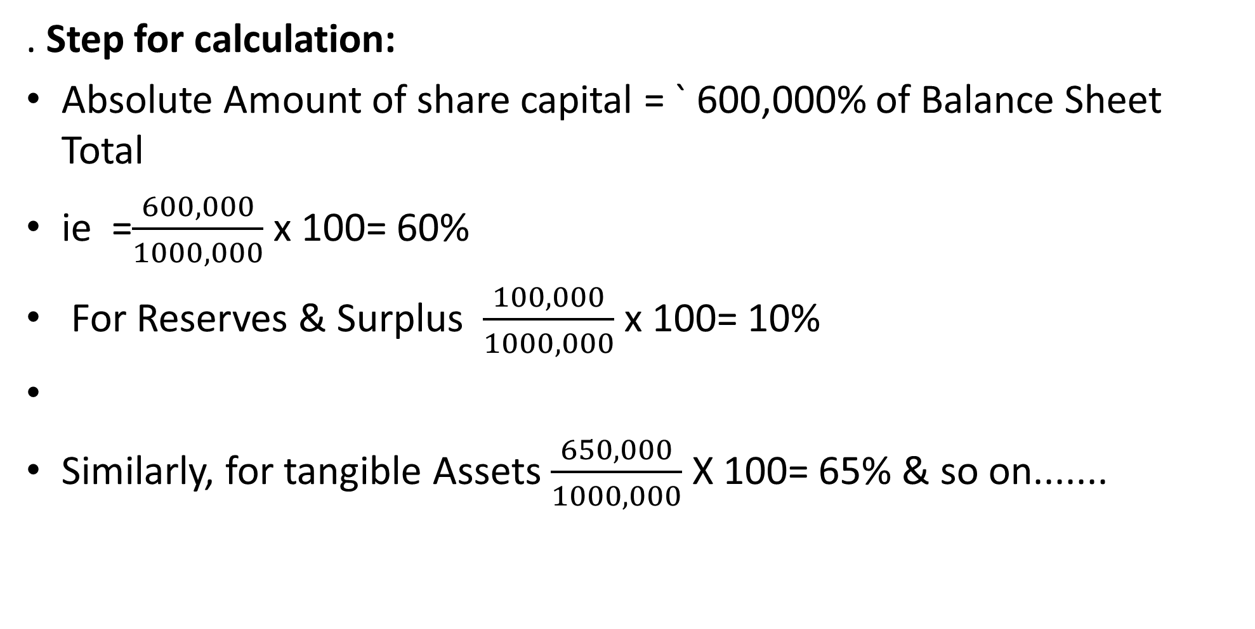
Steps for calculation
.
. Step for calculation:
Absolute Amount of share capital = ` 600,000% of Balance Sheet Total
ie =$\frac{600,000}{1000,000}$ x 100= 60%
For Reserves & Surplus $\frac{100,000}{1000,000}$ x 100= 10%
Similarly, for tangible Assets $\frac{650,000}{1000,000}$ X 100= 65% & so on.......

Slide 27
Common Size Income Statement
This is a statement that shows the percentage relation of each income/expense to the Revenue from Operations (Net Sales) .
In analyzing an income statement, sales are often set at 100% with the remaining income statement accounts expressed as a percentage of sales
With the help of the comparison between the Common-size Income Statements of different periods, one can understand the efficiency in earning revenues and incurring expenses.

Slide 28
Illustration
Illustration
Prepare a Common Size Income Statement from the following information.
Particulars | 2022 | 2023
Revenue from operations ( % of cost of material consumed) Cost of material consumed Other expenses ( % of revenue from operations) Other income Tax rate | 125% 240,000 10% 15,000 30% | 140% 250,000 12% 20,000 30%

Slide 29
Solution
Particulars | Amounts | Amounts | % of Revenue from operation (Net Sales)
 | 2022 ($) | 2023($) | 2022 % | 2023%
I. Revenue from operations II. Add Other revenue III. Total revenue IV. Expenses Materials consumed Other expenses Total expenses V. Profit before tax(III-V) Less income tax VI. Profit after tax | 300,000 15,000 | 350,000 20,000 | 100.00 5.00 | 100.00 5.71
 | 315,000 | 370,000 | 105.00 | 105.71
 | 240,000 30,000 | 250,000 42,000 | 80.00 10.00 | 71.43 12.00
 | 270,000 | 292,000 | 90.00 | 83.43
 | 45,000 (13,500) | 78,000 (23,400) | 15.00 (4.50) | 22.80 (6.69)
 | 31,500 | 54,600 | 10.50 | 15,59

Slide 30
Objectives/Utility of Common Size Statements.
The basic objective of a Common-size Income Statement is to analyse the change in individual terms of the Income Statement.
2. It is also prepared to study the trend in different items of Incomes and Expenses.
3. Lastly, it is prepared for the assessment of efficiency.

Slide 31
Dupont System of Analysis
It was created by the DuPont Corporation in the 1920s.
The DuPont analysis is also referred to as the DuPont identity.
The Du Pont system is a method of breaking down return ratios into their components to determine which areas are responsible for a firm’s performance.

Slide 32
Dupont System of Analysis
The DuPont formula uses the relationship among financial statement accounts to decompose a return into components; that is efficiency, margins and leverage (or equity multiplier).
The rationale is that these are three key drivers of performance ie Return on Equity (ROE);
ROE = Profit Margin x Total Asset Turnover x Leverage Factor

Slide 33
Formula
ROE = (Net Income/Revenues) x (Revenues/Total Assets) x (Total Assets/ Shareholders' Equity)
Net Profit margin indicates profitability; asset turnover ratio evaluates the efficiency in the usage of the assets of the firms, while Equity Multiplier is a proxy for financial leverage.
Thus, the DuPont Analysis highlights that a firm may increase its ROE by maintaining a high Net Profit Margin, efficient use of total assets and optimum leverage.

Slide 34
Stages of DuPont Analysis
In DuPont analysis, ROE is divided into various parts to determine and decide which particular factor is responsible for the changes in ROE
1 Determine Net Profit Margin
Net profit Margins refer to the ratio of bottom-line profits compared to total revenue or sales a company generates.
Net Profit Margin = Revenue ÷ Net Income
High net profit margins indicate that a company can generate considerable profit from sales.

Slide 35
Stages of DuPont Analysis Ctd
2. Determine Asset Turnover Ratio
The asset turnover ratio refers to how a company uses its assets efficiently to generate income or revenue.
Asset Turnover Ratio = Net Sales ÷ Average Total Assets
Asset turnover ratios can vary from sector to sector as not all investments can return as much as others.
.

Slide 36
Stages of DuPont Analysis Ctd
3.Determine Equity Multiplier (EM) or Financial Leverage
Financial leverage, or gearing, refers to using debt or borrowed capital to finance a company's assets or investments. It is a strategy employed by firms to amplify their potential ROE.
Financial Leverage = Company's Total Assets ÷ Total Stockholders' Equity
Most companies use financial leverage to carry out projects and investments and finance their business operations, especially when they are accompanied by capital.

Slide 37
Illustration
Apply DuPont Analysis method to calculate and compare the ROE of Aponet and Samonet
 | APONET | SAMONET
Net Profit Margin | 25.31% | 12.8%
Asset Turnover Ratio | 1.09 | 0.57
Equity Multiplier | 5.52 | 4.06
ROE | 25.31% x 1.09 x 5.52 = 1.5228 | 12.8% x 0.57 x 4.06 = 0.2962

Slide 38
Summary
In comparative statement deviation for current year to previous year is always divided by previous year amount.
In common size statement of Profit & Loss take revenue from operation as common base not the total revenue.
In common size Balance Sheet take Balance Sheet total amount either total assets or total liabilities as common base.
DuPont analysis is just one of many tools used to evaluate a company's financial performance, and a higher DuPont analysis score generally indicates a higher level of profitability.

Slide 39
References
Financial statement analysis(2014) :K. R. Subramanyam., McGraw-Hill Education
Financial Analysis Tools and Technique: A Guide for Manager, Erich Helfert,McGraw Hill (2001)
Financial Management and Analysis Workbook : Step-By-Step Exercises and Tests to Help You Master Financial Management and Analysis:Frank J. Fabozzi, Pamela P. Peterson, and Wendy D. Habegger (2004):

