Slide 1
Course: Financial Analysis
Lecture 5- Financial Forecasting - Percentage Sales Method
Course Instructor: Dr. Charity Njoka (PhD)

Slide 2
Intended Learning Outcomes
By the end of this lesson , you should be able to,
Explain the meaning and the process
of financial forecasting
2. Evaluate the percentage of sales
method of financial forecasting
3. Apply percentage of sales method
in financial forecasting

Slide 3
Introduction
Financial forecasting involves deciding in advance the financial requirements of the firm in order for it to meet its objectives.
It is the process of estimating or predicting how a business will perform in the future.
Forecast’ means to form an opinion beforehand i.e. to make a prediction.

Slide 4
Introduction- Definitions
Financial forecasting means a systematic projection of the expected action of finance through financial statements.
Such forecasting needs past records, cash flow and fund-flow behaviour, the applications of financial ratios etc. along with the industrial economic condition.
It is a kind of plan which will be formulated at a future date for a specified period.

Slide 5
Importance of Financial Forecasting
It allows the company's managers to plan for the future.
The purpose is not to predict next year's outcome.
There are so many uncertainties that truly exist thus accurate predictions may not be possible.
However, forecasting lets you decide in what direction to move your company.

Slide 6
Importance of Financial Forecasting Ctd
5. Provides a benchmark for measuring future performance
6. Identifies potential risks and cash shortfalls
7. Provides an estimate of future cash needs and whether external financing will be needed
8. It helps you decide on particular strategies or between various strategies. It can show you the things that the company must do to improve.
9. Making decisions affects the future of company.

Slide 7
Importance of Financial Forecasting Ctd
9. Forecasting can help you understand the many ways that the decision can interrelate with the company's financial condition.
10. By planning you attempt to reduce some of the uncertainty about the future.
11. You can determine some of the things are that you need to do to make the decision a success and what some of the potential pitfalls are those may undermine it.

Slide 8
Determinants of a Forecast
Financial forecasting requires the following three considerations
1-Accuracy of the forecast
Before any forecast process is undertaken, business decisions should be made as to how much accuracy can be reasonably expected from it.
.

Slide 9
Determinants of a Forecast Ctd
2-Cost-Benefit trade off
It is always possible to obtain more accurate forecast of some financial variable if more effort is used.
The main issue would be to justify whether the extra cost of the process will bring in more benefits and enhance the process of forecasting.
Ideally the costs should not outweigh the potential benefits
.

Slide 10
. Determinants of a Forecast Ctd
3-Timeliness of the forecast.
Careful consideration of the timeliness of the forecast can be broken into three issues.
i)How timely the forecast is: As events change new information becomes available, forecasts must be updated. Managers should know how frequently these forecasts need to be updated and consequently the cost of updating the forecast should be weighed against the potential benefit or increased accuracy.
.

Slide 11
. Determinants of a Forecast Ctd
3-Timeliness of the forecast.
ii) -How far into the future should the forecast go: e.g. does the decision that is to be made require one year or 10 years forecast? Forecasts are however best relied upon in the short term.
ii) -The level of data details necessary e.g. whether to use monthly, quarterly or annual data.
.

Slide 12
Types of forecast
1. Qualitative/judgmental forecast
2. Time series forecast
3. Causal forecast .

Slide 13
1. Judgmental
These forecasts are derived from judgment and experience. The major short coming of this type of forecast are;
i) Subjective
ii) Require the input from many people hence time consuming
iii) Some people may withhold crucial information if they think that their opinion differs with the other people e.g. forecast that are obtained through the Delphi approach.

Slide 14
2. Time series forecast & 3.Causal forecast
Time series is the tracking of a particular variable over time using the time series data.
A model is created that would predict its future movements.
NB:In time series analysis the financial analyst does not identify the factors that cause the movement of a particular financial variable over time.
Causal forecasting is concerned with explaining the cause and effect relationship of the variable

Slide 15
Process of Financial Forecast
Financial forecasting is a systematic structured process which may be iterative in some cases as it is based on assumptions.
Forecasting financial statements is important for a number of reasons among them planning for the future and providing information to the company’s investors.
There are various methods of financial forecasting such as:
1) Percentage of sales method,
2) Regression analysis
3) Time series
4) Pro forma financial statements 5) Others

Slide 16
Percentage of Sales method.
The simplest method of forecasting income statements and balance sheets is the percentage sales method
This method has the added advantage of requiring relatively little data to make a forecast.
The fundamental assumption of the percentage of sales method is that some, but not all, income statement and balance sheet items maintain a constant relationship with the level of sales.

Slide 17
Steps in Percentage of Sales method
Isolate the balance sheet items that are expected to vary with sales e.g.
Current assets – These have a direct a relationship with sales e.g. if sales increase, stock is also expected to increase and so will debtors due to increase in credit sales.
b) Fixed assets (Non-Current assets) – These also have a direct relationship with sales e.g. extra orders may require extra machines.

Slide 18
Steps in Percentage of Sales method Ctd
c) Current liabilities – These also have a direct relationship with sales e.g. more of raw materials (e.g. creditors) may be required to produce additional units.
Long term liabilities – This will remain constant, and there may be no direct relationship between sales and long term liabilities.

Slide 19
Steps in Percentage of Sales method Ctd
e) Ordinary share capital – This will also remain constant as is the case with long term liabilities.
f) Retained earnings – This will depend on the firm’s profitability and dividend policy.

Slide 20
Steps in Percentage of Sales method Ctd
2. Determine the actual relationship between the balance sheet items and sales e.g. fixed assets (Non-current assets) may be 40% of sales, current assets 30% of sales etc.
3. Forecast the future sales and the balance sheet items required to support the forecast sales.
.

Slide 21
Steps in Percentage of Sales method Ctd
4. Determine the external financial requirements, which is the difference between the sources of funds and uses of funds.
5. Decide on the source of the additional funds required e.g. will the additional funds come from retained earnings or long-term loan capital.

Slide 22
Illustration
Exat Ltd has found a consistent relationship among the following accounts as a percentage of sales.
Current assets – 65%
Net fixed assets – 25%
Accounts payable – 10%
Other current liabilities – 12%
Net profit after taxes – 5%.
The company’s sales for year 1 (2020) were $10,000,000 and are expected to grow at 10% every year.

Slide 23
Illustration Ctd
From the following a)Determine Exat Ltd financial requirements and b) Prepare a Pro forma statement of financial position as at 31.12.2025
Assets | $’000
Non-Current Assets | 2500
Current assets | 6500
Total | 9000
Financed by;
Ordinary share capital | 2000
Retained Earnings | 2600
Long term loan | 1000
Current liabilities
Accounts payable | 1000
Notes payable | 1200
Other current liabilities | 1200
Total | 9000

Slide 24
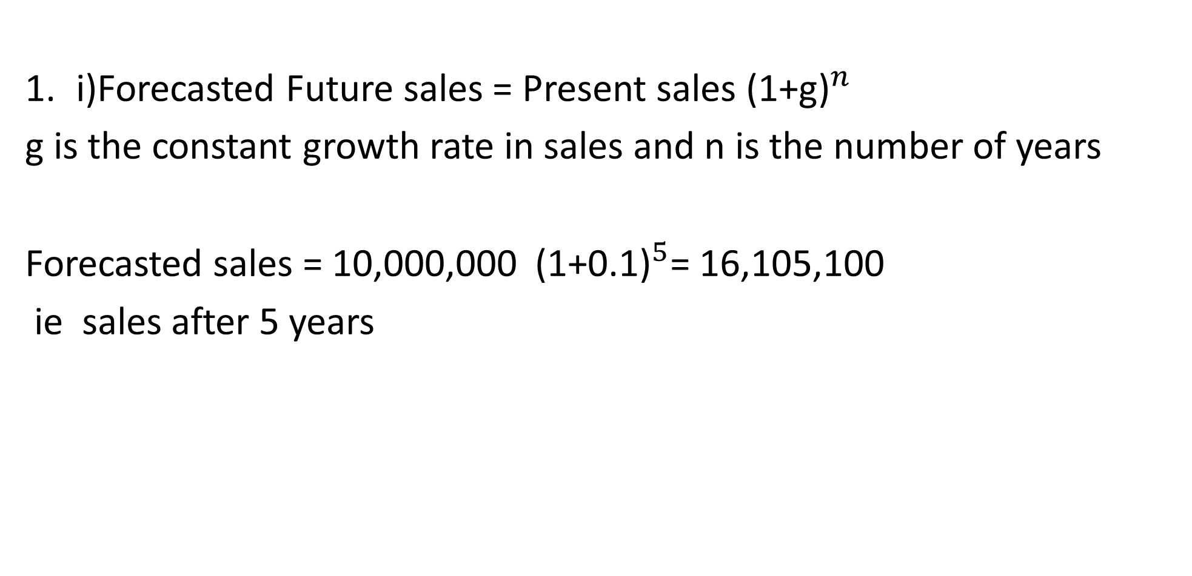
Solution- a)Forecasted Future sales
i)Forecasted Future sales = Present sales (${\text{1+}\text{g}\text{)}}^{n}$
g is the constant growth rate in sales and n is the number of years
Forecasted sales = 10,000,000 (${\text{1+0.1}\text{)}}^{5}$= 16,105,100
ie sales after 5 years

Slide 25
Solution- Value of assets and liabilities after 5 years
Current assets = 65% x 16,105,100 = 10,468,515
Fixed assets = 25% x 16,105,100 = 4,026,275
Accounts payable =10% x 16,105,100 = 1,610,510
Other current liabilities=12% x 16,105,100 = 1,932,612
NB:% relationships of accounts are multiplied by sales figure in 5 years

Slide 26
Retained Earnings (RE)
RE for year ended 31.12.20 ……………………………. = 2,600,000
RE for year ended 31.12.21 = 5% x (10,000,000 x 110%) = 550,000
RE for year ended 31.12.22 = 5% x (11,000,000 x 110%) = 605,000
REfor year ended 31.12.23 = 5% x (12,100,000 x 110%) = 665,500
REfor year ended 31.12.24 = 5% x (13,310,000 x 110%) = 732,050
RE for year ended 31.12.25 = 5% x (14,641,000 x 110%) = 805,255
Total retained earnings 5,957,805
NB: RE are 5% ( related to net profit after taxes)of sales that are growing at 10% p,a

Slide 27
Financial requirements after 5 years solution Ctd
Uses of funds
Increase in the current assets
(10,468,315 – 6,500,000) = 3,968,315
Increase in fixed assets
(4,026,275 – 2,500,000) = 1,526,275
Payments of notes payable = 1,200,000
6,694,590

Slide 28
Financial requirements after 5 years Ctd-
Sources of funds
Increase in retained earnings
(5,957,805 – 2,600,000) = 3,357,805
Increase in accounts payable
(1,610,510 – 1,000,000) = 610,510
Increase in other current liabilities
(1,932,612 -1,200,000) = 732,612
4,700,927
Therefore, external financial requirements
= 6,694,590, - 4,700,927= 1,993,663

Slide 29
Pro Forma Financial Statements
:
The most comprehensive look at the future financial performance of a company can be obtained by developing a set of pro forma statements.
The pro forma statements represent a broad operational plan for the business and the anticipated cumulative impact of assumed future decisions on its financial condition.
The statements are prepared by taking the most readily available estimates of future activity and projecting, account by account, the assumed results and conditions.

Slide 30
Pro Forma statement of financial Position
Assets
Non-Current Assets | 4,026,275
Current assets | 10,,468,315
Total | 14,494,590
Financed by;
Ordinary share capital | 2,000,000
Retained Earnings | 5,957,805
Long term loan | 1,000,000
Current liabilities
Accounts payable | 1,993,663
Notes payable | 1,610,510
Other current liabilities | 1,932,612
Total | 14,494,590

Slide 31
Illustration
Management of ABC ltd wants to establish the amount of financial needs for the next 2 years. The statement of financial position as at 31.12.23 $ 000 $ 000
Assets Financed by
Non current assets 124,800 Ordinary share capital 84,000
Stock 38,400 Retained profits 35,200
Debtors 28,800 12% long term loan 20,000
Cash 7,200 Trade creditors 36,000
Accrued expenses 24,000
Total assets 199,200 Total 199,200

Slide 32
Additional information
For the year ended 31.12.23 sales amounted to $ 240m.
The firm projects that the sales will increase by 15% in 2024 and 20% in 2025.
After tax profit on sales has been 8 % but the management is pessimistic about the future and intends to maintain a dividend payout ratio of 80%.
Assets are expected to vary directly with the sales.

Slide 33
Additional information Ctd
5. Trade creditors and accrued expenses form the spontaneous sources of financing.
6. Any external financing will be effected through the use of a commercial paper.
Required
1. Determine the amount of external financing required for the next 2 yrs.
2. A proforma statement of financial positions as at 31.12.2025

Slide 34
Solution
Sales for 2024 = 240,000 x 1.15 = 276.000
If sales increase by 15% , assets will also increase by the same
Non-current assets = 115% x 124,800 = 143,520
Stock = 115% x 38,400 = 44,160
Debtors = 115% x 28,800 = 32,120
Cash = 115% x 7,200= 8,280
Creditors= 115% x 36,000 = 41,400
Accrued expenses = 115% x 24,000=27,600

Slide 35
Solution Ctd
.
. Forecast 2025
F.A = 120% x 143,520 = 172,224
Stock = 120% x 44,160 = 52,992
Debtors 120% x 32,120=39,744
Cash = 120% x 8,280 = 9,936
Creditors = 120% x 27,600 = 33,120
NB: sales increase by 20% in th second year, hence same % increase in assets

Slide 36
a)Common Size Income Statement
2024
Retained earnings:
Balance b/d 35,200
After tax profit = 8% (115% x 240,000) =22,080
Less dividends 80% (17,664)
39,616
2025
Balance b/d 39,616
After tax profit = 8% (115% 120 %x 240,000) =26,496
Less dividends 80% (21,197)
Balance c/d 44,915

Slide 37
Illustration
Financial Requirements
Uses of funds
Increase in fixed assets
= 172,224 – 124,800 = 47,424
2. Increase in stock = 52,992 – 38,400 = 14,552
3. Increase in debtors = 39,744 – 28,800 = 10,944
4. Increase in cash = 9,936 – 7,200 = 2,736
Total 75,696

Slide 38
Financial requirements-Ctd
Sources of funds
Increase in retained profits = 44,915 – 35,200 = 9,715
2. Increase creditors = 49,680-36,000= 13,680
3. Increase in accrued expenses = 33,120-24,000=9,120
Total 32 515
External financing = 75,696 – 32,515 = 43,181

Slide 39
Proforma Balance sheet
Assets
Non-CA 172,224
Stock 52,992
Debtors 39,744
Cash 9,936
Total 274896
Financed by:
Share capital 84,000
Retained 44,915
Long term loan 20,000
Trade creditors 49,680
Accrued expenses 33,120
Commercial papers 43,181
Total 274896

Slide 40
REFERENCES
Financial Analysis Tools and Technique: A Guide for Manager, Erich Helfert, McGraw Hill (2001)
The Essentials of Financial Analysis, Samuel Weaver, McGraw Hill (2012)
Financial statement analysis :K. R. Subramanyam., McGraw-Hill Education(2014)

