Slide 1
Course: Financial Analysis
Lesson 6: Financial Forecasting - Regression And Time Series Methods
Course Instructor: Dr. Charity Njoka (PhD)

Slide 2
Intended Learning Outcomes
By the end of this lesson , you should be able to,
1 Apply simple regression analysis in financial forecasting
2. Apply the linear trend extrapolation method (time series)
of financial forecasting

Slide 3
Regression Analysis
Regression analysis is the statistical technique that identifies and model the relationship between two or more variables.
i.e. predictor/explanatory also known as dependent variable whose value is to be predicted and an independent variable(s) about which knowledge is available.
The technique is used to find the equation that represents the relationship between the variables.

Slide 4
Linear regression models
There are two major types
Simple linear regression
Ii) Multiple linear regression

Slide 5
Simple Linear Regression
This is where there is one dependent variable and one independent variable
y = a +bx
where:
y = dependent variable
x = Independent variable
a, b = constants

Slide 6
Multiple Regression Model
This is where there is more than one independent variable.
Y=a+b1x1+b2x2+…+bnxn
Where;
x1, x2…..xn are the independent variables
Y= dependent variable

Slide 7
Simple Linear Regression Model
The least-squares method is widely used in regression analysis for estimating the parameter values in a regression equation.
The regression method includes all the observed data and attempts to find a line of best fit.
To find this line, a technique called the least-squares method also known as (ordinary least square method) is used.

Slide 8
Error Term
To explain the least-squares method, we define the error as the difference between the observed value and the estimated one and denote it with u.
Symbolically, u = Y - Y',
Where Y = observed value of the dependent variable
Y' = estimated value based on Y' = a + bX
.

Slide 9
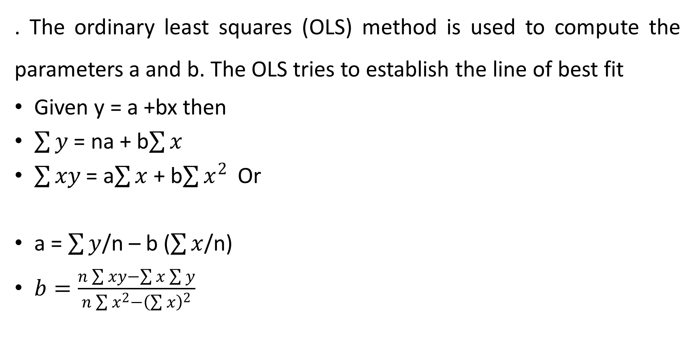
OLS Formula
. The ordinary least squares (OLS) method is used to compute the parameters a and b. The OLS tries to establish the line of best fit
Given y = a +bx then
$\sum{y}$ = na + b$\sum{x}$
$\sum{xy}$ = a$\sum{x}$ + b$\sum{x^{2}}$Or
a = $\sum{y}$/n – b ($\sum{x}$/n)
$b=\frac{n\sum{xy}−\sum{x}\sum{y}}{n\sum{x^{2}}−{\left(\sum{x}\right)}^{2}}$

Slide 10
Illustration
.
X | Y
Energy Expenditure | Output( Tonnes)
106 | 20
138 | 21
158 | 25
172 | 26
120 | 21
142 | 23
184 | 28
102 | 20
164 | 25
192 | 29

Slide 11
Required
a). Determine the regression line that relates the energy expenditure with the output
b). Using the regression line estimate the energy expenditure in the month output if planned is i)27 tonnes ii) 40 tonnes
c) Determine the forecasted expenditure when the output is 20 tonnes using the model. What is the error term?
.

Slide 12
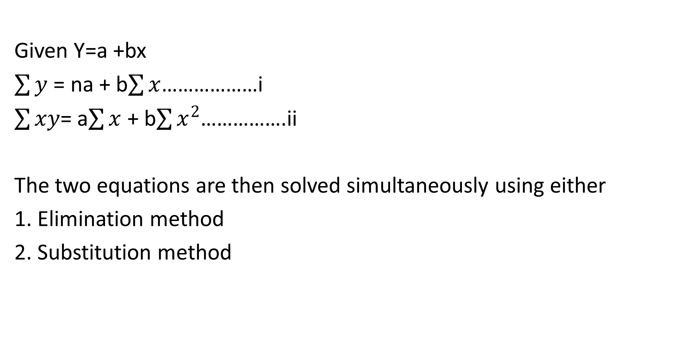
Solution
Given Y=a +bx
$\sum{y}$ = na + b$\sum{x}$………………i
$\sum{xy}$= a$\sum{x}$ + b$\sum{x^{2}}$…………….ii
The two equations are then solved simultaneously using either
1. Elimination method
2. Substitution method

Slide 13
Solution
Y | X | Xy | X2
106 | 20 | 2120 | 400
138 | 22 | 3036 | 484
158 | 25 | 3950 | 625
172 | 26 | 4472 | 676
120 | 21 | 2520 | 441
142 | 23 | 3266 | 529
184 | 28 | 5152 | 784
102 | 20 | 2040 | 400
164 | 25 | 4100 | 625
192 | 29 | 5568 | 841
1478 | 239 | 36224 | 5805

Slide 14
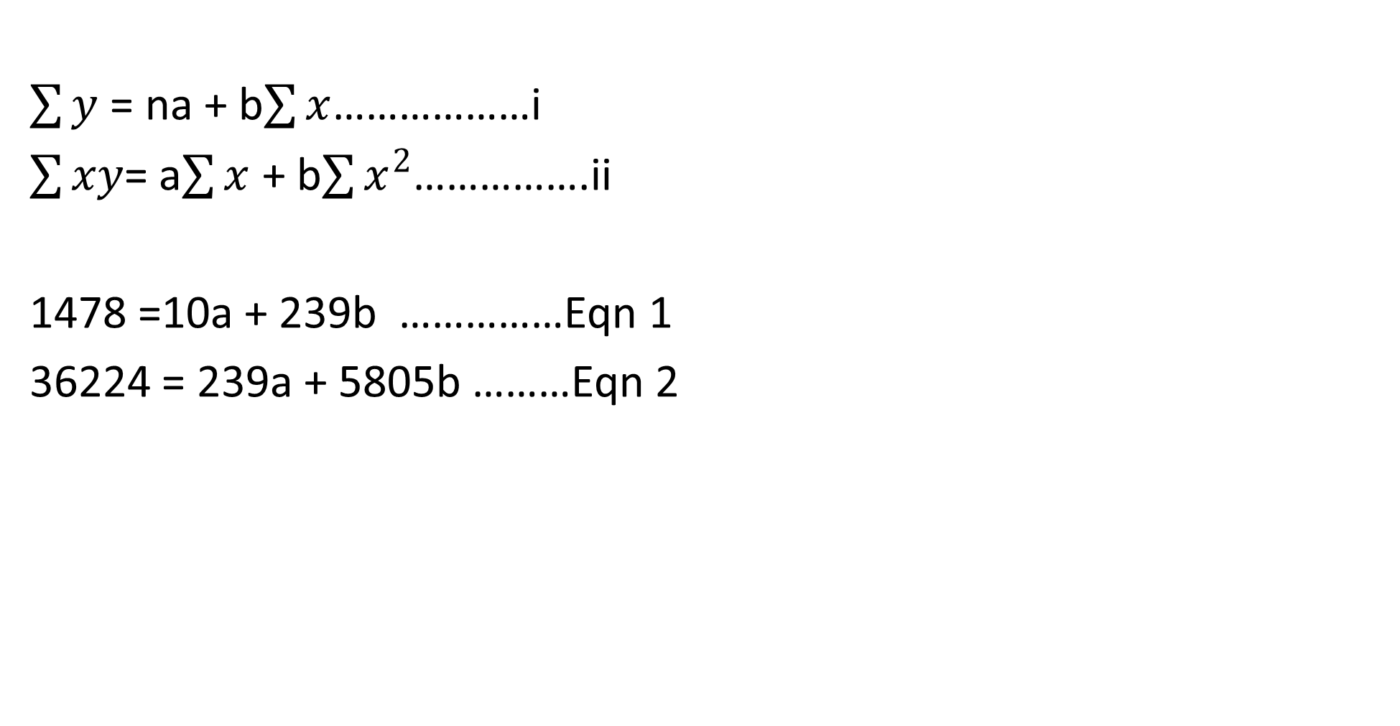
Models
$\sum{y}$ = na + b$\sum{x}$………………i
$\sum{xy}$= a$\sum{x}$ + b$\sum{x^{2}}$…………….ii
1478 =10a + 239b ……………Eqn 1
36224 = 239a + 5805b ………Eqn 2

Slide 15
Solution ctd
Elimination Method …
Multiply Eqn 1 by 239 and Eqn 2 by 10
353242 = 2390a + 57121b………… Eqn 3
362240 = 2390a + 58050b …………..Eqn 4
8998 = 929b , b = 9.69
Now replace ‘b’ with 9.69
1478 = 10a + 239 (9.69)
10a = -837.91 , a = -83.79
a) y = -83.79 + 9.69x

Slide 16
Solution ctd.
b) i)for 27 tonnes , replace x with 27
Expenditure, y = -83.79 + 9.69(27)
= $ 177.84
ii) for 40 tonnes
Expenditure y = -83.79 +9.69(40)
= $ 303.81

Slide 17
Solution ctd
c) Determine the forecasted expenditure when the output is 20 tonnes using the model
y = -83.79 + 9.69 (20)
= $110.01 (forecasted)
Error term
The difference between the forecasted result variable and the actual result variable is referred to as the error term.
=$106 (actual)
Error term = 110.06 – 106 = 4.01

Slide 18
Linear trend extrapolation method (Time series analysis)
The ability to forecast the future with high degree of accuracy is very important.
. Time series analysis comprises methods for analyzing time series data in order to extract meaningful statistics and other characteristics of the data.
Time series forecasting is the use of a model to predict future values based on previously observed values

Slide 19
Time series and its components
The process of developing a forecast starts with collection of past data for several time periods (time series ).
The time periods can vary in length they can be quarterly, yearly, monthly or even daily, hourly eg the price of actively trading stock.
A time series is a collection of data for some variable and the main purpose of time series analysis is to predict or forecast future values of the variable from the past observations.

Slide 20
Components of Time Series
The series contains at least one of the following 4 components:
1. Secular trend (T)
The trend is the long run behavior of the variables over an extended length of time .It reflects the general direction of the time series which could be upwards or downwards or constant. Such are caused by changes in demography, technology or climate.
2. The seasonal variations(S)
These are patterns in a time series data that occur and recur within almost the same time period in successive periods. Such are caused by weather, customs and religion

Slide 21
Components of Time Series Ctd
3. The cyclical variation(C)
These are patterns of fluctuations above and below the trend line ordinarily in the medium term. They are best explained by the business cycles
4. Random variations(e)
Are irregular factors that do not have huge impact on time series data eg evaporation, spillage etc. They are normally inherent and one can only try to minimize their occurrence. This is the error term

Slide 22
Components of Time Series
5. Erratic factors
These are variations in a time series that are caused by unusual occurrence such as war, floods, political issues, earthquakes etc but with huge impact on time series data.
Due to their nature they cannot be predicted hence cannot be mathematically modelled.

Slide 23
Types of time series models
1. Additive model = y= T+S+C+e
The additive model is appropriate when the components of the time series are independent of each other. The seasonal influence through time is constant
2. Multiplicative model = y= Tx S x C x e
The multiplicative model is appropriate when the components are dependent on each other.

Slide 24
Techniques of Extracting the trend line
1. Semi average method
2. Least square method
3. Moving averages
4. Exponential smoothing

Slide 25
1. Semi average method
This method is simple and relatively objective.
Here the data is divided into two equal halves and an arithmetic mean of the two sets of values determined.
When data provided is even we simply divide it into two halves and then calculate average of each half.
When data is odd, we can leave the middle data.

Slide 26
Advatages & Disadvantages of Semi average method
Advantages
1. The method is simple to understand as compared to other methods for measuring secular trends
2. Everyone who applies this method will get the same result
Disadvantages
1 The method assumes a straight line relationship between the plotted points without considering the fact whether the relationships exists or not
2. If we add data to the original data then we have to do the complete process again for the new data to get the new trend values and the trend line also changes

Slide 27
Question- Observe the following data
Week/ day | Week 1 | Week2
Mon | 250 | 260
Tue | 320 | 380
Wed | 340 | 410
Thur | 520 | 670
Frid | 410 | 420

Slide 28
Solution
Find the mean of the 2 groups
Week 1 =1,840/5 = 368
Week 2= 2140/5 = 428
Use the two points to construct the equation
 | M | T | W | T | F | Total
Week 1 | 250 | 320 | 340 | 520 | 410 | 1,840
Week 2 | 260 | 380 | 410 | 670 | 420 | 2,140

Slide 29
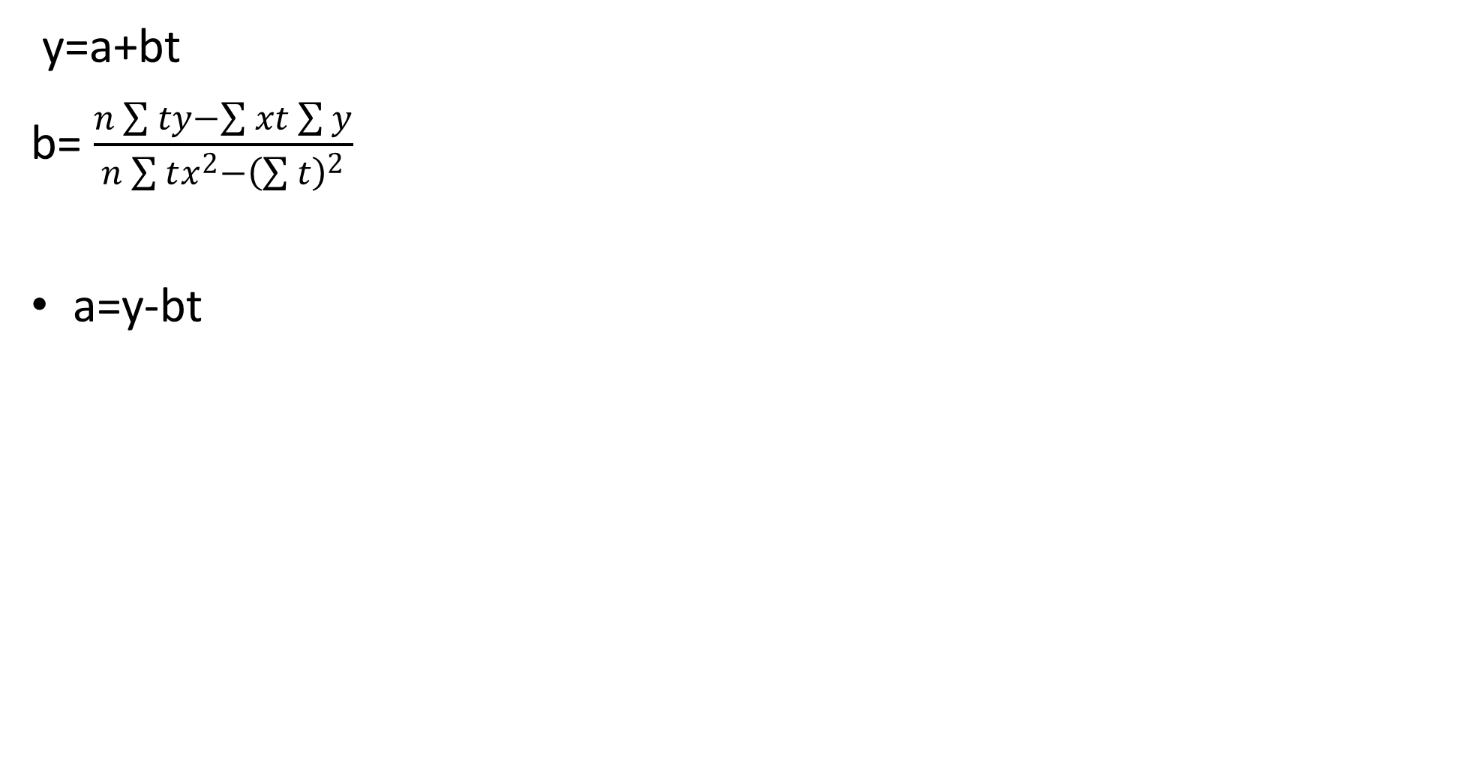
Ordinary least squares (OLS) method
:
y=a+bt
b= $\frac{n\sum{ty}−\sum{xt}\sum{y}}{n\sum{tx^{2}}−{\left(\sum{t}\right)}^{2}}$
a=y-bt

Slide 30
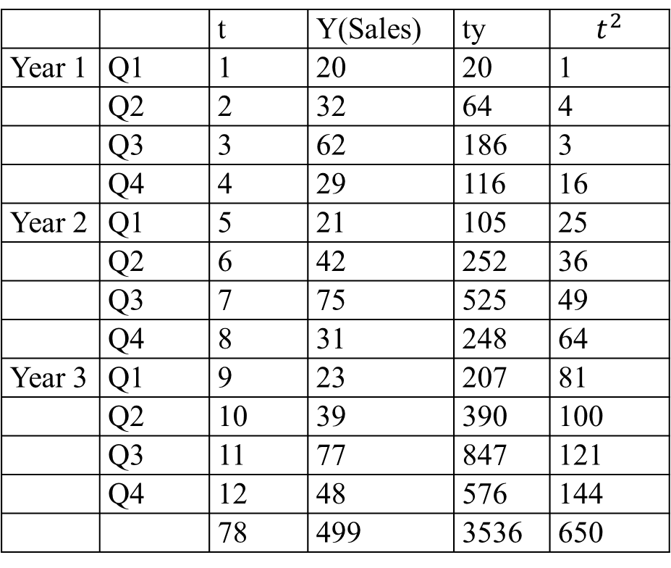
2nd Illustration
 |  | t | Y(Sales) | ty | $$t^{2}$$
Year 1 | Q1 | 1 | 20 | 20 | 1
 | Q2 | 2 | 32 | 64 | 4
 | Q3 | 3 | 62 | 186 | 3
 | Q4 | 4 | 29 | 116 | 16
Year 2 | Q1 | 5 | 21 | 105 | 25
 | Q2 | 6 | 42 | 252 | 36
 | Q3 | 7 | 75 | 525 | 49
 | Q4 | 8 | 31 | 248 | 64
Year 3 | Q1 | 9 | 23 | 207 | 81
 | Q2 | 10 | 39 | 390 | 100
 | Q3 | 11 | 77 | 847 | 121
 | Q4 | 12 | 48 | 576 | 144
 |  | 78 | 499 | 3536 | 650

Slide 31
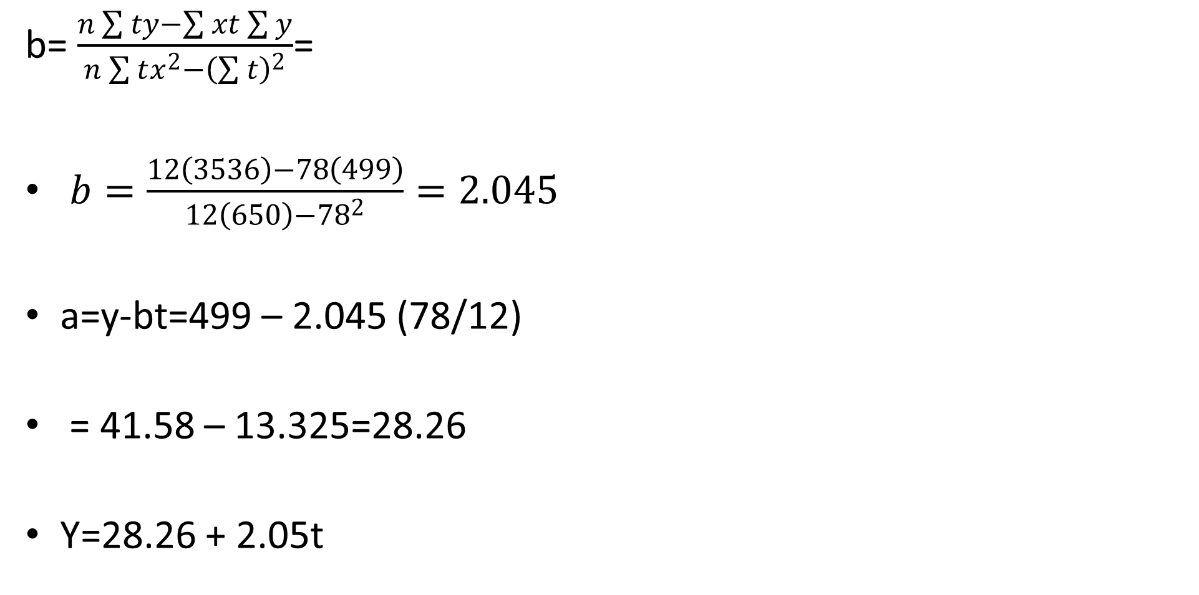
Solution:
b= $\frac{n\sum{ty}−\sum{xt}\sum{y}}{n\sum{tx^{2}}−{\left(\sum{t}\right)}^{2}}$=
$b=\frac{12\left(3536\right)−78\left(499\right)}{12\left(650\right)−{78}^{2}}=2.045$
a=y-bt=499 – 2.045 (78/12)
= 41.58 – 13.325=28.26
Y=28.26 + 2.05t

Slide 32
Moving Averages
Moving averages are averages that are updated as new information is received.
With the moving average, a manager simply employs the most recent observations to calculate an average, which is used as the forecast for the next period.
The period can be a month, a day, a quarter year etc

Slide 33
Illustration
Assume that the marketing manager has the following sales data.
Date Actual Sales
Jan.1 46
2 54
3 53
4 46
5 58
6 49
7 54
Required: Predict the sales for the seventh and eighth days of January, using i) one is a six-day moving average and ii) a three-day average.

Slide 34
Solution
Case 1
Y'7 = (46 + 54 + 53 + 46 + 58 + 49)/6 = 51
Y'8 (54 + 53 + 46 + 58 + 49 + 54)/6= 52.3
where Y' = predicted
Case 2
Y'7 = (46 + 58 + 9)/3= 51
Y'8 = (58 + 49 + 54)/3=53.6

Slide 35
Observations /notes
In terms of weights given to observations, in case 1, the old data received a weight of 5/6, and the current observation got a weight of 1/6.
In case 2, the old data received a weight of only 2/3 while the current observation received a weight of 1/3.
Thus, the marketing manager's choice of the number of periods to use in a moving average is a measure of the relative importance attached to old versus current data.

Slide 36
Advantages and Disadvantages of Moving Average
1.The moving average is simple to use and easy to understand.
However, there are two shortcomings.
1. It requires you to retain a great deal of data and carry it along with you from forecast period to forecast period.
2. All data in the sample are weighted equally.
3. If more recent data are more valid than older data, why not give it greater weight?

Slide 37
Exponential Smoothing
.
.Exponential smoothing gets around the disadvantages of moving averages.
It is a popular technique for short-run forecasting by financial managers.
It uses a weighted average of past data as the basis for a forecast.
The procedure gives heaviest weight to more recent information and smaller weights to observations in the more distant past factors such as market conditions, prices, or the effects of competitors' actions.

Slide 38
Exponential Smoothing
.
The reason for this is that the future is more dependent upon the recent past than on the distant past.
The method is known to be effective when there is randomness and no seasonal fluctuations in the data.
One disadvantage of the method, however, is that it does not include industrial or economic factors such as market conditions, prices, or the effects of competitors' actions.

Slide 39
The Model
The formula for exponential smoothing is:
Y't+1 = αYt + ( 1 - α ) Y't
or in other words,
Y'new = αY old + (1 - α ) Y'old
where Y'new = Exponentially smoothed average to be used as the forecast.
Y-old = Most recent actual data.
Y'old = Most recent smoothed forecast.
α = Smoothing constant.
The higher the α, the higher the weight given to the more recent information

Slide 40
Illustration
Time period (t) Actual sales
(1000)(Yt)
1 $60.0
2 64.0
3 58.0
4 66.0
5 70.0
6 60.0
7 70.0
8 74.0
9 62.0
10 74.0
11 68.0
12 66.0
13 60.0
14 66.0
15 62.0

Slide 41
Solution
To initialize the exponential smoothing process, we must have the initial forecast.
The first smoothed forecast to be used can be
1. First actual observations.
2. An average of the actual data for a few periods.
For illustrative purposes, let us use a six-period average as the initial forecast Y'7 with a smoothing constant of = 0.40.

Slide 42
Solution Ctd
Then Y'7 = (Y1 + Y2 + Y3+ Y4 + Y5 + Y6)/6
= (60 + 64 + 58 + 66 + 70 + 60)/6 = 63
Note that Y7 = 70.
Then Y'8 is computed as follows:
Y'8 = αY7 + (1 - α) Y'7
= (0.40)(70) + (0.60)(63)
= 28.0 + 37.80 = 65.80

Slide 43
Solution Ctd
Similarly,
Y'9 = αY8 + (1 - α) Y'8
= (0.40)(74) + (0.60)(65.80)
= 29.60 + 39.48 = 69.08
and
Y'10 = αY9 + (1 - α)Y'9
= (0.40)(62) + (0.60)(69.08)
= 24.80 + 41.45 = 66.25

Slide 44
REFERENCES
Financial statement analysis(2014) :K. R. Subramanyam., McGraw-Hill Education
Financial Analysis Tools and Technique: A Guide for Manager, Erich Helfert,McGraw Hill (2001)
Financial Management and Analysis Workbook : Step-By-Step Exercises and Tests to Help You Master Financial Management and Analysis:Frank J. Fabozzi, Pamela P. Peterson, and Wendy D. Habegger (2004):

