Slide 1
RESEARCH METHODS AND TECHNICAL WRITING
BAR 301
WEEK 4: Research Problem
BY
Dr. Julius Kahuthia Mwangi

Slide 2
Learning Objectives
By the end of this lesson, you should be able to;
Define a research problem
Give steps of identifying a research problem
Identify sources of a research problem
Discuss the various types of variables
Highlight criteria for a good research title.

Slide 3
Part One
Introduction
Sources of research problem
Steps in Identification of problems for academic research.
Internal criteria of selecting a problem
External criteria of selecting a problem

Slide 4
Introduction
A research problem is a gap in existing knowledge, a contradiction in an established theory, or a real-world challenge that a researcher aims to address in their research.
It is at the heart of any scientific inquiry, directing the path of an investigation.

Slide 5
Sources of Problems
1. Reading: When we critically study books and articles relating to the subject of our interest, pertinent questions may arise in our mind. Similarly, areas of research may strike to our mind when we read research reports.
2. Academic experience: Classroom lectures, class discussions, seminar discussions and out-of-class exchanges of ideas with fellow students and professors will suggest many stimulating problems to be studied.

Slide 6
Sources of Problems
3. Daily experience: Life is dynamic. We learn new things and undergo new experiences every day. If we are alert, inquisitive and sensitive to life situations, we may hit upon questions worth of investigation, "It is a mark of scientific genius to be sensitive to difficulties where less gifted people pass untroubled by doubts." The story about Newton justifies to this. Though apples might have fallen on the heads of people before Newton's time, only the sensitive Newton applied his mind on this event which led to the discovery of "Law of Gravitation."

Slide 7
Sources of Problems
4. Exposure to field situations: Field visits, internship training and extension work provide exposure to practical problems which call for study.
5. Consultations: Discussions with experts, researchers, administrators and business executives will help a researcher to identify meaningful problems for research.

Slide 8
Sources of Problems
6. Brain storming: Intensified discussion within a group of interested persons may often be a means of identifying pertinent questions, and of developing new ideas about a problem.
7. Research: Research on one problem may suggest problems for further research.
8. Intuition: Sometimes new ideas may strike to one's mind like a flash. Reflective mind is a spring of knowledge.

Slide 9
Steps in Identification of problems for academic research.
1. Selection of the discipline: The discipline or subject in which one proposes to do research may be selected, e.g., Economics, Commerce, Management, Technology, Psychology etc.
One can select any subject, which one has studied thoroughly and which has interested most. Where one has to do research in his field of specialization (e.g., Marketing Management or Finance Management or Personnel Management in M.B.A. Programme), one has to choose the subject of one's specialization.

Slide 10
Steps in Identification of problems for academic research.
2. Demarcating the broad area or a particular aspect of the selected subject: The second step is to select a particular aspect of the selected subject. For example, if the selected subject is Financial Management, then one may select capital budgeting, financial leverage, working capital management or profit management as specific area of study.
One should identify a specific area of interest.

Slide 11
Steps in Identification of problems for academic research.
3. Identifying two or more specific topics in the selected broad area: This is the final step in identification, of problem. This requires a grasp of the branch of the subject as a whole and awareness of work already done on it.
A review of concerned literature including research theses and survey of published research, intensive reading and reflective thinking, and discussion with the guide will help a student in identifying specific topics or issues for research.

Slide 12
Criteria of Selection
The selection of one appropriate researchable problem out of the identified problems requires evaluation of those alternatives against certain criteria. These criteria may be grouped into:
(a) Internal (or personal) criteria or factors, and
(b) External criteria or factors.

Slide 13
Criteria of Selection: Internal criteria
(1) Researcher's interest: The problem should interest the researcher and be a challenge.
Without interest and curiosity, the researcher may not develop sustained perseverance.
Interest in a problem depends upon the researcher's educational background, experience, outlook and sensitivity.

Slide 14
Criteria of Selection: Internal criteria
(2) Researcher's competence: A mere interest in a problem will not do.
The researcher must be competent to plan and carry out a study of the problem. S/He must have the ability to grasp and deal with it.
S/He must possess adequate knowledge of the subject matter, relevant methodology and statistical procedures.

Slide 15
Criteria of Selection: Internal criteria
(3) Researcher's own resources: In the case of a research to be done by a researcher on his/her own, consideration of her/his own financial resource is pertinent. Does the cost involved in conducting the study of the problem within the means of the researcher?
Time resource is more important than finance. Research is a time consuming process. What is the time that the researcher can be able to spare for the research work? Is it adequate to meet the time requirements of the problem?

Slide 16
Criteria of Selection: External factors include
(1) Researchability of the problem: The problem should be researchable, i.e., amenable for finding answers to the questions involved in it through scientific method.
To be researchable a question must be one for which observation or other data collection in the real world can provide the answer.
Some questions may not be researchable, e.g., how will a new fiscal policy affect distributive justice? Which new management trainees have potential for top management?

Slide 17
Criteria of Selection: External factors include
(2) Importance and urgency: Problems requiring investigation are unlimited, but available research efforts are very much limited. Therefore in selecting problems for research, their relative importance and significance should be considered. ·
An important and urgent problem should be given priority over an unimportant one.
Research must be focused on useful and urgent problems.

Slide 18
Criteria of Selection: External factors include
(3) Novelty or originality: The problem must have novelty. There is no use of wasting one's time and energy on a problem already studied thoroughly by others.
This does not mean that replication is always needless. In social sciences in some cases, it is appropriate to replicate (repeat) a study in order to verify the validity of its findings to a different situation.

Slide 19
Criteria of Selection: External factors include
(4) Feasibility: A problem may be a new one and also important, but if research on it is not feasible, it cannot be selected.
Some of the questions that should be considered in examining the feasibility are:
  Are suitable research techniques such as measurement devices and techniques of analysis available?
  Are accurate and reliable data available? In some cases, available data may be tinged by emotions. Ethnic conflicts, strikes and lockouts, poverty and affluence are examples of topics heavily weighted by emotions .

Slide 20
Criteria of Selection: External factors include
  Will the authorities of the concerned institutions extend the required cooperation in furnishing data or permit access to records? Some organizations do not easily extend cooperation to researchers .
  Will the respondents be willing to be interviewed?
  Can the study be completed within the time available?

Slide 21
Criteria of Selection: External factors include
(5) Facilities: Research requires certain facilities such as well-equipped library facility, suitable and competent guidance, data processing facility, etc. Hence, the availability of the facilities relevant to the problem must be considered.
(6) Usefulness and social relevance: 'Above all, the study of the problem should make significant contribution to the concerned body of knowledge or to the solution of some significant practical problem. It should be socially relevant. This consideration is particularly important in the case of higher-level academic research and sponsored research.

Slide 22
Criteria of Selection: External factors include
(7) Research personnel: Research undertaken by professors and by research organizations require the services of investigators and research officers.
Appropriate qualified and experienced research personnel are not easily available for the study of some problems.

Slide 23
End of part one

Slide 24
Part two
Features of a good research problem
Research Variables
Conceptual Framework
Stating the Topic / Title of the research project

Slide 25
Features of a good research problem
It should be original
It should be neither very general nor very specific
It should be solvable
It should be feasible
There should be a discrepancy between what is known and what should be known or what exists and what should exist

Slide 26
Research Variables
A variable is any kind of attribute, characteristic or property of the population that is capable of taking on different values that you are trying to measure, manipulate and control in a research.
All studies analyze a variable, which can describe a person, place, situation, thing or idea.
A variable's value can change between groups, places or over time

Slide 27
Types of variables: Independent variables
Independent variables, also known as predictor variables or explanatory variables, are factors that are manipulated or controlled by the researcher in an experiment or study.
These variables are believed to have an effect on the dependent variable, which is the outcome or response being measured

Slide 28
Types of variables: Dependent Variables
Dependent variables, also known as outcome variables or response variables, are the variables that are observed and measured in a study.
They are the variables that are hypothesized to be influenced by the independent variables.
These are factors whose value or behaviour changes as a result of a change in other aspects or variables influencing them.

Slide 29
Types of variables:Intervening/ mediating variables
These are variables that come between an independent variable and a dependent variable in a causal chain.
They explain the relationship between the independent and dependent variables by clarifying the underlying mechanism or process through which the independent variable influences the dependent variable.
Intervening variables are essential for understanding the full causal pathway between the independent and dependent variables.
They provide insight into how and why changes in the independent variable lead to changes in the dependent variable.

Slide 30
Types of variables: Moderating/moderator variables
These are variables that influence the strength or direction of the relationship between an independent variable and a dependent variable.
In other words, moderating variables specify when or for whom an independent variable is likely to have an effect on a dependent variable.
They can amplify, diminish, or even reverse the relationship between the independent and dependent variables.
Moderating variables are important because they help researchers understand the conditions under which certain effects occur.

Slide 31
Types of variables: Extraneous variables
These are variables that are not the focus of a study but can affect the results nonetheless.
They are external factors that may influence the relationship between the independent and dependent variables, leading to incorrect conclusions if not properly controlled for.
Extraneous variables can introduce bias or error into research findings by obscuring or distorting the true relationship between the variables of interest.
They can arise from various sources, such as environmental factors, participant characteristics, measurement errors, or experimental conditions.

Slide 32
Types of variables: Confounding variables
These are a specific type of extraneous variable that can affect the results of a study by influencing both the independent and dependent variables.
They are variables that are related to both the independent variable and the dependent variable but are not part of the causal pathway being studied.
Confounding variables can lead to spurious or misleading associations between the independent and dependent variables if they are not properly controlled for.
They can obscure the true relationship between the variables of interest, leading to incorrect conclusions about causality.

Slide 33
Types of variables: Control/covariates variables
These are variables that are held constant or accounted for in a study to minimize their potential influence on the relationship between the independent and dependent variables.
Unlike confounding variables, which are related to both the independent and dependent variables, control variables are not of primary interest in the study but are included to increase the accuracy and precision of the analysis.
Control variables can serve several purposes:
          Minimize Bias:
          Increase Precision:
          Enhance Generalizability:

Slide 34
Types of variables: Composite variables
Composite variables, also known as composite scores or composite measures, are created by combining multiple individual variables into a single, aggregate measure.
This is done to capture a broader construct or concept that cannot be adequately represented by any single variable alone.
Composite variables are often used in research and statistical analysis when studying complex phenomena or constructs that involve multiple dimensions.

Slide 35
Types of variables: Composite variables
There are several methods for creating composite variables:
Weighted Sum: Individual variables are combined by multiplying each variable by a weight and then summing the products.
Factor Scores: Factor analysis can be used to identify underlying factors or dimensions in a set of variables.
Index or Scale: Composite variables can be created by averaging or summing scores on individual variables that measure different aspects of the same construct.

Slide 36
Conceptual Framework
It is a diagram of proposed causal linkages among a set of variables / concepts believed to be related to a particular problem.
It is drawn from one or more theories, empirical evidence or knowledge specific to the particular case.
The variable/ concept and/ or its indicators are in boxes while the relationships are shown by arrows as seen in the figure on next slide;

Slide 37
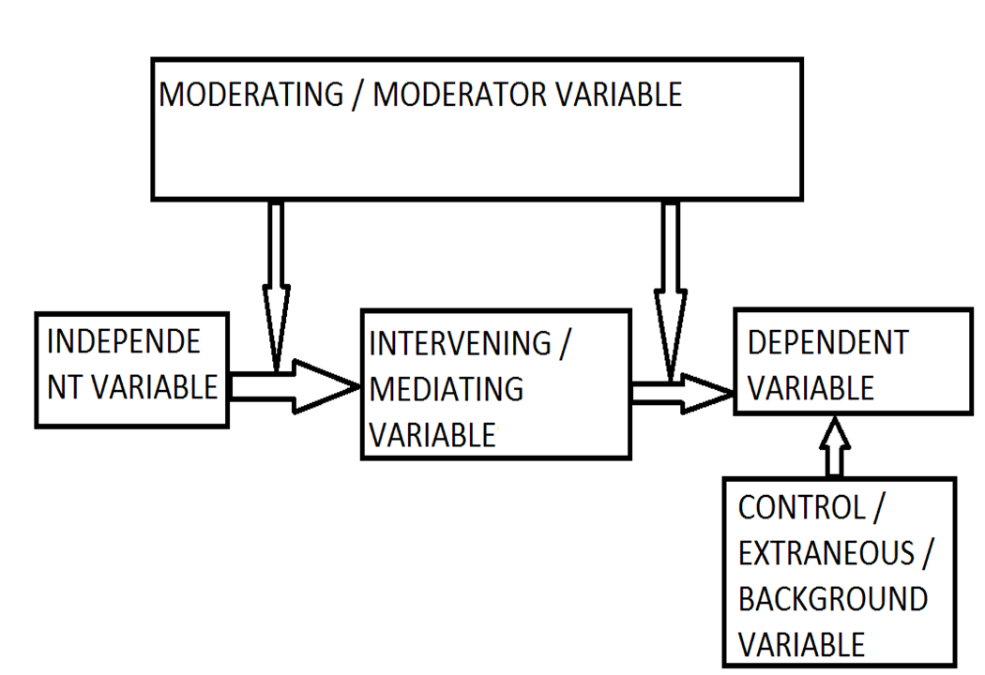
A Conceptual Framework

Slide 38
Example
A study has the following variables;
  Independent variable - Staff Skills
  Dependent variable - Employee productivity
  Intervening variable - allocation of tasks
  Control variable - Company policy
  Extraneous variables - Gender, Attitude towards work
The conceptual framework diagram will be as follows:

Slide 39
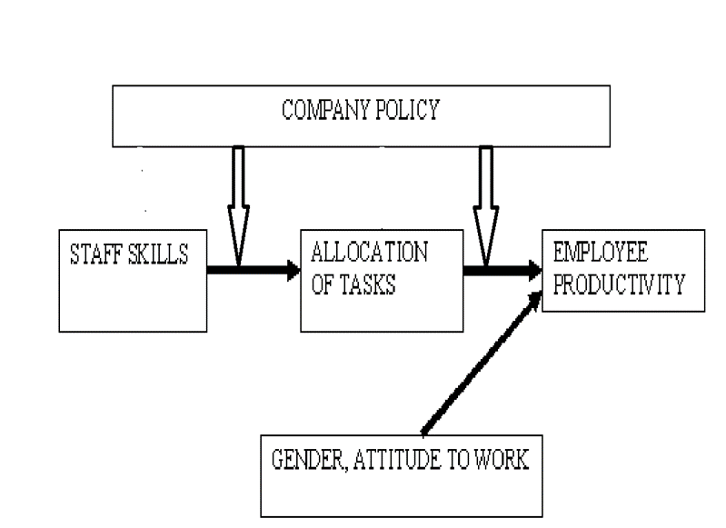
Example

Slide 40
Stating the Topic / Title of the research project
Topic is a sentence which conveys the message of what the proposal is about.
It is related to the purpose of the study and should contain the major variables to be used ie the dependent and independent variables.
It must be brief, concise and accurate, reflecting the content of the research.
A good title has 10-25 words

Slide 41
Criteria for a research title
Normally a research topic should satisfy the following criteria:
  state the key variables included in the study,
  relate it to the research design and/or state relationship between variables for associational studies,
  state the population/area/organisation to which results would be applicable or where the data will be collected from.

Slide 42
Criteria for a research topic
Normally a research topic should satisfy the following criteria:
  avoid redundant words like impact, relationship, effectiveness, etc.,
  use only acceptable discipline-related terms,
  should neither be too long to be over explicit nor too short to be over implicit; it should be concise and to the point.

Slide 43
Summary
Sources of research problem
Steps in Identification of problems for academic research.
Criteria of selecting a problem (internal and External)
Features of a good research problem
Research Variables
Conceptual Framework
Stating the Topic / Title of the research project

Slide 44
End of lesson four
References
Research methods for business: A skill-building approach. Sekaran, U., & Bougie, R. John Wiley & Sons, Inc.,2013.
Research methods: Quantitative and qualitative approaches. Mugenda, O. M. & Mugenda, A. G. Nairobi: ACTS Press, 2003.
Research for Business students (5th Ed.). Saunders et al. London: Prentice Hall, 2009.
Qualitative research methods for the social sciences. Berg, B. L., Boston: Allyn Bacon, 2009.

