Slide 1
Course: English Skills
Lecture 1: Introduction to English Grammar
Lecturer:
Susan Mwangi

Slide 2
Introduction to English Grammar
What is Grammar?
Parts of Speech

Slide 3
What is Grammar?
The term grammar refers to either the inherent structure of words and sentences (morphology and syntax respectively) in a language; or to the study and description of this structure published as grammar rules about the language. Grammar can also include:
Orthography (spelling, punctuation and capitalization)
Semantics (word meanings)
Phonetics and phonology (sounds)
Pragmatics (language use in context)

Slide 4
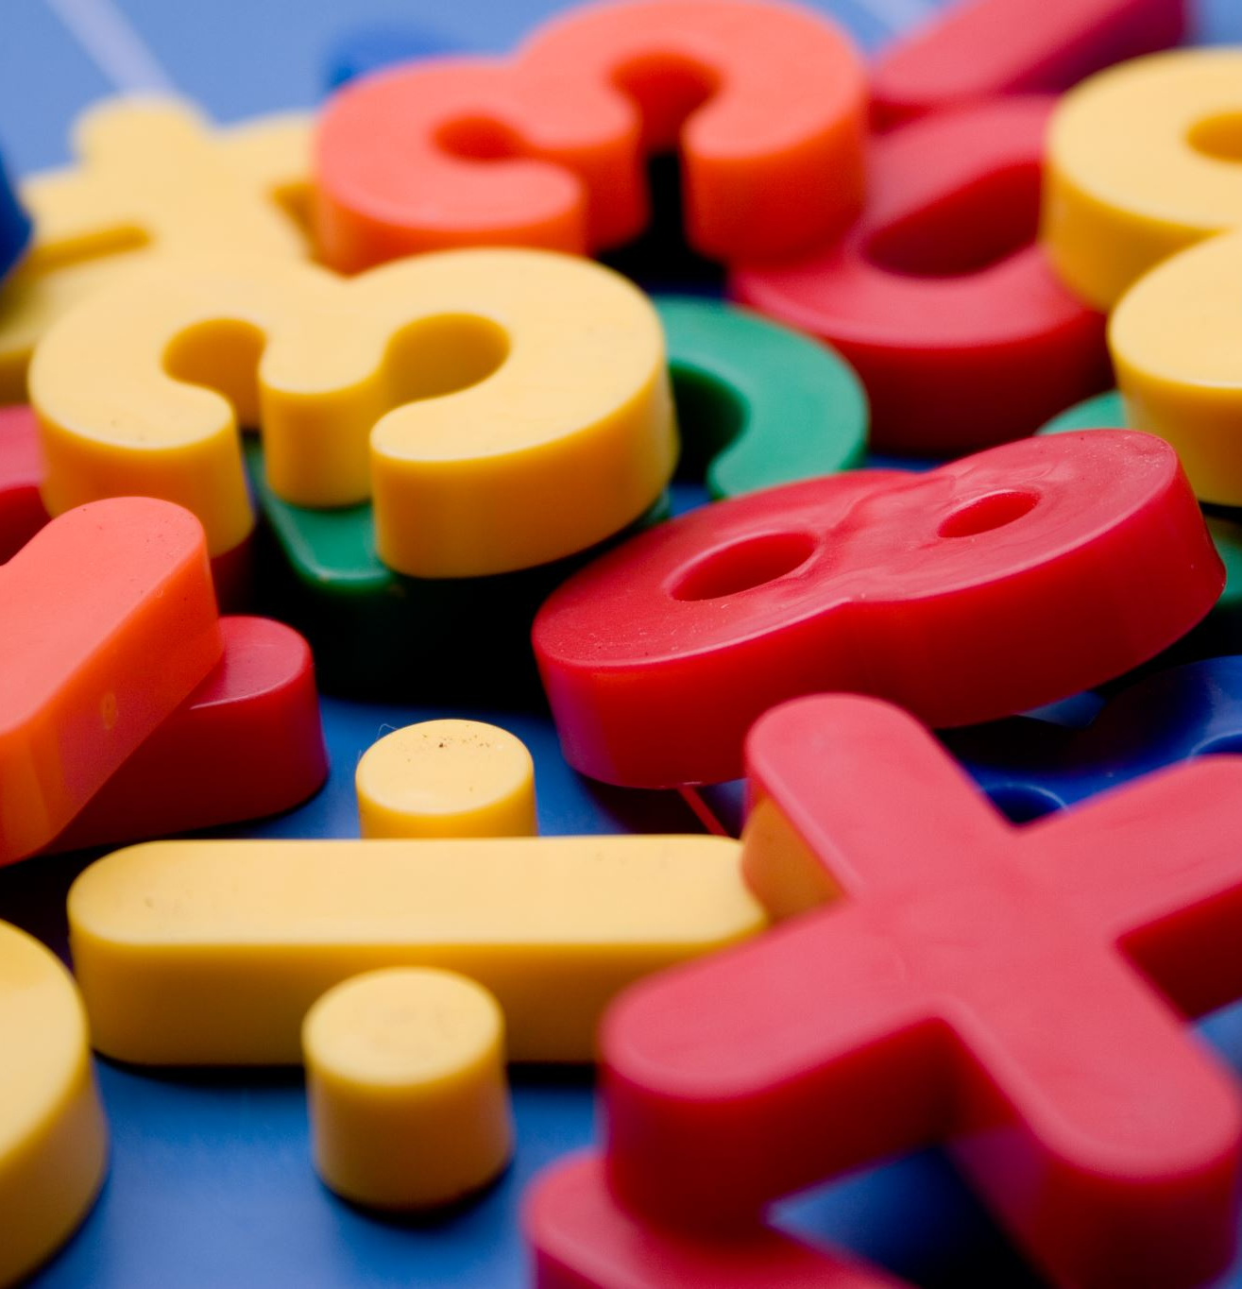
What is Grammar… cont.
Grammar explains how the language should be structured, using various categories such as:
Number: refers to formation of singular and plural nouns and other parts of the sentence that have to agree with number (e.g. child vs. children)
Gender: a category hardly existent in English, but alive in German. It regards the differences between masculine (der Löffel, spoon) feminine (die Gabel, fork) or even neuter (das Messer, knife) nouns and how these affect other words in a properly phrased sentence.
The formation of verbs caters for the tense: For example, in English we have distinctions in verb formation such as: I write - She writes; We write - We are writing.

Slide 5

What is grammar…cont.
In summary, we can therefore consider the term Grammar to encompass word grammar and sentence grammar.
Word grammar is further divided according to the different parts of speech - containing verbs, nouns, adjectives, adverbs, pronouns, prepositions, conjunctions and interjections.
Sentence grammar relates to the construction of phrases, clauses and full sentences, all the way up to paragraphs and full texts.

Slide 6
Parts of Speech
Nouns | Pronouns
Verbs | Adverbs
Adjectives | Prepositions
Conjunctions | Interjections
There are 8 parts of speech in English grammar

Slide 7
Nouns
A noun is a word which names a person, a place or a thing, in other words it is a naming word. For example, chair, table, book, New York, computer, cup, boy, John, hospital, Newton, garden, room, man, Paris, doctor, and pen are nouns because each of these words is a name of a person, a place or a thing.

Slide 8
Types of Nouns
There are various types of nouns

Slide 9
Common and Proper Nouns
Common Noun: This is the name of a common or a non-specific thing, place, or person.
For example: book, pen, room, garden, girl, road, camera, month, day, chair, school, boy, car, are common nouns because each of these nouns refers to a common thing, place or person.
Proper Noun: This is the name of a particular or a specific place or person. For example: Nairobi, April, Monday, St. Paul’s University, New York, Kenya, Wanjiku, Newton, Einstein, Kenyatta International Convention Centre, are proper nouns because each of these nouns refers to a particular place or person. In English grammar, a proper noun always begins with a capital letter and is usually but not always preceded by definite article ‘The’ (as explained below).
If a common noun is specified, it becomes a proper noun. For example, day is a common noun but if it is specified like Monday or Friday, it becomes proper noun. Similarly, man is a common noun but if it is specified like James, it becomes a proper noun.

Slide 10
Use of the definite article “The” for proper nouns
The definite article “the” is used before some proper nouns. Here are some rules for the use of the article before proper nouns:
The article “the” is not used before the name of countries or cities, for example, Nairobi, Tanzania, Kampala, South Africa, Paris, Egypt. But if the name of country, city or place expresses a group of places, lands or states, then article “the” will be used before it. For example: The Philippines, The Netherlands, The United States.
The article “the” is not used before the name of universities, for example: St. Paul’s University, Yale University, or Columbia University. But if the name of the university is written in a way that it includes the word “of” then the article “the” will be used before it. For example, The University of British Colombia, The University of Oxford, The University of Toronto.

Slide 11
Use of the definite article “The”…cont.
Article “the” is used before names composed of both common nouns and proper nouns, for example The New York City, The Dominion of Canada, The River Nile.
“The” is used before the names of laws, principles, theories or devices, for example, The Pythagorean Theorem, The Law of Newton. But if the proper noun is used in possessive form, no article will be used, for example Newton’s Laws of Motion, Hooke’s Law of Elasticity, Dalton’s Law of Partial Pressures.
“The” is also used with the names of oceans, seas, rivers, deserts or forests (but not lakes and falls). For example: The Indian Ocean, The Mediterranean Sea, The Sahara, The Black Forests.

Slide 12
Use of the definite article “The”…cont.
“The” is also used before the names of buildings, hotels and libraries that have particular names, for example, The Brunel Hotel, The Nairobi National Museum, The Library of Congress.
“The” is used before the name of a geographical region and points on globe, for example The Middle East, The West, The Equator, The North Pole
“The” is usually used before the names of organizations for example, The Association of Chartered Accountants, The World Health Organization.

Slide 13

Countable and Uncountable Nouns
Countable Nouns
A noun which can be counted is called a countable noun.
Pen is a countable noun because we can count it and can say one pen, two pens, three pens or more pens. Pen, chair, cup, room, man, baby, bottle, dog, cat are examples of countable nouns.
Singular and Plural noun (Countable Nouns)
A countable noun can be singular as well as plural. Article “a” or “an” is used before a singular noun but not before a plural noun.
If a singular noun starts with a consonant letter then “a” is used before it, i.e. a book, a cat, a pen. If a singular noun starts with a vowel letter or with a consonant which sounds like a vowel in that particular word, “an” is used before it i.e. an apple, an umbrella, an onion, an hour.

Slide 14
Uncountable nouns
Uncountable Nouns (Non-count Nouns)
Uncountable nouns refer to substances which cannot be counted.
For example, water is an uncountable noun because we cannot count it. We cannot say, one water or two water. Such substances which cannot be counted in terms of numbers are called uncountable or non-count nouns.
Examples: Water, milk, bread, honey, rain, furniture, news, information, pleasure, honesty, courage, weather, music, preparation, warmth, wheat are examples of uncountable nouns.

Slide 15



Other types of Nouns include the following:
Other types of Nouns include the following:
Abstract and Concrete Nouns
An abstract noun names an idea, event, quality, or concept (freedom, love, courage...). Concrete nouns name something recognizable through the senses (table, dog, house...).

Slide 16
Other types of Nouns….cont.
Animate and Inanimate Nouns
Animate nouns refer to a person, animal, or other creature (man, elephant, chicken...). An inanimate noun refers to a material object (stone, wood, table...).
Collective Nouns
A collective noun describes a group of things or people as a unit (family, flock, audience...).
Compound Nouns
Compound nouns refer to two or more nouns combined to form a single noun (sister-in-law, schoolboy, fruit juice).

Slide 17



Articles
The definite article "the" is used for a definite, specific or particular noun.
Example: He bought the shirt.
The article “the” before the noun “shirt” in above sentence means that the shirt, he bought, is a specific or particular shirt and not any shirt.
English language has two articles, “the and a/an”. An article is used for a noun.
Definite Article: “The”
The definite article “a/an” is used for an indefinite, non-specific or non-particular (common) noun.
Example: He bought a shirt.
The article “a” before the noun “shirt” in the above sentence means that the shirt he bought is any shirt and not a specific shirt.
Indefinite Article: “A/An”

Slide 18
Pronouns
A Pronoun is a word that is used instead of a noun, e.g. he, she, it, they, his, her, him its etc.
Example: John is an intelligent student. He goes to school daily. He studies a lot. He is making preparation for the examination. He will get high marks in the examination.
In the above paragraph, the pronoun “he” is used instead of the noun “John”. If we do not use the pronoun in above paragraph, we will have to use the noun “John” again and again in each sentence. So, the purpose of the pronoun is to avoid the repetition of a noun.
Examples. He, she, it, they, you, I, we, who, him, her, them, me, us, whom, his, its, their, your, mine, our, whose, myself, himself, herself, yourself, which, this, that, these, those, are the pronouns which are most commonly used in English grammar.

Slide 19
Types of Pronouns
Pronouns can be divided into following groups:
Personal Pronouns: e.g. I, you, He, she, it, they, who, me, him, her, them, whom
Possessive Pronouns: e.g. yours, mine, his, hers, ours, theirs,
Reflexive Pronouns: e.g. myself, himself, herself, itself, yourself, ourselves, themselves
Reciprocal Pronoun: e.g. each other, one another
Relative Pronouns: e.g. who, whom, whose, which, that
Demonstrative Pronoun: e.g. this, these, that, those

Slide 20
Types of pronouns ….cont.
Personal Pronouns
A Personal pronoun describes a particular person or thing or group.
A Personal pronoun describes the person speaking (I, me, we, us), the person spoken to (you), or the person or thing spoken about (he, she, it, they, him, her, them).
Example: He helps the poor.
The pronoun “he” in the above sentence describes a person who helps the poor.

Slide 21
Types of pronouns …..cont.
Use of Personal Pronouns
Number | Person | Personal Pronoun
 |  | Subject | Object
Singular | 1st Person | I | Me
 | 2nd Person | You | You
 | 3rd Person | He, She, It | Him, Her, It
Plural | 1st Person | We | Us
 | 2nd Person | You | You
 | 3rd Person | They | Them

Slide 22
Types of pronouns …..cont.
Examples:
She is intelligent
They are playing chess.
He sent me a letter.
It is raining.
We love our country.
The teacher appreciated them.
I met him yesterday.
He gave her a gift.
Did you go to home?

Slide 23
Types of pronouns …..cont.
Possessive Pronouns
A Possessive Pronoun indicates close possession, ownership or relationship of a thing/person to another thing/person.
For example: yours, mine, his, hers, ours, theirs, hers.
Example: This book is mine.
The pronoun “mine” describes the relationship between a book and the person (me) who possesses this book or who is the owner of this book.

Slide 24
Types of pronouns …..cont.
Number | Person | Possessive Pronoun
Singular | 1st Person | Mine
 | 2nd Person | Yours
 | 3rd Person | Hers, his, its
Plural | 1st Person | Ours
 | 2nd Person | Yours
 | 3rd Person | Theirs

Slide 25
Types of pronouns …..cont.
Examples:
That car is hers.
Your book is old. Mine is new.
The pen on the table is mine.
The smallest cup is yours.
The car is ours not theirs.
I have lost my camera. May I use yours?
They received your letter. Did you receive theirs?

Slide 26
Types of pronouns …..cont.
Reflexive Pronouns
A Reflexive pronoun describes a noun when the noun’s action (subject’s action) affects the noun (subject) itself.
For example: himself, yourself, herself, ourselves, themselves, itself are reflexive pronouns.
Reflexive pronouns always act as objects not subjects, and they require an interaction between the subject and an object.

Slide 27
Reflexive Pronouns
Number | Person | Subject | Reflexive Pronoun
Singular | 1st Person | I | Myself
 | 2nd Person | You | Yourself
 | 3rd Person | He, she, it | Himself, Herself, Itself
Plural | 1st Person | We | Ourselves
 | 2nd Person | You | Yourselves
 | 3rd Person | They | Themselves

Slide 28
Types of pronouns …..cont.
Examples:
I looked at myself in the mirror.
You should think about yourself.
They prepared themselves for completion.
He bought a car for himself.
He locked himself in the room.
He who loves only himself is selfish.

Slide 29
Types of pronouns …..cont.
(iv) Reciprocal Pronouns
Reciprocal Pronouns are used when each of two or more subjects reciprocate to the other,
or when two subjects act in the same way towards each other, or, more subjects act in the same way to one another.
Example: A loves B and B loves A. We can therefore say that A and B love each other.
There are two reciprocal pronouns:
Each other
One another

Slide 30
Types of pronouns …..cont.
Examples:
John and Mary are talking to each other.
The students gave cards to one another.
The car and the bus collided with each other.
The students in the class greeted one another.

Slide 31
Types of pronouns …..cont.
  Relative Pronouns
A Relative Pronoun replaces a noun which had been mentioned before and which requires more information is to be given about it.
Or
A relative pronoun can be defined as a word which joins relative clauses with other clauses to form sentences.
For example: This is the person, who helped her.
In this sentence the word “who” is a relative pronoun which refers to the noun (the person), which is already mentioned at the beginning of the sentence (This is the person) and more information (he helped her) is given after using a relative pronoun (who) for the noun (the person).
Similarly, in above sentence the pronoun “who” joins two clauses which are “This is the person” and “who helped her”.

Slide 32
Types of pronouns …..cont.
Examples
The most commonly used five relative pronouns are, who, whom, whose, which, that.
“Who” is for subject and “whom” is used for object. “Who” and “whom” are used for people. “Whose” is used to show possession and can be used for both people and things. “Which” is used for things. “That” is used for people and things.
Examples:
This is the girl who got first position in class.
An adjective is a word that modifies a noun.
The man whom I met yesterday is a nice person.
It is the planning that makes the event succeed.
The boy who is laughing is my friend.
That is the boy whose father is a doctor.
The car which I like is red.

Slide 33
Types of pronouns …..cont.
  Demonstrative Pronouns
A demonstrative pronoun is a pronoun that points to a thing or things.
For example: this, that, these, those, none, neither
These pronouns point to a thing or things in short distance/time or long distance/time.
Short distance or time: This, these.
Long distance or time: That, those.
Demonstrative pronouns “this and that” are used for singular things while “these or those” are used for plural things.
Examples:
This is black.
That is heavy.
Can you see these?
Do you like this?
John brought these.
Those look attractive.
Have you tried this?

Slide 34

Personal Reflection
Differentiate between the following terms:
Concrete and Abstract Nouns
Countable and uncountable Nouns
Reflexive and Reciprocal Pronouns
Definite and Indefinite Articles
2. Construction sentences using the Parts of speech indicated in Question 1.

Slide 35

THANK YOU

