Slide 1
English Skills
WEEK 7 – Clauses
Dr. Susan Mwangi
St. Paul’s University

Slide 2

Introduction & Overview
In this section, the focus is on the nature of a clause in English grammar. Different types of clauses are discussed as well as their characteristics and functions within a sentence. This section also highlights the main differences between a phrase and a clause.

Slide 3

  Learning Outcomes
By the end of the lesson, the learner should be able to:
Identify a clause within a sentence.
Demonstrate knowledge of various types of clauses.
Illustrate the use of clauses in the construction of sentences.

Slide 4
What is a Clause?
A clause is a group of related words containing a subject and a predicate.
For example:
He laughed.
He climbed the mountain.
The baby ate the banana.
A clause refers to a group of related words (within a sentence or itself as an independent clause that forms a sentence) which has both a subject and a predicate.
Example
I will meet him in the office.

Slide 5
The first part of the above sentence “I will meet him” is a clause because it has a subject “I” and a predicate “will meet him”. On the other hand, the rest of the sentence “in the office” lacks both a subject and a predicate (verb and other related words). Such a group of words is called a phrase.
A clause may stand on its own as a simple sentence or may join another clause to make a sentence. Therefore, a sentence consists of one, two or more clauses.

Slide 6
Examples
He is sleeping. (one clause)
The children were laughing at the joke. (one clause)
The teacher asked a question, but no one answered. (two clauses)
I am happy, because I won a prize. (two clauses)
I like Mathematics, but my brother likes Biology,
because he wants to become a doctor. (three clauses)

Slide 7
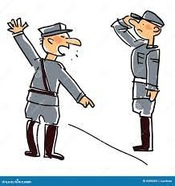
Clauses are divided into two main categories:
Main clause (also called independent clause)
Subordinate clause (also called dependent clause)

Slide 8
Main Clause (Independent Clause)
A main clause or an independent clause is a clause that can stand on its own as a meaningful sentence.
In English grammar, a main clause forms a simple sentence and as we have already mentioned, the clause contains a subject and a predicate.
The predicate may consist of a verb, an object, an adverbial and a complement.
A simple sentence may not contain all these components, however, it must contain a subject and a verb.
The additional components are dependent on the type of verb in the sentence, that is whether it is a transitive verb or an intransitive verb. The sentences below contain transitive verbs:
  The county government built the bridge.
  He played the guitar.
  The English teacher marked the exams.

Slide 9
Main Clause (Independent Clause)
In each of these sentences, the verb action is carried over from the subject to the direct object. This means that the direct object is the person or thing that is directly affected by the action.
When the verb is an intransitive verb, the action stops with the doer or the subject of the sentence.
A verb is intransitive when the action by the verb does not pass from the doer to anything or anyone.
Intranstive verbs are not followed by anything for their meanings to be complete. Let us look at the examples below:
  She prayed.
  The baby slept
  He arrived late. (followed by adverb)

Slide 10
Main Clause (Independent Clause)
Example: He is buying a shirt which looks very nice.
The above sentence has two clauses “He is buying a shirt” and “which looks very nice”. The first clause expresses a complete thought and can stand alone as a sentence. Such a clause is called a main or independent clause.
The clause “which looks very nice” does not express a complete thought and cannot stand on its own as a sentence. It depends on another clause (main clause) to express a complete idea. Such a clause is called subordinate or dependent clause.

Slide 11
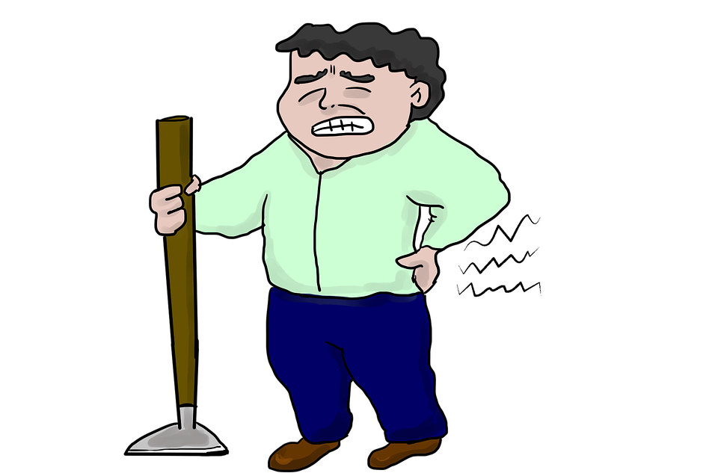
Examples of the main clause/ independent clause:
  I met the boy who had helped me.
  She is wearing a shirt which looks nice.
  The teacher asked a question which was difficult.
  He takes medicine because of backaches.
  He became angry and smashed the vase into pieces.
In the above sentences, each underlined part shows the main clause. It expresses a complete thought and can stand on its own as a sentence. Hence, a main clause or an independent clause is normally referred to as a simple sentence.

Slide 12
Subordinate or dependent clause
A subordinate (or dependent) clause is a clause which does not express a complete thought and depends on another clause (main clause) for meaning. A subordinate clause does not express a complete idea and cannot stand on its own as a sentence. Therefore, a sentence having a subordinate clause must have a main clause
Example: He likes Chinese rice which tastes spicy.
The clause “which tastes spicy” in the above sentence is a subordinate clause because it does not express a complete thought and it cannot stand on its own as a sentence. It depends on the main clause “he likes Chinese rice” to express a complete thought.

Slide 13

Examples of subordinate clauses
I met the boy who had helped me.
I bought a table that costs $ 100.
Since he arrived, the children are have been excited.
If the students are mentored, they will perform well.

Slide 14
Types of Subordinate Clauses
A subordinate (dependent) clause may function as a noun, an adjective or an adverb in a sentence. On the basis of their function in a sentence, subordinate clauses can be divided into the following types:
  Noun Clause
  Adjective Clause
  Adverbial Clause

Slide 15
Noun Clause
A dependent clause that functions as a noun in a sentence is called a noun clause. A noun clause performs the same function as a noun in a sentence.
Example: What he did caused a problem in his family.
In above sentence the clause “what he did” functions as a noun, hence it is a noun clause. A noun clause functions as a noun in a sentence, therefore it can function as a subject, object, or predicate in a sentence. A noun clause starts with words such as “that, what, whatever, who, whom, whoever, whomever”.

Slide 16

Examples
Whatever you learn will help you in future. (noun clause as a subject)
What you said made me laugh. (noun clause as a subject)
He knows that he will pass the test. (noun clause as an object)
I realize what he would have thought. (noun clause as an object)

Slide 17
Adjectival Clause
A dependent clause that functions as an adjective in a sentence is called an adjectival clause. The function of an adjective is to modify (describe) a noun or a pronoun. Similarly, a noun clause modifies a noun or a pronoun.
Example: He wears a shirt which looks nice.
The clause “which looks nice” in the above sentence is an adjectival clause because it modifies the noun “shirt” in the sentence. An adjectival clause always precedes the noun it modifies.

Slide 18

Examples
  I met the boy who had helped me.
  An apple that smells bad is rotten.
  The book which I like is helpful in preparation for test.
  The house where I live has four rooms.
  The person who was shouting needed help.
An adjectival clause begins with a relative pronoun (that, who, whom, whose, which, or whose) and is also known as a relative clause. Adjectival (relative) clauses can be restrictive clauses or nonrestrictive clauses.

Slide 19
Restrictive and Nonrestrictive Clauses
A restrictive clause limits the meaning of a preceding noun or pronoun.
A nonrestrictive clause tells us something about a preceding noun or pronoun but does not limit the meaning of the preceding noun or pronoun.
A restrictive clause helps to define the nouns or noun phrases they qualify.
They are essential to the meaning of the nouns and noun phrases they qualify in that they limit the meanings of the nouns or noun phrases.

Slide 20
Example
The student, who studied a lot passed the test. (restrictive clause)
The student who had attended all the lectures, passed the test. (nonrestrictive clause)
In the first sentence the clause “who studied a lot” restricts information to the preceding noun (student), it means that there is only one student who studied a lot, hence it is a restrictive clause.
In the second sentence the clause “who had attended all the lectures” gives us information about the preceding noun but does not limit this information to the preceding noun. It means that there can be several other students in the class who had attended all the lectures.

Slide 21
A comma is always used before a restrictive clause in a sentence and also after a nonrestrictive clause if it is within a main clause. “That” is usually used to introduce a restrictive clause while “which” is used to introduce a nonrestrictive clause. The information that a nonrestrictive clause provides is not essential to our understanding of the sentence. It is therefore also known as a non-defining clause while a restrictive clause is known as a defining clause.
Example
The table that costs Ksh. 1000 is made of steel. (restrictive clause)
The table, which costs Ksh. 1000, is made of steel. (nonrestrictive clause)
The place where she lives is safe. (restrictive clause)

Slide 22
Adverbial Clause
A dependent clause that functions as an adverb in a sentence is called an adverbial clause. An adverbial clause functions like an adverb. It modifies a verb, an adjective or other adverbs in a sentence. It modifies (describes) the situation in the main clause in terms of “time, frequency (how often), cause and effect, contrast, condition, intensity (to what extent).”
The subordinating conjunctions used for adverbial clauses are as follows.
Time: when, whenever, since, until, before, after, while, as, by the time, as soon as
Cause and effect: because, since, now that, as long as, so, so that,
Contrast: although, even, whereas, while, though
Condition: if, unless, only if, whether or not, even if, providing or provided that, in case

Slide 23

Examples
Don’t go before he comes.
He takes medicine because he is ill.
Although he tried a lot, he couldn’t climb up the tree.
Unless you study for the test, you can’t pass.
I will go to the school unless it rains.
You are safe as long as you drive carefully.

Slide 24
A Comparison between Phrases and Clauses
A clause is defined as a group of related words that contains a subject and a predicate (verb).
For example, he came.
A phrase is defined as a group of related words that does not contain a subject and a verb.
For example, on the table.
Consider the following example.
He is laughing at a joke.
The above sentence has two parts “he is laughing” and “at a joke”.

Slide 25
The first part of the sentence “he is laughing” is a clause because it has a subject (he) and a predicate (is laughing).
The second part of the sentence “at a joke” is a phrase because it does not contain a subject and a verb.
The difference between a clause and a phrase is that a clause consists of both a subject and a verb, but a phrase lacks both a subject and a verb.

Slide 26

Examples
The underlined part of each of following sentences shows a clause, while the rest of the sentence shows a phrase.
He reached school on time.
I was standing near a wall.
She is singing in a loud voice.
She made tea for the guests.
He bought a book for his friend.
I will meet him in my office.

Slide 27

Summary
A clause is a group of related words containing a subject and a predicate.
A clause refers to a group of related words (within a sentence or itself as an independent clause that forms a sentence) which has both a subject and a predicate.
Two main types of clauses:
  a main or independent clause
  A subordinate or dependent clause

Slide 28
Personal Reflection
Identify the main clause and the subordinate clause in the following sentences:
a) Einstein, who failed his university entrance exam, discovered relativity.
b) I will introduce you to the man who owns this car.
c) The topic in which Mary is most interested is Scientific theory.
d) The man who is sitting next to Ann never said a word.
e) Although women have been participating actively in politics, they have not been able to influence policy making substantially.
f) When John found his dog, he was very happy.

Slide 29
Answers for the Personal Reflection
The main clause (in boldface) and the subordinate clause (in italics)
a) Einstein, who failed his university entrance exam, discovered relativity.
b) I will introduce you to the man who owns this car.
c) The topic in which Mary is most interested is Scientific theory.
d) The man who is sitting next to Ann never said a word.
e) Although women have been participating actively in politics, they have not been able to influence policy making substantially.
f) When John found his dog, he was very happy.

Slide 30
Thank you

