Slide 1
English Skills
WEEK 8 – Sentences I
Dr. Susan Mwangi
St. Paul’s University

Slide 2
Introduction and Overview
In this section, we define what a sentence is and explore the grammatical functions in a sentence.
These include: subjects, objects, predicates and complements.

Slide 3
Learning Outcomes
By the end of the lesson, the learner should be able to:
Identify the different grammatical functions in a sentence.
Demonstrate ability to construct a sentence appropriately.
Distinguish between active and passive voice

Slide 4
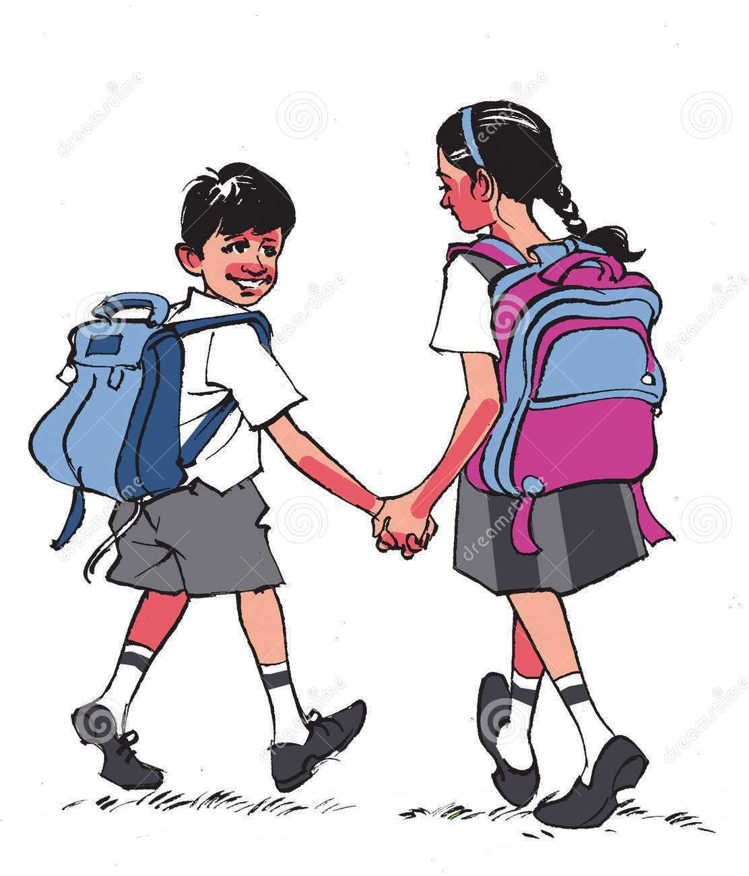
What is a Sentence?
A sentence is a group of words which expresses a complete thought.
Example: He bought a car.
The above group of words expresses a complete thought. Such a combination of words is called a sentence.
Now, look at another group of words “book a read him”. This group of words does not make complete sense so it cannot be called a sentence. A sentence is a combination of words that includes a subject and a verb and which expresses a complete idea. A sentence begins with a capital letter and ends with a period, question mark or exclamation mark.
Examples:
He goes to school.
She is eating an apple.
My name is John.
What are you doing?

Slide 5
Grammatical functions in sentences
Subject and Predicate
A sentence consists of two parts i.e. a subject and a predicate.
Sentence = Subject + Predicate
Subject
The part of the sentence which performs an action is called a subject. A subject is sometimes also defined as the part of the sentence which is being spoken about in a sentence (especially in sentences having a static verb). A subject can be a noun, pronoun, noun clause or noun phrase.
Examples
He is flying a kite.
John is driving a car.
She ate an apple
I wrote him a letter.

Slide 6
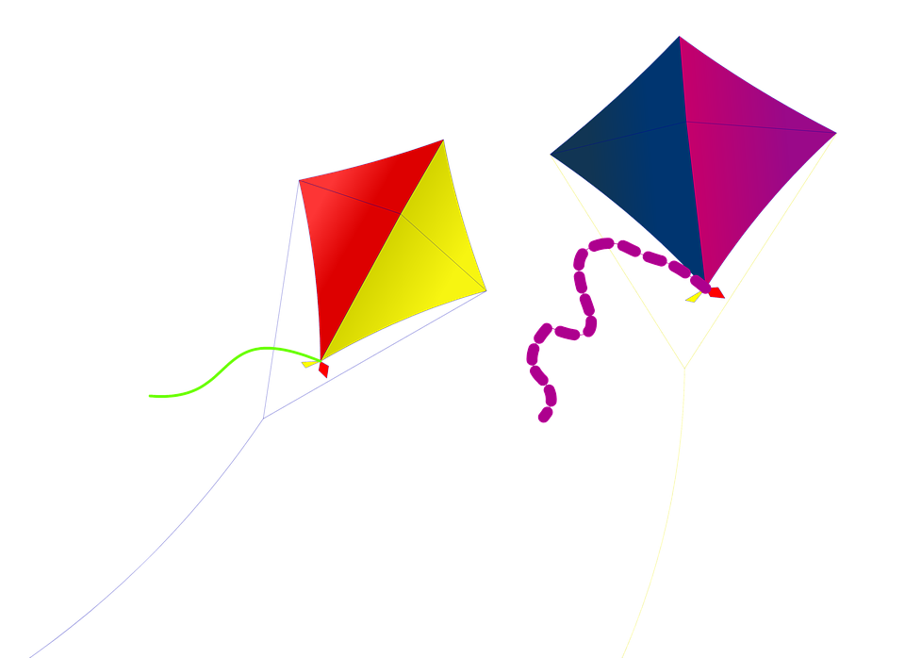
Predicate
The predicate is the part of a sentence which tells about the subject.
Examples
He is flying a kite.
John is driving a car.
She ate an apple
I wrote him a letter.
Subject refers to the actor of a sentence. The part of a sentence about which something is told in a sentence is the subject of the sentence, while the part of a sentence that tells something about the subject is the predicate of the sentence.

Slide 7
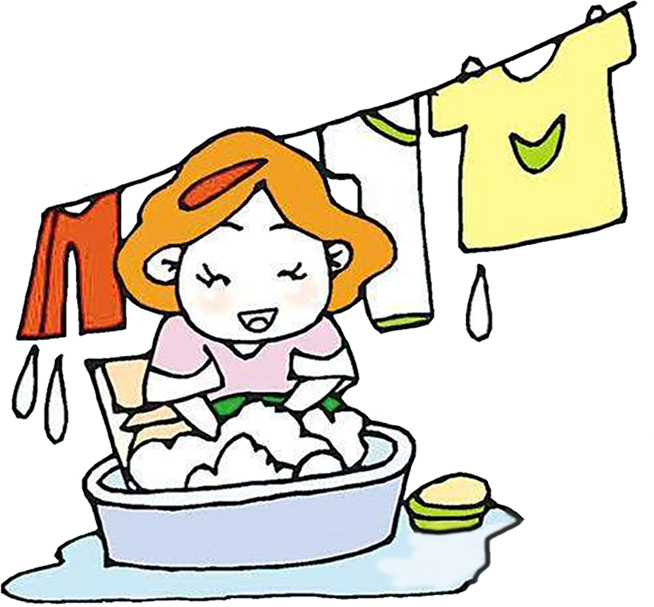
Example
She is washing her clothes.
In the above example, “she” is the subject because it performs an action of washing clothes. We can also say that “she” is the subject because something (that she is washing her clothes) is told about it in sentence. The rest of the sentence “is washing her clothes” is the predicate of the sentence because it tells something (washing her clothes) about the subject.

Slide 8
Direct and Indirect Objects
A direct object is the receiver of the action within a sentence. For example, “He hit the ball.” Be careful to distinguish between a direct object and an object complement.
They named their daughter Natasha.
In that sentence, "daughter" is the direct object and "Natasha" is the object complement, which renames or describes the direct object.

Slide 9
The indirect object identifies to or for whom or what the action of the verb is performed. The direct object and indirect object are different people, places or things. The direct objects in the sentences below are in boldface; the indirect objects are in italics.
The instructor gave his students A’s.
Grandfather left Rosa and Ronald all his money.
Jossy sold me her boat.
Incidentally, the word me (and similar object-form pronouns such as him, us, them) is not always an indirect object; it will also serve, sometimes, as a direct object.
Bless me/her/us!
Call me/him/them if you have questions.

Slide 10
In English, nouns and their accompanying modifiers (articles and adjectives) do not change form when they are used as objects or indirect objects, as they do in many other languages. "The radio is on the desk" and "I borrowed the radio" contain exactly the same word form used for quite different functions. This is not true of pronouns, however, which use different forms for different functions. (He [subject] loves his grandmother. His grandmother loves him [object].)

Slide 11

Complements
A complement (notice the spelling of the word) is any word or phrase that completes the sense of a subject, an object, or a verb. As you will see, the terminology describing predicates and complements can overlap and be a bit confusing. A subject complement follows a linking verb; it is normally an adjective or a noun that renames or defines the subject in some way.
  A glacier is a huge body of ice.
  Glaciers are beautiful and potentially dangerous at the same time.
  This glacier is not yet fully formed. (verb form acting as an adjective, a participle)

Slide 12
Adjective complements are also called predicate adjectives; noun complements are also called predicate nouns or predicate nominatives.
An object complement follows and modifies or refers to a direct object. It can be a noun or adjective or any word acting as a noun or an adjective.
  The convention named Douglas Vice President to keep him happy. (The noun "Vice President" complements the direct object "Douglas"; the adjective "happy" complements the object "him.")
  The clown got the children too excited. (The participle "excited" complements the object "children.")
A verb complement is a direct or indirect object of a verb.
  Granny left Ronald all her money. (Both "money" [the direct object] and "Ronald" [the indirect object] are the verb complements of this sentence.)

Slide 13
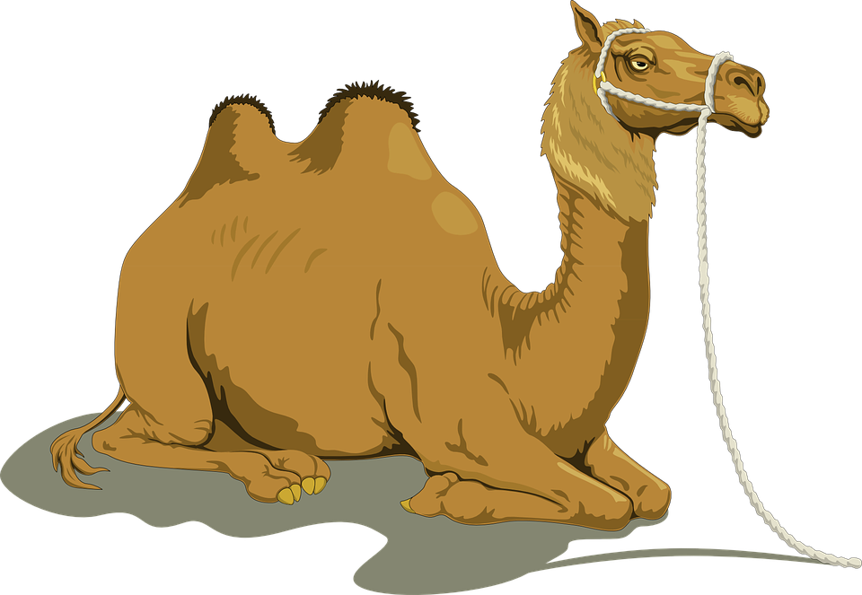
Types of Complements
The Complement can often be confused with the Object. While the Subject and the Object of a clause, in the vast majority of cases, refer to different entities. The Complement gives more information about either the Subject or the Object. As with the Subject and Object elements, there is only one grouping or phrase which is considered to be the Complement of a clause.
The Subject Complement
Let’s begin by looking at some pairs of sentences where this information centres on the Subject.
Bill hit Harry.
Bill is a policeman.
The camel carried the load.
The camel smells awful.
A car hit the lamp post.
A car was what she wanted for her birthday.

Slide 14
In the preceding examples the first sentence of each pair contains an object – Harry, the load, the lamp post. These are clearly not the same entities as the subjects of the sentences. However, the same cannot be said for the second sentence of each pair where there is a strong connection between the subjects and the phrases, a policeman, awful and what she wanted for her birthday. These phrases act to identify the Subject more precisely. These are known as complements; more specifically they are subject complements because they define the subjects of the clauses, in this case Bill, the camel and a car.
In most sentences where the complement defines the subject, you will find a particular type of verb being used. The most usual is the verb “to be” and its forms (am, are, was, have been) followed by a noun phrase or an adjectival phrase, often as a single word. In the instances above, a policeman is a noun phrase and awful is an adjective.
Noun phrase as Subject Complement:
Love is a drug.
This is her pen.
He is the father of three.
Time is the great healer.
Those animals were very rare Siberian tigers.

Slide 15

Adjectival phrase as Subject Complement:
The weather is hot.
All the passengers were Russian.
The little cottage was nice and cosy.
Her teeth were pearly white.
The argument became more heated.
The weather gradually got hotter and hotter.
In all of these cases, the phrases after is, was and were define the subject. You should notice that, although two of the complements in the first set of examples contain adjectives (great, very rare Siberian), these are still treated as noun phrases because the main words in the groups are themselves nouns (healer, tigers).

Slide 16
There is a particular type of verb that is often used in clauses with a subject complement and that verb is usually “be”. However, there is a small number of other verbs either closely connected with “be or to do” that frequently occur in this type of clause. A short list with examples might include the following:
Be type: seem, appear, become, turn out, grow, remain
The sky seems clearer today.
He turned out to be a bad influence.
His client became more and more angry.
Sense type: look, sound, feel, taste, smell (all followed by like with a noun)
Her voice sounds lovely.
That sounds like heaven.
The tea tastes foul.

Slide 17
Subordinate Clause
There is still one type of subject complement that we haven’t looked at yet – this is the subordinate clause.
Example: A car was what she wanted for her birthday.
Here “a car” is the subject, the verb is “was” and the complement defining the subject is “what she wanted for her birthday”, which is a clause since it has its own subject (she) and verb (wanted). Other examples of clauses used as subject complements are:
Justice is what we’re looking for.
The first thing I did was open all the windows.
The remaining problem is where to find the money.
Our only option is to run away.

Slide 18
The Object Complement
In all the instances in the previous section the complement gives additional information about the subject of the clause. Additional information can similarly be given about the object. Look at the examples below:
Everyone thought him an idiot.
The accusation made me livid.
The whole town wanted the outlaw dead.
The board has made him manager.
I find it difficult to believe.
Here, the phrases in bold are giving extra information about the objects of the clauses which are “him, me, the outlaw, him, it”. The object complement usually follows the object of the clause as in all the examples above and the choice of verb is not so restricted as it is with the subject complement clauses.

Slide 19
What is an Object Complement?
An object complement is a noun, a pronoun, or an adjective which follows a direct object to rename it or state what it has become.
Verbs of making (e.g., to make, to create) or naming (e.g., to name, to call, to elect) often attract an object complement. In the examples below, the object complements are in italics and the direct objects are in bold.
To make her happy
To name her Heidi

Slide 20
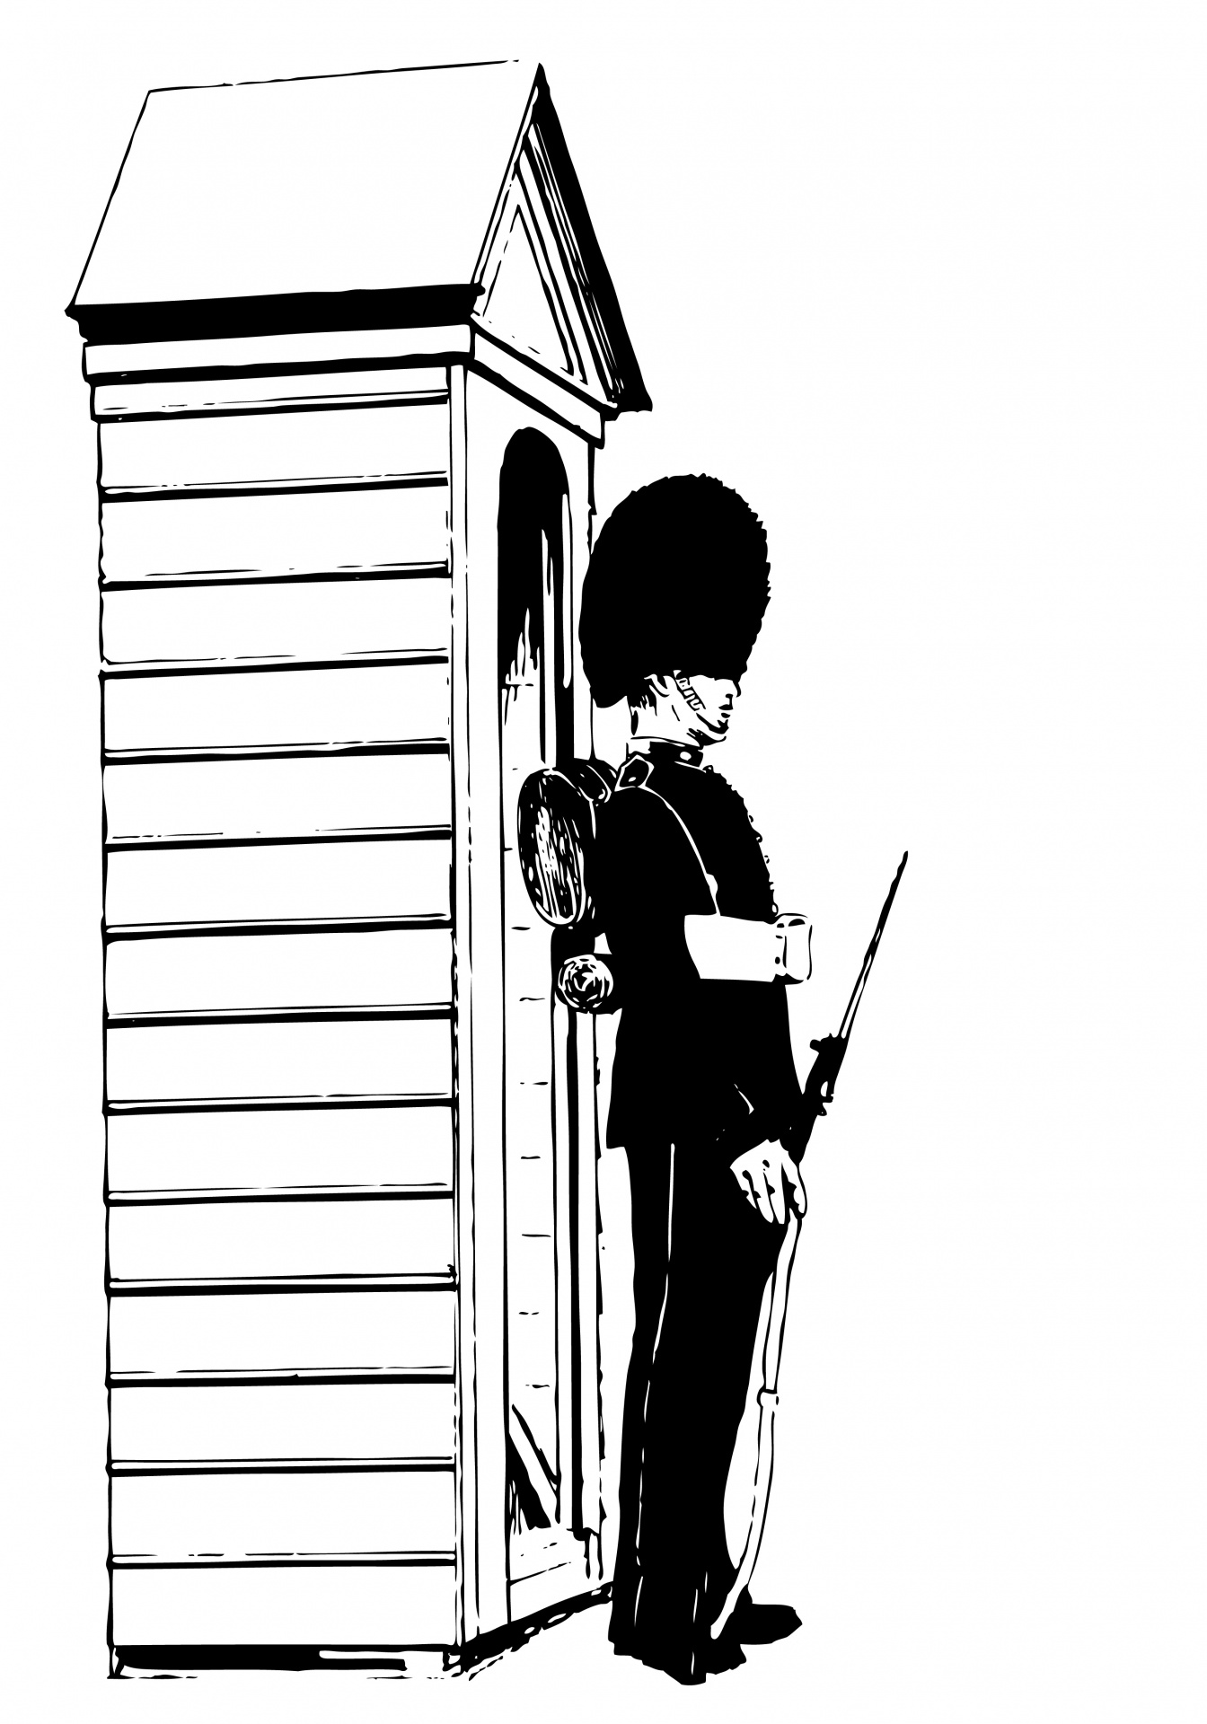

However, there are many other verbs that can take an object complement. For Example:
To consider someone wise
To paint something purple
To catch somebody stealing
Examples of Object Complements
Here are some more examples of object complements:
I found the guard sleeping.
We all consider her unworthy.
I declare this centre open.
We consider fish spoiled once it smells like this.
An object complement is not always one word. It could be a phrase. For example:
I found the guard sleeping in the barn.
We all consider her unworthy of the position.
This Photo by Unknown Author is licensed under CC BY-NC

Slide 21
Active and Passive Voice
There are two main ways to express an action of a subject in relation to its object:
Active voice
Passive voice
In the “active voice”, the subject acts upon the object, while in the “passive voice” the object is acted upon by the subject. It can also be said that, in the “active voice”, the subject does something on the object, while in the “passive voice”, the object is acted upon by the subject. The normal structure of an active voice sentence is subject+verb+object but in the passive voice, the normal structure of the sentence is reversed according to certain rules and becomes, object+verb+subject. The real meaning of a sentence does not change whether the sentence is expressed in the active voice or in the passive voice. The active voice is most preferable in writing because it gives a direct and more concise meaning.

Slide 22
The passive voice is used in certain instances due to the following reasons:
When intentionally hiding the subject of sentence. For example, a student who failed in exam might say, Some chapters were not studied.
Another example: Women were not treated as equals.
When the passive voice better explains the idea that the sentence wants to express. For example, when one says, Cloth is sold in yards, is better than to say, Shopkeepers sell cloth in yards.
When the passive voice better emphasizes the main thought of the sentence. For example, when students are misbehaving, the lecturer may say, “The students will be suspended immediately.”
When the subject is not exactly known. For example, His watch was stolen. It is not known who stole his watch, the subject (thief) is not exactly known so it is better to use passive voice for such sentence.

Slide 23
Changing from active voice to passive voice
The positions of the subject and the object are interchanged i.e. the object shifts to the place of subject and subject shifts to the place of object in passive voice. Example:
Active voice: I write a letter.
Passive voice: A letter is written by me.
The subject “I” of the sentence shifted to the place of the object “letter” and the object “letter” shifted to the place of the subject “I” in the passive voice.
Sometimes the subject of the sentence is not used in the passive voice. The subject of the sentence can be omitted in the passive voice, if without subject the sentence can still give enough meaning. Examples:
Passive voice: Cloth is sold in yards.

Slide 24
3. The 3rd form of the verb (past participle) is always used as the main verb in sentences that use the passive voice (for all tenses). The base form of the verb or the present participle will never be used in the passive voice. The word “by” is used before the subject in the sentences. Example:
Active voice: He sings a song.
Passive voice: A song is sung by him.
4. The word “by” is not always used before the subject in the passive voice. Sometimes words “with, to, etc” may also be used before the subject in the passive voice.
Examples:
Active voice: The water fills the tub.
Passive voice: The tub is filled with water.
Active voice: He knows me.
Passive voice: I am known to him..
5. Auxiliary verbs are used in passive voice according to the tense of sentence.
The auxiliary verb for each tense is illustrated below:

Slide 25

Sentences which cannot be changed into passive voice
Transitive and intransitive verbs
A verb can be either transitive or intransitive. A transitive verb needs an object (in the sentence) to give complete meaning while an intransitive verb does need an object (in the sentence) to give complete meaning.
For example:
Transitive verb
He sent a letter.
(Send is a transitive verb and it needs an object i.e. letter to express full meaning.)

Slide 26
Intransitive Verb
He laughs.
(Laugh is an intransitive verb and it does not need an object for expressing full meaning.)
Sleep, go, reach, sit, die, are examples of intransitive verbs.
An intransitive verb cannot be changed into passive voice
The sentences having intransitive verbs (belonging to any tense) cannot be changed into the passive
voice. The reason is that there is no object in these sentences and without an object, the passive
voice is not possible.

Slide 27
A sentence can only be changed into passive voice if it has a subject and an object. Sometimes the subject may be omitted in the passive voice but it does not mean that there is no subject. Such sentences have a subject but the subject is so common, familiar or known that even if it is omitted, the sentence still gives full meaning.
For example,
Cloth is sold in yards.
The following tenses can also not be changed into passive voice:
Present perfect continuous tense
Past perfect continuous tense
Future continuous tense
Future perfect continuous tense

Slide 28
Direct and indirect speech
There two ways to convey a message of a person, or the words spoken by a person to another person.
Direct speech
Indirect speech
Suppose your friend whose name is John tells you, “I will give you a pen”. When you get home, you want to tell your brother what your friend told you. There are two ways to tell him:
Direct speech: John said, “I will give you a pen”.
Indirect Speech: John said that he would give me a pen.
In direct speech, the original words of a person are narrated (no change is made) and they are enclosed in quotation marks, while in indirect speech, some changes are made to the original words of the person because these words have been uttered in the past. The tense will need to change accordingly and the pronoun as well.

Slide 29
In indirect speech the statement of the person is not enclosed in quotation marks, instead, the word “that” may be used before the statement to show that it is indirect speech. Indirect speech is also called reported speech.
Reporting verb: The verb in the first part of the sentence (i.e. he said, she said, he says, they said, she says,) before the statement of a person in the sentence is called the reporting verb.
Examples: In the following examples the reporting verb is “said”.
He said, “I work in a factory”. (Direct speech)
He said that he worked in a factory. (Indirect speech)
They said, “We are going to the cinema”. (Direct speech)
They said that they were going to the cinema. (Indirect speech)

Slide 30

Rules for indirect speech
Reported speech is not enclosed in quotation marks.
Use of word “that”: The word “that” is used as a conjunction between the reporting verb and reported speech.
Change in pronoun: The pronoun (subject) of the reported speech is changed according to the pronoun of the reporting verb or object (person) of the reporting verb (first part of sentence). Sometimes the pronoun may not change.
In following example, the pronoun of the reported speech is “I” which will be changed in indirect speech into the pronoun (Subject) of the reporting verb that is “he”.

Slide 31
Example:
Direct speech: He said, “I am happy”.
Indirect Speech: He said that he was happy.
Direct speech: I said to him, “You are intelligent”.
Indirect Speech: I told him that he was intelligent.
Change in time: Time is changed according to certain rules such as: now to then, today to that day, tomorrow to next day and yesterday to previous day, etc.
Examples:
Direct speech: He said, “I am happy today”.
Indirect Speech: He said that he was happy that day.

Slide 32

Change in the tense of reported speech:
If the first part of the sentence (reporting verb part) belongs to the past tense, the tense of
reported speech will change. If the first part of the sentence (reporting verb part) belongs to
the present or future tense, the tense of reported speech will not change.
Examples:
Direct speech: He said, “I am happy”.
Indirect Speech: He said that he was happy. (Tense of reported speech changed)
Direct speech: He says, “I am happy”.
Indirect Speech: He said that he is happy. (Tense of reported speech did not change)

Slide 33

Personal Reflection
Change the following sentences into passive voice:
He sings a song.
The boy killed the spider.
He bought the potatoes.
Farmers sow maize in the rainy season.
Are you writing a letter?
The workers were digging a canal.

Slide 34
Answers for the Personal Reflection
Change the following sentences into passive voice:
He sings a song.
The song was sung by him.
b) The boy killed the spider.
The spider was killed by the boy.
c) He bought the potatoes.
The potatoes were bought by him.
d) Farmers sow maize in the rainy season.
Maize is sown by farmers in the rainy season.
e) Are you writing a letter?
Is the letter being written by you.
f) The workers were digging a canal.
A canal was dug by the workers

Slide 35
Thank you

