Slide 1

English Skills
WEEK 10 – Essay Writing I
Dr. Susan Mwangi
St. Paul’s University

Slide 2

Introduction and Overview
A well written essay requires that one is conversant with the rules of grammar in that particular language and that one is able to organize his or her ideas in a coherent and logical manner. This section guides us through the steps of writing an essay, from selecting a topic to the final touches of revising and proofreading your essay.

Slide 3

Learning Outcomes
By the end of the lesson, the learner should be able to:
Identify an essay topic when one has not been assigned.
Develop an outline for the essay.
Write a thesis statement.
Show ability to write different paragraphs of an essay.
Demonstrate knowledge of revising and proofreading the essay.

Slide 4


The Structure of an Essay
An essay can have many purposes, but the basic structure is usually the same. Your purpose of writing may be to argue on a particular point of view or to explain the steps necessary to complete a task. Regardless of the purpose, your essay will have the same basic format.
In this lesson, we shall discuss a few straightforward steps that you can follow when writing your essay. These steps will guide you through the essay writing process:
Make a decision on your topic
Develop an outline of your main ideas
Write your thesis statement
Write the introduction
Write the body of your essay
Write the conclusion
Preview your essay

Slide 5
Topic Has Been Assigned
In situations where the topic has been assigned, you may have no choice concerning the topic. In this case, you will need to think about the type of essay you are expected to write. Should it be a general overview, or a specific analysis of the topic? If it should be an overview, then you are probably ready to move to the next step. If it should be a specific analysis, make sure that your content is going to be very specific as well. If it is a general one, you will need to include narrower subtopics in the body of the essay.
For example, the topic “Politics in Kenya” is a general one. If your objective is to write an overview, this topic is suitable. If your objective is to write a specific analysis, this topic is too general. You must narrow it down to something like, "Factors affecting Politics in Kenya" or “The effects of Politics on the youth in Kenya”. Once you have determined that your topic will be suitable, you can move on to the next step. In the case of a general analysis, these suggested topics can serve as subtopics in the essay.

Slide 6
Topic Has Not Been Assigned
If you have not been assigned a topic, then the choices you can make are limitless. Sometimes that seems to make the task of starting even more intimidating. However, it may not be such a daunting task as you are now free to choose a topic of interest to you based on your interests, environment or experiences.
Define your Purpose
The first thing you need to do is to think about the purpose of the essay that you are writing. Is your purpose to persuade people to accept your point of view, to explain to people how to complete a particular task, to educate people about a particular person, place, thing or idea, or something else entirely? The topic that you choose must fit the purpose of your essay.

Slide 7


Brainstorm Ideas of Interest
Once you have determined the purpose of your essay, write down some ideas that interest you. No matter what the purpose of your essay is, you will still have many ideas to consider.
If you have trouble thinking of ideas for your essay, start by looking around you. Is there anything in your surroundings that interests you? Think about your life. What experiences have you had or what occupies most of your time? Can you develop a topic from that? Write down all these ideas that come to mind.

Slide 8
Evaluate Each Potential Idea
Consider each one of these ideas as potential topics for your essay and think about the purpose for your writing. If the purpose is to explain, be sure it is a subject about which you are particularly well-informed. If the purpose is to persuade, be sure it is a subject about which you are quite passionate about. It is important to note that the most important factor in choosing a topic is the number of ideas you have about that topic. Even if none of the ideas you thought of seem particularly appealing, try choosing one to work with. It may turn out to be a better topic than you had initially thought.
Organize Your Ideas
The purpose of an outline is to put your ideas about the topic down in a moderately organized format. The structure you create here may still change before the essay is complete, therefore do not agonize over this.

Slide 9
Outline
Begin your outline by writing your topic at the top of the page.
Next, write the Roman numerals I, II, and III, spread apart down the left side of the page.
Next to each Roman numeral, write the main ideas that you have about your topic, or the main points that you want to make.
  If you are trying to persuade, you want to write your best arguments.
  If you are trying to explain a process, you want to write the steps that should be followed.
  You will probably need to group these into categories.
  If you have trouble grouping the steps into categories, try using Beginning, Middle, and End.
  If you are trying to inform, you want to write the major categories into which your information can be divided.
Under each Roman numeral, write a, b and c down the left side of the page.
Next to each letter, write the facts or information that support that main idea.

Slide 10
Write a Thesis Statement
Now that you have decided, at least tentatively, what information you plan to present in your essay, you are ready to write your thesis statement.
The thesis statement tells the reader what the essay will be about, and what point you, the author, will be making. You know what the essay will be about. That was your topic.
Now you must look at your outline and decide what point you will be making. What do the main ideas and supporting ideas that you listed say about your topic?
The thesis statement is that sentence or two in your text that contains the focus of your essay and tells your reader what the essay is going to be about. The thesis statement can be written directly or implied.

Slide 11
Tips for Writing Your Thesis Statement
1. Determine what kind of paper you are writing:
  An analytical paper breaks down an issue or an idea into its component parts, evaluates the issue or idea, and presents this breakdown and evaluation to the audience.
  An expository (explanatory) paper explains something to the audience.
  An argumentative paper makes a claim about a topic and justifies this claim with specific evidence. The claim could be an opinion, a policy proposal, an evaluation, a cause-and-effect statement, or an interpretation. The goal of the argumentative paper is to convince the audience that the claim is true based on the evidence provided.
2. Your thesis statement should be specific; it should cover only what you will discuss in your paper and should be supported with specific evidence.
3. The thesis statement usually appears at the end of the first paragraph of a paper.
4. Your topic may change as you write, so you may need to revise your thesis statement to reflect exactly what you have discussed in the paper.

Slide 12
Thesis Statement Examples:
Example of an analytical thesis statement:
An analysis of the university scholarship award process reveals the challenge of giving the award to students with excellent grades versus students with strong extracurricular backgrounds.
The paper that follows should:
explain the university scholarship award process
explain the challenges facing the scholarship award process for students with excellent grades
explain the challenges facing the scholarship award process for students with extracurricular backgrounds

Slide 13
Example of an expository (explanatory) thesis statement:
The life of the typical university student is characterized by time spent studying, attending class and socializing with peers.
The paper that follows should:
explain how students spend their time studying, attending class and socializing with peers
Example of an argumentative thesis statement:
High school graduates should be required to take a year off to pursue community service projects before joining university in order to increase their maturity and global awareness.
The paper that follows should:
Present an argument and give evidence to support the claim that students should pursue community projects before joining university.

Slide 14

The Introduction of the Essay
The introduction should be designed to attract the reader's attention and give him/her an idea of the essay's focus.
Begin with an attention grabber.
The attention grabber you use is up to you, but here are some ideas:
  Startling information
  This information must be factual and verifiable, though it does not need to be totally new to your readers. It could simply be a pertinent fact that explicitly illustrates the point you wish to make such as some statistics. If you use a piece of startling information, ensure that you elaborate on it.
  Anecdote
  An anecdote is a story that illustrates a point. Ensure your anecdote is short, to the point, and relevant to your topic. This can be a very effective opener for your essay, but it should be used carefully.

Slide 15
  Dialogue
  In some cases, one may use a dialogue at the beginning of the essay. An appropriate dialogue does not have to identify the speakers, but the reader must understand the point you are trying to convey. Use only two or three exchanges between speakers to make your point. Follow a dialogue with a sentence or two of some elaboration.
  Summary Information
  A few sentences explaining your topic in general terms can lead the reader gently to your thesis. Each sentence should become gradually more specific, until you reach your thesis.
If the attention grabber was only a sentence or two, add one or two more sentences that will lead the reader from your opening to your thesis statement.
Finish the paragraph with your thesis statement.

Slide 16
The Body Paragraphs
In the body of the essay, all the preparation up to this point comes to fruition. The topic you have chosen must now be explained, described or argued.
Each main idea that you wrote down in your diagram or outline will become one of the body paragraphs. If you had three or four main ideas, you will have three or four body paragraphs.
Each body paragraph will have the same basic structure.
There are 3 main parts of a paragraph: Topic sentence, Supporting details and Closing sentence.

Slide 17
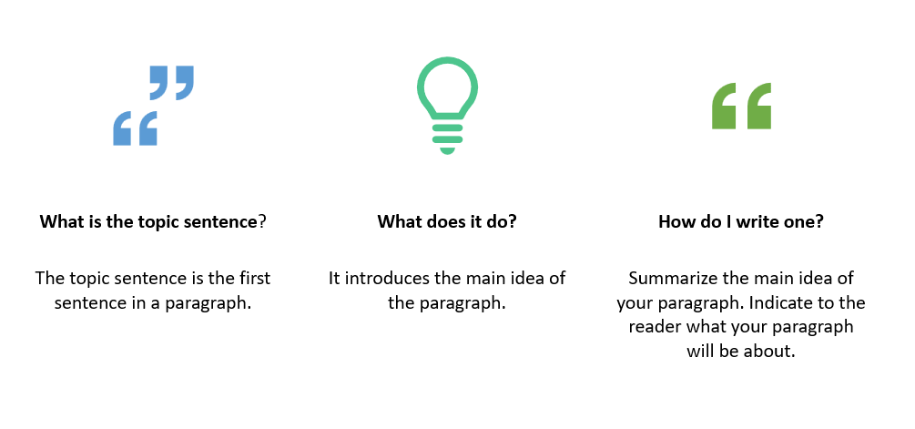
Topic Sentence

Slide 18
Example:
There are three reasons why Canada is one of the best countries in the world. First, Canada has an excellent health care system. All Canadians have access to medical services at a reasonable price. Second, Canada has a high standard of education. Students are taught by well-trained teachers and are encouraged to continue studying at university. Finally, Canada's cities are clean and efficiently managed. Canadian cities have many parks and lots of space for people to live. As a result, Canada is a desirable place to live.

Slide 19
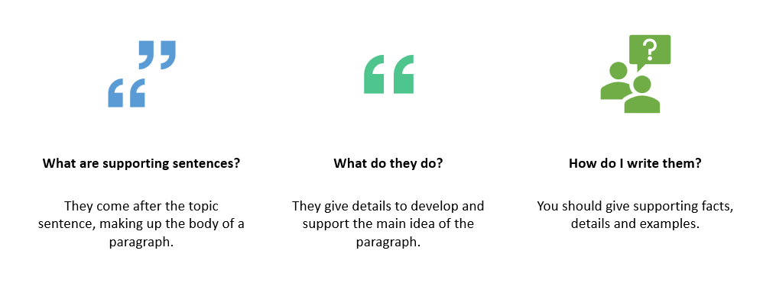
Supporting Details

Slide 20
Example:
There are three reasons why Canada is one of the best countries in the world. First, Canada has an excellent healthcare system. All Canadians have access to medical services at a reasonable price. Second, Canada has a high standard of education. Students are taught by well-trained teachers and are encouraged to continue studying at university. Finally, Canada's cities are clean and efficiently managed. Canadian cities have many parks and lots of space for people to live. As a result, Canada is a desirable place to live.

Slide 21
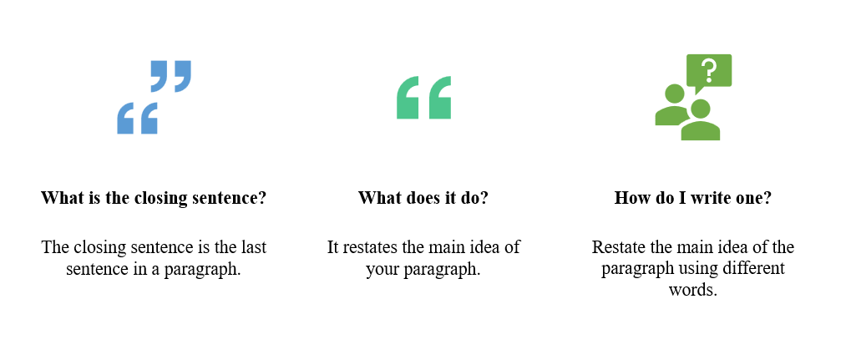
Closing Sentence

Slide 22
Example:
There are three reasons why Canada is one of the best countries in the world. First, Canada has an excellent health care system. All Canadians have access to medical services at a reasonable price. Second, Canada has a high standard of education. Students are taught by well-trained teachers and are encouraged to continue studying at university. Finally, Canada's cities are clean and efficiently managed. Canadian cities have many parks and lots of space for people to live. As a result, Canada is a desirable place to live.

Slide 23
Write the Conclusion
The conclusion brings closure to the reader, summing up your points or providing a final perspective on your topic. All the conclusion needs is three or four strong sentences which do not need to follow any set formula. Simply review the main points (being careful not to restate them exactly) or briefly describe your feelings about the topic. The conclusion should wrap up or summarize the ideas you have already discussed. Do not introduce any new ideas in this paragraph.

Slide 24

Preview your Essay
You have now completed all of the paragraphs of your essay. Before you can consider this a finished product, ensure that the essay has been properly formatted.
Check the order of your paragraphs
Look at your body paragraphs. Which one is the strongest? You might want to start with the strongest paragraph, end with the second strongest, and put the weakest in the middle. Whatever order you decide on, be sure it makes sense. If your essay is describing a process, you will probably need to stick to the order in which the steps must be completed.

Slide 25
Check your writing
Nothing can substitute the revision of your work. By reviewing what you have done, you can improve weak points that otherwise would be missed. Read and reread your essay.
Does it make logical sense?
Leave it for a few hours and then read it again. Does it still make logical sense?
Do the sentences flow smoothly from one to another? If not, try to add some words and phrases to help connect them. Transition words, such as therefore, consequently, or however may be used. They are useful when moving from one paragraph to another or from one sentence to the next.
Have you run a spell checker or a grammar checker?
These help to correct grammatical errors but they cannot catch every error. Therefore, you need to read through your work once more to ensure there are no grammatical errors.

Slide 26
Check the instructions for the assignment again
When you prepare a final draft, you must be sure to follow all the instructions you have been given.
Are your margins correct?
Have you titled the essay as directed?
What other information (name, admission number, date, etc.) should you include?
Did you check the spacing of your lines?
Did you check the font type/size?
What other formatting instructions have you been given?

Slide 27

Personal Reflection
Write an essay on any one of the following topics:
The role of AI in higher education
Social media is the cause of many social evils in our society today
Our education system does not serve the needs of the society

Slide 28
Answers for the Personal Reflection
The role of AI in higher education
  The essay will be an expository or explanatory essay. It will explain what the role of AI is in higher education
  You will be required to provide adequate details to explain the role of AI clearly
2) Social media is the cause of many social evils in our society today
  The essay that follows should present an argument and give evidence to support the claim that social media is the cause of many social evils in our society today. One may also choose to present an argument against this claim.
3) Our education system does not serve the needs of the society
  The essay that follows should present an argument and give evidence to support the claim that our education system does not serve the needs of the society. Alternatively, one may choose to present an argument against this claim.

Slide 29
Answers for the Personal Reflection ….cont.
For each essay, ensure that you follow these steps to guide you through the essay writing process:
Make a decision on your topic
Develop an outline of your main ideas
Write your thesis statement
Write the introduction
Write the body of your essay
Write the conclusion
Preview your essay

Slide 30
Thank you

