Slide 1
Programming and Problem Solving
Lecture 3
Problem solving tools
Lecturer: Dr. Joshua Okemwa

Slide 2
Lecture learning outcomes
At the end of the lecture you will be able to:
Identify tools used in problem solving
Know the guidelines and steps of using various tools
Scenario of application of each tool.

Slide 3
1.0 Computer based problem solving tools
Computer-Based Problem Solving Process is a work intended to offer a systematic treatment to the theory and practice of designing, implementing, and use of tools during the problem solving process.
In this presentation we will consider tools used in program design and later give an overview of programming language to be used in this course.

Slide 4
cont.
In program design we are mainly interested in designing:
    Algorithms
    Flowchart
    Pseudocodes

Slide 5
2.0 An algorithm introduction
An algorithm is an effective step-by-step procedure for solving a problem in a finite number of steps. In other words, it is a finite set of well-defined instructions or step-by-step description of the procedure written in human readable language for solving a given problem. An algorithm itself is division of a problem into small steps which are ordered in sequence and easily understandable

Slide 6
cont.
Algorithms are very important to the way computers process information, because a computer program is basically an algorithm that tells computer what specific tasks to perform in what specific order to accomplish a specific task. The same problem can be solved with different methods. So, for solving the same problem, different algorithms can be designed. In these algorithms, number of steps, time and efforts may vary more or less.

Slide 7
2.1 Characteristics of algorithm
Finiteness: An algorithm should have finite number of steps and it should end after a finite time.
Input: An algorithm may have many inputs or no inputs at all.
Output: It should result at least one output.

Slide 8
cont.
4. Definiteness: Each step must be clear, well-defined and precise. There should be no any ambiguity.
5. Effectiveness: Each step must be simple and should take a finite amount of time.

Slide 9
2.2 Guidelines of developing algorithms
An algorithm will be enclosed by START (or BEGIN) and STOP (or END).
To accept data from user, generally used statements are INPUT, READ, GET or OBTAIN.
To display result or any message, generally used statements are PRINT, DISPLAY, or WRITE.

Slide 10
Cont.
5. Generally, COMPUTE or CALCULATE is used while describing mathematical expressions and based on situation relevant operators can be used.
Note: A good programmer must know how to create an optimized solution for the given problem statement using minimal resources and processing time.

Slide 11
2.3 Example of an algorithm
Calculation of Simple Interest
Step 1: Start
Step 2: Read principle (P), time (T) and rate (R)
Step 3: Calculate I = P*T*R/100
Step 4: Print I as Interest
Step 5: Stop

Slide 12
2.4 Advantages of algorithm
Effective Communication: Since algorithm is written in English like language, it is simple to understand step-by-step solution of the problems.
Easy Debugging: Well-designed algorithm makes debugging easy so that we can identify logical error in the program.
Easy an Efficient Coding: An algorithm acts as a blueprint of a program and helps during program development.

Slide 13
Cont.
4. Independent of Programming Language: An algorithm is independent of programming languages and can be easily coded using any high level language.
5. Easy to understand: the language used is simple and plan, easy to comprehend by everyone.

Slide 14
2.5 Disadvantages of algorithms
Developing algorithm for complex problems would be time consuming and difficult to understand.
Understanding complex logic through algorithms can be very difficult.

Slide 15
3.0 Flowchart
Flowchart is basically a pictorial or diagrammatic representation of an algorithm using standard symbols.
In other words, flowchart is a graphical representation that explains the sequence of operations to be performed in order to solve a problem under consideration.

Slide 16
3.1 Standard flowchart symbols
To express different operations in the flowchart various standard symbols are used. All symbols are connected among themselves in order to show the flow of information and processing.
Different symbols as prescribed by American National Standard Institute (ANSI) which are frequently required while drawing flowchart are shown below.

Slide 17
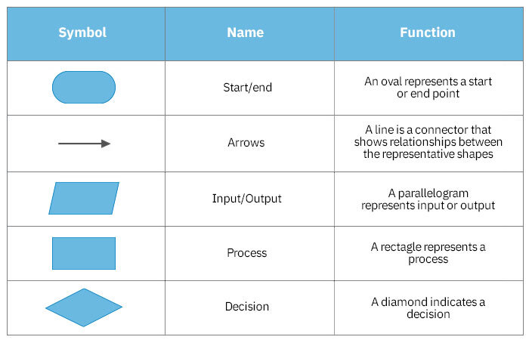
Diagram
Fig 3.1
Source smartdraw.com

Slide 18
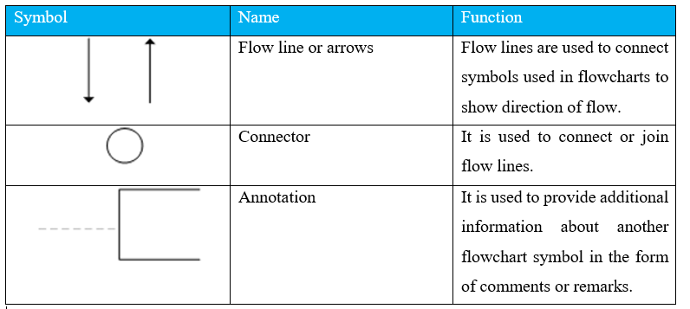
Diagram
Fig 3.2

Slide 19
3.2 Guidelines for preparing a flowchart
Standard symbols should be used while drawing flowchart.
Ensure that flowchart has START (or BEGIN) and STOP (or END).
Flowchart should be neat, clean and easy to follow. There should be no any ambiguity.
The usual direction of flowchart is from top to bottom or from left to right.

Slide 20
Cont.
5. The terminal symbol, that is, START/BEGIN or STOP/END should have only one flow line.
6. Only one flow line should come out from process symbol.
7. Only one flow line should enter a decision symbol, but two or three flow-lines, one for each possible answer, can leave the decision symbol.

Slide 21
cont.
8. If the flowchart is lengthy and complex connector symbol should be used to reduce the number of flow lines.
9. Avoid intersection of flow lines.
10.Use annotation symbol to describe steps more clearly.

Slide 22
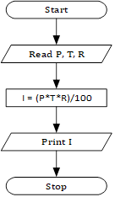
3.3.Example of flowchart for calculating simple interest
Fig 3.3

Slide 23
3.4 Advantages of flowchart
Effective Communication : Flowcharts are better way of communicating the logic of the system.
Effective Analysis : Using flowchart problem can be analyzed more efficiently.
Easy Debugging and Efficient Testing : The Flowchart helps in debugging and testing process.
Efficient Coding : The flowcharts are very useful during program development phase.

Slide 24
cont.
5. Proper Documentation : Flowcharts serves as a good program documentation, which is needed for various purpose.
6. Efficient Program Maintenance : Maintenance of operating programs becomes easy with the help of flowchart.

Slide 25
3.5 Disadvantages of flowcharts
Complex Logic: For complicated logic, flowchart becomes complex and clumsy.
Difficulty in Modifications: If change is required in the logic then flowchart needs to be redrawn and requires a lot of time.

Slide 26
4.0 Pseudocode
Pseudocode is structured English for describing algorithms concisely. It is made up of two words, namely, pseudo meaning imitation and code meaning instructions.
As the name suggests, pseudocode does not obey the syntax rules of any particular programming language i.e. it is not a real programming code. It allows the designer to focus on main logic without being distracted by programming languages syntax.

Slide 27
4.1 Guidelines for preparing pseudocode
Pseudocode will be enclosed by START (or BEGIN) and STOP (or END).
Pseudocode should be concise so ignore unnecessary details.
To accept data from user, generally used statements are INPUT, READ, GET or OBTAIN.
To display result or any message, generally used statements are PRINT, DISPLAY, or WRITE.
Generally used keywords are capitalized while preparing pseudocode.

Slide 28
4.2 Example
Calculation of Simple Interest
      Step 1: START
      Step 2: READ P, T, R
      Step 3: I = P*T*R/100
      Step 4: PRINT I
      Step 5: STOP

Slide 29
4.3 Advantages of Pseudocode
It allows the designer to focus on main logic without being distracted by programming languages syntax.
Since it is language independent, it can be translated to any computer language code.
It allows designer to express logic in plain natural language.

Slide 30
cont.
4. It is easier to write actual code using pseudocode.
5. Unlike algorithms, pseudocodes are concise so pseudocodes are more readable and easier to modify.

Slide 31
4.4 Disadvantages of pseudocode
There are no accepted standards for writing pseudocodes and designer use their own style while writing pseudocodes.
Pseudocode cannot be compiled and executed so its correctness cannot be verified by using computers.

Slide 32
5.0 computer program
In this stage, process of writing actual program takes place. A coded program is most popularly referred to as a source code. The coding process can be done in any language (high level and low level). The actual use of computer takes place in this stage in which the programmer writes a sequence of instructions ready for execution. Coding is also known as programming.

Slide 33
5.1 Characteristics of a good program
Comment clauses in the program help to make the program readable and understandable by people other than the original programmer.
It should be efficient.
It must be reliable enough to work under all reasonable conditions to provide a correct output.
It must be able to detect unreasonable error conditions and report them to the end user or programmer without crashing the system.
It should be easy to maintain and support after installation.

Slide 34
References
Introduction to the Design and Analysis of Algorithms" by Anany Levitin (2018, 4th Edition)
https://terrorgum.com/tfox/books/flowchartandalgorithmbasics.pdf
https://eduwavepool.unizwa.edu.om/lmsdatapool/00017295/LearningObjects/Notes_123_M_ISSA.pdf

