Slide 1
Programming and Problem Solving
Lecture 5
Programming basics II
Lecturer: Dr. Joshua Okemwa

Slide 2
Lecture learning outcomes
At the end of the lecture you will be able to:
Understand the structure of C++ programming language
Evaluate the basic concepts of object oriented programming
Design and develop programs for various real life scenarios

Slide 3
1. Introduction
Becoming proficient in a programming language equips you with the skills to design, implement, and maintain software systems efficiently and effectively. It's not just about writing code that works; it's about writing code that is readable, maintainable, and scalable.

Slide 4
BASIC STRUCTURE OF C++ LANGUAGE
The program written in C++ language follows this basic structure.
    Documentation section
    Linking section
    Definition section
    Global declaration section & class declarations
    Member function definition
    Main function section main() { Declaration section Executable section }

Slide 5
Explanation
i) Documentation section : comes first and is used to document the use of logic or reasons in your program. It can be used to write the program's objective, developer and logic details.
It can be also used to write for purpose of the program. Whatever written in the documentation section is the comment and is not compiled by the compiler.The documentation is done in C language with /* and */ . Whatever is written between these two are called comments.

Slide 6
Cont…
ii) Linking section : This section tells the compiler to link the certain occurrences of keywords or functions in your program to the header files specified in this section. e.g. #include using namespace std; directive causes the preprocessor to add the contents of the iostream file to the program.
It contains declarations for cout and cin. ➢ cout is a predefined object that represents the standard output stream. The operator << is an insertion operator, causes the string in double quotes to be displayed on the screen.

Slide 7
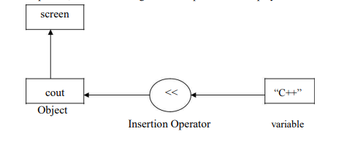
Diagram

Slide 8
cont…
The statement cin>>n; is an input statement and causes the program to wait for the user to type in a number. The number keyed is placed on the variable “n”. The identifier cin is a predefined object in C++ that corresponds to the standard input stream. The operator >> is known as extraction operator. It extracts the value from the keyboard and assigns it to the value variable on its right.

Slide 9
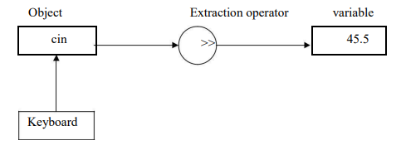
Diagram

Slide 10
Cont…
iii) Definition section: Each definition must be on a separate line. The SECTIONS keyword can be on the same line as the first definition or on a preceding line. The .def file can contain one or more SECTIONS statements.
This SECTIONS statement sets attributes for one or more sections in the image file, and can be used to override the default attributes for each type of section.
It is used to declare some constants and assign them some value. e.g. #define MAX 25

Slide 11
Cont…
iv) Global Declaration Section: Here the variables and class definitions which are used through out the program (including main and other functions) are declared so as to make them global(i.e accessible to all parts of program). e.g. int i; //this declaration is done outside and before main()
V) Sub Program or Function Section: This has all the sub programs or the functions which our program needs.
void display() { cout< < “ c++ is better’’; }

Slide 12
Cont…
  vi) Main function section : It tells the compiler where to start the execution from main() { point from execution starts } main function has two sections
  declaration section : In this the variables and their data types are declared.
  Executable section or instruction section : This has the part of program which actually performs the task we need.

Slide 13
Example
A program to add Two Numbers with User Input
        #include <iostream>
        using namespace std;
        int main() {
        int x, y;
        int sum;

Slide 14
Example
cout << "Type a number: ";
        cin >> x;
        cout << "Type another number: ";
        cin >> y;
        sum = x + y;
        cout << "Sum is: " << sum;
        return 0;
        }

Slide 15
2. Classes and objects
Class: A group of objects that share common properties for data part and some program part are collectively called as class.
A class is a blueprint for creating objects, while an object is an instance of a class. Classes define the properties (attributes) and behaviors (methods) that objects of that class can have.
Objects are the basic run-time entities in an object-oriented system. They may represent a person, a place, a bank account, a table of data or any item that the program must handle.

Slide 16
Cont…
The term objects means a combination of data and program that represent some real word entity.
  Example:
consider an example named Amit; Amit is 25 years old and his salary is 2500. The Amit may be represented in a computer program as an object. The data part of the object would be (name: Amit, age: 25, salary: 2500)

Slide 17
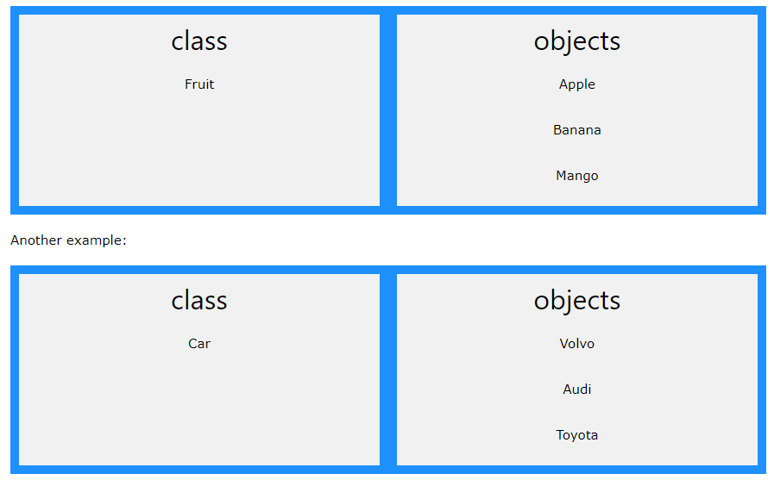
Example

Slide 18
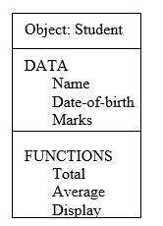
Example

Slide 19
Example
Create a class called "MyClass":
class MyClass { // The class
public: // Access specifier
int myNum; // Attribute (int variable)
string myString; // Attribute (string variable)
};

Slide 20
Explanation
The class keyword is used to create a class called MyClass.
The public keyword is an access specifier, which specifies that members (attributes and methods) of the class are accessible from outside the class. You will learn more about access specifier later.

Slide 21
Cont…
Inside the class, there is an integer variable myNum and a string variable myString. When variables are declared within a class, they are called attributes.
At last, end the class definition with a semicolon ;.

Slide 22
OBJECTS
Create an Object
In C++, an object is created from a class. We have already created the class named MyClass, so now we can use this to create objects.
To create an object of MyClass, specify the class name, followed by the object name.
To access the class attributes (myNum and myString), use the dot syntax (.) on the object:

Slide 23
Example
Create an object called "myObj" and access the attributes:
class MyClass { // The class
public: // Access specifier
int myNum; // Attribute (int variable)
string myString; // Attribute (string variable)
};
int main() {

Slide 24
Example
MyClass myObj; // Create an object of MyClass
// Access attributes and set values
myObj.myNum = 15;
myObj.myString = "Some text";
// Print attribute values
cout << myObj.myNum << "\n";
cout << myObj.myString;
return 0;
}

Slide 25
Class Methods
Methods are functions that belongs to the class.
There are two ways to define functions that belongs to a class:
Inside class definition
Outside class definition
In the following example, we define a function inside the class, and we name it "myMethod".
Note: You access methods just like you access attributes; by creating an object of the class and using the dot syntax (.):

Slide 26
Inside Example
class MyClass { // The class
public: // Access specifier
void myMethod() { // Method/function defined inside the class
cout << "Hello World!";
}
};
int main()
{
MyClass myObj; // Create an object of MyClass
myObj.myMethod(); // Call the method
return 0;
}

Slide 27
Cont…
To define a function outside the class definition, you have to declare it inside the class and then define it outside of the class. This is done by specifying the name of the class, followed the scope resolution:: operator, followed by the name of the function:

Slide 28
Outside Example
class MyClass { // The class
public: // Access specifier
void myMethod(); // Method/function declaration
};
// Method/function definition outside the class
void MyClass::myMethod() {
cout << "Hello World!";
}
int main() {
MyClass myObj; // Create an object of MyClass
myObj.myMethod(); // Call the method
return 0;
}

Slide 29
c++ Access Specifiers
In C++, there are three access specifiers:
public - members are accessible from outside the class
private - members cannot be accessed (or viewed) from outside the class
protected - members cannot be accessed from outside the class, however, they can be accessed in inherited classes.

Slide 30
Example
class MyClass {
public: // Public access specifier
int x; // Public attribute
private: // Private access specifier
int y; // Private attribute
};
int main() {
MyClass myObj;
myObj.x = 25; // Allowed (public)
myObj.y = 50; // Not allowed (private)
return 0;
}

Slide 31
REFERENCES
Stroustrup, B. (2013). The C++ Programming Language (4th ed.). Addison-Wesley.
Smith, J. (2020). Modern C++ Programming. ABC Publishing.
https://www.simplilearn.com/tutorials/cpp-tutorial/class-and-object-in-cpp

