Slide 1
Programming and Problem Solving
Lecture 6
Data types & tokens
Lecturer: Dr. Joshua Okemwa

Slide 2
Lecture learning outcomes
At the end of the lecture you will be able to:
Know the data types supported in C++ program
Understand the tokens available in C++ programs
Evaluate the importance of each token and its application

Slide 3
1. Data type
A data type is used to indicate the type of data value stored in a variable. All C compilers support a variety of data types. This variety of data types allows the programmer to select the type appropriate to the needs of the application as well as the machine. ANSI C supports the following classes of data types:
1.Primary (fundamental) data types.
2.Derived data types.
3.User-defined data types

Slide 4
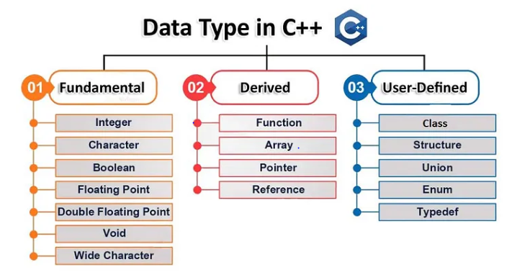
Diagram
Source: medium.com

Slide 5
Classes of Data Types
1.Primitive Data Types: These data types are built-in or predefined data types and can be used directly by the user to declare variables. example: int, char, float, bool, etc.
Primitive data types available in C++ are: Integer, Character, Boolean, Floating Point, Double Floating Point, Valueless or Void, Wide Character.

Slide 6
Cont…
2. Derived Data Types: The data types that are derived from the primitive or built-in datatypes are referred to as Derived Data Types. These can be of four types namely: Function, Array, Pointer, Reference
3. Abstract or User Defined: These data types are defined by the user itself. Like, as defining a class in C++ or a structure. C++ provides the following user-defined datatypes: Class, Structure, Union, Enumeration, Typedef defined Datatype

Slide 7
Primitive data types
Integer: The keyword used for integer data types is int. Integers typically require 4 bytes of memory space and range from -2147483648 to 2147483647.
Character: Character data type is used for storing characters. The keyword used for the character data type is char. Characters typically require 1 byte of memory space and range from -128 to 127 or 0 to 255.

Slide 8
Cont…
Boolean: Boolean data type is used for storing Boolean or logical values. A Boolean variable can store either true or false. The keyword used for the Boolean data type is bool.
Floating Point: Floating Point data type is used for storing single-precision floating-point values or decimal values. The keyword used for the floating-point data type is float. Float variables typically require 4 bytes of memory space.

Slide 9
Difference in Precision (Accuracy)
When working with numbers that have a lot of decimal digits, we usually hope that the resulting value will be accurate. But the accuracy of our result is dependent on the number of decimal digits we are dealing with.
Don't worry, we're still talking about C++, not mathematics.

Slide 10
Cont…
Float and double both have varying capacities when it comes to the number of decimal digits they can hold. Float can hold up to 7 decimal digits accurately while double can hold up to 15.
The set precision () function is used to tell the compiler the number of decimal places we want printed out.

Slide 11
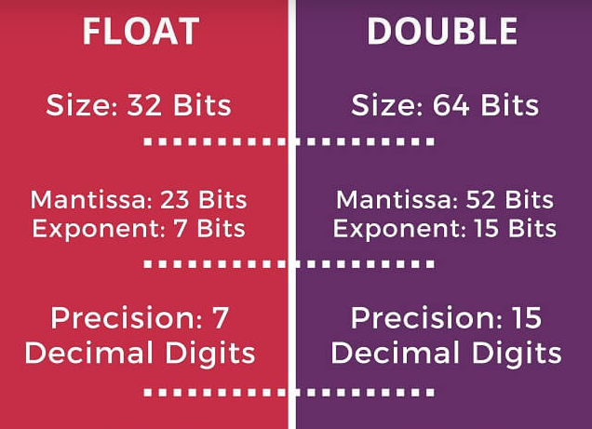
Illustration
Source:favtutor.com

Slide 12
C++ BOOLEANS
Very often, in programming, you will need a data type that can only have one of two values, like:
YES / NO
ON / OFF
TRUE / FALSE
A boolean variable is declared with the bool keyword and can only take the values true or false.
bool isCodingFun = true;
bool isFishTasty = false;
cout << isCodingFun; // Outputs 1 (true)
cout << isFishTasty; // Outputs 0 (false)

Slide 13
Example
#include <iomanip>
#include <iostream>
using namespace std;
int main() {
// Creating a double type variable
double a = 3.912348239293;
// Creating a float type variable
float b = 3.912348239293f;
// Setting the precision to 12 decimal places

Slide 14
Cont…
cout << setprecision(13);
// Printing the two variables
cout << "Double Type Number = " << a << endl;
cout << "Float Type Number = " << b << endl;
return 0; }

Slide 15
2. C++ Tokens
C++ Tokens are the smallest individual units of a program.
C++ is the superset of C and so most constructs of C are legal in C++ with their meaning and usage unchanged. So tokens, expressions, and data types are similar to that of C.
Following are the C++ tokens : (most of c++ tokens are basically similar to the C tokens)
Keywords
Identifiers
Constants
Variables
Operators

Slide 16
Keywords
Keywords are reserved words, which have fixed meaning, and its meaning cannot be changed. The compiler already knows the meaning and working of these keywords. C++ has more numbers of keyword than C, and those extra ones have special working capabilities.
There are 32 of these and they include:

Slide 17
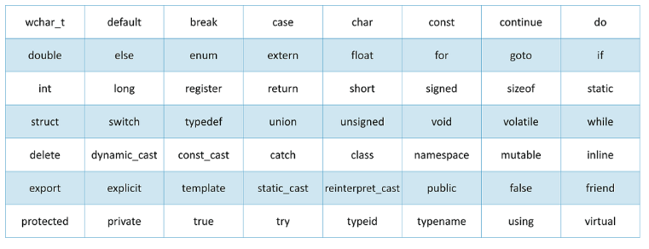
Cont…
Source: edureka.com

Slide 18
Variable
Variables are containers for storing data values.
In C++, there are different types of variables (defined with different keywords), for example:
int - stores integers (whole numbers), without decimals, such as 123 or -123
double - stores floating point numbers, with decimals, such as 19.99 or -19.99
char - stores single characters, such as 'a' or 'B'. Char values are surrounded by single quotes
string - stores text, such as "Hello World". String values are surrounded by double quotes
bool - stores values with two states: true or false

Slide 19
Cont…
Declaring (Creating) Variables
To create a variable, specify the type and assign it a value:
Syntax
type variableName = value;
Where type is one of C++ types (such as int), and variableName is the name of the variable (such as x or myName). The equal sign is used to assign values to the variable.

Slide 20
Example
Create a variable called myNum of type int and assign it the value 15:
int myNum = 15;
cout << myNum;
You can also declare a variable without assigning the value, and assign the value later:
Example
int myNum;
myNum = 15;
cout << myNum;
Note that if you assign a new value to an existing variable, it will overwrite the previous value:

Slide 21
Cont…
A demonstration of other data types:
Example
int myNum = 5; // Integer (whole number without decimals)
double myFloatNum = 5.99; // Floating point number (with decimals)
char myLetter = 'D'; // Character
string myText = "Hello"; // String (text)
bool myBoolean = true; // Boolean (true or false)
Display Variables
The cout object is used together with the << operator to display variables.

Slide 22
cont…
To combine both text and a variable, separate them with the << operator:
Example
int myAge = 35;
cout << "I am " << myAge << " years old.";

Slide 23
Identifiers
Identifiers are names given to different entries such as variables, structures, and functions.
Also, identifier names should have to be unique because these entities are used in the execution of the program.
All C++ variables must be identified with unique names.
These unique names are called identifiers.
Identifiers can be short names (like x and y) or more descriptive names (age, sum, totalVolume).
Note: It is recommended to use descriptive names in order to create understandable and maintainable code:

Slide 24
Example
Example
// Good
int minutesPerHour = 60;
// OK, but not so easy to understand what m actually is
int m = 60;

Slide 25
Cont…
The general rules for naming variables are:
Names can contain letters, digits and underscores
Names must begin with a letter or an underscore (_)
Names are case sensitive (myVar and myvar are different variables)

Slide 26
Cont…
Names cannot contain whitespaces or special characters like !, #, %, etc.
Reserved words (like C++ keywords, such as int) cannot be used as names

Slide 27
Constants
A constant is a value that cannot be altered by the program during normal execution, i.e., the value is constant. When associated with an identifier, a constant is said to be “named,” although the terms “constant” and “named constant” are often used interchangeably
You can define constants in C++.
By using constant keyword

Slide 28
Cont…
Declaration of a constant :
const [data_type] [constant_name]=[value];
When you do not want others (or yourself) to override existing variable values, use the const keyword (this will declare the variable as "constant", which means unchangeable and read-only):

Slide 29
Example
const int myNum = 15; // myNum will always be 15
NOTE: You should always declare the variable as constant when you have values that are unlikely to change:
Example
const int minutesPerHour = 60;
const float PI = 3.14;

Slide 30
Reference
Programming and Problem Solving with C++: Comprehensive" by Nell Dale and Chip Weems (2015, 6th Edition)
Smith, J. (2020). Modern C++ Programming. ABC Publishing.
Problem Solving with C++ by Walter Savitch (2017, 10th Edition)

