Slide 1
Programming and Problem Solving
Lecture 12
Sort Algorithms
(Bubble sort, insertion sort, selection sort Merge sort & Quick sort)
Lecturer: Dr. Joshua Okemwa

Slide 2
Lecture learning outcomes
At the end of the lecture you will be able to:
Identify different types of sort algorithms
Elaborate on sort algorithms
Design sort algorithms.
Implement sort algorithms

Slide 3
Sorting
Sorting refers to rearrangement of a given array or list of elements according to a comparison operator on the elements. The comparison operator is used to decide the new order of elements in the respective data structure. Sorting means reordering of all the elements either in ascending or in descending order.

Slide 4
Sorting Algorithm
A Sorting Algorithm is used to rearrange a given array or list of elements according to a comparison operator on the elements. The comparison operator is used to decide the new order of elements in the respective data structure.
Sorting algorithms are essential techniques in computer science used to rearrange elements in a specific order, typically in ascending or descending order.

Slide 5
Sorting terminology
In-place Sorting: An in-place sorting algorithm uses constant space for producing the output (modifies the given array only). It sorts the list only by modifying the order of the elements within the list.
Internal Sorting: Internal Sorting is when all the data is placed in the main memory or internal memory. In internal sorting, the problem cannot take input beyond its size.

Slide 6
cont…
Stable sorting: When two same data appear in the same order in sorted data without changing their position is called stable sort.
Unstable sorting: When two same data appear in the different order in sorted data it is called unstable sort.
External Sorting : External Sorting is when all the data that needs to be sorted cannot be placed in memory at a time.

Slide 7
Characteristics of sort algorithms
1.Space Complexity:
In-Place: Algorithms that require only a constant amount of extra space in addition to the input array.
Out-of-Place: Algorithms that require additional space proportional to the size of the input array.
2. Stability:
Stable: If the algorithm maintains the relative order of equal elements in the sorted output as they appear in the input array.
Unstable: If the algorithm does not guarantee the preservation of the relative order of equal elements.

Slide 8
Cont…
3. Comparison-Based vs. Non-Comparison-Based:
Comparison-Based: Algorithms that sort elements by comparing them pairwise (e.g., Bubble Sort, Quick Sort).
Non-Comparison-Based: Algorithms that do not rely solely on pairwise comparisons (e.g., Radix Sort, Counting Sort).
4. Adaptability:
Adaptive: If the algorithm's performance improves when applied to partially sorted or nearly sorted arrays.
Non-Adaptive: If the algorithm's performance remains the same regardless of the initial order of the elements.

Slide 9
cont…
5. Stability:
Stable: If the relative order of equal elements is preserved after sorting.
Unstable: If the relative order of equal elements may change after sorting.
6. Randomness:
Deterministic: Algorithms with a predictable behavior that produce the same output for the same input.
Randomized: Algorithms that use randomness or probability in their operation (e.g., Quick Sort with randomized pivot selection).

Slide 10
Application of sorting algorithms
Searching Algorithms: Sorting is often a crucial step in search algorithms like binary search, Ternary Search, where the data needs to be sorted before searching for a specific element.
Data management: Sorting data makes it easier to search, retrieve, and analyze.

Slide 11
Cont.
Machine learning: Sorting is used to prepare data for training machine learning models.
Data Analysis: Sorting helps in identifying patterns, trends, and outliers in datasets. It plays a vital role in statistical analysis, financial modeling, and other data-driven fields.

Slide 12
Cont.
Database optimization: Sorting data in databases improves query performance.
Operating Systems: Sorting algorithms are used in operating systems for tasks like task scheduling, memory management, and file system organization.

Slide 13
Advantages of sorting algorithms
Efficiency: Sorting algorithms help in arranging data in a specific order, making it easier and faster to search, retrieve, and analyze information.
Improved Performance: By organizing data in a sorted manner, algorithms can perform operations more efficiently, leading to improved performance in various applications.

Slide 14
cont…
Simplified data analysis: Sorting makes it easier to identify patterns and trends in data.
Reduced memory consumption: Sorting can help reduce memory usage by eliminating duplicate elements.
Improved data visualization: Sorted data can be visualized more effectively in charts and graphs.

Slide 15
Disadvantages of sorting algorithms
Time complexity: Sorting algorithms can have high time complexity, especially for large datasets.
Space complexity: Some sorting algorithms require additional memory space to perform their operations.

Slide 16
cont…
Stability: Some sorting algorithms do not preserve the original order of equal elements.
Algorithm selection: Choosing the most appropriate sorting algorithm for a given dataset can be challenging.

Slide 17
Real life example of sorting
There are many real-life examples of sorting. Here are a few:
1. Sorting a deck of cards:
When you sort a deck of cards, you are arranging them in a specific order, such as by suit or by rank. This makes it easier to find the cards you need when you are playing a game.
2. Sorting a list of names:
When you sort a list of names, you are arranging them in alphabetical order. This makes it easier to find the name you are looking for.

Slide 18
Cont…
3. Sorting a list of numbers:
When you sort a list of numbers, you are arranging them in numerical order. This makes it easier to find the largest or smallest number in the list.
4. Sorting a list of dates:
When you sort a list of dates, you are arranging them in chronological order. This makes it easier to see the order in which events occurred.

Slide 19
Benefits of sorting
Sorting can provide a number of benefits, including:
Improved organization: Sorting can help you to organize your data and make it easier to find the information you need.
Increased efficiency: Sorting can help you to work more efficiently by making it easier to find the items you need.
Reduced errors: Sorting can help you to reduce errors by making it less likely that you will overlook important information.

Slide 20
Types of sorting algorithms
There are various types of sorting algorithms, each with its own approach and characteristics.
In this course we will only consider an overview of Comparison-Based Sorting Algorithms. These algorithms sort elements by comparing them pairwise and swapping them if they are in the wrong order.
Other approaches include: Non-Comparison-Based Sorting Algorithms, Hybrid Sorting Algorithms, External Sorting Algorithms

Slide 21
Comparison –Based Sorting Algorithms
Bubble Sort: Compares adjacent elements and swaps them if they are in the wrong order, repeating this process until the entire list is sorted.
Selection Sort: Divides the list into two parts: sorted and unsorted. It repeatedly selects the smallest (or largest) element from the unsorted part and moves it to the sorted part.
Insertion Sort: Builds the sorted array one element at a time by repeatedly taking the next element and inserting it into its correct position in the sorted part of the array.

Slide 22
cont…
Insertion Sort: Builds the sorted array one element at a time by repeatedly taking the next element and inserting it into its correct position in the sorted part of the array.
Quick Sort: Uses a pivot element to partition the array into two parts, such that all elements smaller than the pivot are on its left and all larger elements are on its right. It then recursively applies the same process to the subarrays.

Slide 23
cont.
Merge Sort: Divides the array into two halves, sorts them independently, and then merges them back together.
Heap Sort: Builds a heap data structure from the input array and repeatedly extracts the maximum element to build the sorted array.

Slide 24
Bubble sort
Bubble sort is a sorting algorithm that compares two adjacent elements and swaps them until they are in the intended order.
Just like the movement of air bubbles in the water that rise up to the surface, each element of the array move to the end in each iteration. Therefore, it is called a bubble sort.

Slide 25
How bubble sort works.
Suppose we are trying to sort the elements in ascending order.
First Iteration (Compare and Swap)
Starting from the first index, compare the first and the second elements.
If the first element is greater than the second element, they are swapped.
Now, compare the second and the third elements. Swap them if they are not in order.
The above process goes on until the last element

Slide 26
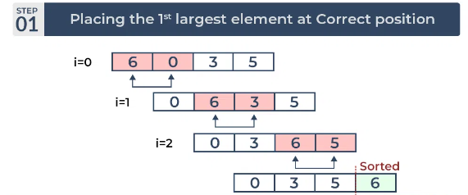
Example. (Pass 1)
The largest element is placed in its correct position, i.e., the end of the array.
Source: greeksforgreeks.org

Slide 27
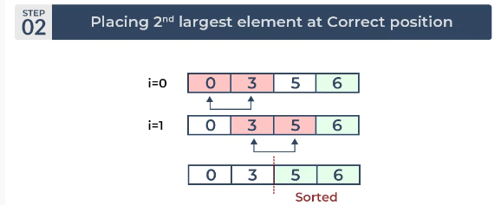
cont... (Pass 2)
The second largest element is placed in its correct position.
Source: greeksforgreeks.org

Slide 28
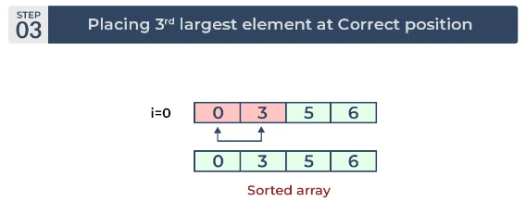
cont... (Pass 3)
Place the remaining two elements at their correct positions.
Source: greeksforgreeks.org

Slide 29
Pseudocode
Procedure bubbleSort(array, M)
array - list of elements to be sorted
M - size of the input array
begin
for i = 0 to M-1 do
for j = 0 to M-1-i do
if array[j] > array[j+1] then
swap array[j] and array[j+1]
end if
end for
end for
end procedure

Slide 30
Advantages of Bubble Sort
Bubble sort is easy to understand and implement.
It does not require any additional memory space.
It is a stable sorting algorithm, meaning that elements with the same key value maintain their relative order in the sorted output.

Slide 31
Disadvantages of Bubble Sort
Bubble sort is very slow for large data sets.
Bubble sort can be in efficient in some cases because it requires comparison operator to determine the relative order of elements in the input data set.

Slide 32
References
Introduction to the Design and Analysis of Algorithms" by Anany Levitin (2018, 4th Edition)
Smith, J. R. (2020). Bubble Sort. In A. Johnson (Ed.), Algorithms and Data Structures (pp. 50-65). Academic Press.
Smith, J. R. (2020). Sorting Algorithms: An In-depth Guide. Academic Press.
https://www.geeksforgeeks.org/linear-search-vs-binary-search/

