Slide 1
COURSE TITLE
ORGANIZATION AND MANAGEMENT
CHAPTER 2 (Week 2)
INTRODUCTION TO ORGANIZATION
Lecture - 2
Meaning and concept of organization, Principles of organization, Types of organization and Organizational structure.
Er. Ishwar Adhikari
Associate Professor
Kathmandu Engineering College, Nepal

Slide 2
Learning Objective
The main objective of this lecture is to understand about :
Meaning and Concept of Organization.
Principle of Organization.
Types of Organization.
Organizational Structure.

Slide 3
INTRODUCTION
A person to be success in any spheres of life needs the support from other people, to which we call organized activity.
A person has unlimited potential; however, the potential will remain unrealized if not carried out properly.
An organization means network of individuals created to achieve a goal.
Organization is associated with developing an outline where the overall work is divided into manageable components in order to facilitate the achievement of objectives or goals. [1]

Slide 4
INTRODUCTION (Cont’d…)
Any plan, whatever may be its scope from entirely personal to international it requires organized activity to fulfill.
Organization is the foundation upon which the whole structure of management is erected.
Organisation is the backbone of management because without an efficient organization no management can perform its functions smoothly.
Derived from the Greek Word Organon, which means “Organ”

Slide 5
INTRODUCTION (Cont’d…)
A set-up where individuals from diverse backgrounds, different educational qualifications and varied interests come together to work towards a common goal is called an organization.
The word ‘organisation’ refers to ‘institution’. Educational institution, a private agency, Government department or business firm; all are organisations.
An organization is a systematic arrangement of people to accomplish specific purpose. [2]
An organization can also be described as system where grouping of different parts that operate together as a whole. [3]

Slide 6
CHARACTERISTICS OF ORGANIZATION

Slide 7
CHARACTERISTICS OF ORGANIZATION (Cont’d..)
INTERACTION
It is almost impossible to imagine an organization with only one person, there should be at least two people interacting so that decisions are taken collaborating with each other.
Employees need to interact to solve problems effectively.
COMMON GOAL/OBJECTIVES
In terms of setting goals in your organization, if you know where you want your organization to go, you'll be in a strong position to know whether or not you've arrived at that goal.
Goal setting is an important tool not only for clarifying direction but also for assessing organizational progress.

Slide 8

CHARACTERISTICS OF ORGANIZATION (Cont’d..)
COOPERATIVE EFFORT AND COORDINATION
A combined effort helps in solving problem easily, and it is very essential in any organization.
There are various departments in an organization, like, marketing department, finance department, sales department, human resource department, so forth and so on.
If any of these departments do not help each other it becomes tedious to achieve the organizational objective.
SOURCE: [4]

Slide 9
CHARACTERISTICS OF ORGANIZATION (Cont’d..)
GOAL ORIENTED
An organization is established to achieve certain goals.
Goal setting define the purpose and nature of work that the organization wants to achieve.
These goals are divided into further team objectives so that individuals are encouraged and motivated toward unified aspirations.
The goals may be a product, service, increase market share, higher profit, increased productivity and superior quality.
Sometimes goals may be multifaceted and conflicting.

Slide 10
CHARACTERISTICS OF ORGANIZATION (Cont’d..)
KNOWLEDGE AND TECHNIQUE
For every organization, people are the key asset.
Their knowledge defines what the business knows and can accomplish.
The knowledge of the staff is also constantly changing, and the knowledge needed for the organization is constantly changing too.
STRUCTURED ACTIVITY
An organizational structure defines how activities such as task allocation, coordination and supervision are directed toward the achievement of organizational aims.

Slide 11
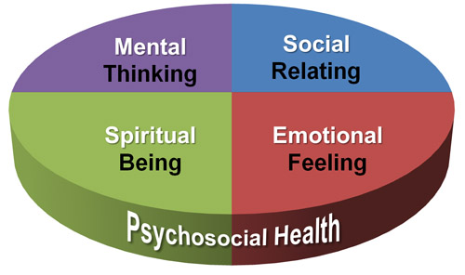
CHARACTERISTICS OF ORGANIZATION (Cont’d..)
PSYCHOSOCIAL SYSTEM
The organization is not just of importance to company management, but is also of great significance for each person’s work situation, both in health terms and in relation to his or her short- and long-term opportunities for making an effective contribution to work.
SOURCE: [5]

Slide 12
PURPOSE OF ORGANIZING
Divides work into specific jobs and departments.
Assign tasks and responsibilities associated with individual jobs.
Coordinates diverse organizational tasks.
Clusters jobs into units.
Establishes relationships among individuals, groups and units.
Establishes formal lines of authority.
Allocates and deploys organizational resources.

Slide 13
PRINCIPLE OF ORGANIZATION
Clearly defined objectives
Objectives should be clearly stated so that all members of the organization understand what they are expected to do.
Specialization
Grouping of activities according to functional specialization and assigned to persons as per their skills and specialized knowledge.
Span of control
Number of persons that can be supervised effectively by one person.

Slide 14
PRINCIPLE OF ORGANIZATION (Cont’d…)
Exception Principle
Routine matters should be dealt by lower level officers and exceptionally complex problems should be referred to higher levels.
Scalar Principle(Chain of command)
The line of authority from to bottom must be clearly defined.
Unity of command
One superior for a group of subordinates.

Slide 15
PRINCIPLE OF ORGANIZATION (Cont’d…)
Communication
The transfer of information, ideas, understanding or feelings among people.
Coordination
The process of ensuring that persons who perform interdependent activities work together in a way that contributes to overall objective attainment.
Discipline
The state of employee self-control and orderly conduct present in an organization.
Policy
A predetermined guide established to provide direction in decision making.

Slide 16
PRINCIPLE OF ORGANIZATION (Cont’d…)
Efficiency
The capability of producing desired results with a minimum of energy, time, cost, materials.
Effectiveness
The capability of bringing about an effect or accomplishing a purpose.
13. Functional authority
The right of staff specialists to issue orders in designated areas or work.
Synergy
The cooperative action of two or more persons working together to accomplish more than they could by working together.

Slide 17
ORGANIZATIONAL STRUCTURE
Organizational structure is the method by which work flows through an organization and allows groups to work together within their individual functions to manage tasks.
It is a framework within which an organization arranges it’s line of authorities and communications and allocates rights and duties.
An organizational structure defines how job titles, roles, and responsibilities are assigned within a company. It helps determine who reports to whom, and who makes decisions about what. [6]
The structure of the organization is similar to the anatomy of a living organism, acts as a framework within which the dynamic activity and process of people doing work takes place.

Slide 18
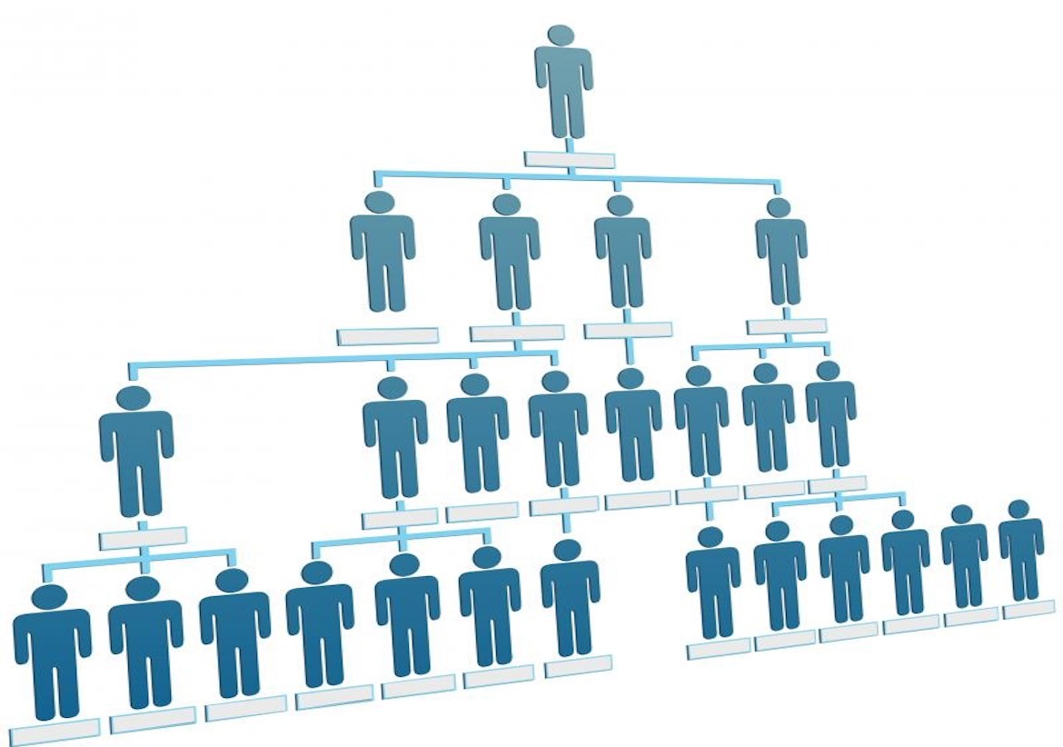
ORGANIZATIONAL STRUCTURE (Cont’d..)
IMPORTANCE
It enables members to know what their responsibilities.
It frees the manager and individual workers to concentrate on their respective roles and responsibilities.
It coordinates all organization activities so that there is minimal conflict.
Avoids overlapping of functions because it pinpoints responsibilities.
Shows to whom and for whom they are responsible.
SOURCE: [7]

Slide 19
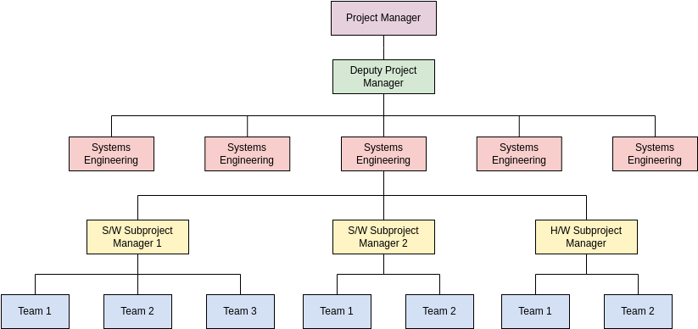
ORGANIZATIONAL CHART
A graphical representation or a diagram of an organization structure showing the functions, departments or positions of the organization and show how they are related.
It provides a visual map of the chain of command and shows the internal structure of a company.
It is a plan of working relationships, showing who is to do the work who is to supervise and direct.
It indicates the hierarchical levels in the management.
SOURCE: [8]

Slide 20
TYPES OF ORGANIZATION
FORMAL ORGANIZATION
Organizations formed under the bindings of some rules and regulation made by country is called formal organizations.
Existing acts, rules, regulations controls formal organizations.
The structures, duties, rights, scopes of the formal organizations are fixed.
Government ministries, departments, business organization formed under company act, partnership act, cooperatives, NGOs are the examples of formal organizations.

Slide 21
TYPES OF ORGANIZATION (Cont’d..)
Advantages of Formal organization
Systematic Working
Formal organization structure results in systematic and smooth functioning of an organization.
Achievement of Organizational Objectives
Formal organizational structure is established to achieve organizational objectives
No Overlapping of Work
In formal organization structure of work is systematically divided among various departments and employees. This results in no duplication or overlapping of work.

Slide 22
TYPES OF ORGANIZATION (Cont’d..)
Advantages of Formal organization
Co-ordination
Formal organizational structure results in coordinating the activities of various departments.
Creation of Chain of Command
Formal organizational structure clearly defines superior subordinate relationship, i.e., who reports to whom.
More Emphasis on work
Formal organizational structure lays more emphasis on work rather than interpersonal relations.

Slide 23
TYPES OF ORGANIZATION (Cont’d..)
Disadvantages of Formal Organization
1. Delay in Action
While following scalar chain and chain of command actions get delayed in formal structure.
Ignores Social Needs of Employees
Formal organizational structure does not give importance to psychological and social need of employees which may lead to demotivation of employees.
Emphasis on Work Only
Formal organization structure gives importance to work only; it ignores human relations, creativity, talents, etc.

Slide 24
TYPES OF ORGANIZATION (Cont’d..)
INFORMAL ORGANIZATION
Informal organizations develop relationships which are built on likes, dislikes, feelings and emotions and share common identity.
Therefore, the network of social groups based on friendships can be called as informal organizations.
There is no conscious effort made to have informal organization.
It emerges from the formal organization and it is not based on any rules and regulations as in case of formal organization.

Slide 25
TYPES OF ORGANIZATION (Cont’d..)
Advantages of Informal Organization
Fast Communication
Informal structure does not follow scalar chain so there can be faster spread of communication.
Fulfills Social Needs
Informal communication gives the due importance to psychological and social need of employees which motivate the employees.
Correct Feedback
Through informal structure the top level managers can know the real feedback of employees on various policies and plans.

Slide 26
Disadvantages of Informal Organization
Spread Rumors
With communication between different members across departments, there are chances of rumours getting spread quickly.
5. No Systematic Working
Informal structure does not form a structure for smooth working of an organization.
6. May Bring Negative Results
If informal organization opposes the policies and changes of management, then it becomes very difficult to implement them in organization.
7. More Emphasis to Individual Interest
Informal structure gives more importance to satisfaction of individual interest as compared to organizational interest.

Slide 27
TYPES OF ORGANIZATION (Cont’d..)
LINE ORGANIZATION
Line organization is the most oldest and simplest method of administrative organization suitable for smaller organization.
An organization that practices the relation of employees in line is called line organizations.
It means that one employee has relation with another employee who is in line. The authority flows from top to down.
This follows the principle that one subordinate has one supervisors.
This is authoritative in nature because subordinates have no right to raise questions on the orders.
Example: Military Administration, Bureaucratic structure.

Slide 28
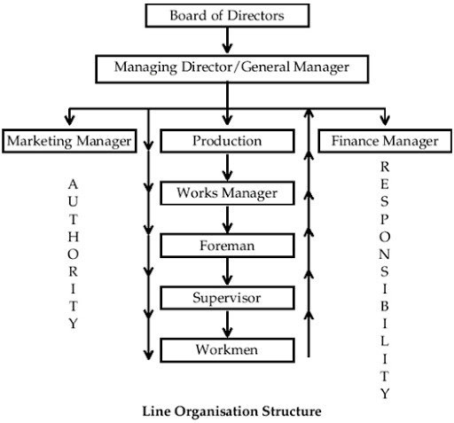
LINE ORGANIZATION (Cont’d..)
FEATURES
It is the most simplest form of organization.
Line of authority flows from top to bottom.
Specialized and supportive services do not take place in these organization.
Unified control by the line officers can be maintained since they can independently take decisions in their areas and spheres.
This kind of organization always helps in bringing efficiency in communication and bringing stability to a concern.
SOURCE: [9]

Slide 29
LINE ORGANIZATION (Cont’d..)
MERITS OF LINE OGANIZATION
SIMPLEST
It is the most simple and oldest method of administration.
UNITY OF COMMAND
In these organizations, superior-subordinate relationship is maintained and scalar chain of command flows from top to bottom.
BETTER DISCIPLINE
The control is unified and concentrates on one person and therefore, he can independently make decisions of his own. Unified control ensures better discipline.

Slide 30
LINE ORGANIZATION (Cont’d..)
FIXED RESPONSIBILITY
Every line executive has got fixed authority, power and fixed responsibility attached to every authority.
FLEXIBILITY
There is a co-ordination between the top most authority and bottom line authority.
Since the authority relationships are clear, line officials are independent and can flexibly take the decision. This flexibility gives satisfaction to line executives
PROMPT DECISION
Due to the factors of fixed responsibility and unity of command, the officials can take prompt decision.

Slide 31
LINE ORGANIZATION (Cont’d..)
DEMERITS OF LINE ORGANIZATION
OVER RELIANCE
The line executive’s decisions are implemented to the bottom. This results in over-relying on the line officials.
LACK OF SPECIALIZATION
A line organization flows in a scalar chain from top to bottom and there is no scope for specialized functions.
For example, expert advices whatever decisions are taken by line managers are implemented in the same way.
3. AUTHORITY LEADERSHIP
The line officials have tendency to misuse their authority positions. This leads to autocratic leadership and monopoly in the concern.

Slide 32
LINE ORGANIZATION (Cont’d..)
4. INADEQUATE COMMUNICATION
The policies and strategies which are framed by the top authority are carried out in the same way.
This leaves no scope for communication from the other end.
The complaints and suggestions of lower authority are not communicated back to the top authority. So there is one way communication.
5. LACK OF COORDINATION
Whatever decisions are taken by the line officials, in certain situations wrong decisions, are carried down and implemented in the same way.
Therefore, the degree of effective co- ordination is less.

Slide 33
4. LINE AND STAFF ORGANIZATION
Line and staff organization is a modification of line organization and it is more complex than line organization.
Specialized and supportive activities are attached to the line of command by appointing staff supervisors and staff specialists who are attached to the line authority.
Staff officers give advice and services to the line officers. Staff officers are generally expert in a particular field.
The authority flows from top to the bottom through the line officers, while the staff officer gives advices at various departments.
Full authority is headed by line officers regarding planning, implementation and control of workers.

Slide 34
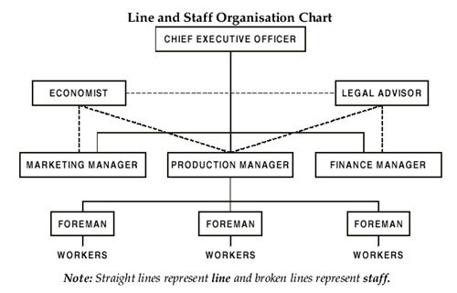
LINE AND STAFF ORGANIZATION (Cont’d…)
FEATURES
Line and Staff Organization is a compromise of line organization. It is more complex than line concern.
  Division of work and specialization takes place in line and staff organization.
  The whole organization is divided into different functional areas to which staff specialists are attached.
  Efficiency can be achieved through the features of specialization.
SOURCE: [9]

Slide 35
LINE AND STAFF ORGANIZATION (Cont’d…)
Merits of Line and Staff organization
RELIEF TO LINE EXECUTIVES
The advice and counseling which is provided to the line executives divides the work between the two.
The line executive can concentrate on the execution of plans and they get relieved of dividing their attention to many areas.
EXPERT ADVICE
The line and staff organization facilitates expert advice to the line executive at the time of need.
The planning and investigation which is related to different matters can be done by the staff specialist and line officers can concentrate on execution of plans.

Slide 36
LINE AND STAFF ORGANIZATION (Cont’d…)
BETTER COORDINATION
Line and staff organization through specialization is able to provide better decision making and concentration remains in few hands.
This feature helps in bringing co-ordination in work as every official is concentrating in their own area.
BENEFITS of RESEARCH and DEVELOPMENT
Through the advice of specialized staff, the line executives get time to execute plans by taking productive decisions which are helpful for a concern.
This gives a wide scope to the line executive to bring innovations and go for research work in those areas. This is possible due to the presence of staff specialists.

Slide 37
LINE AND STAFF ORGANIZATION (Cont’d…)
BALANCED DECISION
The factor of specialization which is achieved by line staff helps in bringing co-ordination.
This relationship automatically ends up the line official to take better and balanced decision.
UNITY OF ACTION
Unity of action is a result of unified control.
In the line and staff authority all the officials have got independence to make decisions. This serves as effective control in the whole enterprise.

Slide 38
LINE AND STAFF ORGANIZATION (Cont’d…)
Demerits of Line and Staff organization
Lack of understanding
In a line and staff organization, there are two authority flowing at one time.
This results in the confusion between the two. As a result, the workers are not able to understand as to who is their commanding authority. Hence the problem of understanding can be a hurdle in effective running.
Lack of sound advice
The line official get used to the expertise advice of the staff. At times the staff specialist also provide wrong decisions which the line executive have to consider.

Slide 39
LINE AND STAFF ORGANIZATION (Cont’d…)
Line and staff conflicts
Line and staff are two authorities which are flowing at the same time.
The factors of designations, status influence sentiments which are related to their relation, can pose a distress on the minds of the employees.
This leads to minimizing of co-ordination which hampers a concern’s working.
Costly
In line and staff concern, the concerns have to maintain the high remuneration of staff specialist. This proves to be costly for a concern with limited finance.

Slide 40
LINE AND STAFF ORGANIZATION (Cont’d…)
Assumption of authority
The power of concern is with the line official but the staff dislikes it as they are the one more in mental work.
Staff steals the show
In a line and staff concern, the higher returns are considered to be a product of staff advice and counseling.
The line officials feel dissatisfied and a feeling of distress enters a concern. The satisfaction of line officials is very important for effective results.

Slide 41
5. FUNCTIONAL ORGANIZATION
The concept of Functional organization was suggested by F.W. Taylor who recommended the appointment of specialists at important positions.
Functional organization brings together in one department all those who are engaged in one activity or in one or more related activities. [10]
Managing Director
GM
( Finance)
GM
( Mktg)
GM
( Prodn)
GM
( Sales)
GM
( HR)

Slide 42
FUNCTIONAL ORGANIZATION (Cont’d…)
Functional organization structure is a classical hierarchy in which each employee has a single superior.
Employees are then organized by specialty and work accomplished is generally specific to that specialty.
Communication with other groups generally occurs by passing information requests up the hierarchy and over to the desired group or manager.
Of all the organizational structures, this one tends to be the most difficult for the project manager.
Principle of unity of command does not apply to such organization as it is present in line organization.

Slide 43
FUNCTIONAL ORGANIZATION (Cont’d…)
ADVANTAGES
Specialization - Better division of labor takes place which results in specialization of function and it’s consequent benefit.
Effective Control - Checks and balances keep the authority within certain limits. Specialists may be asked to judge the performance of various sections.
Efficiency - Greater efficiency is achieved because of every function performing a limited number of functions.
Economy- Specialization compiled with standardization facilitates maximum production and economical costs.
Expansion- Expert knowledge of functional manager facilitates better control and supervision.

Slide 44
FUNCTIONAL ORGANIZATION (Cont’d…)
DISADVANTAGES
Ignorance of Organizational Objectives
Each departmental head works according to his sweet will. Hence, overall organizational objectives suffer.
Difficulty in Interdepartmental Coordination
All departmental heads may work as per their own wish.
Conflict of Interest
Every departmental head wants to become a functional empire. This situation leads to conflicts among the various departmental heads.
Hurdle in Complete Development
This system is a hurdle in the way of the complete development of the employees.

Slide 45
6. MATRIX ORGANIZATION
It is a organization in which there is more than one line of reporting managers.
It means that the employees of the organization have more than one boss.
Authority flows vertically within functional departments while authority of projects flows horizontally crossing the vertical lines. [11]
In multinational companies, the managers and employees should follow the instructions received from the host country and home country.
Therefore, the organizations become matrix in nature so is called matrix organizations.

Slide 46
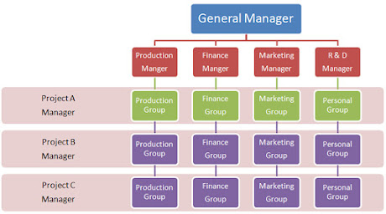
MATRIX ORGANIZATION (Cont’d..)
SOURCE: [12]

Slide 47
MATRIX ORGANIZATION (Cont’d..)
It enhances flexibility because teams can be created, redefined and dissolved as needed.
It assumes a major role in decision making, team members are likely to be highly motivated and committed to the organization.
Employees in a matrix organization have considerable opportunity to learn new skills.
It provides an efficient way for the organization to take full advantage of its human resources.
Employees in matrix organization servers as a bridge between functional unit and project team, enhancing cooperation.
The matrix design gives top management a useful vehicle for organization.

Slide 48
REFERENCES:
[1] Organization – Meaning, Definition, Importance and Principles, MBA Knowledge Base, accessed on 18th March, 2024. https://www.mbaknol.com/management-concepts/organization-meaning-definition-importance-and-principles/
[2] Organization Behavior: Stephen P Robbins, 14th Edition, Prentice Hall Publication, 2011.
[3] Project Management, Planning, Analysis and Control: Bhakti P. Sharma, First Edition, Ekta Books Distributors Pvt. Ltd, Kathmandu, Nepal, 2006.
[4] Strategic Planning: Collaboration, Cooperation, and Coordination, accessed on 19th March 2024, https://publicpuzzle.wordpress.com/2011/02/18/strategic-planning-collaboration-cooperation-and-coordination/

Slide 49
REFERENCES (Cont’d..)
[5] https://faculty.sfcc.spokane.edu/inetshare/autowebs/health101/mental-health/textbook.htm , accessed on 20th March 2024.
[6] What is organizational structure and why is it important? By Allaya Cooks-Campbell, September 1, 2022. Accessed on 20th March, 2024. https://www.betterup.com/blog/organizational-structure
[7] WHAT IS AN ORGANIZATIONAL STRUCTURES? Management Square, Management Methodology, Project Management. Accessed on 20th March 2024. https://www.management-square.com/organizational-structure/

Slide 50
REFERENCES (Cont’d..)
[8] Project Team, Accessed on 20th march 2024, https://online.visual-paradigm.com/diagrams/templates/organization-chart/project-team/
[9] RESEARCHGATE, Uploaded by Abdul-Kahar Adam, Accessed on 20th March 2024, https://www.researchgate.net/figure/Line-Organisation-Structure-Source-Akrani-2010-Organisation-Organisation-Structure_fig2_333210187
[10] Project Management: K. Nagarajan, New Age International (P) Ltd. Publishers, New Delhi, India, 2001.
[11] Project Management, Planning, Analysis and Control: Bhakti P. Sharma, First Edition, Ekta Books Distributors Pvt. Ltd, Kathmandu, Nepal, 2006.
[12] Matrix Organization Structure | Usefulness of Matrix Organization Structure, Accessed on 21st March, 2024. https://analysisproject.blogspot.com/2015/07/matrix-organization-structure.html

