Slide 1
COURSE TITLE
ORGANIZATION AND MANAGEMENT
CHAPTER 3 (Week 3)
MOTIVATION
Lecture - 3
Meaning and concept of motivation, Types of motivation, Theories of motivation and Issues in motivation.
Er. Ishwar Adhikari
Associate Professor
Kathmandu Engineering College, Nepal

Slide 2
Learning Objective
The main objective of this lecture is to understand about :
Meaning and Concept of Motivation.
Types of Motivation.
Theories of Motivation.
Issues in Motivation.

Slide 3
MEANING AND CONCEPT OF MOTIVATION
The term “Motivation” is derived from Latin word MOVERE which means to move.
Motivation is as the willingness to exert high levels of efforts towards organizational goals, conditioned by the effort’s ability to satisfy some individual needs [1].
It is the driving force within us that activates our behavior and considered as the psychological process.
Motivation is a process that starts with a physiological or psychological deficiency or need that activates behavior or a drive that that is aimed at a goal or incentive.

Slide 4
MEANING AND CONCEPT OF MOTIVATION (Cont’d..)
Motivation is the internal force that affects the intensity, direction and persistence of a person’s voluntary choice of behaviour. [2]
  Intensity : How hard a person tries (physically and mentally)
  Direction: Towards beneficial goal
  Persistence: How long a person tries
Motivation = f ( direction, intensity, persistence)
Motivation is an important management tool to harmonize and achieve goals of individuals and organizations.

Slide 5
MEANING AND CONCEPT OF MOTIVATION (Cont’d..)
Unsatisfied need/motives
Tensions-physical, psychological sociological
Drives for satisfying need/motives
Search behavior to satisfy needs / motives
Reduction of Tensions
Satisfied needs
Fig: Process of Motivation.

Slide 6
MEANING AND CONCEPT OF MOTIVATION (Cont’d..)
PRIMARY MOTIVE : Which are predominantly physiological (biological) in nature and unlearned such as air, water, shelter, food, etc;
SECONDARY MOTIVE : Which are social and psychological in nature and comprise needs for affiliation, belongingness, power, prestige, knowledge, competence, recognition, achievement, etc.
INTERNAL MOTIVES: Which start from the ego needs (freedom, prestige, recognition, status, etc.) of the person.
EXTERNAL MOTIVES: Which arise because of the social and family influences

Slide 7
IMPORTANCE OF MOTIVATION
Helps in satisfying the need of the employees in organization.
Change the negative attitude to positive attitude.
Reduce labor turnover and absenteeism.
Helps in introducing changes inside organization.
Improves level of efficiency of employees.
Creating friendly and supportive relationships.
Facilitates innovation and initiatives.
Improves image of organization and morale of employees.

Slide 8
INDICATION OF MOTIVATION
One wants to come to work willingly.
When at work, he or she gives his or her best.
He or she has a definite sense of belonging and pride in the organization.
INDICATION OF DEMOTIVATION
Increasing absenteeism and rate of accident.
Rank Indiscipline
Frustration and Unrest in the Work Place
Violent Behavior of Employees: Strikes, Demonstration etc.
Low Output and Productivity

Slide 9
TYPES OF MOTIVATION
The two main types of motivation are frequently described as being either extrinsic or intrinsic.
Extrinsic motivation arises from outside of the individual and often involves external rewards such as trophies, money, social recognition, or praise.
Intrinsic motivation is internal and arises from within the individual, such as doing a complicated crossword puzzle purely for the gratification of solving a problem. [3]
Intrinsic and extrinsic motivation are the two main types of motivation and represent all motivational drivers.

Slide 10
TYPES OF MOTIVATION (Cont’d…)
Types intrinsic motivation
Competence & Learning Motivation
It states that people are motivated more by the process itself rather than by the reward at the end.
Attitude Motivation
Attitude motivation refers to the type of motivation that's cultivated through the desire to change the way you or other people think and feel.
Achievement Motivation
Achievement motivation states that people are driven by the desire to pursue and achieve specific goals.
People who are driven by this type of motivation desire the achievement of a task or goal itself, and not necessarily because of the reward that’s attached. [4]

Slide 11
TYPES OF MOTIVATION (Cont’d…)
4. Creative Motivation
Many people are motivated by creativity or the innate drive for creative expression.
Creative motivation typically manifests itself as an internal feeling that you have something to say that needs to get out. [4]
Physiological Motivation
Often, humans are driven by some internal force beyond their explanation.
Our actions are motivated by deep physiological feelings that are primal and cannot be ignored, regardless of how hard we try. This represents the physiological motivational factors that are both internal and outside of our control. [4]

Slide 12
TYPES OF MOTIVATION (Cont’d…)
Types of extrinsic motivation
1. Incentive Motivation
Incentive motivation, unlike achievement motivation, says that people are motivated more by the reward than by the achievement of the goal itself.
2. Fear Motivation
Fear motivation is a motivational type that uses consequences to drive people into action. Fear motivation can be thought of as a “negative motivator”.
3. Power Motivation
Power motivation is a motivational factor that says people are motivated by control over their own lives and the lives of others.

Slide 13
THEORIES OF MOTIVATION
Traditional Theory
Fear and Punishment Theory
Reward Theory
Motivation Theories
Carrot and Stick Theory
Maslow Hierarchy Need Theory
Two Factor Theory
Modern/
Content Theory
ERG Theory
McClelland Achievement Theory
Expectancy Theory

Slide 14
THEORIES OF MOTIVATION (Cont’d..)
TRADITIONAL THEORY
Fear and Punishment theory
In this theory, manager develop a strategy of forcing people to work by threatening to punish or dismiss them or cut their reward if they did not work well.
This philosophy is characterized by thinking of aggressiveness and authorities of managers.
It involves the use of threat, coercion, close supervision and tight control of behaviour.
It leads to frustrations, therefore, this approach does not motivate people.

Slide 15
THEORIES OF MOTIVATION (Cont’d..)
Reward Theory
This theory tries to establish a direct relationship between the efforts the people put at work and rewards they gain after the work.
This theory basically is based on the piece rate system which means the more effort the people put more they are likely to be rewarded.
According to this theory, people can be motivated to engage in certain behaviours by external incentives that either promise positive benefits or threaten negative consequences.
It is based on standard that managers should decide on degrees of rewards and punishments.

Slide 16
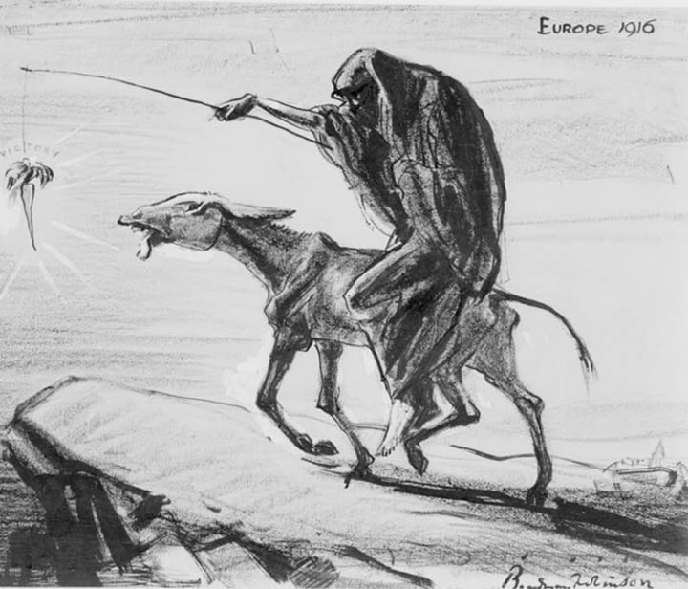
THEORIES OF MOTIVATION (Cont’d..)
Carrot and Stick Theory
This theory suggests a combination of both rewards and penalties for motivation.
We can either encourage someone by providing a reward for favourable behaviour and providing punishment for unfavourable behaviour. [5]
This is based on the strategy of putting carrot in front of donkey and hitting it with the stick from the behind so it has to run.
Carrot refers to the incentives and stick represents the penalties.
SOURCE: [5]

Slide 17
THEORIES OF MOTIVATION (Cont’d..)
MODERN OR CONTENT THEORY
Maslow's Hierarchy of Need Theory
Abraham Maslow's, an American psychologist proposed "need hierarchy theory“ which is probably the most popular theory of motivation.
He Suggested that people have a complex set of strong needs which determines the behavior of individuals.
In 1943, He formulated his theory of hierarchical needs by asking the same question: "what is it that makes people behave the way they do?"
He identified five general type of need that motivates people.

Slide 18
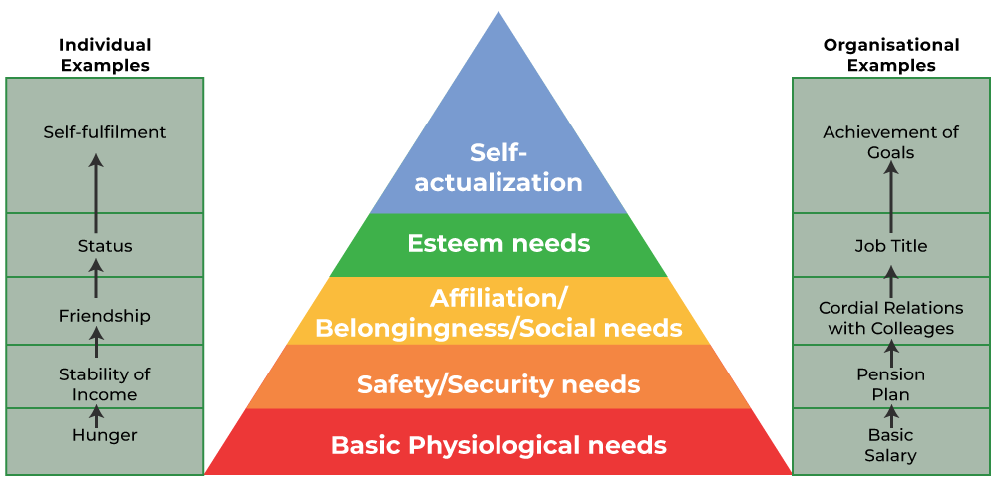
THEORIES OF MOTIVATION (Cont’d..)
SOURCE: [6]
Externally satisfied: Physiological need, Safety need and Social need
Internally satisfied: Esteem need and self actualization need.

Slide 19
THEORIES OF MOTIVATION (Cont’d..)
Physiological need: It includes biological needs like food, shelter, thirst, sex.
Safety need: it included security and protection from physical and emotional harm like financial security, living in safe area, job security etc.
Social need: It includes the belongingness, affection and friendship . The formation of informal groups in the workplace is an example of social or belonging needs.
Esteem need: These needs relate to the desire for recognition and respect from others. Esteem needs include autonomy status, attention, appreciation from others or prestige in society. Generally, employees at a higher level are motivated by such needs. [6]

Slide 20
THEORIES OF MOTIVATION (Cont’d..)
Self Actualization need
Self actualization is the apex of the Maslow Hierarchy need.
It is the quest of reaching one’s full potential as a person.
It includes growth, self-fulfilment and achievement of goals.
Maslow indicated when one need is satisfied, people proceed to another need to satisfy. people always try to satisfy the lower need first then proceed into upper level need.

Slide 21
THEORIES OF MOTIVATION (Cont’d..)
Two Factor Theory
The two-factor theory (also known as Herzberg's motivation-hygiene theory and dual-factor theory)
Two factor theory states that: “There are certain factors in the work place that causes job satisfaction , while a separate set of factors causes dissatisfaction.
According to Herzberg’s , people are influenced by two factors: [7]
Satisfaction and psychological growth are a result of motivation factors.
Dissatisfaction is a result of a lack of hygiene factor.

Slide 22
THEORIES OF MOTIVATION (Cont’d..)
EXTRINSIC, HYGIENE, JOB-CONTEXT OR MAINTENANCE FACTORS
It represents the need to avoid pain in the environment which represents the condition under which job is performed.
Presence of these factors does not cause motivation but their absence causes dissatisfaction.
They are, therefore, dis-satisfiers and not motivators. They simply prevent dissatisfaction.
Examples: Company policy, relationship with boss, salary, working conditions, security etc.

Slide 23
THEORIES OF MOTIVATION (Cont’d..)
INTRINSIC, JOB-CONTENT, OR MOTIVATOR FACTORS
These factors have a positive influence on morale, satisfaction, efficiency and higher productivity.
The factors in this group are satisfiers and motivators.
Their absence does not cause dissatisfaction but their presence has an uplifting effect on employee motivation.
Examples: Achievement, recognition, growth, work itself, responsibility, advancement etc.

Slide 24
THEORIES OF MOTIVATION (Cont’d..)
ERG theory
CLAYTON PAUL ALDERFER , an American Psychologist extended and simplified Maslow’s Hierarchy into a shorter set of three needs.
EXISTENCE
RELATADENESS
GROWTH
ERG THEORY
CLAYTON ALDERFER

Slide 25
THEORIES OF MOTIVATION (Cont’d..)
EXISTENCE NEEDS
This group need is concerned with providing the basic requirements for material existence such as physiological and safety needs of Maslow's model.
In a work context , this need is satisfied by money earned in a job for the purchase of food, shelter and clothing etc.
RELATADENESS NEED
These needs roughly correspond to social and esteem needs in Maslow's model.
This group of need focuses on the desire to establish and maintain interpersonal relationships with family, friends, co-worker and employers.

Slide 26
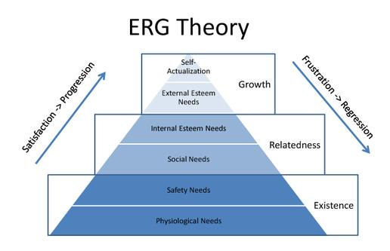
THEORIES OF MOTIVATION (Cont’d..)
GROWTH NEEDS
These needs are about fulfillment of desires to be creative, productive and to complete meaningful tasks.
They are similar to Maslow's self-actualization needs.
These needs are all about personal development. In a work context a person’s job, career, or profession can provide a significant satisfaction of growth needs.
SOURCE: [8]

Slide 27
THEORIES OF MOTIVATION (Cont’d..)
McClelland's THREE NEED THEORY
McClelland proposed that an individual’s specific needs are acquired over time and are shaped by one’s life experience.
He attempt to identify the characteristics of people having need for achievement (N/Ach), need for power (N/Pow), and need for affiliation (N/Aff).
He believes that each person has a need for all three but that people differs in the degree to which the various need motivate their behavior.

Slide 28
THEORIES OF MOTIVATION (Cont’d..)
Need for Achievement
Have been found to have intense desire for success for its own sake and not for money.
They are psychologically concerned mainly with doing things better, career advancement and accomplishment.
They seek challenging assignments, prefer to assume personal responsibilities for results, want prompt feedback on how well they are doing.
They set more difficult but achievable goals for themselves. They believe that easily achievable goals hardly provides them with any sense of achievement.

Slide 29
THEORIES OF MOTIVATION (Cont’d..)
Need for Power
Person who needs personal power wants to direct others, and this need often is perceived as undesirable.
People who need institutional power (also known as social power) want to organize the efforts of others to further the goals of an organization.
Manager with high need of institutional power tend to be more effective than those with a high need of personal power.
They have desire to exercise control over others.

Slide 30
THEORIES OF MOTIVATION (Cont’d..)
Need for Affiliation
People with need for affiliation derive satisfaction from friendship, love and belongingness.
They enjoy interaction with others, seek and lend psychological support and find satisfaction on developing understanding and intimacy with others.
They have a strong desire for acceptance and approval from others.
The need for affiliation is, thus, social need.

Slide 31
THEORIES OF MOTIVATION (Cont’d..)
EXPECTANCY THEORY
Need theories of motivation (Alderfer, Herzberg, Maslow, McClelland) attempt to explain what motivates people in the workplace.
Expectancy theory is a cognitive (perceiving) process theory of motivation that is based on the idea that :
People believe there are relationships between the effort they put forth at work,
The performance they achieve from that effort, and the rewards they receive from their effort and performance.

Slide 32
THEORIES OF MOTIVATION (Cont’d..)
EXPECTANCY THEORY
It states that “the strength of a tendency to act in a certain way depends on the strength of an expectation that the act will be followed by a given outcome and on the attractiveness of that outcome to the individual” [1]
Developed by Victor Vroom and also known as path-goal theory.
According to this theory, motivation to engage in a given behavior is determined by:
  Individual's perception or expectancy about outcomes or rewards likely to result from his given behavior; and
  Attractiveness of that reward to the satisfaction of his needs.

Slide 33
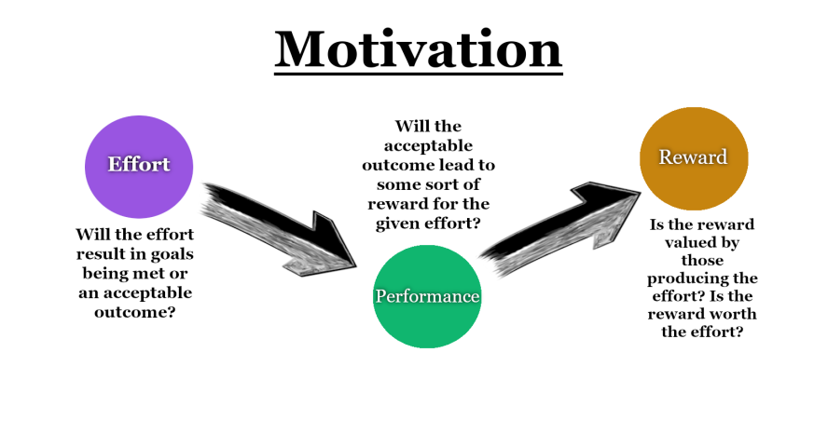
THEORIES OF MOTIVATION (Cont’d..)
3 KEY ELEMENTS :
EXPECTANCY, INSTRUMENTALITY, & VALENCE
A person is motivated to the degree that he or she believes that:
(a)effort will lead to acceptable performance (expectancy),
(b)performance will be rewarded (instrumentality), and
(c)the value of the rewards is highly positive (valence).
Motivation = Expectancy x Instrumentality x Valence
SOURCE: [9]

Slide 34
ISSUES IN MOTIVATION
In any organization, the workforce or people comes to work from different cultural background, expertise, and belongs to various departments and groups.
However, it is not easy for the managers to always keep the employees motivated for the performance and achieving organizational goal.
Some issues managers has to cope for motivating the employees which includes.
a. Motivating to professional employees
b. Motivating low skilled service worker
c. Motivating contingent or temporary worker
d. Motivating people doing repetitive job
e. Motivating diversified workforce.

Slide 35
ISSUES IN MOTIVATION (cont’d..)
Motivating to professional employees
A typical employee today is more likely to be highly trained and educated professional with college degree than a blue collar factory worker. [10]
The issues in motivating them are how to
Provide them with challenging jobs.
Allow them to participate in decisions that affect their work.
Give them autonomy to follow their interest.
Reward them with opportunities to develop their potential.
Give them recognition.

Slide 36
ISSUES IN MOTIVATION (cont’d..)
Motivating low skilled service worker
These jobs are typically filled with people who have limited education and skill and little above minimum wages.
They want other to think what they are working on is important.
The issues in motivating them are how to
Provide flexible work schedule.
Increase pay and benefits.
Make the jobs appealing.

Slide 37
ISSUES IN MOTIVATION (cont’d..)
Motivating contingent or temporary worker
They are part time, contract and other forms of temporary workers.
Temporary workers are not committed to organization. They receive fewer benefits and less pay.
The issues in motivating them are how to
Provide them with training to increase their skills.
Provide opportunities for permanent status.
Ensure equity through appropriate pay plan.

Slide 38
ISSUES IN MOTIVATION (cont’d..)
Motivating people doing repetitive job
They are workers on assembly line and do repetitive jobs which might be boring, stressful and standardized.
The issues in motivating them are how to
Carefully select them.
Provide high pay.
Create pleasant work climate.

Slide 39
ISSUES IN MOTIVATION (cont’d..)
(e) Motivating diversified workforce
Today organization is equipped with different types of workforce like male, female, disabled, professionals, non professionals etc.
All the people might not be motivated by money or position only.
The issues in motivating them are how to
Understand and respond to their diversity.
Be flexible and design work schedules, reward system, physical work settings to reflect their varied needs.
Provide flexible work hours, leave schedules, job sharing, and temporary work assignments.

Slide 40
REFERENCES:
[1] Organization Behaviour: Stephen P. Robbins, 14th Edition, Prentice Hall Publication, 2011.
[2] Organization and Management: Shyam Krishna Joshi, Second Edition, A.K. Books Publishers and Distributors, Kathmandu, Nepal, 2006.
[3] Motivation: The Driving Force Behind Our Actions, By Kendra Cherry, MSED. Updated on May 3, 2023. Accessed on March 24, 2024. https://www.verywellmind.com/what-is-motivation-2795378.
[4] 11 Types of Motivation: What They Are & How to Use Them, by Evan Tarvar, July 15,2020. Accessed on 24th March 2024. https://evantarver.com/types-of-motivation/

Slide 41
REFERENCES (Cont’d…)
[5] Stick And Carrot Theory – Easy Explanation, By Arindra Mishra , October 11, 2021 . Accessed on 24th March 2024. https://managementweekly.org/stick-and-carrot-theory/
[6] Maslow’s Hierarchy of Needs Theory, Accessed on 25th March, 2024. https://www.geeksforgeeks.org/maslows-hierarchy-of-needs-theory/
[7] Construction Management and Equipment: Saurabh Kumar Soni, First Edition, S.K. Kataria and Sons, New Delhi, India, 2014.
[8] Clayton Alderfer ERG Theory, October 15, 2018 by Business Education. Accessed on 25th March 2024. https://www.study4business.com/marketing/clayton-alderfer-erg-theory/

Slide 42
REFERENCES (Cont’d…)
[9] Vroom’s Expectancy Theory of Motivation, BY JOSHUA RENDER On July 8, 2019. Accessed on 25th March, 2024. https://agile-mercurial.com/2019/07/08/vrooms-expectancy-theory-of-motivation/
[10] A Hand Book of Organizational Behaviour and Human Resource Management: Niraj Mishra, Second Edition, Asmita Publication, Kathmandu, Nepal.

