Slide 1
COURSE TITLE
ORGANIZATION AND MANAGEMENT
CHAPTER 5 (Week 5)
COMMUNICATION
Lecture - 5
Introduction to Communication, Structure of Communication, Process of communication, Types and Levels of Communication and Barriers and Enhancement of Communication
Er. Ishwar Adhikari
Associate Professor
Kathmandu Engineering College, Nepal

Slide 2
Learning Objective
The main objective of this lecture is to understand about :
Introduction to communication.
Structure of communication.
Process of communication.
Types and Levels of communication.
Barriers and Enhancement of communication

Slide 3
INTRODUCTION TO COMMUNICATION
The term communication is derived from Latin word “communicare” which means to make common, mutual donation, building together a defense.
Communication is the process of exchanging information between two or more people, through a common system of symbols.
It involves transfer of meaning, if no information or ideas have not been conveyed, communication hasn’t taken place.
Effective management is an output of effective communication. So, It is taken as the fundamental management function and lifeblood of any organization.

Slide 4
INTRODUCTION TO COMMUNICATION (Cont’d..)
Without communication an organization would only be an assembly of men, material and processes which are inoperative.
Organizational effectiveness depends upon the quality of communication.
Managers have to communicate with subordinates and superiors. 50% to 90% of a manager’s time is spent communicating. [1]
Communication involves the systematic and continuous process of telling, listening and understanding.
If communication stops, the organization will cease to exist. Communication is vital for the very existence of the organization.

Slide 5
INTRODUCTION TO COMMUNICATION (Cont’d..)
Management needs to take employees in confidence and make them aware of organizational policies, problems and vision. Following points need interaction with employees for successful running of an organization [2]
(a) Organizations policy and future plans
(b) Results achieved in relation to the industry performance
(c) Achievement of higher productivity
(d) Industrial safety, health and welfare measures
(e) Technical developments
(f) Personal growth prospects

Slide 6
INTRODUCTION TO COMMUNICATION (Cont’d..)
Features of communication
The channels of communication must be clearly set and be known to all.
Every member of the organization should be reached by some channel of communication.
The line of communication should be as direct as possible.
There should be no blockage in the line of communication and formal line should be used.
The communicator should be highly skilled in the art of communication.
The line of communication should be constantly kept open.
Every communication should be authenticated.

Slide 7
INTRODUCTION TO COMMUNICATION (Cont’d..)
Objectives of Communication
To keep employees abreast with external and internal environment.
Develop understanding and cordial relationship with management.
Development of team spirit, group task resolution and psychological bent of mind.
Promote creativity and innovativeness.
Develop social commitment among employees.
Make them aware of their rights, entitlements, and responsibilities.
Prepare employees to accept and implement change.
Prevent misinformation and counter rumours.
Promote participative type of leadership model.

Slide 8
INTRODUCTION TO COMMUNICATION (Cont’d..)
Advantages
Increase productivity
Reduce stress
Better understand what others are saying
Better understand how to get your message across
Enhance relationships
Save time and money.
Characteristics
Continuous process
Complete system
Interactive, timely and ever changing
Mostly irreversible
Intentional and unintentional
Multi directional

Slide 9
STRUCTURE OF COMMUNICATION
The communication structure in an organization refers to the formal and informal channels of communication that exist between different levels of employees and departments.
It defines the flow of information, the people involved in the process, and the procedures that are used to communicate information throughout the organization. [3]
Formal Structure
(a) Vertical Structure
- Top Down
- Down Top
- Both Ways
(b) Horizontal Structure
(c) Diagonal Structure
2. Informal Structure
- Grapevine

Slide 10
STRUCTURE OF COMMUNICATION (Cont’d..)
Formal Structure
Vertical Structure
Downward (Top – Down) Communication
In this pattern the communication flows from superior to subordinates.
Any communication that flows from a manager down the authority or along the chain of commands is downward communication.
It is used to inform, direct, coordinate and evaluate subordinates.
It is in the written form like policy letters, standing orders, staff regulations, handbooks, procedure, manuals and the like.

Slide 11
STRUCTURE OF COMMUNICATION (Cont’d..)
Upward (Down –Top) Communication
Managers rely on individuals below them for information.
Reports are sent upwards in the authority hierarchy to inform higher management of progress towards goals and current problems.
The flow of information from bottom to top helps the top management to know the actions, attitude, opinion and feelings of people.
Hence upward communication is flow from subordinates to higher level managers.

Slide 12
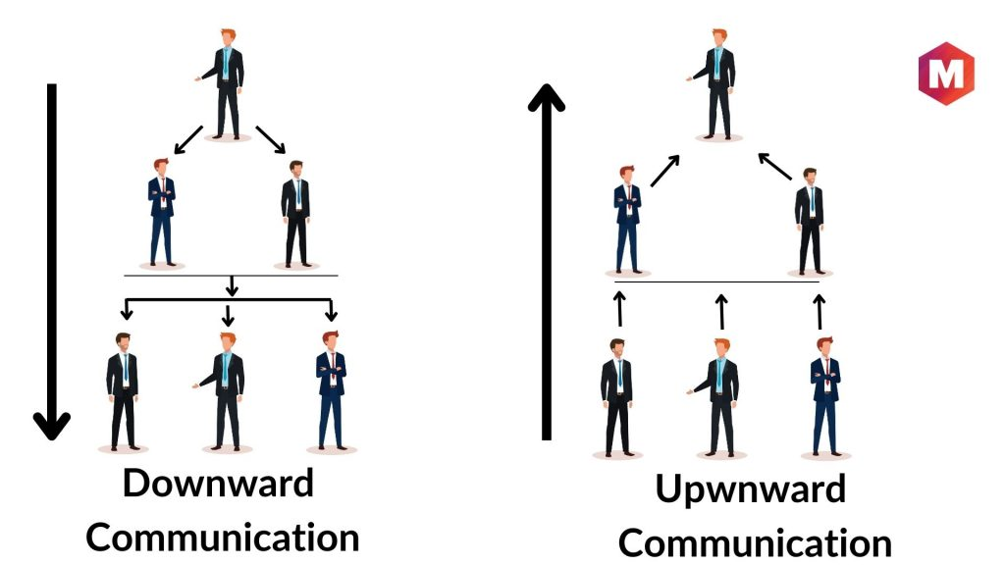
STRUCTURE OF COMMUNICATION (Cont’d..)
SOURCE: [4]

Slide 13
STRUCTURE OF COMMUNICATION (Cont’d..)
Both way Communication
The process of sharing information back and forth between two parties. In other words, it's a conversation where both the sender and receiver invite and offer feedback.
When the communication is flown from both sides top level managers and the subordinates then it is taken as both way communication.
Basically found in those organization which follows participative management.

Slide 14
STRUCTURE OF COMMUNICATION (Cont’d..)
Horizontal Structure
This type of communication refers to communication across departments or between people within different departments.
It does not have a superior – subordinate relationship as downward and upward communication has.
It is more informal in nature and is necessary in promoting a supportive organizational climate.
It is necessary to save time and facilitate coordination.
Horizontal

Slide 15
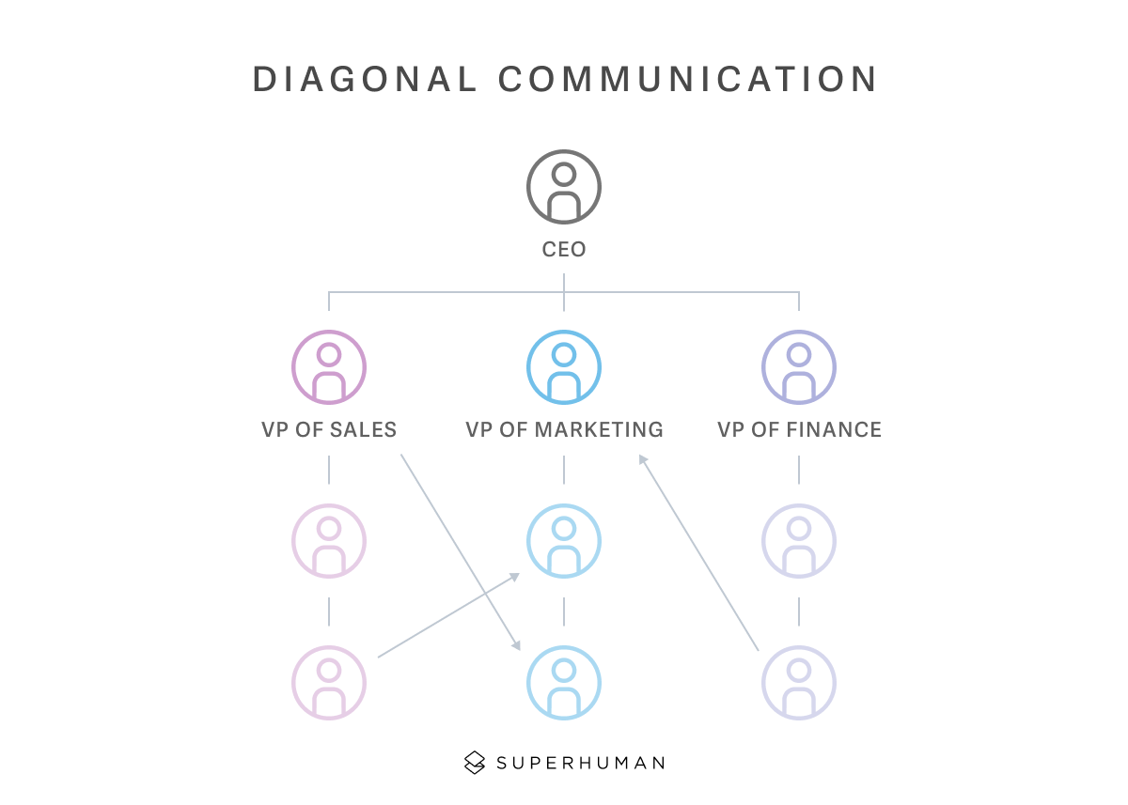
STRUCTURE OF COMMUNICATION (Cont’d..)
Diagonal Communication
Diagonal communication in a workplace is when people from different levels or departments talk directly.
It doesn't follow the conventional top-down or bottom-up patterns. It involves information moving sideways, cutting across different levels and departments. [5]
SOURCE: [5]

Slide 16
STRUCTURE OF COMMUNICATION (Cont’d..)
Informal Structure
It is that communication structure that is not approved by management and not defined by the structural hierarchy.
Grapevine is most common kind of information structure almost present in any organization.
When the formal channels fail or do not work properly and some over-smart people spread rumors, false and irresponsible statement or half-truths in all the directions. It is called the communication on the grapevine channel.

Slide 17
STRUCTURE OF COMMUNICATION (Cont’d..)
Probability
Each randomly tells others
Gossip
One tells all
Single Strand
Each tells one another
Cluster
Some tell selected others
Fig: Forms of Informal Structures

Slide 18
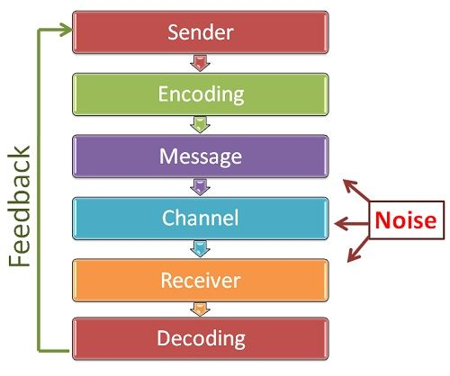
PROCESS OF COMMUNICATION
Communication is the dynamic process of sending and receiving the message/information between two people.
The sender conceptualizes the idea and sends it to the receiver by some medium/means.
The most common ways/means to communicate is by speaking, writing or body language (physical gestures or signs or symbols)
SOURCE: [6]

Slide 19
PROCESS OF COMMUNICATION (Cont’d…)
Developing ideas by sender:
The communicator develops or conceptualizes an idea to be sent.
It is also known as the planning stage since in this stage the communicator plans the subject matter of communication.
Encoding:
Encoding means converting or translation the idea into a perceivable form that can be communicated to others.
The sender begins with the encoding process wherein he uses certain words or non-verbal methods such as symbols, signs, body gestures, etc. to translate the information into a message.

Slide 20
PROCESS OF COMMUNICATION (Cont’d…)
Selecting the medium:
Medium is the channel or means of transmitting the message to the receiver.
Once the sender has encoded his into a message, the next step is to select a suitable medium for transmitting it to the receiver.
The medium of communication can be speaking, writing, signaling, gesturing etc.
Communicating with those outside the organization opens up further possibilities, such as news releases, press conferences, and advertising on television and radio or in magazines, in newspapers, and on the Internet. [7]

Slide 21
PROCESS OF COMMUNICATION (Cont’d…)
Receiving the message by receiver:
This stage simply involves the reception of sender’s message by the receiver.
The message can be received in the form of hearing, seeing, feeling and so on.
The receiver is the person for whom the message is intended or targeted.
He tries to comprehend it in the best possible manner such that the communication objective is attained.
The degree to which the receiver decodes the message depends on his knowledge of the subject matter, experience, trust and relationship with the sender.

Slide 22
PROCESS OF COMMUNICATION (Cont’d…)
Decoding:
Decoding is the receiver’s interpretation of the sender’s message.
Here the receiver converts the message into thoughts and tries to analyze and understand it.
Effective communication can occur only when both the sender and the receiver assign the same or similar meanings to the message.

Slide 23
PROCESS OF COMMUNICATION (Cont’d…)
Feedback:
Feedback means receiver’s response to sender’s message.
It increases the effectiveness of communication.
It ensures that the receiver has correctly understood the message.
Feedback is the essence of two-way communication.
Noise:
It is the disturbances that interfere with the transmission of a message.
Presences of noise reduce the chance of good and effective communication.

Slide 24
TYPES OF COMMUNICATION
Types of Communication based on the communication channels are
Verbal Communication
Non Verbal Communication
The choice as to which method to adopt would largely depend upon the location of the sender and receiver, ability, the nature of the message, urgency with which the information is required to be passed on and the cost involved in passing or receiving the information. [2]

Slide 25
TYPES OF COMMUNICATION (Cont’d..)
Verbal Communication
It refers to the form of communication in which message is transmitted verbally.
Communication is done by the word of mouth and a piece of writing.
Divided into two parts
- Oral Communication and
- Written Communication

Slide 26
TYPES OF COMMUNICATION (Cont’d..)
Oral Communication
Anything that emanates from the mouth is referred as oral communication. Spoken words are used.
Includes face to face conversation, speech, telephonic conversation, television, voice etc.
Communication is influenced by pitch, volume, speed, and clarity of speaking.
Oral communication is the best way of transforming an individual with particular reference to attitude, beliefs, trust and faith.
To make oral communication more effective monotonous speech should be avoided.

Slide 27
TYPES OF COMMUNICATION (Cont’d..)
Oral conversations at the workplace may be formal or informal. In the workplace, oral communication is crucial for:
Meetings - can be formal and informal, depending on the participants and the nature of the discussion.
Videoconferencing - it enables oral communication with participants from around the world.
Telephone - telephone communications are regular in the workplace, especially within office buildings.
Formal Communications - oral communication with managers and clients are frequent at the workplace. Such conversations are formal and precise.

Slide 28
TYPES OF COMMUNICATION (Cont’d..)
Advantages of Oral Communication
It brings quick feedback
Better relationships
Time saving
Effective tool for group communication
Economical
Allows to measure effectiveness immediately.
It’s the only way out during emergency.
In a face to face conversation, by reading facial expression and body language one can trust what’s being said or not.

Slide 29
TYPES OF COMMUNICATION (Cont’d..)
Disadvantages of Oral Communication
Lack of documentation
Distortion in passing the message.
No legal validity
Possibility of misunderstanding.
Unsuitable for long messages.
It is constrained by physical barriers.
Not effective when the target group is spread out.
In a face to face discussion user is unable to think about what he is delivering, so this can be counted as fault.

Slide 30
TYPES OF COMMUNICATION (Cont’d..)
Written Communication
Written signs and symbols are used for the communication.
Message can be transmitted via email, fax, letter, report, memo etc.
Most common form of communication used in the business.
Written communication is generally in the form of standing orders, policy documents, orders, instructions, notes, memos, formal letters, demi official letters etc.

Slide 31
TYPES OF COMMUNICATION (Cont’d..)
Advantages of Written Communication
Ready reference
Legal defense
Mass access
Suitable for distance communication
Message can be edited and revised.
Provides record and back up.
Enables receivers to fully understand it and send appropriate feedback.

Slide 32
TYPES OF COMMUNICATION (Cont’d..)
Disadvantages of Written Communication
Limited to literature world.
Time consuming
Lot of paper work
Need expertise in expression
Doesn’t bring instant feedback.
It takes more time in composing a written message.
Number of people struggles for writing ability.
No immediate clarification

Slide 33
TYPES OF COMMUNICATION (Cont’d..)
Non Verbal Communication
Nonverbal messages are transmitted through gestures, facial expressions, eye contact, touch, posture and through body language.
It is all about the body language of the speaker.
Includes three elements:
Appearance: clothing, hairstyle, neatness,
Body language: gesture, facial expression, postures
Sound: voice, tone, volume, speech rate.
Non verbal communication plays an important role in how people interact with one another.

Slide 34
LEVEL OF COMMUNICATION
Intra personal Communication
Communication that occurs in your own mind.
This type of communication is known as self-talk and is the internal process that people use to think, reflect, and make sense of their experiences.
Example – what to eat or wear, where to go in weekend etc.
It can be considered surface-level communication as both the sender and the receiver of the message is the same person.

Slide 35
LEVEL OF COMMUNICATION (Cont’d..)
Interpersonal Communication
Communication between two people is known as interpersonal communication (IPC)
It is most often face to face conversation.
It can be exchange of ideas, knowledge, instruction, information between two people.
Immediate feedback is possible.
Both sender and receiver are present
Technology mediated IPC is through internet, telephone, mobile etc.

Slide 36
LEVEL OF COMMUNICATION (Cont’d..)
Small Group Communication
Communication within formal or informal groups or team.
It is a group interaction that results in decision making, problem solving and discussion within an organization.
Mass Communication
Mass communication, process of sharing information with a large audience.
Mass communication is accomplished via mass media—that is, technology capable of sending messages to great numbers of people, many of whom are unknown to the sender (e.g., television). [8]

Slide 37
BARRIERS OF COMMUNICATION
When a communication is made by a sender, it must be received correctly by the receiver.
Message must be interpreted by the receiver as has been intended by the sender.
There are various problems like the message does not reach the receiver, problems of encoding and decoding, faulty selection of channel, wrong language or the interpretation of the message. [2]
The list can be long and unending. These problems are called ‘Noise’ in communication.
These problems can be classified as various barriers

Slide 38
BARRIERS OF COMMUNICATION (Cont’d..)
Organizational Barriers
These barriers arise when duties and line of authority are not clearly defined.
Policy
Rules and Regulations
Facilities
Complex organization
Status and position

Slide 39
BARRIERS OF COMMUNICATION (Cont’d..)
Emotional / Psychological barriers
Poor pronunciation
Confused thinking
Communication overload
Attitude
Fear and anxiety
Suspicious, jealousy, anger
Lack of interest and lack of listening
Inattention
Physical Barrier
Poor timing
Choice of channel
Inadequate information
Information overload
Poor hearing
Distances

Slide 40
BARRIERS OF COMMUNICATION (Cont’d..)
Mechanical Barriers
Non availability of proper machines
Presence of defective machine
Interruption
Power Failure
Perceptional Barriers
Lack of common experience
Linguistic : different language and vocabulary.
Low IQ
From receiver side: interrupting the speaker, asking too many questions.
From sender side: unclear message, incomplete sentence.

Slide 41
BARRIERS OF COMMUNICATION (Cont’d..)
Semantic barriers
Symbol with different meaning
Badly expressed message
Faulty translation
Unclarified assumption
Specialist’s language

Slide 42
ENHANCING EFFECTIVE COMMUNICATION
Use Feedback
Many communication problems can be directly attributed to misunderstanding and inaccuracies.
These problems are less likely to occur if the manager uses the feedback loop in communication process.
Feedback can help sender to know about the real response of the receiver
Listen Actively
If the receiver doesn’t give priority and listen to the sender, he/she will not be able to capture the message.
Hence receiver should actively listen to what the sender is saying in order to get the true meaning of information.

Slide 43
ENHANCING EFFECTIVE COMMUNICATION (Cont’d..)
Simplify languages
Since language is the barrier to effective communication, managers should choose words and structure their messages in ways that will make those message clear and understanding to the receiver.
The managers need to simplify his or her language and consider the audience to whom the message is directed to so the language will be tailored to the receivers.

Slide 44
ENHANCING EFFECTIVE COMMUNICATION (Cont’d..)
Constrain Emotions
Emotions can severely cloud and distort the transference of meaning. A manager who is emotionally upset over an issue will not be able to express his message effectively.
Hence he should transmit the message when he has regained his composure.
Avoiding overload of information
Information flow should be regulated by providing it on time.
The message should be up to date and not sent the message at the same time.
If the information is timely it will help in avoiding overload of information at the same time

Slide 45
ENHANCING EFFECTIVE COMMUNICATION (Cont’d..)
Empathy (Fellow feeling)
It is the ability to put oneself on the other person’s role and to assume the viewpoints and emotions of that person
It requires communicators to place themselves in the receivers’ positions and anticipate how the message is likely to be decoded.
It helps in decreasing many barriers to effective communication

Slide 46
REFERENCES
[1] “Effects of differences in subordinate perceptions of superiors’ communication practices”. Schnake, M. E., Dumler, M. P., Cochran, D. S., & Barnett, T. R. (1990). Journal of Business Communication, 27, 37–50.
[2]Organizational Behaviour: V. G. Kondalkar, ISBN (13) : 978-81-224-2487-4, Published by New Age International (P) Ltd., Publishers, New Delhi, India, 2006.
[3] Communication structure in an organization. By Seema Verma, May 2, 2023, Accessed on 9th April 2024. https://www.linkedin.com/pulse/communication-structure-organization-seema-verma-1f/

Slide 47
REFERENCES (Cont’d..)
[4] Downward Communication: Importance, Types & Advantages, By Hitesh Bhasin, June 9, 2023. Accessed on 9th April 2024. https://www.marketing91.com/downward-communication/
[5] Diagonal communication: Definition, examples, and benefits, by
Jenna Scaglione, Dec 26, 2023. Accessed on 9th April 2024. https://blog.superhuman.com/diagonal-communication/
[6] Communication Process: business jargons. Accessed on 9th April 2024. https://businessjargons.com/communication-process.html
[7] Management: Robert Kreitner, Eleventh Edition, Houghton Mifflin Harcourt Publishing Company.2009.
[8] Mass Communication, by Adam Volle. Accessed on 10th April 2024. https://www.britannica.com/topic/mass-communication

