Slide 1
COURSE TITLE
ORGANIZATION AND MANAGEMENT
CHAPTER 6 (Week 6)
GROUP DYNAMICS AND CONFLICT MANAGEMENT
Lecture - 6
Meaning and Concept of Group, Stages of Group Formation, Group Dynamics Theories, Introduction to Conflict, Levels and Types of Conflicts, Approach to Conflict Management
Er. Ishwar Adhikari
Associate Professor
Kathmandu Engineering College, Nepal

Slide 2
Learning Objective
The main objective of this lecture is to understand about :
Meaning and concept of group.
Stages of group formation.
Group dynamics theories.
Introduction to conflict.
Levels and types of conflict.
Approach to conflict management.

Slide 3
MEANING OF GROUP DYNAMICS
A group may be defined as a collection of two or more people who work with one another regularly to achieve common goals.
In a true group, members are mutually dependent on one another to achieve common goals, and they interact with one another regularly to pursue those goals over a sustained period of time. [1]
Thus a group could be co-workers or people example: meeting for lunch or standing at the bus stop. Unlike teams, groups do not necessarily engage in collective work that requires interdependent effort.

Slide 4
MEANING OF GROUP DYNAMICS (Cont’d..)
GROUP DYNAMICS contains two words:
GROUP : Basically collection of two or more persons.
DYNAMICS : comes from Greek word meaning FORCE
GROUP DYNAMICS deals with interaction of the forces among group members in a social situation.
Two or more individuals, interacting and independent, who have come together to achieve particular objective. [2]
Group dynamics deals with the attitudes and behavioural patterns of a group.

Slide 5
MEANING OF GROUP DYNAMICS (Cont’d..)
FOUR DIMENSIONS OF GROUP
See Themselves as Group Members
Two or More People
GROUP
Interact With Each Other
Share Common Goals

Slide 6
MEANING OF GROUP DYNAMICS (Cont’d..)
Difference between Group and Team
GROUP | TEAM
When two or more individuals are classed together either by the organization or out of social needs, it is known as a group. | a team is the collection of people, who are linked together to achieve a common objective.
There is only one head in group | A team can have more than one head
The group member do not share responsibility. | Team members share the responsibility.
The group focuses on achieving the individual goals. | The team members focus on achieving the team goal.

Slide 7
MEANING OF GROUP DYNAMICS (Cont’d..)
Why do people join groups ??
Have a sense of security
Have a status
Develop self esteem
Power
Goal Achievement
Empowerment through sharing of resources.
Affiliation needs

Slide 8
MEANING OF GROUP DYNAMICS (Cont’d..)
Reasons for Group Formation/Joining Groups
Employees’ point of view
  Member security
  Status/identification
  Self-esteem/ego
  Affiliation/social needs
  Power/unity
  Goal achievement
Organizational point of view
  Socialization of new employees
  Getting the jobs done
  Decision making
  Communication

Slide 9
MEANING OF GROUP DYNAMICS (Cont’d..)
Principal of Group Dynamics
The members of group must have a strong sense of belongingness.
The more attraction a group member is to its members, the greater influence it would exercise on its members.
Information relating to the need for changes, plans for change and consequences of the changes must be shared by the members of the group.
The group arise and function owing to common motives.

Slide 10
MEANING OF GROUP DYNAMICS (Cont’d..)
Principal of Group Dynamics
The intergroup relations, group organization, member participation is essential for effectiveness of a group.
Confidentiality is a major requirement which is achieved by mutual respect for one another.

Slide 11
MEANING OF GROUP DYNAMICS (Cont’d..)
Advantages of Group Dynamics
Achievement of objectives.
Increase productivity
Work efficiently
Collaborative effort
Better decisions
Improve job satisfaction and team spirit
Attitude, perception and ideas of members depend on group dynamism
Reduce the absenteeism and labour turnover
Helps to meet individual needs.

Slide 12
MEANING OF GROUP DYNAMICS (Cont’d..)
Disadvantages of Group Dynamics
Group conflicts
Conflict of objectives
Hampers relation due to inequity in contribution
Group with similar opinions will produce routine decision.
Varied opinions will lead to indecisions.

Slide 13
MEANING OF GROUP DYNAMICS (Cont’d..)
Types of Groups
Formal Group
A formal group is a group created for the purpose of doing productive work. It may be called a team, a committee, or simply a work group.
In a formal group, rules and regulation guides the behavior of group.
It is deliberately created to perform specific task and a hierarchy of authority exists.
A formal group is usually formed for the purpose of contributing to the success of a larger organization.

Slide 14
MEANING OF GROUP DYNAMICS (Cont’d..)
The head of a formal group is responsible for the group’s performance accomplishments, but all members contribute the required work.
Formal group can be further divided into:
Command group:
Specified by organization chart and includes supervisor and his subordinates.
Consist of subordinates who have common boss
Task group:
Employees work together to complete a particular task or job.
Specific time period is allotted for completion of tasks.

Slide 15
MEANING OF GROUP DYNAMICS (Cont’d..)
Characteristics of Formal group
Organizational structure by top management .
Structure based on division of labour and efficiency in operation.
Organization concentrates more on performance of job.
Authority responsibility hierarchy
Coordination and control are well specified through process, procedures and rules.

Slide 16
MEANING OF GROUP DYNAMICS (Cont’d..)
Informal Group
Informal groups emerge without being officially designated by the organization.
They form spontaneously and are based on personal relationships or special interests, and not on any specific organizational endorsement. [1]
These are not formed under company rules and policies. They form a consequential part of company by easing out any kind of stress and tension.
Effective communication is ensured from the top to the bottom without the line of authority.

Slide 17
MEANING OF GROUP DYNAMICS (Cont’d..)
Characteristics of Informal group
Natural outcome: not designed and planned.
Created on the basis of some similarities among members.
Voluntary membership: can become member to several informal groups at the same time.
Behaviour of members formed and controlled by group norms.

Slide 18
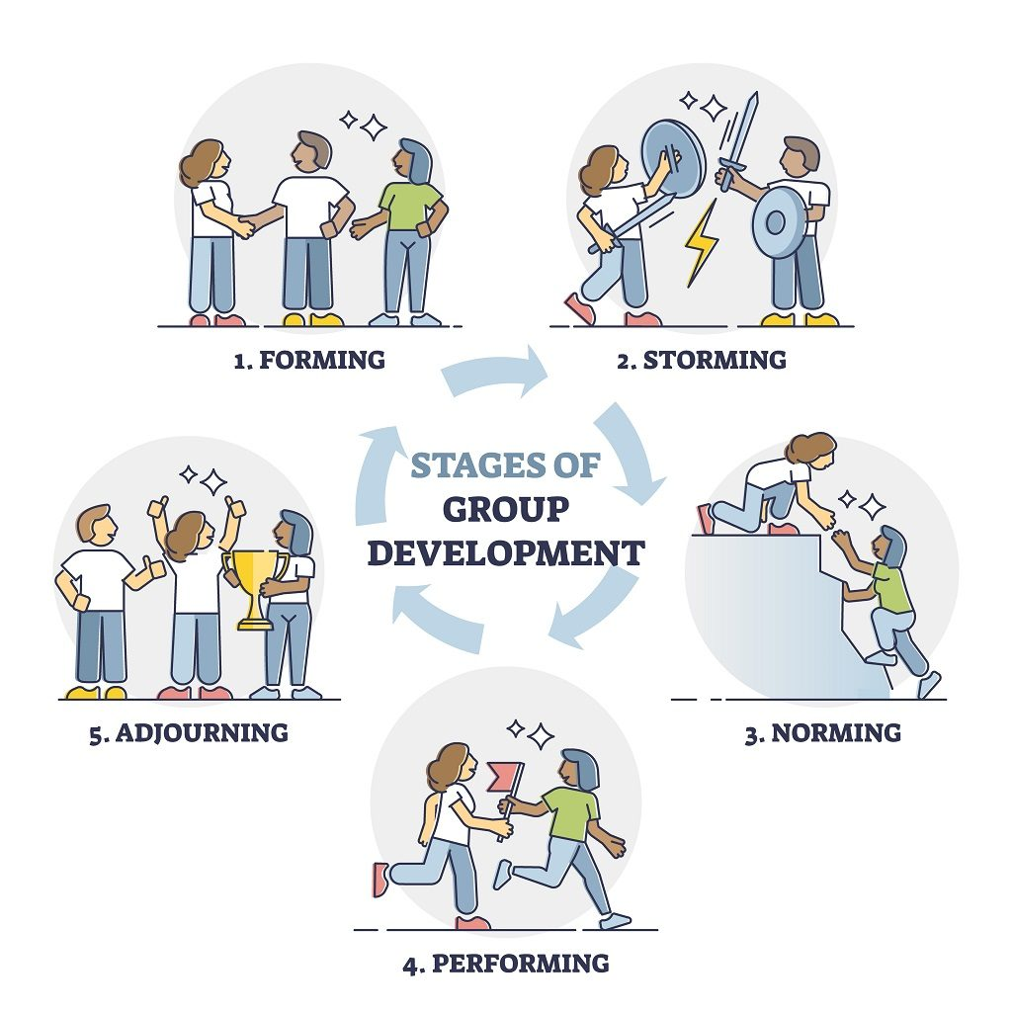
STAGES OF GROUP FORMATION
SOURCE: [3]

Slide 19
STAGES OF GROUP FORMATION (Cont’d..)
Forming
Forming is characterized by a great deal of uncertainty about the group’s purpose, structure, and leadership.
Leaders should provide clear direction, establish goals, and create an environment where team members feel safe to express themselves and ask questions. [3]
In this stage, membership is increased till group is established and also communication pattern is developed.
Evaluation of resources is carried out for achievement of group goals.

Slide 20
STAGES OF GROUP FORMATION (Cont’d..)
Storming
This stage is characterized by conflict and confrontation.
There may be considerable disagreement and conflict among the members about the roles and duties.
Member of the group storm their views and hierarchy of leadership emerges.
In this stage team members work to establish their roles and responsibilities within the project.
The team functions more as individual members than as a cohesive unit.

Slide 21
STAGES OF GROUP FORMATION (Cont’d..)
Norming
In the norming stage of group development, the team has effectively resolved most, if not all, conflicts and can productively work on the project or towards the end goal.
In this stage situation of chaos is settled and members begin to settle into cooperation and collaboration.
“I” feeling is replaced by “we” feeling with high cohesion, group identity etc.
Group norms is developed to guide the individual behavior.
Increase positive behavior and strong feeling of development.

Slide 22
STAGES OF GROUP FORMATION (Cont’d..)
Performing
This stage is where the group is fully functioning and devoted to effectively accomplishing the tasks agreed upon in the norming stage.
The emphasis is on cooperation, problem solving, and achieving group goals.
In the performing stage, productivity and efficiency are typically high.
Group members are not only comfortable with one another, but they're also comfortable with their work and expectations.

Slide 23
STAGES OF GROUP FORMATION (Cont’d..)
Adjourning
This represents the end of group.
For a project team or task force with specific objective is accomplished, the group will disband or have new composition.
Signs of adjourning stage is:
- Sadness at the project's ending
- Feeling excited about what might come next
- Uncertainty about the future

Slide 24
GROUP DYNAMICS THEORIES
PROPINQUITY THEORY
CLASSIC THEORY OF GEORGE HOMANS
BALANCE THEORY
EXCHANGE THEORY

Slide 25
GROUP DYNAMICS THEORIES (Cont’d…)
Propinquity theory
The meaning of propinquity means nearness. This theory tries to explain why people affiliate with one another?
According to this theory, nearness is only the facilitating factor for group formation and cannot be a reason for group formation. [4]
When two persons work in same environment repeatedly, they develop a sense of belongingness and they gradually develop communication which in turn leads to sharing of thought, feeling and discussions.
It is not analytical and does not explain some of the complexities of group formation.

Slide 26
GROUP DYNAMICS THEORIES (Cont’d…)
Classic Theory of George Homans
This theory is based on three elements: activities, interaction and sentiments and are directly related to each other.
George C. Homans states that more the individuals share their activities, the more they will interact with each other, and more stronger their sentiments for each other and vice versa. [4]
The major element is interaction. People in a group interact not just physical propinquity sense, but also to accomplish many group goals.

Slide 27
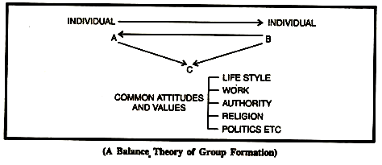
GROUP DYNAMICS THEORIES (Cont’d…)
Balance Theory
According to this theory developed by Theodore Newcomb
“People are attracted to one another on the basis of similar/common attitudes towards common commonly relevant objects and goals”. [5]
Once a relationship is formed balance between attraction and common attitude is tried to maintained or stored.
SOURCE: [6]

Slide 28
GROUP DYNAMICS THEORIES (Cont’d…)
Exchange Theory
This theory is based on Reward- Cost Outcomes of interaction.
A minimum positive level (rewards greater than costs) of an outcome must exits in order for attraction or affiliation to take place. [6]
Here Reward is Satisfaction and Cost is Sacrifice.
Rewards from interactions gratify needs, while costs incurs anxiety, frustration, embarrassment or fatigue.
Propinquity, interaction and common attitudes all have roles in exchange theory .

Slide 29
INTRODUCTION TO CONFLICT
Conflict is defined as a disagreement through which the parties involved perceive a threat to their needs, interests or concerns.
Conflict can be defined “as a disagreement between two or more individuals or groups, with each individual or group trying to gain acceptance of its views or objective over others.”[7]
Conflict is an inevitable or unavoidable part of our everyday professional and personal lives.
Conflict is any situation in which two or more parties feel themselves in opposition.

Slide 30
INTRODUCTION TO CONFLICT (Cont’d..)
WHY DOES CONFLICT OCCUR ???
Personality Clashes
Competition of Resources
Authority issue
Lack of Cooperation
Differences over methods and styles
Low performance
Values of goal differences

Slide 31
INTRODUCTION TO CONFLICT (Cont’d..)
SYMPTOMS OF CONFLICT
INDIVIDUAL
1. Avoidance
- absenteeism, hiding out,
- self centeredness
- hiding behind the rules
2. Repression
ill health, escapist drinking, irregular productivity, low satisfaction, irritability.
Reactive
- flashes of anger, non cooperation, rumours
- destruction, strikes.
INTER GROUP
- Competition
- Appeals to superior for decision
- Decreased rate of interaction
- Low trust

Slide 32
Assumptions About Causes and Values of Conflict
Causes of Conflict | What does it means ?
Misunderstanding | When individuals do not hear what is being said?
Personality Clashes | When individuals do not value “people just like me”
Competition for Resources | When employees believe they are better off competing for resources rather than cooperating
Authority Issues | When employees lack confidence in their leaders or perceive overuse of authority

Slide 33
Assumptions About Causes and Values of Conflict
Lack of Cooperation | When one person does not share information with the whole group
Low performance | When individuals are not working to their potential
Values or goal difference | When individuals value different objectives or outcomes.
Difference over methods or style | When agreement does not exists on standard ways of completing tasks.

Slide 34
INTRODUCTION TO CONFLICT (Cont’d..)
Changing view (Transition) of Conflict
Traditional View
It assumes conflict is bad and views negatively and considered as early approach to conflict.
It uses conflict as synonymous to violence irrational and destruction.
The view held that the conflict arose due to poor communication, lack of openness, lack of trust and failure of managers to be responsive to the needs and aspirations of their employees. [8]

Slide 35
INTRODUCTION TO CONFLICT (Cont’d..)
Human Relations View
It argues that conflict is a natural occurrence.
Conflict should be accepted because it is inevitable and cannot be eliminated.
Minimum level of conflict between the groups would increase competitiveness that will lend itself to higher productivity and increased job satisfaction.
What is required today is innovation, creativity and an ability of the group to meet the social obligations. Hence there is a need for maintaining minimal level of conflict within the group. [8]

Slide 36
INTRODUCTION TO CONFLICT (Cont’d..)
The Interactionism View
Views conflict necessary element for the progress of the organization.
It advocates that harmonious, peaceful, and cooperative group is prone to becoming static, apathetic, and non-responsive to need for change and innovation.

Slide 37
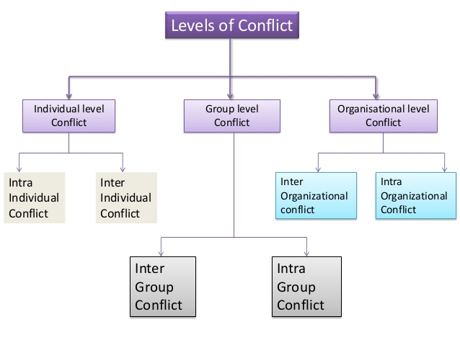
LEVELS AND TYPES OF CONFLICT

Slide 38
LEVELS AND TYPES OF CONFLICT (Cont’d..)
INDIVIDUAL LEVEL CONFLICT
Intra Individual Conflict
It is the conflict that involves single person and arises inside the individual person.
It is internal to the person and is probably most difficult type of conflict
Sources of intra-individual conflict:
  Goal conflict: it is the conflict that arises
  (a) when an individual attempts to achieve a goal that has both positive and negative features
  (b) when two or more competing goals exist.
  Role conflict: it occurs when roles are conflicting in nature.

Slide 39
LEVELS AND TYPES OF CONFLICT (Cont’d..)
Inter-personal Conflict
This is the type of conflict in which two or more individuals are involved.
It occurs when there is the differences between the choices made by different people.
Sources of inter-individual conflicts:
  Personality differences
  Perceptions
  Clashes of values and interests
  Power and status differences

Slide 40
LEVELS AND TYPES OF CONFLICT (Cont’d..)
GROUP LEVEL CONFLICT
Conflict within and between group and groups are common phenomenon.
The common contributing factors to give rise the group level conflict are:
  Heterogeneity members
  Communication distortions
  Decision making
  Unclear roles and responsibility

Slide 41
LEVELS AND TYPES OF CONFLICT (Cont’d..)
Intra- group Conflict
It arises when differences over an issue appear between the members of the same group.
Sources of intra-group conflicts:
  - New problem
  - New value system
  - Role differences
Inter-group Conflict
This type of conflict arises between two or more groups.
The factors contributing to this type of conflict include authority, jurisdiction and resources.
Sources of inter-group conflicts
  - Differences in goals
  - Task interdependence
  - Resource allocation
  - Competitive reward system

Slide 42
LEVELS AND TYPES OF CONFLICT (Cont’d..)
ORGANIZATIONAL LEVEL CONFLICT
Intra-organizational Conflict
This type of conflict is similar to intra-group conflict
Inter-organizational Conflict
This type of conflict arises between two or more organizations.
  Management –government
  Inter-management
  Inter-union
  Union-government
  Union-management

Slide 43
APPROACH TO CONFLICT MANAGEMENT
Conflict management is defined as “the opportunity to improve situations and strengthen relationships”.
Conflict between parties can be resolved by five different modes.
Accommodating
Avoiding
Collaborating
Compromising
Competing

Slide 44
APPROACH TO CONFLICT MANAGEMENT (Cont’d..)
Accommodating
In accommodating mode a person scarifies his own interest for accommodating other person’s interest.
This mode is usually adopted when other person’s view is stronger, you want to achieve goodwill and indicate that you are reasonable.
This strategy of conflict resolution is important when you want other person to give at a later date when it favours you.
The use of accommodation often occurs when one of the parties wishes to keep the peace or perceives the issue as minor.

Slide 45
APPROACH TO CONFLICT MANAGEMENT (Cont’d..)
Avoiding
This style is associated with behaviors such as withdrawal, indifference, side step.
By delaying or ignoring the conflict, the avoider hopes the problem resolves itself without a confrontation.
Those who actively avoid conflict frequently have low esteem or hold a position of low power.
This strategy is useful when issues involved in conflict are of a very minor nature or when more important issues deserve attention

Slide 46
APPROACH TO CONFLICT MANAGEMENT (Cont’d..)
Collaborating
Both parties try to satisfy the needs of both parties.
Collaboration works by integrating ideas set out by multiple people.
The object is to find a creative solution acceptable to everyone.
Collaboration, though useful, calls for a significant time commitment not appropriate to all conflicts.

Slide 47
APPROACH TO CONFLICT MANAGEMENT (Cont’d..)
Compromising
This technique generally appeals to those living in a democracy.
It advocates of compromise say everyone wins because compromise is based on negotiation, on give-and-take.[9]
This strategy prevails most often in conflicts where the parties hold approximately equivalent power.

Slide 48
APPROACH TO CONFLICT MANAGEMENT (Cont’d..)
Competing
One party tries to meet its goal at another party’s expense.
Competing is also useful in emergencies where quick decisions are required.
In this strategy power must be used unilaterally as a weapon when unpopular decisions like termination, pay cuts, layoffs, cost cutting and enforcing discipline are required to be taken.

Slide 49
REFERENCES
[1] Organizational Behaviour: John R. Schermerhorn Jr, James G. Hunt, Richard N. Osborn. Seventh Edition. John Wiley and Sons, Inc. 2002.
[2] Organization Behaviour: Stephen P Robbins, 14th Edition, Prentice Hall Publication, 2011.
[3] Understanding Tuckman's Team Development Stages, By Helen Wale. Accessed on 11th April 2024. https://corporatefinanceinstitute.com/resources/team-development/understanding-tuckmans-team-development-stages/
[4] Group Formation: 5 Theories, Process, by Anuj Kumar, 31 July 2023. Accessed on 12th March 2024. https://getuplearn.com/blog/group-formation/

Slide 50
REFERENCES (Cont’d..)
[5] Organizational Behaviour in Nepal: Dr. Govinda Ram Agrawal. M.K. publishers and dristributors, Kathmandu, Nepal, 2013.
[6] Theories of Group Formation, 18th June 2019. Accessed on 12th April 2024. https://theintactone.com/2019/06/18/mpob-u4-topic-3-theories-of-group-formation/
[7] Austin, David L. “Conflict: A More Professional approach”, Personal administration, Volume 21 July 1976.
[8] Organizational Behaviour: V. G. Kondalkar, New Edge International (P) Limited, Publishers. New Delhi, India, 2007.
[9] Management: Robert Kreitner, Eleventh Edition, Houghton Mifflin Harcourt Publishing Company, USA, 2009.

