Slide 1
COURSE TITLE
ORGANIZATION AND MANAGEMENT
CHAPTER 7 (Week 7)
PERCEPTION AND DECISION MAKING
Lecture - 7
Meaning and concept of perception, Perceptual process, Perceptual errors, Introduction to decision making, Types and condition of decision making
Er. Ishwar Adhikari
Associate Professor
Kathmandu Engineering College, Nepal

Slide 2
Learning Objective
The main objective of this lecture is to understand about :
Meaning and concept of perception.
Perceptual process.
Perceptual errors.
Introduction to decision making.
Types of decision making .
Condition of decision making .

Slide 3
MEANING AND CONCEPT OF PERCEPTION
Our behaviour is not only a function of our personality, values, and preferences, but also of the situation.
Individual differs in the way he sees, interprets and understands a particular event.
A person’s perception is concerned with making judgment about others.
Perception is the process by which individuals select, organize, and interpret their sensory impressions in order to give meaning to their environment. [1]
A process of receiving information about and making sense of the world around us is perception.

Slide 4
MEANING AND CONCEPT OF PERCEPTION (Cont’d…)
Perception differs from one person to another, depending upon needs, values, and expectation .
Individuals organize and interpret things based on their past experience and the important values they consider important.
People respond to situations on the basis of their perception about the reality rather than reality itself.
The study of perception is very important in the organization because it is necessary for the manager to perceive individuals correctly irrespective of their status. [2]

Slide 5
MEANING AND CONCEPT OF PERCEPTION (Cont’d…)
SENSATION
People use their sensory organ to sense.
Senses receives stimuli both from within and outside the body.
PERCEPTION
An individual takes in the raw data through his senses and then, refines, modifies or completely alters it by cognitive.

Slide 6
MEANING AND CONCEPT OF PERCEPTION (Cont’d…)
Nature of Perception
It is the process by which an individual gives meaning to the environment.
It is cognitive (mental)and psychological process.
People’s action, emotions, feelings and thoughts are triggered by their perceptions.
Since perception refers to the acquisition of specific knowledge about objects and events at any particular moment, it occurs whenever stimuli activates the sense organs.

Slide 7
MEANING AND CONCEPT OF PERCEPTION (Cont’d…)
It basically refers to the manner in which a person experiences the world.
It is an almost automatic process and works in much the same way with each individual and yields different perceptions.
A stimulus that is not perceived has no effect on behaviour.
It is the process that operates constantly between us and reality.
Perception is more broader and much complex than sensation.

Slide 8
Factors Influencing Perception
MEANING AND CONCEPT OF PERCEPTION (Cont’d…)
Factors in the perceiver
Attitudes
Motives
Interests
Experience
Expectations
Factors in the Target
Novelty (original or freshness)
Motion
Sounds
Size
Background
Proximity
Similarity
Factors in the situation
Time
Work Setting
Social Setting
Perception
SOURCE: [1]

Slide 9
MEANING AND CONCEPT OF PERCEPTION (Cont’d…)
Importance of Perception
It plays very important role in shaping the personality of individual.
Perception is central in interpreting the world around us.
Managers should be able to distinguish between perceived world and the reality.
It affects the outcome of our behaviour because we act on the basis of what we see.
An understanding of perception important to understand and control the human behaviour.

Slide 10
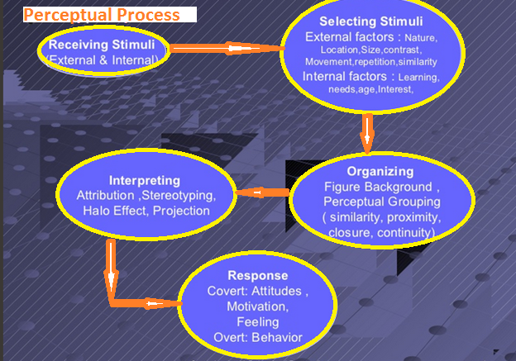
PERCEPTUAL PROCESS
SOURCE: [3]

Slide 11
PERCEPTUAL PROCESS (Cont’d…)
Selection of Stimuli
Selection of stimuli is the first process in perception.
The process of filtering information received by our sense is called selecting stimuli.
We are selecting the stimuli through our senses, like...eyes, ears, tongue, nose, skins.
Factors that influence selective attention are
External factors: Nature , Location ,Color, Size , Contrast , Movement , Repetition
Internal factors : Learning, Inner needs , Interest, Age difference.

Slide 12
PERCEPTUAL PROCESS (Cont’d…)
Organizing
The second stage in the perception process is the organization of that stimulus in brain i.e. developing a positive or negative cerebral response to the stimulus. [3]
This is a process in which people attempt to organize things in such a way that they make sense to them.
This aspect of forming bits of information into meaningful wholes is called the perceptual organization.

Slide 13
PERCEPTUAL PROCESS (Cont’d…)
Grouping
Selected information are grouped on the basis of similarity or proximity (nearness).
For example: if in an institution, two employees resign together, then the manager tend to perceive that their departure were closely related, whereas in reality it might not be so.

Slide 14
PERCEPTUAL PROCESS (Cont’d…)
Interpretation
After the selection and organizing the stimuli has to interpret them in order to make a sensible meaning.
Perceiver can’t draw any meaning without interpretation.
It is a subjective and judgmental process.
Perceiver uses his assumption of people, things, object, and situation.
He makes attributions, uses his judgmental skills distorts information, adds/delete information brings his own subjective feelings, opinion, and emotions, in interpreting and drawing the measures.

Slide 15
PERCEPTUAL ERRORS
Perceptual Errors are mistakes or biases in how we perceive and interpret information from our environment.
These errors can occur due to various factors such as our past experiences, cultural background, or cognitive biases.
Perceptual errors are like misinterpretations or misunderstandings that happen when we see, hear, or experience something, leading us to form inaccurate conclusions or judgments about the world around us. [4]
Perceptual Errors can lead to confusion and poor decisions.
To avoid these mistakes, we should keep an open mind, listen to others, and get all the facts before deciding.

Slide 16
PERCEPTUAL ERRORS (Cont’d..)
Perceptual errors occur when judgments about others are made using shortcuts.
Common perceptual errors are
  Selective perception
  Halo effect
  Stereotyping
  Contrast effect
  Projection
  Impression

Slide 17
PERCEPTUAL ERRORS (Cont’d..)
Selective perception
Everything that occur around us cannot be observed.
People selectively interpret what they see based on their attitude, interest, background and experience.
In an organization so many things keep happening but different people will perceive one fact differently based on individuals selectivity in perceiving which is generally based on his past experience and attitude towards work. [2]

Slide 18
PERCEPTUAL ERRORS (Cont’d..)
Halo effect
It refers to the tendency of people to make judgment about others on the basis of a single trait such as intellectual ability, sociability and appearance.
A halo effect occurs when one attribute of a person or situation is used to develop an overall impression of the individual or situation.
Halo effects are particularly important in the performance appraisal process because they can influence a manager’s evaluations of subordinates’ work performance.

Slide 19
PERCEPTUAL ERRORS (Cont’d..)
Stereotyping (Generalizing)
When we judge someone on the basis of our perception of the group to which he or she belongs, we are using the shortcut called stereotyping. [1]
In order to simplify matters, we often tend to classify people and events into already known categories.
It is the tendency to generalize the characteristics of the objects being observed.
Stereo typing often takes place based on gender, ethnicity, religion etc.

Slide 20
PERCEPTUAL ERRORS (Cont’d..)
Contrast effect
We do not evaluate a person in isolation.
Our reaction to one person is relative to the other.
During selection process, interviewer selects a particular person for a particular job not because he fulfils all requirements but he is generally selected in relation to the other candidates.
Individual selected may be academically, skill wise, experience wise better than those not selected.
So it is a comparative or contrast phenomenon of perception.

Slide 21
PERCEPTUAL ERRORS (Cont’d..)
Projection
You assume a person based on your own traits and not what he actually possesses.
If you were hard working and dependable you would expect others to be so.
People who engage in projection tend to perceive others according to what they themselves are like rather than perceiving others as they really are.
Impression
People frequently form impression of other on the first sight.

Slide 22
DECISION MAKING
Decision making is the act of choosing one alternative from among a set of alternatives.
Decision making is the process of identifying and choosing among alternative courses of action in a manner appropriate to the demands of the situation. [5]
Decision making is the process by which managers responds to a opportunities and threats by analyzing options, and making decisions about goal and course of action.
We have to first decide decision has to be made and then secondly identify a set of feasible alternatives before we select one.

Slide 23
DECISION MAKING (Cont’d….)
SIX ‘C’ of DECISION MAKING
CONSTRUCT a clear picture of precisely what must be decided.
COMPILE a list of requirements that must be met.
COLLECT information on alternatives that meet the requirements.
COMPARE alternatives that meet the requirements.
CONSIDER the “what might go wrong” factor with each alternatives.
COMMIT to a decision and follow through with it.

Slide 24
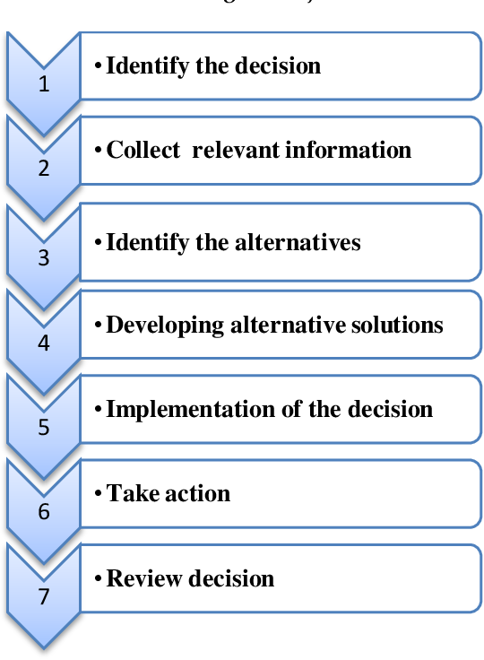
DECISION MAKING PROCESS
A process of making a choice between a number of options and committing to a future course of action is called decision making process. It involves following steps:
SOURCE: [6]

Slide 25
DECISION MAKING PROCESS (Cont’d….)
Step 1: Identify the Problem
Make sure it’s a problem and not just the symptoms of a problem. Problem identification is subjective.
Problem is the discrepancy between the existing and a desired state.
Discrepancies can be found by comparing current results with some standards.
Managers are not likely to characterize discrepancy as a problem if they perceive that they do not have authority, information, or other resources needed to act on it.

Slide 26
DECISION MAKING PROCESS (Cont’d….)
Step 2: Diagnosing the problem
In this stage an extensive analysis of the issues is carried out.
It is necessary to classify the problems in order to know who must take the decision and who must be informed about the decision taken.
Explore the issue from different perspective (using the diverse expertise from the decision making team)
Question of what, how, why, who, when, where is asked so that the issue is fully resolved.
Refine the decision statement based on the analysis.

Slide 27
DECISION MAKING PROCESS (Cont’d….)
Step 3: Discover alternative course of action
In this step all the possible and desirable alternatives are listed.
Creative skills are used and come out with alternatives that may look a little irrelevant rather than restricting yourself.
Adequate research has to be done to come up with the necessary facts that would aid in solving the problems.
Step 4: Evaluate Alternatives
Finding out advantages and disadvantages of each options.
Filter out the problem that you think are impossible or do not serve your purpose.
Rating each option with numerical digit would also help in filtration process.

Slide 28
DECISION MAKING PROCESS (Cont’d….)
Step 5: Select the best alternative
In this step is where hard work you have put in analysing would lead to a proper decision.
This includes selecting the alternative which seems to be best suited for you.
Choice of the best alternative is most critical point in decision making.

Slide 29
DECISION MAKING PROCESS (Cont’d….)
Step 6: Implementing and follow up action
In this step, the result of the decision is experienced whether or not it has solved the need identified in step 1.
If the decision has not resolved the identified need, certain steps of the process is repeated in order to make the new decision.
Includes gathering detailed or different information or discovering additional alternatives on which the decision is based.

Slide 30
DECISION MAKING PROCESS (Cont’d….)
Effective decision must be made to
Maximize :
Some set of factors such as profit, sales, employees welfare and market share etc.
Minimize :
Loss, expenses, or employee turn over
Managers make decision about both problems (undesirable situation) and opportunities (desirable situation)
It may take a long time before a manager can know for sure if the right decision was made.

Slide 31
TYPES OF DECISION MAKING
Managers need to take different decision on the basis of time and requirement.
Managerial decisions may be divided into different types:
Strategic Decisions and Routine Decisions
Programmed Decisions and Non-Programmed Decisions
Policy Decisions and Operating Decisions
Organizational Decisions and Personal Decisions
Individual Decisions and Group Decisions

Slide 32
TYPES OF DECISION MAKING (Cont’d..)
Strategic Decisions and Routine Decisions
Routine decisions are those that the manager makes in the daily functioning of the organization, i.e. they are routine.
Such decisions do not require a lot of evaluation, analysis or in-depth study. In fact, high-level managers usually delegate these decisions to their subordinates.
On the other hand, strategic decisions are the important decisions of the firm. These are usually taken by upper and middle-level management.
They usually relate to the policies of the firm or the strategic plan for the future.

Slide 33
TYPES OF DECISION MAKING (Cont’d..)
Programmed Decisions and Non-Programmed Decisions
Routine problems arise on a regular basis and can be addressed through standard responses, called programmed decisions.
These decisions simply implement solutions that have already been determined by past experience as appropriate for the problem at hand. [7]
These decisions are usually taken by lower management.
For example, granting leave to employees, purchasing spare parts etc. are programmed decisions where a specific procedure is followed.

Slide 34
TYPES OF DECISION MAKING (Cont’d..)
Non-routine problems are unique and new, having never been encountered before. Because standard responses are not available, these circumstances call for creative problem solving.
These non-programmed decisions are specifically crafted or tailored to the situation at hand. [7]
Usually, these decisions are important to the organization. Such decisions are left to upper management.
For example, opening a new branch office will be a non-programmed decision.

Slide 35
TYPES OF DECISION MAKING (Cont’d..)
Policy Decisions and Operating Decisions
Tactical decisions pertaining to the policy and planning of the firm are known as policy decisions.
Such decisions are usually reserved for the firm’s top management officials.
They have a long term impact on the firm and require a great deal of analysis.
Operating decisions are the decisions necessary to put the policy decisions into action.
These decisions help implement the plans and policies taken by the high-level managers.

Slide 36
TYPES OF DECISION MAKING (Cont’d..)
Organizational Decisions and Personal Decisions
When an executive takes a decision in an official capacity, on behalf of the organization, this is an organizational decision.
Such decisions can be delegated to subordinates.
However, if the executive takes a decision in a personal capacity, that does not relate to the organization in any way this is a personal decision.
Obviously, these decisions cannot be delegated.

Slide 37
TYPES OF DECISION MAKING (Cont’d..)
Individual Decisions and Group Decisions
Any decision taken by an individual in an official capacity it is an individual decision.
Organizations that are smaller and have an autocratic style of management rely on such decisions.
Group decisions are taken by a group or a collective of the firm’s employees and management.
For example, decisions taken by the board of directors are a group decision.

Slide 38
DECISION MAKING CONDITIONS
Managers make problem‐solving decisions under three different conditions: certainty, risk, and uncertainty.
Decision making under Certainty
Decision making under Risk
Decision making under Uncertainty

Slide 39
DECISION MAKING CONDITIONS (Cont’d..)
Decision making under Certainty
A condition of certainty exists when there is no doubt about the factual basis of a particular decision, and its outcome can be predicted accurately.[8]
Very few organizational decisions are made under this condition.
This condition is ideal for problem solving. The challenge is simply to study the alternatives and choose the best solution.
A good example is the decision to reorder inventory automatically when stock falls below a determined level.

Slide 40
DECISION MAKING CONDITIONS (Cont’d..)
Decision making under Risk
A condition of risk is said to exist when a decision must be made on the basis of incomplete but reliable factual information.
Reliable information, though incomplete, is still useful to managers coping with risk because they can use it to calculate the probability that a given event will occur and then to select a decision alternative with favourable odds. [8]
Decision is calculated on the basis of which alternative has the highest probability of working effectively.

Slide 41
DECISION MAKING CONDITIONS (Cont’d..)
Decision making under Uncertainty
Condition of uncertainty exists when little or no reliable factual information is available.
Most of the major decision making in today’s organization is done under this condition.
To make the effective decision under this condition, manager has to secure as much as relevant information as possible and approach the situation from logical rational point of view.
Intuitions, judgements, and experience plays an important role in the decision making process.

Slide 42
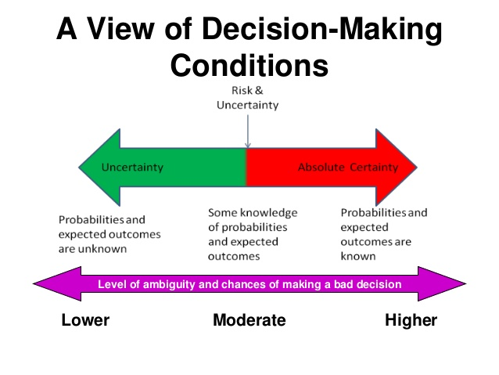
SOURCE: [9]

Slide 43
DECISION MAKING MODEL
Classical decision making model
Classical decision theory views decision makers as acting in a world of complete certainty.
It is an approach to decision making that tells managers how they should make decisions.
Approach assumes managers are rational and logical and decisions will be in the best interest of organization.

Slide 44
DECISION MAKING MODEL (Cont’d…)
Rational decision making model
The rational model of decision-making involves reasoning, facts, and data.
In comparison, intuitive decision-making involves choosing among options without relying on reasoning or analysis.
It involves unconsciously recalling a memory or relying on emotions to make decisions.
Consist of six steps that keeps the decision makers focused on facts and logic and help guard against inappropriate assumptions and pitfalls.

Slide 45
DECISION MAKING MODEL (Cont’d…)
Step 1: Recognizing and defining the decision situation
Step 2: Identifying alternatives
Step 3: Evaluating alternatives
Step 4: Selecting an alternative
Step 5: Implementing the chosen alternative
Step 6: Following up and evaluating the results

Slide 46
REFERENCES:
[1] Organization Behaviour: Stephen P Robbins, 14th Edition, Prentice Hall Publication, 2011.
[2] Organizational Behaviour: V. G. Kondalkar, New Edge International (P) Limited, Publishers. New Delhi, India, 2007.
[3] The individual processes: Perception (Organisational Behaviour and Design), Civil Service India. Accessed on 15th April 2024, http://www.civilserviceindia.com/subject/Management/notes/the-individual-processes-perception.html
[4] Perceptual Errors: Meaning, Types, and Sources. Last updated on 5 March, 2024. Accessed on 15th April 2024. https://www.geeksforgeeks.org/perceptual-errors-meaning-types-and-sources/

Slide 47
REFERENCES (Cont’d…)
[5] R. Duane Ireland and C. Chet Miller, “Decision-Making and Firm Success,” Academy of Management Executive, 18 (November 2004): 8–12.
[6] To Study the Decision Making Process in an Organization for its Effectiveness by Suraj Panpatte, V. Takale, Published on 2019,Business. Accessed on 16th April 2024. https://www.semanticscholar.org/paper/To-Study-the-Decision-Making-Process-in-an-for-its-Panpatte-Takale/82c144cbc66c14b74da81929ad3f5a7b4aa1b82a
[7] Organizational Behaviour: John R. Schermerhorn Jr, James G. Hunt, Richard N. Osborn. Seventh Edition. John Wiley and Sons, Inc. 2002.

Slide 48
REFERENCES (Cont’d…)
[8] Management: Robert Kreitner, Eleventh Edition, Houghton Mifflin Harcourt Publishing Company, USA, 2009.
[9] Decision Making by Seta Wicaksana, January 24, 2013, Slide share a scribed company. Accessed on 16th April 2024. https://www.slideshare.net/wicaksana/decision-making-16151977

