Slide 1
COURSE TITLE
ORGANIZATION AND MANAGEMENT
CHAPTER 9 (Week 9)
ORGANIZATIONAL CHANGE AND DEVELOPMENT
Lecture - 9
Meaning of organizational change, Change Forces, Forms of change, Resistance to change, Approach to organizational change, Meaning and concept of organizational development
Er. Ishwar Adhikari
Associate Professor
Kathmandu Engineering College, Nepal

Slide 2
Learning Objective
The main objective of this lecture is to understand about :
Meaning of Organizational Change .
Change forces.
Forms of change .
Resistance to change .
Approach to organizational change.
Meaning of organizational development .

Slide 3
MEANING OF ORGNIZATIONAL CHANGE
Change is a law of nature and we live in a dynamic world where nothing remain static.
Change refers to any alteration which occurs in over all work environment of an organization.
It may relate to change in technology, organizational structure, working processes, work environment, organizational policy and even the roles people play.
It is the process by which organization move from their present state to some desired future state to increase the effectiveness.
Organizational Change is defined as change that has an impact on the way work is performed and has significant effects on staff.

Slide 4
MEANING OF ORGNIZATIONAL CHANGE (Cont’d..)
When the system is disturbed by internal or external forces change frequently occur or any alteration which occur in overall work environment of an organization is organizational change.
The change may be pressurized by internal and external forces, may affect only one or all the levels and departments or may be related to the organizational structure, people, technology, working or social environment. [1]

Slide 5
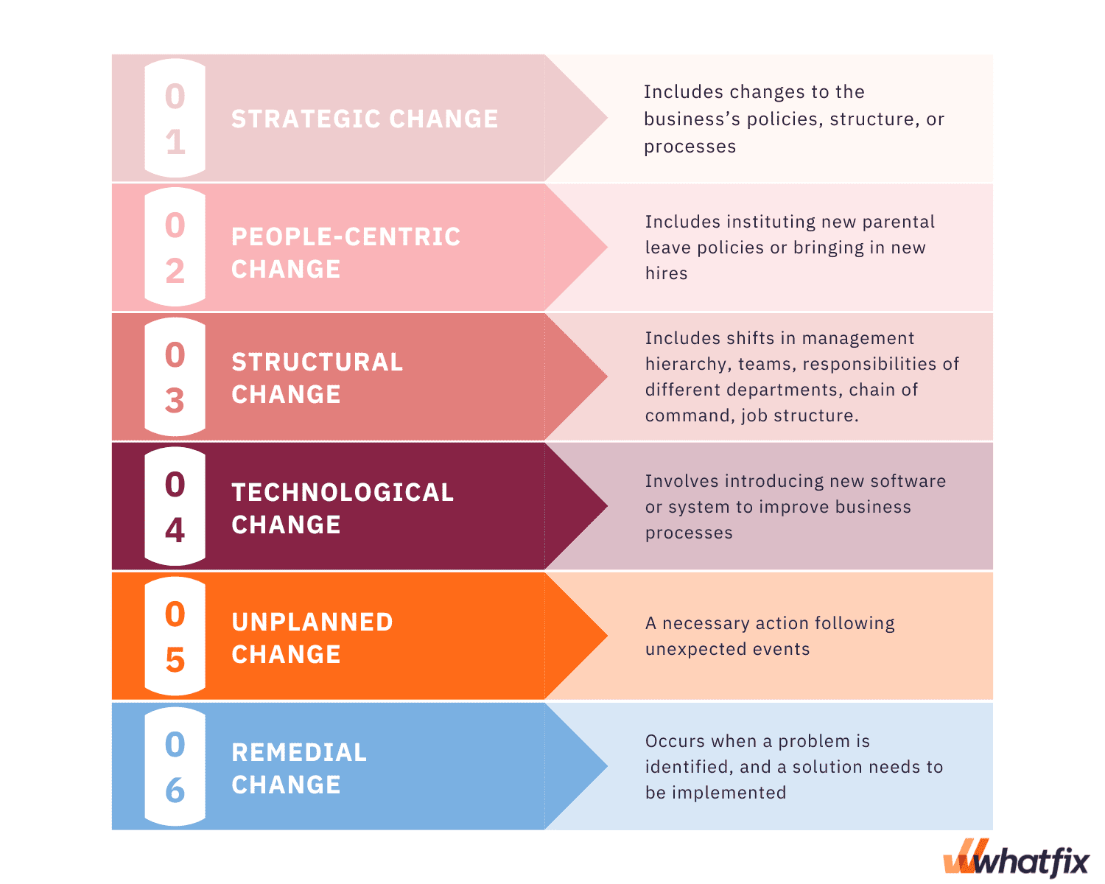
MEANING OF ORGNIZATIONAL CHANGE (Cont’d..)
SOURCE: [2]

Slide 6
CHANGE FORCES
An organization is an open system which has to interact with environment and is solely dependent on it.
Environment is dynamic and changing fast and both internal and external forces encourage organization to change from present to future state.
Any change in environment makes it necessary for the organization to incorporate change in the internal systems, sub-systems and processes. [3]
This change has a chain reaction on the other internal elements of organization.
Change forces are categorized as external and internal.

Slide 7
CHANGE FORCES (Cont’d…)
External Forces
Technological forces
Technology is a major external force which calls for change.
In the recent times information technology has made a remarkable impact on the ability of managers to use information to arrive at a decision. It includes:
Innovation and experimentation to develop new or improved products or processes.
Redesigning jobs arising from new developments in technology.
Changes in the level of technology and the rate of technological change.

Slide 8
CHANGE FORCES (Cont’d…)
Political forces
Political forces are related to management of public affairs. It includes:
Changing political system, institutions and philosophies.
Changing world politics like Russia – Ukraine war, Israel –Hamas war.
Increasing activities of pressure group like social activist, trade unions etc.
Changing role of government from doer to facilitator.
New laws, regulations and deregulations.

Slide 9
CHANGE FORCES (Cont’d…)
Economic and Market forces
Economic system, policies and conditions.
Economic health of the country indicated by per capita income and growth rate.
Inflation and exchange rate changes
Income distribution and poverty minimization.
Resource availability: physical, human, financial etc.
Liberalization and privatization
Workforce diversity in terms of culture, gender, age, skill and professionalism.

Slide 10
CHANGE FORCES (Cont’d…)
Socio Cultural forces
They are reflected by
Demographic changes related to population.
Social change that causes differences among people.
Cross cultural influences and their impacts on values, beliefs, and attitudes.
Ethical problems and dilemmas.

Slide 11
CHANGE FORCES (Cont’d…)
Internal Forces
Internal forces are controllable by the organization. They are reflected by:
Goal changes: the goal of employees changes. Organizational goal experience succession and displacement.
Structure changes: they affect job design and relationships. Coordination mechanism also change.
Resource changes: technology changes make manually performed jobs automated and computerized.

Slide 12
CHANGE FORCES (Cont’d…)
Organization climate changes:
Changes in quality of working environment is reflected by changes in:
Mutuality of interest of labor and management.
Openness in communication and tolerance for conflicts.
Collaborating among employees.
Team work – grouping of activities around teams for results.
Innovation and risk taking
Performance based rewards.

Slide 13
CHANGE FORCES (Cont’d…)
INTERNAL FORCES
EXTERNAL FORCES
Declining Effectiveness.
A crisis Situation
Changes in employee expectations
Changes in the work climate at an organization.
Nature of work force.
Technology
Economic shocks
Competition
Social trends

Slide 14
FORMS OF CHANGE
Planned Change
It is a change resulting from a deliberate decision to alter the organization.
The focus of planned change is primarily on intentional, goal-oriented change.
Companies that wish to move from a traditional hierarchical structure to one that facilitates self-managed team must use a proactive, orchestrated approach.
The change is designed to achieve specific goals and usually involves a detailed roadmap that ensures a smooth transition.

Slide 15
FORMS OF CHANGE (Cont’d…)
Unplanned Change
It is imposed on the organization and often unforeseen.
Changes in government regulation and changes in economy, for example, are often unplanned.
When the forces of unplanned change begin to appear, the appropriate goal is to act quickly to minimize any negative consequences and maximize any possible benefits. [4]
This type of change can be chaotic and requires quick responses to adapt successfully.
Unplanned change can be considered a remedial change or reactionary change, too.

Slide 16
FORMS OF CHANGE (Cont’d…)
Transformational Change
Transformational change in an organisation means a complete overhaul, shaping something entirely new.
This often involves a fundamental overhaul of an organisation’s systems, processes, or culture.
It’s a radical process that may alter the company’s direction, vision, or mission.
This can occur when an organization faces different technologies, significant changes in supply and demand, unexpected losses etc.

Slide 17
FORMS OF CHANGE (Cont’d…)
Radical Change
It is a process by which firms regain competitive advantage after it has been lost or threatened.
This type of extent of change undertaken depends upon the firm’s resources and capabilities, its competitive environment, and its leadership.
It fundamentally change the firm’s processes, system, structure, strategies and core values.

Slide 18
CHANGE AGENT
Change agent are factors that are responsible for the change in individual behaviour.
Change agent is anyone who has the skill and power to stimulate, facilitate and coordinate the change effort.
Other changes like change in organization structure, organizational strategy, process, policy and the like can always be introduced in the organization with proper consultations of the employees so that they are accepted by them.
Change in human behaviour is a complex phenomenon that may require a number of strategies to make desirable change. These are called change agents.

Slide 19
CHANGE AGENT (Cont’d..)
Four types of change agents have been identified[5]
Outside Pressures
External environment like fiscal policy, government policy, technology and social change bring change into the organization.
Change is generally executed by the organizations itself. Government may also indulge and help organizations to adopt to new policy like controlling strike in the organizations.
Changes form Top Management
The organizational change may come from the top management.
It may be in the form of structural, strategic or institutions changes that may be beneficial to the organization with particular reference to employees.

Slide 20
CHANGE AGENT (Cont’d..)
Internal Organizational Development
Organizational objectives must be reviewed from time to time. This is necessitated because of the environmental changes.
Areas where organizational development can be carried out are work design, delegation of authority, team building, empowerment, autonomy, job enrichment , job rotation etc.
Individual level Change
Individual level change refers to change in attitude, skills and behaviour.
If development process like management by objective (MBO) encompasses self decision making, setting objective for self, are introduced, individuals are likely to be more responsible for the work they are assigned.

Slide 21
RESISTANCE TO CHANGE
In organizations, resistance to change is any attitude or behaviour that indicates unwillingness to make or support a desired change.
It is helpful to view resistance to change as feedback that the change agent can use to facilitate gaining change objectives.[5]
It must be emphasised that change brings with it new challenges, new experiences, spirit and associated rewards and therefore it should be welcomed and implemented with positiveness and full support. [3]
However, there are two factors that resist change: Individual Resistance and Organizational Resistance.

Slide 22
RESISTANCE TO CHANGE (Cont’d..)
Individual Resistance
Individual sources of resistance to change reside in basic human characteristics such as perceptions, personalities and needs.
Economic reason: It usually focus on
Fear of technological unemployment.
Fear of reduced work hours and consequently less pay.
Fear of demotion and thus reduced pay.

Slide 23
RESISTANCE TO CHANGE (Cont’d..)
Fear of Job Security
When change is impending, some employees may fear loosing their jobs, particularly when new and advanced technology is introduced.
In recent times there has been the trend for down sizing the organization as a measure of cost cutting.
Changes may diminish the positive qualities the individuals enjoys the job.
Peer Pressure
Individual employee may be prepared to accept change but refuse to accept it for the sake of group.

Slide 24
RESISTANCE TO CHANGE (Cont’d..)
Fear of Failure
Some employee fear changes because they fear their own failure.
For example, introducing new computer system often arouses individuals self doubt about their ability to interact with the computer.
Personality Conflict
A change agent who appears insensitive to employee concerns and feeling may meet considerable resistance because employees perceive that their needs are not being taken into account.

Slide 25
RESISTANCE TO CHANGE (Cont’d..)
Organizational Resistance
Reasons for organizational resistance are:
Resource constraint
Resources are one of the major constraints inside the organization.
The necessary financial, material and human resources may not be available to the organization to make the needed changes.
Structural constraint
Some organizational structure have in built mechanism for resistance to change.
In bureaucratic structure, jobs are narrowly defined and lines of authority are clearly spelled out which makes difficult to implement change.

Slide 26
RESISTANCE TO CHANGE (Cont’d..)
Threat to expertise
Change in organizational pattern may threaten the expertise of the specialized groups. Therefore specialists usually resist to change.
Politics
Organizational change may shift the existing balance power in an organization.
Individuals or groups who hold power under the current arrangement may fear losing these political advantages.

Slide 27
MANAGING RESISTANCE TO CHANGE
Some tactics are used to resist to change:
Education and Communication
Communication about impending change is essential if employees are to adjust effectively.
The details of the change should be provided and its potential consequences.
Educating employees on new work procedures is often helpful.

Slide 28
MANAGING RESISTANCE TO CHANGE (Cont’d..)
Participation
It is difficult for the individuals to resist a change decision in which they are participated.
Prior to making a change, those opposed can be brought into the decision process.
Empathy and Support
Active listening is a excellent tool for identifying reasons behind the resistance.
An expression of concerns about the change can provide important feedback that managers can use to improve the change process.

Slide 29
MANAGING RESISTANCE TO CHANGE (Cont’d..)
Manipulation
Manipulation refers to covert influence attempts.
Twisting and distorting facts to make them appear attractive and creating false rumours to get employees to accept a change.
Coercion
Coercion is application of direct threats or force on resistors.
The change agent essentially force people to accept a change by explicitly or implicitly threating them with the loss of their jobs, promotion possibilities and transferring them.

Slide 30
APPROACH TO ORGANIZATIONAL CHANGE
Different approaches of managing the organizational change have been developed, among them major approaches are:
  Lewin’s Three step model
  Action research model

Slide 31
APPROACH TO ORGANIZATIONAL CHANGE (Cont’d…)
  Lewin’s Three step model
In the year 1951, Kurt Lewin, a social psychologist, has developed this model which is also called “Force Field Analysis”.
According to this model, organizational change can be managed through the interaction between driving and restraining forces.
This model asserts that there are two types of regular forces that affect change:
  Driving forces: Forces that favor or support change
  Restraining forces: Forces that oppose or block change

Slide 32
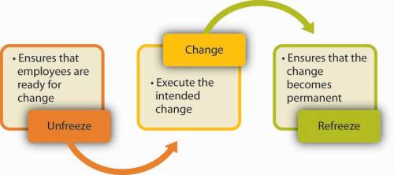
APPROACH TO ORGANIZATIONAL CHANGE (Cont’d…)
Psychologist Kurt Lewin recommends that any change effort be viewed as a process with three distinct phases—unfreezing, changing, and refreezing, all of which must be well handled for a change to be successful.[7]
SOURCE: [8]

Slide 33
APPROACH TO ORGANIZATIONAL CHANGE (Cont’d…)
Stage 1: Unfreezing
Process of finding a method of making it possible for people to let go of an old pattern that was counterproductive in some way.
Unfreezing can be achieved by use of three methods:
- Increasing the driving force that direct behavior away from the existing situation
- Decreasing the restraining forces that negatively affect the movement from the existing equilibrium.
- Finding the combination of two methods listed above.

Slide 34
APPROACH TO ORGANIZATIONAL CHANGE (Cont’d…)
Stage 2: Movement
Process of change in thoughts, feeling, behavior that is in some way more productive.
Once team members have opened up their minds, change can start.
The change process is dynamic and it will take some time to be effective and involve transition period.
People have to take new responsibilities and tasks, which entails learning curve that will first slow the organization down.
A change process is viewed as an investment both in terms of time and allocation of resources.

Slide 35
APPROACH TO ORGANIZATIONAL CHANGE (Cont’d…)
Step 3: Refreezing
Change will only reach its full effect, if it is made permanent.
Once the organizational change have been made, efforts should be made to cement them and make sure the new organization reaches the standards.
Re freezing gives people the opportunity to thrive in the new organization and take full advantage of the change.

Slide 36
APPROACH TO ORGANIZATIONAL CHANGE (Cont’d…)
Action Research Model
This is “A change process that is based on the systematic collection of data and then selection of change action based on what the analyzed data indicate.”
Diagnosis : begins by gathering information about problems, and needed changes from members of the organization.
Analysis : of information is synthesized into primary concern, problem areas and possible actions.
Feedback : requires sharing with employees what has been found from step one and two and the development of plan for the change.

Slide 37
APPROACH TO ORGANIZATIONAL CHANGE (Cont’d…)
Action : is the step where employees set into motion the specific action to correct the problem that were identified.
Evaluation: is the final step to assess the action plan’s effectiveness. Using the initial data gathered as a bench mark, the subsequent change can be compared and evaluated.
Provides two benefits for organization
Problem focused: the change agent looks for problems and the type of problem determine the type of change of action.
Resistance to change is reduced : once employees have actively participated in the feedback process, the change process typically takes on a momentum of its own.

Slide 38
ORGANIZATIONAL DEVELOPMENT(OD)
OD is the act, process or result of furthering, advancing, or promoting the growth of an organization.
Organizational development is a collection of planned change interventions, built on humanistic-democratic values, that seeks to improve organizational effectiveness and employee well being.[9]
The underlying values in OD effort are :
- Respect for people
- Trust and people
- Power equalization
- Confrontation
- Participation

Slide 39
ORGANIZATIONAL DEVELOPMENT(OD) (Cont’d..)
Role of OD
To place emphasis on humanistic value
To treat each human being as a complex person
To increase the level of trust among the members
To increase the level of enthusiasm at all levels
To increase the level of self and group responsibility in planning.
Problem of OD
Discrepancy between ideal and real situations.
Resistance to change
Costly programs
Lack of motivation among members.

Slide 40
ORGANIZATIONAL DEVELOPMENT(OD) (Cont’d..)
OD interventions
Sensitivity training
Also called laboratory training, T-groups (Training groups).
Refers to a unstructured group interaction.
Participants discuss themselves and their interactive process directed by the professional behavior scientist.
Specific result include ; improved listening skill, greater openness, increased tolerance, improved conflict resolution skills.

Slide 41
ORGANIZATIONAL DEVELOPMENT(OD) (Cont’d..)
Survey Feedback
It involves the use of questionnaires to identify discrepancies in member perceptions. Group discussion of survey results suggest remedies.
3. Process consultation
An outside consultant assists the client to perceive, understand and act upon process events. The processes that need improvement are identified jointly by the consultant and the client.

Slide 42
ORGANIZATIONAL DEVELOPMENT(OD) (Cont’d..)
Team Building
It utilizes high interaction group activities to increase trust and openness among team members.
The objective is to improve coordinative efforts of team members which results in team performance.
Clarify the role of each members in the team.
Intergroup Development
It seeks to change the attitude, stereotype, perception that group have each other.
After the identification of difficulty, the group can move into the integration phase, that will improve relation between the group.

Slide 43
REFERENCES:
[1] A Hand Book of Organizational Behavior and Human Resource Management. Niraj Mishra, 2nd Edition, Asmita Publication, Kathmandu Nepal, 2006.
[2] Change Management, 6 Types of Organizational Change, Explained, September 8 2022. Accessed on 25th April 2024. https://whatfix.com/blog/types-of-organizational-change/#:~:text=Organizational%20changes%20are%20those%20that,It's%20a%20broad%20category.
[3]Organizational Behaviour: V. G. Kondalkar, New Edge International (P) Limited, Publishers. New Delhi, India, 2007.
[4] Organizational Behaviour: John R. Schermerhorn Jr, James G. Hunt, Richard N. Osborn. Seventh Edition. John Wiley and Sons, Inc. 2002.

Slide 44
REFERENCES (Cont’d..)
[5] Tichy, N. and H. Hoernstein, “Stand when your number is called : An Empirical attempt to Classify Types of Social Change Agents”. Human Relations, Vol. 29, No. 10.
[6] Donald Klein, “Some Notes on the Dynamics of Resistance to Change:The Defender Role,” in Bennis et al. (eds.), The Planning of Change (1969), pp. 117–124.
[7] Kurt Lewin, “Group Decision and Social Change,” in G. E. Swanson, T. M. Newcomb, and E. L. Hartley (eds.), Readings in Social Psychology (New York: Holt, Rinehart & Winston, 1952), pp. 459–473.

Slide 45
REFERENCES (Cont’d..)
[8] Planning and Executing Change Effectively, Organizational structure and change, Principle of Management. Accessed on 26th April 2024. https://courses.lumenlearning.com/atd-tc3-management/chapter/planning-and-executing-change-effectively/
[9] Organization Behaviour: Stephen P. Robbins, 14th Edition, Prentice Hall Publication, 2011.

