Slide 1
Power Systems Operation and Control
Lecture 1
Introduction to Power Systems
Lecturer: Teshome Goa (Assist. Prof.)
Lecture learning outcomes:
At the end of this lecture, you will be able to:
Understand the power systems
Identify the power systems components'
Understand the basic operation of conventional and non-conventional energy resources
Identify the types of Transmission lines
Knows single phase and three phase power systems, and Per unit analysis

Slide 2
Content
Introduction
Elements of electric power systems
Transmission Systems
Distribution Systems and Load
Single and Three Phase Power System(STPS)
Per Phase Analysis
Power Flow Analysis
Operation of Power Plants
Summary
References

Slide 3
1. Introductions
An electric power system is defined as a network of electrical components used to supply (generate), transmit, and consume electric power.
An electric power system that supplies power to homes and industries for a sizeable region is called an electric grid
There are two types of electrical power such as:
DC power - It is defined as the product of voltage and current, and is produced by DC sources like generators, batteries, fuel cells, etc.
AC power - A flow of charge that exhibits a periodic change in direction is called AC power

Slide 4
2. Elements of electric power systems
An electric power system consists of four main subsystems:
Generation
Transmission
Sub-transmission Systems and
Distribution Systems.
The generation subsystem converts primary energy sources into electrical energy.
The transmission subsystem transfers power over long distances at high voltages.

Slide 5
EEPS Cont.…..
Power System is a network of high tension wires/cables by which the generated Electrical power is transmitted and distributed throughout a region.
Power System consists of the following main components:
a. Generation System- Energy Conversion Methods
b. Transmission System- Ultra-high, Extra-high, High and Medium Voltage levels
c. Distribution System- Low voltage levels
d. The Load or Energy sink- Resistive, Capacitive and inductive Electrical devices

Slide 6
EEPS Cont.….
2.1 Generation systems:
In the generation system, electricity is produced in power plants through:
burning fossil fuels, using hydroelectric power plants or other Renewable energy(RE) resources.
Power generation systems are simply the combination of a potential or stored energy converter providing kinetic energy, which, in turn, creates electric power for different applications
i. Types of Energy Resources:
Oil, Natural Gas, Coal, Atomic energy (Fossil fuel resources)-Conventional resources
Solar, Hydro, wind, hot water/spring, Biomass (RE Resources)

Slide 7
EEPS Cont.….
ii. Types of Energy conversions Techniques
Classified as: Conventional and non-conventional as given in Table [1].
Table 1. Energy conversion Techniques. Url: https://unacademy.com/content/upsc/study-material/environment/conventional-and-non-conventional-sources-of-energy/
Conventional |  | Non-conventional
Conventional non-RE | Conventional RE | 1. Solar energy
1. Mostly fossil fuels found under the ground; | 1. Mostly non-fossil fuels found above the ground; | 2. Wind energy
a. Coal | a. Fire-wood | 3. Hydropower
b. Oil | b. Cattle dung | 4. Nuclear energy
c. Natural gas | c. Vegetable-wastes | 5. Geothermal energy
 | d. Wood- charcoal | 6. Bio-gas
 |  | 7. Tidal Energy

Slide 8
      3. Transmission Systems(TSs)
The bulk electrical energy is transmitted via this power system component from the generation stations where it is created to the primary load centers.
The components of the transmission system are:
Step-up and step-down substations.
Transmission Lines (Overhead or underground )
Insulators
Ground wires
Mechanical structures

Slide 9
      TSs Cont.….
3.1 Characteristic and operation of Transmission lines
Since transmission lines are often run with a balanced three-phase load, phase-by-phase analysis is possible.
A transmission line can be thought of as a two-port network on a phase-by-phase basis.
The voltage V_{s} and current I_{s} at the sending end are connected to the voltage V_{R} and current I_{R} at the receiving end by the use of ABCD constants, as follows:
eqn.(1)
Transmission lines are divided into three categories based on the voltage levels and distance coverage they cover: short, medium, and long.

Slide 10
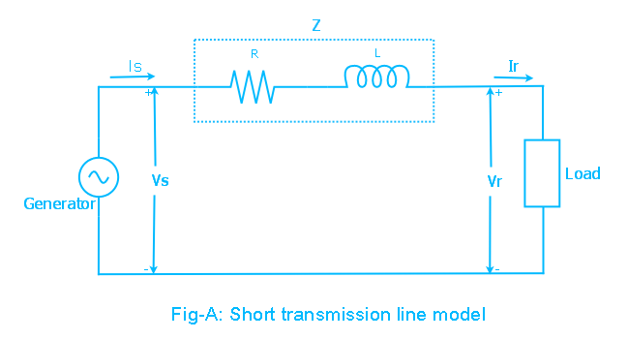
      TSs Cont.….
Short transmission line: A short transmission line has an operating voltage of less than 20 kV and a transmission distance of less than 80 km.
In the case of a short transmission line, the effects of capacitance and conductance may be neglected
All that is left to consider are the series resistance and inductance.
While resistance and inductance are dispersed along the length of a line in reality, for short lines, the resistance and inductance are believed to be aggregated at a single location as presented in Fig.1[2].
Figure 1. Short transmission line representation.
URL: https://eeebooks4u.wordpress.com/wp-content/uploads/2017/03/short_line.png

Slide 11
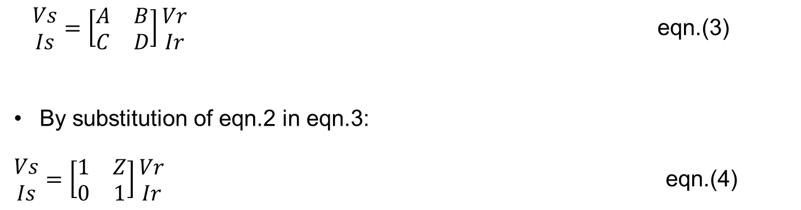
      TSs Cont.….
Based on the two-port network, the medium transmission line sending and receiving end parameters are related as:
eqn.(2)
$\begin{matrix}Vs \\ Is\end{matrix}=\left[\begin{matrix}A & B \\ C & D\end{matrix}\right]\begin{matrix}Vr \\ Ir\end{matrix}$ eqn.(3)
By substitution of eqn.2 in eqn.3:
$\begin{matrix}Vs \\ Is\end{matrix}=\left[\begin{matrix}1 & Z \\ 0 & 1\end{matrix}\right]\begin{matrix}Vr \\ Ir\end{matrix}$ eqn.(4)

Slide 12
      TSs Cont.….
Medium transmission line: A medium transmission line is one that has a voltage of between 20 and 100 kilovolts and a length of 80 to 250 km.
It is necessary to take the capacitance effects into consideration.
As a result, all admissions are combined at the sending, receiving, or center ends.
Approximate line performance calculations have been performed using several different localized capacitance techniques.
The following techniques are employed more frequently presented in Figs. 2&3, respectively:
Nominal T
nominal π

Slide 13
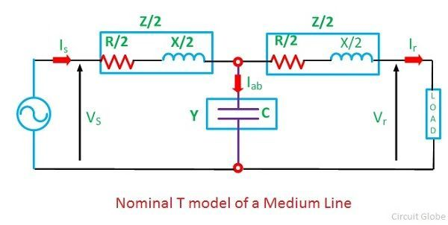
      TSs Cont.….
Figure 2: Nominal T-method Short Transmission line.
url:https://circuitglobe.com/wp-content/uploads/2016/05/t2-model-compressor.jpg
The ABCD parameter is calculated as;
Voltage at the mid-point of the line
eqn.(5)

Slide 14
      TSs Cont.….
Current in the capacitor,
eqn.(6)
Then, the sending-end current and Voltage are given by:
eqn.(7)
eqn.(8)

Slide 15
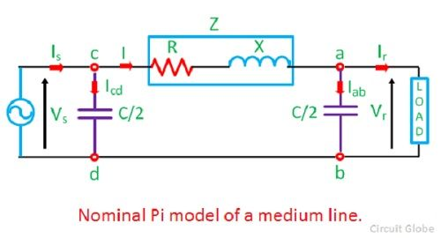
      TSs Cont.….
Nominal π method.
According to this strategy, the complete resistance and inductive reactance are concentrated at the center of the line, while half of the total line capacitance is focused at each end as presented in Fig.3[3].
Figure 3. Nominal π method medium transmission line. url: https://circuitglobe.com/wp-content/uploads/2016/05/pi-model-medium-line.jpg
Using the same procedures, the sending end voltage and current are given by:
eqn.(9)
eqn.(10)

Slide 16
      TSs Cont.….
Long Transmission Line: Transmission lines that span more than 250 km (150 miles) are considered lengthy.
The approximation of the shunt admittance by two constant capacitors at each end of the line is insufficiently accurate for long lines.
Rather, the series impedance and the shunt capacitance need to be thought of as dispersed quantities, and the differential equations of the line should be solved to determine the voltages and currents on it.
On the other hand, a long transmission line can be modeled as a π model with modified shunt admittance Y' and series impedance Z', and calculations can be done on that model using ABCD constants for Fig.4.

Slide 17
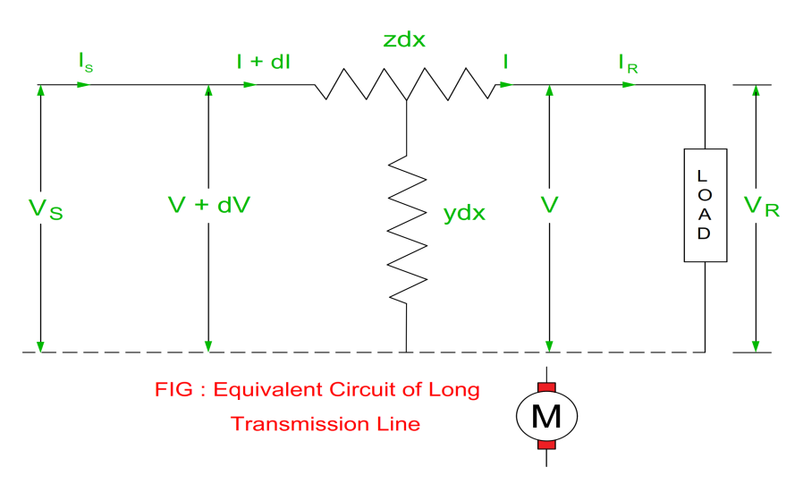
      TSs Cont.….
The series impedance and shunt admittance adjusted values are:
Figure 4. Long transmission line representation.
URL: https://www.myelectrical2015.com/2022/04/abcd-parameters-of-long-transmission.html#google_vignette
eqn.(11)
Where, Z is the series impedance of the line; Y is the shunt admittance of the line; d is the length of the line; γ is the propagation constant of the line:
eqn.(12)

Slide 18
      TSs Cont.….
Where, z is the series impedance per km and y is the shunt admittance per km.
When γd decreases, the ratios tend to 1.0, transforming the model into a medium-length line model.
For a long transmission line, the ABCD constants are;
eqn.(13)

Slide 19
      4. Distribution Systems and Loads
      The distribution system gives out the energy from the medium voltage substations to customers’ location. It is composed of:
    Medium Voltage (MV) lines (33kV, 15 kV)
    MV/LV transformer substations (33/15/ kV to 400/380/220 V)
    Distribution lines (33/15 kV, 380 V 3-phase and 220 v single phase
    Load or Energy Sink:
    Load is the end equipment of the power system where the transmitted electrical energy is converted to other forms of useful energy.

Slide 20
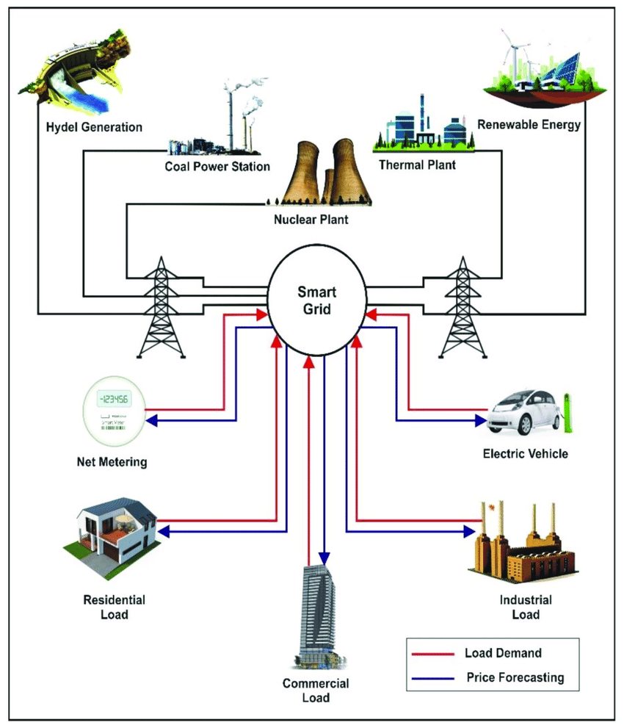
    Finally, the overall power network diagram is presented in Fig.5
Figure 5: Modern power network structures[4].
URL: https://www.mdpi.com/sustainability/sustainability-13-12693/article_deploy/html/images/sustainability-13-12693-g001.png

Slide 21
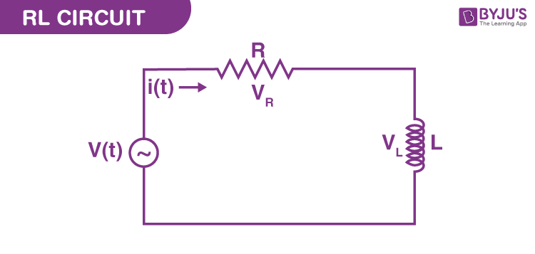
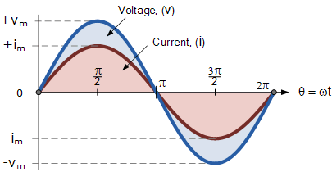
5. Single and Three Phase Power System(STPS)
    a. Single Phase Circuit Components
Sources (voltage or current)
Impedances (resistance, inductance, and capacitance)
The components are connected in series or in parallel, presented in Fig.6
Figure 6. a. RL ckt. url: https://cdn1.byjus.com/wp-content/uploads/2021/04/RL-Circuit-Series-Circuit.png b. RL circuit Phase shift. Url: https://www.electronics-tutorials.ws/wpcontent/uploads/2013/06/acp29.gif?fit=405%2C210?fit=355,226

Slide 22
The Phasor analysis is used to know the single phase power relations
STPS Cont.….
Goal of phasor analysis is to simplify the analysis of constant frequency AC systems
v(t) = V_{max} cos(ωt + θ_{v}) eqn.(14)
i(t) = I_{max} cos(ωt + θ_{I})
Root Mean Square (RMS) voltage of sinusoid
eqn.(15)

Slide 23
STPS Cont.….
Based on the Euler’s identity;
eqn.(16)
Accordingly, the phase notation is rewritten as :
eqn.(17)
Where, V is the r.m.s voltage.
The r.m.s , cosine-referenced voltage is:
eqn.(18)

Slide 24
STPS Cont.….
Then, the power, P(t) is given as;
eqn.(20)
Then, the average power is given by:
eqn.(22)
Complex Power
eqn.(23)
Where, P is real power, Q is reactive power, S is apparent power and Փ is
the power factor

Slide 25
Power flow or conservation of PF
At every node (bus) in the system
  Sum of real power in the node must be zero
  Sum of reactive power in the node must be zero
This is a direct consequence of Kirchhoff’s current law, which states that the total current at each node must be equal to zero.
  Conservation of power follows since S = VI*

Slide 26
STPS Cont.….
b. Balanced 3 Phase (φ) Systems
Single phase is used primarily only in low voltage, low power settings, such as residential and some commercial
A balanced three-phase system which is presented in Fig.7 has :
  Three voltage sources with equal magnitude, but with an angle shift of 120°
  Equal loads on each phase
  Equal impedance on the lines connecting the generators to the loads
Bulk power systems are almost exclusively three phase.

Slide 27
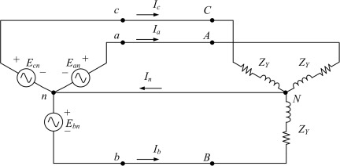
STPS Cont.….
,
eqn.(24)
Figure 7. Balanced Three Phase system with No-Neutral current. url: https://ars.els-cdn.com/content/image/1-s2.0-S1364032115017025-gr5.jpg

Slide 28
STPS Cont.….
Balanced three phase system can transmit more power for same amount of wire, twice as much as single phase
Torque produced by three-phase machines is constant
Three phase machines use less material for same power rating
Three phase machines start more easily than single phase machines

Slide 29
6. Per Phase Analysis
Per phase analysis allows analysis of three phase systems with the same effort as for a single phase system
For per-phase analysis:
  a. All loads and sources Y connected
  b. No mutual Inductance between phases
All neutrals are at the same potential
  All phases are completely decoupled
  All system values are the same sequence as sources.
  The sequence order are phase b lags phase a and phase c lags phase b, known as “positive” sequence;

Slide 30
Per Phase Analysis Cont.…
Steps for per phase analysis
Convert all Δ load/sources to equivalent Y’s
Solve phase “a” independent of the other phases
Total system power S = 3 V_{a} I_{a}*
If desired, phase “b” and “c” values can be determined by inspection (i.e., ±120° degree phase shifts)
If necessary, go back to original circuit to determine line-line values or internal Δ values.

Slide 31
Per Phase Analysis Cont.…
Per Unit values : The ratio of the actual value in any value to the chosen base value of the same unit is known as; per unit value, it has a unit less quantities
A key problem in analyzing power systems is the large number of transformers.
  It would be very difficult to continually have to refer impedances to the different sides of the transformers
This problem is avoided by a normalization of all variables.
This normalization is known as per unit analysis
eqn.(25)

Slide 32
Per Phase Analysis Cont.…
Referring quantities from one side of the transformer to the other side serious errors may be committed, which can be avoided using per unit system.
Voltages, currents and impedances expressed in per unit do not change when they are referred
Per unit impedances of electrical equipment of similar type usually lie within a narrow range, when the equipment ratings are used as base values.
Transformer connections do not affect the per unit values.

Slide 33
Per Phase Analysis Cont.…
In power systems the basic quantities of importance are voltage, current, impedance and power.
For all per unit calculations a base KVA or MVA and a base KV are to be chosen.
The following are some of the guide lines for selection of base values.
Rating of the largest plant or unit for base MVA or KVA.
The total capacity of a plant or system for base MVA or KVA.
Any arbitrary value.

Slide 34
Per Phase Analysis Cont.…
Once the base values or reference values are chosen. the other quantities can be obtained as;
Pick a 1-Ф if VA base for the entire system, S_{B}
Pick a voltage base for each different voltage level, V_{B}. Voltage bases are related by transformer turns ratios. V is phase voltage for 1-Ф
Calculate the current base, I_{B} = S_{B}/V_{B}
Calculate the impedance base, Z_{B}= (V_{B})²/S_{B}
Convert actual values to per unit
Convert back to actual as necessary

Slide 35
Per Phase Analysis Cont.…
Pick a 3-Ф VA base for the entire system,
Pick a voltage base for each different voltage level, V_{B}. Voltages are line to line.
Calculate the current base, I_{B}
IV. Calculate the impedance base

Slide 36
Per Phase Analysis Cont.…
Per Unit Change to Common MVA Base
Parameters for equipment are often given using power rating of equipment as the MVA base
To analyze a system all per unit data must be on a common power base
eqn.(26)
Example A 50 MVA transformer has a leakage reactance or 4%. What is the reactance on a 100 MVA base?

Slide 37
7. Power Flow Analysis
Power is very important for the development of any country. It has the following characteristics:
It can be easily converted to and from other forms of energy.
It can be transmitted and distributed over large area and long distance.
It can be easily controlled
It is economical, because it can be generated in large quantities at one location and distributed to sites where the energy is needed.
used for planning and controlling a system

Slide 38
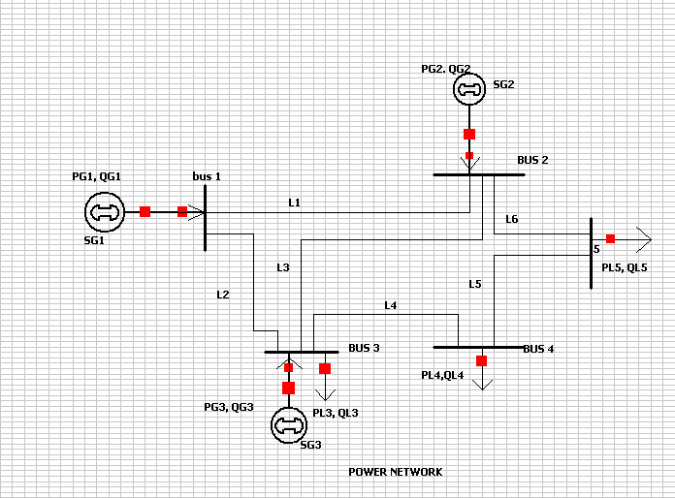
Power Flow Analysis Cont.….
Power flow analysis begins with understanding the power network stricture as presented in Fig.8, which is drawn using power world simulator software.
Figure 8. Power Network Sample

Slide 39
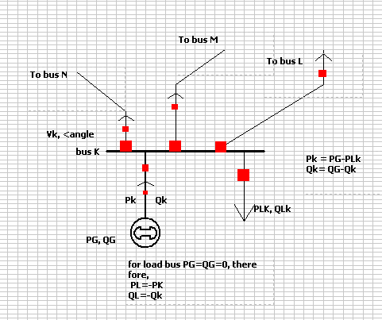
Power Flow Analysis Cont.….
If, only bus k is considered from Fig.8, the power flow equation is given as;
eqn.(27)

Slide 40
Power Flow Analysis Cont.….
Significance of power flow are:
To find out the voltage magnitude and its phase angle at each bus
To determine the active and reactive power flow in each line
Thus, each bus has four state variables:
voltage magnitude
voltage phase angle
real power injection
reactive power injection
In order to perform the analysis, two parameters out of four state
variables should be defined or given.

Slide 41
Power Flow Analysis Cont.….
General objectives of power flow are;
For the successful operation of static power flow analysis ;
Generation must supplies demand (load) and loss.
Node voltage magnitudes must be remain close to rated values.
Generator must operates within specified real and reactive power limits.
lines and transformers should not be overloaded

Slide 42
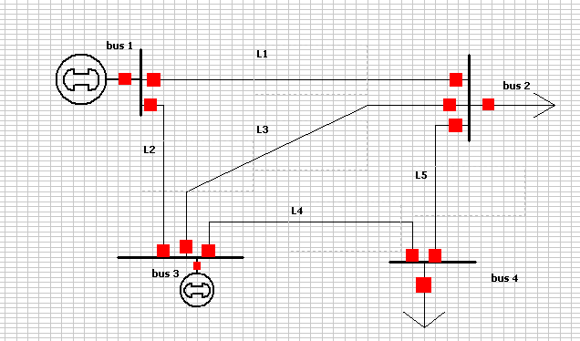
Power Flow Analysis Cont.….
Bus Admittance matrix formulation . It’s formulated based on eqn.28.
eqn.(28)
Considering long transmission line and KCL at each node for Fig.9, the admittance is:
Figure 9. Single line representation of Five bus system

Slide 43
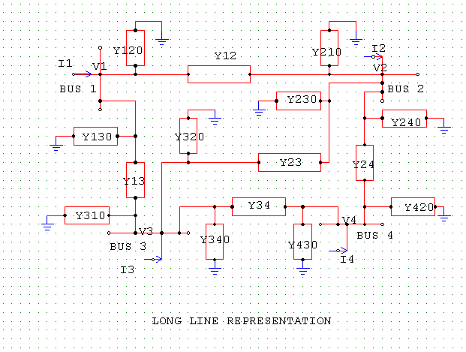
Power Flow Analysis Cont.….
Figure 10. The π model five-bus long transmission line representation

Slide 44
Power Flow Analysis Cont.….
To find out the current ‘I’ flowing into bus I, apply KCL at each bus is presented in Eqn.29
eqn.(29)

Slide 45
Power Flow Analysis Cont.….
The current I in matrix and Y bus matrix forms are given in eqn.30 and eqn.31, respectively. ;
eqn.(30)
eqn.(31)
=

Slide 46
Power Flow Analysis Cont.….
The diagonal element Y₁₁, Y₂₂, Y₃₃ and Y₄₄ are called self (driving point) admittance which is the sum of all admittances connected to the node identified by the repeated subscripts
The other admittances are called mutual (transfer) admittance of the nodes which is negative of admittances connected directly between two nodes.
Diagonal elements of Y bus matrix is the summation of all elements connected to bus i
Off-diagonal elements of Y bus matrix is simply obtained as negative of the magnitude of admittance connected between i and j

Slide 47
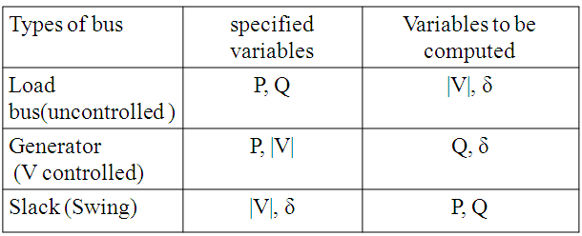
Power Flow Analysis Cont.….
Power flow equations : Based on the known and unknown variables, buses can be classified as;
Load bus: A load bus is a bus that has only loads connected to it; no generation is present.
Real power (P_{Di}) and reactive power (Q_{Di}) are pulled from the supply at this bus.
Since generated powers P_{Gi} and Q_{Gi} are presumed to be positive, P_{Di} and Q_{Di} in a power balancing equation are viewed as negative numbers.

Slide 48
Power Flow Analysis Cont.….
PV or Voltage controlled bus/ generator bus: A voltage controlled bus is any bus in the system where the voltage magnitude can be controlled.
The real power(P) and Voltage (V) are known, whereas, its phase angle and the reactive power (Q) are to be determined.
The limits on the value of the reactive power are also specified.
Slack bus: The place where total energy balance or power mismatch is determined using eqn. 32.
eqn.(32)
In order to determine an unknown variables, a power flow equations is needed. Thus,
applying KCL at each node I is presented in eqn.33;
eqn.(33)

Slide 49
Power Flow Analysis Cont.….
The complex apparent power injected to bus ‘i’ is given as;
eqn.(34)
Substituting ‘i’ in eqn.(34), the complex power (s) is given as;
eqn.(35)
Where,
Note that, the power flow is given by:
eqn.(36)

Slide 50
Power Flow Analysis Cont.….
Separating the real and reactive power from eqn.36, is given as;
eqn.(37)
Eqn.37, reveals the polar form of the load flow equations or static load flow equations.
They are usually expressed in the following forms as mathematical models of the load flow problem.
But during operating condition all the power system variables are not kept constant at rated values and iterative solution is needed, considering eqn.38.
eqn.(38)

Slide 51
Power Flow Analysis Cont.….
In case of iterative techniques, the soln. is obtained in an orderly fashion starting from its initial approximate soln. for initial guess.
The number of steps needed to obtain real soln. depends on the initial guess’s , problem size and the iterative technique used.
Thus, based on the named constraints, the approximate soln. may converge, diverge or oscillate.
The round-off error in this case goes on getting corrected in each step.
Commonly used iterative load flow techniques are;
Gauss–Seidel method
Newton–Raphson method
Fast decoupled method

Slide 52
8. Operation of Power Plants(OPPs)
a. Operation of Conventional Power Plants (OCPPs):
The primary characteristics of CPPs, such as thermal or hydro generation, which aid in frequency regulation and load shifting, are output stability and controllability[5].
CPPs often have bulk generation and are based on fossil fuels, both of which are bad for the environment.
They may, like a hydro plant that ruins the local topology, occupy and have an impact on a big geographic area.
Because CPPs are located close to the raw material source, energy may be lost during transmission, leading to greater generation and further environmental pollution.

Slide 53
OPPs Cont.….
b. Operation of Non-Conventional Power Plants (ONCPPs)
Non-Conventional Power Plants: Non-conventional power plants utilize renewable energy sources that are naturally replenished and practically inexhaustible
N-CPPts are located near to grid with reduced transmission power loss compared to CPPTs.
However, their intermittent characteristics compared to CPPTs needs daily operation and control aspects with respect to load variations and climate change
Specifically, their resources needs to be adjusted per seconds

Slide 54
Summary
In summary, the basics of power systems is discussed in this lecture.
The structure of power systems, its components and operation is well presented.
Besides this, the three types of power transmission lines and their two-port network equation is also discussed.
On top of it, the basics of power flow analysis is also discussed
Finally, the basic operation of conventional and non-conventional power plant is also mentioned.

Slide 55
References
[1]. L., Ying; C., Yung-ho and L., Tai-Yu. ‘’Research on New and Traditional Energy Sources in OECD Countries’’. MDPI: Int. J. Environ. Res. Public Health. V.16(1122), 2019. doi:10.3390/ijerph16071122.
[2]. A., Mustafa Mahmmed. ‘’ Determination and Analysis of Transmission Line Performance (Short-Medium Transmission Line)’’ International Journal of
Science and Engineering Investigations. V.6(60). PP.189-193. 2017.
[3]. P., Carla; G., Rafael and C., Eriberto. ‘’Experimental design and performance for medium transmission lines using TQ NE9080 line simulator’’. TENCON IEEE Region 10 Conference. 2017. pp. 2347-2352.
[4]. Y., Adnan; A., Rao Muhammad; S., Mustafa and etl. ‘’ A Novel Machine Learning-Based Price Forecasting for Energy Management Systems’’. MDPI: Sustainability. V.13(12693). 2021. https://doi.org/10.3390/su132212693
[5]. B., Oluleke; Z., Zhenbin; D., Tomislav and etl. ‘’Smart grid evolution: Predictive control of distributed energy resources—A review’’. International Journal of Electrical Power & Energy Systems. V.147(108812), 2023. https://doi.org/10.1016/j.ijepes.2022.108812

Slide 56
Thank you !

