Slide 1
Power Systems Operation and Control
Lecture 2
Economic Load Dispatch (ELD)
Lecturer: Teshome Goa (Assist. Prof.)
Lecture learning outcomes:
At the end of this lecture, you will be able to:
Know the economic operation of power system
Understand the Economic load dispatch of thermal power plant
Develop the mathematical model and different computational methods for ELD
Understand the Lambda iteration Economic Load Dispatch

Slide 2
Content
Introduction
Economic Load Dispatch
Economic Operation of Thermal Power Plant (EOTPP)
Economic Dispatch Problem Formulation
Solving ED Problems using unconstrained minimization
Lambda-Iteration Based ED Solution
Summary
References

Slide 3
1. Introduction
Operating power systems efficiently is important for providing affordable electricity to the customers
Especially, the costs for fuel, operators' and labor should be minimized for efficient operations.
Using new and modern generator-turbine units, specially in steam power plants operate more efficiently than older models, meaning they can produce more energy with less fuel.
Accordingly, it's crucial to optimize the contribution of each unit and load in the system to minimize the cost of electrical energy . This comprises:
Managing Load, balancing demand across various loads to prevent overloading and ensure efficient operation.

Slide 4
Introduction Cant….
Allocating generation among units or power plants in a way that minimizes overall operating costs while taking fuel prices and operational efficiencies into account is known as economic dispatch.
Doing Unit Commitment: Prioritizing the use of newer, more efficient units by carefully selecting which generators to turn ON in accordance with their efficiency and the level of demand at the time.
Checkups: Upgrading or maintaining outdated equipment on a regular basis can lower expenses and increase overall efficiency.
Integration of renewable energy: Whenever possible, utilizing renewable energy sources can assist cut fuel expenses and lessen dependency on fossil fuels.
Power systems can function more profitably by putting these tactics into practice, which will help both suppliers and customers while allowing them to adjust to shifting energy needs.

Slide 5
2. Economic Load Dispatch (ELD)
Economic Operation of Power systems is the decision-making associated with the use of existing equipment to generate, transmit, and deliver energy.
The common Power system elements that needs operation and control are Voltage, Current, Power, Energy, Frequency, and Impedance
The operation of power system needs proper coordination between these devices to maintain the system remain within acceptable limits.
For this purpose, we need to use many numerical techniques and modem stochastic or meta-heuristics computational techniques.

Slide 6
ELD Cont.…..
During operation of plants, the generators maybe in one of the following states:
Base supply without regulation: The output is a constant.
Base supply with regulation: output power is regulated based on system load.
Automatic non-economic regulation: output level changes around a base setting as area control error changes.
Automatic economic regulation: output level is adjusted, with the area load and area control error, while tracking an economic setting.
Regardless of the units operating state, it has a contribution to the economic operation, even though its output is changed for different reasons.

Slide 7
ELD Cont.…..
Factors influencing the optimal power generation with minimum cost are;
Operating efficiency of prime mover and generator
Fuel costs
Transmission losses
The most efficient generator in the system does not guarantee minimum costs, because;
It may be located in an area with high fuel costs
It may be located far from the load centers that results in high transmission losses
Accordingly, the problem is to determine generation at different plants to
minimize the total operating costs

Slide 8
ELD Cont.…..
The economic dispatch problem is defined as allocating the total demand among generating units to minimize the overall costs
In addition to continuous decisions on how to allocate the demand among generating units:
The economics of electricity generation also requires the calculation of an optimum time schedule for the start-up and shutdown costs of the generating units.
Since the units’ start-up or shutdown costs can be significant, on/off scheduling decisions must be optimally coordinated with the ELD of the continuous generation outputs

Slide 9
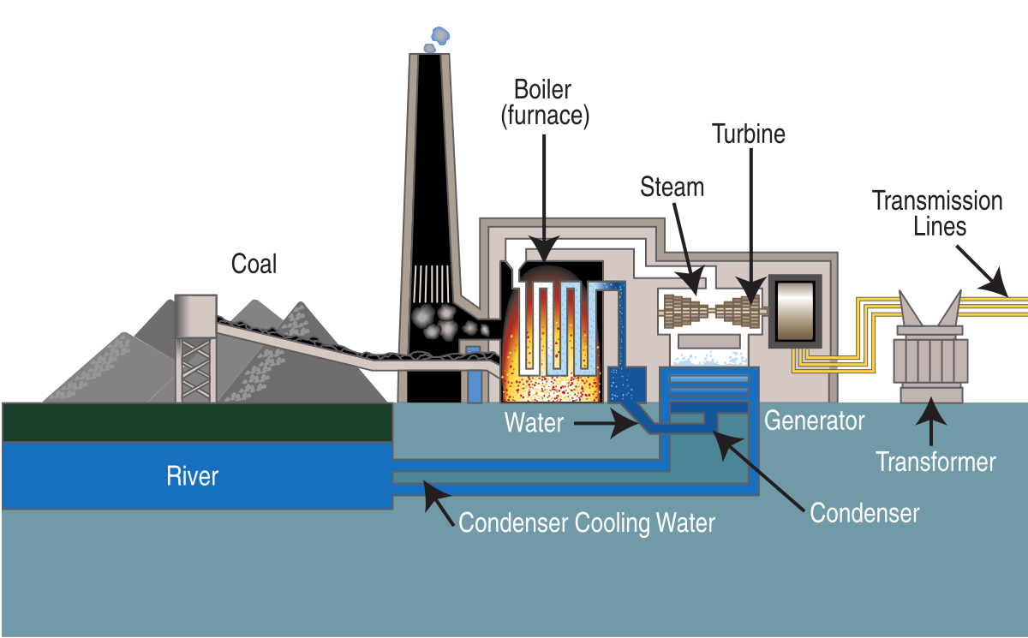
3. Economic Operation of Thermal Power Plant (EOTPP)
In analyzing the economic operation of a thermal unit comprising a boiler, turbine, and generator, input-output modeling is crucial for efficiency and cost management as presented in Fig.1.
Figure 1. Thermal Power Plant Components.
Url: https://upload.wikimedia.org/wikipedia/commons/4/4a/Coal_fired_power_plant_diagram.svg

Slide 10
EOTPP Cont.…
The main components of thermal Power Plant Unit
Boiler: Converts fuel into steam.
Turbine: Transforms steam energy into mechanical energy.
Generator: Converts mechanical energy into electrical energy
Transformer and Transmission lines: electrical energy Transportation takes place
Input Requirements
Heat Input: Measured in British thermal units (Btu/hr.) or calories (Cal/hr.), measures the amount of heat removed from a room in one hour
Fuel Cost: Expressed in USD/hr, accounting for the economic aspect of fuel
consumption (coal, gas, etc.)

Slide 11
EOTPP Cont.…
Output Specifications
Electrical Output: Measured in kilowatts (kW) or megawatts (MW), indicating the power generated for the grid and local use.
Auxiliary Power Needs
Auxiliary power requirements are critical and can vary between 2% to 5% of the total generation capacity. This includes[1]:
  Boiler Feed Pumps
  Fans
  Condenser Circulating Water Pumps

Slide 12
EOTPP Cont.…
EOTPP is influenced by the following points :
Efficiency: The ratio of useful output to input (energy or cost) influences profitability.
Load Balancing: Ensuring that generated power meets both grid and auxiliary demands.
Fuel Type Impact: Different fuels have varying costs and efficiencies, affecting overall output and economic viability.
Operational Flexibility: Ability to adjust to changes in load or fuel supply to optimize performance.
Thus, the thermal unit's design and operation must carefully balances input costs with output efficiency, factoring in auxiliary power needs to ensure reliability and economic feasibility.

Slide 13
EOTPP Cont.…
For economic operation, understanding of the following three system variables are important.
Control variables.
Disturbance variables.
State variables.
a. Control variables:
Real Power (P): This is the actual power generated by the power plants, used to meet the demand. It's a controllable variable that helps maintain the system's stability.
Reactive Power (Q): This is the power that helps maintain voltage levels necessary for the proper functioning of the system.
Like real power, reactive power can be controlled to optimize system performance.

Slide 14
EOTPP Cont.…
b. Disturbance Variables (P and Q):
Demand (P and Q): The total real and reactive power demands represent uncontrolled variables affecting the system.
The demands can fluctuate due to changes in load and are considered disturbances since they cannot be directly controlled by operators.
c. State Variables (V and δ):
Voltage Magnitude (V): This indicates the voltage level at different nodes in the system.
Phase Angle (δ): This is the angle difference between voltage at a bus and a reference bus.
It reflects the power flow and stability of the system.
Both V and δ are influenced by the control variables (P and Q).

Slide 15
4. Economic Dispatch Problem Formulation (EDPF)
EDPF involves allocating demands among multiple generating units to minimize the overall cost.
Economic Dispatch(ED) supplies the existing system demand with all operating generation units and generators(power plants) in the most economical manner.
The cost for ED involves:
The cost involved for installation of these equipment can be regarded as the capital cost.
The cost involved for the operation of these equipment is known as variable cost.
Further the interest incurred on capital cost can form a part of the variable cost.
The variable cost also depend on the power output.

Slide 16
EDPF Cont.….
Hence, the variable or operating cost of the units must be expressed in terms of power output.
In general, the power output is directly proportional to the fuel input as given by eqn.(1)
eqn.(1)
The maximum efficiency occurs at tangent point of the output v_{s} and fuel input
Optimization Problem:
Let P_{D} be the total load demand and N is the number of generating units. Each unit generates a certain amount of power: 𝑃₁,𝑃₂,…,𝑃_{N}.
The goal is to find an optimal allocation of the total load P_{D} to these N units such that the overall generation cost is minimized.

Slide 17
EDPF Cont.….
Mathematically speaking, the problem is to minimize total fuel cost, the optimization can be expressed in eqn.2.
eqn.(2)
Subject to:
eqn.(3)
Where C(Pi) is the cost function for the i^{th} generating unit, which typically increases with higher output.
However, to come up with this optimization, it is necessary to know the input-output characteristics of each unit as given by;

Slide 18
EDPF Cont.….
A. Input-Output Characteristics of Units
It provides the relationship between the input needed to generate energy as given by;
Input to the Turbine are:
Heat Energy Requirement: Represents the thermal energy supplied to the turbine for converting water(hydro-thermal) into steam, which is measured in either Btu/hr. or kCal/hr.
Cost of Fuel: Reflects the economic aspect of fuel consumption, considering different types of fuels
Output from the Generator
Net Electrical Power Output : the actual electricity produced by the generator after accounting for auxiliary needs, measured in kW or MW

Slide 19
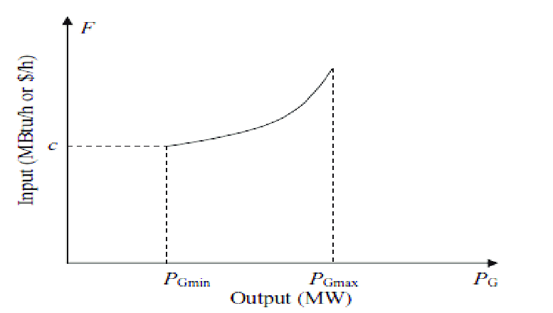
EDPF Cont.….
The idealized curve establishes a relationship between energy input and electrical output is presented in Fig.2[2]
Figure 2. Input-output curve of steam turbine.
Url. https://www.researchgate.net/profile/Wahyuda-Wahyuda/publication/334056151/figure/fig1/AS:832198810796032@1575423066157/The-input-output-characteristics-of-power-plant.png
Where, Y-axis is the Energy input and X-axis is electrical output.

Slide 20
EDPF Cont.….
In terms of heat, the unit is kcal/hr (or) Btu/hr or in terms of the amount of fuel, the unit is tons of fuel/hr, which becomes millions of kCal/hr.
The curve includes:
Minimum and Maximum Operating Points
Factors Influencing Limits:
Steam Cycle, thermal Characteristics of Materials and their operating Temperature.
Higher temperatures generally improve efficiency but also impose material constraints.

Slide 21
EDPF Cont.….
Non-Smooth Curve: In reality, the input-output curve may exhibit irregularities due to various factors such as:
  Mechanical losses
  Variations in fuel quality
  Changes in operating conditions (e.g., pressure, temperature)
The actual performance data can be used to create a more accurate input-output curve, which may involve:
  Collecting empirical data from unit operation
  Applying interpolation techniques to fill gaps in data for smoother transitions between operational points.

Slide 22
EDPF Cont.….
B. Cost curve of Steam turbine
Cost curve is the fuel input per hour is multiplied with the cost of the fuel (expressed in Rs./million kCal)
Steps to Create Cost Curves from Input-Output Curves
i. Identify the Input-Output Relationship:
  Start with the input-output curve, which shows the relationship between the fuel input (in terms of mass or volume) and the steam output (in kCal or another unit).
ii. Determine Fuel Cost:
  Obtain the cost of the fuel, typically expressed in Rs./million kCal.
  Which reflects your fuel cost per unit of energy generated.

Slide 23
EDPF Cont.….
iii. Calculate Fuel Input:
  For each level of steam output, determine the corresponding fuel input required (in hours) from input-output curve.
iv. Calculate Total Fuel Cost:
  Multiply the fuel input (in hours) by the cost of the fuel, which is presented in eqn.4:
eqn.(4)
v. Include Fixed Costs:
  Add any fixed costs associated with steam generation
  (e.g., maintenance, labor, overhead).

Slide 24
EDPF Cont.….
vi. Calculate Total Cost:
  The total cost at each output level can be calculated as:
eqn.(5)
vii. Compute Average and Marginal Costs:
  Average Cost:
  eqn.(6)
  Marginal Cost:
    Determine the change in total cost with a small increase in output. This can often be estimated from the slope of the total cost curve.

Slide 25
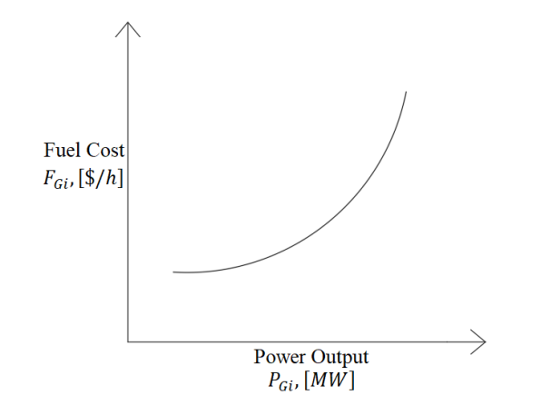
EDPF Cont.….
Plotting the Curves: the x-axis, represent the steam output (in kCal) and the y-axis, represent the cost (in Rs.). Then, the total cost curve: average cost curve, and marginal cost curve is presented in Fig.3
Figure 3. Cost curve.
Url: https://www.researchgate.net/profile/Cenk-Andic/publication/366694235/figure/fig1/AS:11431281110770172@1672740430964/Cost-curve-of-a-power-unit-12-A-power-system-consisting-of-N-generating-units-is-shown.ppm

Slide 26
EDPF Cont.….
C. The Incremental Fuel Cost (IFC)
IFC is the ratio of a small change in fuel input to the corresponding small change in steam output.
eqn.(7)
To begin, identify the input-output curve:
Select Points for Calculation: Choose two points on the input-output curve, denoted as A and B.
Point A corresponds to an initial fuel input and output, whereas point B corresponds to a slightly increased fuel input and the resultant output.
Calculate Changes: Determine the small changes in fuel input and output based on Fig.4.
eqn.(8)

Slide 27
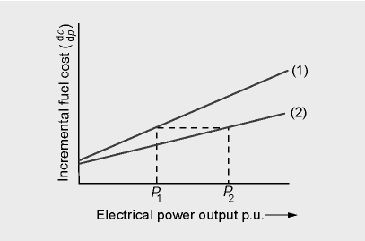
EDPF Cont.….
Figure 4 Incremental Fuel cost curve. url: https://encrypted-tbn0.gstatic.com/images?q=tbn:ANd9GcT6fE3VsLSSw8kSCHkhuc-pABwdlAva0meDuQ&s
Slope of the IFC Curve: A steeper slope indicates a higher incremental cost for producing additional steam, which could suggest diminishing returns.
Use in Decision-Making: The IFC curve can be used for operational decisions,
such as determining optimal production levels and evaluating the cost-effectiveness.

Slide 28
EDPF Cont.….
Substitute the changes into the IFC formula
eqn.(9)
This gives you the incremental fuel cost for that specific range of output
Repeat for Multiple Points:
To create the IFC curve, repeat the calculation for multiple pairs of points along the input-output curve.
Which provides a series of IFC values corresponding to different output levels.

Slide 29
EDPF Cont.….
In general, the fuel cost, Fi for a plant is approximated as a quadratic function of the generated output P_{Gi} as given by:
eqn.(10)
The incremental fuel cost is given by
eqn.(11)
The incremental fuel cost is a measure of how costly it will be to produce an increment of power.
The incremental production cost, is made up of incremental fuel cost plus the incremental cost of labor, water, maintenance etc.

Slide 30
EDPF Cont.….
The IFC of a single generator , eqn.(11) can be further extended to N generator considering the generation limits and other constraints.
The units normally operate between P_{Gmin}, the minimum loading limit and P_{Gmax}, which is the maximum output limit.
Each generating unit is assigned as a function, C(PGi), characterizing its generating cost in $/h in terms of the power produced in MW, PGi, during one hr.
This function is obtained by multiplying the heat rate curve, expressing the fuel consumed to produce 1MW during 1hr, by the cost of the fuel consumed during that hour.

Slide 31
EDPF Cont.….
Considering N generating units, the total production cost is :
eqn.(12)
where P_{Gi} is unit generation level,
The generation units are required to supply total load, P_{D} as given by:
eqn.(13)
Thus, the objective is to supply the demand while minimizing the total generations cost and maximum reliability.

Slide 32
5. Solving ED problems using unconstrained minimization
This is a minimization problem with a single equality constraint.
Assume for unconstrained minimization, a necessary condition for a minimum is the gradient of the function must be zero,
The gradient generalizes, the first derivative for multi-variable problems as presented in eqn.(14)[3].
eqn.(14)

Slide 33
Solving ED problems Cont.…
When the minimization is constrained with an equality constraint, we can solve the problem using the method called Lagrange Multipliers
Key idea is to represent a constrained minimization problem as an unconstrained problem.
This is generalized as minimizing f(x) subject to the function g(x) as given ;
eqn.(15)
Using Lagrange : eqn.(16)
Then, the following conditions should met to minimize :
eqn.(17)

Slide 34
Solving ED problems Cont.…
Accordingly, If the system total demand is P_{D total} and all generating units contribute to supply this demand, total production or generation must be;
eqn.(18)
The ED problem consists of minimizing the total cost with respect to the unit generation output subject to the above power balance, and to the generating unit operational limits
eqn.(19)
Using the method of Lagrange multipliers, neglecting losses and generating limits for simplicity, we have: eqn.(20)
where F(P_{G}) is objective function for minimization and G(P) is equality constraint.
Therefore, eqn.(21)

Slide 35
Solving ED problems Cont.…
Which gives:
eqn.(22)
eqn.(23)
It states that at the optimum all the power plant/units operate in the same incremental cost ,which is equal to the Lagrange multiplier λ.
In addition to the load should be taken up always at the lowest incremental cost
In addition, it must be ensured that the generations so determined are with in their limits.
Thus, if the generation limits are considered, the Lagrange function becomes;
eqn.(24)

Slide 36
Solving ED problems Cont.…
where new multipliers, are incorporated, corresponding to the minimum and maximum power outputs of each generating unit.
The optimal conditions is:
eqn.(25)
The marginal cost will be operated at equal incremental cost if the generation is within the limits.
Otherwise, the generation has to be kept constant at the capacity limit for that unit and eliminated from further optimum calculations.

Slide 37
Solving ED problems Cont.…
Example 1:Assume two generators are interconnected into a grid is required supply a maximum demand of 800 MW. Determine the ED of the generators neglecting transmission losses using Lagrange multiplier based on their input cost function as given below.
Solution:
Step 1: Derivate the cost of each power plant to its generation using Lagrange equation as given by :

Slide 38
Solving ED problems Cont.…
Then, the equality constraint is:
The three equations (Linear equations ) can be rewritten as:
In matrix form:
Solution

Slide 39
Solving ED problems Cont.…
Check : IFC₁=IFC₂
Determine the cost of each generation

Slide 40
Solving ED problems Cont.…
From the solution, both generators have the same marginal (or incremental) cost, and this common marginal cost is equal to λ.
Intuition behind solution:
  If marginal costs of generators were different, then by decreasing production at higher marginal cost generator, and increasing production at lower marginal cost generator we could lower overall costs.
  Generalizes to any number of generators.
If demand changes, then change in total costs can be estimated from λ.

Slide 41
6. Lambda-Iteration ED Solution
  The lambda iteration algorithm is a technique for solving nonlinear programming issues like ED by repeatedly updating a set of numbers called multipliers, or lambdas[4]. Basic steps are:
  Formulate the Objective function. Minimize the total generation cost while meeting the total demand and adhering to generator limits. It’s the quadratic cost function of each generator
  Calculate the total cost function, summation of all generator cost function
  Set power balance equation
  Set the Initial Guess for Lambda: Start with an initial guess for the incremental cost (lambda, λ), which is the derivative of the total cost function with respect to power
  Calculate the generation Levels for each generator, set its output based on the current value of lambda.

Slide 42
Lambda-Iteration Cont.….
  Check Power Balance: Calculate the total generation
  Update Lambda as If P_{total}<P_{D} increase lambda. And If P_{total}>P_{D}, decrease lambda that adjusts the generation outputs in the next iteration.
  Repeat Until Convergence: Continue iterating until P_{total} is within an acceptable tolerance of demand.
  Incorporate Losses (if needed)

Slide 43
Lambda-Iteration Cont.….
Example: Perform the best ELD for the three generators using the lambda iteration method. The three generators having their cost function ,and generation limits s as given below are expected to feed the demand of 1000 MW.
Cost function
Generation limits

Slide 44
Lambda-Iteration Cont.….
Solution
Start initial guess,
Determine the generation contribution for each using ICF as:
Calculate the total generation is:
Update lambda, since, the total power generation is <the demand
After few iteration,
P​=1004.17, while P1=450, P2=316.67 and P3= 237.5 MW for lambda=20.5

Slide 45
Summary
The goal of economic dispatch is to meet demand while minimizing costs by maximizing the output of producing units
The lambda iteration technique skillfully manages generator limitations such as minimum and maximum outputs by iteratively adjusting the generation levels based on the cost until the optimal dispatch is reached.
It is crucial to remember that economic dispatch functions on the presumption that every unit has already agreed to run
Transmission limitations are frequently overlooked in favor of focusing just on generation costs in the fundamental formulation of economic dispatch.
To guarantee dependability and prevent overloading transmission lines, it is imperative to take these restrictions into account in real-world situations.

Slide 46
References
[1]. A., Azrina; K.,Tatjana and D.,Nedis. ‘’Auxiliary Power Systems of Advanced Thermal Power Plants’’. Springer Nature. pp. 117–125, 2020. https://www.researchgate.net/publication/334447068.
[2]. K., EL-Naggar; R., AlRashidi and K. Al-Othman. ‘’Estimating the input–output parameters of thermal power plants using PSO’’. ELSEVIER: Energy Conversion and Management. V.50(7), 2009, pp.1767-1772. https://doi.org/10.1016/j.enconman.2009.03.019.
[3]. M., Steven; K., Edwin and R., James. ‘’First-Order Conditions for Set-Constrained Optimization’’ MDPI: Mathematics 2023, pp.1-14. https://doi.org/10.3390/math11204274
[4]. M., Azis; Mutmainnah; Lutfi and etl. ‘’Optimizing Economic Dispatch through Web-based Applications using Lambda Iteration Algorithm for Efficient Power System Operation. Indonesian Journal of Electrical and Electronics Engineering (INAJEEE). V.6(1).pp.1-8, 2023.

Slide 47
Thank you !

