Slide 1
Power Systems Operation and Control
Lecture 5
Optimal power flow analysis (OPFA)
Lecturer: Teshome Goa (Assist. Prof.)
Lecture learning outcomes:
At the end of this lecture, you will be able to:
Understand the notion of optimal power flow and learn the key steps for solving it.
Develop the mathematical formulation of Optimal power flow (OPF)
Identify the OPF solution techniques and compare it with ELD &UC
Knows the application of OPF

Slide 2
Content
Introduction
Similarities and Differences Between OPF, ELD and UC
Objectives of OPF
Mathematical Formulation OPF
OPF Solution Techniques
Application of OPF
Summary
References

Slide 3
1. Introduction
Optimal Power Flow (OPF) is a mathematical optimization technique for power systems that determines the most efficient and cost-effective functioning of electrical power networks.
It involves determining the best settings for numerous control variables (such as generating outputs, voltage levels, line loading and transformer taps) while meeting operational restrictions.
The following are OPF's main objectives:
Minimizing Generation Costs: Lowering the total cost of producing electricity by maximizing power plants' production in accordance with their cost functions.

Slide 4
Introduction Cont.…
Ensuring Power Balance: Preserving the balance between the production and consumption of power, taking system losses into consideration.
Operational Constraint Satisfaction: Respecting technical and physical restrictions, such as transmission line capacities, voltage levels, and generator output limits.
An objective function that reflects costs and a number of restrictions that represent the operational reality of the power system are commonly used in mathematical formulations of the OPF problem.
Resource Allocation: Optimal Dispatch, by optimizing the dispatch of generators, OPF ensures that available resources are used efficiently, balancing supply and demand effectively.

Slide 5
Introduction Cont.…
Grid Reliability: System Stability, OPF contributes to maintaining system stability and reliability by ensuring that generation meets demand while respecting operational limits.
Flexibility With the increasing integration of renewable energy sources (like wind and solar), OPF helps in managing their variability and ensuring that the grid remains balanced.
Reduced Emissions: By optimizing generation from cleaner sources and minimizing reliance on fossil fuels, OPF can contribute to lower greenhouse gas emissions and a more sustainable energy mix.
OPF assists utilities in fulfilling standards and regulations pertaining to efficiency, dependability, and emissions.

Slide 6
Introduction Cont.…
OPF is essential to improving operational efficiency and enabling cutting-edge features like demand response and real-time monitoring as power systems transition to smart grids.
OPF can assist utilities in making well-informed decisions regarding the development of infrastructure by aiding in the long-term planning of investments in generation and transmission.
OPF facilitates operational decisions in real-time, enabling system operators to react promptly to shifts in generation or demand.
Cost of energy Price Signals: OPF can help stabilize energy prices by streamlining transmission and generation, giving customers better price signals, and promoting efficient

Slide 7
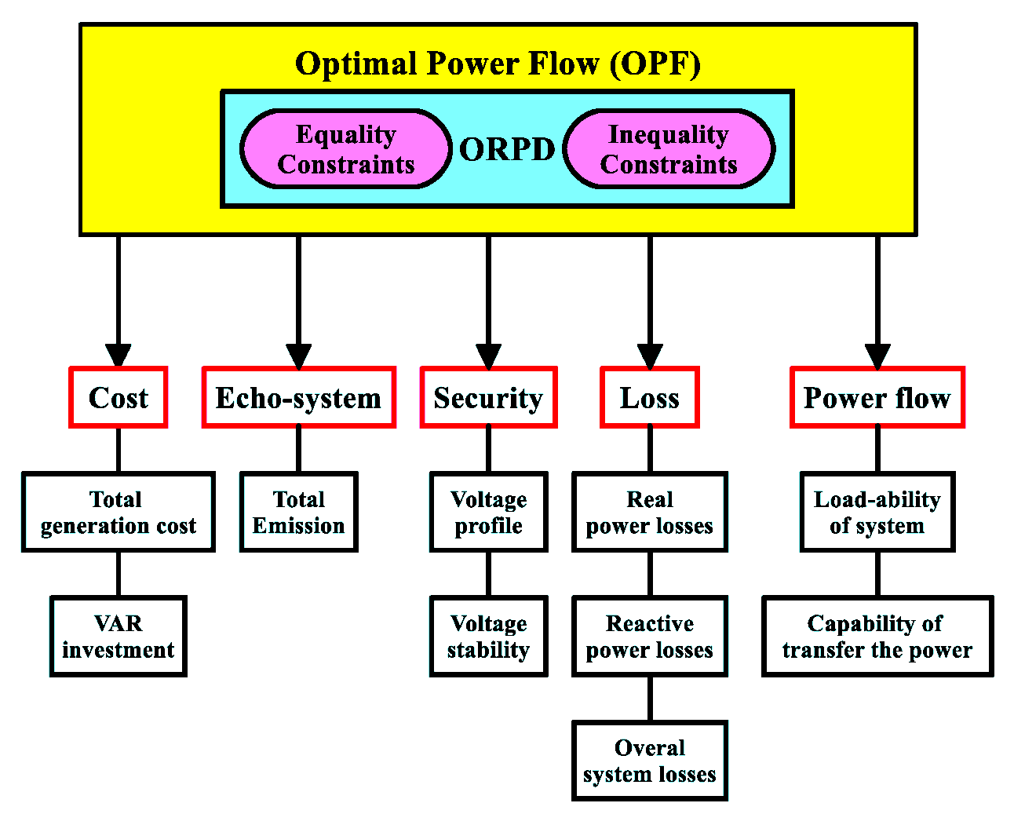
Introduction Cont.…
Generally, OPF needs to understand the overall power system reliability and it comprises many parameters as presented in Fig.1[1].
Figure 1: OPF components.
Url: https://pub.mdpi-res.com/processes/processes-09-01319/article_deploy/html/images/processes-09-01319-g003.png?1627628286

Slide 8
2. Similarities and Differences Between OPF, ELD and UC
a. Similarities:
Objective: All aim to optimize the operation of power systems to ensure efficiency, reliability, and cost-effectiveness.
Integration: They often work together in the overall power system management process. For instance, UC decisions impact ELD, and ELD can be integrated into OPF
Solutions. Uses the mathematical models, all three techniques use mathematical formulations and optimization techniques to achieve their objectives.

Slide 9
Similarities and Differences Cont.…
Table 1: The difference between OPF, ELD and UC
Features | Optimal Power Flow (OPF) | Economic Load Dispatch (ELD) | Unit Commitment (UC)
Definition | Determines the optimal generation levels and voltage settings while satisfying system constraints. | Determines the optimal output of generation units to meet demand at minimum cost over a given time period. | Schedules which generators should be online or offline to meet demand over a specified time frame.
Time | Typically focuses on real-time or near-real-time operation. | Generally concerns short-term dispatch (e.g., hourly). | Deals with longer time frames (e.g., day-ahead scheduling).
Constraints | Considers voltage levels, power flows, generator limits, and security constraints. | Primarily focuses on generation costs and demand satisfaction. | Considers startup and shutdown costs, ramp rates, and generator availability.

Slide 10
3. Objectives of OPF
Minimizing Cost: The primary goal is to reduce the total generation cost by optimizing the dispatch of generators.
Minimizing Emissions: OPF can help to minimize environmental impacts by reducing emissions from fossil fuel-based generation, promoting cleaner energy sources.
Minimizing Losses: It aims to reduce electrical losses in transmission and distribution systems, enhancing overall system efficiency.
Maintaining Voltage Levels: Ensuring voltage levels remain within operational limits is critical for system stability and reliability.
Enhancing Security: OPF seeks to enhance the security of the power system by ensuring that operational constraints are met, thus preventing potential outages.

Slide 11
Objective Cont.…
Reliability and Security System Stability: Ensure that the power system operates securely without experiencing outages or instabilities, maintaining a balance between generation and demand.
Constraint Satisfaction: Meet all operational constraints, such as generation limits, transmission capacities, and reserve requirements, to enhance overall system reliability.
Harmonic Mitigation: Reduce voltage and current harmonics in the system, which can adversely affect equipment performance and lifespan.
Frequency Stability: Maintain frequency within acceptable limits to ensure the proper functioning of electrical devices and overall system integrity.

Slide 12
4. Mathematical Formulation OPF
The mathematical formulation of Optimal Power Flow (OPF) involves a set of objective functions and constraints that define the optimization problem as given by[2];
Objective Function:
The objective of OPF is usually to minimize the total generation cost, which can be expressed as:
eqn.(1)
Where, 𝐶_{i} (𝑃_{i}) is the cost function of generator i, which is a quadratic function, P_{(i​)} is the power output of generator i and N is the total number of generators.
The costs typically minimized include:
Generation Costs: The cost of electricity produced by power plants, which can be represented as a function of generation levels (usually quadratic functions).

Slide 13
Mathematical Formulation Cont.…
Fuel Costs: Expenses related to the fuel consumed by generators, often varying based on fuel type and market prices.
Operational Costs: Costs associated with operating and maintaining power plants, including labor, maintenance, and overhead.
Transmission Losses: The energy lost as electricity travels through transmission lines, which can be a function of current flow and line resistance.
Emissions Costs: If applicable, costs associated with carbon emissions or other environmental impacts, often included in the form of penalties for higher emissions.
Load shedding Costs: Costs incurred when the demand exceeds supply and load must be curtailed.
Market Prices: Costs related to purchasing power from the market

Slide 14
Mathematical Formulation Cont.…
Constraint: a. Power Balance constraints:
Based on energy conservation, the total real power generated must meet the total demand and loss as given as; eqn.(2)
The power transmission line losses can be modeled using a loss formula, represented as:
eqn.(3)
Where, L_{ij} is the transmission line loss coefficients between tow generators, generator i and j.
Lij refers to the measure of energy loss in transmission lines due the line parameters.
Reactive Power Balance: Similar to active power, but focuses on reactive power generation and consumption

Slide 15
Mathematical Formulation Cont.…
The line loss is approximated as:
eqn.(4)
Where, k_{i} is the loss coefficient of generation i and given as;
eqn.(5)
b. The generation Limit Constraints: OPF should consider the generation limit constraints as given by;
eqn.(6)

Slide 16
Mathematical Formulation Cont.…
Voltage Constraints:
eqn.(7)
Where, j​ is the voltage at bus 𝑗.
Power Flow constraints :
Thermal Limits: Power flow on each transmission line must not exceed its thermal rating.
Voltage Stability Limits: Ensures that the system remains stable under different load conditions.
eqn.(8)

Slide 17
Mathematical Formulation Cont.…
Transmission Limits: For each line, line(i,j):
eqn.(9)
Angle Limits: In some formulations, the angle difference between buses may also be constrained:
eqn.(10)
These equations and limits ensure that the power system operates reliably while minimizing costs, adhering to physical and operational constraints.

Slide 18
Mathematical Formulation Cont.…
Ramp Rate Constraints: Limits on how quickly a generator can increase or decrease its output.
Reserve Requirements: Ensures that there is sufficient generation capacity available to meet unexpected increases in demand or generation outages.
Network Constraints: Ensures that the topology of the power system (e.g., open/closed switches) is respected.
Security Constraints: Includes considerations for contingencies, ensuring the system can withstand sing-le or multiple outages.

Slide 19
5. OPF Solution Techniques
Optimal Power Flow (OPF) models can be categorized based on various criteria, such as the objective function, the types of constraints, and the formulation techniques[3]. Here are the main types:
Deterministic OPF: Focuses on minimizing costs under certain deterministic conditions, assuming fixed demand and generation characteristics.
Stochastic OPF: Incorporates uncertainties in load, generation (especially from renewable sources), and market prices by using probabilistic methods to optimize the expected cost.
3. Robust OPF: Addresses uncertainties by optimizing the worst-case scenario, ensuring the solution is feasible under a variety of potential operating conditions.

Slide 20
OPF Solution Techniques Cont.…
Multi-objective OPF: Simultaneously optimizes multiple objectives, such as minimizing generation costs while maximizing reliability and minimizing emissions.
Dynamic OPF: Considers the time-varying nature of loads and generation, optimizing power flow over time intervals rather than at a single snapshot.
AC OPF: Uses alternating current (AC) power flow equations, capturing the nonlinear characteristics of the power system, including voltage drops and phase angles.
DC OPF: Simplifies the problem using direct current (DC) power flow equations, which assume lossless lines and ignore reactive power. It is easier to solve but less accurate for real-world applications.

Slide 21
OPF Solution Techniques Cont.…
Network-constrained OPF: Specifically considers transmission network constraints, ensuring that power flows do not exceed line limits while optimizing generation.
Security-constrained OPF (SCOPF): Adds security constraints to the OPF model to ensure that the system can withstand disturbances (e.g., generator outages) while still optimizing costs.
Integrated OPF: Combines generation and transmission optimization, taking into account both the generation costs and the cost of expanding or operating the transmission network.
Each OPF model serves different needs and conditions in power system operations, enabling operators to find the most efficient and reliable solutions under various scenarios.

Slide 22
OPF Solution Techniques Cont.…
AC OPF : AC Optimal Power Flow (AC OPF) solutions involve optimizing the power flow in an electrical grid while considering both real and reactive power, along with voltage magnitudes and angles.
Overview of AC OPF Objective[4]:
Minimize the total generation cost while satisfying power flow equations, generation limits, and system constraints.
Key Components are:
The real power (P), which is actual power consumed by loads and reactive power (Q), it’s the power that helps to maintain voltage levels.
Voltage Magnitudes (V): Voltage at each bus.
Phase Angles (𝜃): Angle difference between voltages at different buses.

Slide 23
OPF Solution Techniques Cont.…
The best way of doing AC power flow is using NR power flow solution
N-R iterative method approximate set of non-linear eqns. to set of linear eqns. using Taylor’s expansion as given by, Let’s consider two functions:
eqn.(11)
Where, K1 and K2 are constants
Assume that x₁₍₀₎ and x₂₍₀₎ are estimate solution and let’s designate Δx1 (0) & Δx2 (0) to correct the solution. Then, eqn.(11) can rewritten as:
eqn.(12)

Slide 24
OPF Solution Techniques Cont.…
The Δx₁₍₀₎ & Δx₂₍₀₎ by expanding eqn.(12). in Taylor’s series gives:
eqn.(13)
Then, its partial derivatives for first order only taken and rewritten as;
eqn.(14)

Slide 25
OPF Solution Techniques Cont.…
Equation 14 can be rewritten as:
eqn.(15)
Where, J⁽⁰⁾ is called Jacobean of initial estimate and by finding it we can determine Δx₁₍₀₎ & Δx_{2(0).} By correcting the initial estimate we have;
eqn.(16)
Then, repeat the process until the correction is small
To use the above discussion for power flow problem, choose polar coordinate as designated as:
eqn.(17)

Slide 26
OPF Solution Techniques Cont.…
From this;
eqn.(18)
J^{(i)} consists of the partial derivatives of P & Q with respect to each variables(voltage and its angle )
For 3 bus system if bus 1 is swing, matrix eqns. for each iteration is
eqn.(19)
J1
J2
J3
J4

Slide 27
OPF Solution Techniques Cont.…
Δδ_{k} and Δ|V_{k}| found from the eqn.(19) is added in pervious value to calculate new value of P & Q, and process is repeated until desired precision index achieved.
To achieve quick convergence, N-R is sensitive for initial
Estimate. as initial estimate, the nominal voltages values can be used.
For PV bus J with respect to constant V will be omitted & row Q also, and calculated after convergence.
The 4 steps applied for N-R power flow problem are as follow
1.
eqn.(20)

Slide 28
OPF Solution Techniques Cont.…
Where; eqn.(21)
2. calculate Jacobean matrix
3. solve the following equation to find Δδ(i) and ΔV(i)
eqn.(22)
4.Compute
eqn.(23)
5. Finally find real and reactive power at slack bus

Slide 29
OPF Solution Techniques Cont.…
Finally, the mathematical formulation of AC OPF is given by:
Objective function: Cost minimization
Power Flow Equations (AC): as presented in previous slides should meet.
Constraints(AC):
Power balance
Generation limits
Voltage limits

Slide 30
OPF Solution Techniques Cont.…
Example: For simple 3-Bus System given below perform the OPF, based on the following data.
Generators cost function:
System Description:
Bus 1: is a Generator bus having: P 1​ = 200 MW, 0<=Q1​ <= 50 MVAR
Bus 2:Load bus: P2 = 85 MW, Q 2​ = 25MVAR
Bus 3: Load bus: P 3​ = 60 MW, Q 3​ = 15 MVAR
Solution: The objective is minimizing the generation cost while satisfying power flow and voltage constraints as

Slide 31
OPF Solution Techniques Cont.…
Step 1: Formulation of objective function as:
Set up Power balance and voltage constraints' as:
If the transmission line reactance of 0.1 P.u is considered
Power Flow Equations: Use the AC power flow equations to relate the bus voltages and angles
Solve the problem using optimization software like PSAT or others. The results using PSAT simulation software based on Fig.2 is presented in Table 1.

Slide 32
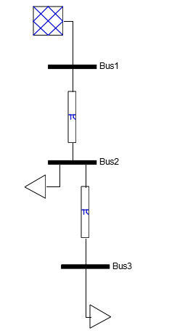
OPF Solution Techniques Cont.…
The single line diagram using PSAT software for three buses, generator at bus 1, loads at bus 2 and 3 is presented in Fig.2
Figure 2: single Line diagram three bus systems

Slide 33
OPF Solution Techniques Cont.…
Table 1: The power flow Results based on NR solution using PSAT software
POWER FLOW RESULTS
Bus | V [p.u.] | phase [rad] | P gen [p.u.] | Q gen [p.u.] | P load [p.u.] | Q load [p.u.]
Bus1 | 1 | 0 | 1.45 | 0.704913 | 0 | 0
Bus2 | 0.94075 | -0.15475 | -7.8E-12 | 4.32E-12 | 0.85 | 0.25
Bus3 | 0.922233 | -0.22396 | 9.65E-12 | 3.37E-12 | 0.6 | 0.15
LINE FLOWS
From Bus | To Bus | Line | P Flow | Q Flow | P Loss | Q Loss
 |  |  | [p.u.] | [p.u.] | [p.u.] | [p.u.]
Bus1 | Bus2 | 1 | 1.45 | 0.704913 | -2.2E-16 | 0.25994
Bus2 | Bus3 | 2 | 0.6 | 0.194973 | 1.11E-16 | 0.044973

Slide 34
6. Application of OPF
Optimal Power Flow (OPF) has various key advantages in the energy sector, including increasing the efficiency and reliability of power networks as given by:
Generation Scheduling: assists in determining the ideal generation levels for power plants to meet demand while reducing costs and conforming to operational constraints.
Economic dispatch: It optimally shares demands among several units, ensuring that electricity is produced at the lowest possible cost while taking into account fuel prices and operational constraints.
Transmission Network Optimization: OPF is used to improve the flow of electricity across transmission lines, decreasing congestion and assuring reliable power delivery across the grid.
Renewable Energy Integration: supports the inclusion of renewable energy sources, helping to manage unpredictability and maximize their use in conjunction with conventional

Slide 35
Summary
In this lecture, the optimal power flow solution importance in economic operation of power system is discussed.
Thus, optimal power flow important for the generation cost minimization, power system reliability and stability.
OPF is broader than ELD and UC operation of power network, which comprises so many constraints like transmission line thermal limit, bus voltage and its angle limit, generation limits and hence the integration of RE in the network reliability.
In addition, the solution techniques for optimal power flow like Deterministic, Stochastic and Robust OPF methods are also discussed
Finally, the OPF analysis not only gives significant insights into operational efficiency, but also serves as a critical instrument for strategic planning and decision-making in the power sectors

Slide 36
References
[1]. N., Ehsan Naderi; N., Hossein Narimani; P., Mahdi and etl. ‘’’State-of-the-Art of Optimal Active and Reactive Power Flow: A Comprehensive Review from Various Stand points’’.MDPI:Processes 2021. V. 9(8), 1319. https://doi.org/10.3390/pr9081319
[2].K., Aurangzeb; S., Shafiq ; M., Alhussein and etl. ‘’ An effective solution to the optimal power flow problem using meta-heuristic algorithms. Front. Energy Res. 11:1170570. pp: 1-17.https://doi:10.3389/fenrg.2023.1170570.
[3]. A., Ali; A., Hassan; M., Keerio and et al. ‘’A novel solution to optimal power flow problems using composite differential evolution integrating effective constrained handling techniques’’. Sci Rep 14, 6187 (2024). https://doi.org/10.1038/s41598-024-56590-5.
[4]. D.,Azad; A., Dimitra and A.,Eduardo. ‘’Initial estimate of AC optimal power flow with graph neural networks’’. Elsevier: Electric Power Systems Research. V.234(2024). https://doi.org/10.1016/j.epsr.2024.110782

Slide 37
Thank you !

