Slide 1
Power Systems Operation and Control
Lecture 8
Power System Control
Lecturer: Teshome Goa (Assist. Prof.)
Lecture learning outcomes:
At the end of this lecture, you will be able to:
Understand the importance power system control
Knows the objective of power system control
Differentiate the level of power system controls
Identify the power system control technologies and challenges in control

Slide 2
Content
Introduction
Importance of Power System Control
Objectives of Power System Control
Levels of Control in Power Systems
Control Strategies in Power Systems
Power System Control Technologies
Challenges in Power Control
Future Trends in Power System Control
Summary
References

Slide 3
1. Introduction
Power system control is a critical aspect of electrical engineering that ensures the reliable and efficient of power systems.
As the global economic growth is highly relay on energy, understanding the fundamentals of power system control becomes increasingly important for reliable and effective energy supply.
Power system control needs the knowledge of understanding power system components: generation, transmission, distribution, and load that plays important roles while delivering power to the load.
The primary objectives of power system control include[1]:
Ensuring the system remains stable under normal and abnormal conditions.

Slide 4
Introduction Cont.…
Maintaining the balance between generation and load to keep system frequency within acceptable limits
Regulating voltage levels to ensure quality and reliability of electricity supply.
Automatic Generation Control (AGC): Balances generation with load demand automatically.
Voltage Regulation, utilizing the devices like transformers and capacitors to maintain voltage levels.
Load Frequency Control (LFC),adjusts power output to keep frequency stable.

Slide 5
2. Importance of Power System Control
Effective control mechanisms prevent blackouts and ensure that electricity supply is consistent and reliable[2].
Optimizing generation and minimizing losses in transmission and distribution enhance overall system efficiency, reducing operational costs.
With the increasing penetration of renewable sources like solar and wind, control systems are essential for managing their variability and ensuring stability.
Control strategies help in minimizing the cost of electricity generation while meeting demand, which is crucial for economic sustainability.
Efficient power system control contributes to reducing emissions by optimizing the use of cleaner energy sources.

Slide 6
Importance Cont.…
Power system control is crucial for several reasons, contributing to the overall reliability, efficiency, and sustainability of electrical systems. Here are some key aspects highlighting its importance:
Control system helps to maintain balance between supply and demand, reducing the risk of system failures and blackouts that guarantees the system reliability
Ensure that the system can recover from disturbances like sudden load changes or faults without significant degradation in performance, which maintains dynamic stability[3].

Slide 7
Importance Cont.…
Important for better integration of RE while handling Variability: As renewable energy sources like wind and solar are intermittent, control systems manage their integration into the grid, ensuring stability despite fluctuations.
Enhanced control technologies facilitate the development of smart grids[4], which can dynamically adjust to changes in energy production and consumption.
Optimizing generation dispatch and reducing operational costs lead to lower electricity prices for consumers.
Effective control strategies enhance competition in electricity markets.

Slide 8
Importance Cont.…
By optimizing the mix of energy sources, control systems can minimize the reliance on fossil fuels, thereby reducing greenhouse gas emissions.
Promoting the use of cleaner energy sources aligns with global sustainability goals.
Control systems provide real-time data on system performance, enabling proactive management and decision-making.
Advanced control mechanisms can detect faults quickly and initiate corrective actions to prevent damage and restore normal operation.

Slide 9
3. Objectives of Power System Control
Power system control is essential for the efficient and reliable operation of electrical networks. Its main objective are[5]:
a. Maintain Stability:
Dynamic Stability: Maintain the system’s ability to return to a steady state after disturbances, ensuring resilience against sudden changes or faults.
Transient Stability: Manage the system’s response to short-term disturbances, like faults or sudden load changes, to prevent widespread outages.

Slide 10
Objectives Cont.…
b. Frequency Control(FC):
To balance generation and load, ensure that power generation matches demands in real-time to maintain system frequency within acceptable limits.
Automatic Generation Control (AGC), implement automatic adjustments to generation resources to keep frequency stable.
c. Voltage Regulation:
Maintain Voltage Levels, provides that voltage remains within specified limits throughout the network to support the safe operation of electrical devices.
Reactive power management, control the reactive power flow to stabilize voltage levels, particularly in areas with high demand or variable renewable energy generation.

Slide 11
Objectives Cont.…
d. Economic Operation:
Minimize Operational Costs: Optimize the dispatch of generation resources to minimize fuel costs while meeting demand efficiently.
Market Efficiency: Support fair competition in electricity markets by enabling efficient price signals and reducing congestion.
e. Load Management:
Demand Response: Implement strategies to adjust consumer demand based on real-time conditions, helping to balance supply and demand.
Load Forecasting: Use predictive analytics to anticipate changes in load, allowing for proactive adjustments in generation.

Slide 12
Objectives Cont.…
f. Promote system Integration:
Control the unpredictability and variability of renewable energy sources to make sure they can be used efficiently without jeopardizing the stability of the system.
Make it possible for decentralized energy sources like wind and solar to be continuously integrated.
g. System Monitoring and Control:
Keep an eye on system metrics at all times to evaluate performance and make wise choices.
h. Environmental Compliance:
Optimize generation techniques to reduce environmental effect and adhere to sustainability and emissions laws.
Promote procedures that cut waste and improve system efficiency overall.

Slide 13
4. Levels of Control in Power Systems
The levels can be categorized into: strategic control, primary control, secondary control, and tertiary control, respectively.
Strategic Control:
This level comprises long-term planning and operational strategies for the entire system.
Involves decisions regarding generation expansion, resource allocation, and energy trading in electricity markets.
Includes load forecasting, generation capacity planning, and integration of renewable resources.
Manages bidding and economic dispatch in competitive electricity markets.
Main tools needed are: Energy management systems (EMS), market
management systems, and supervisory control and data acquisition (SCADA) systems.

Slide 14
Levels of Control Cont.…
b. Primary Control:
provides immediate response to changes in system conditions, primarily focusing on maintaining stability through:
Automatic Generation Control (AGC): Balances generation to match load in real-time, maintaining frequency within predefined limits.
Frequency Control: Reacts to short-term deviations in system frequency by adjusting generation output automatically.
Voltage Control: Adjusts reactive power output to stabilize voltage levels across the grid.
Primary control devices, such as governors and Automatic Voltage Regulators (AVRs)

Slide 15
Levels of Control Cont.…
c. Secondary Control:
provides a longer-term correction to restore system frequency and voltage to their desired set-points after disturbances through :
Load Frequency Control (LFC): Adjusts the output of generation units to correct any frequency imbalances over a longer time-frame.
Voltage Regulation: Fine-tunes voltage levels after initial adjustments by primary control.
Coordinated Control: Works across multiple units and regions to ensure system-wide stability and efficiency.
Secondary control systems, such as centralized control centers that monitor and manage generation and grid conditions.

Slide 16
Levels of Control Cont.…
d. Tertiary Control :
Represents the highest level of control in power systems, focusing on broader operational management and coordination of resources across the grid.
This level is essential for ensuring system stability and efficiency, especially in complex environments with diverse generation sources and loads.
operates above primary and secondary control levels, dealing with longer-term operational decisions and resource management.
Manages and optimizes the dispatch of generation resources over a more extended timeframe, typically ranging from hours to days, ED, UC , OPF control

Slide 17
5. Control Strategies in Power Systems
Power systems can be managed using various control strategies that reflect different organizational structures and operational philosophies[6]. The three common strategies are:
1. Centralized Control:
Under this approach, the entire power system is monitored and controlled by a single central controller.
Centralized Making of Decisions takes place: To decide on generation, load balancing, and system stability, the central controller analyzes data from multiple grid components.
It guarantees that every part of the system is operating in harmony, maximizing resource allocation and disruption response.
Offers a thorough summary of system performance, facilitating well-informed choices.
Compared to localized systems, efficient resource management can better optimize generation and distribution.

Slide 18
Control Strategies Cont.…
Its drawbacks is single Point of Failure, the system as a whole may be affected if the central controller malfunctions.
Problems with scalability, may find it difficult to adjust to networks that are huge or changing quickly.
2. Distributed Control:
This method makes use of several local controllers that can speak with one another but function independently.
Localized Management: Using local data to inform decisions, each controller is in charge of a particular region or part of the power system.
Without waiting for orders from a central authority, local controllers are able to manage their resources and react to local situations.

Slide 19
Control Strategies Cont.…
Robustness: The ability of other controllers to function in the event of a failure increases system resilience.
Easier to grow since additional parts can be added without requiring significant system redesigns.
Its disadvantage is the possibility of coordination problems: If independent operation is not well controlled, it could result in inefficiencies or disputes.
Restricted Global Optimization is another drawbacks: Local choices might not always be in line with the objectives of the system as a whole.
3. Decentralized Control:
By utilizing the advantages of both distributed and centralized control, this approach blends aspects of both approaches.
Hierarchical Management is possible: For major decisions, a central authority coordinates with local controllers, who function independently.

Slide 20
Control Strategies Cont.…
More flexible, because the central controller maintains the stability and effectiveness of the entire system, local units are able to react swiftly to changes.
Balance of Control: Provides the coordinated supervision of centralized control with the resilience of distributed systems.
Improved Responsiveness: While centralized monitoring preserves strategic alignment, local controllers are able to respond quickly to local conditions.
Complex Implementation is the limitation: To work well, complex coordination and communication systems are needed.
Possibility of conflicting goals another problem: Careful management is required to match local initiatives with more general system objectives.

Slide 21
6. Power System Control Technologies
Many technologies have greatly improved the control and operation of power systems.
The following are some of the major technologies that are essential to power system control:
SCADA, or supervisory control and data acquisition: Offers real-time power system operation monitoring and control.
It gathers information from distant sensors and grid devices.
enables operators to make well-informed decisions by visualizing system performance.
Enhances response times during disruptions by enabling remote equipment control.
The simplified SCADA control of power system is presented in Fig.1

Slide 22
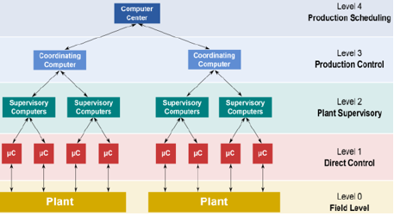
Power System Control Cont.….
Figure 1. Typical SCADA control of Power plants.
Url:https://www.ijraset.com/images/text_version_uploads/imag%201_31113.png

Slide 23
Power System Control Cont.….
Energy Management Systems (EMS):
An energy management system (EMS) is a set of tools combining software and hardware that optimally distributes energy flows between connected distributed energy as presented in Fig.2.
Supports the planning and operation of power systems by optimizing resource allocation.
Assimilates the data from SCADA and other sources for analysis and decision-making.
Performs tasks such as economic load dispatch, unit commitment, OPF and load forecasting.
Improves operational efficiency and reliability by providing tools for real-time decision support

Slide 24
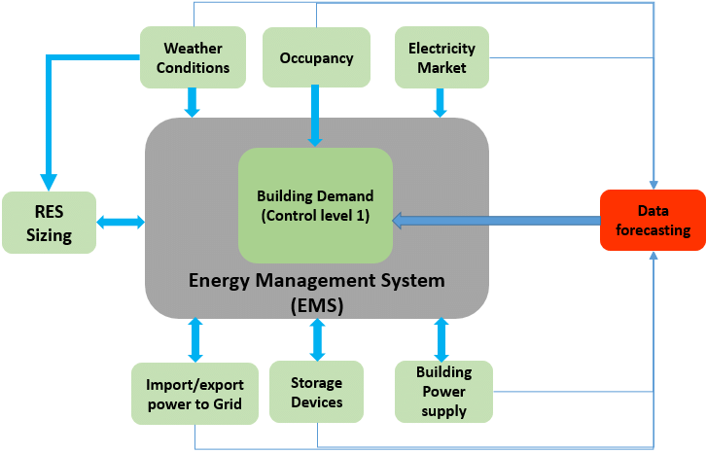
Power System Control Cont.….
Figure 2. Energy Management system for different operational aspects.
Url: https://www.researchgate.net/publication/334494731/figure/fig1/AS:781359622660096@1563302059102/Energy-management-system.ppm

Slide 25
Power System Control Cont.….
3. Advanced Metering Infrastructure (AMI): AMI is an integrated, fixed-network system that enables two-way communication between utilities and customers, which is presented in Fig.3.
Enables two-way communication between utilities and consumers.
Provides real-time data on energy consumption and system performance.
Supports demand response programs by allowing utilities to incentivize energy savings during peak times.
Enhances billing accuracy and customer engagement through detailed consumption data.

Slide 26
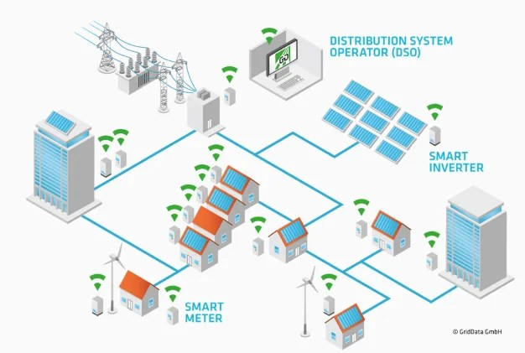
Power System Control Cont.….
Figure 3. Advanced Metering Instrument.
url: https://i0.wp.com/paktechpoint.com/wp-content/uploads/2020/05/img_5ed04e23cd1cc.png

Slide 27
Power System Control Cont.….
4. Phasor Measurement Units (PMUs):
A key part of Wide Area Monitoring Systems (WAMS) is the Phasor Measurement Unit (PMU), which can simultaneously measure the voltage magnitude and phase angle at each system bus in the power system
It also measures current magnitude and phase angle at each branch (lines, transformers, and other series elements)
Provides high-precision measurements of voltage, current, and phase angle.
Enhances situational awareness and monitoring of system stability.
Facilitates the implementation of wide-area monitoring and control strategies.

Slide 28
Power System Control Cont.….
5. Smart Grid Technologies: Smart grids are electricity network that use digital technologies, sensors and software to better match the supply and demand of electricity in real time
Integrates advanced communication and automation technologies into power systems.
Enhances grid reliability, efficiency, and sustainability through real-time data exchange and automation
Supports the integration of renewable energy sources and electric vehicles.
Facilitates demand-side management and consumer participation in energy markets.

Slide 29
Power System Control Cont.….
6. Control Algorithms and Optimization Techniques:
Utilize mathematical models and algorithms to optimize power system operations and control.
Implement techniques like linear programming, GA, PSO, AI applications, mixed-integer programming, and machine learning for decision-making.
Enhance economic dispatch , load forecasting, and reliability analysis for optimal controlling
Adapt to changing system conditions and optimize resource utilization.

Slide 30
Power System Control Cont.….
7. Artificial Intelligence (AI) and Machine Learning:
Improve decision-making processes and predictive analytics in power systems.
Analyzes large datasets for pattern recognition, anomaly detection, and predictive maintenance
Enhances operational efficiency by optimizing scheduling and resource management.
Supports the development of intelligent grid technologies and automated control systems.

Slide 31
7. Challenges in Power Control
For electrical networks to remain stable, dependable, and efficient, power system control is crucial.
It does, however, confront a number of difficulties that could make operations more difficult.
The following are some of the main obstacles:
A. Renewable Energy Source Integration:
Uncertainty and Variability: Because solar and wind energy are intermittent, power generation may fluctuate, making load balancing and stability more difficult.
Stability of the Grid: With increased use of renewable energy sources, maintaining frequency and voltage stability becomes more difficult and calls for sophisticated control techniques.

Slide 32
Challenges in Power Control Cont.…
B. Aged Infrastructure:
Many power systems rely on aging infrastructure that may not be equipped to handle modern demands or integrate new technologies.
Increased failure rates: aging equipment can lead to more frequent outages and reliability issues, necessitating better monitoring and management.
C. Cyber-security Fears:
Vulnerability to Attacks: As power systems become more digitized and interconnected, they are increasingly susceptible to cyber-attacks that could disrupt operations.
Data Integrity: Ensuring the integrity and security of data transmitted across networks is crucial for reliable system operation.

Slide 33
Challenges in Power Control Cont.…
d. Operational Complexity of System :
Interconnected Networks: Modern power systems are highly interconnected, making it difficult to manage and control multiple regions and systems simultaneously.
Coordination challenges, effective communication and coordination among various control centers and operators are essential for maintaining system reliability.
e. Regulatory and Market Dynamics:
Evolving Policies, changes in regulations and market structures can create uncertainty and impact operational strategies.
Economic Pressures, Operators must balance reliability with cost-effectiveness, which can be challenging in competitive market environments.

Slide 34
8. Future Trends in Power System Control
Enhanced automation: More autonomous control systems
Advanced several Algorithms: AI and machine learning applications
More decentralized energy resources and Control: Micro-grids and distributed generation
Enhanced and sophisticated communication Technologies: IoT in power systems
These needs special attributes in identifying the control variables, advanced modeling of the system, using of best optimization and coordinated control of the network using advanced power control techniques.

Slide 35
Summary
The brief overview power system control, its importance and challenge is discussed in this lecture.
In summary, the variety of power systems control levels like centralized, distributed, and decentralized control approach's in terms of their application, advantage and disadvantage is well discussed.
The basics of control strategies such as Automatic Generation Control (AGC), Load Frequency Control (LFC), and etc is also discussed.
Besides this, the modern control technologies like SCADA, Energy Management Systems (EMS), and smart grid technologies in terms of monitoring, control, and optimization of power systems is also discussed.
on the other hands, the challenges in controlling modern power systems such as aging of infrastructure, cyber-security threats, and growing regulatory frameworks, which needs to be addressed while controlling power system is another idea of this lecture note.

Slide 36
References
[1]. F., Georgios; P., Christos and V.,Vasiliki. ‘’Power System Control Centers and Their Role in the Restoration Process after a Major Blackout’’. WSEAS Transactions on Power Systems. V.18(2023). DOI: 10.37394/232016.2023.18.7.
[2]. G., Abdul and M., Junita. ‘’International Journal of Innovative Computing, Information and Control(IJICIC)’’. V.8(10), 2012. Pp:1-25. https://www.researchgate.net/publication/266012791.
[3]. B., Amel; Y., Nour and L., Ahmed. ‘’Power System Transient Stability Analysis Considering Short-Circuit Faults and Renewable Energy Sources’’. MDPI: Eng. Proc. 2024, V.67(1), 42; https://doi.org/10.3390/engproc2024067042.
[4]. K., Muhammad. ‘’Smart grids and renewable energy systems: Perspectives and grid integration challenges’’. Elsevier: Energy Strategy Reviews. V.51(2024), 101299. https://doi.org/10.1016/j.esr.2024.101299
[5]. M., Sohrab; D., Subash;W., Xiaojun and etl. ‘’A Review on Optimization Objectives for Power System Operation Improvement Using FACTS Devices’’. MDPI: Energies 2023, V.16(1), 161. https://doi.org/10.3390/en16010161
[6]. M., Shahraeini; M., Hossein and M., Sadegh. ‘’Comparison Between Communication Infrastructures of Centralized and Decentralized Wide Area Measurement Systems’’. IEEE TRANSACTIONS ON SMART GRID. V.2(1), 2011. pp:206-211. DOI: 10.1109/TSG.2010.2091431

Slide 37
Thank you !

