Slide 1
Power Systems Operation and Control
Lecture 9
Modeling of Components for Power system control
Lecturer: Teshome Goa (Assist. Prof.)
Lecture learning outcomes:
At the end of this lecture, you will be able to:
Understand the importance Modeling Power system Components
Knows the Speed governor systems and its importance
Differentiate the modeling of each components for controlling the frequency of system

Slide 2
Content
Introduction
2.Basics of LFC and AVAR Control
Modeling of Speed Governor
Turbine Model
Generator model
Load Model
Summary
References

Slide 3
1. Introduction
Modeling components for power system control involves representing various elements of the power grid such as speed governor, turbine, generators, transformers, transmission lines, and loads—using mathematical models.
A steam turbine governor is a component of the turbine control system that regulates rotational speed in response to changing load conditions.
The governor output signal manipulates the position of a steam inlet valve or nozzles which in turn regulates the steam flow to the turbine
Turbine and generators are the main components that can be used as reseachduling the generation based on the changing load.
These models help in analyzing system behavior, optimizing performance[1]:

Slide 4
Introduction Cont.…
Power system control is the process of monitoring, coordinating and controlling the generation, transmission and distribution of electrical energy.
The physical plant to be controlled comprises generating plants that produce energy and feed it to the load through transformers and the HV transmission network(grid), based on interconnected generating plants
Either generation or load must balance supply and demand because transmission lines offer very little energy storage
At generating plants, turbine governors regulate production, while computers in the control center, which is located far from the generating plants, handle automatic generation control.

Slide 5
Introduction Cont.…
Residential, commercial, and industrial loads can all be remotely supervised and controlled using load management,
It’s also known as demand-side management, which is applied to sub-transmission and distribution circuits.
Overall energy management is performed at control canter, typically called system control centre's, by computer systems called energy management systems /EMS/, data acquisition and remote control is performed by SCADA etc.

Slide 6
Introduction Cont.…
To balance the generation against load at the lowest possible cost, AGC operates online in real time and consists of two main functions as well as a number of smaller ones.
Controlling load frequency and economic dispatch are the main tasks.
Minor tasks are the reserve monitoring, which ensures that the system has adequate reserve, interchange scheduling, which starts and finishes scheduled interchanges,
In addition, other comparable monitoring and record tasks, such as load forecasting, fault allocation, and fault analysis, are examples of minor services.
With the constraints of the controls at hand, generation control and ED reduce the present cost of energy production and transmission.

Slide 7
Introduction Cont.…
Energy control, the supervisory layer, is responsible for efficiently scheduling production and transmission on a worldwide scale and at intervals that correspond with cost optimization.
In a power system, there are numerous variables to regulate, but we primarily control voltage and frequency by adjusting the generators', load's, and other system components' other characteristics.
Maintaining dependability, security, stability, operating in the most cost-effective manner, and improved quality (frequency within the limit of 3%), as well as voltage (5% HV, 10% LV), are imperative for an efficient and secure power system.

Slide 8
Introduction Cont.…
Frequency is global phenomena, it’s the same in one node and other[2].
Whereas, the voltage is local phenomena that voltage in each substation is different.
However, both of, change in frequency and deviation of voltage from nominal value affect normal operation of the system, and needs to be monitored very well.
This needs modeling and developing the transfer function of each component for effective control of both frequency and Voltage.

Slide 9
Introduction Cont.…
Frequency can be controlled by controlling the active power and load
which is active power is controlled at generation or the injected power and the load can be controlled by monitoring the consumed power.
It is preferred to control the power at generation side and rather than controlling from demand side, the load end control advisable during emergency case. Generally the control approach is given as:
Case 1: When the total generation < demand , results in = reduction in system frequency.
Thus, the recommended solution is just increasing the generation increase, or decreasing the load.
Decreasing the load is not advisable as it affect power reliability.

Slide 10
Introduction Cont.…
Case 2: when the total generation > demand, the system frequency rises
The mitigation technique is rescheduling the generation( decrease it) and increasing the load , but increasing the load is not possible from utility side.
The two cases scenario is presented in Fig.1
Finally, it is observed that energy is stored in the form of kinetic energy and can go no where.
Accordingly, when load increases, this stored energy will be taken to feed the demand , the stored kinetic energy will decrease and hence speed decrease.

Slide 11
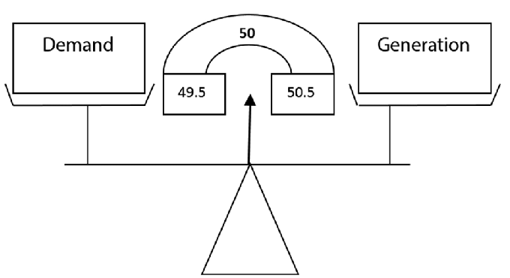
Introduction Cont.…
The frequency of the system will decrease because of the reduction of speed of generator.
Figure 1: The variation in Frequency based on generation-demand relation.
Url: https://www.researchgate.net/publication/325567506/figure/fig1/AS:634404896522241@1528265322297/Relation-of-frequency-with-generation-and-demand.png

Slide 12
Introduction Cont.…
When load decrease, further kinetic energy will be stored and results in the increments of speed and frequency
On other hands, the reactive power control is responsible mainly for controlling the voltage, which is a local problem.
Based on the above presentation , it’s noted that there are two basic generation control loops:
Frequency control loop or LFC, AGC, MW-F control loop
MVAR-Voltage, Q-V control loop
The overall, block diagram is presented in Fig.2

Slide 13
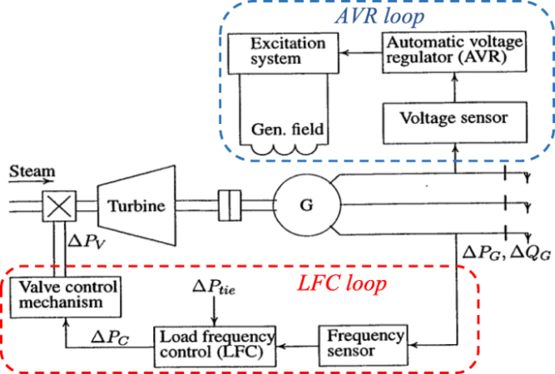
Introduction Cont.…
Figure 2: LFC and AVR control Loop.
Url:https://www.researchgate.net/publication/359877348/figure/fig1/AS:1174762151780352@1657096531149/control-systems-of-synchronous-generator.ppm

Slide 14
2.Basics of LFC and AVAR Control
Controlling the power flow in the tie-lines and preserving power balance among interconnected areas are the goals of load frequency control.
Electric power must always be produced at a rate equal to its consumption because it cannot be stored in vast quantities.
AVR, or automatic voltage regulator: The excitation utilized affects how the AVR is constructed. When the generator turns, the stator provides input to all.
For non-linear load applications, AVRs that may receive a second input are utilized to lessen or completely eliminate internal harmonics brought on by load feedback signals.
The two most popular kinds are: The silicone controlled rectifier (SCR) senses the stator's power level and decides when to fire the exciter voltage. can lead to issues when utilized

Slide 15
Basics of LFC and AVAR Cont.….
Accordingly, the knowledge, modeling and controlling of the following three components is very important for efficient control of frequency in power systems.
a. Speed governing system
b. Turbine and generator, the spinning components
c. The load and its behavior
Speed governing system: The speed governor is the main primary tool for the LFC, whether the machine issued alone to feed a smaller system or a part of the most elegant arrangement.

Slide 16
Basics of LFC and AVAR Cont.….
The key components of a speed-governing system, such as those used in steam turbines, are schematically arranged in Fig. 3 to regulate the generator's output and maintain a steady frequency.
The main components are:
a. Fly Ball Speed Governor
It’s the heart of the system which senses the change in speed (frequency).
As the speed increases the fly balls move outwards and the point B on linkage mechanism moves downwards. The reverse happens when the speed decreases.

Slide 17
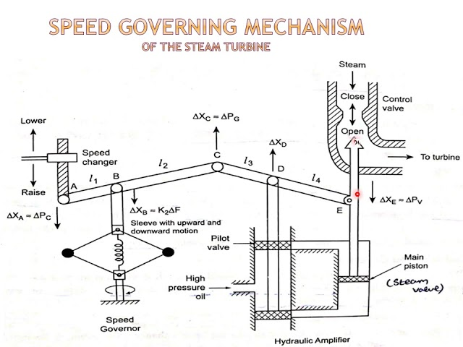
Basics of LFC and AVAR Cont.….
Figure 3. Speed Governor System.
Url: https://i.ytimg.com/vi/DXopWjWpYcY/sddefault.jpg

Slide 18
Basics of LFC and AVAR Cont.….
The centrifugal fly-balls driven either directly or through gearing by the turbine shaft.
The mechanism provides upward and downward vertical movements proportional to the change in speed.
B- Linkage Mechanism
These are links for transforming the fly-balls movement to the turbine valve through a hydraulic amplifier and providing a feedback from the turbine valve movement.
ABC is a rigid link pivoted at B and CDE is another rigid link pivoted at D.
This link mechanism provides a movement to the control valve in proportion to change in speed.
It also provides a feedback from the steam valve movement.

Slide 19
Basics of LFC and AVAR Cont.….
C- Hydraulic Amplifier:
It comprises a pilot valve and main piston arrangement, low power level pilot valve movement is converted into high power level piston valve movement.
This is necessary in order to open or close the steam valve against high pressure steam.
Very large mechanical forces are needed to operate the steam valve.
Therefore, the governor movements are transferred into high power forces via several stages of hydraulic amplifiers.
D- Speed Changer
The speed changer consists of a servomotor which can be operated manually or automatically for scheduling load at nominal frequency.
By adjusting this set point, a desired load dispatch can be scheduled at nominal frequency.

Slide 20
3. Modeling of Speed Governor
The Speed governor senses the change in speed (or frequency) and hence it can be regarded as heart of the system[3].
The standard model of a speed governor operates by the fly-ball mechanism.
The speed governing system is the primary LFC loop and its simple schematic representation is shown in Fig.3.
Fly-balls moves outward when speed increases and the point B on the linkage mechanism moves downwards, the reverse happens when the speed decreases.
The movement of point B is proportional to the change in shaft speed

Slide 21
Modeling of Speed Governor Cont.….
In order to understand the operation, we should consider two cases
The first is when speed changer is given Raise or Lower command but speed of the turbine remains constant
second when speed of turbine is changed but command is not given to the speed changer.
Under these conditions, the position of the joints will be changed according to the applied phenomena.

Slide 22
Modeling of Speed Governor Cont.….
Option One: Speed changer is given Raise command and speed is constant.
eqn.(1)
Option II: Speed changer is constant and speed is increased.
eqn.(2)

Slide 23
Modeling of Speed Governor Cont.….
Hence a relation can be established based on the above facts.
eqn.(3)
Where k1 , k2, k3 and k4 are constants and depend on the length of arms and k5 depends on oil pressure and geometries of cylinder.

Slide 24
Modeling of Speed Governor Cont.….
Let us assume that the steam is operating under steady state and is delivering power P⁰_{G} from the generator at nominal speed or frequency f_{o}
Under this condition, the prime mover valve has a constant setting χ⁰_{E,} the pilot valve is closed, and the linkage mechanism is stationary.
Now, we will increase the turbine power by ΔP_{C} with the help of the speed changer.
For this, the movement of linkage point A moves downward by a small distance Δx_{A} and is given by;
eqn.(4)

Slide 25
Modeling of Speed Governor Cont.….
The link point ‘C’ will move upward because of linkage (A-B-C) action.
Let it be further, the link point ‘D’ moves the piston in pilot servo (V), resulting in higher pressure oil flow in the upper part of the main piston
The piston moves downward by an amount ΔX_{D} and the steam valve opening increases
It increases the torque developed by the turbine.
This increased torque increases the speed of generator and frequency (Δf)

Slide 26
Modeling of Speed Governor Cont.….
This change of speed results in the outward movement of fly ball of the speed regulator.
Thus the link ‘B’ moves slightly downward a small distance ΔX_{B}.
Due to the movement of link point B, the link point ‘C’ also moves downward by an amount ΔX_{C}’’ which is also proportional to Δf.
Thus the net movement of link point C is

Slide 27
Modeling of Speed Governor Cont.….
From eqn.(5), it’s observed that ΔX_{A} = K_{C} ΔP_{C} and by subst., let:
And
Thus, the net movement of C is given by:
eqn.(8)

Slide 28
Modeling of Speed Governor Cont.….
The movement D, ΔX_{D} is the amount by which pilot valve opens, which the function of ΔX_{C} and ΔX_{E} and written as

Slide 29
Modeling of Speed Governor Cont.….
It, can be rewritten as:
Now , assume the flow of oil to the servomotor is proportional to the position of change in ΔX_{D} of the pilot valve ‘V’, Then the movement of ΔX_{E} is given by
eqn.(13)

Slide 30
Modeling of Speed Governor Cont.….
Taking the Laplace transform of each
eqn.(14)
and by substitution: eqn.(15)

Slide 31
Modeling of Speed Governor Cont.….
If: eqn.(16)
Where, the value of T_{G}<100 m/s and the above eqn. is rewritten as:
eqn.(17)

Slide 32
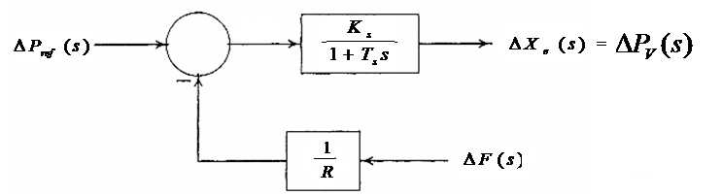
Modeling of Speed Governor Cont.….
Substituting and Simplifying , we get: This can be represented using block diagram as shown in Fig.4.
Figure 4: Block diagram representation of speed governing system.
url: https://image.slidesharecdn.com/unit4automaticgenerationcontrol-201109143319/85/Unit-4-Automatic-Generation-Control-13-320.jpg

Slide 33

4. Turbine model
Figure 5 illustrate the turbine-generator mechanical connection.
The turbine-generator model depends on whether we have hydro-turbines, or in case of steam turbines we have reheat or non-reheat type of steam turbines.
For a simple a non-reheat type turbine model is given by a single time constant,
eqn.(18)
Taking input power to the turbine is Pv /power from the valve opening/ and output power is mechanical power Pm, the block diagram becomes

Slide 34
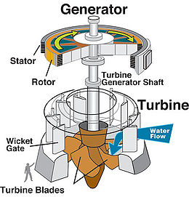
Turbine model cont.…
Figure 5. The turbine Generator Mechanical coupling.
Url: https://d9-wret.s3.us-west-2.amazonaws.com/assets/palladium/production/s3fs-public/thumbnails/image/wss-wu-hydropower-turbine-diagram.jpg

Slide 35


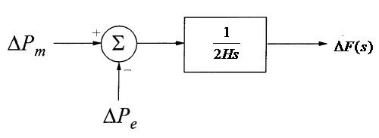
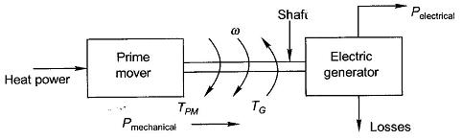
5. Generator Model
The basic configuration of turbine and generator is shown in Fig.6. Here, based on swing equation,
eqn.(19)
For a change Δ in mechanical and electrical power, the above equation using per unit system becomes,
Taking Laplace transform, we get
eqn.(20)
Figure 6. Turbine-generator block diagram.
url: https://www.eeeguide.com/wp-content/uploads/2015/10/Introduction-to-Electrical-Machines.jpg

Slide 36
6. Load Model
Power system loads are typically a combination of various electrical equipment, Electrical power for resistive loads, such heating and lighting loads, is frequency independent.
When motor loads, like fans and pumps, are involved, variations in motor speed cause the electrical power to fluctuate with frequency.
A composite load's total frequency-dependent properties can be stated as
eqn.(21)
Where ΔP_{L} is the non-frequency-sensitive load change, Δf is the frequency-sensitive load change, and D is expressed as percent change in load divided by percent change in frequency.
Substituting the above equation to the previous model (generator model), we get the following block diagram

Slide 37
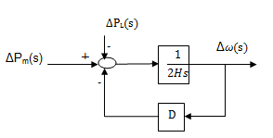
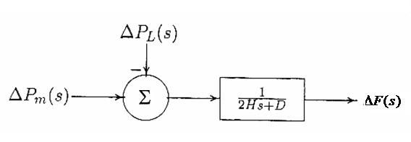
Load Model Cont.…..
Figure 7. Load model block diagram.
https://www.researchgate.net/publication/275351560/figure/fig2/AS:650470800510986@1532095732402/a-The-block-diagram-representation-of-the-generator-and-load-Eliminating-the-simple.png
Using transfer function of closed loop can be G(s)/1 + G(s) H(s), the above model can be further simplified as follows [taking G(s) = 1/2Hs and H(s) = D]

Slide 38
Summary
The brief overview power systems modeling like the speed governor, turbine, generator and load is modeled in this lecture.
It is observed that speed governor system takes paramount in controlling the generator frequency, which needs to modeled properly.
The other fundamental components are modeling the turbine, generator and load(frequency independent and frequency dependent loads) also takes special attention in system frequency control,
besides this, the relationship between load variation and generation rescheduling to maintain acceptable system frequency is also discussed in detail
The behavior of frequencies and Voltage control is also discussed well.

Slide 39
References
[1]. E., İlyas. ‘’Governors for hydro-turbine speed control in power generation: a SIMO robust design approach’’. Elsevier: Energy Conversion and Management. V.45(13–14), 2004, Pp:2207-2221. https://doi.org/10.1016/j.enconman.2003.11.008.
[2]. B., Tomislav; H., Ninoslav and K., Igor. ‘’A new perspective on frequency control in conventional and future interconnected power systems’’. Elsevier: International Journal of Electrical Power & Energy Systems. V.156(2024), 109731. https://doi.org/10.1016/j.ijepes.2023.109731
[3]. Z., Han;, Z., Zhu, and X., Tian. "Custom Modeling of Generalized Speed Governor Applied to Long-Term Power System Dynamic Simulation" . Second International Conference on Computer and Electrical Engineering, Dubai, United Arab Emirates, 2009, pp. 398-402, doi: 10.1109/ICCEE.2009.73.

Slide 40
Thank you !

