Slide 1
Power Systems Operation and Control
Lecture 10
Load frequency controlling(LFC)
Lecturer: Teshome Goa (Assist. Prof.)
Lecture learning outcomes:
At the end of this lecture, you will be able to:
Understand the importance of frequency control
Knows the single area modeling of frequency control
Differentiate the free governor and reference control mechanisms
Develop the composite system modeling

Slide 2
Content
1. Introduction
2. Single Control Area(SCA)
3. Single Area Control System Analysis
4. COMPOSITE SYSTEM IN SINGLE CONTROL AREA Generator model
Summary
References

Slide 3
1. Introduction
A single-area control system is designed to maintain the balance between generation and load within a specific area.
A single area control system (SAC) typically refers to a system used in power grid management to control and optimize the operation of a specific area within a larger power system
The primary goal is to ensure that the system operates at its desired frequency and power output.
To analyze a single-area control system in a power system, we need to consider both steady-state and dynamic responses, as well as the effects of control mechanisms.
It focuses on maintaining the balance between electricity supply and demand, ensuring reliability, and managing resources effectively.

Slide 4
Introduction Cont.…
Components of the Control System
Generation Control: Regulating output from power plants to meet demand.
Load Forecasting: Predicting electricity demand based on historical data and trends.
Frequency Control: Maintaining the system frequency within acceptable limits.
Data Monitoring: Continuous monitoring of system parameters to detect issues.

Slide 5
Introduction Cont.…
Communication Systems: Facilitating real-time data exchange among control centers.
Provides Improved Reliability: Minimizes outages and enhances service quality.
Better for Operational Efficiency: Optimizes resource use, reducing costs.
Adapts to changes in demand and supply conditions.
Used by utilities to manage localized power systems, such as cities or regions and Integrates renewable energy sources to enhance sustainability.

Slide 6
2. Single Control Area(SCA)
A models for speed governor, turbine-generator and load (frequency dependant and non-frequency dependant loads are very important and used as an input for frequency control[1].
However, in practice, a single generator feeds a large area rarely exist and the model developed could be extended into large system.
Thus, several generators are connected in parallel, which are located in different places and remote area will supply the power needs of overall area.
Normally, these generators have to be synchronized and have to have the same response characteristics in load demand.

Slide 7
SCA Cont.…
This kind of coherent operational is called a single control area(SCA).
In control area , the frequency is assumed to be the same throughout in static as well as dynamic conditions.
In such a case, it is possible to define a control area, grouping all the generators in the area together and treating them as a single equivalent generator,
Thus, for the purpose of developing a suitable control strategy, a control area can be reduced to a single speed governor, turbo-generator and load system.
Putting together, the carious models derived so far is considered as a single control area can be conceived in Fig.1.

Slide 8
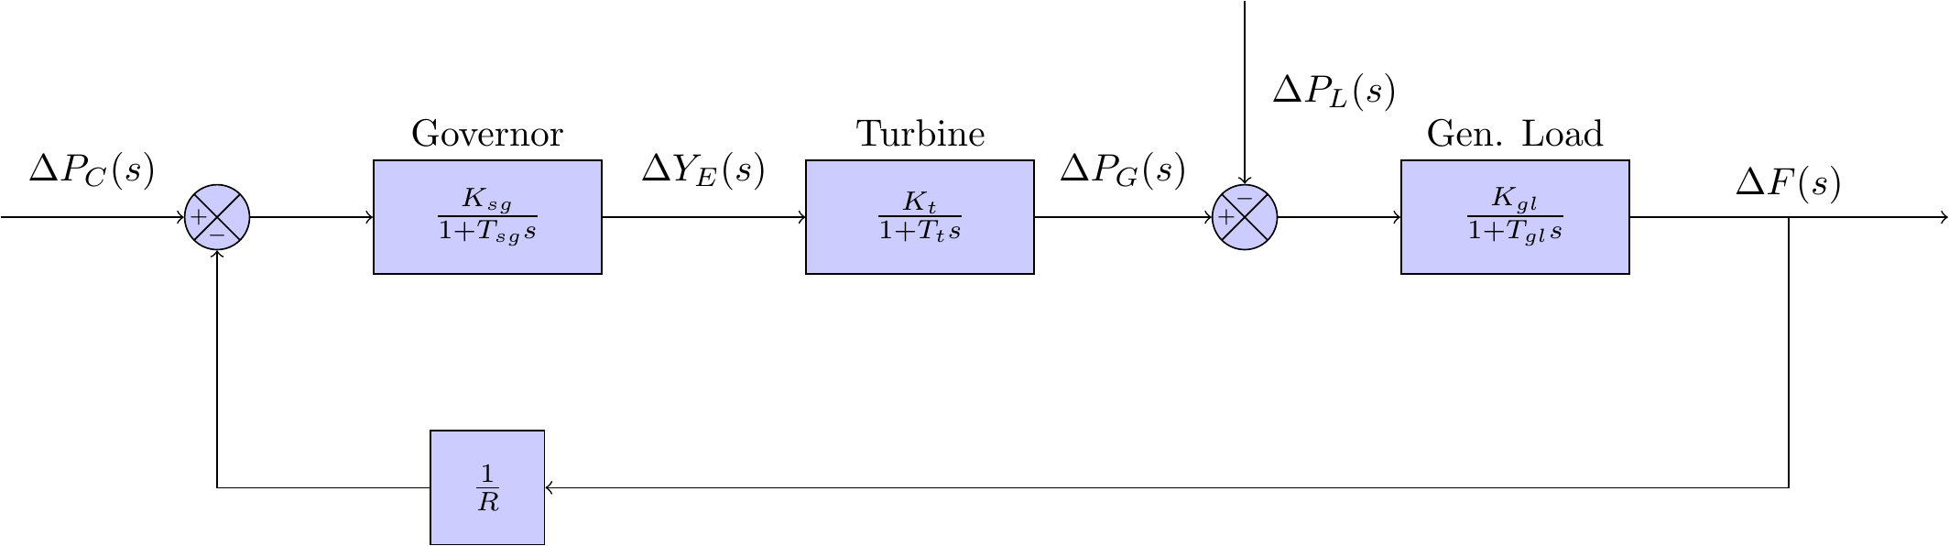
SCA Cont.…
The block diagram of single area system, where the gain and time constant in each block are as described in the individual section before, is as shown below[2].
Figure 1. Single area control system. Url:https://skreynolds.github.io/assets/single_area_p_control_model.png
eqn.(1)

Slide 9
SCA Cont.…
In a SCA, the basic recruitments for fruitful operation of the network are :
The generation must be adequate enough to meet all the load demand and losses.
The system frequency must be maintained with narrow and acceptable limits.
The system voltage profile must be maintained within reasonable and acceptable limits
In case of interconnected operation, the tie-line power flows must be maintained at the specified values.

Slide 10
SCA Cont.…
If the generation is not adequate enough to balance the load demand & loss, it is imperative that one of the following alternatives will be considered for keeping the system in operating condition:
Starting fast peaking units
Load shedding for unimportant loads, and
Generation rescheduling
Scheduled maintenances and repairing the units
Demand side management

Slide 11
3. Single Area Control System Analysis
The model in Fig.1 shows that there are two important incremental inputs to the load frequency control system[3]:
Which are the ΔPref, the change in speed changer setting, and ΔP_{L}, the change in load demand.
Assume a simple situation in which the speed changer has a fixed setting (ΔPref, = 0.) and the load demand changes.
This is known as free governor operation.
In the given condition, the block diagram will be simplified and presented in Fig.2

Slide 12
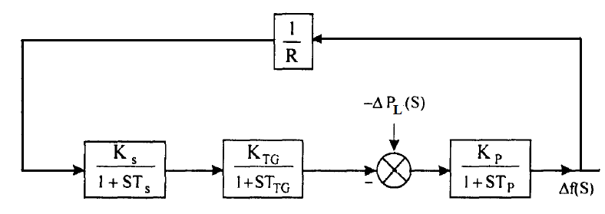
Single Area Control System Analysis Cont.,…
Figure 2. Free governor operation
Free governor operation or Load change only:
Considering Ts < T_{G} << TP and K_{S}K_{TG} ≅ 1, the dynamic response which is giving the change in frequency as a function of the time for a step change in load
Then, the block diagram is further reduced and presented in Fig.3.

Slide 13
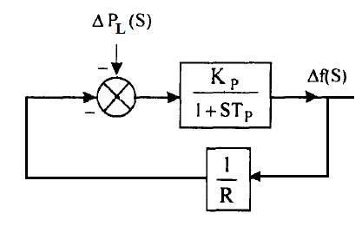
Single Area Control System Analysis Cont.,…
Figure 3. Simplified Free governor block diagram
Considering the transfer function presented in eqn.2, the overall system frequency for free governor or load change only is presented in eqn.3.

Slide 14
Single Area Control System Analysis Cont.,…
For, eqn.(2)
Then the output frequency is given as:
eqn.(3)
By substitution the output input relation is presented in eqn.(4).
eqn.(4)
Output
Step input

Slide 15
Single Area Control System Analysis Cont.,…
The partial fractions for the expression can be simplified using:
eqn.(5)
Accordingly, the expression in eqn.4 can be simplified
eqn.(6)

Slide 16
Single Area Control System Analysis Cont.,…
The Laplace transform of eqn.6 given as:
eqn.(7)
Where,

Slide 17
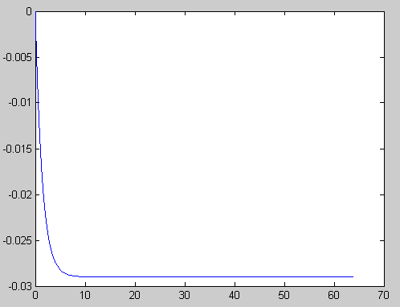
Single Area Control System Analysis Cont.,…
The plot of change in frequency versus time for first order approximation given above is as shown below. steady state result (at t = ∞)
eqn.(8)
Figure 4. The dynamic response of eqn.7
Therefore, we can say that the LFC system posses inherently steady state error for a step input of load change provided that the reference setting remains unchanged.
dynamic response
Δ Frequency (Hz)
Steady state change in frequency = -ΔPL /(D+1/R)
Time(sec)

Slide 18
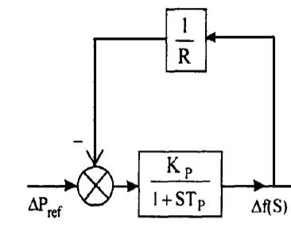
Single Area Control System Analysis Cont.,…
B. Reference Power setting control only while load is constant:
Consider now the steady effect of changing speed changer setting with load demand remaining fixed. Similar to the previous condition, letting Ts < TTG << TP and KSKTG ≅ 1, the simplified block diagram and transfer function is presented in Fig.5.
Figure 5. Reference power setting only

Slide 19
Single Area Control System Analysis Cont.,…
eqn.(9)

Slide 20
Single Area Control System Analysis Cont.,…
Eqn.(10)
Output
Step input
Which, means that:
Eqn.(11)

Slide 21
Single Area Control System Analysis Cont.,…
Following the same procedure as case A, the steady state change in frequency due to change in reference setting will have similar expression:
eqn.(12)
If the speed change setting is changed by ΔPref while the load demand changes by ΔPL, the steady state frequency change is obtained by superposition, i.e.
eqn.(13)
According to the above equation, the frequency change caused by load demand can be compensated by changing the setting of the speed changer, i.e. for Δf = 0.
eqn.(14)

Slide 22
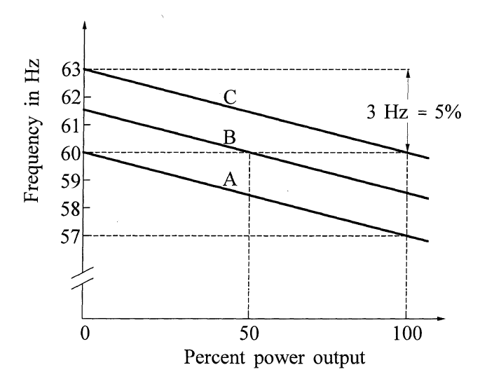
Single Area Control System Analysis Cont.,…
Figure: Effect of speed changer setting on the frequency stability of the system.
Url: https://slideplayer.com/slide/10874514/39/images/26/Figure%3A+Effect+of+speed+changer+setting+on+the+frequency+stability+of+the+system.jpg
Therefore, for this purpose, a signal from Δf is fed through an integrator to the speed changer resulting in the block diagram configuration shown below.

Slide 23
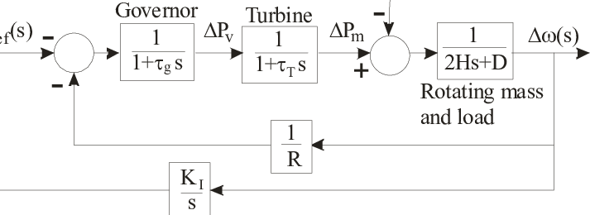
Single Area Control System Analysis Cont.,…
Figure 6. Integral control of single area frequency control.
https://www.researchgate.net/publication/224651818/figure/fig1/AS:669033770790917@1536521489876/Block-diagram-of-a-single-area-load-frequency-control.png

Slide 24
Single Area Control System Analysis Cont.,…
Now, the analysis on input-output relation results
eqn.(15)
Neglecting TS and TTG, both have << Tp and KSKTG ≅ 1, eqn.(15), is rewritten as;
eqn.(16)

Slide 25
Single Area Control System Analysis Cont.,…
Rearranging,
eqn.(17)
Then, the change in steady state frequency is :
eqn.(18)

Slide 26
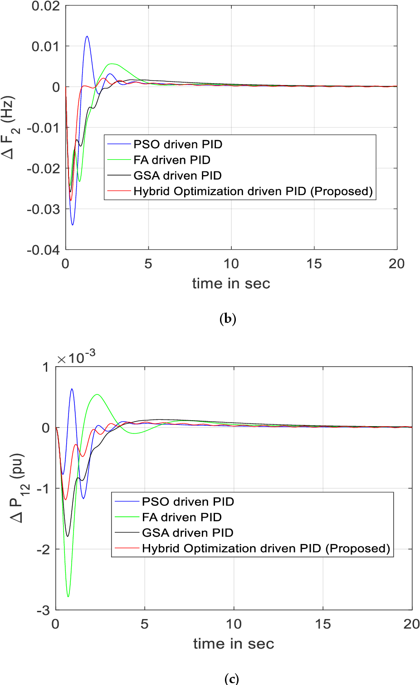
Single Area Control System Analysis Cont.,…
Figure 7: The PID control results with different optimization.
https://ai2-s2-public.s3.amazonaws.com/figures/2017-08-08/d1cc751540adf680dca379c82503d9e522ae587b/12-Figure3-1.png

Slide 27
Single Area Control System Analysis Cont.,…
Here we find that the steady state change in frequency has been reduced to zero by the addition of the integral controller.
In central load frequency control of a given control area, the change (error) in frequency is known as Area Control Error (ACE).
The additional signal fed back in the modified control scheme presented above is the integral of ACE.
Which, reduces the error to zero and advisable to apply the integral over derivative

Slide 28
Single Area Control System Analysis Cont.,…
From the above analysis, it is clear that proportional integral and derivative control strategy can be applied for load frequency control.
While proportional control is inherent in the feedback through the governor mechanism itself, derivative control when introduced improves transient performance and ensures better margin of stability for the system.
The selection of the gain controller in the secondary LFC should be such that:
i. control loop must be stable
ii. Frequency error should return to zero

Slide 29
4. COMPOSITE SYSTEM IN SINGLE CONTROL AREA:
In a composite system for frequency control within a single area, you typically focus on managing the generation and consumption of electrical power to maintain a stable frequency across the network.
Generation Sources:
Conventional Power Plants: These include fossil fuel, nuclear, and hydroelectric plants that can be controlled to adjust output based on demand.
Renewable Energy Sources: Wind, solar, and other renewables contribute to the mix but are less predictable. Integration with storage or backup systems is essential.
Energy Storage Systems: Batteries or pumped hydro storage can quickly inject or absorb power to stabilize frequency.

Slide 30
composite system Cont.….
Load Management:
Demand Response: Programs that adjust consumer demand based on real-time frequency or grid conditions.
Smart Grids: Advanced metering infrastructure allows for real-time data collection and analysis, enabling more responsive load management.
Control Systems:
Automatic Generation Control (AGC): This system balances the output of multiple power plants and adjusts them in real-time to match the load and maintain frequency.
Frequency Regulation: Techniques that involve adjusting the output of generation sources based on real-time frequency measurements. The composite system is given in Fig.8

Slide 31
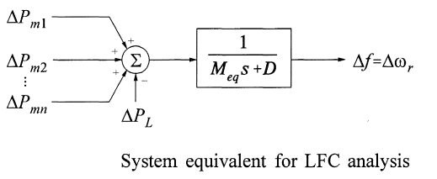
composite system Cont.….
The composite power/frequency characteristics of a power system thus depends on the combined effect of the droops of all generator speed governors.
It also depends on the frequency characteristics of all the loads in the system as given in Fig.
where Meq /equivalent generator/
= ΣM
Figure 8. composite system.
Url: https://slideplayer.com/slide/10874514/39/images/29/COMPOSITE+SYSTEM+IN+A+SINGLE+CONTROL+AREA%3A+The+composite+power%2Ffrequency+characteristics+of+a+power+system+thus+depends+on+the+combined+effect+of+the+droops+of+all+generator+speed+governors.+It+also+depends+on+the+frequency+characteristics+of+all+the+loads+in+the+system..jpg
For a system with N generators and a composite load-damping constant of D, the steady-state frequency deviation following a load change ΔPL is given by

Slide 32
Summary
The brief overview of single area control is discussed in this lecture.
It is noted that there is no single generator, governor , turbine and load exists in reality, but the number of generators and other systems are considered as a single system for SAC.
The two basic approaches used are: changing the load only or free governor mechanism and reference setting changing are adopted in this lecture to come up with the real-time control.
In addition, the advantage of integral control while minimizing the error is discussed in this lecture
Finally, the composite system modeling considering N-Generation units is also discussed well.

Slide 33
References
[1]. S., Pahadasingh; C., Jena and C., Panigrahi. "SCA Based Load Frequency Control Incorporating Electric Vehicle Using Cascaded Controller’’. International Conference on Power Electronics and Energy (ICPEE), Bhubaneswar, India, 2021, pp. 1-5, doi: 10.1109/ICPEE50452.2021.9358648.
[2]. D., Serhat and Y., Nuran. ‘’Load Frequency Control of A Single Area Power System using Gravitational Search Algorithm.’’ confrenace , 2012. pp.1-6. DOI: 10.1109/INISTA.2012.6246992.
[3]. K., Dillip; K., Bikash; P., Swagatika and etl. ‘’Load Frequency Control of a Single Area Power System using Firefly Algorithm’’. International Journal of Engineering Research & Technology (IJERT). V.9(5), 2020.

Slide 34
Thank you !

