Slide 1
Power Systems Operation and Control
Lecture 12
Reactive Power Control and Voltage Stability Analysis
Lecturer: Teshome Goa (Assist. Prof.)
Lecture learning outcomes:
At the end of this lecture, you will be able to:
Distinguish the need of reactive power compensation
Understand the objectives of load compensation
Identify the operation of uncompensated and compensated Lines
Knows the voltage stability analysis in power system

Slide 2
Content
Introduction
Reasons for Reactive Power Compensation
Objective of load compensation
Operation of Uncompensated and Compensated Transmission Line
Voltage Stability Analysis in Power Systems
Summary
References

Slide 3
1. Introduction
Reactive power, which is measured in Volt-Amps Reactive or VARs is a type of power that alternates between the source and load in an AC electrical system[1].
Unlike real power, which performs actual work like driving motors, lighting, the reactive power does not perform work but is essential for maintaining voltage levels in the system, ensuring that energy is available for inductive loads such as motors, transformers, and other equipment.
However, reactive power can cause inefficiencies in the power system, as it increases the total apparent power that measured in Volt-Amps or VA that must be supplied.

Slide 4
Introduction Cont.…
It also affects the overall system apparent power flow that leads to the variation in transmission line reactive power, which may affects the short circuit current currying capacity of the line
This results in higher transmission losses and can require larger equipment capacities.
Reactive power compensation is the process of managing or reducing the effects of reactive power to improve the efficiency and stability of an electrical power system[2].

Slide 5
2. Reasons for Reactive Power Compensation
Voltage Regulation: In order to keep an electrical system's voltage levels stable, reactive power is essential.
While excessive voltage can result in overvoltage situations, low voltage can harm equipment.
It’s a matter of maintain acceptable voltage at the receiving end during no-load and loaded condition as given by:
eqn.(1)

Slide 6
Reasons for Reactive Power Compensation Cont.….
Efficiency of the System: Because of the increased apparent power caused by excessive reactive power, more current must pass via transmission lines, increasing losses and decreasing system efficiency.
Enhancement of Power Factor, the power factor (PF) is the ratio of apparent power to true power. Excessive reactive power results in a poor power factor, which makes it inefficient because more apparent power is required to provide the same amount of real power.
Reactive power compensation can raise the power factor and lower system losses, which is presneted in Fig.1.
Stability of the Grid: In a power system, too much or too little

Slide 7
Reasons for Reactive Power Compensation Cont.….
Then, the average power is given by:
eqn.(1)
Complex Power
eqn.(2)
Where, P is real power, Q is reactive power, S is apparent power and Փ is the power factor, which is presented in Fig.1

Slide 8
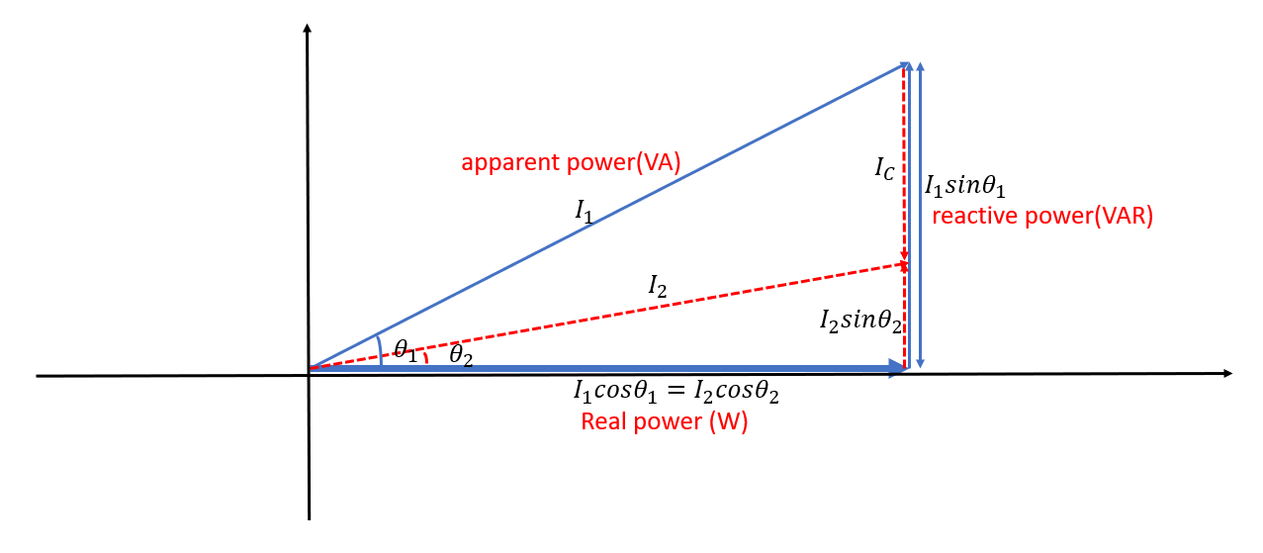
Reasons for Reactive Power Compensation Cont.….
Figure 1. The relationship between real, reactive and apparent power. Url:https://i.sstatic.net/tgrrk.png

Slide 9
Reasons for Reactive Power Compensation Cont.….
From Fig.1, the power factor is represented as:
eqn.(3)
It is observed that as the power factor increases, the power loss decreases and the system overall efficiency increases.
Which means from the relationship
eqn.(4)

Slide 10
Reasons for Reactive Power Compensation Cont.….
Example: If industry A receiving 1030MW power from the utility to drive 1000MW load. Assume the power factor of the industrial load 0.8 and the power loss of 30MW. If the power factor is increased from 0.8 to 0.95 when capacitor(MVAr) is installed at the PCC of the network, determine the system power loss and efficiency based on the new power factor. Solution:

Slide 11
Reasons for Reactive Power Compensation Cont.….
The system efficiency from power system background knowledge is given by:
It’s observed that the system efficiency is increased as the power loss decreases while using reactive power compensations

Slide 12
3. Objective of load compensation
Load compensation is the process of maintaining a system's voltage and power quality as load conditions change to ensure reliable and efficient operation.
In electrical power networks, load adjustment is commonly employed to stabilize and fix voltage irregularities caused by varying load demands.
The primary objectives of load adjustment are as follows:
Voltage regulation: aims to maintain a steady voltage level at the load terminal even when the load fluctuates.
By guaranteeing that all equipment operates within its rated voltage ranges, electrical gadgets become more reliable and long-lasting.

Slide 13
Objective of load compensation Cont.…
Improve the power factor of the system by compensating for reactive power (inductive or capacitive loads). This reduces the phase difference between voltage and current.
A higher power factor minimizes energy losses and reduces the need for excessive generation and transmission capacity, making the system more efficient.
Reduction of Losses: Reduce both active and reactive losses in the system by correcting voltage imbalances and minimizing unnecessary reactive power flow.
Increases system efficiency and reduces operational costs associated with energy losses in transmission and distribution lines as presented in Fig.2.

Slide 14
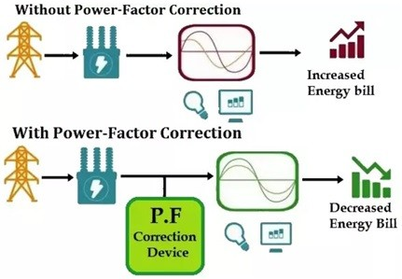
Objective of load compensation Cont.…
Figure 2. The power factor correction vs Energy bill.
https://media.licdn.com/dms/image/C5612AQEB1jE-6GW_4w/article-cover_image-shrink_600_2000/0/1643019746720?e=2147483647&v=beta&t=LlElWvDK9VHmcxTvexVl8rDs80Dl4NtfrxAYI3isnY4.

Slide 15
Objective of load compensation Cont.…
Compensate for voltage dips, swells, or fluctuations that occur due to varying load conditions or network disturbances.
Ensures that the voltage at the consumer's end remains stable, reducing the risk of equipment malfunction or failure.
Distribute load more evenly across different parts of the network, or among multiple generating units, by compensating for sudden load changes.
Enhances the reliability of the power system by ensuring that no single part of the system becomes overloaded.

Slide 16
Objective of load compensation Cont.…
Provide a fast and responsive adjustment to changing load conditions, such as sudden increases or decreases in demand.
Helps prevent voltage fluctuations or power quality issues in the system, ensuring a stable supply of electricity to the consumers.
Minimize or eliminate harmonics generated by non-linear loads (like rectifiers, variable-speed drives, etc.), which can affect the performance and efficiency of the power system.
Improves the quality of power supplied to consumers and reduces the risk of equipment damage caused by harmonic distortion.

Slide 17
Objective of load compensation Cont.…
Transmission and Distribution Cost Reduction: By improving load compensation, less expensive reactive power compensation equipment (such capacitors or synchronous condensers) and large-scale generation are required overall.
reduces the capital and operating expenses related to electricity system infrastructure.
Improved System dependability and Efficiency: By maintaining voltage stability and minimizing needless power losses, load compensation can improve the power system overall dependability and efficiency.
reduces the incidence of voltage-related disruptions and outages, guaranteeing a steady power supply for both residential and commercial customers.

Slide 18
4. Operation of Uncompensated and Compensated
Transmission Lines
Transmission lines are used in electrical power systems to transport electricity from power plants to end users over great distances.
However, a number of variables, such as the load, line length, and line characteristics, influence these transmission lines, resulting in problems including reactive power flow, power losses, and voltage drops
Two situations that illustrate how these problems are addressed are compensated transmission lines and uncompensated transmission lines.

Slide 19
The operation Cont.…
Transmission lines without active or reactive power adjustment equipment (such as capacitors, inductors, or synchronous condensers) fitted to enhance performance are known as uncompensated transmission lines.
It is run without any extra components to mitigate the built-in problems of reactive power, line losses, and voltage drops[3].
Uncompensated transmission lines' characteristics include:
Drop in Voltage: The inductive and resistive characteristics of the line cause large voltage dips in long transmission lines.
The length of the line and the quantity of current being pulled (load) cause this drop to grow.

Slide 20
The operation Cont.…
Because transmission lines are inductive, they naturally generate reactive power.
This may result in a trailing power factor, which lowers system performance and may lead to voltage instability, particularly when there is a high load.
Uncompensated transmission lines have higher active and reactive power losses, especially when operating over extended distances.
Resistance (I²R losses) and the line's reactive power demand are the causes of these losses.
Poor voltage regulation from the absence of correction causes the voltage at the load end to fluctuate greatly based on the load and distance.

Slide 21
The operation Cont.…
Operation of Uncompensated Lines:
Inductive Reactance Dominates: The inductive reactance of long transmission lines becomes more significant as the transmission distance increases.
This causes the voltage to lag behind the current, resulting in a poor power factor.
Voltage Regulation Issues: Without compensation, voltage may drop significantly at the far end of the line, particularly during periods of high load. This can affect equipment performance and reliability.
Loss of Efficiency: With no compensation, the system may require more generation capacity to meet the demand, leading to higher energy losses and inefficient power distribution.

Slide 22
The operation Cont.…
2. Compensated Transmission Lines:
Devices or methods intended to rectify or lessen the adverse impacts of inductive reactance, voltage dips, and reactive power flow are included in compensated transmission lines.
Enhancing the transmission system's overall efficiency, lowering losses, and improving the voltage profile are the objectives. The following are ways to compensate:
a. Series Compensation: This method uses capacitors placed in series with the line. As shown in Fig. 3, these capacitors help sustain voltage levels and lower the transmission line's overall reactance by counteracting the inductive reactance of the line by supplying leading reactive power.
Series compensation can enhance voltage regulation, lower losses, and boost the line's power transfer capacity.
Benefits include lower line losses, better voltage profiles, and increased transmission capacity.

Slide 23
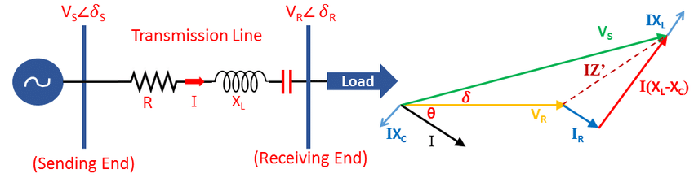
The operation Cont.…
Figure 3. Series compensated Transmission Line.
Url: https://www.researchgate.net/publication/337238441/figure/fig2/AS:878425241841665@1586444306214/Series-compensation-on-a-transmission-line.ppm

Slide 24
The operation Cont.…
Shunt compensators: Reactive power compensation is achieved by installing synchronous condensers or shunt capacitors at the middle or end of the line.
Shunt compensation injects leading reactive power, which enhances the voltage profile along the line.
By counteracting the inductive reactive power generated by the transmission line and load, shunt capacitors can increase power factor and stabilize voltage.
Benefits include better voltage control, a decrease in the system's need for reactive power, and increased system stability overall.

Slide 25
The operation Cont.…
Static Var Compensators (SVC) and STATCOMs: These are advanced devices used for dynamic reactive power compensation.
SVC (Static Var Compensator) and STATCOM (Static Synchronous Compensator) provide fast and flexible reactive power compensation to regulate voltage and improve system stability.
It enhanced control over voltage fluctuations, better dynamic response to load changes, and increased system reliability.
Flexible AC Transmission Systems (FACTS):FACTS devices such as Thyristor-Controlled Series Capacitors (TCSC) or Unified Power Flow Controllers (UPFC) can be used for more sophisticated compensation schemes, improving the transmission system's performance and stability in real-time.

Slide 26
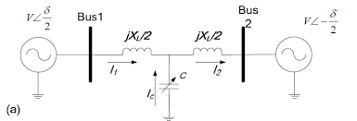
The operation Cont.…
The analysis begins with basic principal of power compensation in transmission system [4] as shown in the simplified model shown in Fig.4.
Two power grids are connected by a transmission line which is assumed lossless and represented by a reactance XL. δ =δ1-δ2
Figure 4. The simplified model of power transmission system.
https://encrypted-tbn0.gstatic.com/images?q=tbn:ANd9GcRlAjMFVnxUwIyRi3X9k6Et_HXfaA_6-QjxIw&s

Slide 27
The operation Cont.…
In Fig.4, the shunt-connected capacitors are used to maintain the voltage levels by compensating the reactive power to transmission lines.
A simplified model of transmission system with shunt compensation is shown in Fig.4, where a controlled capacitor C is shunt-connected at the midpoint of transmission line.
The voltage magnitude at the connection point is maintained as V and the compensation is presented by eqn. 5
The injected reactive power by the capacitor to regulate the voltage at the midpoint of the transmission line is calculated as:
eqn.(5)

Slide 28
The operation Cont.…
Characteristics of Compensated Transmission Lines:
Improved Voltage Regulation: Compensation devices help regulate voltage by either injecting or absorbing reactive power as needed.
This helps maintain a more constant voltage level along the entire length of the transmission line, even under varying load conditions.
Reduced Line Losses: By improving the power factor and controlling reactive power flow, compensated lines reduce losses, particularly reactive losses
which can improve the efficiency of the power system.

Slide 29
The operation Cont.…
Increased Power Transfer Capability: With series compensation, the line's total reactance is reduced, allowing more power to be transmitted over the same line without causing excessive voltage drops or overheating.
Better Power Factor: Compensation techniques, particularly shunt capacitors or synchronous condensers, improve the system's overall power factor by reducing the amount of reactive power that must be supplied by the generation system.
Dynamic Performance: Devices like SVCs and STATCOMs provide fast, continuous adjustments to reactive power to accommodate rapid changes in load, improving system stability and reducing voltage fluctuations.

Slide 30
The operation Cont.…
Operation of Compensated Lines:
Series Compensation: When series capacitors are used, they reduce the total inductive reactance of the line, which helps to increase the power transfer capacity, decrease the line's impedance, and mitigate voltage drops.
Shunt Compensation: Shunt devices like capacitors or synchronous condensers inject leading reactive power into the system to balance out inductive reactive power, reducing the strain on the system and improving voltage levels.
Enhanced System Stability: Dynamic compensation devices like STATCOM can adjust the reactive power in real-time to stabilize the system during load variations or disturbances, ensuring the voltage and power flow remain stable.

Slide 31
The operation Cont.…
Table 1:Comparison: Uncompensated vs. Compensated Transmission Lines[5].
Feature | Uncompensated Line | Compensated Line
Voltage Regulation | Poor voltage regulation; voltage drops | Better voltage regulation; more stable voltage
Power Factor | Poor power factor (lagging due to inductance) | Improved power factor (reduced reactive power demand)
Line Losses | Higher active and reactive power losses | Reduced losses, especially reactive power losses
Transmission Capacity | Limited, due to high reactance and voltage drops | Increased capacity, as series compensation reduces reactance

Slide 32
The operation Cont.…
Feature | Uncompensated Line | Compensated Line
System Stability | Prone to voltage instability and reactive power issues | Improved system stability and voltage control
Dynamic Response | Slow response to load changes | Fast dynamic response with devices like SVC, STATCOM
Compensation Devices | None (except for natural line impedance) | Series capacitors, shunt capacitors, SVC, STATCOM, FACTS
Efficiency | Less efficient, especially over long distances | More efficient due to improved voltage and power factor

Slide 33
5. Voltage Stability Analysis in Power Systems
The ability of a power system to sustain constant voltages at each bus in the system both during regular operation and following disturbance is known as voltage stability.
The ability of the system to withstand voltage collapse, or significant voltage variations, and sustain appropriate voltage levels throughout the grid is known as voltage stability.
Significant operational issues like voltage collapses, blackouts, and damage to electrical equipment can result from voltage instability.
Power engineers can maintain a stable power supply by using voltage stability analysis to identify the boundaries of voltage stability and implement remedial solutions

Slide 34
Voltage Stability Analysis in Power Systems Cont.…
Steps needed in Voltage stability analysis(steady state) are :
Collect the necessary data of the network(generation, line, load, bus and other data)
Model the network for steady state case , without any contingency
Observe the network performances (bus voltage, line flow , load power, and bus voltage angles)
Compare the results with acceptable standards
Design the voltage stability improvement mechanisms if the network voltage stability is violated

Slide 35
Voltage Stability Analysis in Power Systems Cont.…
Steps needed in Voltage stability analysis(dynamic stability analysis ) are :
Collect the necessary data of the network(generation, line, load, bus and other data)
Model the network for steady state case , without any contingency
Observe the network performances (bus voltage, line flow , load power, and bus voltage angles)
Compare the results with acceptable standards
Apply contingency if the steady state case is under acceptable limits
Observe the network power system parameters with contingency
Design the voltage stability improvement mechanisms if the network voltage stability is violated
Check the network stability with the compensation devices

Slide 36
Voltage Stability Analysis in Power Systems Cont.…
Types of Voltage Stability:
Static analysis is usually performed by examining the system's power flow or load flow solution.
Dynamic voltage stability is the system's time-dependent reaction to disruptions like abrupt changes in load, generator failures, or faults.
It examines how the system respon The ability of the system to sustain constant voltage levels in steady-state circumstances is the major focus of static voltage stability.
Without taking into account quick dynamics or time-varying effects, it investigates how voltage is impacted by modifications to the load and system setup.
Usually, static analysis is carried out by examining the system's power flow or load flow solution.It examines how the system responds over time and whether a disturbance can cause the system to stabilize.
The relationship between the electrical network and the control systems—such as load controllers and automatic voltage regulators—is taken into account by dynamic stability.

Slide 37
Summary
It is observed that the reactive power compensation is very important in maintaining the system voltage stability, reduces the power loss and enhances the overall efficiency of power network.
Thus, compensated transmission lines are critical for modern power systems that operate over long distances or in areas with fluctuating load demands.
They help mitigate voltage drops, reduce reactive power, improve system efficiency, and enhance overall power transfer capacity.
Whereas, uncompensated lines, while simpler, suffer from significant issues like voltage instability, increased losses, and limited transfer capacity, making compensation an essential part of modern electrical transmission systems.
The ability of power network to withstand a credible contingency like gradual change in load voltage, voltage collapse, or significant voltage variations while sustaining an acceptable voltage levels throughout the network bus before and after contingency is known as voltage stability.

Slide 38
References
[1]. S., Adegoke; Y., Sun and Z., Wang . ‘’A mini review on optimal reactive power dispatch incorporating renewable energy sources and flexible alternating current transmission system’’. Springer: Electr. Eng V.106(2024). Pp: 3961–3982. Doi: https://doi.org/10.1007/s00202-023-02199-2
[2]. N., Akhil; K., Kamal; B., Muhammad and etl. ‘’Reactive power compensation is the process of managing or reducing the effects of reactive power to improve the efficiency and stability of an electrical power system’’. Elsevier: Results in Engineering. V.23(2024). https://doi.org/10.1016/j.rineng.2024.102449
[3]. H., Dushuo; W., Fan; Z., Guangquan and etl. ‘’Analysis on Electrical Characteristics of Interconnected Power Supply System of Traction Substation Group’’. 2024 . doi: 10.1007/978-981-99-9319-2_53.
[4]. M., Puka; N., Hobdari; L., Gjini and M., Qemali. "Impact of shunt compensation in improving voltage level of overhead transmission lines“. 2015. UBT International Conference. https://knowledgecenter.ubt-uni.net/conference/2015/all-events/48
[5]. S.,Ya Min and Z., Aung. ‘’Performance Analysis on Transmission Line for Improvement of Load Flow’’. Advanced Materials Research. V.433-440(2012). Pp: 7208-7212. doi:10.4028/www.scientific.net/AMR.433-440.7208.

Slide 39
Thank you !

