Slide 1
Power Systems Operation and Control
Lecture 13
Voltage control
Lecturer: Teshome Goa (Assist. Prof.)
Lecture learning outcomes:
At the end of this lecture, you will be able to:
Understand the importance generator voltage control
Knows the Analysis mechanism of generator voltage control
Develop the mathematical model of Voltage control
Identify the types transmission and load side voltage control

Slide 2
Content
Introduction
Analysis of Generator Voltage Control
Mathematical Representation of AVR Control
Voltage controller at Transmission and Load side
Summary
References

Slide 3
Introduction
Voltage control refers to maintaining or adjusting the voltage at a specific point in a system (like a power grid, amplifier, or electronic circuit).
Voltage control is essential in ensuring that devices or systems operate within the specified voltage limits for optimal performance, efficiency, and safety.
In power systems, voltage control is used to maintain voltage levels within acceptable ranges to prevent voltage instability and ensure reliable power distribution.
Industrial and domestic loads, both, require real and reactive power.
Hence, generators have to produce both real and reactive power.
Reactive power is required to excite various types of electrical equipment as well as transmission network.
Basically, the reactive power transmitted over a line a great impact on the voltage profile.

Slide 4
Introduction Cont.…
Hence, by controlling the production, absorption and flow of reactive power at all levels in the system, the control of voltage levels is accomplished.
For efficient and reliable operation of power systems, the control of voltage and reactive power should satisfy the following objectives;
Voltage at the terminals of all equipment in the system are within acceptable limits.
The reactive power flow is minimized so as to reduce losses to a practical minimum.
Key components are:
Voltage Regulators: Devices that automatically maintain a constant voltage level.

Slide 5
Introduction Cont.…
Tap-Changing Transformers: Transformers that adjust the voltage by changing the number of turns in the winding.
Shunt Capacitors/Inductors: Used to provide reactive power support to regulate voltage.
Synchronous Condensers: Machines that provide reactive power, helping to maintain system voltage levels.
Voltage Control Challenges in Power Systems:
Voltage regulation is more difficult in areas far from generation sources
Demand fluctuations can cause voltage drops or surges.
Reactive power balance must be maintained to ensure stable voltage.

Slide 6
Introduction Cont.…
Important generators of reactive power are
  Over-excited synchronous machines
  Capacitor banks, the capacitance of overhead lines and cables
  Static var compensators
Important consumers of reactive power are
  inductive static loads, shunt reactors, inductance of overhead lines and cables

Slide 7
Introduction Cont.…
Under-excited synchronous machines,
Transformer inductances, induction motors
Static var compensators
For some of these, the reactive power is easy to control, while for others it is practically impossible.
The most important devices for reactive power and voltage control are described hereafter.

Slide 8
2. Analysis of Generator Voltage Control
Generators are often operated at constant voltage by using an AVR which senses the terminal voltage level
Then, adjusts the excitation to maintain constant terminal voltage also maintain the reactive output at the required level.
The main purpose of the excitation system of a synchronous machine which may be either:
DC excitation, AC excitation or Brushless excitation scheme is to feed the field winding with direct current so that the main flux in the rotor is generated, which is presented in Fig.1.

Slide 9
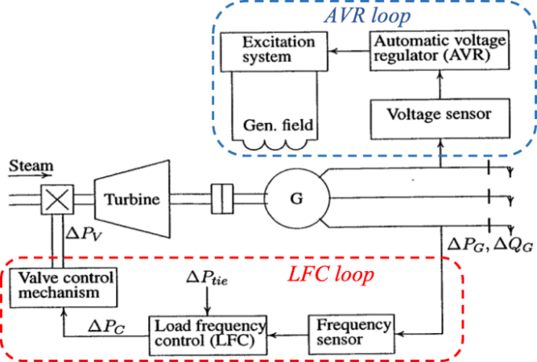
Analysis of Generator Voltage Control Cont.…
Figure 1. AVR control loop.
URL: https://www.researchgate.net/publication/359877348/figure/fig1/AS:1174762151780352@1657096531149/control-systems-of-synchronous-generator.ppm

Slide 10
Analysis of Generator Voltage Control Cont.…
In mathematical terms, the terminal voltage is the potential difference that is obtained at the generator's output terminals and is modeled to show how it varies in relation to loads.
In addition to decreasing as load increases (load current times the square of armature reaction), it is proportional to the generated EMF[1].
The relationship between the alternator's terminal voltage and induced voltage is shown in Fig. 2, and it may be expressed mathematically as follows:
Under different loading conditions especially when there is constant real power and variable reactive power demand, the terminal voltage will vary.

Slide 11
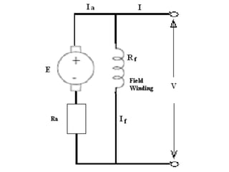
Analysis of Generator Voltage Control Cont.…
Initially, assume that the current is operating at unity power factor and no reactive power generation at the alternator.
Figure 2. The relationship between terminal voltage and induced EMF of Generator.
URL: https://image.slidesharecdn.com/10-4-1terminalvoltage-090521230733-phpapp01/85/10-4-1-Terminal-Voltage-9-320.jpg.

Slide 12
Analysis of Generator Voltage Control Cont.…
Then, for any change in reactive power demand, the alternator should supply the demand, if there is no any other device to respond.
On the other hands, if the excitation is not changes as load varies, the terminal voltage of the alternator deviate from the desired value.
This affects the voltage distribution in the system.
Accordingly, to avoid the voltage fluctuation the excitation of the alternator has to take action accordingly.
To understand how the voltage can be maintained using excitation system, separate the voltage control diagram should be consider as given in Fig.3.

Slide 13
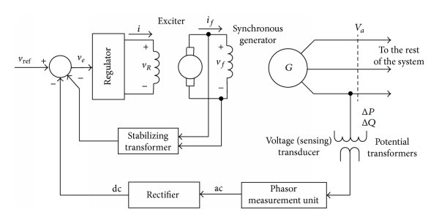
Analysis of Generator Voltage Control Cont.…
  Vref - VT = Δe
eA = kA Δe,
V_{T}
Figure 3. The AVR Voltage excitation system
https://www.researchgate.net/publication/270915156/figure/fig5/AS:1088660296470549@1636568249232/The-schematic-block-diagram-of-the-generator-excitation-control-system.jpg

Slide 14
Analysis of Generator Voltage Control Cont.…
An excitation system's primary job is to supply the synchronous generator's field winding with the required direct current. To maintain the necessary terminal voltage, the excitation system must be able to automatically modify the field current.
An exciter, a different source, provides the DC field current.
Over the years of their development, excitation systems have evolved into a variety of shapes.
The various kinds of excitation systems are as follows.
1. DC excitation Systems
2. AC excitation Systems
3. brushless AC excitation Systems
4. static excitation Systems

Slide 15
Analysis of Generator Voltage Control Cont.…
An exciter is a DC generator that supplies power to the primary synchronous generator in a DC excitation system.
Slip rings and brushes are used to supply the necessary field current to the synchronous generator because its field is located in the rotor.
The same turbine shaft that powers the generator itself also powers the DC generator.
Fig. 4 depicts one type of basic DC excitation system[2].
The response time of this kind of DC excitation device is slow.
Typically, a 10 MVA synchronous generator needs a large DC generator with an exciter power rating of 20 to 35 KW.
DC excitation systems are gradually becoming obsolete as a result of these factors.

Slide 16
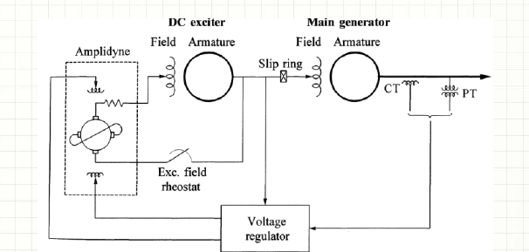
Analysis of Generator Voltage Control Cont.…
Figure 4. DC excitation system.
Url: https://eepowerschool.com/wp-content/uploads/2018/06/DC-excitation-system-with-amplidyne-voltage-regulators.png

Slide 17
Analysis of Generator Voltage Control Cont.…
In an AC excitation system, an alternator with a high enough rating to provide the necessary field current to the main synchronous generator's field takes the place of the DC generator.
This plan rectifies the voltage of a three-phase alternator and obtains the required DC supply.
It is typically necessary to have two sets of slip rings: one to supply the synchronous generator's rotating field and the other to feed the alternator's rotating field.
Figure 5 displays the fundamental building parts of an AC excitation system.

Slide 18
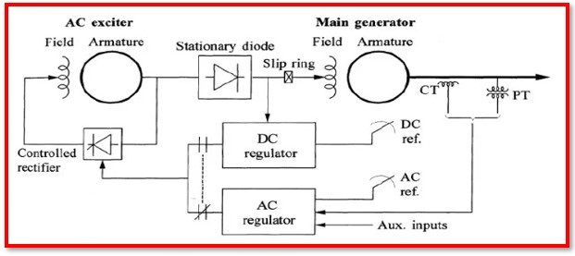
Analysis of Generator Voltage Control Cont.…
Figure 5. AC excitation system.
Url: https://cdn.automationforum.co/uploads/2022/08/Excitation-System-in-Generator-4.jpg

Slide 19
Analysis of Generator Voltage Control Cont.…
In a static excitation system, a system of transformers, rectifiers, and reactors feeds back some of the AC from each phase of the synchronous generator output as DC excitations to the field windings.
To first excite the field windings, an external DC source is required.
The storage batteries that are used to start the engine of engine-driven generators can provide the initial excitation.

Slide 20
Analysis of Generator Voltage Control Cont.…
Brushless AC excitation, which uses an inverted alternator with a field at the stator and an armature at the rotor as the exciter, has supplanted the older form of AC excitation system.
The exciter's AC voltage is changed to DC voltage using a full wave rectifier.
The synchronous generator's field, the exciter's armature, and the full wave rectifier make up the spinning parts.
The revolving parts or rotor are fixed to a single shaft.
Figure 6 depicts this type of brushless AC excitation system.

Slide 21
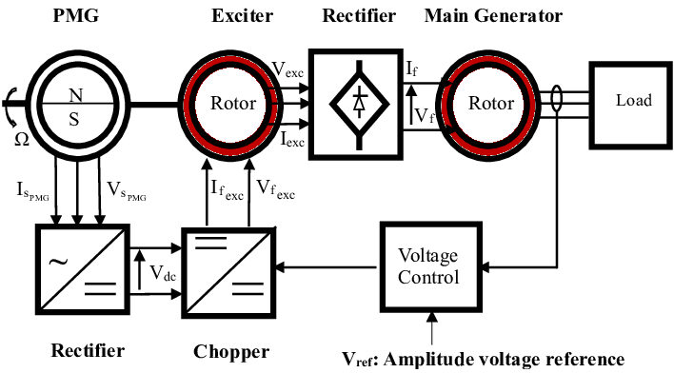
Analysis of Generator Voltage Control Cont.…
Figure 6. Brushless excitation synchronous generator.
Url: https://www.researchgate.net/publication/329883863/figure/fig1/AS:707174099603456@1545614852641/Schematic-mechanism-of-brushless-excitation-synchronous-generator.png

Slide 22
Analysis of Generator Voltage Control Cont.…
Generally, during typical little and gradual variations in the load, the alternator terminal voltage must remain constant.
The alternators have an Automatic Voltage Regulator (AVR) for this reason.
The primary element of the AVR loop is the exciter, which provides the alternator field with DC power
It must have a suitable speed of response (rise time less than 0.1 seconds) and a sufficient power capacity (in the low MW range for big alternators).
There are many different kinds of exciters. The exciter in older power plants was a DC generator that was powered by the main shaft.
With this configuration, slip rings and brushes are needed to deliver DC power to the synchronous generator field.
These days, most exciters are either brushless or AVR loop as presented in Fig.7

Slide 23
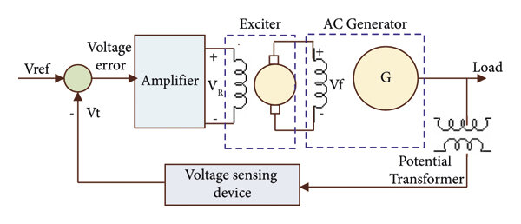
Analysis of Generator Voltage Control Cont.…
Figure 7. The simplified Circuit diagram of AVR control.
URL: https://www.researchgate.net/publication/367445648/figure/fig1/AS:11431281115270492@1674828275475/Simplified-model-of-the-AVR-loop.jpg

Slide 24
3. Mathematical Representation of AVR Control
The function of important components and their transfer function is given below
  Potential transformer: It gives a sample of terminal voltage, VT
  Differencing device: at the feedback point, V_{ref} - V_{T} = Δe
  Error amplifier: It demodulates and amplifies the error signal. Δe_{A} = k_{A} Δe, where k_{A} is amplifier gain.
  SCR power amplifier and exciter field: It provides the necessary power amplification to the signal for controlling the exciter field as presented in eqn.1.
  eqn.(1)

Slide 25
Mathematical Representation of AVR Control Cont.…
where Δi_{e} is the change in exciter field current.
If 1A change in field current produce k volt change in the output, then :
eqn.(2)
Then, the transfer function of the exciter using Laplace equation can be expressed as :
eqn.(3)
Then, for alternator that its field is excited by the main exciter voltage
Accordingly, under the no-load condition, the alternator produces a voltage proportional to field current as presented in eqn.(4).
  eqn.(4)

Slide 26
Mathematical Representation of AVR Control Cont.…
  The input voltage signal Δef to the generator field, when applied to the circuit results in the following Kirchhoff's voltage equation.
  If the output voltage deviations is by Δv, then, the relationship between field current and voltage for L_{fa} is the mutual inductance between the field and stator phase winding is presented in eqn.(5).
eqn.(5)

Slide 27
Mathematical Representation of AVR Control Cont.…
Hence, the transfer function for the generator block based on the input-output voltage relationship is provided in eqn.6
eqn.(6)
Where, K_{gf} is the gain constant equivalent to and T_{gf} is the settling time constant given by

Slide 28
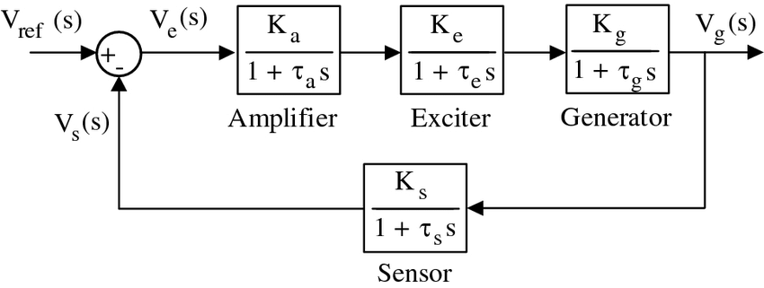
Mathematical Representation of AVR Control Cont.…
Finally, the voltage regulator loop is developed based on the above equations, eqn.1 to eqn.6 relationship and presented in Fig.8
Figure 8. The AVR closed loop control block diagram.
Url:https://www.researchgate.net/publication/337023929/figure/fig1/AS:960027519094795@1605899805553/Block-diagram-of-an-AVR-system.png

Slide 29
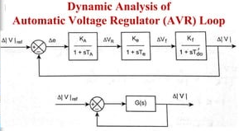
Mathematical Representation of AVR Control Cont.…
The equivalent transfer function blocks of the AVR loop can be grouped into a single block and presented in Fig.9.
Figure 9. AVR Control Transfer function loop.
Url: https://image.slidesharecdn.com/unit-3-ppt2-230816075010-873ab49b/85/UNIT-3-PPT-2-pptx-28-320.jpg.
eqn.(7)

Slide 30
Mathematical Representation of AVR Control Cont.…
From eqn.7, the input-output relation can be given by:
eqn.(8)
It is observed that we can change or control the output voltage by changing the reference input voltage while changing or controlling the excitation systems and other necessary parameters.

Slide 31
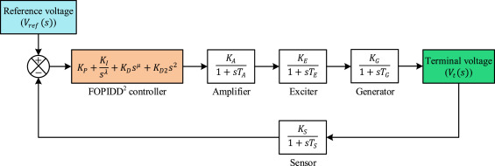
Mathematical Representation of AVR Control Cont.…
The error can be further reduced using PID controller with tunings as presented in Fig.10[3].
Figure 10. The AVR control with PID control system.
Url: https://ars.els-cdn.com/content/image/1-s2.0-S2772671123002206-gr4.jpg

Slide 32
4. Voltage controller at Transmission and Load side
Shunt Reactors: are used to compensate for the effects of line capacitance, particularly to limit voltage rise on open circuit or light load.
Shunt Capacitors at Transmission and distribution systems: supply reactive power and boost local voltages. They are used throughout the system and are applied in a wide range of sizes.
Synchronous condenser: is a synchronous machine running without a prime mover or a mechanical load.
By controlling the field excitation, it can be made to either generate or absorb reactive power.
Static VAR compensators (SVCs): may be comprised of two different elements, i.e TCR and TSC.

Slide 33
Voltage controller at Transmission and Load side Cont...
By delaying the firing of the Thyristors, a continuous control of the current through the reactor can be obtained, with the reactive power consumption varying between 0 and V2/X.
SVC: By combining the TCR with a suitable number of capacitor banks, a continuous control of the reactive power can be achieved by a combination of capacitor bank switching and control of reactor
current.
The control system of the SVC controls the reactive output so that the voltage magnitude of the controlled node is kept constant.

Slide 34
Summary
The brief overview of Voltage control in the power system is discussed in this lecture.
Thus, maintaining the system voltage, specifically the generation and network bus voltage is very essential for reliable and stabile power supply
Voltage control can be achieved either by controlling the generation voltage using AVR, transformer tap changing and hence using reactive power generating equipment's.
In this lecture, the AVR control loop modeling is carried out through the modeling of voltage transformer, amplifier, excitation system and the generator itself.
Accordingly, the overall closed loop of AVR is developed and its transfer function is also carried out.
Finally, the importance of using PID control in minimizing the error is also discussed.

Slide 35
References
[1]. C., Martin; K., Chi; Z., Chunbo and etl. ‘’State-of-Charge Determination From EMF Voltage Estimation: Using Impedance, Terminal Voltage, and Current for Lead-Acid and Lithium-Ion Batteries’’. IEEE TRANSACTIONS ON INDUSTRIAL ELECTRONICS, V.54(5), 2007. Digital Object Identifier 10.1109/TIE.2007.899926.
[2]. R., Mehdi and V., Abolfazl. ‘’Rotary Diode Failure Detection in Brushless Exciter System of Power Plant Synchronous Generator’’. Proceeding of 6th Conference on Thermal Power Plants, Iran University of Science and technology, 19-20 Jan. 2016. DOI: 10.1109/CTPP.2016.7482926.
[3].I., Davut; M., Rizk; S., Václav and etl. ‘’A novel control scheme for automatic voltage regulator using novel modified artificial rabbits optimizer’’. Elsevier: e-Prime - Advances in Electrical Engineering, Electronics and Energy. V.6(2023). https://doi.org/10.1016/j.prime.2023.10032

Slide 36
Thank you !

