Slide 1
Power Systems Operation and Control
Lecture 14
Power system Security-Contingency Analysis
Lecturer: Teshome Goa (Assist. Prof.)
Lecture learning outcomes:
At the end of this lecture, you will be able to:
Understand the security constraints contingency analysis
Knows the process of contingency analysis
Differentiate the types of security assessment techniques
Formulate the sensitivity analysis methods to rank the contingency

Slide 2
Content
Introduction
Important Components of Contingency Analysis
Process of Contingency Analysis
Security Assessment Techniques
Sensitivity Analysis
Applications of Contingency Analysis in real world
Summary
References

Slide 3
1. Introduction
The capacity of a power system to continue operating steadily and dependably in the face of disruptions or failures is known as power system security[1].
These disruptions may be brought on by operational mistakes, weather-related conditions, or equipment malfunctions.
Making ensuring the power system is secure, reliable, and capable of swiftly recovering from disruptions is the aim of power system security.
Contingency analysis is one of the main methods used to evaluate a power system's security.
In order to make sure the power system can continue to function dependably, this procedure assesses how well the system performs under a range of possible fault or failure scenarios, or contingencies.

Slide 4
Introduction Cont.…
Contingencies Analysis:
Helps to ascertain whether a power system can withstand the loss of essential components (such as generators, transmission lines, transformers, etc.) without resulting in system instability or operational limit breaches[2].
contingency analysis involves simulating a variety of fictitious failure scenarios.
It ensures that the system can endure disruptions (such as a line outage or a generator tripping) and carry on without experiencing cascading failures is known as system reliability.
Operational Limits: Verifying that during the contingency, transmission line loading, generator outputs, and voltages do not beyond their operational limits.

Slide 5
Introduction Cont.…
Determining if load shedding is required to preserve system stability is known as load shedding.
Maintaining voltage levels within reasonable bounds following a disruption is known as voltage stability.
Evaluating the system's capacity to sustain frequency within reasonable limitations is known as frequency stability.
Types of Contingencies are :
Single Contingencies: The failure of a single system component, such as loss of a transmission line, loss of a generating unit, failure of a transformer and loss of a system bus.

Slide 6
Introduction Cont.…
Multiple Contingencies: The failure of multiple components occurring simultaneously, which could lead to more severe consequences, such as cascading failures or blackouts
N-1 Contingency: A standard used in power system security analysis, which assumes that the system is able to tolerate the failure of any single component
N-2, N-3 Contingencies: More severe contingency scenarios involving the loss of two or three components, respectively.
Contingency analysis more than N-1 is more complex and needs critical engineering solutions

Slide 7
2. Important Components of Contingency Analysis
Simulation of Power Flow: Simulating the system's power flow under typical circumstances and then modeling the system's reaction to different contingencies is the most popular technique for doing contingency analysis[3].
Usually, state estimation or load flow techniques are used for this.
Network Topology: The network topology, which includes the linkages between transmission lines, transformers, and generators, is taken into consideration in contingency analysis.
System Constraints: A number of operational restrictions are put in place during the analysis: limits of the generator, restrictions on voltage at different busses and thermal restrictions of transmission lines.

Slide 8
Important Components of Contingency Analysis Cont.…
Security Criteria: A number of standards are established to assess the stability of the system:
Verifying that the voltages at each bus stay within allowable bounds is known as voltage stability.
Keeping transmission cables from being overloaded past their thermal limits is known as transmission overload.
Making certain that no generators are operating above their capacity limits is known as generator overloading.

Slide 9
3. Process of Contingency Analysis
The following steps are needed[4]:
Power System Modeling Generators, loads, transmission lines, transformers, and buses are all included in the comprehensive model of the power system.
Simulate Base Case: The "healthy" system is represented by the system being examined in its typical working state, or base case.
Use contingencies: A number of malfunctions or failures are modeled, including the loss of a generator or transmission line.
The way the system reacts to these occurrences is examined.

Slide 10
Process of Contingency Analysis Cont.….
Evaluate Stability: The system's performance is assessed following each circumstance to determine whether it is still secure and stable
Mitigation Measures: Considering the outcomes of the contingency analysis, then:
Re-dispatching generation to balance the system.
Changing the topology by switching lines or equipment.
Installing additional equipment, such as reactive power compensators or flexible AC transmission systems (FACTS).

Slide 11
Process of Contingency Analysis Cont.….
An equally important factor in the operation of a power system is the desire to maintain system security.
Security of supply is a measure of the power system’s capacity to continue operating within defined technical limits even in the event of the withdrawal of a major power system element
Failure such as an interconnector or large generator or any piece of equipment in the system due to either internal or external causes such as lightning strikes, objects hitting transmission towers, or human errors in setting relays.
Hence, the EMS has to operate the system at minimum cost, with the guaranteed alleviation of emergency conditions such as violations of operating limits, contingencies.

Slide 12
Process of Contingency Analysis Cont.….
Three main tasks that are performed in an energy control center can be categorized as part of system security:
A. System monitoring: provides operators of the power system with current, relevant information on the state of the power system.
Data is measured and transmitted by telemetry systems, which are then processed by digital computers in a control center, which alert operators in the event of an overload or limit violation.
B. Contingency analysis: this simulates "what if" scenarios and emergency identification in order to predict potential system issues (outages) before they happen.

Slide 13
Process of Contingency Analysis Cont.….
This makes it possible for system operators to identify defensive operating states in which no single contingency occurrence will result in voltage violations or overloads.
C. Corrective action analysis: enables the operator to modify the power system's operation in the event of a contingency.
Corrective action is more advisable while the system is at alert stage rather than in extremes state.
If it goes into the extremes state the system blackout will be takes place.

Slide 14
4. Security Assessment Techniques
1. Contingency analysis
Determining the degree of security of a power system is crucial for both planning and daily operations[5].
Since power system security must be interpreted as protection against a number of predefined contingencies without accounting for dynamic concerns, the concept of security and its quantification are conditioned.
Operations personnel must understand which line or generator failures may cause flows or voltages to fall below allowable thresholds.
Until "all credible outages" have been examined, security assessment or contingency analysis procedures model single failure events

Slide 15
Security Assessment Techniques Cont.….
Events, such as a single line or generator outage) or multiple equipment failure events (such as two transmission lines, one transmission line plus one generator, etc.).
The contingency analysis process examines all lines for every outage that is tested.
The contingency analysis process compares all of the network's lines and voltages to their respective limitations for every outage that is tested.
The first step in contingency analysis defining the contingency

Slide 16
Security Assessment Techniques Cont.….
the list of contingencies to be processed is defined based on the probability of occurrence, which is high and which one is low.
The challenge is how to select contingency is needs in-depth knowledge in terms of examining the network
while keeping in mind the real-time operation's requirement for a quick response and ensuring that none of the troublesome ones are overlooked.
Using an approximate model of the power system is one method to speed up the solution process in a contingency analysis technique.
This model should capture the network topology, voltage levels, power flows, and generation capacities.

Slide 17
Security Assessment Techniques Cont.….
Selecting Contingency Scenarios:
A set of potential contingency scenarios is selected, these may include:
Loss of a transmission line or transformer.
Loss of a generation unit or a load.
Line faults or short circuits.
Voltage or frequency instability.
Scenarios are chosen based on the likelihood of occurrences or based on worst-case analysis and the sample is presented in Fig.1.

Slide 18
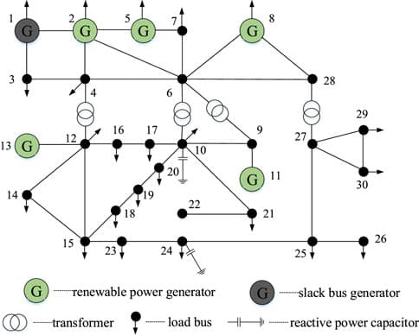
Security Assessment Techniques Cont.….
Figure 1 . Security constrained optimal power flow.
https://library.fiveable.me/_next/image?url=https%3A%2F%2Fstorage.googleapis.com%2Fstatic.prod.fiveable.me%2Fsearch-images%252F%2522Security_constraints_in_Smart_Grid_optimization%253A_thermal_limits_voltage_limits_N-1_criterion_contingency_analysis.%2522-fenrg-10-1086577-g002.jpg&w=640&q=75

Slide 19
Security Assessment Techniques Cont.….
Power Flow Analysis: For each contingency, a power flow analysis (also called load flow analysis) is performed to simulate how the system would behave if the contingency were to occur.
This analysis solves the system of nonlinear algebraic equations describing the electrical power system, calculating voltage magnitudes and angles, real and reactive power flows, and other system parameters.
The sample power flow analysis results based on the contingency Evaluation is shown in Fig.2

Slide 20
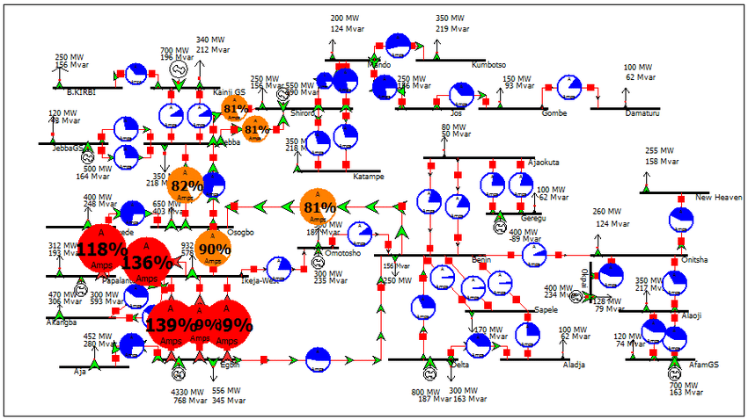
Security Assessment Techniques Cont.….
Figure 2. Contingency based Power flow.
https://www.researchgate.net/profile/Fabian-Izuegbunam/publication/327644869/figure/fig1/AS:670641845989378@1536904884248/Existing-Nigeria-330kV-Power-Grid-Power-World-Flow-Model.ppm

Slide 21
Security Assessment Techniques Cont.….
Post-Contingency Stability Assessment:
After the contingency is applied in the model, the system's ability to return to normal operation or stable operation is evaluated.
This includes, checking if voltage levels remain within acceptable limits.
checking if power flows are within the thermal and stability limits of transmission lines.
Assessing if generators remain synchronized or if there are risks of cascading failures.
Analyzing whether load shedding or re-dispatching generation might be needed to restore stability

Slide 22
5. Sensitivity Analysis
In some cases, sensitivity analysis is conducted to determine which contingencies have the most significant impact on the system’s performance.
This helps in prioritizing critical components and enhancing the reliability of the grid.
For many systems, the linear sensitivity method, which is developed from the DC load flow method provides sufficient capacity by displaying the estimated change in line flows for changes in generation on the network configuration.
Nevertheless, the DC power flow's drawback is that only branch MW flows are computed; neither bus voltage nor MVAR flows are known.

Slide 23
Sensitivity Analysis Cont.…..
The linear sensitivity factors are basically two types:
Generation shift factors – change in line flow (Δfl) due to generation outage (ΔPi)
eqn.(1)
2. Line outage distribution factors - change in line flow (Δf_{l}) due to line outage (f_{k})
eqn.(2)
Accordingly, the loading of line is checked for the generation and line outage cases through sensitivity analysis

Slide 24
Sensitivity Analysis Cont.…..
The flow on line ‘l’ under the assumption that all the generators in the interconnection participate in making up the loss, use eqn.3
eqn.(3)
Where, Yj_{i} is proportionality factor for pick-up on generating unit ‘j’ when unit ‘i’ fails
The power flow on line ‘l’ with line k out can be determined using the ‘d factors
eqn.(4)
Where, f⁰ is the pre-outage flow on each line;
Accordingly, the severity of outage can ranked on the descending order from the most severe outage, which leads to entire network instability to the least-severe outage that will have less impact on the network stability.

Slide 25
Sensitivity Analysis Cont.…..
B. Contingency Ranking Through Performance indices(PI) :
Based on PI, the contingencies are ranked in rough order of severity employing contingency selection algorithms to shorten the list.
The performance indices shows, which line is overloaded or not.
Thus, the overload performance of N interconnected line outage one by one is curried out using eqn.5
eqn.(5)

Slide 26
Sensitivity Analysis Cont.…..
The line results in higher PI valued ranked at the top definition for the overload performance index (PI) is as follows:
The selection steps, then involves a mater of developing the PI Table from the largest to least values .
Accordingly, the lines corresponding to the top of the list are taken as the candidates for the short list.
Another way, to perform an outage case selection is called 1P1Q method, which is used to perform the ranking considering both real and reactive power effect on the network stability.
It is considered as a decoupled power flow, which is used to determine power flow through the lines and the voltage limit violation at each node. Thus, a different PI can is rewritten as:
  eqn.(6)

Slide 27
Sensitivity Analysis Cont.…..
Evaluating Contingency:– evaluation of contingency is usual carried out by the successive individual cases evaluation in decreasing order of severity, from the worst to least case.
The voltage magnitude evaluation takes paramount and the most critical factor in assessing contingencies in most power networks.
Accordingly , the detail evaluation of AC power flow analysis based on whether the network overloaded and voltage limit violations check-ups are important.
When an AC power flow is to be used to study each contingency case, the speed of solution and number of cases to be studied are also another critical.
The flow chart for AC power flow analysis while checking contingency is presented in Fig.3

Slide 28
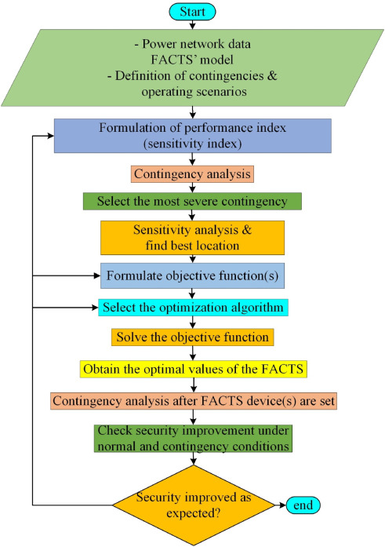
Sensitivity Analysis Cont.…..
Figure 3. Security based contingency analysis.
url: https://ars.els-cdn.com/content/image/1-s2.0-S2405844023017310-gr5.jpg

Slide 29
Sensitivity Analysis Cont.…..
D. Ooperating state:
Classifying the potential system states according to the security level is necessary for a proper understanding of the roles played by the various activities involved in system operation. There are four states:
i. Normal state: no equipment is being overloaded, and all system variables fall within the typical range. Without breaking any of the rules, the system can survive a contingency and functions in a secure manner.
ii. In the alert state, all constraints are met and all system variables remain within the allowable range.
Nevertheless, the system has been compromised to the point where an emergency could result in an equipment overload. The in extremis state may occur if the disruption is really acute.

Slide 30
Sensitivity Analysis Cont.…..
    Emergency state: if a significant enough disruption takes place while the system is in the alert state. Many buses in this condition have low voltages and/or equipment loads that are higher than short-term emergency limits.
    The system is still functional and can be put back into alert mode by starting emergency control.
    Extremis: - cascade outages and even a shutdown of a significant chunk of the system if the actions taken are ineffective. Protecting as much of the system as possible from a widespread blackout is the goal of control measures like load shedding and managed system separation.
    A restorative state is one in which all facilities are being reconnected and the system load is being restored through control measures. The system moves away from this.
    The four states are given in Fig.4

Slide 31
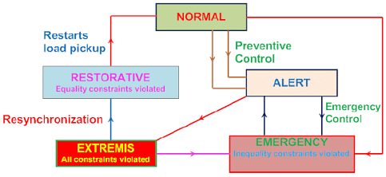
Sensitivity Analysis Cont.…..
Figure. 4Operating state of Power system.
Url:https://edurev.gumlet.io/ApplicationImages/Temp/1611942_2f256fbd-9ba0-40c6-9a79-23e8f606b17b_lg.PNG?w=400&dpr=2.6

Slide 32
Sensitivity Analysis Cont.…..
e. Mitigation and Corrective Actions:
If a contingency leads to instability or overloads, corrective actions are recommended.
These might include: Upgrading transmission lines or equipment.
Implementing additional generation capacity or flexible load resources.
Deploying control schemes (e.g., dynamic line ratings, voltage regulation, or generation rescheduling).
Proposing new operational procedures to enhance the grid’s resilience.

Slide 33
6. Applications of Contingency Analysis in real world
Transmission planning: Making sure transmission networks are resilient to outages.
Real-time System Operations: Assisting grid operators with decision-making to keep the system stable in the case of outages.
Identifying crucial elements whose failure could cause widespread instability and taking action to lower risks is known as risk management.
Reliability assessment is the process of evaluating and making sure power systems adhere to reliability criteria like those set out by the IEEE and NERC (North American Electric Reliability Corporation).
Should comply with the national standards

Slide 34
Applications of Contingency Analysis Cont.….
Helps for Automatic Load Dispatching:
The central hub for power system operation, planning, monitoring, and control is the load dispatch department.
Electricity must be generated as needed because it cannot be stored.
Therefore, it is crucial that the power system be designed and run as efficiently and affordably as possible.
The simple schematic diagram of load dispatch is presented in Fig.5
This is the Load Dispatch Center's primary goal.

Slide 35
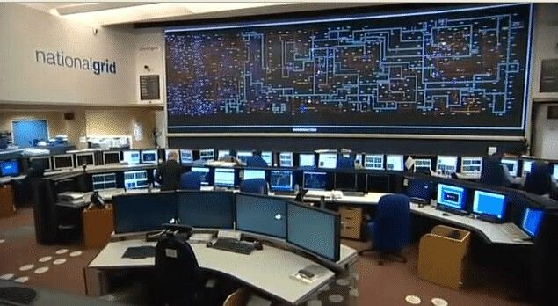
Applications of Contingency Analysis Cont.….
Figure. 5 National Load Dispatch center Sample.
https://i.pinimg.com/736x/66/f9/c6/66f9c62b69060cf87cae6643bb1fe1d5.jpg

Slide 36
Applications of Contingency Analysis Cont.….
To guarantee the electrical system operates in unison.
Giving instructions, exercising monitoring, and exercising control—all necessary for integrated operation in order to maximize power system economy and efficiency.
Resource scheduling and rescheduling for the power system's most efficient and cost-effective operation
To plan the substation equipment and generating unit shutdowns, including transmission lines, while maintaining supply quality and continuity.
System restoration in the shortest amount of time after grid disruptions in a methodical manner.
Energy accounting is the responsibility of the State System.
Gathering and providing information about power system operation.

Slide 37
Summary
In this lecture, the security based contingency analysis for better and stabile operation of power system is discussed
Specifically, the importance of contingency analysis in power system prior to the occurrence of abnormal conditions, which lead to the network instability is discussed well.
In line with this, the security analysis methods like generation shift factor, transmission line outage factor and PI are discussed to rank the impact of some creditable outage in overall network stability.
The types of contingency like N-1, N-2 and N-3 are also discussed well.
In conclusion, a critical technique for evaluating the robustness and dependability of power systems is contingency analysis.

Slide 38
References
[1].M., Asit ; K., Ramasamy; V., Renuga and etl. ‘’Power system resilience and strategies for a sustainable infrastructure: A review’’.Elsevier: Alexandria Engineering Journal. V.105, 2024, Pp:261-279. https://doi.org/10.1016/j.aej.2024.06.092
[2]. A., Rehman; A., Farooq; S., Khan and etl. ‘’Steady state Contingency Analysis of IEEE-39 Bus system Using PSS/E’’. International Journal of Advanced Natural Sciences and Engineering Researches. V.7(7), 2023. Pp: 78–85. https://doi.org/10.59287/ijanser.1339
[3]. A., Reddy; S., Mandal; A. Samanta and etl. "Assessment of Power System Security using Contingency Ranking Analysis“. 5th International Conference on Energy, Power and Environment: Towards Flexible Green Energy Technologies (ICEPE), 2023. pp. 1-6, doi: 10.1109/ICEPE57949.2023.10201584.
[4]. D., Chu; G., Samuel; E.,Eric and T., Emmanuel. ‘’Analysis of contingency scenarios towards a suitable transmission pathway in the southern interconnected grid (SIG) of Cameroon’’. Elsevier: e-Prime - Advances in Electrical Engineering, Electronics and Energy V.7(2024). https://doi.org/10.1016/j.prime.2024.100486
[5]. A., Engidaw ; N., George and M., Christopher. ‘’Techniques of power system static security assessment and improvement: A literature survey’’. Heliyon. V.9(3), 2023. https://doi.org/10.1016/j.heliyon.2023.e14524

Slide 39
Thank you !

