Slide 1

Entrepreneurship and Design Thinking
Lecture two: design thinking and Innovation
Lecturer: Stephen Githii

Slide 2

Introduction
In our lecture one we dived into who an entrepreneur is, their traits, motivations and challenges that characterize their journey
In this lecture we will focus on design thinking and innovation, which is methodology to help an entrepreneur or business to remain relevant, ahead of the competition

Slide 3

Learning Outcomes
Understand and follow the process of design thinking
Generate and refine possible solution/ideas for an identified problem

Slide 4

Opening activity for the topic
This activity will help the learners to appreciate what design thinking is through experience

Slide 5
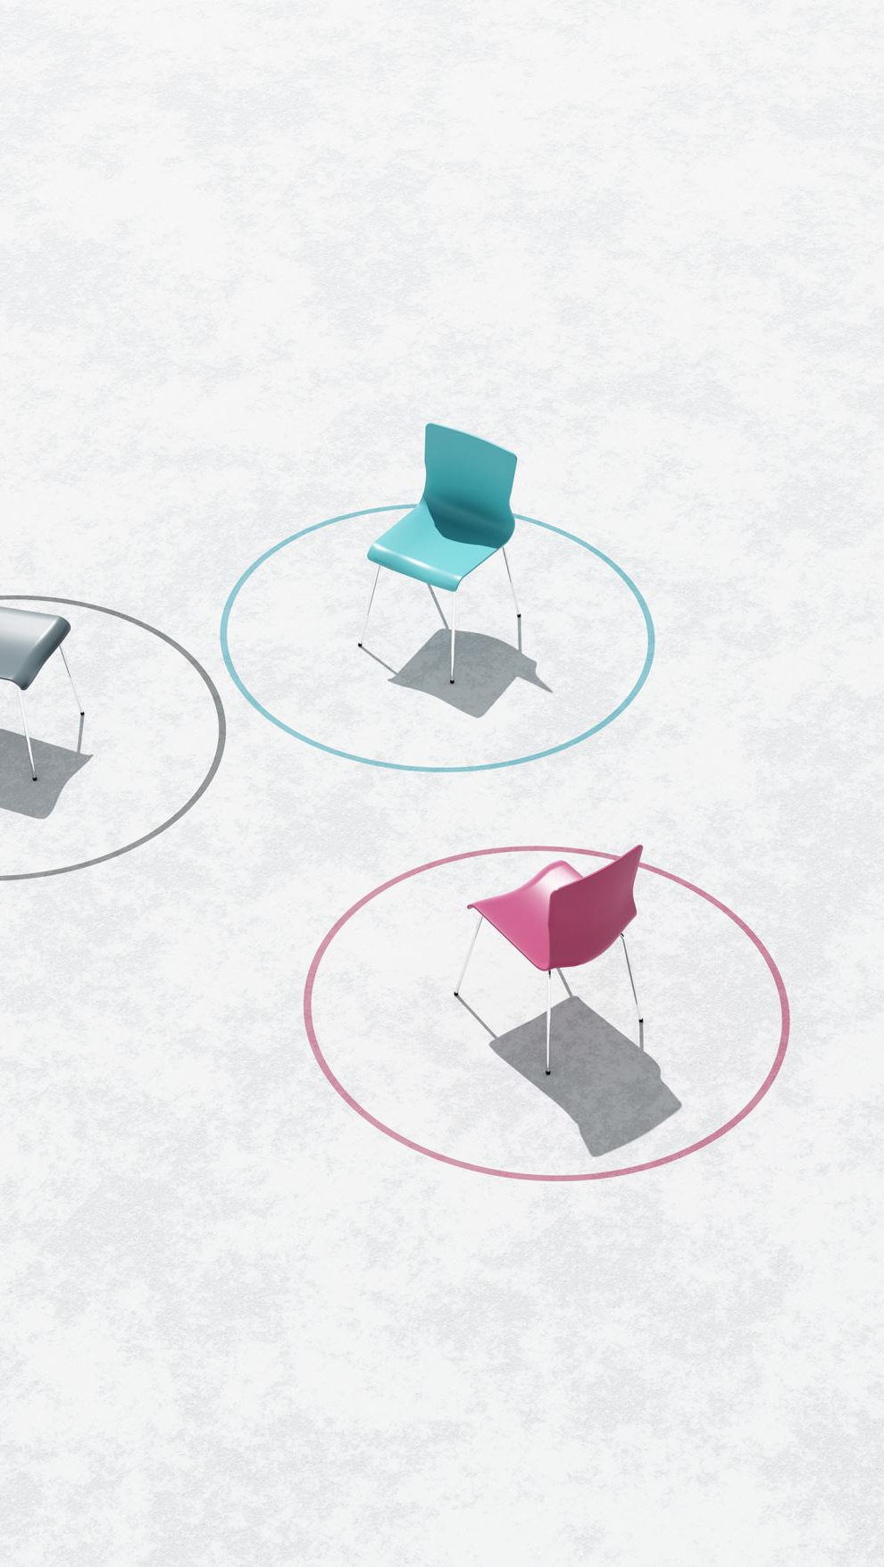
Activity 1 : Design Thinking Dash
This can be downloaded from github https://github.com/mollyclare/design-dash/blob/e87c4dd13a62a299a4d5a8b00413333f3411d762/Design%20Dash%20-%20EN.pdf

Slide 6
Instructions
This is a super-fast introduction to design thinking
Create a group of 3-4 participants
Using post-its, they sketch themselves and their name
Then each team choose a number between 1-30
The circle the number they have chosen
Each team member share three ways they connect with the topic using post-its
Invite an interviewee from another group to a conversation
Use your interview to frame a human-centered design problem
Draw an idea that solves the problem that you found
Build your idea!

Slide 7

Instructions
Hand your prototype to your interviewee
1
Iterate your prototype using the feedback you got from your interviewee
2
Present the iterated product to them and hear and observe their reactions
3

Slide 8
What is Design Thinking?
Design thinking is a flexible and adaptable approach to problem solving and it has evolved over time
  IDEO, this is a global design and innovation firm that is widely known for its human-centered approach
  Stanford design school- their process has five phases; empathize, design, ideate, prototype and test
  IBM design thinking- They use a loop focusing on three main aspects; observe, reflect and make

Slide 9
What is Design Thinking-phases?
Understand
Observe
Synthesis
Ideate
Prototype
Test

Slide 10

UNDERSTAND PHASE
Entrepreneur wants to gain a deep understanding of the problem
From a design thinking perspective, it is about immersing yourself in the user’s world
This phase mostly happens outside the user's environment

Slide 11

Tools for the phase
Desktop research and stakeholder mapping may be useful tools in gathering the necessary information that an entrepreneur needs to understand the problem

Slide 12

Output of this phase
Clear problem statement and
A list of stakeholders and potential needs

Slide 13

Example
If a bank is trying to come up with a technological solution to farmers, it will first collect data and information about them and this could entail challenges they are facing, trends in the market, current financial solutions they are using

Slide 14
2. OBSERVE PHASE
In this phase the entrepreneur must now move to the user’s environment to experience the problem firsthand
The objective here is to understand and observe their behaviors

Slide 15

Tools for the phase
Interview guide and questionnaire: structure few questions to help you gather more information of the problem
Shadowing: Staying with the user and following them in their normal routine to see what they do and how they do it
Journey mapping: this helps you to track the user’s journey from start to the end

Slide 16

Output of the phase
Identification of the pain points: An entrepreneur can see first-hand the pain points that the user is facing and how they are facing them
Clear sets of user behavior patterns
A clear set of key insights and opportunities for innovation

Slide 17

3. SYNETHSIS PHASE
The phase helps the entrepreneur to find the true meaning of the research done
The phase is about trying to make sense of data gathered, trends from the data, to narrow down the problem
To be clearer about the problem

Slide 18

Tools for the phase
Persona: Creating a detailed and vivid profile of the user based on your observations
Empathy map: An empathy map is a visualization that captures our understanding of a set of users

Slide 19

Output of the phase
A refined problem statement that is clear
A persona highlighting user’s pain points and needs
Areas of innovation

Slide 20

4. IDEATION PHASE
After the problem is now well understood and clear in the mind of an entrepreneur, the next phase is to start getting answers or possible solutions to it
This process entails exploration of possible solutions to the identified problem or challenge

Slide 21
Tools for the phase
Brainstorming- this could be a group or individual activity where participants express the idea that comes to mind without criticism or evaluation
01
Brain write- this is not verbal but written, normally you write down your idea and after a few minutes you pass it on to the next person who could build on it
02
Brain walk – this is like brain write, however instead of passing on a note you walk to other people stations where you can elaborate their ideas
03

Slide 22

Tools for the phase
Worst possible idea- here instead of focusing on good idea, you flip the brainstorming by calling for worst possible ideas
Sketches- design thinking is heavy on visual, and sketches allow participants to express their idea in the form of a picture or diagram
Storyboard –stories are common ways of communication

Slide 23

Output of the phase
Potential “best” and most promising idea which can move to the next phase of prototyping

Slide 24
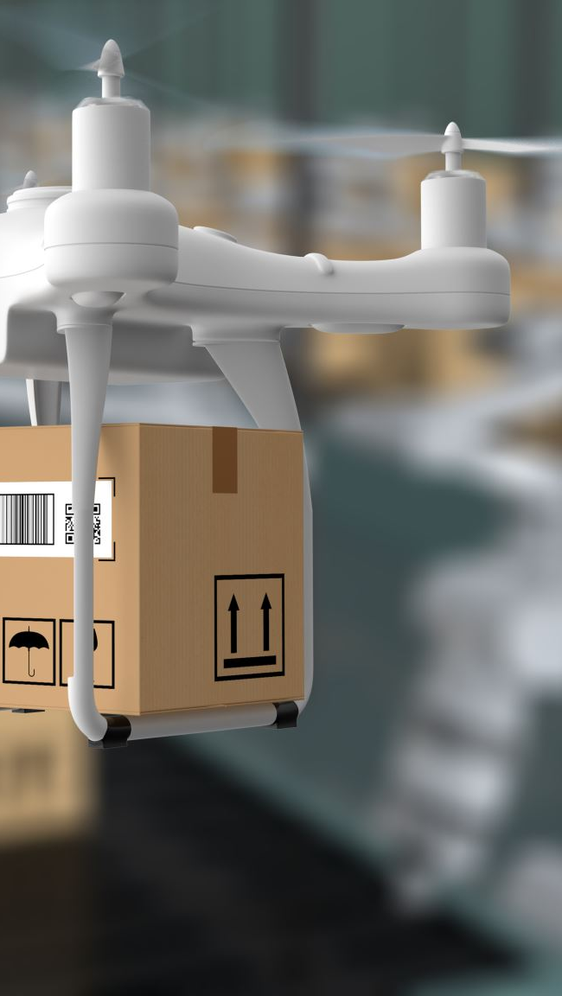
Example
For a food delivery service, ideas may include new ordering features, automated customer support, use of drones, or partnerships with local courier services

Slide 25
5. PROTOTYPING PHASE
In this phase, the entrepreneur creates a tangible solution that the user can relate with
Using available and inexpensive materials the entrepreneur tries to come up with a number of prototypes

Slide 26

Tools for the phase
Low fidelity prototype- Sketches, models, wire frames are often used in this phase since they are quick to make and iterate using available resources
Storyboarding: This is a visual sequence of how a user would interact with the solution

Slide 27
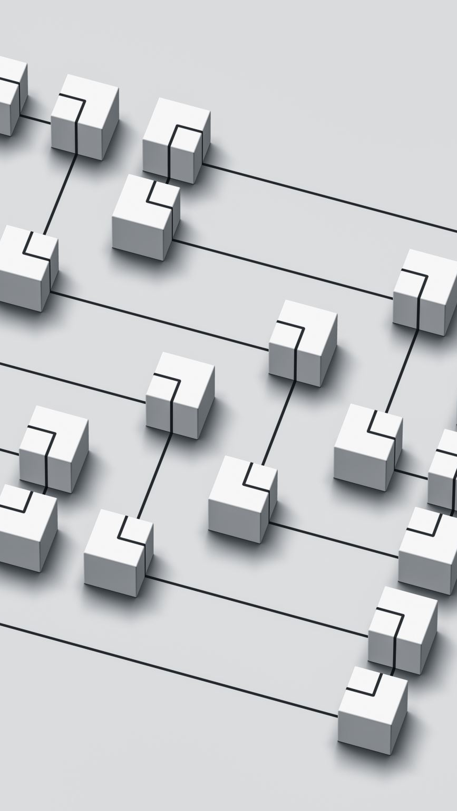
Output for this phase
A working model of prototype that users can interact with

Slide 28

Example
A team that was trying to solve the inadequate food problem came up with a solar powered irrigation system as shown in picture

Slide 29
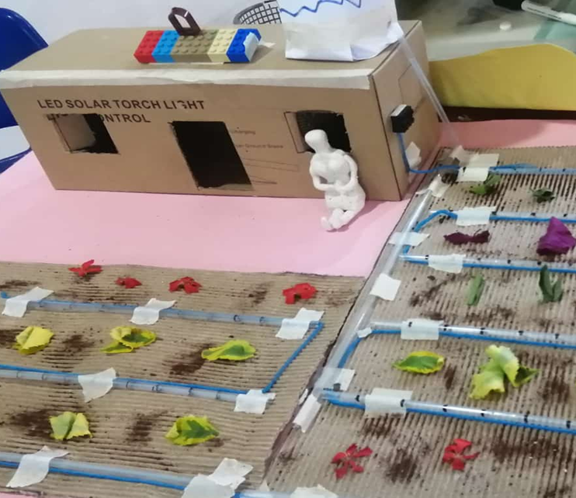
Sample Prototype

Slide 30
6. TESTING PHASE
Entrepreneur goes out with the prototype they have developed and test how the user would interact with the solution
Every iteration makes the prototype more and more realistic and functional

Slide 31

Tools for the phase
Feedback capture grid: with four quadrants;
I like, I wish, what if grid:

Slide 32
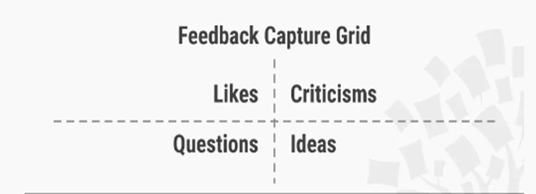
Feedback capture grid
Dam and Teo 2023

Slide 33

Output of the phase
User feedback/insights
A refined solution that is ready for further development or implementation

Slide 34
Individual Learning Activity -Case Study
How did they use design thinking?
What phases of design thinking are you able to identify?
In their research, what did Mobisol design thinkers find insightful?
What is the business model for Mobisol and why is it appropriate for its users?
What are some of the challenges that Mobisol faced and how did they use design thinking to overcome them?

Slide 35
Summary
Design thinking is a process that entrepreneurs use to be creative and innovative
In this topic we looked at this methodology using six phases: Understand, observe, Synthesis, Ideate, Prototype and testing
This iterative approach ensures the final solution is both innovative and user centered
Next topic we look at forms of business ownership

Slide 36
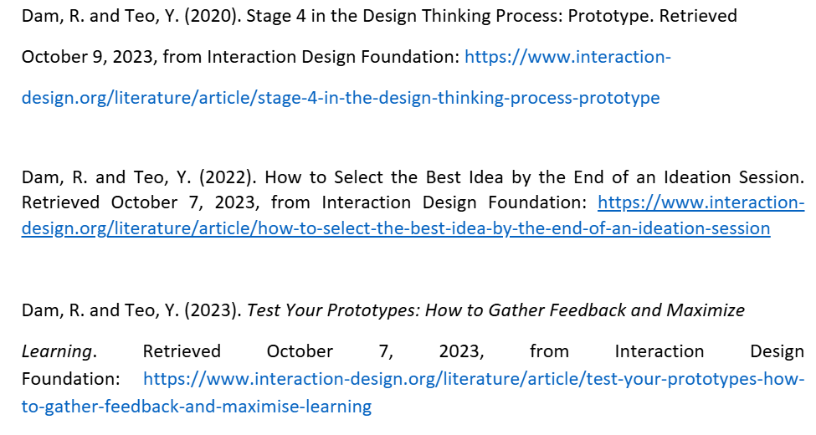

References

