Slide 1

LECTURE 6: BUSINESS MODEL CANVAS
LECTURER: STEPHEN GITHII
ENTREPRENEURSHIP AND DESIGN THINKING

Slide 2

Logo Quiz adopted from https://www.scoutsni.org/wp-content/uploads/LoGo-Quiz.pptx
Are you Ready?

Slide 3


Slide 4


Slide 5


Slide 6


Slide 7


Slide 8


Slide 9
Answers
Nike
Dominos
Amazon
Google
Cadbury
Starbuck

Slide 10
Starting Point
Are you entrepreneurial spirited?
Are you constantly thinking about how to create value and build new businesses, or how to improve or transform your organization?
Are you trying to find innovative ways of doing business to replace old, outdated ones?

Slide 11

What are your answers?

Slide 12
If yes to any of the ....
Welcome to BMC
This topic is for you

Slide 13
Learning Outcomes
Understand the nine building blocks of BMC
Gain the ability to visualize and map out a business model in a single page
Articulate clear value proposition that address the need of different customer segments
Analyze and improve business models

Slide 14

What is Business Model Canvas ?

Slide 15
Let us start from a Business Model
It describes the rationale of how an organization creates, delivers, and captures value
A shared language for describing, visualizing, assessing, and changing business models

Slide 16
So why BMC?
When you already have a business idea- about to launch a business
Positioning your model and business in a dynamic competitive environment
Re-designing/rethinking your business model
Reality check- you need to check if the business is still on course

Slide 17
Who has used it successfully?
Xerox- photocopier leasing in 1959
Diners club introduction of credit cards in 1950
iPods versus iTunes
Grameen bank
Uber
Netflix

Slide 18
Components of BMC
9 components see the diagram
Think of them as a jigsaw puzzle- every component is important

Slide 19
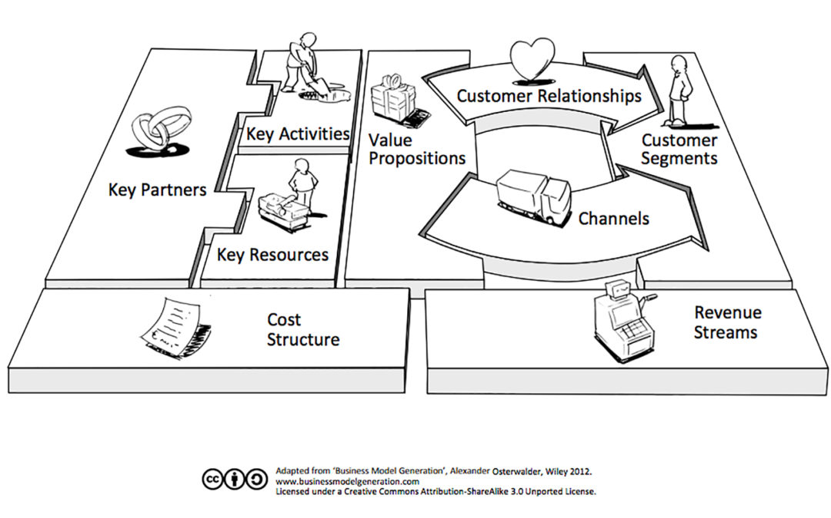
Let us break it down- The nine building blocks

Slide 20
1. Customer Segments
The different groups of people or organizations an enterprise aims to reach and serve
Without customers, no company can survive for long
An organization must make a conscious decision about which segments to serve and which segments to ignore

Slide 21
Customer groups represent separate segments if...
Their needs require and justify a distinct offer
They are reached through different Distribution Channels
They require different types of relationships
They have substantially different profitability
They are willing to pay for different aspects of the offer

Slide 22
Different customer segments you can think of
Mass – electronics
Niche- car parts manufacturers
Segmented- banks
Diversified- Amazon
Multi-sided platform- Credit card, People daily

Slide 23
Activity/question for your business/idea(1)
For whom are we creating value?
Who are our most important customers?

Slide 24

ITERATE ON WHO YOU ARE CREATING VALUE FOR

Slide 25
2. Value proposition
Describes the bundle of products and services that create value for a specific Customer Segment.
The Value Proposition is the reason why customers turn to one company over another
It is the brand promise to your customers
Simply put VP is a statement or phrase that tell us how your brand/product/service will benefit us-as your customers (Zehner, 2024)

Slide 26

sample possible vp
  Newness- iPhone
  Performance- MacBook, BMW
  Customization- Dell, Nike By You
  Design- Apple sleek phones
  Price- nano, fly 540, Ryanair
  Cost reduction- Walmart
  Risk reduction- Paypal, Anti-virus firms
  Accessibility- Microsoft office 365
  Convenience- uber, bolt

Slide 27
Activity/questions for your business/idea (2)
  What value do you deliver to the customer?
  Which one of your customer’s problems are you helping to solve?
  Which customer needs are you satisfying?
  What bundles of products and services are you offering to each Customer Segment?

Slide 28

3. Channels
Describes how a company communicates with and reaches its Customer Segments to deliver a Value Proposition
Communication, distribution, and sales Channels comprise a company's interface with customers
Channels are customer touch points that play an important role in the customer experience

Slide 29
Functions of Channels
Raising awareness among customers about a company’s products and services
Helping customers evaluate a company’s Value Proposition
Allowing customers to purchase specific products and services
Delivering a Value Proposition to customers
Providing post-purchase customer support

Slide 30
Types of Channels
Direct- Sales people, your store, online
Indirect

Slide 31
4. Customer Relationships
Describes the types of relationships a company establishes with specific Customer Segments
Clarify the type of relationship it wants to establish with each Customer Segment
Relationships can range from personal to automated

Slide 32
Customer relationships may be driven by the following motivations
Customer acquisition
Customer retention
Boosting sales

Slide 33
Types of relationships
Personal assistance- on site, call, email
Dedicated personal assistant- banking
Self-service
Automated services
Communities
Co-creation- You-tube

Slide 34
Activity/question for your business/idea (4)
What type of relationship does each of our Customer Segments expect us to establish and maintain with them?
Which ones have we established?
How costly are they?
How are they integrated with the rest of our business model?

Slide 35
6. Key Resources
Describes the most important assets required to make a business model work
These resources allow an enterprise to create and offer a Value Proposition, reach markets, maintain relationships with Customer Segments, and earn revenues
The resources vary with the type of business
Categorized as: physical, financial, intellectual, or human

Slide 36
What are their key resources?
Coca-Cola
M-Pesa
Amazon
Tesla
Netflix
Airbnb

Slide 37
Activity/questions for your business/idea (6)
What Key Resources do our Value Propositions require?
What Key Resources do our Distribution Channels require?
What Key Resources do our Customer Relationships require?
What Key Resources do our Revenue Streams require?

Slide 38
6. Key Activities
Describes the MOST important things/actions a company must do to make its business model work
They also differ from business to business
What must we do for our model to hold?

Slide 39
Types of activities
Production
Problem solving
Platform/network

Slide 40
Activity/questions for your business/idea (6)
Think of bread maker versus a university!!
  What Key Activities do our...
    Value Propositions require?
    Distribution Channels?
    Customer Relationships?
    Revenue streams?

Slide 41
8. Key Partnerships
Describes the network of suppliers and partners that make the business model work
Companies create alliances to optimize their business models, reduce risk, or acquire resources and activities
People/organizations that if we do not work with our business will collapse
Think of a three-legged stool if one of the legs is removed who are these “legs” in your business?

Slide 42
Types of partnership
Strategic alliances between non-competitors
Competition: strategic partnerships between competitors
Joint ventures to develop new businesses
Buyer-supplier relationships to assure reliable supplies

Slide 43
ACTIVITY/questions for your business/idea
Who would you Partner with and why?
What would be their role?

Slide 44
9. Cost Structure
Describes all costs incurred to operate a business model
Creating and delivering value, maintaining Customer Relationships, and generating revenue all incur costs
Costs can be calculated after defining Key Resources, Key Activities, and Key Partnerships
Costs should be minimized in every business model

Slide 45
There are two broad classes of business model Cost Structures
Cost-driven-focus on low cost
Value-driven- focus on quality/premium

Slide 46
Activity/questions for your business/idea (9)
What are the most important costs inherent in your business model?
Which Key Resources are most expensive?
Which Key Activities are most expensive?

Slide 47
5. Revenue Streams
Represents the cash a company generates from each Customer Segment
If customers comprise the heart of a business model, Revenue Streams are its arteries
Each Revenue Stream may have different pricing mechanisms

Slide 48
Types of Revenue Streams
Recurring revenue- this represents income from ongoing payments like subscriptions , membership
Transactional based revenue- When you make sale to one time customer

Slide 49
Several ways of generating revenue streams
Asset sales
Usage fee- Telcos
Subscription fee- gym, Netflix
Lending/leasing/Renting- car rentals
Licensing –media, fast food
Brokerage fee- real estate
Advertising- Google, YouTube

Slide 50
ACTIVITY/questions for your business/idea (5)
What would be your revenue streams?
Which one would bring more revenue?

Slide 51
Topic Review
BMC is a tool that provides a visual framework for developing, describing, ang analyzing a business model
It makes us understand how business creates, deliver, and captures value for its customers
In our next lecture we will look at marketing requirements for an entrepreneur

Slide 52
Reference
Zehner M. (2024), Guide to Value Proposition Statements that Capture & Convert.
SendGrid. https://sendgrid.com/en-us/blog/value-proposition-statementsaccessed
on 10/10/2024

