Slide 1

ENTREPRENEURSHIP AND DESIGN THINKING
LECTURE 8: ELECTRONIC COMMERCE AND ENTREPRENEURSHIP
LECTURER: STEPHEN GITHII

Slide 2
Overview
In the last lecture we looked at marketing requirements for an entrepreneur, where we mentioned digital marketing essentials
Given the place of technology and the trends within the consumers it is becoming important for entrepreneurs to push their boundaries and even operate as if there are no boundaries
Electronic commerce is enabling this shift

Slide 3
Learning Outcomes
Define ecommerce and its benefits to an entrepreneur
Pick the evolution and trends in ecommerce

Slide 4
Learning Outcomes
Identify the challenges in ecommerce
Choose the right ecommerce business model for your venture

Slide 5
Introduction
E-commerce involves buying and selling goods and services over the internet, including online transactions and digital payments
It encompasses a wide range of activities such as products, services, banking, investment among others
It operates in all four major market segments: business to business , business to consumer , consumer to consumer , and consumer to business

Slide 6
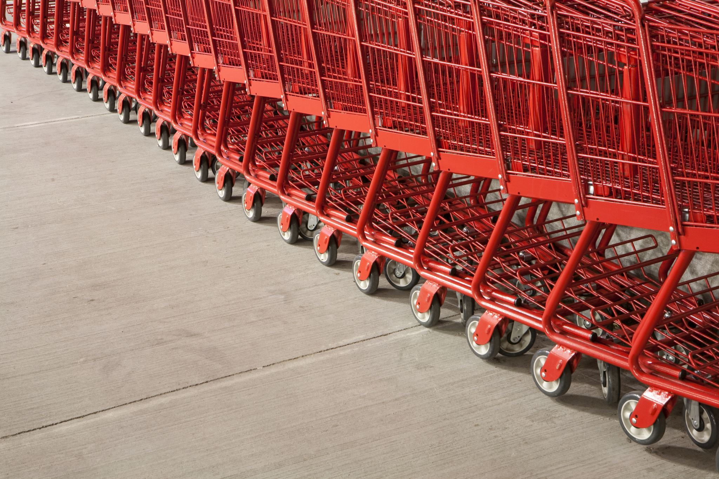
How does e-commerce differ from traditional commerce
Reach: E-commerce has the potential of breaking down the geographical barriers allowing a business to reach the global population
Convenience: E-commerce business is taunted as operating 24/7, meaning it does not close, while for traditional business, night may mean closer

Slide 7
How does e-commerce differ from traditional commerce
Customer interaction: Remember what we talked about in BMC under customer relationship and channels?
Cost: E-commerce businesses are likely to have lower operating costs as the cost associated with physical storefronts is not there

Slide 8
How does e-commerce differ from traditional commerce
Product Range: E-commerce may have a very wide range of products and variety unlike the traditional business which may be limited to what can fit in a physical store.

Slide 9

How does e-commerce differ from traditional commerce
Personalization: With data analytics and AI, e-commerce can personalize your shopping experience leading to a more satisfied customer and improved patronage

Slide 10
How does e-commerce differ from traditional commerce
Expansion potential: e-commerce has more potential to scale without attracting the same cost a brick and mortal business would attract

Slide 11
E-commerce Models

Slide 12
Business to Business (B2B)
These are the transactions that happen between businesses
It entails companies selling products or services to other companies
Example would be Alibaba, a marketplace where other companies can buy goods from

Slide 13

2. Business to Customer (B2C)
This is where the business sells its products or services directly to consumers
This is the most common form of e-commerce
A good example in this category is Amazon, where you and I can purchase variety of products
Netflix offer us a streaming service directly

Slide 14

3. Consumer to Business (C2B)
In this category, individuals sell/supply products or services to businesses
Not a common form of business, but the growth is eminent
A good example is Shutterstock, which allows individuals photographers and artists to sell their image and artwork to businesses for use in marketing and advertising

Slide 15
4. Consumer to Consumer (C2C)
In this category, it involves transactions between consumers
It is usually facilitated by a third party
A good example here would be eBay, which is an online auction site

Slide 16
Evolution and Growth of E-commerce
E-commerce began in the early 1990s with the advent of the internet
The early adopters were Amazon and eBay
In the late 1990s, there was surge in dot-com businesses but so many failed because of unsustainable business models

Slide 17
Evolution and Growth of E-commerce
After the late 1990s bumble, the industry started to mature in 2000
Those that had survived the period were now on growth trajectory

Slide 18
Evolution and Growth of E-commerce
There were better payment methods and gateways and better logistics solutions
With the rise of mobile phone penetration and growth of smartphones, we have witnessed a serious growth in mobile commerce
M-commerce is projected to hit $ 3.4 trillion by 2027 in sales (Jobanputra, n.d.)

Slide 19

Trends in E-commerce
Use of AI: E-commerce is heavily reliant on artificial intelligence to provide a very personalized shopping experience
Privacy and Security concerns: There is growing concern from consumers about the privacy of their information as they transact in e-commerce

Slide 20
Trends in E-commerce
Ethics and Sustainability: Consumers are increasingly becoming concerned about environment and ethics, this has seen more businesses adopt eco-friendly practices

Slide 21
Trends in E-commerce
Innovation in Supply Chain: In their bid to improve efficiency, e-commerce businesses are always innovating to improve speed and efficiency
Virtual and Augmented Reality : This is helping to bring a different level of realism to shoppers as they can visualize products in real life settings

Slide 22
Trends in E-commerce
Social media: The growth of social media has also had an impact in e-commerce, and this has seen the advent of “social commerce” where customers can purchase directly from social media apps

Slide 23
Trends in E-commerce
Voice assistants: There is advent of voice commerce, for example Alexa and Google Assistant help shoppers using voice commands

Slide 24

Challenges of e-commerce from an entrepreneur perspective
Building and maintaining the platform: Successful e-commerce requires customer friendly sites and seamless payment gateways; all these are costly to develop and to maintain for a start-up
Cybersecurity Threats: Instances of data breaches are constant headache that entrepreneurs will have to deal with

Slide 25
Challenges of e-commerce from an entrepreneur perspective
Logistic management: One of the biggest headaches that entrepreneurs must deal with and was the main cause of the downfall of many dot.com in the late 1990s is logistics
Building Trust: For a new start-up, it is not easy to build trust and credibility, it takes time and resources to do so

Slide 26

Challenges of e-commerce from an entrepreneur perspective
Stiff competition: The e-commerce space is highly competitive and all fighting for the same market, therefore becoming recognized in such a space is a tough game especially for small entrepreneurs

Slide 27
Challenges of e-commerce from an entrepreneur perspective
Complicated legal frameworks: There are complex web of e-commerce laws and regulations which make it uphill tasks for an entrepreneur to adhere to
Cultural differences: The intricacies of operating in different countries, regions and cultures are a real and continuous challenge that entrepreneurs will have to deal with

Slide 28
Setting up an online store-Design Thinking way
Understand: Carry out research to understand your niche, market demand, competition and target audience
Observe: Observe consumer behaviors, identify their preferences, taste and pain points

Slide 29
Setting up an online store-Design Thinking way
Synthesis: From the information derived in observe and understand define the core problem and an insight for your business, what value will you deliver and how
Ideate: Generate ideas for your online store; such as the website, product offering, marketing strategies

Slide 30
Setting up an online store-Design Thinking way
Prototype: Make a choice of e-commerce platform upon which you start building your website
Test: Launch your online store and gather feedback from real users

Slide 31
Topic Review
What e-commerce is and how it differs with traditional brick and mortar business
Benefits that e-commerce accord to an entrepreneur Evolution, trends, and challenge of e-commerce
Different models of e-commerce Setting up an online shop
Next topic we will look at Financial requirements for entrepreneurship

Slide 32
References
Emb, T. (2024, June 18). The evolution of e-commerce: past, present, and future. EMB Blogs. https://blog.emb.global/the-evolution-of-e-commerce/
Jobanputra, K. (n.d.). Predictions And Trends Shaping The Future. Forbes.com. https://www.forbes.com/councils/forbesbusinesscouncil/2023/12/29/e-commerce-evolution-predictions-and-trends-shaping-the-future/

