Slide 1
ENTREPRENEURSHIP AND DESIGN THINKING
LECTURE 12: SOCIAL ENTREPRENEURSHIP
LECTURER: STEPHEN GITHII

Slide 2
OVERVIEW
The last lecture looked at family business, where we focused on the following
What constituted a family business
The characteristics of a family business
Their contributions to the global economy

Slide 3
OVERVIEW
Succession plan and its importance in family businesses
Dynamics and conflicts in family business and how
The current lecture we will look at different aspects of social entrepreneurship

Slide 4
LEARNING OUTCOMES
Define and outline characteristics of social entrepreneurship
Differentiate social entrepreneurship from the traditional entrepreneurship
Outline types of social enterprises

Slide 5
LEARNING OUTCOMES
Examine business model for social enterprise
Apply design thinking for social good
Challenges and opportunities for social entrepreneurs

Slide 6
INTRODUCTION
Social entrepreneurship is a branch of entrepreneurship which focuses on social value creation as its primary mission
Social entrepreneurs utilize sustainable and innovative business models to solve pressing problem in the society

Slide 7
INTRODUCTION
Any profit generated is reinvested to further social or environmental goal rather than to the shareholders

Slide 8
CHARACTERISTICS OF SOCIAL ENTREPRENEURSHIP
Society-oriented: The mission of these enterprises is driven by the need to solve pressing issues in society rather than profit maximization.
Community engagement: Such enterprises are likely to co-create the solution with the people it is likely to benefit from it.

Slide 9
CHARACTERISTICS OF SOCIAL ENTREPRENEURSHIP
Innovation: Social entrepreneurs are creative usually moving from the normal solutions to address the need of the society
Impact: The social impacts of these enterprises are clear and measurable, normally around the society and environment

Slide 10
CHARACTERISTICS OF SOCIAL ENTREPRENEURSHIP
Sustainability: The enterprises are focused on long-term and financial sustainability

Slide 11
Difference between social and traditional entrepreneurship
Focus: Social entrepreneurship is primarily focused on creating social or environmental impact and bringing a positive change in this.
Success measurement: For social enterprises, success is usually in terms of the impact they have had on the community on the specific issue it was to handle such as poverty

Slide 12
Difference between social and traditional entrepreneurship
Profit: To social enterprises, while profit generation is important it is often secondary to the social mission they have.
Stakeholder focus: The social enterprise focuses on a wider spectrum of stakeholders and engage deeply with the community.

Slide 13
Types of Social Entrepreneurship
Non-Profit Organization: These organizations focus on addressing the issue(s) in the society without primary focus on making profit. They are reliant on donation and grants
For profit: These aim at generating profit while achieving social or environmental goals. Recall the Ecopost I share in our earlier lecture, this is a good example in this category

Slide 14
Types of Social Entrepreneurship
Hybrid: These are those enterprises that may have both mission that is non-profit and profit structures, where a portion of their profits may be invested in their social initiatives. Examples here may include one-for-one or buy-one, give one model such as TOMS Shoes, Warby Parker, Two Degrees Food and Soapbox Soaps.
Cooperatives: These are started and operated by a group of people who have come together with a common goal.

Slide 15
Types of Social Entrepreneurship
Community led project: These are initiatives started by locals or groups within the community to address a specific issue, they rely on volunteers and support from the local community.
Socially responsible business: This is a business which in its quest for profit incorporates social responsibility such as ethics and being environmentally friendly.

Slide 16
Types of Social Entrepreneurship
Microfinance institutions: These institutions provide financial services to the bottom of the pyramid who may not access the mainstream banks with the goal of empowering them economically. A good example is Grameen Bank in Bangladesh.

Slide 17
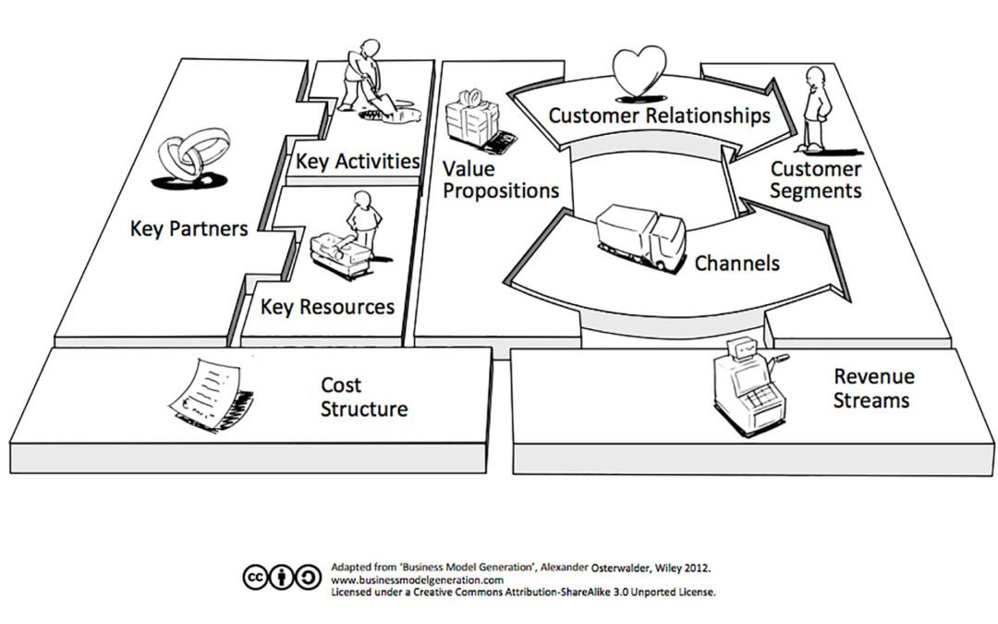
Social Enterprise Business Model

Slide 18
Business Model of Social Enterprise
Recall lecture six where we looked at business model
Business model represents how a business creates, delivers, and capture value
Simply it is how a business/organization makes money

Slide 19
Business Model of Social Enterprise
9 components that we looked at are represented in the previous slide.
For a social enterprise there might be a few changes in the model

Slide 20
Value proposition
For a social enterprise it includes both financial and social aspects.
It must clearly define the societal problem being addressed and the tangible benefits to the society
For instance, Ecobana is a Kenyan company that makes sanitary pads from organic materials, they are not only cost effective but also environmentally friendly

Slide 21
2. Target audience
A social enterprise may have dual target audiences
One being the customer who may benefit from the product, or the service being offered
Second it could be the community who may be benefiting from the social or environmental impact of the enterprise
The Ecopost that we gave as an example in our earlier lecture, has its customers who buy from it the plastic post and fencing solution, while the community from where they collect the plastic waste from enjoy a cleaner environment.

Slide 22
3. Revenue Streams
Social enterprise develops revenue stream model that will ensure long-term sustainability
Therefore, the usual streams such as sales of goods and subscriptions may be present in their model
Grants and donations may be added to their stream
Impact driven partnerships with such bodies as government, private companies may also be present

Slide 23
4. Customer relationship
Remember this talks about how you build and maintain relationships with your customers
For a social enterprise, they are more deeply connected with their customers emotionally since they are tackling a pressing need in the community
They are likely to use community engagement, customer support, and educational workshops
Lionlights a social enterprise in Kenya that produce solar light that mimic presence of human being which deter lions from attacking homesteads and domesticated animals employ educational workshops with the local communities

Slide 24
5. Channels
This represents how a firm deliver its value proposition to its customer segments
It could be online, physical stores or community centers or through partnerships with other organizations
Social enterprise may mostly utilize direct distribution to the community so that they can take advantage of the opportunity to educate them or via partnership with an organization that supports the good course

Slide 25
6. Key Activities
These represents the critical actions that a social enterprise must take to achieve its mission
They might include production, outreach, marketing, training, and advocacy
The key aspect here is that the activities must be impactful
The actions are designed to cause positive change in the society

Slide 26
7. Key Resources
These are essential assets that an enterprise needs to be able to deliver its value proposition
It includes human resource, physical resources, intellectual resources as well as the financial resources
Bear in mind that such resources in a social enterprise should help it to achieve its social or environmental goals alongside financial return

Slide 27
8. Key Partnership
These are key external organizations or individuals that will help the social enterprise to achieve its mission
As we noted in lecture 6, these represent the three legs in a three-legged stool who if removed the social enterprise will literally collapse
They may include the community, government, NGOs or other social enterprises

Slide 28
9. Cost Structure
Social enterprise is highly driven by the need to be efficient
The focus is so much on cost effective methods that do not compromise the quality or impact of the solution
This ensure that the beneficiaries who in most cases are at the bottom of the pyramid access the product
The Ecobana, we cited earlier sources the raw materials from local available banana fiber hence lowering the cost of the pads and making them available to many girls in the country

Slide 29
Using Design Thinking for Social Good
The approach is human-centered, therefore prioritizing the would-be user in crafting the solution
Solutions are grounded on empathy which is achieved via understand and observe phases of design thinking process
Collaboration is key for social good to be achieved, working closely with the community will ensure that they provide solution to their own challenges

Slide 30
Using Design Thinking for Social Good
Prototyping principles of fail fast learn faster is useful in delivering social good, it encourages the experimentation mind for entrepreneurs who want to do good for their community
Empowering community is at the heart of doing social good. By co-creating with the community, they are able to contribute to solving their problems.

Slide 31
Challenges for social entrepreneurs
Access to capital: Unlike the for-profit enterprise, social ones may have a hard time convincing funders and financial institutions as they are often thought of as high risk.
Balancing between mission and profit: the dual objectives that we talked about at the beginning of this lecture may be a tough one. The need to cause social or environmental impact while being financially sustainable is not easy (Sotikare, 2023).

Slide 32
Challenges for social entrepreneurs
Measuring social impact: Usually this is not an easy task and developing the tools and having personnel who can do it may be expensive
Legal framework: different countries have different legal requirements on how social enterprises must be run. In other countries such laws are absent or always evolving.
Market perception: Acceptance by the community and consumer is not as fast, to convince them to prioritize impact over cost may be a challenge

Slide 33
Challenges for social entrepreneurs
Scalability: Growing social enterprise while remaining true to the mission may not be an easy task for an entrepreneur, equally, what works well in one community may not work in another.
Diverse stakeholders: social enterprises have diverse stakeholders with diverse expectations unlike in a pure for-profit business. Stakeholders such as beneficiaries are not easy to deal with.

Slide 34
Opportunities for Social Entrepreneurs
Policy and institutional support: In many countries now, there is growing policy support for social enterprise in areas such as tax incentives and favorable laws.
Access to global markets: Those addressing issues such as climate change are likely to have global appeal with their products, this can be made possible through the online platforms.

Slide 35
Opportunities for Social Entrepreneurs
There is growing acceptance of the model by the consumers, and they are becoming more conscious of social and environmental issues.
Growth of supporting ecosystems: we have witnessed an increase in number of impact investors, incubators, and accelerators focused on social enterprises (Sotikare, 2023).

Slide 36
Topic Review
We have looked at what constitutes social enterprise as compared to the traditional entrepreneurship
We examined the unique characteristics of social enterprises
We looked at the different types of social enterprises
We explored the uniqueness of social enterprise business model
We pointed out how design thinking can be used for social good
We finalized with challenges and opportunities for social entrepreneurs

Slide 37
Reference
Sotikare, T. (2023, August 1). The Power of Purpose-Driven entrepreneurship — How social entrepreneurs are changing the world. Entrepreneur. https://www.entrepreneur.com/leadership/how-social-entrepreneurs-are-changing-the-world/456407

