Slide 1
SPECIAL APLLICATION OF MARKETING RESEARCH
WEEK 2
RESEARCH CYCLE
Dr John N Kamau

Slide 2
Welcome!
Welcome to week 2 lecture
It is my joy to have you in this class
Last week we introduced the course
We examine the core topic
Research cycle

Slide 3

Intended Learning Outcomes
  At the end of this lecture, you will be able to:
Be
  Describe product lifecycle and its significance to an organization
Describe
  Discuss the research cycle and its connection to product lifecycle
Discuss
  Examine various stages of research cycle
Examine
  Discuss the implications of research cycle to marketing managers
Discuss

Slide 4

Quotes on research cycle
1. “When the product is right, you don’t have to be a great Marketer. “Seth Godin
2. “Don’t find customers for your products, find products for your customers. “David Ogilvy
3. “Watch the product life cycle; but more important, watch the market life cycle. “Philip Kotler
4. “By having your talent spend their workday solving unexpected problems in the product life cycle, you are missing out on the chance to exploit new market opportunities. “Peter Drucker
5. "The life cycle of a product begins with an idea, is nurtured through development, marketed for growth, maintained during maturity, and retired in decline." Anonymous

Slide 5
Quotes on research cycle
6. "Managing the product lifecycle is about ensuring that your product evolves to stay relevant to its customers." Jim Brown
7. "Innovation is the key to prolonging a product’s lifecycle, but eventually, all products meet their end." Peter Drucker
8. "Products, like everything in life, have a life cycle. They are born, they grow, they reach maturity, and eventually, they fade away." Philip Kotler
9. "In the product lifecycle, the focus must constantly shift: from invention to market penetration, from growth to profitability, and ultimately, from decline to reinvention or replacement." Geoffrey Moore

Slide 6
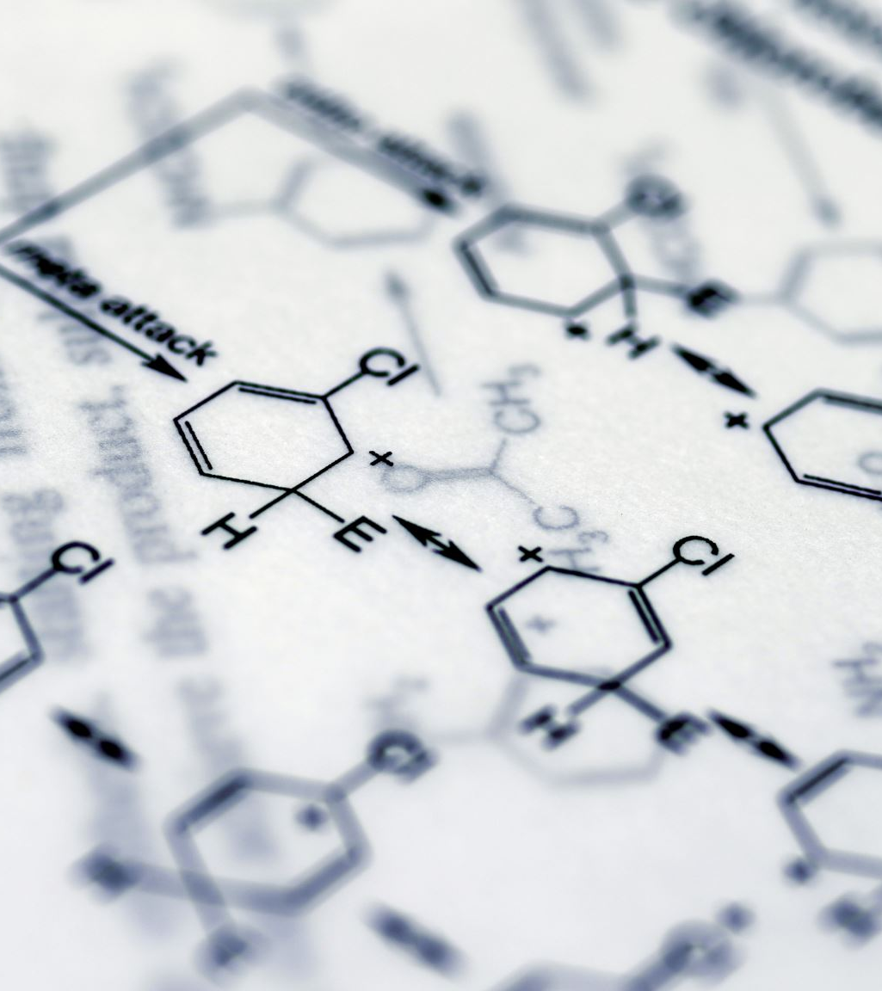
Definition of product lifecycle
Kotler (2012) defines product lifecycle as "The product life cycle (PLC) describes the stages a product goes through from when it was first thought of until it is finally removed from the market.
Jean-Jacques Lambin (2007) "The product life cycle concept describes the sales pattern of a product over time, divided into four distinct phases: introduction, growth, maturity, and decline. This cycle allows companies to develop strategies for maximizing profitability at each stage.

Slide 7
Definition of product lifecycle
" Aaker (1991) "The product life cycle is a model that outlines the stages through which a product passes, from development to eventual withdrawal from the market, guiding strategic marketing decisions and product management.“
Lamb, Hair, & McDaniel (2018) "The product life cycle is a concept that provides a way to trace the stages of a product's acceptance, from its introduction (birth) to its decline (death), offering marketers a framework for anticipating changes in market dynamics and profitability."

Slide 8
Definition of product lifecycle
Stanton (2004) "The product life cycle refers to the stages that a product goes through from when it is first introduced to the market until it is finally withdrawn, emphasizing the need for different marketing strategies as the product moves through its life."

Slide 9

Definition cont.
From definitions we observe
1. All definitions agree that the product lifecycle consists of distinct stages—introduction, growth, maturity, and decline—which represent the typical trajectory of a product’s market presence over time.
2. The scholars emphasize the strategic significance of recognizing the product lifecycle.
3. The lifecycle concept provides a framework to anticipate market dynamics such as competition, customer adoption, and changing demand.
4.The lifecycle model helps businesses allocate resources effectively.

Slide 10
Definition cont.
From definitions we observe
5. Kotler focuses on the marketing strategy across the product's phases, highlighting the importance of adapting promotional efforts
Porter, while not providing a direct definition, views the lifecycle through the lens of competitive advantage, emphasizing how businesses must modify their strategies in different stages to remain competitive.
Aaker sees the lifecycle as important for brand management, suggesting that companies need to maintain or enhance brand equity as products progress through their lifecycle
Lamb, Hair, & McDaniel take a more practical view, suggesting the lifecycle helps in forecasting and planning.

Slide 11
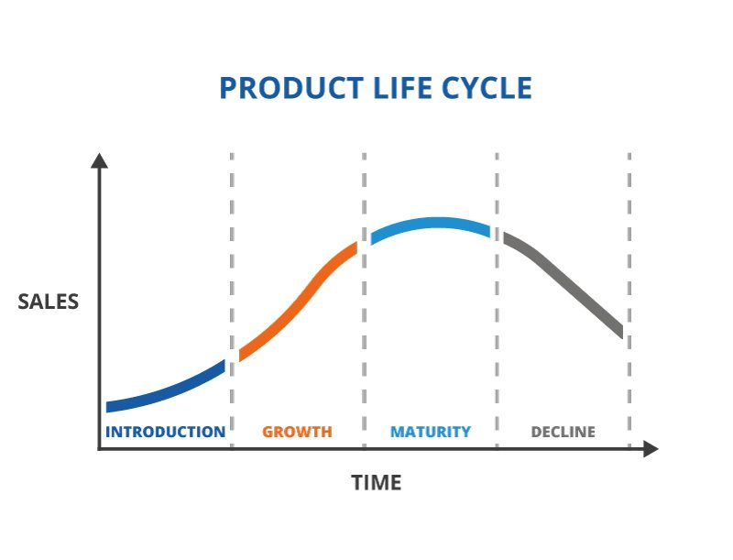
Product lifecycle
Source: TWI Global. "What is a Product Life Cycle?" TWI-Global.com, https://www.twi-global.com/technical-knowledge/faqs/what-is-a-product-life-cycle. Retrieved sept 2024

Slide 12
Significance of product lifecycle
The product lifecycle is a versatile concept, central to both marketing and business strategy.
It serves as a roadmap for understanding how a product evolves in the marketplace,
Guiding organizations in optimizing strategies around innovation, marketing, resource allocation, and competitive positioning at each stage.
Research cycle is built around product life cycle

Slide 13
The research cycle
The research needs and activities of a company change overtime, especially as its product line matures and grows.
Changes in the competitive environment influence and even dictate the types of research studies that must be carried out.
The research cycle illustrates the changing configuration of research needs that brands face as they or their markets mature Dilon (1994).
The research cycle acknowledges the fact that as products move through their life cycle they have unique needs.
The research cycle, which can be divided into pre-launch, rollout and established markets, recognizes such changes and specifically matches research activities to the unique needs of a product during each stage of its life cycle.

Slide 14
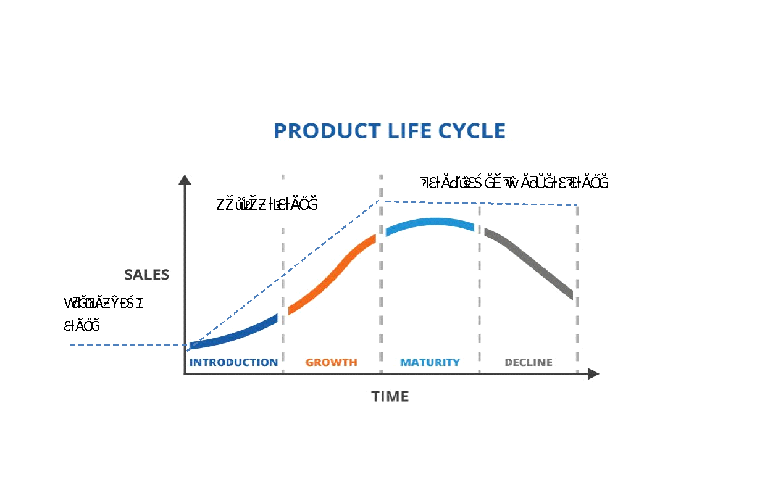
Research cycle
Source: Kamau, J. N. (2024). The research cycle [Lecture]. Special applications of marketing research Africa Nazarene University

Slide 15
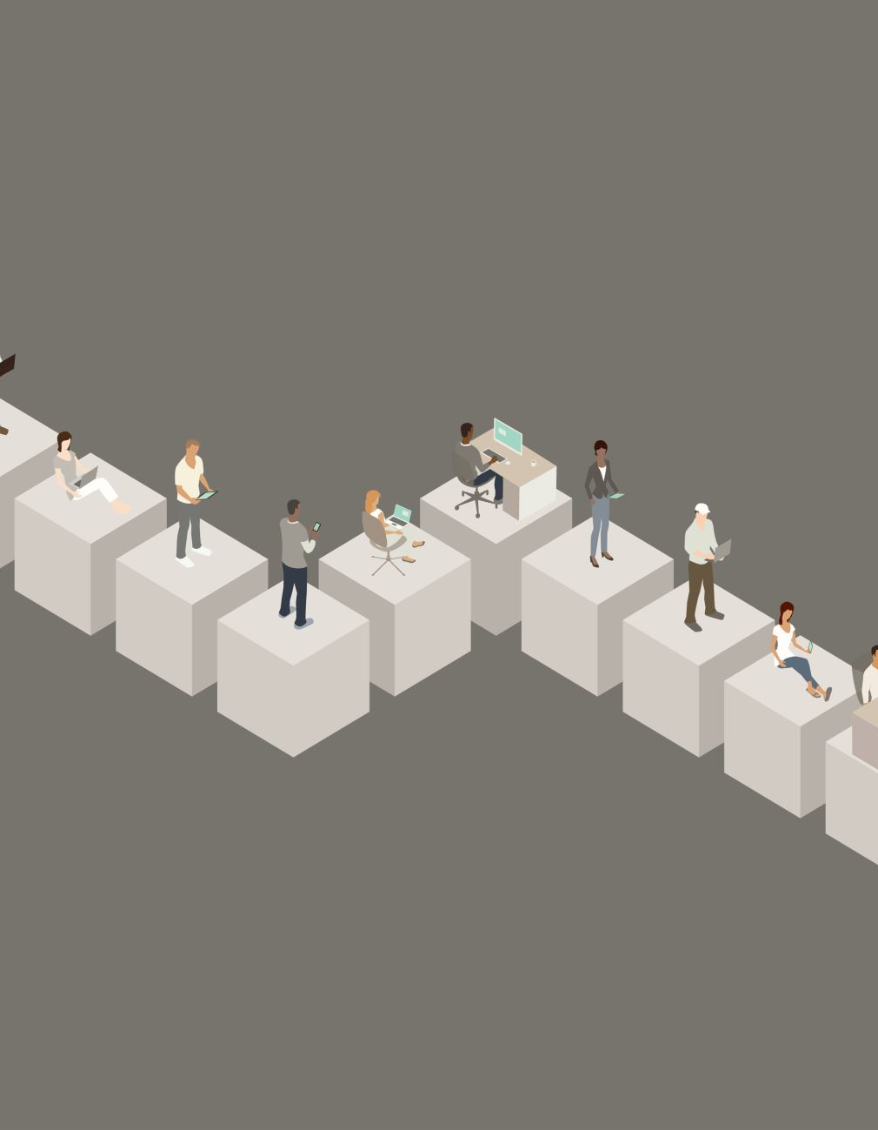
Prelaunch stage
1. This is the initial stage in research cycle.
assist the marketing managers in developing and introducing new and improved
All the marketing research activities are designed to ensure that a national rollout, if undertaken will be successful
The pre-launch stage of a product development cycle involves all the preparatory activities conducted before the product is officially released into the market.
The goal is to gather insights, validate assumptions, and fine-tune the product and its market approach to maximize the chances of success upon launch.

Slide 16

Prelaunch stage
Key Activities in the Pre-launch Stage:
Market Research: Identifying target customer needs, preferences, and behaviors.
Concept and Product Testing: Assessing product features, usability, and appeal.
Brand Name and Package Testing: Ensuring the product name and packaging resonate with the market and convey the intended message.
Test Marketing: Launching the product in a controlled or limited market to assess real-world performance and refine strategies.
Marketing Strategy Development: Planning promotional campaigns, pricing, distribution channels, and launch tactics.

Slide 17

Advantages of the Prelaunch Stage:
Customer Feedback Collection
Risk Mitigation
Market Awareness and Buzz
Competitive Advantage
Strategy Refinement

Slide 18

Disadvantages of the Prelaunch Stage:
Increased Costs
Time-Consuming
Potential for Negative Early Impressions
Limited Scope of Feedback
Market Leakage

Slide 19

2. Roll-out stage
According to Dillon (1994),this is the stage of the research cycle that provides information about product/ market activities in the introduction and growth stages of a product life cycle.
The chief purpose of marketing research in this phase is to provide information about what is going on in the market place.
Throughout this phase, research studies that track consumer awareness level and attitudes and trial and repeat purchase are extremely significant.
Two research activities undertaken in this phase are market tracking and positioning studies.

Slide 20
2. Roll-out stage
A) Market Tracking Studies:
Market tracking studies involve the continuous monitoring and analysis of key market indicators, including sales data, consumer behavior, and competitive activities.
The goal is to identify trends, shifts in consumer preferences, and changes in the competitive landscape over time.
This type of research helps businesses make informed decisions about product development, marketing strategies, and overall market positioning.

Slide 21

2. Roll-out stage
B) Positioning Studies:
Positioning studies focus on understanding how a brand or product is perceived in relation to its competitors in the minds of consumers.
These studies assess brand attributes, consumer perceptions, and the competitive landscape to determine the most effective positioning strategy.
The insights gained help organizations refine their messaging, differentiate their offerings, and enhance brand loyalty by aligning their products with consumer needs and preferences.

Slide 22
Roll-out stage
Research Activity | Purpose | Activities | Outcome
Market Tracking | To monitor and analyze market trends, consumer behavior, and competitor activities over time. | - Collect data on sales, pricing, and market share - Analyze consumer preferences and buying patterns - Monitor competitor strategies and performance | - Identify emerging trends - Understand market dynamics - Inform strategic decisions
Positioning Studies | To assess how a brand or product is perceived in the market relative to competitors and to define a positioning strategy. | - Conduct surveys and focus groups - Analyze brand perception and attributes - Evaluate competitor positioning | - Clarify brand identity - Develop effective marketing strategies - Enhance competitive advantage

Slide 23
Benefits of Rollout stage
Implementation of Findings
Market Readiness
Feedback Loop
Resource Allocation
Competitive Advantage.

Slide 24

Demerits of rollout stage
Risk of Misinterpretation
High Costs
Market Dynamics
Limited Scope
Time Constraints

Slide 25
3.Established Markets stage
This is the third stage of research cycle that covers information about maturity and decline stages of the product lifecycle.
Research focuses on new ways to build interest in the product or identifying new segments and on developing effective ways to become more competitive.
The emphasis is firmly on competition.
Research activities undertaken in established markets include among others market’s structure studies and market segmentation studies.

Slide 26
Market Structure Studies
These studies analyze the characteristics of a market, including:
Number of Competitors
Market Concentration
Barriers to Entry
Product Differentiation
Pricing Strategies

Slide 27
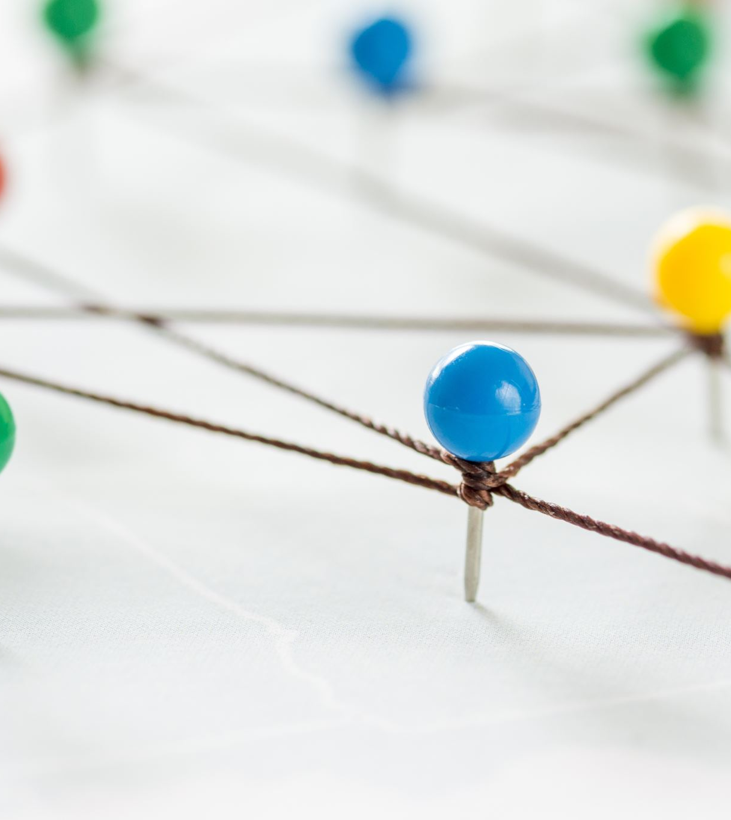
Market structure studies cont.
Research activities associated with market structure studies typically involve a combination of qualitative and quantitative methods.
The key activities involved include
Data Collection
Competitive Analysis
Market Mapping
SWOT Analysis
Regulatory Review

Slide 28
Advantages of market structure studies
Competitive Insights
Informed Decision-Making
Identification of Trends
Resource Allocation

Slide 29
Disadvantages of market structure studies
Complexity: Analyzing the competitive landscape can be complex and time-consuming, especially in highly fragmented markets.
Dynamic Nature: Market conditions can change rapidly, making findings quickly outdated.
Limited Scope: May not capture emerging trends or disruptions from new entrants or technologies.

Slide 30
Market Segmentation Studies
Market segmentation studies focus on dividing a broader market into smaller, more defined segments based on specific criteria, such as:
Demographics
•Geographics
Psychographics
Behavioral Factors

Slide 31
Market segmentation studies cont.
Research activities associated with market segmentation studies typically involve a combination of qualitative and quantitative methods. The main activities carried out include
Data Collection
Data Analysis
Persona Development
Testing and Validation
Market Size Estimation

Slide 32
Advantages of Market Segmentation Studies
Targeted Marketing: Enables more effective marketing by tailoring messages and products to specific consumer groups.
Increased Customer Satisfaction: Helps identify and meet the unique needs of different segments, leading to higher customer satisfaction and loyalty.
Enhanced Efficiency: Reduces waste in marketing efforts by focusing resources on high-potential segments.
Better Product Development: Informs product features and benefits that resonate with specific segments.

Slide 33
Disadvantages of Market Segmentation Studies
Over-Simplification: There's a risk of oversimplifying consumer behavior by segmenting too rigidly, which may overlook individual differences.
Data Limitations: Quality of insights heavily depends on the accuracy and comprehensiveness of the data collected.
Cost: Conducting thorough segmentation

Slide 34
References
Aaker, D. A. (1991). Managing Brand Equity: Capitalizing on the Value of a Brand Name. Free Press.
Dillon W.M, Madden T.J, and Firtle N.H (1994) Marketing research in a marketing environment, Irwin-McGraw-Hill. UK
Kotler, P. (2012). Marketing Management (14th ed.). Pearson Education.
Lamb, C. W., Hair, J. F., & McDaniel, C. (2018). MKTG (11th ed.). Cengage Learning.
Lambin, J. J. (2007). Market-Driven Management. Palgrave Macmillan.
Stanton, W. J., Etzel, M. J., & Walker, B. J. (2004). Fundamentals of Marketing (14th ed.). McGraw-Hill
.TWI Global. "What is a Product Life Cycle?" TWI-Global.com, https://www.twi-global.com/technical-knowledge/faqs/what-is-a-product-life-cycle. Retrieved sept 2024
Kamau, J. N. (2024). The research cycle [Lecture]. Special applications of marketing research Africa Nazarene University

Slide 35
End
End
Thank you
Next lecture: Concept testing studies

