Slide 1

SPECIAL APLLICATION OF MARKETING RESEARCH
WEEK 3 LECTURE
CONCEPT TESTING
DR. JOHN N KAMAU

Slide 2



Introduction
Welcome to week 3 lecture
It is my joy to have you in this class
Recap of last week
We now focus on concept testing

Slide 3




Intended Learning Outcomes
DESCRIBE A CONCEPT IN THE CONTEXT OF NEW PRODUCT DEVELOPMENT
EXAMINE VARIOUS TYPES OF CONCEPT TESTS
DISCUSS CONCEPT TESTING PROCEDURE
EVALUATE WAYS OF TESTING CONCEPTS

Slide 4

Quotes on concept testing
1. “Failure is okay when it's de-risked by a smaller trial, which is exactly what a concept test accomplishes. It optimizes an already-good product” anonymous
2. “Testing leads to failure, and failure leads to understanding” Burt Rutan
3. “Science is curiosity, testing and experimenting” Venkatraman Ramakrishnan

Slide 5
Quotes on concept testing
4. “Never stop testing, and your advertising will never stop improving.” David Ogilvy
5. “Manufacturing is more than just putting parts together. It's coming up with ideas, testing principles and perfecting the engineering, as well as final assembly” James Dyson
6. “I think that probably the most important thing about our education was that it taught us to question even those things we thought we knew. To say you've got to inquire, you've got to be testing your knowledge all the time in order to be more effective in what you're doing.” Thabo Mbeki.

Slide 6

Quotes on concept testing
7. “Concept testing is critical in identifying a product’s potential before investing heavily in its development.” – Philip Kotler
8. “You don’t just build a product, test it to see if it works; you test the concept first to ensure there’s demand.” – Steve Blank
9. “The purpose of concept testing is to weed out bad ideas early and focus on the ones that resonate with your target audience.” – Marty Cagan

Slide 7
Quotes on concept testing
10. “Great ideas are born in the creative process, but only validated through proper concept testing.” – Al Ries
11. “Concept testing is the first step in a journey that transforms an idea into a successful product or service.” – Clayton Christensen

Slide 8

New product development
Idea Generation:
Idea Screening
Concept Development & Testing
Business Analysis
Product Development

Slide 9
New product development
6. Market Testing
7. Commercialization
8. Post-launch Evaluation

Slide 10
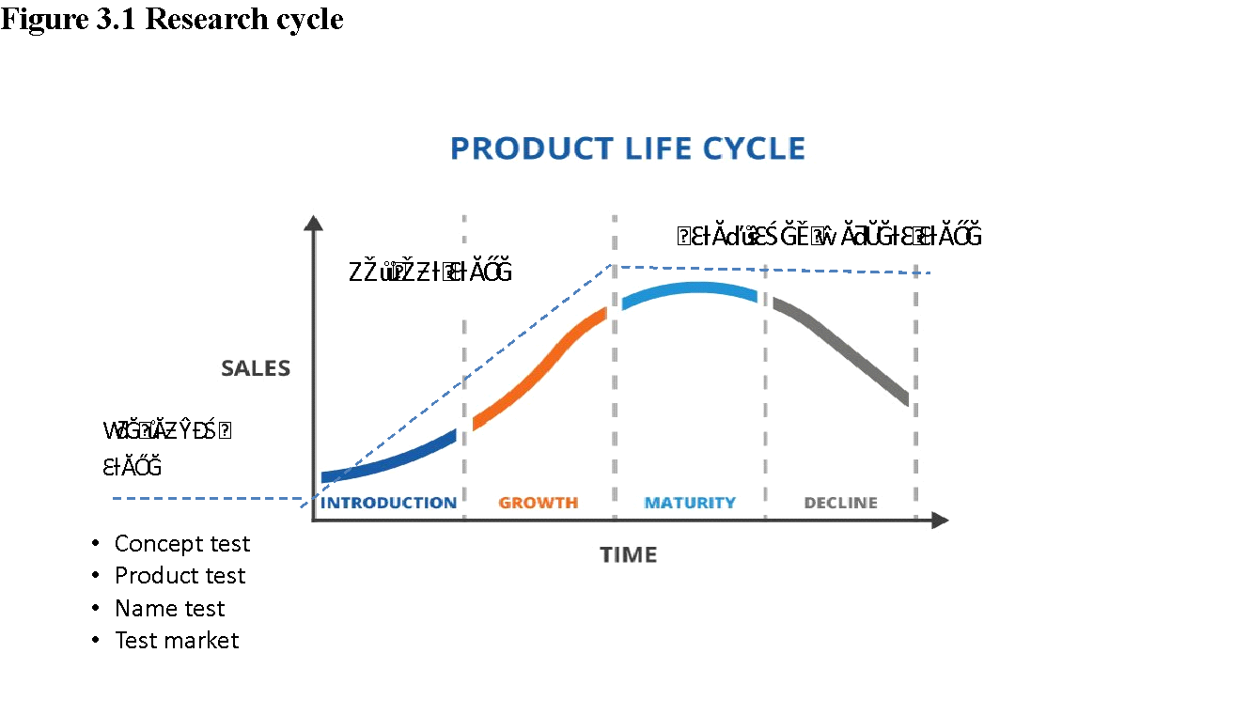
Research cycle
Source: Kamau, J. N. (2024). The research cycle [Lecture]. Special applications of marketing research Africa Nazarene University

Slide 11

Definition of concept
Concept and product testing procedures are directed at understanding consumers’ perceptions of physical product characteristics, end benefit and consequently, the product’s ultimate market acceptance. Thus, concept and product tests play an important role in developing effective marketing strategy (Dillon, 1994).
Kotler and Keller (2016) define concept testing as “the process of evaluating new product ideas or marketing strategies by presenting them to target consumers before actual development to gauge interest and potential success.”

Slide 12
Definition of concept
Urban and Hauser (1993) explain that “concept testing is a method used in marketing research to assess consumer reactions to a product idea, concept, or prototype in order to refine and validate it before committing to full-scale production.”
Crawford and Di Benedetto (2015) state that “concept testing involves presenting early-stage ideas or product concepts to potential customers to gather feedback on their appeal, uniqueness, and feasibility, helping businesses make informed development decisions.”

Slide 13

Definition of concept
McDaniel and Gates (2010) describe concept testing as “an evaluation technique where businesses seek feedback from their target market on various elements of a proposed product or service, such as features, pricing, or positioning, before investing in its launch.”

Slide 14

Definition of concept test
Consumer Perception Focus: Concept testing procedures are designed to understand how consumers perceive various product characteristics, such as physical attributes, benefits, and overall appeal
Early Evaluation: Concept testing occurs early in the product development process

Slide 15
Definition of concept test
Market Research Tool: It is fundamentally a marketing research tool that provides valuable insights into consumer reactions
Informed Decision-Making: Concept testing plays a crucial role in helping businesses make informed decisions by gathering consumer feedback on the product’s appeal, uniqueness, and feasibility, which is vital in developing effective marketing strategies

Slide 16

Definition of concept test
Holistic Evaluation: It involves evaluating multiple aspects of a product concept, such as features, pricing, and positioning

Slide 17

Philosophy of concept testing
Quantitatively assess the relative appeal of ideas or alternative product positioning that aim the product at different target market segments by highlighting product features that are most desired by such segments of the population
Provide necessary information for developing the product and product advertising
Indicate segments of the population in which the product is likely to be concentrated

Slide 18
Significance of concept testing
Early Identification of Viability: Concept testing allows businesses to evaluate whether an idea has the potential for success before extensive investment in development
Consumer Feedback: By directly engaging with potential customers, businesses can gather qualitative and quantitative feedback on their product concepts

Slide 19
Significance of concept testing
Risk Reduction: Product development involves significant financial risk
Informed Decision-Making: The insights gained from concept testing enable more informed decision-making at various levels within an organization
Enhanced Product-Market Fit: A strong alignment between product features and consumer needs is crucial for market success

Slide 20
Significance of concept testing
Cost-Effectiveness: By identifying flaws and areas for improvement early
Competitive Advantage: Understanding consumer preferences through concept testing can provide a competitive edge.
Iterative Improvement : Concept testing is not a one-time event; it can be repeated multiple times during the development cycle.

Slide 21



Concept testing and research cycle
Early pre-launch stage:, concept testing used to screen new product ideas and to identify the most promising concepts
Pre-launch stage: Concept testing used to estimate ultimate consumer demand for the basic product concept before risking national rollout
After roll-out stage: Concept tests used after rollout to investigate the level of consumer interest in a competitive new product

Slide 22

Categories of concept testing
There are two broad categories of concept tests (Dillon 1994):
1. Concept screening tests: They identify and prioritize these ideas (out of many concepts) with greatest potential for further testing and development.
The screening can be undertaken with respect to:
Many different new product ideas
Alternative end benefit incentives for the same new product idea.

Slide 23
Categories of concept testing
2. Concept evaluation tests: They gauge the level of consumer interest in a new product idea and determine the major strengths and weaknesses of the appeal/concept.
These tests are performed at various stages of the product research cycle, that is, early in the pre-launch stage or just before a test market.
Concept screening tests are designed to evaluate a set of ideas before significant resources are committed to their development

Slide 24
TYPES OF CONCEPT TEST
Type of Concept Testing | Description | Strengths | Weaknesses
Qualitative Concept Testing | Involves focus groups, interviews, or discussions with a small group of target consumers for feedback. | - In-depth Insights: Deep exploration of consumer attitudes and perceptions. - Flexibility: Facilitates spontaneous discussion, uncovering unexpected insights. - Emotional Reactions: Understands emotional responses crucial for branding. | - Limited Sample Size: Results may not be generalizable. - Bias Potential: Group dynamics may lead to conformity. - Time-Consuming: Requires significant time for organization and analysis.

Slide 25
Types of concept test
Type of Concept Testing | Description | Strengths | Weaknesses
Quantitative Concept Testing | Employs surveys or questionnaires distributed to a larger sample for numerical data on concept viability. | - Statistical Validity: Results are statistically valid and generalizable. - Scalability: Can reach a broad audience quickly. - Objective Data: Provides measurable data for easy analysis. | - Lack of Depth: May miss nuanced consumer insights. - Response Bias: Participants may provide socially desirable answers.

Slide 26
TYPES OF CONCEPT TEST
Type of Concept Testing | Description | Strengths | Weaknesses
Prototype Testing | Involves creating a physical or digital prototype for consumer interaction and feedback. | - Real-world Interaction: Consumers experience the product, leading to relevant feedback. - Identifies Usability Issues: Uncovers practical problems not evident in concept discussions. - Iterative Development: Provides a basis for iterative improvements based on feedback. | - Costly: Developing prototypes can be expensive. - Limited Scope: Feedback may be limited to current features. - Time-Consuming: Prototyping and testing can extend development timelines.

Slide 27
TYPES OF CONCEPT TEST
Type of Concept Testing | Description | Strengths | Weaknesses
Concept Testing with Concept Boards | Uses visual presentations that include images, text, and stimuli to convey a product idea. | - Visual Appeal: Helps consumers visualize the concept, enhancing understanding. - Quick Feedback: Efficiently gathers consumer reactions and preferences. - Useful for Marketing: Can test branding and promotional elements. | - Ambiguity: Visuals can be interpreted differently, leading to varied feedback. - Surface-Level Insights: May not provide deep insights into consumer motivations. - Dependence on Design Quality: Poorly designed boards can mislead participants.

Slide 28
TYPES OF CONCEPT TEST
Type of Concept Testing | Description | Strengths | Weaknesses
Market Simulation | Uses simulated market environments where consumers interact with the concept and competitors. | - Realistic Environment: Mimics actual shopping conditions for insights into consumer behavior. - Competitive Analysis: Helps understand how a product might perform relative to competitors. - Dynamic Feedback: Allows for immediate adjustments based on consumer interactions. | - Complex Setup: Creating a realistic simulation can be expensive and technically complex. - Limited Context: May not capture all external factors influencing buying decisions. - Behavioral Bias: Consumer behavior in simulations may not reflect actual purchasing behavior.

Slide 29

Procedure of concept testing
Gauging overall consumer interest
Understanding specific preferences or dislikes about the concept
Identifying potential barriers to purchase

Slide 30
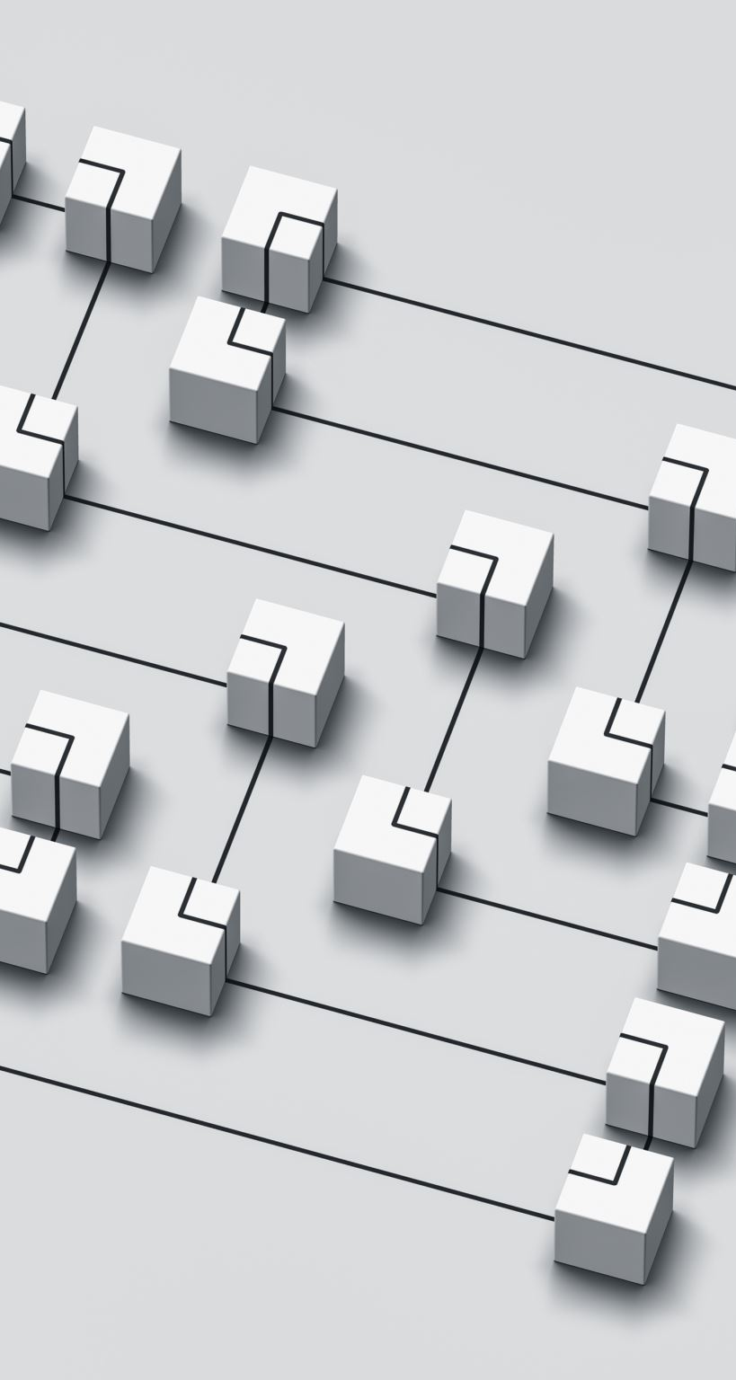
Procedure of concept testing steps
1. Define the Research Objectives: Clearly articulate what you want to learn from the concept testing.
Objectives may include:
Gauging overall consumer interest.
Understanding specific preferences or dislikes about the concept.
Identifying potential barriers to purchase.
Example Objective: "Determine the appeal of a new organic snack bar among health-conscious consumers aged 25-40."

Slide 31
Procedure of concept testing steps
2. Develop the Concepts: Generate a variety of product or marketing concepts that include:
Product Features: Details about ingredients, packaging, or unique selling points.
Positioning Statements: How the product fits within the market and its competitive advantage.
Prototyping: If possible, create physical or visual prototypes to provide consumers with a tangible representation of the concepts.

Slide 32
Procedure of concept testing steps
3. Select the Sample: this involves two main activities
•Target Audience Identification: Use demographic and psychographic criteria to select participants who reflect the intended market.
• Sample Size: Consider statistical power when determining sample size. A larger sample may provide more reliable insights but can be more costly.

Slide 33
Procedure of concept testing steps
4. Choose the Testing Method: there are two major methods of testing
a. Qualitative Methods: these are methods that focus on content analysis and may be conducted through: , Focus Groups: and In-depth Interviews:
b) Quantitative Methods: Surveys and Conjoint Analysis which is advanced statistical technique assesses consumer preferences by presenting various product attributes in combination.

Slide 34
Procedure of concept testing steps
5. Pretest the Materials: pilot testing is significant to manage the cost and time. It consist of
• Pilot Testing: Run a small-scale pretest to identify any issues with the questions or materials.
• Feedback Incorporation: Adjust the materials based on pretest results to enhance clarity and relevance.

Slide 35
Procedure of concept testing steps
6. Conduct the Main Test: this is implementation stage that considers:
• Execution: Implement the full-scale testing, ensuring that the process is consistent and unbiased.
• Data Collection: Gather responses systematically, monitoring for any anomalies or issues during data collection.

Slide 36
Procedure of concept testing steps
7. Analyze the Data: this will involve
• Statistical Analysis: Use software tools (like SPSS or R) to perform statistical analyses, including descriptive statistics, regression analysis, or factor analysis.
• Qualitative Analysis: For qualitative data, thematic analysis can help identify common themes or sentiments expressed by participants.

Slide 37
Procedure of concept testing steps
8. Report Findings: Create a comprehensive report that includes:
• Executive summary of key findings.
• Detailed analysis and visual representations (charts, graphs).
• Recommendations based on consumer feedback.
• Stakeholder Presentation: Prepare to present findings to stakeholders, emphasizing actionable insights and next steps.

Slide 38
Procedure of concept testing steps
9. Decision Making: this considers
• Actionable Insights: Use the findings to inform product development or marketing strategies.
• Iterative Process: Consider further rounds of testing or refinement based on initial results, especially if consumer feedback indicates significant areas for improvement.

Slide 39




3.9 Procedure of concept testing requirements
Iterative Process: Consider further rounds of testing or refinement based on initial results, especially if consumer feedback indicates significant areas for improvement
Maintain Objectivity: Ensure that the testing process remains unbiased, avoiding leading questions or manipulative techniques
Engage Participants: Create an environment that encourages honest feedback, especially in qualitative settings
Follow Up: After testing, consider follow-up interviews or surveys to delve deeper into specific consumer insights

Slide 40

Benefits of Concept Testing
Reduced Risk of Failure:
Consumer-Centric Insights:
Refinement of Ideas:
Market Segmentation:

Slide 41
Benefits of Concept Testing
Informed Decision-Making: Data-driven insights support strategic decisions, leading to more confident investments in new products or marketing initiatives
Enhanced Marketing Strategies: Understanding how consumers perceive concepts can guide messaging and positioning, increasing the likelihood of market success

Slide 42



Challenges of Concept Testing
Potential for Bias: Consumer responses may be influenced by the way questions are framed or by group dynamics in focus groups, leading to skewed results
Interpretation of Feedback: Analyzing qualitative feedback can be subjective, making it challenging to draw clear conclusions from open-ended responses
Sample Representation: Obtaining a truly representative sample of the target audience can be difficult, potentially leading to unrepresentative findings
Limited Scope: Concept testing typically focuses on initial ideas; later stages of product development may introduce new variables not accounted for in early testing

Slide 43
Challenges of Concept Testing
5. Cost and Time: Conducting thorough concept testing can be resource-intensive, requiring time and budget that may not always be available.
6. Overreliance on Consumer Feedback: While consumer input is valuable, excessive reliance can stifle innovation, as consumers may not envision future trends or disruptive concepts.

Slide 44

References
Crawford, C. M., & Di Benedetto, C. A. (2015). New Products Management (11th ed.). McGraw-Hill Education.
Dillon, W. R. (1994). Marketing Research in a Marketing Environment (3rd ed.). McGraw-Hill.
Kotler, P., & Keller, K. L. (2016). Marketing Management (15th ed.). Pearson.
McDaniel, C., & Gates, R. (2010). Marketing Research Essentials (8th ed.). Wiley.
Urban, G. L., & Hauser, J. R. (1993). Design and Marketing of New Products (2nd ed.). Prentice Hall.
Urban, G. L., & Hauser, J. R. (1993). Design and Marketing of New Products (2nd ed.). Prentice Hall.

Slide 45
References
McDaniel, C., & Gates, R. (2010). Marketing Research Essentials (8th ed.). Wiley.
Crawford, C. M., & Di Benedetto, C. A. (2015). New Products Management (11th ed.). McGraw-Hill Education.
Malhotra, N. K., & Birks, D. F. (2007). Marketing Research: An Applied Approach (3rd ed.). Pearson Education.
Kotler, P., & Keller, K. L. (2016). Marketing Management (15th ed.). Pearson.

Slide 46
References
Urban, G. L., & Hauser, J. R. (1993). Design and Marketing of New Products (2nd ed.). Prentice Hall.
Crawford, C. M., & Di Benedetto, C. A. (2015). New Products Management (11th ed.). McGraw-Hill Education.
Givon, M., & Mahajan, V. (1982). "An Analysis of Market Simulation Models." Marketing Science, 1(3), 241-274.
Kamau, J. N. (2024). The research cycle [Lecture]. Special applications of marketing research Africa Nazarene University

Slide 47


End
THANK YOU
NEXT LESSON : PRODUCT TESTING

