Slide 1

SPECIAL APLLICATION OF MARKETING RESEARCH
WEEK 5 LECTURE
NAME RESEARCH
DR JOHN N KAMAU

Slide 2

Welcome
Welcome to week 5 lecture
Its my joy to have you in the class
Last week we focused on product test
This week we focus on brand name test
Proverbs 22:1 “A good name is more desirable than great riches; to be esteemed is better than silver or gold.

Slide 3
Intended Learning Outcomes
Define a brand name
Discuss the significance of a brand name
Examine various branding approaches
Evaluate name testing procedure
Discuss benefits and challenges in branding

Slide 4
5.3 Quotes on brand names
"Your brand name is only as good as your reputation." – Richard Branson
"A brand is not a product, but the promise of an experience." – Alexander Isley
"A great brand name is the beginning of a great story." – Alina Wheeler
"A brand is a voice, and a product is a souvenir." – Lisa Gansky
"Your brand name should work across languages and cultures. Simplicity is key." – David Airey
"The best brand names tell a story in a single word." – Simon Mainwaring

Slide 5
5.3 Quotes on brand names
"A brand is not a product, but the promise of an experience." – Alexander Isley
"A brand is a voice, and a product is a souvenir." – Lisa Gansky
"Your brand name should work across languages and cultures. Simplicity is key." – David Airey
"A name is a powerful thing. It has to inspire and define." – Jonathan Gabay
"A brand name that’s meaningful resonates in the hearts of consumers." – Marty Neumeier
"A strong brand name is the foundation of a successful brand strategy." – Laura Ries
"The best brand names tell a story in a single word." – Simon Mainwaring

Slide 6
Quotes on brand names
"A brand name is a shortcut to a customer’s gut feeling." – Seth Godin
"A brand name is the one investment that can multiply the value of your product." – Steve Forbes
"Choosing a brand name is not about being clever, it’s about being clear." – Al Ries
"Your brand name should evoke the essence of your company and its values." – Tony Hsieh
"A good name is a passport to the future; it shapes perception before the product is even seen."
"The brand name is the start of a conversation between you and your customer." – Patrick Hanlon

Slide 7
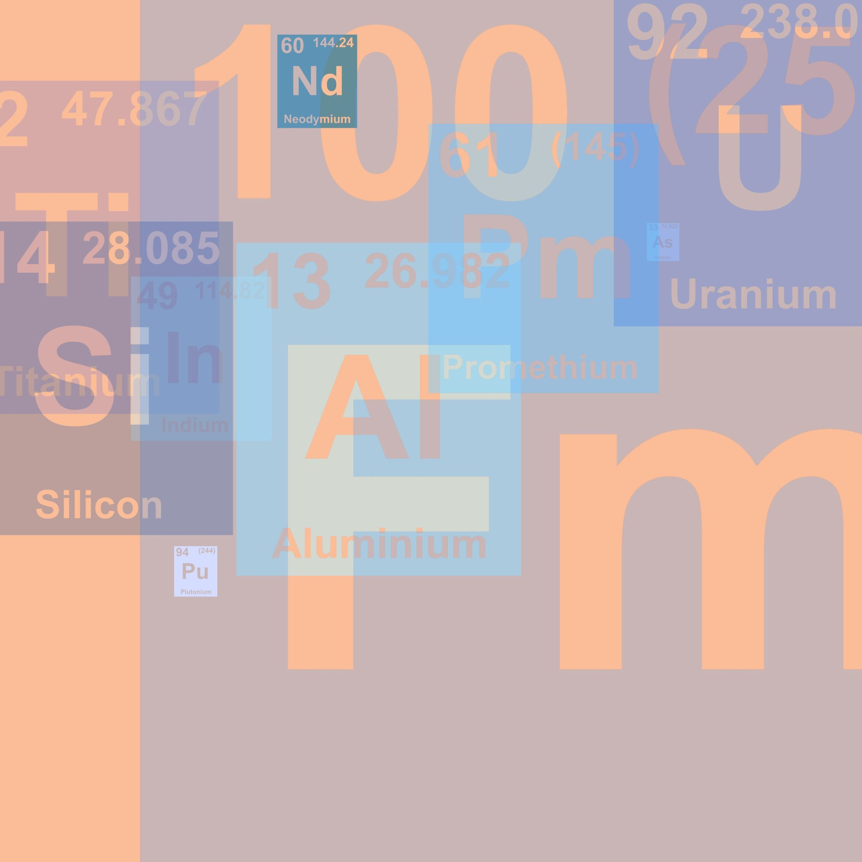
Definition of brand name
Kotler and Armstrong (2006) defined a brand name as a term, sign, symbol or design or a combination of these intended to identify the products or services of one seller or group of sellers and differentiate them from those of competitors.
Doyle (1991) it is a name, symbol, design or some combination, which identifies the “product” of a particular organization as having sustainable differential advantage.
Aaker (1996) defines a brand as "a distinguishing name and/or symbol (such as a logo, trademark, or package design) intended to identify the goods or services of either one seller or a group of sellers, and to differentiate those goods or services from those of competitors."

Slide 8
Definition of brand name
Kapferer (2008) describes a brand as "a sign whose function is to disclose the hidden qualities of the product which are inaccessible to contact, allowing for differentiation and meaning beyond the mere product.“
Keller (2003) defines a brand as "a name, term, sign, symbol, or design, or a combination of them, intended to identify the goods or services of one seller or group of sellers and to differentiate them from those of competitors, while also creating strong, favorable, and unique associations in the minds of consumers “w
de Chernatony and McDonald (1992) explain a brand as "an identifiable product, service, person or place, augmented in such a way that the buyer or user perceives relevant, unique, sustainable added values which match their needs most closely."

Slide 9
From definitions ……
1. Name and brand name are used interchangeably in definitions
2. The definitions provide a comprehensive view of what a brand is, with each emphasizing slightly different aspects.
3. Identification and Differentiation: Almost all definitions, including Kotler and Armstrong (2006), Doyle (1991), Aaker (1996), Keller (2003), and de Chernatony and McDonald (1992), stress that a brand's fundamental purpose is to identify a product or service and differentiate it from competitors.
This is typically done through names, symbols, designs, or a combination of these elements.

Slide 10
From definitions ……
4. Sustainable Advantage: Doyle (1991) and de Chernatony and McDonald (1992) highlight that a brand offers a sustainable advantage, meaning it provides something enduring and distinct, often tied to customer perception and value.
5. Added Value and Meaning: Kapferer (2008) and de Chernatony and McDonald (1992) introduce the idea that brands go beyond just being identifiers. They signify deeper, hidden qualities or values that resonate with consumers.
6. Consumer Associations: Keller (2003) expands on differentiation by including the creation of favorable and unique associations in the minds of consumers, underlining the importance of brand perception.

Slide 11

Denotative and connotative meaning of brand names
a) Denotative Meaning: This refers to the literal or explicit meaning of a name.
It’s the direct definition without any emotional or cultural context.
For example, "Mustang" as a brand name literally denotes a wild, untamed horse, which is the straightforward definition.
b) Connotative Meaning: This goes beyond the literal meaning and refers to the associations and imagery that a name provokes in the minds of consumers.

Slide 12
Functions of a brand name
Function | Description | Example | Source
Identifies the Product | Names help identify products to consumers, retailers, distributors, and manufacturers. | "Coca-Cola" signals a specific soft drink. | Keller (2003)
Differentiates the Product | Distinguishes a product from competitors and conveys physical and emotional benefits. | "Apple" evokes innovation and status. | Aaker (1991)
Adds Value | Branding increases perceived product value. Branded products are often seen as higher quality. | "Nike" shoes vs. unbranded sneakers. | Keller (2003)
Simplifies Buying Decision | Consumers look for familiar brands, reducing decision-making complexity. | A customer always buys "Tide" detergent. | Aaker (1991)

Slide 13
Functions of a brand name
Function | Description | Example | Source
Simplifies Marketing Decisions | Branding enhances marketing efforts by giving products distinctive and recognizable names. | "McDonald's" uses its established brand image. | Aaker (1991)
Builds Customer Loyalty | Strong branding creates loyal customers through emotional attachment and consistency. | "Starbucks" customers return for brand experience. | Keller (2003)
Helps Introduce New Products | Established brands make launching new products easier, leveraging familiarity and trust. | "Apple" introduced the iPhone successfully. | Kapferer (2008)
Secures Demand | Familiar brands ensure steady demand by maintaining consumer trust and reducing the need for heavy ads. | "Colgate" enjoys consistent sales in toothpaste. | Aaker (1991)

Slide 14
Functions of a brand name
Function | Description | Example | Source
Enables Premium Pricing | Strong brands can charge higher prices due to perceived superiority. | "Rolex" commands premium pricing for watches. | Kapferer (2008)
Increases Buyer Assurance | Branding provides assurance of quality, reducing perceived risk. | "Sony" TVs are trusted for durability. | Keller (2003)
Assists in Quality Evaluation | Brands allow quick assessment of product quality without detailed inspection. | "Mercedes-Benz" symbolizes automotive quality. | Keller (2003)

Slide 15
Functions of a brand name
Function | Description | Example | Source
Offers Psychological Reward | Branding enhances self-image and social status for consumers. | "Louis Vuitton" provides luxury and exclusivity. | Kapferer (2008)
Assists in Brand Association | Brands link certain experiences or emotions with the product. | "Disney" is associated with family fun and magic. | Kapferer (2008)
Reduces Social and Psychological Risks | Branding provides social status and reduces the risk of being seen negatively by peers. | "Tesla" buyers are seen as environmentally aware. | Kapferer (2008)

Slide 16
Characteristics of a good brand name
Characteristic | Description | Example | Source
Suggests Quality and Benefits | Implies the quality or benefits that the product delivers, helping consumers understand expectations. | "UCHUMI" suggests affordability. | Aaker (1991)
Easy to Pronounce, Recognize, and Remember | Should be simple to say, recall, and recognize. Short names are often more memorable. | "Bic," "Aim," and "Blue Band" are easy to remember. | Keller (2003)
Distinctiveness | Must stand out from competitors and be unique for easy identification. | "Kodak" and "Colgate" are distinctive names. | Kapferer (2008)
Easily Translatable Across Languages | Should translate easily into different languages without losing meaning or acquiring negative connotations. | "Kodak" and "Coca-Cola" translate well globally. | Aaker (1996)

Slide 17
Characteristics of a good brand name
Characteristic | Description | Example | Source
Capable of Registration and Legal Protection | Unique enough to be trademarked, ensuring legal protection against competitors. | "Apple" is trademarked for technology products. | Keller (2003)
Differentiates from Competitors | Highlights how the brand’s offerings are distinct from others in the market. | "Nike" emphasizes performance. | Kapferer (2008)
Compatibility with Brand Image | Should align with the overall image and identity the company wants to project. | "Tiffany & Co." matches its luxury image. | Aaker (1996)
Memorable | Should stick in consumers' minds for easy recall during purchasing decisions. | "Google" is unique and catchy. | Keller (2003)

Slide 18
Characteristics of a good brand name
Characteristic | Description | Example | Source
Flexible and Adaptable | Versatile enough to accommodate line extensions or new product categories. | "Amazon" expanded from books to various products. | Aaker (1996)
Positive Connotation | Should evoke positive feelings and associations, contributing to a favorable image. | "Sunshine" suggests freshness and happiness. | Kapferer (2008)
Appeal to Target Audience | Must resonate with the intended audience, reflecting their values and preferences. | "Red Bull" appeals to younger consumers. | Keller (2003)
Avoids Negative Connotations | Should steer clear of negative associations or meanings in different cultures. | "Nova" was marketed differently in Spanish-speaking areas. | Aaker (1991)

Slide 19
Characteristics of a good brand name
Characteristic | Description | Example | Source
Short and Concise | Shorter names are often more effective and adaptable to logos and packaging. | "Pepsi" and "BMW" are short and recognizable. | Keller (2003)
Phonetic Appeal | Should have a pleasant sound or rhythm that enhances memorability and appeal. | "Coca-Cola" has a melodic sound. | Kapferer (2008)
Cultural Relevance | Must reflect the norms, values, and tastes of the target market. | "Häagen-Dazs" conveys premium quality despite being American. | Aaker (1996)

Slide 20

Brand categories
i. Manufacturer brands: These brands are developed by producers and are supported through integrated marketing efforts that involve other elements of the marketing mix, such as pricing, distribution, and promotion.
Examples include Kimbo, Cowboy, Omo, Blueband, Royco, and Jogoo.
ii. Own-label brands: Also referred to as private labels, store brands, or dealer brands, these are developed and owned by wholesalers or retailers.
Retailers use own-label brands as a strategy to increase their bargaining power against manufacturers, competing primarily on price.
Examples include Tuskys' sugar, rice, bread, and cakes, as well as private labels from supermarkets like Nakumatt and Uchumi in Kenya.

Slide 21
Brand categories
iii. Generic brands: These brands merely indicate the product category (e.g., detergent, coffee, tea, flour) and lack a specific brand name.
Generic products are typically sold at very low prices and dominate industries like pharmaceuticals.
They are packaged plainly, often with just the product type labeled, such as detergent or canned peas.
iv. Family brands: Family brands allow companies to use the same brand name across multiple products, leveraging existing brand equity.
For example, Samsung uses its brand name for a variety of products, such as smartphones, televisions, and home appliances.

Slide 22

Brand categories
v. Individual brands: These are separate brand names for different products within the same company, allowing firms to target distinct market segments.
Procter & Gamble uses individual brands such as Tide for laundry detergent, Pampers for baby diapers, and Gillette for grooming products, each serving different consumer needs (Kotler & Keller, 2016).
vi. Service brands: These brands are associated with services rather than physical goods, relying heavily on customer experience.
For example, Uber is known for transportation services, while Airbnb is a major player in the hospitality sector.

Slide 23
Brand categories
vii. Luxury brands: These brands emphasize high-end quality, exclusivity, and premium pricing.
Brands like Gucci, Rolex, and Louis Vuitton are recognized for their craftsmanship, status appeal, and association with wealth.
viii. Co-brands: Co-branding occurs when two or more companies collaborate to create a product that benefits from both brand names.
An example of this is the partnership between Nike and Apple to produce the Nike+ fitness products, which combine Nike’s athletic expertise with Apple’s technology (Blackett & Boad, 1999).

Slide 24

Objective and philosophy of brand testing
A brand name should be legible, easy to pronounce, memorable, and distinctive.
Consistency across all uses of the name is essential to ensure it becomes firmly planted in the minds of consumers (Keller, 2013).

Slide 25
Reasons and Objectives for Name Testing
To generate new name ideas
To assess legibility and ease of pronunciation
To evaluate the association with the product category
To measure distinctiveness
To determine the name's ability to convey strategic promises related to product use and benefits

Slide 26

Approaches to Naming a Product
1. Company Name : Some companies use their corporate name for their products. Examples include SONY, LG, COMPAQ, and PANASONIC, where the corporate brand is attached to their products. In contrast, companies like Procter & Gamble use individual brand names such as ALWAYS, VICKS, ARIEL, and PAMPERS (Kotler & Keller, 2016).
2. Explicit Descriptive Name: These names directly describe the product. Examples include Light n’ Lively, Wheat Chex, and Rice Krispies, where the name provides an immediate description of the product's characteristics (Keller, 2013).
3. Line Names: These are names used for a group of products within a company’s portfolio. For instance, Bidco has various names for its cooking fat brands, such as Chipo, Kimbo, and Cowboy, while its cooking oil line includes names like Golden Fry, Soya Gold, and Elianto.
4. Implicit Imagery Names: These names do not directly describe the product but suggest its attributes through imagery. Examples include Pampers, Tiger, Simba, Ngombe, Nyati, and Tusker, which evoke certain qualities or associations indirectly (Kotler & Keller, 2016).

Slide 27

Approaches to Naming a Product
5. Created Names: Some brands use names that initially have no inherent meaning, but through advertising, they come to reflect favorable characteristics.
Examples include Aim, Marlboro, and Kodak, which gain meaning through marketing campaigns (Keller, 2013).
6. Designer Names: These are names associated with well-known fashion designers who lend their names to mass-marketed products, sometimes unrelated to fashion.
For example, Yves St. Laurent is a prominent designer name used in fashion and accessories, and even in non-fashion industries like automobiles (Kapferer, 2015).

Slide 28
Approaches to Naming a Product
7. Acronyms or Initialism Names: Many companies use acronyms or abbreviations of longer names to create simpler, catchier product or brand names. F
or example, IBM (International Business Machines), KFC (Kentucky Fried Chicken), and BMW (Bayerische Motoren Werke) use initials for easier recall and branding.
8. Geographical Names: Some brands use geographical names to evoke a sense of origin, heritage, or quality associated with a particular place.
Examples include IKEA (from founder Ingvar Kamprad’s initials and Elmtaryd, the farm he grew up on, and Agunnaryd, his hometown in Sweden), California Pizza Kitchen, or Evian (named after a town in the French Alps).

Slide 29
Approaches to Naming a Product
9. Evocative Names: These names are designed to evoke an emotion or idea rather than describe the product literally. An evocative name conveys a feeling or imagery associated with the brand.
For example, Amazon evokes a vast, diverse marketplace, and Nike draws from the Greek goddess of victory.
10. Founders' Names: Many brands are named after their founders, creating a personal touch and often a legacy. Examples include Ford (named after Henry Ford), Walt Disney, and Louis Vuitton.
Such names emphasize authenticity and origin.

Slide 30
Approaches to Naming a Product
11. Historical or Mythological Names: Companies sometimes use historical or mythological references in naming to evoke certain qualities.
For instance, Hermes (Greek god of commerce and travel) and Apollo Tires (after the Greek god associated with light and strength) draw on mythological figures to convey strength, reliability, or prestige.
12. Alphanumeric Names: Alphanumeric names are a combination of letters and numbers, often used in industries like electronics or automobiles.
These names are useful for indicating product models, versions, or technical features. Examples include iPhone 14, Audi A4, and Canon EOS 5D.

Slide 31
Procedures of name testing
1. Defining Brand Strategy and Corporate Direction: The first step is to clearly define the brand strategy and the company’s corporate direction, including its vision and mission.
The brand strategy outlines long-term marketing support for the brand, defining characteristics of the target consumers and the image the brand wants to project.
2. Listing Synonyms and Antonyms: Next, list relevant synonyms (words with the same or similar meaning) and antonyms (words with opposite meanings) that align with the brand strategy and corporate direction.

Slide 32
Procedures of name testing
3. Creating Promising Names: Combine the objectives, benefits, and the identified synonyms/antonyms to generate a list of potential names.
4. Testing Multiple Names: It’s essential to test several alternative names rather than a single option.
Testing should never be done in isolation to avoid bias; comparisons help provide context for better evaluation.

Slide 33
Procedures of name testing
5. Name Testing Process: The name testing process usually takes place in high-traffic central locations such as malls, where respondents are exposed to a set of names.
6. Legibility and Pronunciation: Respondents are asked to read and pronounce the names to assess ease of use.
Association: Questions such as "What product does this name make you think of?" are asked to measure the name's association with a product category.
Distinctiveness: Respondents are asked if the name reminds them of other brands and why.
Imagery and End Benefits: Semantic differential scales are used to describe the name’s imagery and the perceived product benefits.

Slide 34
Procedures of name testing
7. Use of Celebrity or Designer Names: Sometimes, brands use celebrity or designer names to market their products. In these cases, name tests also assess:
Familiarity: How well the target audience knows the celebrity.
Appropriateness: Whether the celebrity or designer is seen as appropriate for the product category.
Imagery: Using semantic differentials, respondents describe the celebrity’s or designer’s image (Kapferer, 2015).

Slide 35
Procedures of name testing
8. Sampling Practices: At least 100 respondents are typically interviewed at a central location.
These respondents are usually users of the product category, and specific quotas related to age and gender may be applied to reflect market composition.
9. Action Standards: Evaluation criteria for names include:
The importance of various metrics (legibility, distinctiveness, etc.).
The relative importance of descriptors and associations.
Available resources for creating a creative name that may require marketing to render it meaningful.

Slide 36
Other considerations in name testing
i. Concept Testing: Before conducting name tests, it can be beneficial to perform concept testing, which involves presenting respondents with the product concept along with its name.
This helps gauge the overall perception of the product and its proposed name, ensuring that both align with consumer expectations and desires (Keller, 2013).
ii. Market Segmentation Analysis: Conducting a market segmentation analysis can help identify different consumer segments that may react differently to various names.

Slide 37
Other considerations in name testing
iii. Feedback on Brand Positioning: Gathering feedback on how the name fits within the broader brand positioning is essential.
iv. Longitudinal Testing: Consider conducting longitudinal studies where the same names are tested over time.
This can reveal shifts in consumer perception and allow for adjustments based on evolving market conditions and consumer preferences.

Slide 38
Other considerations in name testing
v. Cultural and Linguistic Checks: Ensure that the proposed names are culturally appropriate and do not have unintended meanings in different languages or cultures, especially if the product will be marketed internationally.
vi. Legal Considerations: Before finalizing a name, conduct a trademark search to ensure that the name is legally available and not infringing on existing trademarks.
vii. Iterative Refinement: Based on the feedback gathered from name tests, be prepared to iterate on the names or even return to the brainstorming phase.
.

Slide 39
Other considerations in name testing
viii. Pre-Launch Testing: Before officially launching a new name, consider a pre-launch test with a small segment of the target audience to see how the name performs in a real-world context.
ix. Integration with Marketing Strategies: Finally, consider how the chosen name will fit into broader marketing strategies.
This includes how the name will be used in advertising, promotions, and overall brand communications.

Slide 40

Determinants of successful brand
Differentiation: Successful brands must stand out from their competitors by offering unique benefits that consumers can perceive as valuable. Differentiation can be achieved through various means, such as unique features, design, branding, or customer experience.
Good Quality: Quality is a cornerstone of successful branding. Brands positioned on superior quality attract consumers who seek reliable and durable products.
Added Value: Top brands are not only known for quality but also for providing added value that competitors cannot easily replicate. Added value can come from additional services or features.
Innovation: Continuous innovation is vital for brands to adapt to changing consumer tastes and preferences. Successful brands must stay ahead of the competition by evolving their products, services, and marketing strategies.

Slide 41
Determinants of successful brand
Management and Employee Support: A brand's success is often contingent on the support it receives from top management and employees.
Long-Term Integrated Communications Support: Building a successful brand requires consistent and integrated marketing communications over an extended period.
Brand Loyalty: Brand loyalty refers to the tendency of consumers to consistently choose a particular brand over others, often driven by positive experiences, satisfaction, and emotional connection.
Brands that foster loyalty can benefit from repeat purchases and strong word-of-mouth marketing.

Slide 42

Determinants of successful brand
Brand Awareness: Brand awareness is crucial for brand success. It refers to how familiar consumers are with a brand and its products.
Emotional Connection: Successful brands often create strong emotional connections with consumers.
Customer Engagement: Engaging customers through various channels, such as social media, events, and personalized marketing, helps brands build relationships with their audience.
Consistency: Consistency in branding, messaging, and customer experience is vital for building trust and credibility.

Slide 43

Determinants of successful brand
Adaptability: In an ever-changing market, brands need to be adaptable and responsive to consumer trends and preferences.
Strong Brand Identity: A strong brand identity helps consumers recognize and connect with a brand. This includes elements such as logo, color scheme, and overall design.
Corporate Social Responsibility (CSR): Brands that engage in socially responsible practices can enhance their reputation and build consumer trust.

Slide 44

Challenges of Brand Name Testing
1. Subjectivity of Perception: Consumers' perceptions of names can be highly subjective and influenced by personal experiences, cultural backgrounds, and individual preferences.
2. Limited Sample Size: Often, brand name tests involve a relatively small sample size, which may not accurately represent the broader target market.
3. Position Bias: The order in which names are presented during testing can influence respondents' perceptions and preferences
4. Difficulty in Isolating Variables: When conducting name tests, it can be challenging to isolate the effects of the name from other influencing factors, such as the product's attributes, marketing context, or promotional materials.
5. Cultural Sensitivity and Linguistic Challenges: Brand names may have different meanings or connotations across cultures and languages.

Slide 45

Challenges of Brand Name Testing
6. Misalignment with Brand Strategy: Sometimes, the names being tested may not align with the overall brand strategy or positioning.
7. Complexity of Measurement: Measuring the effectiveness of a brand name involves various metrics, such as recall, recognition, emotional response, and association with product categories.
8.Timing of Testing: The timing of brand name testing can impact results.
9. Influence of Brand Equity: Existing brand equity can overshadow new name testing, particularly if a company has established brands with strong recognition.
10. Resistance to Change: Internal stakeholders may resist testing new names due to attachment to existing brand names or fear of change.

Slide 46

Questions

Slide 47
References
Aaker, D. A. (1991). Managing Brand Equity: Capitalizing on the Value of a Brand Name. The Free Press.
Aaker, D. A. (1996). Building Strong Brands. The Free Press.
Blackett, T., & Boad, B. (1999). Co-Branding: The Science of Alliance. Palgrave Macmillan.
de Chernatony, L., & McDonald, M. (1992). Creating Powerful Brands. Butterworth-Heinemann.
Doyle, P. (1991). Marketing Management and Strategy. Prentice Hall.
Kapferer, J. N. (2015). The Luxury Strategy: Break the Rules of Marketing to Build Luxury Brands (2nd ed.). Kogan Page Publishers.
Kapferer, J.-N. (2008). The New Strategic Brand Management: Creating and Sustaining Brand Equity Long Term. Kogan Page.

Slide 48

References
Keller, K. L. (2003). Strategic Brand Management: Building, Measuring, and Managing Brand Equity. Pearson Education.
Keller, K. L. (2013). Strategic Brand Management: Building, Measuring, and Managing Brand Equity (4th ed.). Pearson.
Kotler, P., & Armstrong, G. (2006). Principles of Marketing (11th ed.). Pearson Prentice Hall.
Kotler, P., & Keller, K. L. (2016). Marketing Management (15th ed.). Pearson.
Pelsmacker, P. D., Geuens, M., & Bergh, J. V. D. (2007). Marketing Communications: A European Perspective (3rd ed.). Pearson Education Limited.
Zeithaml, V. A., Bitner, M. J., & Bitner, J. R. (2009). Services Marketing: Integrating Customer Focus Across the Firm (5th ed.). McGraw-Hill.
Zeithaml, V. A., Bitner, M. J., & Gremler, D. D. (2018). Services Marketing: Integrating Customer Focus Across the Firm (7th ed.). McGraw-Hill Education.

Slide 49
End
End
Thank you
Next lesson : package testing

