Slide 1
PACKAGE TESTING
WEEK 6 LECTURE
DR John N Kamau

Slide 2
Welcome!
Welcome to week 6 lecture
It is my joy to have you in the class
Recap of last week lecture on name test
Focus on package test
“Live a life worthy”

Slide 3

Intended learning outcomes
1. Define packaging
2. Examine various forms of packaging
3. Evaluate the procedure of package testing
4. Discus benefits and challenges of package testing

Slide 4
Quotes on Package
1. "Packaging is the silent salesman that speaks volumes about your brand. “Steve Jobs (paraphrased)
2. "Good packaging creates a connection; great packaging creates a relationship. "Marty Neumeier, The Brand Gap
3. "In marketing, packaging is not just protection—it's presentation." Philip Kotler, Marketing Management
4. "Your packaging is the first experience a customer has with your product. Make it count." Martin Lindstrom, Brand Sense
5. "The package tells a story before the product even speaks for itself." Seth Godin, Purple Cow

Slide 5
Quotes on Package
6. "Packaging is the clothing your product wears—make sure it's dressed for success." Joe Duffy, Brand Packaging Magazine
7. "Consumers may judge a book by its cover, but they buy a product by its packaging." Paul Rand, Design, Form, and Chaos
8. "In the retail world, packaging is your product’s ambassador." Malcolm Gladwell, Blink
9. "First impressions are made in seconds—packaging shapes those impressions." Don Norman, The Design of Everyday Things
10. "Packaging is a marketing tool that turns a product into an experience." Paco Underhill, Why We Buy: The Science of Shopping

Slide 6
What is package?
The package design is one of the most important marketing components for a product.
1. Packaging involves the activities of designing and producing the container or wrapper for a product (Kotler and Armstrong, 1996).
2. "A package is a coordinated system of preparing goods for safe, secure, efficient, and effective distribution and storage.“
Packaging is crucial in maintaining the integrity of the product through the supply chain, from manufacturing to the final consumer.
It also involves optimizing the size, shape, and materials used for better efficiency (Soroka, 1999).

Slide 7
What is package?
3. "Packaging is the science, art, and technology of enclosing or protecting products for distribution, storage, sale, and use.“
The "art" part reflects the aesthetic and branding dimensions, while "science" and "technology" focus on the functional aspects of protection and preservation (Robertson, 2006).
4. "A package serves as a medium that communicates the brand message to the customer while providing protection and convenience to the product.“
Packaging is often seen as the "silent salesman" on the shelf (Klimchuk & Krasovec, 2012).
5. "Packaging is not only a container but also a promotional tool that influences buying behavior and conveys product identity."
The appeal of packaging plays a significant role in differentiating products in a crowded marketplace, directly impacting consumer behavior and purchase decisions (Underwood, 2003).

Slide 8
Observations from definitions
Logistical Function: Packaging is fundamentally about protecting and facilitating the distribution of products.
It ensures that goods remain intact throughout the supply chain, which is essential for maintaining product quality and safety.
Multidisciplinary Nature: The definitions collectively emphasize that packaging is not merely a container; it integrates art, science, and technology.
Communication Tool: Packaging is depicted as a vital medium for communication between the brand and the consumer.
It conveys essential product information, shapes consumer perceptions, and influences buying behavior.

Slide 9
Observations from definitions
Consumer Experience: The focus on packaging as an experience-enhancing element is noteworthy.
It can also evoke emotional responses that can enhance brand loyalty
Promotional Role: It not only serves to protect the product but also acts as a billboard in the retail environment, capturing attention and differentiating the product in a crowded marketplace.
Brand Identity: Packaging is seen as a critical component of brand identity.
It not only reflects the brand's values and aesthetics but also influences how consumers perceive the product's quality and value.

Slide 10
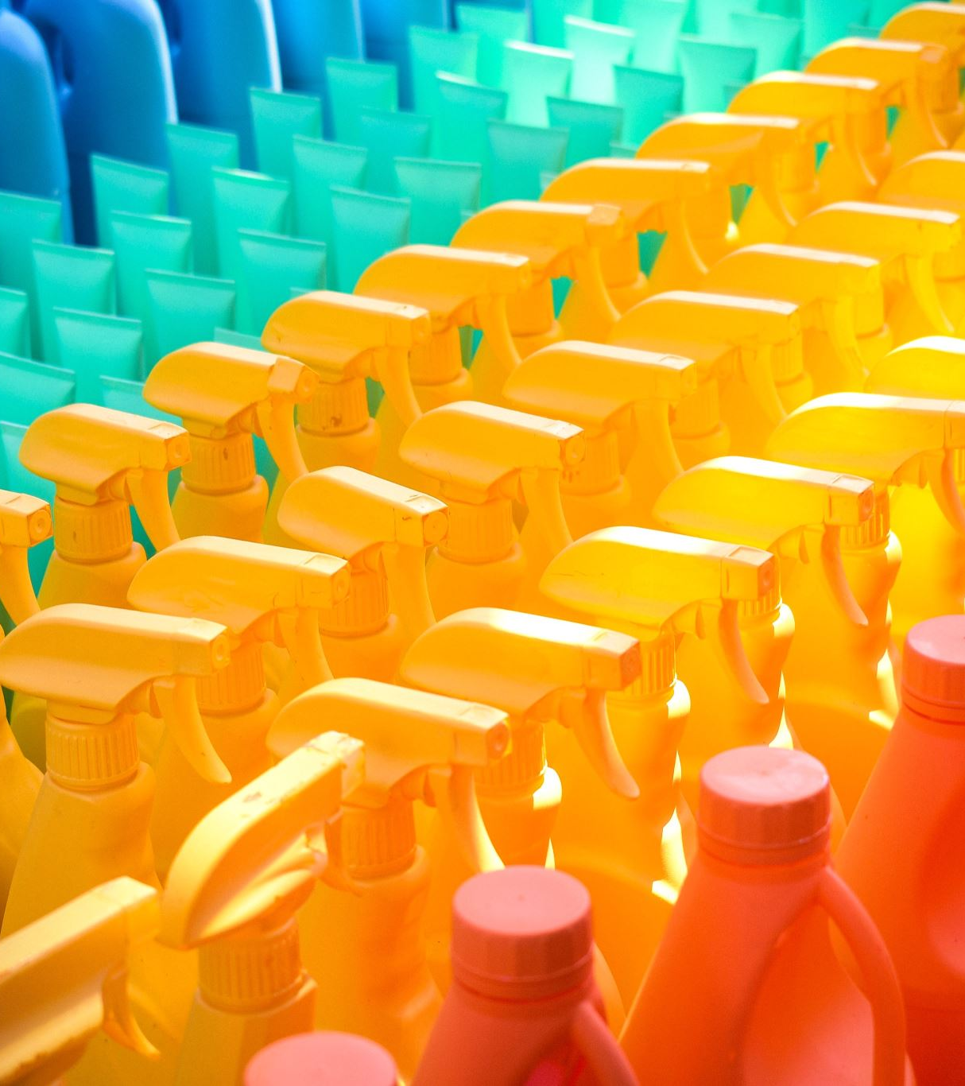
Functions of package
1. It Contains the Product: Packaging serves as a container that holds the product, ensuring it remains intact and undamaged.
For example, a cereal box contains the cereal within a plastic bag, preventing spillage (Keller, 2008).
2. It Protects the Product/Prevents Tampering: Packaging provides protection against physical damage, environmental factors, and contamination.
For example, child-resistant caps on medication bottles prevent unauthorized access and tampering (Rundh, 2005)
3. It Dispenses the Product: Packaging can facilitate the easy dispensing of the product.
For instance, squeeze bottles for condiments like ketchup allow for controlled dispensing without mess (Clement, 2011)

Slide 11
Functions of package
4. It Provides Points of Purchase Advertising: Packaging acts as a promotional tool at the point of sale, attracting consumers' attention.
Eye-catching designs on snack food packaging often increase impulse purchases (Underwood, 2003)
5. It Serves as an Attention-Getting Device: Unique or colorful packaging can draw consumers’ eyes on store shelves, helping products stand out.
An example is Coca-Cola’s limited-edition packaging for special events (Silayoi & Speece, 2007)
6. It Provides a Reminder to Current Users: Packaging can act as a reminder for customers to repurchase.
For instance, a coffee brand may feature a design that resonates with loyal customers, reminding them of the brand (Keller, 2008)

Slide 12
Functions of package
7. It Is a Source of Information: Packaging provides vital information, including directions for use, ingredients, and cautionary notes.
For example, food products must list ingredients and nutritional information on their packaging (Robertson, 2006)
8. It Provides a Vehicle for Announcing Promotions and Deals: Packaging can convey promotional offers or discounts.
For instance, a cereal box may have a sticker announcing a "buy one, get one free" deal (Brennan, 2015)
9. It Promises Physical and Emotional End Benefits: Packaging communicates the benefits of the product, both tangible and emotional.
For example, luxury skincare products often use elegant packaging to evoke feelings of indulgence and self-care (Klimchuk & Krasovec, 2012)

Slide 13
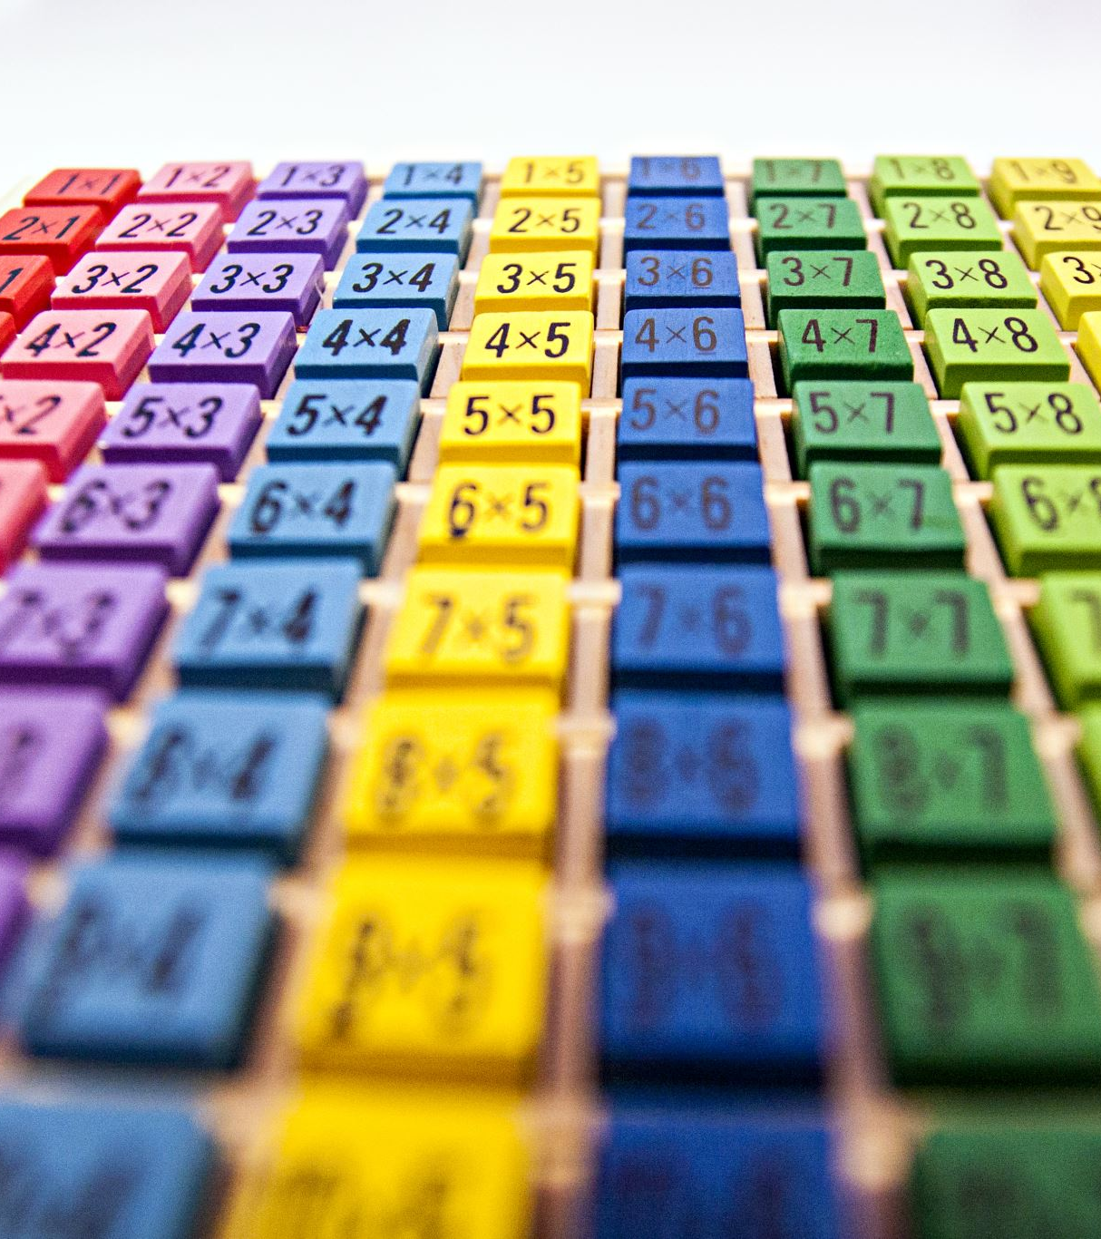
Functions of package
10. It Encourages Purchase/Makes a Sale: Attractive packaging can influence consumer decisions and encourage purchases.
For example, brightly colored candy wrappers appeal to children, leading to impulse buys (Silayoi & Speece, 2007)
11. Provide for Placement on Store Shelves: Packaging design must consider how products will be displayed on shelves.
Products like beverages often have wide bases and distinctive shapes for easier stacking and visibility (Underwood, 2003)
12. Describes the Product: Packaging should effectively describe what the product is and its uses.
For instance, a can of soup often has images and descriptions of the ingredients, highlighting its flavor profile (Clement, 2011)

Slide 14

Functions of package
13. Present or Reduce the Possibility of Theft: Security features in packaging can deter theft.
For example, electronics often come with security tags or tamper-proof seals to discourage shoplifting (Brennan, 2015)
14. Provide for Ease of Shipping, Moving, and Handling: Well-designed packaging facilitates transportation and handling.
For instance, bulk items like soda are often packaged in cartons for easy stacking and transport (Robertson, 2006)
15. Facilitates Branding and Recognition: Packaging reinforces brand identity, helping consumers recognize products quickly.
The iconic shape of a Coca-Cola bottle or the distinctive Tiffany blue box are prime examples of brand recognition through packaging (Keller, 2008)

Slide 15
The Importance of Packaging Decisions in Marketing
Decisions related to packaging encompass various elements such as the size and shape of the package, the materials used, and its color and texture (including roughness or smoothness), as well as the brand mark.
The packaging should aim to elicit a positive response from consumers while also being easy for retailers to handle.
Companies should regularly evaluate their packaging in light of shifts in consumer preferences and technological advancements.
Additionally, organizations must acknowledge the environmental impact of their packaging choices, with many opting for environmentally friendly solutions that promote decomposition, recycling, and safety.
Research conducted by Elliot C. Young (1987) indicates that an average package in a supermarket generates approximately 15 billion exposures annually.

Slide 16
Types of packaging
a) Primary Packaging: Primary packaging is the first layer that directly contains the product.
Its main function is to protect the product and provide essential information to consumers.
Common examples include bottles, cans, and boxes.
b) Secondary Packaging: Secondary packaging is designed to hold multiple units of primary packaging for storage and transportation.
This type of packaging often features branding and promotional elements.
An example is a cardboard box that contains several bottles of soda.
c) Tertiary Packaging: Tertiary packaging is used for bulk handling, storage, and transportation.
It protects products during shipping and helps in warehouse management.
Examples include pallets, shipping boxes, and crates.

Slide 17
Types of packaging
d) Flexible Packaging: Flexible packaging is made from materials such as plastic, film, or foil that can change shape when filled or sealed.
This type of packaging is lightweight, can reduce waste, and is often used for snacks and beverages.
A common example is the packaging for potato chips, which is flexible and allows for easy opening and resealing. (Klimchuk & Krasovec, 2012)
e) Rigid Packaging: Rigid packaging is made from solid materials and does not change shape when filled.
It is often used for products that require strong protection. Examples include glass jars for sauces and plastic containers for yogurt.
f) Eco-Friendly Packaging: Eco-friendly packaging is designed to minimize environmental impact.
It may be made from biodegradable materials or designed for easy recycling.
An example is a box made from recycled cardboard or a plant-based plastic bag.

Slide 18
Types of packaging
g) Tamper-Evident Packaging: This type of packaging includes features that show if a product has been tampered with.
Examples include seals on medicine bottles and shrink wrap on food products.
h) Specialty Packaging: Specialty packaging includes unique designs that enhance the consumer experience.
An example is the elegant packaging used for perfumes that often reflects the brand's identity and exclusivity
i) Convenience Packaging: Convenience packaging focuses on user-friendly features that make products easier to use or transport.
Examples include single-serve packages, resealable bags, and easy-pour spouts.

Slide 19
Characteristics of a good package
Characteristic | Description | Examples
Safety and Security | Protects the product from contamination, damage, and tampering. | Tamper-evident seals on food and pharmaceutical products.
Appeal to Target Market | Design and messaging resonate with the intended audience. | Packaging aimed at children featuring bright colors and cartoon characters.

Slide 20
Characteristics of a good package
Characteristic | Description | Examples
Functionality | Designed for ease of use and convenience. | Resealable bags for snacks that enhance user experience.
Environmental Responsibility | Takes into account its environmental impact, favoring recyclable or biodegradable materials. | Eco-friendly packaging by companies like Unilever.
Cost-Effectiveness | Economically feasible for production while maintaining quality and effectiveness. | Affordable packaging solutions that do not inflate product prices.

Slide 21
Characteristics of a good package
Characteristic | Description | Examples
Ease of Selection within Product Line | Facilitates easy selection among similar products in a brand's lineup. | A series of yogurt flavors using consistent design schemes with different colors indicating flavor.
Right Quality Impression | Conveys the quality of the product through high-quality materials and sophisticated designs. | Luxury perfumes packaged in elegant, high-quality boxes.
Reflects Product Image | Aligns with the overall brand identity and values of the product. | Organic food products with earthy colors and natural textures.

Slide 22
Characteristics of a good package
Characteristic | Description | Examples
Simplicity | A clean and straightforward design that is easy to understand. | A minimalist skincare product packaging that conveys purity.
Quickly Communicates Product Identity | Instantly conveys what the product is and its primary use, helping consumers make quick decisions. | A juice box with fruit imagery that communicates its content.
Use of Focal Points | Highlights key benefits or features that distinguish the product. | A "100% Natural" label on food products to draw consumer attention.
Stands Out from Competition | Captures attention on crowded shelves with unique shapes, vibrant colors, or distinctive branding. | Coca-Cola's contour bottle design that is iconic and recognizable.

Slide 23
Objectives of Package Tests
The key objectives of package tests include:
1. Assessing Visibility of Package Alternatives: One of the primary objectives of package testing is to evaluate how different packaging options stand out on retail shelves compared to one another and against established brands.
Tests may involve shelf simulations or eye-tracking studies to measure which designs draw attention and encourage purchase
2. Conveying Perceptions of Physical and Emotional End Benefits:
Tests aim to assess how well packaging alternatives convey the physical benefits (e.g., freshness, quality) and emotional benefits (e.g., luxury, enjoyment) that consumers seek.

Slide 24
Objectives of Package Tests
The key objectives of package tests include:
3. Assessing the Believability of Claims. Package tests evaluate whether consumers find the claims made on packaging (e.g., "100% Organic" or "No Preservatives") believable.
4. Effectiveness in Stimulating Trial: Tests are conducted to determine if certain packaging designs or features effectively encourage consumers to take the first step of trying a product.
5. Assessing Functionality and Clarity of Instructions:
Tests may involve usability studies where participants interact with the packaging to identify any confusion regarding opening mechanisms, usage instructions, or product information.

Slide 25

Procedure of package test
The process of package testing involves systematic procedures designed to evaluate the effectiveness of different packaging designs.
1. Research Design: The initial stage of package testing involves designing a research framework that defines the objectives and methodologies for the test.
Unlike name tests, package tests require a more in-depth approach due to the complexities involved in evaluating visual and perceptual responses to packaging.

Slide 26
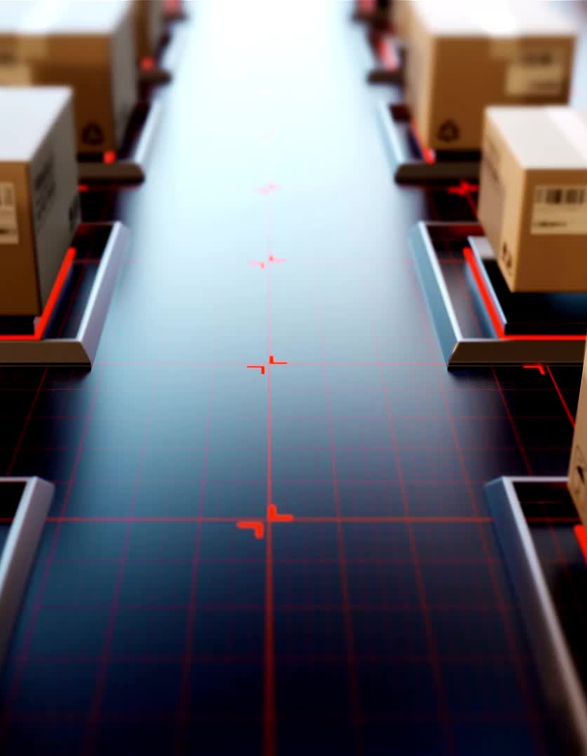
Procedure of package test
2. Control of Exposure: The visibility and image of package alternatives must be meticulously controlled during testing.
It is important to note that a package's high visibility score when tested in isolation may diminish when placed among competitive products.
Therefore, it is critical to include the current package design of the established product in the test as a control.
Moreover, other products positioned at the front end of stores should also be included, even if they belong to different categories, to simulate a realistic shopping environment (Underwood, 2003; Silayoi & Speece, 2007)

Slide 27

Procedure of package test
3. Use of Slides for Exposure Control:
Control over exposure to package alternatives is sometimes achieved by using slides.
This method allows researchers to manage how respondents view packaging designs, providing greater control over exposure compared to using actual displays.
Although testing can be conducted in real store environments, either in test markets or simulated test markets, this approach is infrequently utilized due to practical and cost considerations related to producing the product in multiple packages (González-Benito & González-Benito, 2006)

Slide 28
Procedure of package test
4. Questionnaire Development: Common questions may include:
Brand Imagery: Respondents describe their impressions of the product using semantic differential scales.
Aesthetic Appeal: Questions assess whether respondents find the package pleasant to look at and interesting.
Functional Characteristics: Evaluation of the package’s ability to prevent contamination or damage, as well as its convenience for storage and dispensing.
Likes and Dislikes: Open-ended questions allow respondents to share spontaneous reactions to the packaging and product.
Purchase Intent: Questions designed to gauge respondents' willingness to try the product.
Product Usage and Demographics: Collecting data on category usage and demographic information such as age, gender, marital status, income, education, occupation, and religion (Kotler & Keller, 2016)

Slide 29
Procedure of package test
5. Sampling Method: Interviews for package testing should be conducted in high-traffic, central locations, aiming for a minimum of 100 respondents who are current category users.
Specific age and gender requirements may also be established to ensure the sample accurately reflects the target market (Clement, 2011)
6. Approach to Analysis: The analysis phase focuses primarily on visibility and image scores across the alternative package designs.
The researchers will test these scores, calculating proportions and means to determine which designs perform best.
This quantitative analysis helps in assessing how well each package meets the predetermined objectives (Brennan, 2015)

Slide 30
Procedure of package test
7. Action Standards: Establishing performance standards is essential for evaluating package tests. These standards can include:
Visibility: The new package must equal or exceed the visibility of the current or competitive package design.
Key Attributes Ratings: The package must achieve equal or better ratings on critical attributes and end-benefit scales.
Weight of Image vs. Visibility: Determining whether visibility or image will have greater importance in the analysis process. (Rundh, 2005)

Slide 31
Other considerations in package test
Literature Review: Before conducting package tests, it is beneficial to perform a literature review to understand existing research on packaging effectiveness.
Prototype Development: Create prototypes of the packaging designs to be tested. This may involve using different materials, shapes, and sizes.
Focus Groups: Conduct focus groups with potential consumers to gather qualitative insights about initial impressions and perceptions of the packaging.

Slide 32
Other considerations in package test
Behavioral Observations: In addition to surveys, observing consumer behavior in real or simulated shopping environments can provide insights into how packaging influences purchase decisions.
A/B Testing: Implement A/B testing by presenting two versions of the packaging to different consumer segments simultaneously.
Longitudinal Studies: Conduct longitudinal studies to assess how consumer perceptions of packaging change over time.

Slide 33
Other considerations in package test
Market Simulation: Simulate market conditions by introducing the packaging designs in a controlled retail environment.
Data Analysis Techniques: Utilize advanced data analysis techniques, such as regression analysis or cluster analysis, to identify patterns and correlations in consumer responses.
Post-Test Evaluation: After conducting the tests and analyzing the data, a post-test evaluation is essential.
This involves summarizing findings, identifying key takeaways, and making recommendations for package design improvements.

Slide 34
Other considerations in package test
Feedback Loop: Establish a feedback loop with product developers and marketers to ensure insights from package testing inform future packaging strategies.
Sustainability Consideration: Include assessments of the environmental impact of the packaging materials and design.
Final Presentation: Prepare a comprehensive report or presentation summarizing the testing results, insights, and recommendations for stakeholders.

Slide 35
Challenges of Package Testing
Key challenges faced during package testing include the following:
1. Consumer Variability: Consumers have diverse preferences, behaviors, and cultural backgrounds, which can affect how they perceive and respond to packaging.
Example: A package that appeals to a younger audience may not resonate with older consumers, leading to inconsistent feedback across different demographic groups.
2. Environmental Factors: The testing environment can significantly influence consumer responses.
Example: A brightly colored package may stand out in a dimly lit testing area but could be less effective in a well-lit retail environment.
3. Limited Testing Resources: Conducting comprehensive package tests can be resource-intensive, requiring significant time, money, and effort.
Example: A small food manufacturer may only have a limited budget to conduct package tests, hindering their ability to explore multiple designs or test in various environments.

Slide 36

Challenges of Package Testing
Key challenges faced during package testing include the following:
4. Impact of Established Brands: When testing new packaging for established brands, the existing packaging can heavily influence consumer perceptions.
Example: If a well-known snack brand changes its packaging, consumers may automatically associate the new design with a lower quality due to attachment to the original packaging.
5. Testing in Isolation: Testing packages in isolation can yield skewed results, as the absence of competitive products may not accurately reflect real-world consumer behavior.
Example: A package that receives high scores in isolation may lose its appeal when consumers see it among competitors on a retail shelf.

Slide 37
Challenges of Package Testing
Key challenges faced during package testing include the following:
6. Measurement and Evaluation Metrics: Determining the right metrics to measure package effectiveness can be challenging.
Example: While some researchers may focus solely on visibility scores, others may prioritize consumer purchase intent, leading to differing conclusions about package effectiveness.
7. Rapidly Changing Trends: Consumer preferences and market trends can change quickly, making it challenging to conduct package tests that remain relevant.
Example: A package design that is trendy now may quickly become outdated requiring companies to continually invest in package testing to stay competitive.

Slide 38
References
Brennan, L. (2015). The Marketing Plan: A Step-by-Step Guide. Cengage Learning.
Clement, J. (2011). Packaging Design: Successful Product Branding from Concept to Shelf. John Wiley & Sons.
González-Benito, O., & González-Benito, J. (2006). The Role of Packaging in the Marketing Strategy of Food Products. International Journal of Food Science & Technology.
Keller, K. L. (2008). Strategic Brand Management: Building, Measuring, and Managing Brand Equity. Pearson Education.
Klimchuk, M. R., & Krasovec, S. A. (2012). Packaging Design: Successful Product Branding from Concept to Shelf. John Wiley & Sons.
Kotler, P., & Armstrong, G. (1996). Principles of Marketing. Prentice Hall.
Kotler, P., & Keller, K. L. (2016). Marketing Management. Pearson Education.

Slide 39
References
Robertson, G. L. (2006). Food Packaging: Principles and Practice. CRC Press.
Rundh, B. (2005). The Multi-faceted Dimension of Packaging: The Marketing Perspective. Packaging Technology and Science.
Silayoi, P., & Speece, M. (2007). The Importance of Packaging Attributes: A Conjoint Analysis Approach. European Journal of Marketing.
Soroka, W. (1999). Fundamentals of Packaging Technology. Institute of Packaging Professionals.
Underwood, R. L. (2003). The Communicative Power of Product Packaging: Creating Brand Identity via Lived and Mediated Experience. Journal of Marketing Theory and Practice.
Underwood, R. L., & Klein, N. M. (2002). Packaging as Marketing Communication: Effects of Package Color, Size, and Shape on Perceptions of Product Quality. Journal of Marketing Theory and Practice, 10(4), 18-27.
Young, E. C. (1987). The Role of Packaging in Marketing Strategy.

Slide 40
End
Thank you
Next lesson: Test market studies

