Slide 1
COURSE: FUNDAMENTALS OF MARKETING
LECTURE 1: INTRODUCTION TO MARKETING
LECTURER: DR LUCY KARIMI KIRIMA
Lecture learning outcomes:
At the end of the lecture, you will be able to:
Understand the concept of marketing
Discuss various concepts of marketing
Examine marketing arena and philosophies of marketing

Slide 2
Concept of market
The term ‘market’ is derived from Latin word called ‘marcatus’ which means trade, merchandise, traffic or place of business
Place where sellers and buyers carry out transactions for the involvement of the exchange of services and goods

Slide 3
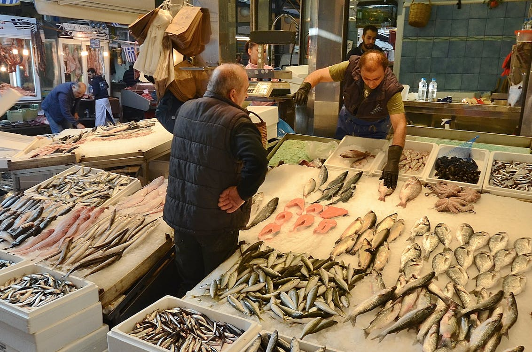
Place Concept
A market is a convenient meeting place of buyers and sellers to gather together in order to conduct buying and selling activities.
It is a physical location where buyers and sellers personally meet to affect purchase and sales
https://www.pexels.com/photo/people-fish-market-marketplace-3713/

Slide 4
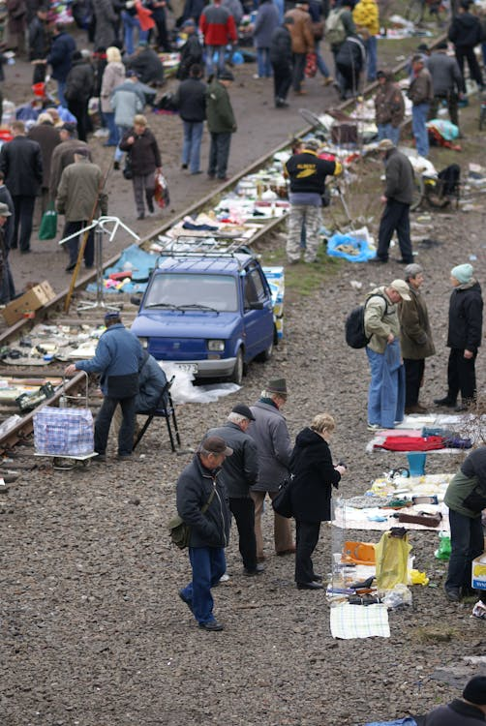
Buying and Selling in a marketplace
https://www.pexels.com/photo/people-are-gathered-around-a-train-track-with-lots-of-cars-16910295/

Slide 5
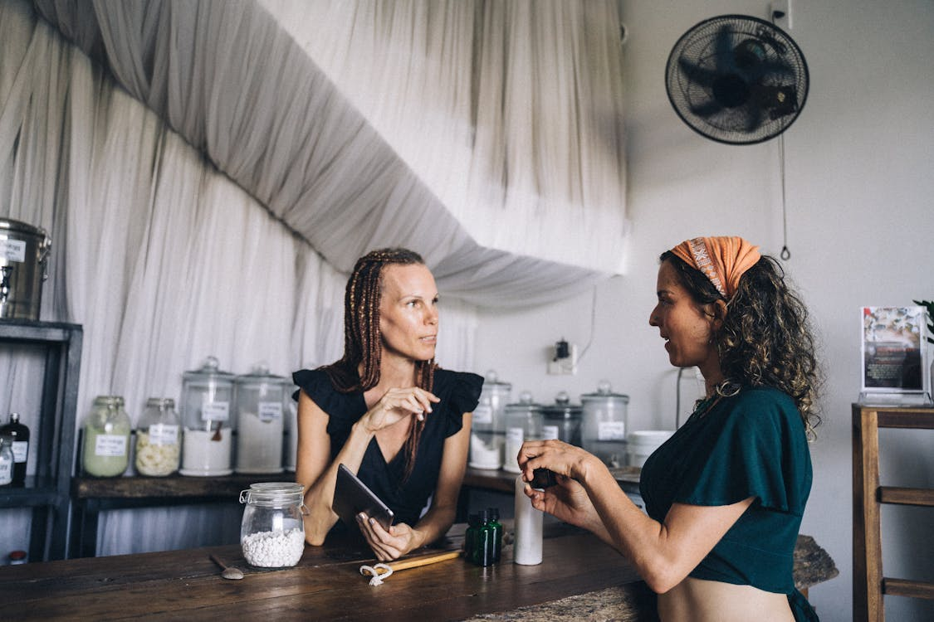
Marketer
Refers to the person who organises the various marketing activities such as market research, product planning, pricing, distribution
https://www.pexels.com/photo/photo-of-women-talking-7772172/

Slide 6
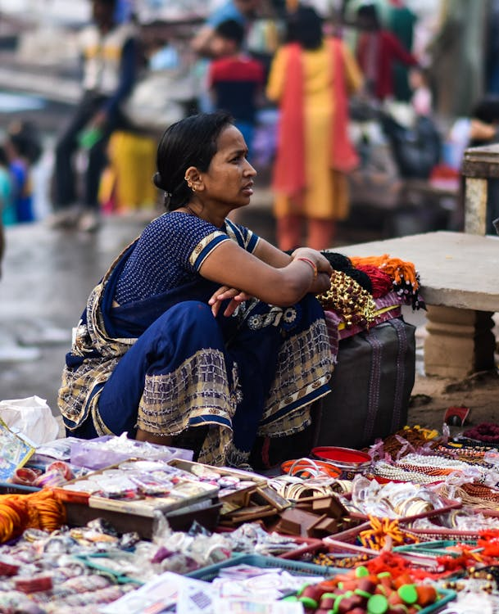
Seller
Refers to a person or organization, who is directly involved in the process of exchange of goods and services for money. This includes the wholesaler, retailer
https://www.pexels.com/photo/a-woman-sitting-on-the-ground-with-a-bunch-of-stuff-17729514/

Slide 7
Buyer and Consumer
Buyer: A buyer is one who is directly involved in the process of purchase of goods and services. He/she is one who selects the goods, makes payment and takes the delivery.
Consumer: One who uses the product or service. For example, you bought a shoe and gifted it to your friend who uses it. In this case your friend is the consumer, and you are a buyer. However, a consumer can also be the buyer.

Slide 8
Customer and virtual Market
Customer: A customer usually refers to the person who takes the buying decision.
A customer can also be the consumer. Similarly, the buyer may be different from the customer, or one can be the customer as well as the buyer.
Virtual Market: Today with advancement in technology, the buyer and sellers can interact by using the internet.

Slide 9
Concept of Marketing
According to American Marketing Association (2004) - "Marketing is an organizational function and set of processes for creating, communicating and delivering value to customers and for managing relationships in a way that benefits both the organization and the stakeholder."
According to Eldridge (1970) - "Marketing is the combination of activities designed to produce profit through ascertaining, creating, stimulating, and satisfying the needs and/or wants of a selected segment of the market."

Slide 10

Marketing
Marketing is a process by which companies create value for customers and build strong customer relationships in order to capture value for customers in return.
https://www.pexels.com/photo/man-in-blue-button-up-shirt-standing-in-front-of-gray-and-black-espresso-machine-4820837/

Slide 11
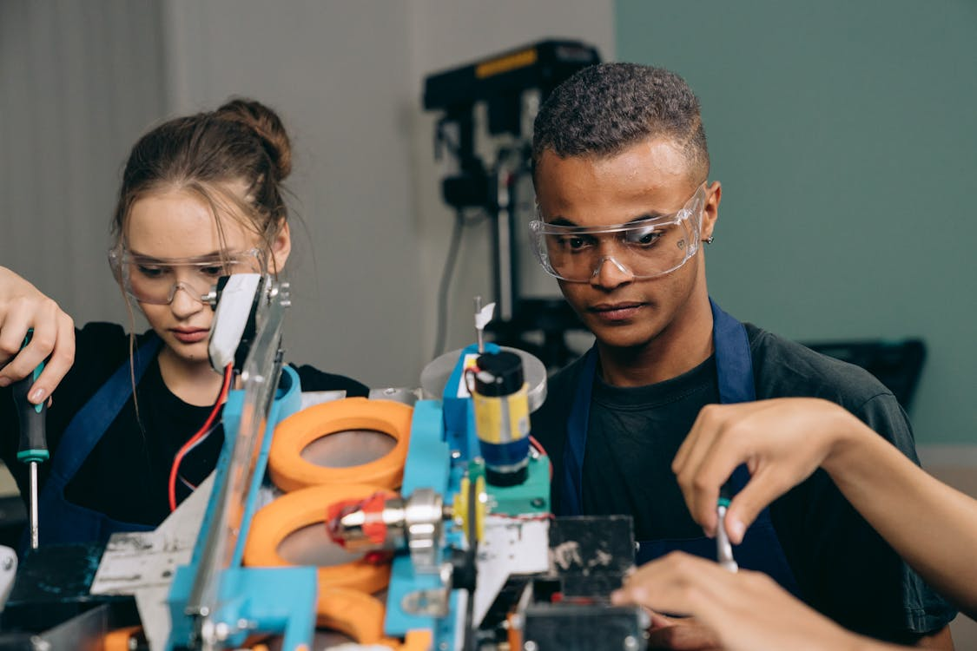
Marketing
Marketers aim to create products that satisfy needs, wants and demands and marketing aims to create value and utility.
https://www.pexels.com/photo/man-and-woman-sitting-at-the-table-9242857/

Slide 12
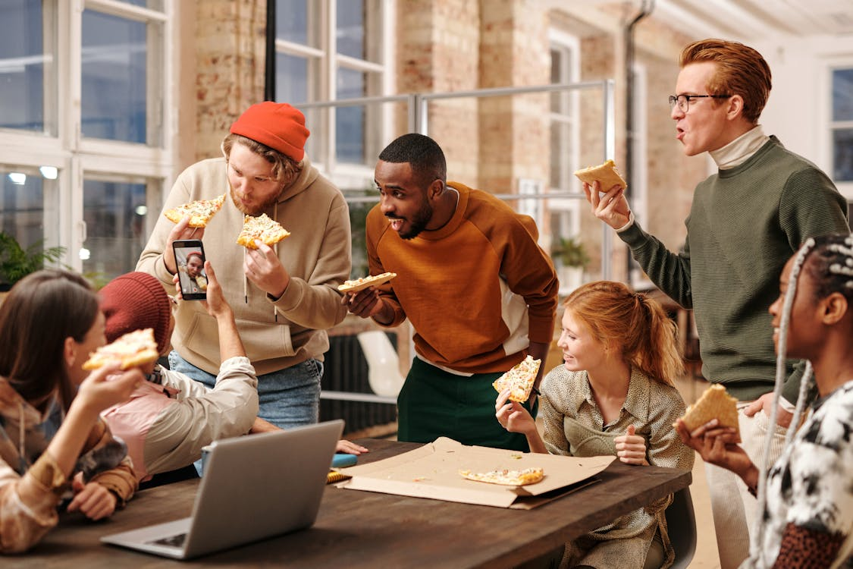
Key terms in marketing
Need is a state of felt deprivation of some basic satisfaction
Types of need:
Stated need (Minimum price)
Real need (Psychological price)
Unstated need (Service for post purchase)
Delighted need (Supplementary-Gift)
Secret need (Show up, gesture).
https://www.pexels.com/photo/people-eating-pizza-in-the-office-6150423/

Slide 13
Wants and Needs
Wants are needs driven by desires shaped by culture, society and individual personality
Demands are wants that are backed by purchasing power and a willingness to purchase. Wants become demand when backed by purchasing power

Slide 14
Exchange and transaction
Exchange and transaction is the way to obtain products and services. An exchange will only occur when the following conditions are satisfied:
There must be two parties
Each must have something to offer
Each must be able to negotiate, deal and decide
Each must be able to communicate and deliver to one another

Slide 15
Value and satisfaction
Value and satisfaction: Value can be defined as a ratio between what the customers get and what they give in return. The customers gets benefit and assumes costs
When value of the products or services is high, customers are willing to pay more for the products. Value is the perceived benefit gained from having/using a product – the cost of obtaining it.
Customer satisfaction is the extent to which a product’s perceived performance matches a buyer’s expectation

Slide 16
Product or offering and Value proposition
Product : People satisfy their needs and wants with products. A product is any offering that can satisfy a need or want
Value proposition is the set of benefits or values it promises to deliver to customers to satisfy their needs. It is actually the answer of customer’s question: ‘Why should I buy your product?’

Slide 17
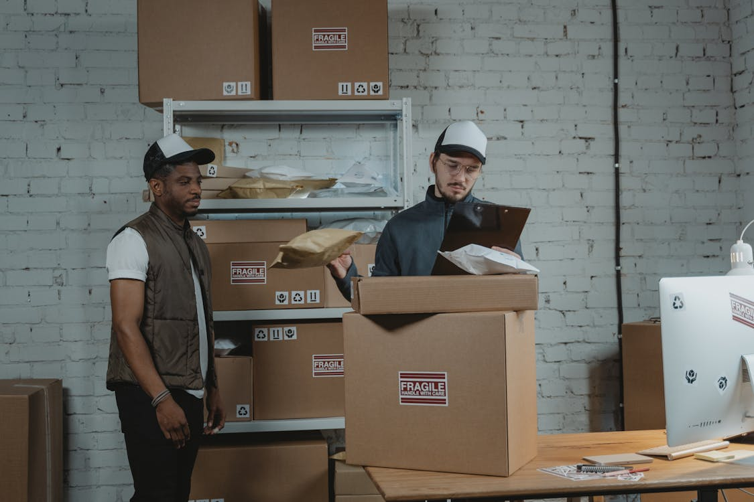
Relationships and Networks
Transaction marketing is part of a larger idea called relationship marketing.
Relationship marketing aims to build long-term mutually satisfying relations with key parties —customers, suppliers, distributors—in order to earn and retain their long-term preference and business.
https://www.pexels.com/photo/man-in-black-polo-shirt-standing-beside-brown-cardboard-box-6169649/

Slide 18
TRADITIONAL CONCEPT OF MARKETING
Marketing means selling goods and services that have been produced.
This concept of marketing emphasizes on promotion and sale of goods and services and little attention is paid to consumer satisfaction

Slide 19
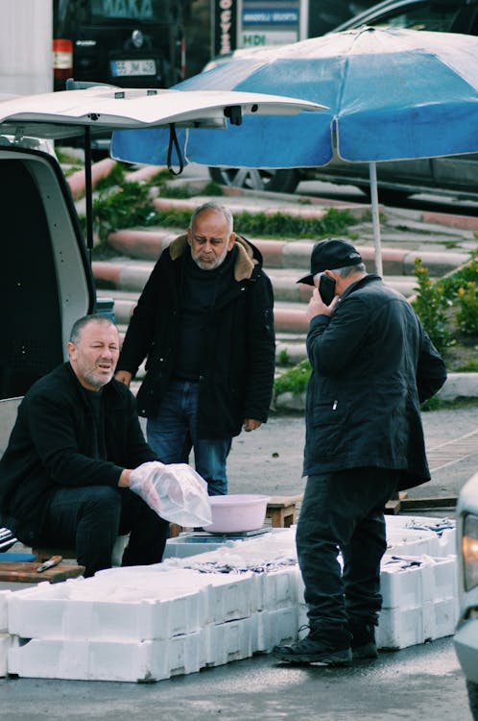
Characteristics of traditional Marketing
The main focus of this concept is on product, i.e., we have a product and it has to be sold. So, we have to persuade the consumers to buy the product.
• All efforts of the marketing people are concentrated on selling the product. They adopt all means like personal selling and sales promotion to boost the sales.
• The ultimate goal of all marketing activity is to earn profit through maximisation of sales.
https://www.pexels.com/photo/men-at-bazaar-14401173/

Slide 20
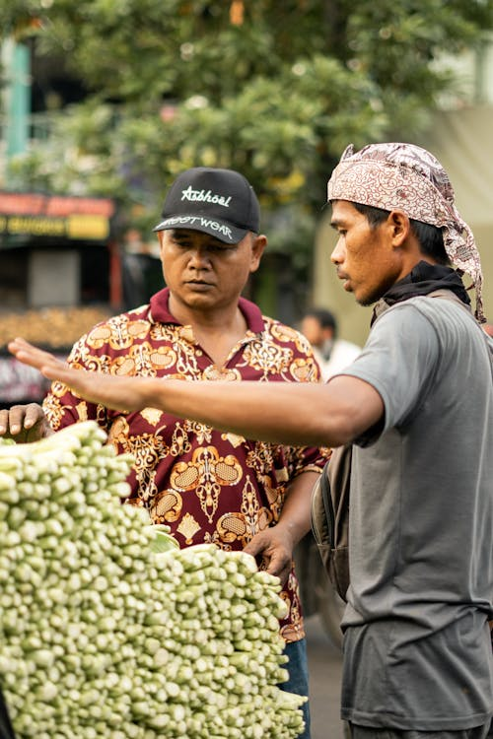
Traditional Marketing
Ralf S. Alexander and Others, “Marketing is the performance of business activities that direct the flow of goods and services from the producer to consumer or user”.
https://www.pexels.com/photo/two-men-standing-on-a-market-and-talking-7569596/

Slide 21
MODERN CONCEPT OF MARKETING
The modern concept of marketing considers the consumers’ wants and needs as the guiding spirit and focuses on the delivery of such goods and services that can satisfy those needs most effectively
Thus, marketing starts with identifying consumer needs, then plan the production of goods and services accordingly to provide him the maximum satisfaction.
the products and services are planned according to the needs of the customers rather than according to the availability of materials and machinery.
All activities (manufacturing, research and development, quality control, distribution, selling) are directed to satisfy the consumers

Slide 22

Characteristics of modern Marketing
The marketing activity starts with an assessment of the customer’s needs and plans the production of items that satisfy these needs most effectively
All marketing activities like product planning, pricing, packaging, distribution and sales promotion are combined into one as coordinated marketing efforts
https://www.pexels.com/photo/ethnic-woman-entering-house-with-cardboard-boxes-6347560/

Slide 23
Characteristics of modern marketing
Developing a product that can satisfy the needs of the consumers: taking promotional measures so that consumers come to know about the products. Its features, quality, availability etc.
Pricing the product keeping in mind the target consumers purchasing power and willingness to pay

Slide 24
Characteristics of modern marketing
Packaging and grading the product to make it more attractive and undertaking sales promotion measures to motivate consumers to buy the product and taking various other measures for example after sales service to satisfy the consumers needs.
The main aim of all effort is to earn profit through maximisation of customer satisfaction

Slide 25

Modern Marketing Summary
The term ‘modern marketing’ can be expressed as the achievement of corporate goals through meeting and exceeding customer needs better than the competition.
https://www.pexels.com/photo/happy-asian-buyer-with-bundle-of-bay-leaves-in-market-5709284/

Slide 26
Distinction between a social and a managerial definition for marketing.
• According to a social definition, marketing is a societal process by which individuals and groups obtain what they need and want through creating, offering, and exchanging products and services of value freely with others.
• As a managerial definition, marketing has often been described as “the art of selling products.”

Slide 27

Peter Drucker view
Peter Drucker, a leading management theorist, says that
“the aim of marketing is to make selling superfluous.
The aim of marketing is to know and understand the customer so well that the product or service fits him and sells itself.
https://www.pexels.com/photo/happy-ethnic-woman-with-salad-leaf-5709271/

Slide 28
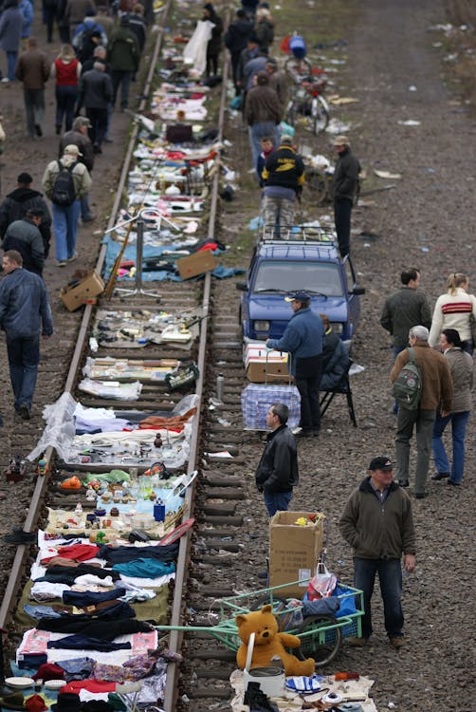
Marketing arena
The word “ARENA” is derived from Latin word “HARENA” which means smooth or fine. Marketing arena is a process of composing of a large open space surrounded on most or all sides by varieties of products and brands.
https://www.pexels.com/photo/people-are-walking-on-the-tracks-near-a-train-16910270/

Slide 29
Marketing arena
Seeking: The purpose of seeking is to discover the customer and customer needs. The marketing opportunity is revealed through an analysis of the environment.
Matching: Marketing is a matching process. Customer demand has to be matched with organizational resources and environmental limitations, such as competition, government regulations, general economic conditions and so on.
Programming: The marketing programme, called the marketing mix, covering product, price, promotion and distribution strategies will be formulated and implemented to accomplish the twin objectives of customer satisfaction and profitability.

Slide 30
Features of Marketing
Customer Value - Customer value is the process of marketing that facilitates the exchange of the services and products between the buyers and sellers.
Needs and Wants - Needs and wants is another vital process of marketing that helps groups or individuals to obtain what they need and what they want
Creating a Market Offering - The creation of market offerings like taste, size, or quality that are available at a given location or outlet.

Slide 31
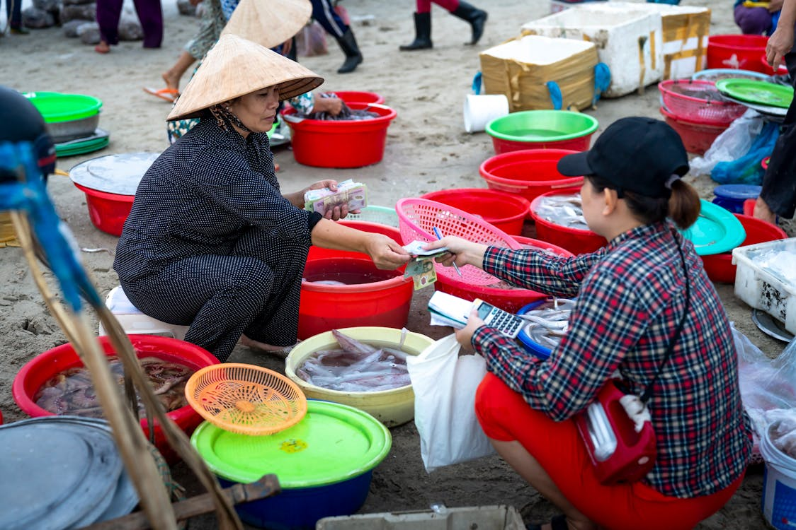
Features of Marketing
Exchange Mechanism - The exchange mechanism is the process of marketing that involves the exchange of services and products for money or some other products.
https://www.pexels.com/photo/asian-woman-selling-seafood-on-street-market-3871758/

Slide 32
References
Fundamentals of marketing, Marilyn, A, S, John, D, Routledge (Taylor and Francis) London New York,2007
Principles of marketing. Rashmi. R. Das. https://ddceutkal.ac.in/Downloads/UG_SLM/Commerce/Principle_Marketing.pdf
Marketing Fundamentals, University of New South Wales, Spoonfeedme
Principles of Marketing, Pearson. 17th edition, Kotler P. and Armstrong G,2017

Slide 33
References
Essentials of Marketing 17th Edition, William Perreault, Joseph Cannon, E. Jerome McCarthy , McGraw-Hill Education,2021
Marketing, Polese, Francesco, and Evert Gummesson, ProQuest Ebook Central, http://ebookcentral.proquest.com/lib/aunke -ebooks / detail. action? docID =4856363,2017
Skitterphoto (2015). https://www.pexels.com/photo/people-fish-market-marketplace-3713
Ajay Kumar (2023).https://www.pexels.com/photo/a-woman-sitting-on-the-ground-with-a-bunch-of-stuff-17729514/

Slide 34
References
Roman Biernacki (2023). https://www.pexels.com/photo/people-are-gathered-around-a-train-track-with-lots-of-cars-16910295/
Anna Tarazevich (2021). https://www.pexels.com/photo/photo-of-women-talking-7772172/
Cotton Bro Studio (2020). https://www.pexels.com/photo/man-in-blue-button-up-shirt-standing-in-front-of-gray-and-black-espresso-machine-4820837/
Mikail Nilov (2021). https://www.pexels.com/photo/man-and-woman-sitting-at-the-table-9242857/
Mikhail Nilov (2021). https://www.pexels.com/photo/man-and-woman-sitting-at-the-table-9242857

Slide 35
References
Diva Plaralaguna (2020).https://www.pexels.com/photo/people-eating-pizza-in-the-office-6150423/
Tima Miroshnichenko (2020). https://www.pexels.com/photo/man-in-black-polo-shirt-standing-beside-brown-cardboard-box-6169649/
Mustaf4ucar (2022). https://www.pexels.com/photo/men-at-bazaar-14401173/
Yusen El Jihan (2021).https://www.pexels.com/photo/two-men-standing-on-a-market-and-talking-7569596/
Liza Summer (2020(.https://www.pexels.com/photo/ethnic-woman-entering-house-with-cardboard-boxes-6347560/

Slide 36
References
Yusen El Jihan (2021).https://www.pexels.com/photo/two-men-standing-on-a-market-and-talking-7569596/
Liza Summer (2020(.https://www.pexels.com/photo/ethnic-woman-entering-house-with-cardboard-boxes-6347560/
Sam Lion (2020). https://www.pexels.com/photo/happy-asian-buyer-with-bundle-of-bay-leaves-in-market-5709284/
Sam Lion (2020). https://www.pexels.com/photo/happy-ethnic-woman-with-salad-leaf-5709271/
Quang Nguyen Vinh (2020). https://www.pexels.com/photo/asian-woman-selling-seafood-on-street-market-3871758/

