Slide 1
COURSE: FUNDAMENTALS OF MARKETING
LECTURE 4: MARKETING ENVIRONEMENT
LECTURER: DR LUCY KARIMI KIRIMA
Lecture learning outcomes:
At the end of the lecture, you will be able to:
Understand the marketing environment
Discuss internal marketing environment
Examine external marketing environment

Slide 2
Business Operations
No business operates in a vacuum. Decisions are made within a context of competition, customer characteristics, behaviour of suppliers and distributors, and of course within a legislative and social framework.
People working within organisations are contributing to the welfare of society and of each other and obtaining satisfaction of their own needs in return: this complex network of exchanges results in a better standard of living for everybody.

Slide 3
Marketing Environment
Marketing system of every business organisation is influenced by a large number of controllable and uncontrollable factors that surround the company. So the marketing system of a company must have to operate within the framework of the environmental forces.
Environment refers to all internal and external factors, which directly or indirectly influence the organization’s Marketing

Slide 4

Marketing Environment
According to Philip Kotler, a company's marketing environment consists of the actors and forces outside of marketing that affect marketing management's ability to develop and maintain successful transactions with its target consumers
https://www.pexels.com/photo/man-in-brown-crew-neck-t-shirt-and-blue-denim-jeans-holding-black-and-white-book-4865737/

Slide 5
FEATURES OF MARKETING ENVIRONMENT
Specific and General Forces: Refers to different forces that affect the marketing environment. Specific forces include those forces, which directly affect the activities of the organization.
General forces are those forces, which indirectly affect the organization. Examples of general forces are social, political, legal, and technological factors.
Complexity: Implies that a marketing environment includes number of factors, conditions and influences. The interaction among all these elements makes the marketing environment complex in nature.

Slide 6
Features of marketing environment
Uncertainty:Implies that market forces are unpredictable in nature. Every marketer tries to predict market forces to make strategies and update their plans. It may be difficult to predict some of the changes, which occurs frequently
Vibrancy:Implies the dynamic nature of the marketing environment. A large number of forces outline the marketing environment, which does not remain stable and changes over time.

Slide 7

Features of marketing environment
Relativity: Explains the reasons for differences in demand in different countries. The product demand of any particular industry, organization, or product may vary depending upon the country, region, or culture.
https://www.pexels.com/photo/paper-bags-surrounded-the-texts-7987750/

Slide 8
Types of Marketing Environment
Organisation's Internal Environment:Organisations financial, production and human resource capabilities influence its marketing decisions to a large extent. For instance, while deciding about the sales targets, it is necessary to see whether the existing production facilities are enough to produce the additional quantities or not.
Micro Environment
Micro environment refers to the environment, which is closely linked to the organization, and directly affects organizational activities. It can be divided into supply side and demand side environment

Slide 9
Micro Environment
Suppliers: are an essential part of every organization. It provides raw material to produce goods and services. Suppliers can influence the profit of an organization because the price of raw material determines the final price of the product
Marketing Intermediaries: helps organizations in establishing a link with customers. They help in promoting, selling, and distributing products. Market intermediaries are the intermediary parties that help a business to distribute its products in the market. The market intermediaries can be wholesalers, retailers, and distributors.

Slide 10
Marketing intermediaries
Resellers: It purchases the products from the organizations and sells to the customers. Examples of resellers are wholesalers and retailers.
Distribution Centers: It helps organizations to store the goods. A warehouse is an example of distribution center.
Marketing Agencies: It promotes the organization’s products by making the customers aware about benefits of products. An advertising agency is an example of marketing agency.
Financial Intermediaries: It provides finance for the business transactions. Examples of financial intermediaries are banks, credit organizations, and insurance organizations.

Slide 11

Micro Environment
Customers: buy the product of the organization for final consumption. Customers are the most crucial component of the business.
Customers are the target audience of the product, and the preference of customers influences all the marketing and business efforts of a company. The main goal of an organization is customer satisfaction
https://www.pexels.com/photo/woman-in-a-hijab-buying-groceries-4199400/

Slide 12
Micro Environment
Competitors:The competitors are the other businesses that sell similar products as other products or are part of the same strategic group in the industry. It helps an organization to differentiate its product to maintain position in the market.
Customers: Each type of consumer market has certain unique characteristics and the marketer should be fully acquainted with the art of persuading and selling to these consumers

Slide 13
Types of publics
Public: General public do take interest in the business undertaking. The company has a duty to satisfy the people at large along with competitors and the consumers.
Press: This is one of the most important group, which may make or break a company. It includes journalists, radio, television, etc. Press people are often referred to as unwelcome public. A marketing manager must always strive to get a positive coverage from the press people.
Financial Public: These are the institutions, which supply money to the company

Slide 14

Publics
Government: Politicians often interfere in the business for the welfare of the society and for other reasons. A prudent manager has to maintain good relation with all politicians irrespective of their party affiliations
General Public: This includes organisations such as consumer councils, environmentalists,
https://www.pexels.com/photo/a-man-and-a-woman-smiling-while-looking-at-each-other-7103117/

Slide 15

Macro Environment
Macro environment involves a set of environmental factors that is beyond the control of an organization. These factors influence the organizational activities to a significant extent. Macro environment is subject to constant change. The changes in macro environment bring opportunities and threats in an organization
https://www.pexels.com/photo/elderly-man-looking-at-a-product-8422692/

Slide 16
Macro Environment
Demographic Environment: Demographic environment is the scientific study of human population in terms of elements, such as age, gender, education, occupation, income, and location
Demographic environment is responsible for the variation in the tastes and preferences and buying patterns of individuals. The changes in demographic environment persuade an organization to modify marketing strategies to address the altering needs of customers

Slide 17

Macro Environment
Economic Environment: Economic environment affects the organization’s costs structure and customers’ purchasing power. The purchasing power of a customer depends on the current income, prices of the product, savings, and credit availability.
https://www.pexels.com/photo/ethnic-girl-choosing-fruit-from-box-in-bazaar-with-mother-5094489/

Slide 18
Factors of economic environment
Inflation: It influences the customers’ demand for different products. For example, higher petrol prices lead to a fall in demand for cars.
Interest Rates: It determines the borrowing activities of the organization. For example, increase in interest rates for loan may lead organizations to cut their important activities.
Unemployment: It leads to a no income state, which affects the purchasing power of an individual.
Customer Income: It regulates the buying behavior of a customer. The change in the customer’s income leads to changed spending patterns for the products, such as food and clothing.

Slide 19
Macro Environment
Monetary and Fiscal Policy: It affects all the organizations. The monetary policy stabilizes the economy by controlling the interest rates and money supply in an economy; whereas, fiscal policy regulates the government spending in various areas by collecting the revenue from the citizens by taxing their income
Natural Environment: Natural environment consists of natural resources, which are needed as raw materials to manufacture products by the organization

Slide 20
Macro Environment
Socio-Cultural Environment: Socio-cultural environment comprises forces, such as society’s basic values, attitudes, perception, and behavior. These forces help in determining that what type of products customers prefer, what influences the purchase attitude or decision, which brand they prefer, and at what time they buy the products.
Technological Environment: Technology is one of the elements that have great potential to influence the business of an organization. It is dynamic, as it changes rapidly. Technology provides several threats and opportunities to the business environment

Slide 21
Technological trends that affect the marketing environment
Pace of Technological Change: leads to product obsolescence at a rapid pace. If the pace of technological change is very rapid then organizations need to modify their products as and when required
Research and Development: helps in increasing growth opportunities for an organization. Many organizations have developed a separate team for R&D to bring innovation in its products
Increased Regulation: refers to government guidelines to ban unsafe products. Marketers should be aware of these regulations to prevent their violation.

Slide 22
Macro Environment
The political and legal environment has a serious impact on the economic environment of a country.
Political and Legal Environment: Political and legal environment consists of legal bodies and government agencies that influence and limit the organizations and individuals
Every organization should take care of the fact that marketing activities should not harm the political and legal environment prevailing in a country.

Slide 23
Legislations affecting the marketing activities
Anti-pollution laws, which affect the production or manufacturing of various products.
Customer legislation, which tries to protect the customer’s interest

Slide 24
Natural factors affect the marketing activities
Natural Resources: serves as raw material for manufacturing various products. Every organization consumes natural resources for the production of its products. Organizations are realizing the problem of depletion of resources and trying best to use these resources judiciously.
Weather: leads to opportunities or threats for the organizations
Pollution: includes air, water, and noise pollution, which lead to environmental degradation. Now-a-days, organizations tend to promote environment friendly products through its marketing activities

Slide 25
Significance for scanning the Marketing Environment
Decide on matters related to Government-legal-regulatory policies in a particular country so as to formulate its strategies successfully amidst these policies.
Allocate its resources effectively and diversify either into a new market segment
The business environment is not static. It is continuously changing with fast speed
Become well acquainted with the changes in the environment.
Gain qualitative information about the business environment; which will help him to develop strategies in order to cope with ever changing environment.
.Conduct marketing analysis in order to understand the markets needs and wants so as to modify its products to satisfy these market requirements.

Slide 26
Significance for scanning the Marketing Environment
Identify its weaknesses such as lower quality of goods or services; lack of marketing expertise; or lack of unique products and services; and prepare strategies to convert its weaknesses into strengths.
Identify the threats from the environment in terms of new competitors, price wars, competitor’s new products or services, etc.; and prepare its strategies on the basis of that.
Identify the opportunities in the environment and exploit these opportunities to firm’s advantage

Slide 27

Significance for scanning the Marketing Environment
Identify its strengths and fully exploit them in firm’s advantage. These strengths can be in terms of marketing expertise, superior product quality or services, or giving unique innovative products or services.
https://www.pexels.com/photo/focused-woman-working-on-laptop-at-desk-7015027/

Slide 28
Importance of Marketing Environment
Identification of Opportunities: helps an organization in exploiting the chances or prospects for its own benefit
Identification of Threats: gives warning signals to organizations to take the required steps before it is too late
Managing Changes: helps in coping with the dynamic marketing environment. If an organization wishes to survive in the long run then it has to adapt to the changes occurring in the marketing environment

Slide 29
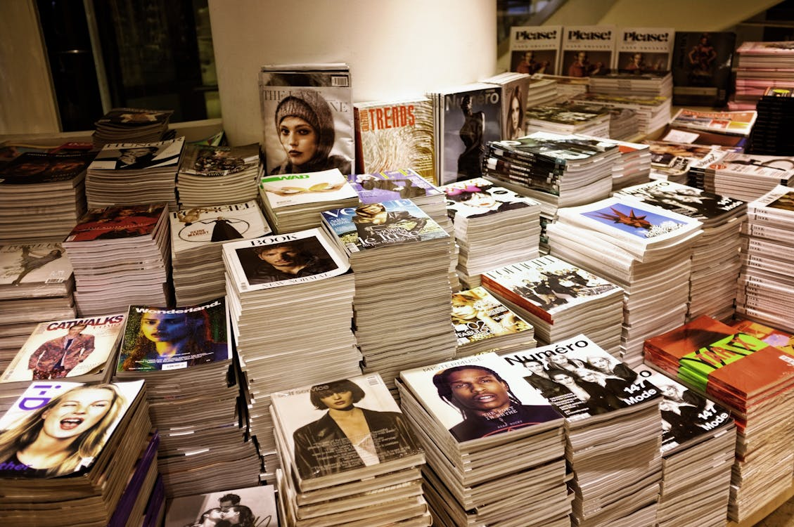
Key Note
Every business organization is a part of the business environment, within which it operates. No entity can function in isolation because there are many factors that closely or distantly surround the business, which is known as a business environment
https://www.pexels.com/photo/assorted-book-lot-264600/

Slide 30
Conclusion
Microenvironment, and Macro environment. The former affects the working of a particular business only, to which they relate to, while the latter affects the functioning of all the business entities, operating in the economy.
Macro environment refers to the general environment that can affect the working of all business enterprises.
Micro environment is defined as the nearby environment, under which the firm operates.

Slide 31
References
CottonBro (2020). https://www.pexels.com/photo/man-in-brown-crew-neck-t-shirt-and-blue-denim-jeans-holding-black-and-white-book-4865737/
Jack Sparrow (2020). Tamhttps://www.pexels.com/photo/woman-in-a-hijab-buying-groceries-4199400/anna Rumee(2020). https://www.pexels.com/photo/paper-bags-surrounded-the-texts-7987750/
Kampus Production (2021). https://www.pexels.com/photo/elderly-man-looking-at-a-product-8422692/
Kimanji Ongino (2018). https://www.pexels.com/photo/ethnic-girl-choosing-fruit-from-box-in-bazaar-with-mother-5094489/

Slide 32
References
Edmond Dantes (2021). https://www.pexels.com/photo/a-man-and-a-woman-smiling-while-looking-at-each-other-7103117/
Pixabay (2013). https://www.pexels.com/photo/assorted-book-lot-264600/
George Milton (2021). https://www.pexels.com/photo/focused-woman-working-on-laptop-at-desk-7015027/

