Slide 1
FUNDAMENTALS OF MARKETING
LECTURE 5: CONSUMER AND MARKET BEHAVIOUR
LECTURER: DR LUCY KARIMI KIRIMA
Lecture learning outcomes:
At the end of the lecture, you will be able to:
Understand the concept of consumer behavior
Discuss the concept of consumer behavior with reference to marketing
State the role of consumer behavior in the marketing strategy of a product

Slide 2
Consumer Behavior
Consumer behavior is helpful in understanding the purchase behaviour and preferences of different consumers.
Consumer behavior is the study of how individual customers, groups or organizations select, buy, use, and dispose ideas, goods, and services to satisfy their needs and wants. It refers to the actions of the consumers in the marketplace and the underlying motives for those actions.

Slide 3
Concept of consumer Behaviour
According to Engel, Blackwell, and Mansard, ‘Consumer behavior is the actions and decision processes of people who purchase goods and services for personal consumption’.
According to Louden and Bitta, ‘Consumer behavior is the decision process and physical activity, which individuals engage in when evaluating, acquiring, using or disposing of goods and services’.

Slide 4
Consumer Behaviour
Consumer behavior is a process, and purchase forms one part of this process. There are various endogenous psychological and exogenous environmental factors which influence this process. All these factors and the type of influence which they exert on an individual's consumption behaviour can be understood and analysed.
Importance of consumer behavior lies in the fact that behavior can be understood and influenced to ensure a positive purchase decision.

Slide 5
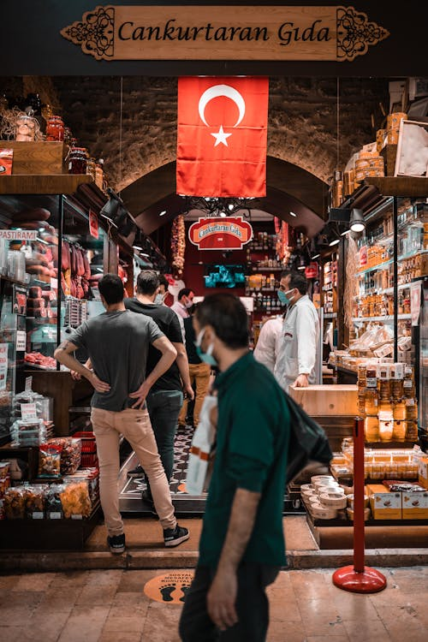
Consumer Behavior
Consumer behavior is about how consumers behave in situations involving goods, services, ideas and experiences. The situations could cover pre-purchase, purchase and post-purchase
https://www.pexels.com/photo/people-on-a-street-market-in-turkey-8064502/

Slide 6
Nature of Consumer Behaviour
Marketing factors such as product design, price, promotion, packaging, positioning and distribution.
Personal factors such as age, gender, education and income level.
Psychological factors such as buying motives, perception of the product and attitudes towards the product.
Situational factors such as physical surroundings at the time of purchase, social surroundings and time factor.

Slide 7
Nature of Consumer Behaviour
Situational factors such as physical surroundings at the time of purchase, social surroundings and time factor.
Social factors such as social status, reference groups and family.
Cultural factors, such as religion, social class—caste and sub-castes
Undergoes a constant change: Consumer behaviour is not static. It undergoes a change over a period of time depending on the nature of products.

Slide 8
Nature of Consumer Behaviour
Varies from consumer to consumer
All consumers do not behave in the same manner. Different consumers behave differently. The differences in consumer behaviour are due to individual factors such as the nature of the consumers, lifestyle and culture
Varies from region to region and country to county:
The consumer behaviour varies across states, regions and countries. For example, the behaviour of the urban consumers is different from that of the rural consumers

Slide 9
Nature of Consumer Behaviour
Information on consumer behaviour is important to the marketers:
Marketers need to have a good knowledge of the consumer behavior. They need to study the various factors that influence the consumer behavior of their target customers
Leads to purchase decision:
A positive consumer behaviour leads to a purchase decision. A consumer may take the decision of buying a product on the basis of different buying motives.

Slide 10
Nature of Consumer Behaviour
Varies from product to product
Consumer behaviour is different for different products. There are some consumers who may buy more quantity of certain items and very low or no quantity of other items
Improves standard of living
The buying behaviour of the consumers may lead to higher standard of living. The more a person buys the goods and services, the higher is the standard of living

Slide 11

Nature of Consumer Behaviour
Reflects status
The consumer behaviour is not only influenced by the status of a consumer, but it also reflects it.
https://www.pexels.com/photo/man-in-black-jacket-holding-a-rattan-plastic-basket-5486163/

Slide 12
Scope of consumer Behaviour
Demand Forecasting: Consumer behaviour helps in the forecasting of demands for the business. Business can identify the needs and wants of the customers by understanding their behavior. They can easily find out their unfulfilled needs and demands
If they get a clear idea of what customer needs, a business can design their products accordingly. It will help them in the forecasting of demands for products by understanding their behavior. The business will be able to identify the market opportunities available to them.

Slide 13
Scope of consumer Behaviour
Educating Customer: Consumer behavior helps marketers to identify how customers spend on their buying decision. By understanding their behavior marketers can easily guide their customers about how they can improve their buying decisions
They can suggest ways to save their money and guides them with better options available in the market. Customers get aware of different opportunities available to them as per their behavior.

Slide 14
Scope of consumer Behaviour
Assists in Designing Product Portfolio: Designing the right product portfolio is a challenging task for every business
Consumer behavior helps in identifying the class and requirements of peoples. This helps in designing products as per people‘s needs and include in the product portfolio of the company
This way business is able to design the optimum product portfolio and able to serve its customers in a better way

Slide 15
Scope of consumer Behaviour
Marketing Management: Marketing has an important role in the successful functioning of every business. Better understanding of customer needs, problems and expectations will help the business in framing sound marketing strategies. If a company is able to do marketing effectively it can attract more and more customers
Understanding customer behavior will help companies to have better knowledge about their customers. This will ultimately help business in conducting their marketing in a better way.

Slide 16
Scope of consumer Behaviour
Market Mix: Designing an accurate mix of important elements like product, price, place and promotion are important for every business. It helps in finding out the dislikes and unfulfilled wants of customers
Selecting The Target Market: Consumer behavior helps in identifying target customers from the market.
It helps in segmentation of the overall market into different groups. Grouping of customers and identification of their needs will help business in serving them better.
This helps marketers in designing the optimum marketing mix for improving the effectiveness of marketing strategies

Slide 17
Consumer involvement
Consumer involvement is defined as a state of mind that motivates consumers to identify with product/service offerings, their consumption patterns and consumption behavior. Involvement creates within consumers an urge to look for and think about the product/service category and the varying options before making decisions on brand preferences and the final act of purchase. It is the amount of physical and mental effort that a consumer puts into a purchase decision.

Slide 18
Consumer involvement
It creates within a person a level of relevance or personal importance to the product/service offering and this leads to an urge within the former to collect and interpret information for present/future decision making and use. Involvement affects the consumer decision process and the sub processes of information search, information processing, and information transmission

Slide 19
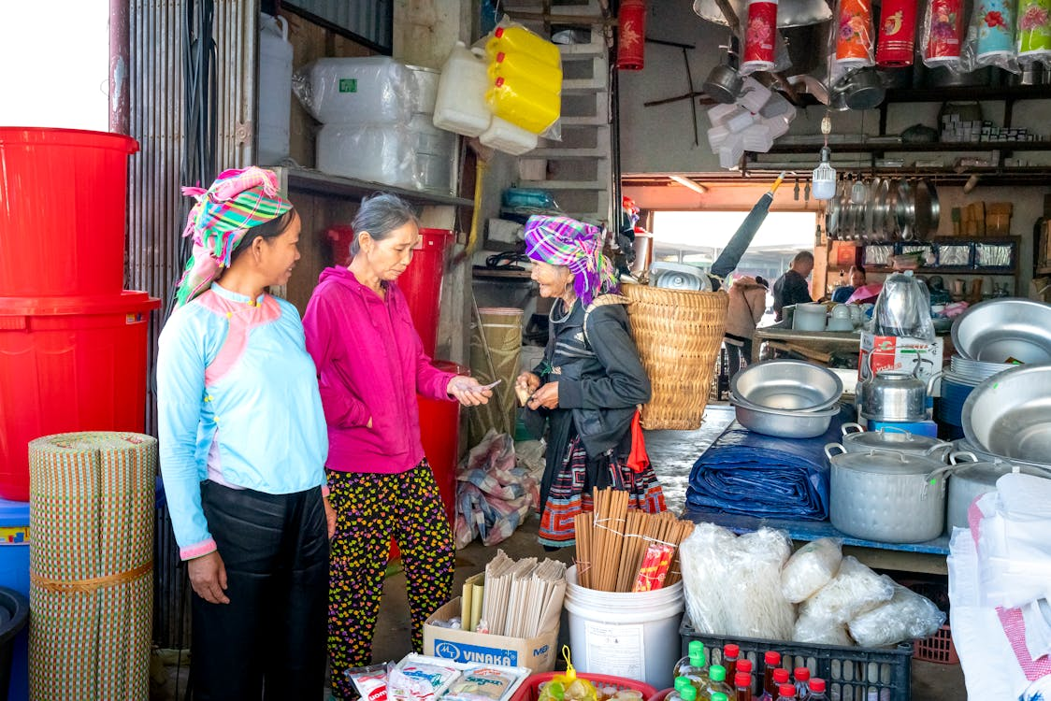
Types of Consumer Involvement
Situational involvement: This is a state of arousal directed towards attaching relevance to a person/object/situation for a short term. As an affective state, it creates a level of involvement when a person thinks about a particular person/object/situation.
https://www.pexels.com/photo/smiling-asian-vendor-speaking-with-shopper-in-market-6130869/

Slide 20
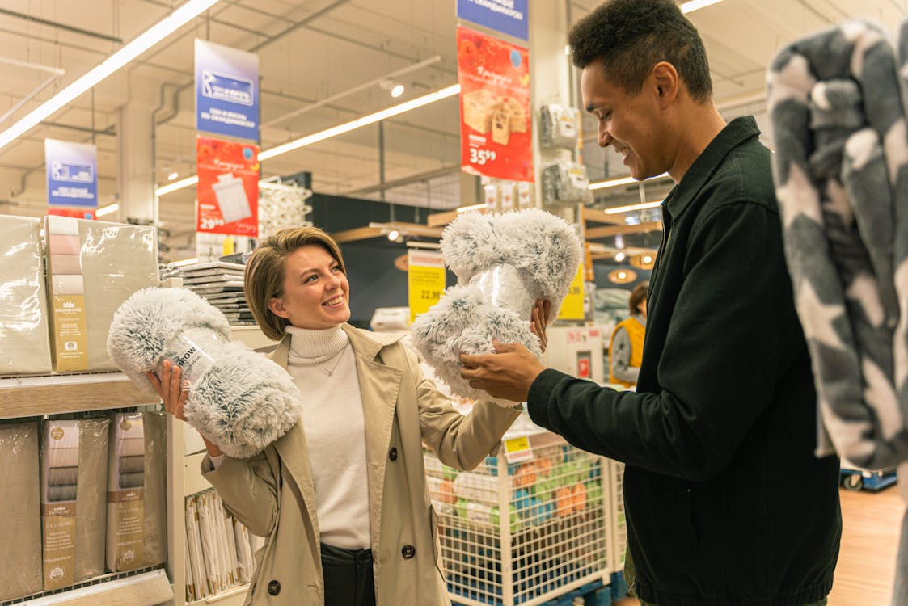
Types of Consumer Involvement
Enduring involvement: When the level of involvement towards the product/service category extends over a period of time across situations, it is referred to as enduring involvement. The person shows a high-level of interest in the product category and spends time collecting and processing information and integrating it within his memory
https://www.pexels.com/photo/man-in-black-suit-jacket-holding-woman-in-white-coat-5486114/

Slide 21
Factors Influencing Consumer Behaviour
Demand Forecasting
Demand for a product begins with wants and desires of buyers (individuals, family or organisation). Effective demand for a product needs purchasing power (income, assets and credit) as well as buying motives, i.e., willingness to buy a product. When the effective demand for all buyers is added up, the result is the total market demand for the product
Psychological factors such as individual consumer needs and motivations, perceptions, attitudes, the learning process and personality characteristics are the similarities which operate across different types of people and influence their behaviour

Slide 22
Factors Influencing Consumer Behaviour
Company Demand
Company demand is the volume of sales expected under given environmental conditions for a specific forms. It is a function of the firm’s strategic marketing effort and specifies the amount of sales turnover which would be realised by a company under different levels of company’s selling efforts
Industry Forecast: It indicates the customer demand under the expected level of marketing effort which can be put forward by all the sellers within an industry

Slide 23
Buyer Characteristics
Cultural Factors
Culture-The set of basic values, perceptions, wants and behaviors learned by a member of society from family and other important institutions.
Cultural group-A group of people with shared value systems based on common life experiences and situations.
Social class-Relatively permanent and ordered divisions in a society whose members share similar values, interests and behaviors.

Slide 24

Buyer Characteristics
Social Factors
Family role and status
Opinion Leaders
Reference Groups
Membership Groups
https://www.pexels.com/photo/people-in-a-supermarket-shopping-3985055/

Slide 25
Personal Factors
Personality and self-concept-Personality refers to the unique psychological characteristics that distinguish a person or group
Demographics-Standard population descriptors e.g. age, economic situation, life-cycle stage, education, occupation.
Lifestyles-A person’s pattern of living as expressed in his or her activities, interests and opinions.

Slide 26
Psychological Factors
Beliefs and attitudes-Belief: A descriptive thought that a person holds about something. Attitude: A person’s consistently favourable or unfavourable evaluations, feelings and tendencies towards an object or idea.
Motive (or drive-A need that is sufficiently pressing to direct the person to seek satisfaction.
Perception-The process by which people select, organise and interpret information to form a meaningful picture of the world.
Learning-Changes in an individual’s behaviour arising from experience.

Slide 27
What affects consumer behavior
The process of making decisions Problem recognition and the search for information
▪ Regarding behavior, attitudes or values.
▪ Unfulfilled need, financial situation o Making judgements and decisions
▪ Effort level and relation to time, mental and emotional memory
Making post decision evaluations
▪ Judge if decisions was correct, and whether to repeat purchase
The psychological core: internal consumer processes
Motivation, ability and opportunity
Exposure, attention, perception, comprehension
Memory and knowledge
Forming and changing attitudes.

Slide 28

What affects consumer behavior
The consumers culture: external processes
Culture: typical or expected behaviours, norms, and ideas that characterize a group of people
Reference group: a group of people consumers compare themselves with for information
Diversity- regional, ethnic, religious groups o Household and social class influences ▪ Low, middle, high class
Values, personality, and lifestyle ▪ Beliefs, activities, interests, opinions
https://www.pexels.com/photo/angry-woman-holding-her-hair-short-hair-9514645/

Slide 29
What affects consumer behavior
Consumer behavior outcomes and issues.
CB symbolize who we are
Symbols: external signs that consumers use to express their identity
CB diffused through a market eg) communicated information
CB, ethics, and social responsibility.
Balance immediate outcome against long term outcome, balance own interest against interest of others.
Product produced ethicallt
Conflicting priorities

Slide 30

Marketers and consumer Behaviuor
Marketers expect that by understanding what causes the consumers to buy particular goods and services, they will be able to determine—which products are needed in the marketplace, which are obsolete, and how best to present the goods to the consumers.
https://www.pexels.com/photo/couple-checking-in-at-hotel-5137964/

Slide 31
Conclusion
Consumer behavior is the study of how individual customers, groups or organizations select, buy, use, and dispose ideas, goods, and services to satisfy their needs and wants. It refers to the actions of the consumers in the marketplace and the underlying motives for those actions.

Slide 32
References
Fundamentals of marketing, Marilyn, A, S, John, D, Routledge (Taylor and Francis) London New York,2007
Principles of marketing. Rashmi. R. Das. https://ddceutkal.ac.in/Downloads/UG_SLM/Commerce/Principle_Marketing.pdf
Marketing Fundamentals, University of New South Wales, Spoonfeedme

Slide 33
References
Principles of Marketing, Pearson. 17th edition, Kotler P. and Armstrong G,2017
Essentials of Marketing 17th Edition, William Perreault, Joseph Cannon, E. Jerome McCarthy , McGraw-Hill Education,2021
Marketing, Polese, Francesco, and Evert Gummesson, ProQuest Ebook Central, http://ebookcentral.proquest.com/lib/aunke -ebooks / detail. action? docID =4856363,2017
Musa Ortac (2018). https://www.pexels.com/photo/people-on-a-street-market-in-turkey-8064502/

Slide 34
References
Hannah Bickmore (2021).https://www.pexels.com/photo/angry-woman-holding-her-hair-short-hair-9514645
Antoni Shkraba (2020). https://www.pexels.com/photo/man-in-black-jacket-holding-a-rattan-plastic-basket-5486163/
Quang Nguyen Vinh (2020).https://www.pexels.com/photo/smiling-asian-vendor-speaking-with-shopper-in-market-6130869/
Antoni Shkraba (2020). https://www.pexels.com/photo/man-in-black-suit-jacket-holding-woman-in-white-coat-5486114/
Gustavo Fring (2020).https://www.pexels.com/photo/people-in-a-supermarket-shopping-3985055

