Slide 1
COURSE: FUNDAMENTALS OF MARKETING
LECTURE 7: PRODUCT
LECTURER: DR LUCY KARIMI KIRIMA
Lecture learning outcomes:
At the end of the lecture, you will be able to:
Understand what is a product
Discuss essential attributes of a Product
Examine classification of Goods
Discuss new product development
Examine product life cycle

Slide 2
PRODUCT
Product is a physical or a non-physical good or service, made by a company to be sold to a customer fulfilling specific customer's stated or unstated needs.
A product has a benefit which completes a customer need and for which a customer pays.
A finished set of goods or input materials or even services are classified as products.

Slide 3
PRODUCT
A product is not complete in itself and requires other factors of business like marketing, distribution, sales, service etc. to be successful.
Product is one of the main components of marketing—all marketing activities revolve around the product
A product is what a seller has to sell and what a buyer has to buy. It satisfies the needs of customers

Slide 4
PRODUCT
Customers purchase products because they are capable of realizing some benefits to the purchaser
A marketer can satisfy the needs and wants of his customers by ‘offering something’ in exchange for money. And this ‘offering’ is basically a product.
A bad product not only generates bad name for the firm but also affects negatively the price set for the product, dissuades the channel members and reduces the believability of the promotional measures

Slide 5
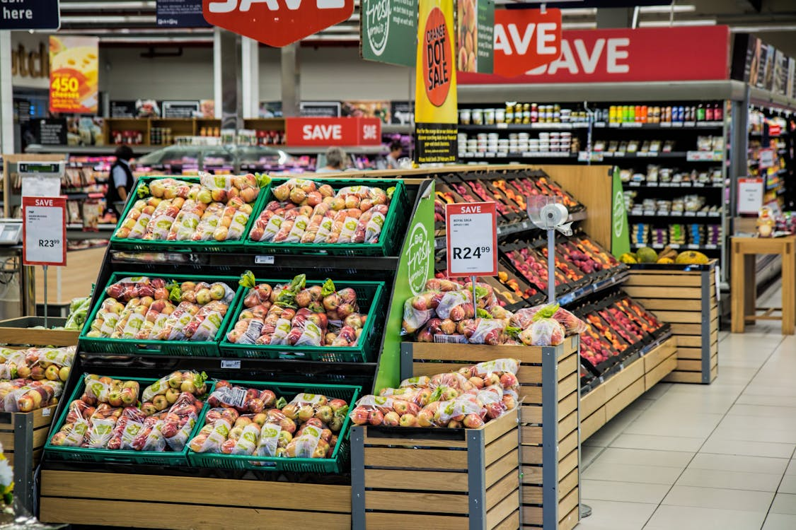
PRODUCT
According to Philip Kotler “A product is anything tangible or intangible that can be offered to a market for attention, acquisition use or consumption that might satisfy a need or want”.
• According to Cravens, Hills and Woodruff “Product is anything that is potentially valued by a target market for the benefits or satisfactions it provides, including objects, services, organizations, places people and ideas”.
https://www.pexels.com/photo/grocery-store-264636/

Slide 6
Features of a Product
Tangibility: Products are tangible in nature, customers can touch, seen or feel a products
Intangible Attributes: Service products are intangible in nature, services like, consultancy, banking, insurance
Associated Attributes: The attributes associated with product may be, brand, packaging, warranty, guarantee, after sales services etc
Associated Attributes: The attributes associated with product may be, brand, packaging, warranty, guarantee, after sales services etc

Slide 7
Features of a Product
Exchange Value: Irrespective of the fact that whether the product is tangible or intangible, it should be capable of being exchanged between buyer and seller for a mutually agreed price.
Customer Satisfaction: A product satisfies the customer needs and wants of customers, value of products is also determined by the level of satisfaction given by a product after purchase.

Slide 8
Features of Product Concept of Marketing
No Concern with Customers' Need The product concept does not care for customers' needs, wants or interest, preference etc. rather it focuses attention on producing quality and durable goods at lower cost
Emphasis on Product Quality Product concept of marketing gives emphasis to produce quality goods in large quantity.
Reasonable Price The product concept believes that no hard effort needs to sell quality products at reasonable price.

Slide 9

Features of Product Concept of Marketing
Quality Improvement
The product concept believes that quality product should be improved to attract customers.
https://www.pexels.com/photo/family-doing-grocery-shopping-3985062/

Slide 10
Attributes of a Product
Tangible or Intangible: It may be capable of being touched, seen and felt
Associated Attributes: A product consists or various product features and accompanying services. Thus, a product is comprised of attributes including colour, package, brand name, accessories, installation, instruction to use, manufacturing prestige, retailer's prestige, after sale service,
Exchange Value: A product must be capable of being exchanged between a buyer and seller at a mutually acceptance cost.
Satisfaction: It should be capable of providing, satisfaction to the buyers both real and psychological

Slide 11
Dimensions of a product
Managerial Dimension:
It covers the core specifications or physical attributes, related service, brand, package, product life-cycle, and product planning and development
Consumer Dimension:
To the consumer a product is actually a group of symbols or meanings. People buy things not only for what they can do, but also for what they mean. Each symbol communicates a certain information

Slide 12

Dimensions of a product
Social Dimension:
To the society salutary products and desirable products are always welcome as they fulfill the expectations of social welfare and social interests. Salutary products yield long-run advantages but may not have immediate appeal. Desirable products offer benefits, immediate satisfaction and long-run consumer welfare.
https://www.pexels.com/photo/pastry-shop-glass-display-with-selection-of-desserts-4409269/

Slide 13
Levels of product
Generic product: The generic product is a basic version of the product made up of only those features necessary for it to function eg a bed, towels, a bathroom, a mirror, and a wardrobe in a hotel
Core benefit: The first and the basic level is the core product/benefit the customers look at. It is the basic good or service purchased, aside from its packaging or accompanying services.
The core benefit is the fundamental need or wants that the customer satisfies when they buy the product or service

Slide 14
Levels of product
Expected product: The expected product is the set of features that the customers expect when they buy the product eg clean sheets, clean towels, Wi-fi, and a clean bathroom in an hotel
Augmented product: The augmented product refers to any product variations, extra features, or services that help differentiate the product from its competitors eg in an hotel inclusion of a concierge service or a free map of the town in every room.

Slide 15

Levels of product
Potential product: The potential product includes all augmentations and transformations the product might undergo in the future- to surprise and delight customers the product must be augmented- this could mean a different gift placed in the room each time a customer stays
https://www.pexels.com/photo/assorted-spices-at-counter-in-street-market-5273033/

Slide 16
Product Classification
Speciality goods refer to those items which possess unique characteristics and/or brand identification and for which a significant group of buyers are habitually willing to make a special purchasing effort eg TV. radio, refrigerators.
Convenience Goods
Convenience Goods, usually of semi-durable nature, refer to those comparatively high value items which the customers buy after paying consideration as to quality, price, design

Slide 17

Product Classification
Industrial Goods
Industrial Goods refer to those goods which are destined to be sold primarily for use in producing other goods or rendering services as contrasted with the goods destined to be sold primarily to the ultimate consumers eg Raw materials, Equipment and Fabricated items
https://www.pexels.com/photo/man-in-black-suit-standing-near-brown-wooden-chair-4820684/

Slide 18
New Product
New products are “new” in varying degrees. They may be minor or major modifications of a firm’s existing products. They may be new to the particular firm but not new to the market
A product may be new to the market, something not previously available in any form.
(original products, improved products, modified products, and new brands that the firm develops through its own Research and Development efforts.)

Slide 19
New Products
Booz, Allen & Hamilton identified six types of new products
New-to-the-World Products
New-Product Lines
Additions to Existing Product Lines
Improvements in / Revisions to Existing Products
Repositioning is modifying the existing products/brands in some way
Cost Reductions: New products that provide similar performance at lower cost

Slide 20
New Development Process
Developing new product is a real challenge for any firm . The reason is that if the product is not well accepted by the target consumers, investment goes into ashes.
Development of product, in essence, is the process of fitting the proposed product to the requirements and opportunities of the market.

Slide 21

New product development stages
Idea Generation
The first step in developing new products is idea generation. Usually, the marketing executive will create or obtain a pool of ideas that can be examined for possible commercialization
https://www.pexels.com/photo/man-rummaging-through-iron-cabinet-8114294/

Slide 22
Idea Generation Techniques
Forced Relationships: In this technique, number of objects are first listed and then each of the object is considered in relation to every other object to create a new product having multiple use
Attribute Listing Technique: Under this technique, major attributes of a product are first listed and than efforts are taken to modify attribute (s)

Slide 23
New product development stages
Idea Screening
In this step the marketing executive will try to eliminate all those ideas that do not appear to hold reasonable promise. Through this the executive can reduce the cost of further studying ideas that may never reach commercialization
Ideas should be measured against nine criteria :compatibility with objectives, compatibility with company image, compatibility with other lines, compatibility with manufacturing processes, compatibility with cost limits, identified target market, marketable through existing channels, degree differs from competition, and legally protectable

Slide 24

New product development stages
Marketing Strategy Development
As soon as the concept testing is done, product manager, in order to introduce the product in the market will develop a preliminary marketing strategy plan which may be further modified depending on the necessity
https://www.pexels.com/photo/wood-person-art-creative-7205810/

Slide 25
New product development stages
Business Analysis
After the product concept and marketing strategy is developed, attractiveness of the proposal is evaluated by the management to see whether company’s objectives will be attained considering cost involved, sales to be made and profit that may be generated from this sales.
Business analysis consists of :
(a) estimating total sales (including estimation of first-time sales, estimation of replacement sales, and estimation of repeat sale),

Slide 26
Business analysis consists of :
Estimating cost and profits.
Total Sales: It is necessary for management to know whether estimated total sales of the proposed product will warrant satisfactory profit to decide on product development
Estimating Costs and Profits: The next step in business analysis is estimation of costs and profits. When sales forecasts are prepared, management wants to see the costs that may involve in making the estimated sales as well as the profits that may be generated from such sales.

Slide 27

Business analysis consists of :
To evaluate the merit of a new product proposal, companies use different financial measures such as break-even analysis in order to estimate how many units it should sell to reach a position where costs and revenues are same
https://www.pexels.com/photo/photo-of-women-at-the-meeting-3810792/

Slide 28
Product Development
Commercialization
When a product reaches this stage in the development process, it is completed. Marketer reaches this final decision based on the results of market testing and the decision is launching the product.
Product Development
At this stage a prototype is developed for each of the relatively few product concepts that survive business analysis

Slide 29
Product Life Cycle
Introduction Stage
This stage involves introducing a new and previously unknown product to buyers. Sales are small, the production process is new, and cost reductions through economies of size or the experience curve have not been realized

Slide 30
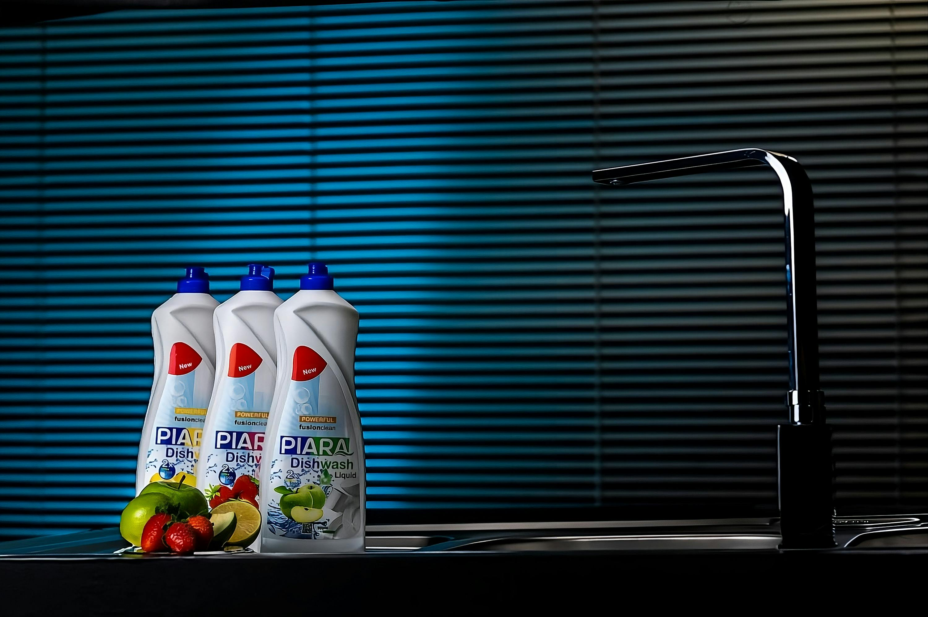
Product Life Cycle
Growth Stage
In this stage, sales grow rapidly. Buyers have become acquainted with the product and are willing to buy it. New buyers enter the market and previous buyers come back as repeat buyers.
https://www.pexels.com/photo/piara-dishwash-liquid-display-in-modern-kitchen-28764305/

Slide 31
Product Life Cycle
Mature Stage
In this stage, the market becomes saturated. Production has caught up with demand and demand growth slows precipitously. There are few first-time buyers. Most buyers are repeat buyers. Competition becomes intense, leading to aggressive promotional and pricing programs to capture market share from competitors or just to maintain market share.

Slide 32
Product Life Cycle
Decline Stage
In this stage, buyers move on to other products and sales drop. Intense rivalry exists among competitors. Profits dry up because of narrow profit margins and declining sales. Some businesses leave the industry. The remaining businesses try to revive interest in the product. If they are successful, sales may begin to grow. If not, sales will stabilize or continue to decline.

Slide 33
References
Fundamentals of marketing, Marilyn, A, S, John, D, Routledge (Taylor and Francis) London New York,2007
Principles of marketing. Rashmi. R. Das. https://ddceutkal.ac.in/Downloads/UG_SLM/Commerce/Principle_Marketing.pdf
Marketing Fundamentals, University of New South Wales, Spoonfeedme

Slide 34
References
Principles of Marketing, Pearson. 17th edition, Kotler P. and Armstrong G,2017
Essentials of Marketing 17th Edition, William Perreault, Joseph Cannon, E. Jerome McCarthy , McGraw-Hill Education,2021
Pixabay (2016).https://www.pexels.com/photo/grocery-store-264636/
Gustavo Fring (2020). https://www.pexels.com/photo/family-doing-grocery-shopping-3985062/

Slide 35
References
Nadizhda Moryak (2020).https://www.pexels.com/photo/pastry-shop-glass-display-with-selection-of-desserts-4409269/
Julia Volk (2017). https://www.pexels.com/photo/assorted-spices-at-counter-in-street-market-5273033/
Cotton bro (2020).https://www.pexels.com/photo/man-in-black-suit-standing-near-brown-wooden-chair-4820684/
Annushka Ahuja(2021). https://www.pexels.com/photo/man-rummaging-through-iron-cabinet-8114294/

Slide 36
References
Los Muertos Crew (2021). https://www.pexels.com/photo/wood-person-art-creative-7205810/
RF Studio (2020). https://www.pexels.com/photo/photo-of-women-at-the-meeting-3810792/
Shahin Mren(2024). https://www.pexels.com/photo/piara-dishwash-liquid-display-in-modern-kitchen-28764305/

