Slide 1
FUNDAMENTALS OF MARKETING
LECTURE 8: BRANDING
LECTURER: DR LUCY KARIMI KIRIMA
Lecture learning outcomes:
At the end of the lecture, you will be able to:
1.Understand the concept of brand and branding
2. Examine important factors about branding
3.Discuss the 3Cs of branding
4.Discuss characteristics of brand

Slide 2
History of Branding
In a time before fences were used in ranching to keep one‘s cattle separate from other people‘s cattle, ranch owner‘s branded, or marked, their cattle so they could later identify their herd as their own.
The concept of branding also developed through the practices of craftsmen who wanted to place a mark or identifier on their work without detracting from the beauty of the piece. These craftsmen used their initials, a symbol, or another unique mark to identify their work and they usually put these marks in a low visibility place on the product.

Slide 3
Meaning of Brand
Brands are a means of differentiating a company‘s products and services from those of its competitors. There is plenty of evidence to prove that customers will pay a substantial price premium for a good brand and remain loyal to that brand. It is important, therefore, to understand what brands are and why they are important.

Slide 4
Meaning of Brand
A mixture of tangible and intangible attributes symbolized in a trademark, which, if properly managed, creates influence and generates value.
A product, but one that adds other dimensions that differentiate it in some way from other products designed to satisfy the same need.-Rational and tangible, Symbolic, emotional and intangible.
A successful brand is an identifiable product, service, person or place, augmented in such a way that the buyer or user perceives relevant unique added values which match their needs most closely
A name, term, sign, symbol or design, or a combination of these, that is intended to identify the goods and services of one business or group of businesses and to differentiate them from those of competitors.

Slide 5
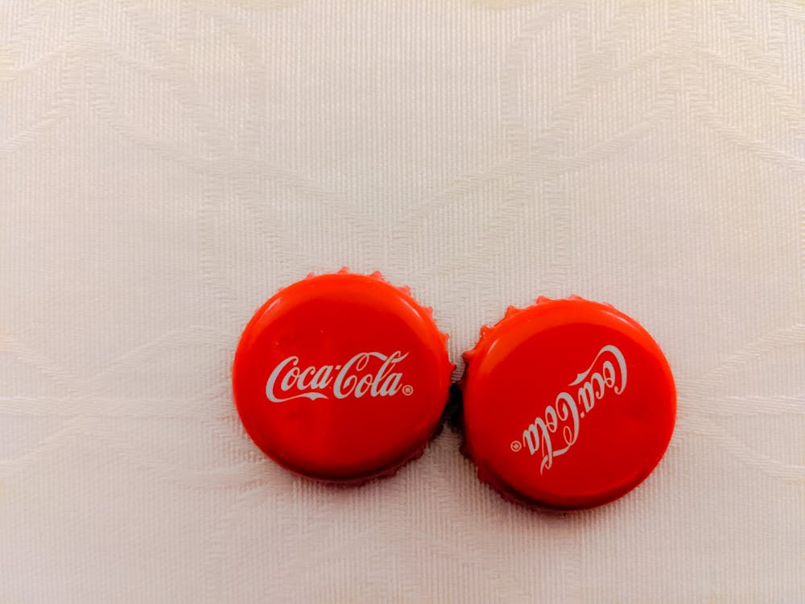
Brand
A name, term, sign, symbol or design, or a combination of these, that is intended to identify the goods and services of one business or group of businesses and to differentiate them from those of competitors.
phttps://www.pexels.com/photo/close-up-hoto-of-coca-cola-bottle-caps-10409649/

Slide 6
Branding
Features of brand:
Brand is Massive asset.
Brand is Promotional Tool.
Brand is tool to Protect Market.
Brand is a Means of Identification for Customers
Branding is the exercise of giving a specified name to a product or group of
product of one seller.
The process of finding and fixing the means of identification is called Branding. Naming product, like a naming a baby, is known as branding.
Thus branding is the management process by which the product is named; i.e. branded.

Slide 7
Branding
Branding is the business process of managing your trademark portfolio so as to maximize the value of the experiences associated with it,
Experts argue as to which stakeholders should be the main focus of the branding process, but this is probably the wrong question as their experiences are all inter-related:
Employees - the more your employees value your brands and understand what to do to build them, the more your customers, suppliers, local communities and opinion leaders will value them. The more attractive your brands are to potential employees, the more they are likely to want to work for you.

Slide 8
Branding
Customers - the more your customers value your brand, the more they will buy your products and services, and recommend them to other people
Stock/share holders- strong brands multiply the asset value of your company (90% of the asset value of some major corporations lies in their intellectual property), and assure them that the company has a profitable future. They also allow you to afford to give competitive dividends to your current stock/share holders.
Suppliers - suppliers like to be associated with strong brands as this benefits their own reputation in the eyes of other current or potential customers
Intermediaries - retailers, distributors and wholesalers value strong brands as they improve their own profit margins.

Slide 9
Branding
Opinion leaders - the media, politicians and non-government organizations are more respectful of strong brands.
Local communities - supportive local authorities can make life easier in many ways, and offer better deals, if you have prestigious brands.The local communities provide work force and can be highly disruptive if they perceive you as damaging their environment.
Purchasers and licensees - the question prospective purchasers and licensees ask is ―how much more profit can be got form products and services sold under that brand than under any brand

Slide 10
Characteristics of a Brand
With increased experience, buyers and users become more sophisticated, so the brand would need to be augmented in more refined ways, with added values satisfying non-functional (e.g. emotional) as well as functional
The generic level is the commodity form that meets the buyer, or user‘s basic needs, for example the car satisfying transportation need
Within the expected level, the commodity is value engineered to satisfy a specific target‘s minimum purchase conditions, such as functional capabilities, availability, pricing, etc.

Slide 11
Characteristics of a Brand
With even more experience of the brand, and therefore with a greater tendency to be more critical, it is only creativity that limits the extent to which the brand can mature to the potential level. For example, grocery retail buyers once regarded the Nestle confectionery brands as having reached the zenith of the augmented stage. To counter the threat of their brands slipping back to the expected brand, level, and therefore‘ having to fight on price, Nestle shifted their brands to the potential level by developing software for retailers to manage confectionery shelf space to maximize profitability.

Slide 12
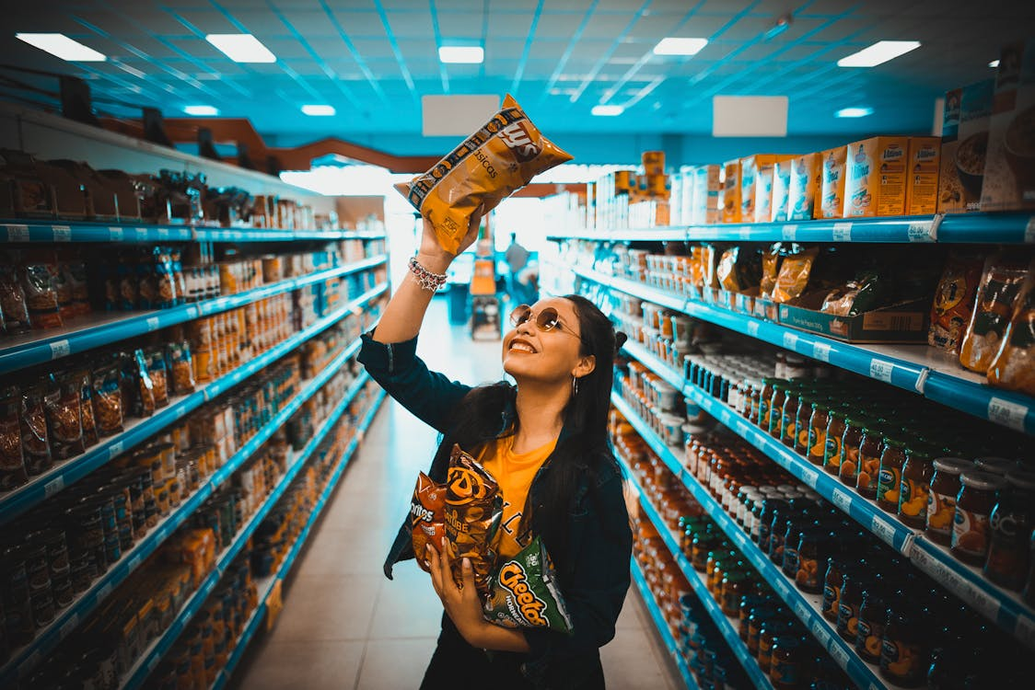
Brand
Brands need to provide customers with a consistent, compelling experience in order not to confuse them, as confusion leads to doubt
https://www.pexels.com/photo/a-woman-in-black-long-sleeve-shirt-holding-a-potato-chips-4090833/

Slide 13
Dimensions of a Brand
The Essence of the Brand
How are you going to describe the essence of the brand to your colleagues and business partners in one short, memorable, and motivating sentence? What makes it special?
Slogan
How are you going to describe the essence of the brand to your customers in one short, memorable, and motivating sentence?
This should hint at the central organizing thought, without necessarily stating it.- the central organizing thought of the BMW brand is -competitive achievement, but the slogan is -the ultimate driving machine

Slide 14
Dimensions of a Brand
The Values of the Brand
What does the brand stand for? What does it believe in? What would it make a stand on?
Heritage
All great brands have stories about them. Some are favorable, some are less favorable, but all of them work to explain what the brand is all about
The Personality of the Brand
If the brand were indeed human, what sort of person would it is - jovial, serious, sporty, aristocratic, or cunning?
Tastes/Appearance
What does the brand like? What does it look like? What does it wear? How does it speak?
This will include the iconography of the brand - the icons, the symbols, the trade dress, the typeface, and the look and feel.

Slide 15

Dimensions of a Brand
Emotional Benefits
What does the brand do for its customers?
Avoids pain
Reduces pain
Gives pleasure
Hard Benefits
What does the brand offer its customers in tangible, quantifiable terms? These are the benefits as in ―Features, Advantages and Benefits
https://www.pexels.com/photo/woman-showing-her-red-cup-13226200/

Slide 16
Brand Awareness is Vitally Important
Brand awareness is vitally important for all brands but high brand awareness without an understanding of what sets the company apart from the competition does virtually no good. Many marketers experience confusion on this point.
Strategic awareness occurs when not only does the person recognize your brand, but they also understand the distinctive qualities that make it better than the competition.
Strategic awareness occurs when you have differentiated your brand in the mind of your market.

Slide 17
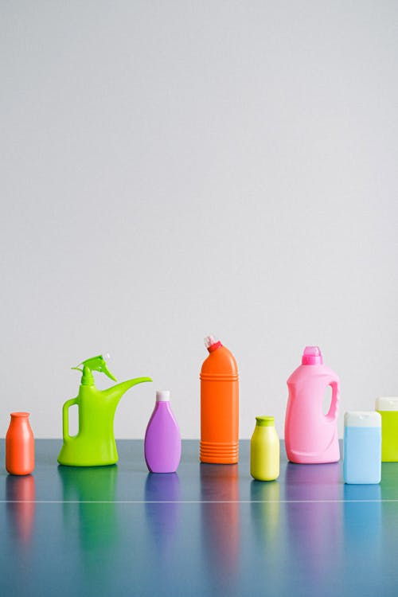
Brands and Products
Brands are rarely developed in isolation. They normally fall within a business‘ product line or product group
A product line is a group of brands that are closely related in terms of their functions and the benefits they provide
https://www.pexels.com/photo/reusable-containers-for-cleaning-products-on-table-5217887/

Slide 18
Establishing a brand
If a brand is successful in making a connection with people and communicating its distinct advantage, people will want to tell others about it and word-of-mouth advertising will develop naturally not to mention writers in the press will want to write about the brand.
Branding is to communicate what the brand distinctively stands for using as few words or images as possible

Slide 19
Brand Management
If a brand is not effectively managed then a perception can be created in the mind of the market that you do not necessarily desire.
Branding is all about perception. Brand management recognizes that your market‘s perceptions may be different from what you desire while it attempts to shape those perceptions and adjust the branding strategy to ensure the market‘s perceptions are exactly what you intend.

Slide 20
Benefits of a strong Brand
A strong brand can command a premium price and maximize the number of units that can be sold at that premium. Branding helps make purchasing decisions easier
Branding will help you fence off your customers from the competition and protect your market share while building mind share.
A strong brand influences the buying decision and shapes the ownership experience.
Branding creates trust and an emotional attachment to the product or company

Slide 21
Benefits of a strong brand
A strong brand can make actual product features virtually insignificant. A solid branding strategy communicates a strong, consistent message about the value of your company.
A strong brand helps you sell value and the intangibles that surround your products.
A brand is something that nobody can take away from you. Competitors may be able to copy your products, your patents will someday expire, trade secrets will leak to the competition, your proprietary manufacturing plant will eventually become obsolete, but your brand will live on and continue to be uniquely yours

Slide 22
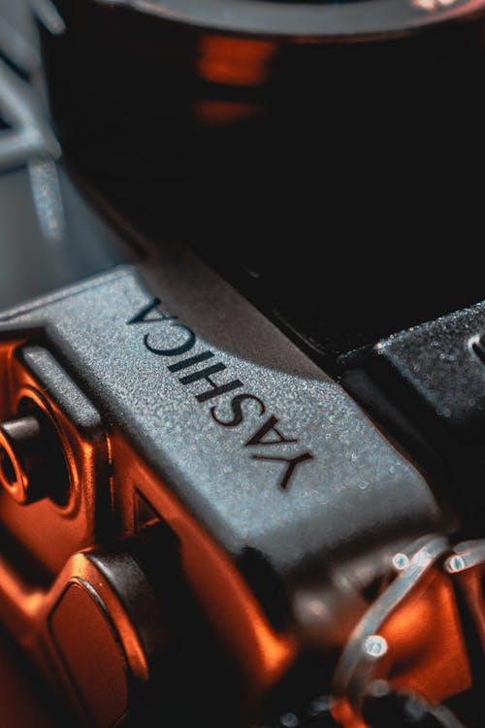
Benefits of a strong brand
A strong brand signals that you want to build customer loyalty, not just sell product.
Branding builds name recognition for your company or product
A brand will help you articulate your company‘s values and explain why you are competing in your market.
https://www.pexels.com/photo/close-up-photo-of-an-engine-brand-11671100/

Slide 23
The 3 Cs of Branding
Consistency
In addition to being clear about who they are, strong brands are also consistent. They are always what they say they are.
For Volvo, they are always about safety. They don‘t change their focus from model to model. When new editions come out each year, they are safe too. And Volvo consistently communicates that.
Clarity
Strong brands are clear about what they are and what they are not. They understand their unique promise of value. And this promise of value sets them apart from their competitors

Slide 24
The 3 Cs of Branding
Quality
Quality is a vital ingredient of a good brand. Remember the core benefits- the things consumers expect. These must be delivered well, consistently
Constancy
It is not enough to be clear and consistent if you are not always visible to your target audience. Strong brands are constant; they are always there for their customers and prospects. They don‘t go into hiding.
For Coke, the world is the target market. That is why you can‘t make it through a day without being exposed to their bright red color or familiar script logo

Slide 25
Key Factors about Branding
Positioning can be achieved through several means, including brand name, image, service standards, product guarantees, packaging and the way in which it is delivered
Positioning
Positioning is about the position a brand occupies in a market in the minds of consumers. Strong brands have a clear, often unique position in the target market.

Slide 26
Key Factors about Branding
Communication-All elements of the promotional mix need to be used to develop and sustain customer perceptions
Repositioning
Repositioning occurs when a brand tries to change its market position to reflect a change in consumer‘s tastes. This is often required when a brand has become tired, perhaps because its original market has matured or has gone into decline.
The repositioning of the Lucozade brand from a sweet drink for children to a leading sports drink is one example

Slide 27
Key Factors about Branding
Long-term perspective
This leads onto another important factor in brand-building: the need to invest in the brand over the long-term. Building customer awareness, communicating the brand‘s message and creating customer loyalty takes time.
First-mover advantage
Business strategists often talk about first-mover advantage. In terms of brand development, by -first-mover they mean that it is possible for the first successful brand in a market to create a clear positioning in the minds of target customers before the competition enters the market.
Eg Gillette, Coca Cola and Sellotape that, in many ways, defined the markets they operate in and continue to lead.

Slide 28
Key Factors about Branding
Brand extension
Brand extension refers to the use of a successful brand name to launch a new or modified product in a same broad market. A successful brand helps a company enter new product categories more easily
Internal marketing
Management should ensure that the brand is marketed ―internally‖ as well as externally
Brand stretching
Brand stretching refers to the use of an established brand name for products in unrelated markets

Slide 29
Types of brand
Manufacturer brands
Manufacturer brands are created by producers and bear their chosen brand name. The producer is responsible for marketing the brand. The brand is owned by the producer
Own label brands
Own-label brands are created and owned by businesses that operate in the distribution channel – often referred to as ―distributors

Slide 30
References
Fundamentals of marketing, Marilyn, A, S, John, D, Routledge (Taylor and Francis) London New York,2007
Principles of marketing. Rashmi. R. Das. https://ddceutkal.ac.in/Downloads/UG_SLM/Commerce/Principle_Marketing.pdf
Marketing Fundamentals, University of New South Wales, Spoonfeedme

Slide 31
References
Principles of Marketing, Pearson. 17th edition, Kotler P. and Armstrong G,2017
Essentials of Marketing 17th Edition, William Perreault, Joseph Cannon, E. Jerome McCarthy , McGraw-Hill Education,2021
Marketing, Polese, Francesco, and Evert Gummesson, ProQuest Ebook Central, http://ebookcentral.proquest.com/lib/aunke -ebooks / detail. action? docID =4856363,2017

Slide 32
References
Rashmi R Das .Principles of Management (http://ddceutkal.ac.in/Dowload/UG.SLM/Commerce/Principle-Marketing.pdf
Chahat Azam .Concept of products. https://dspmuranchi.ac.in/pdf/Blog/1)%20PRODUCT%20CONCEPT.pdf.Faculty of Commerce DSPMU.
Baglandesh Open University .New Product Development . http://www.ebookbou.edu.bd/Books/Text/SOB/MBA/mba_3313/Unit-06.pdf
Brand Management .Madhu S Kamar (2015)Knowledge Management and Research Organization .

Slide 33
References
Vindhya Chandrasekharan (2021). https://www.pexels.com/photo/close-up-photo-of-coca-cola-bottle-caps-10409649/
Dario Solano (2020). https://www.pexels.com/photo/a-woman-in-black-long-sleeve-shirt-holding-a-potato-chips-4090833/
Drift Shutterbug (2022). https://www.pexels.com/photo/woman-showing-her-red-cup-13226200/
Anna Shvets(2020). https://www.pexels.com/photo/reusable-containers-for-cleaning-products-on-table-5217887/

Slide 34
References
Amir Esrafili (2022). https://www.pexels.com/photo/close-up-photo-of-an-engine-brand-11671100/

