Slide 1
COURSE: FUNDAMENTALS OF MARKETING
LECTURE 1: INTRODUCTION TO MARKETING
LECTURER: DR LUCY KARIMI KIRIMA
LECTURE 9: PACKAGING
LECTURER: DR LUCY KARIMI KIRIMA
Lecture learning outcomes:
At the end of the lecture, you will be able to:
1.Understand the concept of packaging
2.Discuss the objectives and features of packaging
3. Examine types and design of packaging
Discuss importance and packaging cost

Slide 2
PACKAGING
Physical products require packaging to protect them from damage and to present both the product and its brand attractively to a target group of consumers.
Packaging provides a surface upon which to communicate information about the product and the brand, and a s such, it is an essential element of product branding
Packaging also works to convey the brand characteristics that will position it within the minds of consumers and that will ultimately differentiate it from its competitors.

Slide 3
PACKAGING
The physical materials used for packaging products also importantly contribute to the overall brand statement projected
Packaging is often the first point of contact that a consumer has with a brand, so it is hugely important that it initially draws their attention and also quickly conveys the messages that both present and support the brand

Slide 4
Packaging
Packaging is best described as a coordinated system of preparing goods for transport, distribution, storage, retailing, and use of the goods.
It is a complex, dynamic, scientific, artistic, and controversial business function. Fundamental function of packaging: contain, protects/preserves transports informs/sells. Packaging functions range from technical ones to marketing oriented ones.

Slide 5

Technical and Marketing Function
Technical Functions include; contain, measure, protect, dispense, preserve and store
Marketing Functions on the other hand include; communicate, promote, display, sell, inform and motivate
https://www.pexels.com/photo/woman-in-purple-tank-top-applying-tonic-on-her-face-8131577/

Slide 6
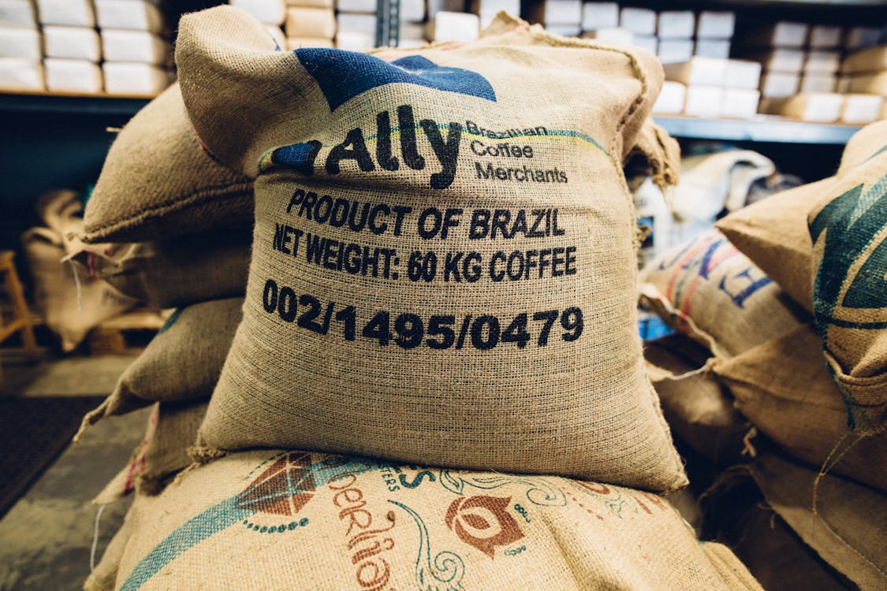
Definition
Kotler defines packaging as "all the activities of designing and producing the container for a product."
Packaging can be defined as the wrapping material around a consumer item that serves to contain, identify, describe, protect, display, promote, and otherwise make the product marketable and keep it clean
https://www.pexels.com/photo/sacks-of-coffee-beans-2868982/

Slide 7
Objectives of packaging
Information: Packaging provides information about the product. It identifies the product and its manufacturer. It informs about product ingredients, directions for use, price, date of manufacture etc.
Protection: Packaging aims to protect the product from damages. It preserves quality of the product from damages that occur from climatic conditions, mishandling, spilling and evaporation.
Storage: Packaging facilitates storage of products till they are used.

Slide 8
Objectives of packaging
Distribution: packaged products are convenient to handle and distribute. They can be easily transported.
Positioning: packaging is used for positioning of products. Differentiated packages facilitate product differentiation. Consumers perceive product differences based on packaging.

Slide 9
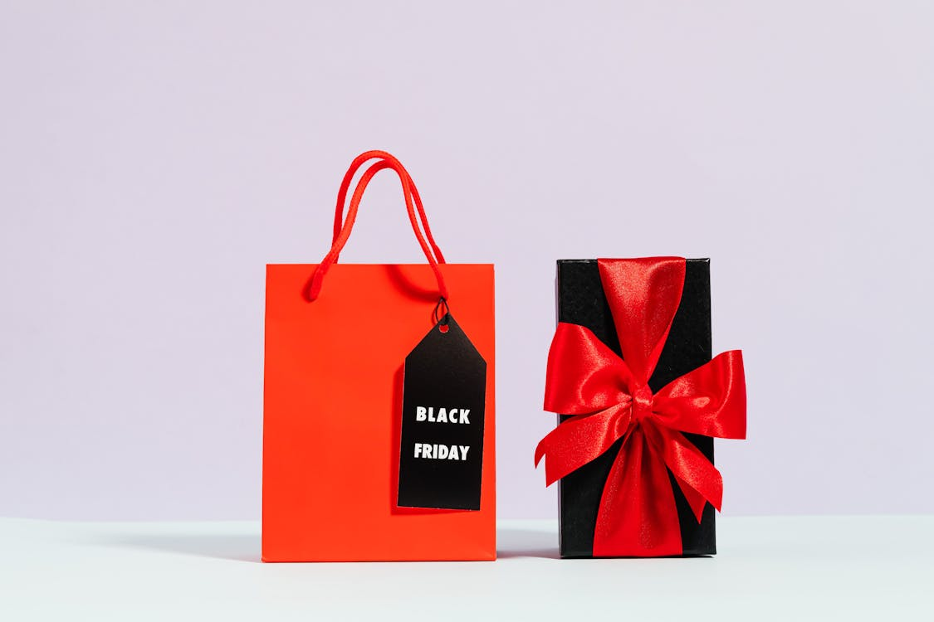
Objectives of packaging
Promotion: packaging promotes the product. Advertising messages and sales promotion schemes can be printed on packages. They facilitate self-service marketing.
https://www.pexels.com/photo/red-paper-bag-beside-a-present-5625124/

Slide 10
Packaging Functional requirements
Containment
Most products must be contained before they can be moved from one place to another. To function successfully, the package must contain the product. This containment function of packaging makes a huge contribution to protecting the environment
Protection and preservation
The basic function of package is to protect and preserve the contents during transit from the manufacturer to the ultimate consumer. It is the protection during transport and distribution

Slide 11
Packaging Functional requirements
Communication
A major function of packaging is the communication of the product. A package must communicate what it sells. When international trade is involved and different languages are spoken, the use of unambiguous, readily understood symbols on the distribution package is essential
Packaging protects the interests of consumers. Information includes quantity; price; inventory levels; lot number; distribution routes; size; elapsed time since packaging; color; and merchandising and premium

Slide 12
TYPES OF PACKAGING
Secondary package.
Secondary package is the packaging that holds together the individual units of a product or good .It is designed to deliver mass quantities of the product or goods to the point of sale or end user
Primary package
This is the material that first cover or envelopes the product and holds it. This is usually the smallest unit of distribution and it is the package which is directly in contact with the content .It is the last layer removed by the consumer during unboxing

Slide 13

Secondary package.
Secondary packaging is intended to protect not only the product, but also the primary packaging
common examples of secondary packaging include cardboard cartons, cardboard boxes and cardboard/plastic crates
The secondary package contains two or more primary packages and protects the primary packages from damage during distribution and storage. Its main aim is branding display and logistical purposes as well as protecting and collating individual units during storage.
https://www.pexels.com/photo/a-person-in-brown-jacket-and-green-pants-holding-brown-cardboard-box-7642193/

Slide 14
Tertiary package
Tertiary packaging is the packaging that is used to protect not only the product but also the primary and secondary packaging. Example: When you order some items from an online shopping site, the sealed cardboard box that you open is the tertiary packaging. The main purpose of tertiary packaging is to protect and transport the goods ,and to ensure that they arrive in good condition to their destination during the process. They must be of hard and resistant cardboard. Examples: Corrugated cartons, Barrel containers.

Slide 15
Essentials of packaging
Packaging as per environment : Packaging of products must be done in a manner that it remains healthy until it reaches a customer. The packs must not have any chemicals or harmful products that could harm user in any means.
Packaging provides convenience : Packaging of product must be done as per the use of customer. Like if you are packing a snack or chips it must be in easy to open and easy to enjoy pack so that a user can enjoy it
Packaging in attractive packs: It is only the packets that are visible to customer which he can see for making the purchasing decision of a product thus packaging must display properly about the product such that it tends a customer to buy it immediately

Slide 16
Essentials of packaging
Packaging must be eco friendly: A business owner of a manufacturing firms needs to remember that even when he needs to provide a product in attractive and effective packaging it must suit his pockets. That is the cost involved in packaging must be manageable for the owner.
Packaging with proper label : A pack must define the product inside it. It must include its direction to use, ingredients, guarantees

Slide 17
Essentials of packaging
Packaging must abide the packaging rules :As per the rules of packaging the ingredients like spices, snack, chips etc. must be packed in quality packets such that they remain healthy and is easy to destroy that it does not create any harm to environment.
Advertising with packaging : sometimes packaging is not sufficient the owner need to advertise its product with the packaging so that when a user sees the pack he can identify that this packaging belongs to which company and what is inside the packs.

Slide 18
Features of good packaging
Convenience: Convenience is one of the good features of packaging. The packaging provides size options and it facilitates provisions for the easy opening of the products.
Status or prestige: Packaging creates confidence among the customers and it creates status and prestige of the products
Act as promotional tool: Good packaging can sell the product more easily and quickly as it works as a promotional tool.

Slide 19
Features of good packaging
Adaptability: The package should be of moderate size so that it can be kept in proper place. It should be adapted in all the places. Adaptability is very essential in packaging.
Dependability: The packaging should be dependable. Dependability indicates the positive idea of a customer about the manufacturing of the product

Slide 20
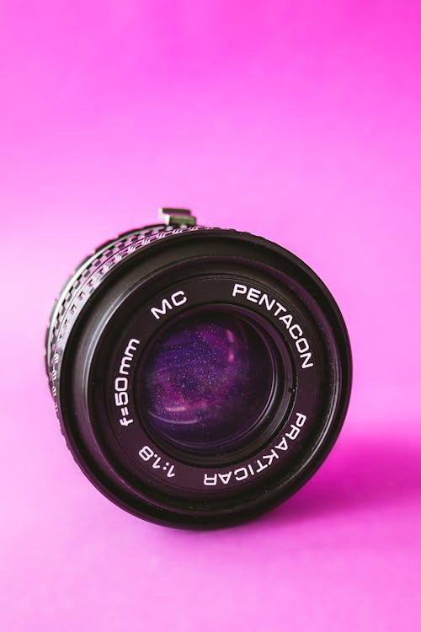
Features of good packaging
Handsome design: The packaging should have a handsome design. The handsome design attracts the customers to buy the products. To get touch with the taste and fashion of the customers, a constant renewal of design is required.
https://www.pexels.com/photo/black-pentagon-lens-2386602/

Slide 21
IMPORTANCE OF PACKAGING
Creation of demand: Packaging plays an important role in the creation of demand by attracting the consumers.
Protection of the product: Packaging helps to protect the product from heat, light, moisture, evaporation, dust etc. during its long passage from the factory to the target customers
Transportation: Packaging facilitates transportation of products from one place to another. It ensures easy transportation and better handling of products in transit.

Slide 22
IMPORTANCE OF PACKAGING
Guidelines to customers: Packaging helps as a guidelines for the customers. From the informative Literature regarding the quality and use of the Product, the customers get the guidelines. The customers are ensured about the quality of the products.
Better storage: Packaging acts as a better storage of the products. Goods with good packages can be stored in the retail shop also in lesser price

Slide 23
IMPORTANCE OF PACKAGING
Facilitates for carrying: Packaging plays an important role in carrying the goods in transit and from one place to another. It is made in different sizes and it facilitates provisions for easy and open carrying
Identification of product differentiation: Packaging helps to identity the product differentiation easily. It ensures the individuality of the products and one product can be easily differentiated with each other

Slide 24

IMPORTANCE OF PACKAGING
Economy: Packaging helps to reduce the cost of marketing the goods by reducing losses from damages. As packaging Is helpful for sales promotion, so it helps to attain economy in the cost structure of the producers and marketers.
https://www.pexels.com/photo/gummy-bears-in-plastic-bottle-14433551/

Slide 25
PACKAGE DESIGN.
Not all package designs carry pictures, there are some with name of the product and usage’s package designs are cut out and folded into packets with many sides,
Package design are part of market strategies which must be capable of arousing peoples curiosity and interest to buy.
Package design involves the creation of a products container and how it looks to consumers who might purchase it.
Designs must be well executed because the more attractive they are the better for the product for the ever competitive market

Slide 26
Types of packaging
Transport packing: The product entering the trade need to be packed well enough to protect against loss damage during handling, transport and storage. e.g. fiberboard, wooden crate etc.
Consumer Packing: This packaging holds the required volume of the product for ultimate consumption and is more relevant in marketing. E.g. beverages, tobacco etc.

Slide 27
CUSHION MATERIALS
Shock protection against vibration.
Protection against abrasion.
Protection of grease proof and waterproof barriers at point of contact with solid blocks.
Protection of moisture vapor barriers at points of contact with sharp edges of the article itself.
Protection of small projections.
Filling of void space in the container.
Cushioning is that part of packaging, which protects the article from damage due to shock and vibration

Slide 28
PACKAGING COST
Material cost: It means the cost of the pack and quality control cost.
Storage and handling cost of empty packages: This include the handling cost of bulky packages, heavy materials of construction, drums etc.
Packaging operation costs: This includes the cost involved in operations like, cleaning the package product filling – closing, labeling – unitizing, stenciling, handling cylindrical slums etc.
Storage of filled packages: This includes the cost incurred to shift the goods from one form of packaging to another.

Slide 29
PACKAGING COST
Transportation cost of filled packages: This involves the transportation cost by sea, air etc. (freight by volume).
Loss and Damage cost: It is related to the loss and damage during operation, transportation delivery etc. Insurance cost: It varies depending on the vulnerability of package.
Effect of packages on sales: The package that influence on sales.
Obsolescence Cost: This cost involves when changes in the packaging materials, packages and labels happen.

Slide 30

Packaging cost
Package developmental cost: This include the evaluation cost, pilot test cost, field testing cost, consumer research cost, feedback cost, final trial cost etc
https://www.pexels.com/photo/a-person-working-on-the-documents-using-a-calculator-8297220/

Slide 31
References
Fundamentals of marketing, Marilyn, A, S, John, D, Routledge (Taylor and Francis) London New York,2007
Principles of marketing. Rashmi. R. Das. https://ddceutkal.ac.in/Downloads/UG_SLM/Commerce/Principle_Marketing.pdf
Marketing Fundamentals, University of New South Wales, Spoonfeedme

Slide 32
References
Principles of Marketing, Pearson. 17th edition, Kotler P. and Armstrong G,2017
Essentials of Marketing 17th Edition, William Perreault, Joseph Cannon, E. Jerome McCarthy , McGraw-Hill Education,2021
Role of packaging in marketing product and organization. Dileep Kumar (2006). Hensard University Toru Orua

Slide 33
References
Packing and Packaging .S Natarajan, M. Govindarajan,V Kumar. Government Arts College, Coimbatore
Marketing, Polese, Francesco, and Evert Gummesson, ProQuest Ebook Central, http://ebookcentral.proquest.com/lib/aunke -ebooks / detail. action? docID =4856363,2017

Slide 34
References
Ron Lach 92021). https://www.pexels.com/photo/woman-in-purple-tank-top-applying-tonic-on-her-face-8131577/
Kelly (2019). https://www.pexels.com/photo/sacks-of-coffee-beans-2868982/

