Slide 1
FUNDAMENTALS OF MARKETING
LECTURE 10: PRICING
LECTURER: DR LUCY KARIMI KIRIMA
Lecture learning outcomes:
At the end of the lecture, you will be able to:
Understand the concept of pricing
Examine objectives of pricing
Discuss importance and methods of pricing
Explain and determine pricing policy and factors influencing pricing policy

Slide 2
PRICING
Pricing is one of the four elements of the marketing mix, along with product, place and promotion
According to Adam Smith, “the price of everything, what everything really costs, in the toil and trouble of acquiring it.”

Slide 3
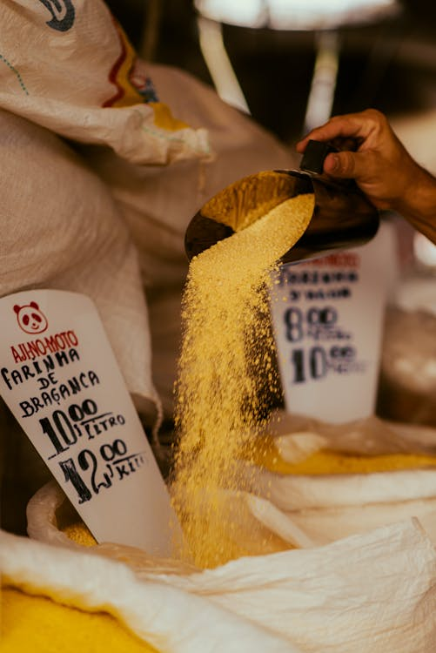
Product Price
According to W J Stanton, “Price is the amount of money which is needed to acquire in exchange of some combined assortment of a product and its accompanying services.”
https://www.pexels.com/photo/braganca-manioc-flour-25383640/

Slide 4
Pricing
Pricing is the process of determining the value of a product or service in terms of money before it is offered to the market for sale.
According to W J Stanton, “pricing is the functions of determining the products value in monetary terms.”
Pricing refers to managerial approach or task that involves establishing pricing objectives, identifying the factors that govern price, ascertaining its importance, determining value and implementing it.

Slide 5
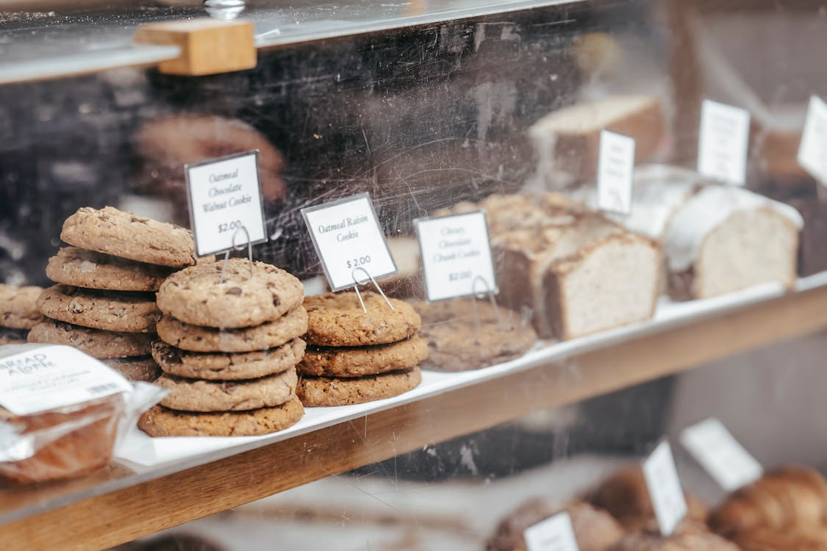
Objectives of pricing
Achieving a Target ROI
Every concern will have the objective to achieve a certain rate of return on investments and frame the pricing policy in order to achieve that rate
Control Cash Flow
A principal pricing objective is to return cash as much as possible within a given period. Investment in research and development, market development, promotion etc should pay back within a specified period
https://www.pexels.com/photo/various-tasty-pastry-placed-on-counter-6097827/

Slide 6
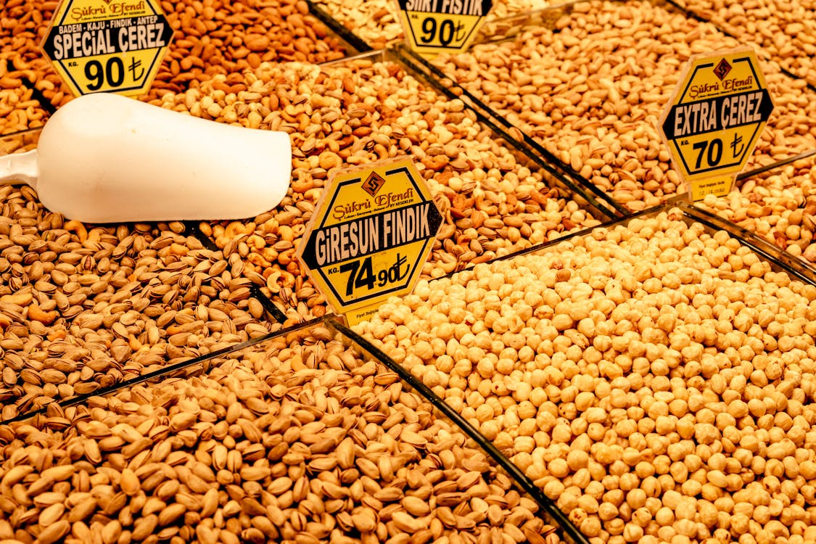
Objectives of pricing
Price Stability
Company with stable price is ranked high in the market. Company formulates pricing policies and strategies to eliminate seasonal and cyclical fluctuations.
https://www.pexels.com/photo/nuts-on-market-stall-12944682/

Slide 7
Objectives of pricing
Achieving market share
Sometimes, price and pricing are taken as the tool to increase its market share. When company assumes that its market share is below than expected, it can raise it by appropriate pricing; pricing is aimed at improving market share.
Prevention from competition
Pricing can be used as one of the effective means to fight against the competition and business rivalries. Lesser prices are charged by some firms to keep their competitors out of the market. But a firm cannot afford to charge fewer prices over a long period of time.

Slide 8
Importance of pricing
In other words, price is very important in determining demand and supply of goods or services. So, pricing plays a decisive role in smooth functioning of market-oriented economy
Importance of pricing in the economy
Pricing is taken as a major function in open market system or free industrial system. Price of a product or services affects wages, cost, interest and profit. So, price of any product affects the price paid for the factors of production such as labour, land, capital and entrepreneurship.

Slide 9
Importance of pricing in the Business Firm
The price of any product becomes the major determinant of its market demand. Price of the product of any firm influences competitive situation and market share. Similarly, the price directly contributes to the income and net profit of a firm.
On the whole among the marketing activities of a firm, pricing is such a sensitive aspect to which the consumers, competitive firms and government are directly concerned.

Slide 10
Importance of pricing to customers
When the price of goods falls down the customers are more attracted towards the goods, and when their income level declines, they like to buy low priced goods so, price of goods affects customers benefits.
Price is important in selecting goods according to the need and financial capacity of consumers. The price makes the customers confident about the quality of the goods they buy. Generally, high price makes the customers perceive good quality of a product.

Slide 11
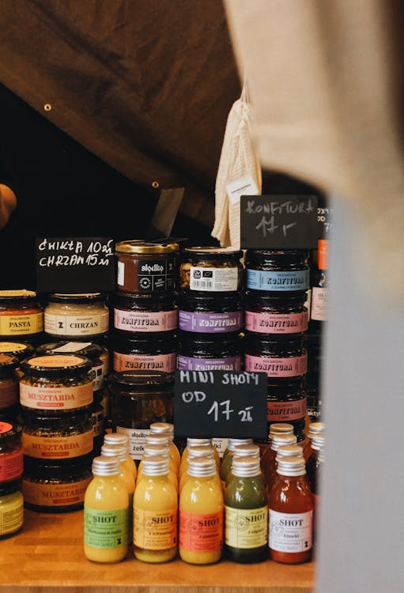
Methods of pricing
Cost-oriented methods
1) Cost-oriented pricing
Cost-plus pricing involves adding a certain percentage to cost in order to fix the price. For instance, if the cost of a product is rs.200 per unit and the marketer expects 10% profit on costs, then the selling price will be rs.220. The difference between the selling price and the cost is the profit.
https://www.pexels.com/photo/assorted-jams-on-glass-bottles-12070252/

Slide 12
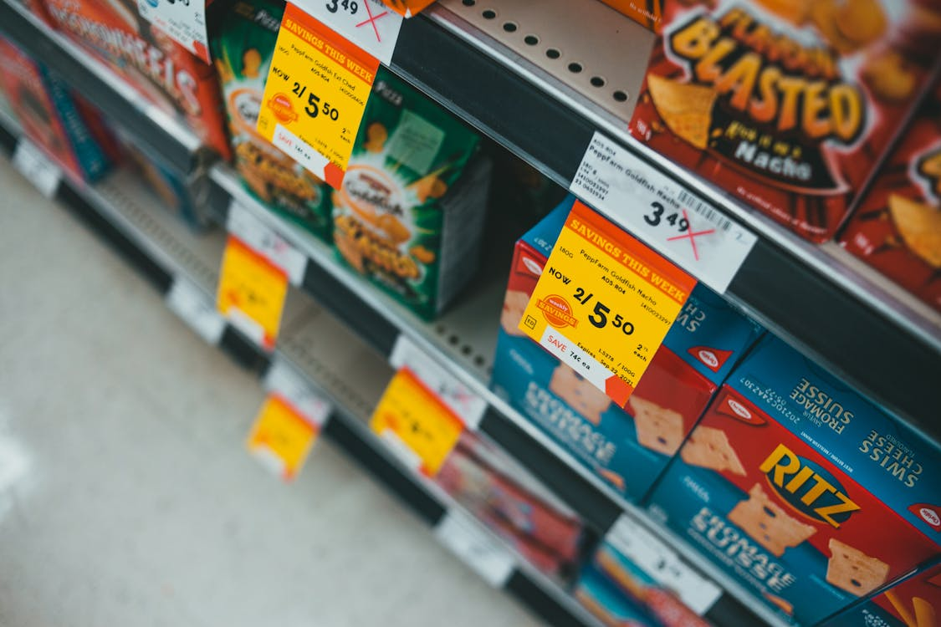
Cost-oriented methods
Mark-up pricing
Mark-up pricing is a variation of cost pricing. In this case, mark-ups are calculated as a percentage of the selling price and not as a percentage of the cost price. Firms that use cost-oriented methods use mark-up pricing. The following used to determine mark-up pricing:-
Mark-up pricing= Average unit cost/selling price.
https://www.pexels.com/photo/assorted-labeled-boxes-on-white-shelf-9592528/

Slide 13

Cost-oriented methods
Break-even pricing
In this case, the firm determines the level of sales needed to cover all the relevant fixed and variable costs. The break-even price is the price at which the sales revenue is equal to the cost of goods sold. In other words, there is neither profit nor loss. The following formula is used to calculate the break-even point:
Contribution= Selling Price- Variable cost per unit BEP= Fixed cost/Contribution * Sales
https://www.pexels.com/photo/variety-of-squashes-on-a-pot-10011980/

Slide 14
Cost-oriented methods
Target return pricing
In this case, the firm sets prices in order to achieve a particular level of return on investment (ROI). The target return price can be calculated by the following formula:
Target return price= Total costs+ (Desired % ROI investment)/Total sales in units However, this method helps to ensure that prices exceed all costs and therefore contribute to profit.

Slide 15
Cost-oriented methods
Early cash recovery pricing
Some firms may fix a price to realize early recovery of investment involved, when market forecast suggest that the life of the market is likely to be short, such as in the case of fashion-related products or technology-sensitive products. This method is used to maximize short-revenues and reduce the firm’s medium-term risk.

Slide 16
Market-oriented methods
Perceived value pricing
A good number of firms fix the price of their goods and services on the basis of customers’ perceived value. They consider customers’ perceived value as the primary factor for fixing prices and the firm’s costs as the secondary. The customers’ perception can be influenced by several factors such as advertising, sales on techniques, effective sales force and after sale-service staff.

Slide 17
Market-oriented methods
Going-rate pricing
The benchmark for setting prices is the price set by major competitors. It includes:
a. Competitors’ parity method: A firm may set the same price as that of the major competitor.
b. Premium pricing: A firm may charge a little higher if its products have some additional special features as compared to major competitors.
C. Discount pricing: A firm may charge a little lower price if its products lack certain features as compared to major competitors.

Slide 18
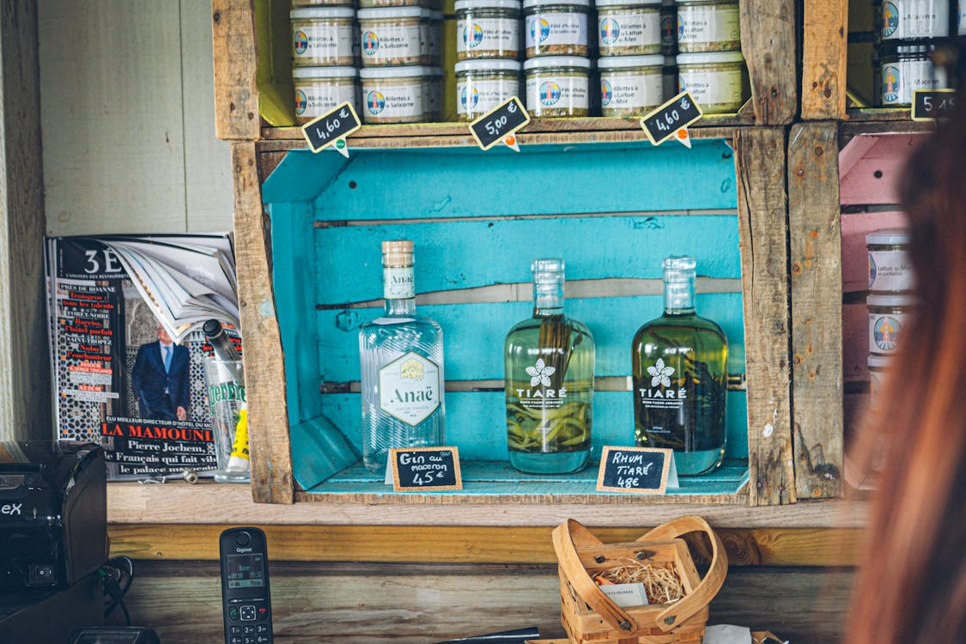
Sealed-bid pricing
This pricing is adopted in the case of large orders or contracts, especially those of industrial buyers or government departments. The firms submit sealed-bids for jobs in response to an advertisement.
https://www.pexels.com/photo/bottles-of-rum-and-gin-17637315/

Slide 19
Differentiated pricing
Firms may charge different prices for the same product or service. It includes the following:
Customer segment pricing: Here different customer groups are charged different prices for the same product or service depending on the size of the order, payment terms, and so on.
b. Time pricing: Here different prices are charged for the same product or service at different timings or season. It includes off-peak pricing, where low prices are charged during low-demand tunings or season.

Slide 20
Differentiated pricing
Product form pricing
Here different versions of the product are priced differently but not proportionately to their respective costs. For instance, soft drinks of 200, 300, 500 ml etc are priced according to this strategy.
c. Area pricing: Here different prices are charged for the same product in different market areas. For instance, a firm may charge a lower price in a new market to attract customers.

Slide 21
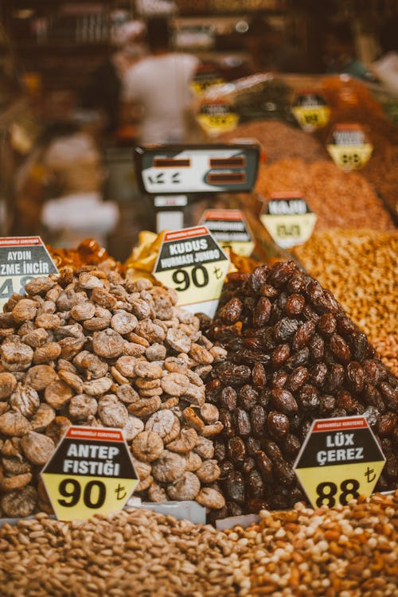
Pricing policies
Price Skimming/High price policy
This policy is applied when a new product is introduced. The product is brought to market at a high initial price. This strategy is followed in case of products which have a very short life and quickly become obsolete, such as electronic gadgets, fashionable products, book and magazines covering-current issue etc.
https://www.pexels.com/photo/piles-of-dried-fruits-and-nuts-for-sale-5336641/

Slide 22
Penetration pricing/Low price policy
Penetration pricing/Low price policy
In this policy the introductory price of a product is low which may subsequently increase. The idea behind entering the market with a low selling price is to attract customers towards the market and increase the market coverage, which results in higher volume of production and consequently reduces cost.
Variable pricing
Where the selling price charged is varied from customer to customer depending on his bargaining capability, it is variable pricing. For example, vegetable and fruits vendors, granite merchants etc.

Slide 23
Bundle pricing
A group of products sold as a package is called a product bundle or bundle pricing. The price of the bundle includes the price of all individual products constituting the bundle. For example, make-up kit, shaving-kit etc.
Market segment pricing
In this strategy the customers will be divided into different segments based on common feature and a single price is charged to customers belonging to a segment. For example, Railways divide the customers into 3 categories as children, adults, senior citizen and they charged differently.

Slide 24
Product-line pricing
Time pricing
Where the price charged is related to time, it is time pricing. For example, Auto charges one and a half time the regular fare between 9pm and 6am.
A product line has different brands or models of a product. Where the prices of each model or brand is different from the other. For example, the product line ‘Tea’ of HUL has Brooke Bond, Red Label, 3Roses, Taaza where each variety carries a different price.

Slide 25
Premium pricing
Premium pricing strategy establishes a price higher than the competitors. Premium pricing can be a good strategy for companies entering the market with a new market and hoping to maximize revenue during the early stages of the product life cycle.
Location pricing
The prices charged will depend upon the location of supply of product or service. Railways charge different fares for II class, A/C sleeper coaches. In a hospital charges are different for general ward, special ward etc.

Slide 26
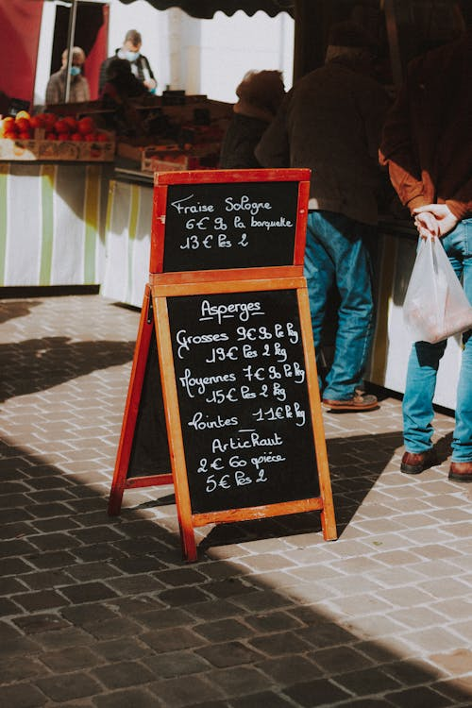
Psychological pricing
This strategy is commonly used by marketers in the prices they establish for their products. For instance, rs.99 is psychologically “less” in the minds of consumers than rs.100. It’s a minor distinction that can make a big difference.
https://www.pexels.com/photo/advertising-blackboard-on-street-market-7841134/

Slide 27
Geographic pricing
A producer may cover a wide area for the distribution of his product. The distance and transportation cost involved in moving the products from the place of production to different regions for marketing, plays a pivotal role in fixing the selling price.
Single pricing
If a single price is charged without discriminating between regions and customers, it is single-price policy. Example, Hindustan Unilever Ltd, Wipro consumer products sell their products at a single price throughout the country.

Slide 28
Factors influencing pricing policy
Demand
Demand is usually depicted by demand curve. Marketers use the curve to estimate changes in total demand for a product based on differing prices
Cost
Cost of a product play a vital role in pricing policy of an organization. By understanding the costs, marketers can judge profitability in advance. They can move resources to the highest profit opportunities and make best use of available scarce resources. By comparing costs with those of competitors, it is possible to assess production efficiency and estimate the relative profits each competitor can expect at various prices.

Slide 29
Objectives
Competition
Determination of price is influenced by present and potential competition. The competitors’ price helps the firm in setting its price.
Pricing objectives of the company will also play a crucial role in pricing policy. Price is based on the objectives set by the company. Objectives of company can be classified into (1) maintaining ROI, (2) stability in prices, (3) maximizing profits, (4) meeting competition. Company may consider any one or more of the objectives listed above before the price is fixed.

Slide 30
Distribution channel
Distribution channel
Goods are made available to the consumers through middlemen. Each one of them has to be compensated for the services rendered. This compensation should be included in the ultimate price the consumer pays.
Government
Government interference such as control of prices, levying of taxes etc will also influence pricing policy of an organization. If government increases tax, the ultimate consumer will have to may more for the product due to the increased tax component added in the price.

Slide 31
Economic Conditions
Economic condition prevailing in the country influences price fixation. Usually prices are raised during inflation because of the increase in costs. During periods of depression, prices are reduced as survival becomes a problem.
Ethical considerations
Sometimes company may sell certain products not for making profits but as a public welfare measure. For example, company may sell certain life-saving drugs or vaccines at a price which covers only the cost of production.

Slide 32
Types of buyers
Price fixation is largely dependent on the types of consumers. Different buyers may have different motives and values. Quality, safety, status, symbol and beauty are the four different considerations a buyer can observe. Thus, pricing decision is based on perceived value of customers.
Product Differentiation
Product differentiation is one of the marketing strategies to reach many customers. Many products can be differentiated in form the size. Shape, colour, coating, physical structure. Based on these factors price also varies.

Slide 33
References
Fundamentals of marketing, Marilyn, A, S, John, D, Routledge (Taylor and Francis) London New York,2007
Principles of marketing. Rashmi. R. Das. https://ddceutkal.ac.in/Downloads/UG_SLM/Commerce/Principle_Marketing.pdf
Marketing Fundamentals, University of New South Wales, Spoonfeedme

Slide 34
References
Principles of Marketing, Pearson. 17th edition, Kotler P. and Armstrong G,2017
Essentials of Marketing 17th Edition, William Perreault, Joseph Cannon, E. Jerome McCarthy , McGraw-Hill Education,2021
Role of packaging in marketing product and organization. Dileep Kumar (2006). Hensard University Toru Orua
Packing and Packaging .S Natarajan, M. Govindarajan,V Kumar. Government Arts College, Coimbatore

Slide 35
References
Marketing, Polese, Francesco, and Evert Gummesson, ProQuest Ebook Central, http://ebookcentral.proquest.com/lib/aunke -ebooks / detail. action? docID =4856363,2017
Rashmi R Das .Principles of Management (http://ddceutkal.ac.in/Dowload/UG.SLM/Commerce/Principle-Marketing.pdf
Laura James (2020). https://www.pexels.com/photo/various-tasty-pastry-placed-on-counter-6097827/

Slide 36
References
Bia Sousa (2024). https://www.pexels.com/photo/braganca-manioc-flour-25383640/
Oleksandr P(2022). https://www.pexels.com/photo/nuts-on-market-stall-12944682/
Anastasila Lopshyska(2022). https://www.pexels.com/photo/assorted-jams-on-glass-bottles-12070252/
Erik Mclean (2021). https://www.pexels.com/photo/assorted-labeled-boxes-on-white-shelf-9592528/

Slide 37
References
Mathias Reding( 2022). https://www.pexels.com/photo/variety-of-squashes-on-a-pot-10011980/
Tim Durand(2023).https://www.pexels.com/photo/bottles-of-rum-and-gin-17637315/
Roman Ondintsov (2020).https://www.pexels.com/photo/piles-of-dried-fruits-and-nuts-for-sale-5336641/
Mathias Reding (2021)https://www.pexels.com/photo/advertising-blackboard-on-street-market-7841134/

