Slide 1
COURSE: FUNDAMENTALS OF MARKETING
LECTURE 12: CHANNELS OF DISTRIBUTION
LECTURER: DR LUCY KARIMI KIRIMA
Lecture learning outcomes:
At the end of the lecture, you will be able to:
Understand the concept of channels of distribution
Examine the functions, importance and classification of channels of distribution
Explain and discuss types and factors influencing criteria for selecting channels of distribution

Slide 2
CHANNELS OF DISTRIBUTION
The term distribution collectively refers to all the acts or services rendered by various agencies. It consists of operation or series of operation which physically brings the goods from the producer into the hands of the final user. The Word Channel is derived form the French Word “Cannal”. The channel of distribution refers to the pathway taken by the goods as they flow from the point of production to the point of consumption.
Channel of distribution is the pathway or course or route through which the product delivered or spread out.

Slide 3
CHANNELS OF DISTRIBUTION
According to American Marketing Association defines distribution channel as, “structure of intra-company organization units and extra-company agents and dealers, wholesale and retail, through which a commodity, product or
service is marketed.”
According to Philip Kotler, “distribution channel is the set of firms and individuals that take title, or assist in transferring title, to the particular good or service as it moves from the producer to the consumer.”

Slide 4
Marketing channel functions
Contact: It is concerned with searching out and communicating with the prospective buyers.
Matching: It is concerned with shaping and fitting the offer to the buyer’s requirements like grading, assembling and packaging.
Research: It is concerned with gathering of information necessary for planning and facilitating exchange.
Promotion: It is concerned with development and dissemination of persuasive communications about the offer.
Negotiation: Here the attempt is to reach final agreement on price and other terms of the offer so that transfer of ownership or possession can be effected.

Slide 5
Marketing channel functions
Physical Distribution: It is concerned with transporting and storing of the goods.
Financing: It is concerned with acquisition and dispersal of funds to cover the costs of the channel work.
Risk-taking: It is concerned with making assumption of risks in connection with carrying out the channel work.

Slide 6

Importance of channel of distribution
A channel of distribution for a product is the route taken by the title to goods as they move from the producer to the ultimate consumer or industrial user. It brings maximum profit to all.
The channel of distribution is very important to the producer and the consumer.
https://www.pexels.com/photo/man-checking-the-paper-while-carrying-the-packages-6169052/

Slide 7
Classification of distribution channels
Two-level channel
It contains two intermediaries in the form of wholesalers and retailers through whom the manufacturer channelizes his products to consumers. Many companies opt for this channel as it is very convenient in the movement of goods.
Zero-level channel
It is also known as direct channel. It consists of manufacturer selling directly to consumers. The major direct channel selling are door-to-door selling, mail order selling and manufacturer-owned stores. Manufacturer to Consumer.
One-level channel
It contains only one selling intermediary in the form of retailer. In this channel, manufacturer depends on retailer for selling his product.

Slide 8
Classification of distribution channels
Types of distribution channel
1. Consumer channels
Manufacturers may reach out to consumers either directly i.e. without using distribution channels, or by using one or more distribution channel members.
Three-level channel
It contains three intermediaries, the jobber is the new entry here. The task of jobber is to intervenes between the wholesalers and retailers, that is jobber buys from wholesalers and sells to the retailers of small scale who are not serviced by the large wholesalers. The jobber is known as “Semi-Wholesaler.”
Manufacturer -Wholesaler -Jobber /Retailer Consumer

Slide 9
Types of distribution channel
Manufacturer to wholesaler to retailer to consumer
For small retailers with limited order quantities the use of wholesalers makes economic sense. Wholesalers buy in bulk from producers and sell smaller quantities to numerous retailers.
Manufacturer to consumer
The company contacts customers directly through salespersons, mail, telephone, or internet and makes sales. The products are sent directly to customers by the manufacturers.
Manufacturer to retailer to consumer
Retailers have grown in size. Growth in retailer size means that it has become economic for manufacturers to supply directly to retailers rather than through wholesalers.

Slide 10

Types of distribution channel
Manufacturer to agent to wholesaler to retailer to consumers
A company uses this channel when it enters foreign markets. It does not have enough sales to warrant the setting up of a sales and distribution infrastructure, and therefore, it delegates the task of selling its product to an agent who does not take title to the goods. The agent contacts wholesalers in the foreign market and receives commission on sales.
https://www.pexels.com/photo/man-and-woman-checking-the-packages-5025635/

Slide 11
Industrial channels
Industrial channels are usually shorter than consumer channels
Manufacturer to industrial customer
This is a common channel for expensive industrial products like heavy equipment’s and machines. There needs to be close relationship between the manufacturer and the customer, because the product affects the operations of the buyer. The seller has to participate in many activities like installation, commissioning, quality control and maintenance jointly with the buyer. The seller is responsible for many aspects of the operations of the product long after the product is sold.

Slide 12
Industrial channels
Manufacturer to distributor to industrial customer
For less expensive, more frequently purchased products, distributors are used
Manufacturer to agent to industrial consumer
A company that sells industrial products can employ the services of an agent who may sell a range of products from several producers on a commission basis. Such an arrangement spreads selling costs and is beneficial to companies who do not have the resources to set up their own sales and distribution operation.

Slide 13

Industrial channels
Manufacturer to agent to distributor to industrial customers
The manufacturer employs an agent rather than a dedicated sales force to serve distributors mainly because it is less expensive to do so. The agent may sell the goods of several suppliers to an industrial distributor, who further sells it to the business user.
https://www.pexels.com/photo/man-in-blue-t-shirt-standing-beside-white-van-6169591/

Slide 14
Service channels
Distribution channel for services are usually short, and are either direct or use an agent
Service provider to consumer or industrial customer
Agents are used when the service provider is geographically away from customers and when it is economical for the provider to establish its own local sales team.
Service provider via internet to consumer or industrial customer
Increasingly, services like music, software solutions and financial information are being distributed via internet. It is a very useful channel for information products. For example: e-tickets.

Slide 15
Factors influencing the selection of a channel
1. Market consideration
(a) Nature of the market: This is one of the important factors in market consideration. Consideration takes place about the product which is meant for customer or the industrial buyer. Long channel will have to be employed if the product is meant for consumer market and industrial market.
(b) The number of potential customers: There is the need for a number of middlemen service if the number of potential customers is large

Slide 16
Market consideration
Geographic Concentration of the Market: Direct selling is effective if the customers are concentrated in a few places. If they are situated over the whole country, then a large number of middlemen will have to be employed.
Order Size: If the sales volume is large, direct selling is suitable. Industrial distributors sell industrial operating supplies.
Customer Buying habit: This affects the channel policies very much. When the buyer’s habit and purchase pattern of consumers are frequent and small in size, then indirect selling is suitable.

Slide 17
2. Product consideration
Unit sale value of the product: When the unit value of a product is high, direct channel is effective. On the other hand, when the unit value is low, the direct channel is ineffective. If the product is of low value, larger and cheaper channels will be better. Short and costly channels may be used of the products is of high value.
Bulk and Weight: To minimize the freight, heavy or bulky goods may be sent by train or truck.
Perishable Nature: Perishable products such as milk, dairy products, bread, meat etc are sent by shorter channel or direct channel, while long channel is used for non perishable products.

Slide 18

Product consideration
Technicality: The technical nature of the product requires services. Hence, sales and servicemen are needed to explain the use of the product to the customers.
Seasonal: Sales of the product are subject to seasonal variation, for example, woolen clothes etc. Hence to sell these seasonal products intermediaries are needed. Direct selling is ineffective.
https://www.pexels.com/photo/man-in-white-shirt-standing-beside-woman-in-white-shirt-6169641/

Slide 19
3. Company consideration
Financial Strength: Financially sound companies are in a better position to select and design their distribution channel
Reputation: It has been said that reputation travels faster than man. There are many companies, which have good reputation because of the product preference by the customers. Many intermediaries are eager to have connection with such companies.
Market Control: When a firm wants to exercise control over the price, the way in which customers are served etc., direct channel is suggested.

Slide 20
Middlemen consideration
Middlemen consideration
The middlemen, who is able to offer a good facility of storage may be considered. The channel which facilitates maximum sales must be preferred. The cost of each attractive channel may be estimated on the basis of unit sale. The best type of channel which gives a low unit cost of marketing may be considered.
Consumer consideration
The characteristics of buyers as to their number, location, frequency of the purchase, quantities bought by them etc influence the channel selection. If the customers are scattered geographically, a long channel can be adopted. Consumers may wish to have the product at a convenient place

Slide 21
Factors governing selecting a Channel of distribution
The nature of the product: These factors include physical characteristics of a product and their impact on the selection of a particular channel of distribution
Perishability: Products which are perishable in nature are distributed by employing a shorter channel of distribution so that goods could be delivered to the consumers without delay. For example, fruits, vegetables, milk products etc.
Size and weight of product: Bulky and heavy products like coal and food grains etc are directly distributed to the users because they involve heavy transportation costs

Slide 22

The nature of the product
Unit value of a product
Products with lesser unit value and high turnover are distributed by employing longer channels of distribution. Household products like utensils, cloth, cosmetics etc take longer time in reaching the customers.
https://www.pexels.com/photo/delivery-man-in-ppe-carrying-a-box-6170453/

Slide 23
Factors governing selecting a Channel of distribution
Product lines
A manufacturer producing different products in the same line sells directly or through retailers and lesser time is consumed in their distribution. On the other hand, a manufacturer dealing only in one item appoints sole selling agents, wholesalers and retailers for selling the product
Technical nature of products
Industrial products which are highly technical in nature are usually distributed directly to the industrial users and take lesser time and adopt shorter channel of distribution

Slide 24
2. The nature of the market
Number of prospective buyers
If the number of buyers is likely to be more, the distribution channel will be long. On the other hand, if the number of consumers is expected to be less, the manufacturer can effectively sell directly to the consumers by appointing salesman.
Size of the order
If the size of the order placed by the customers is big, direct selling can be undertaken by the manufacturer as in case of industrial goods. But where the size of the order is small, middlemen are appointed to distribute the products.
Geographic concentration of market
Where the customers are concentrated at one particular place or market, distribution channel will be short and the manufacturer can directly supply the goods in that area by opening his own shops or sales depot.

Slide 25
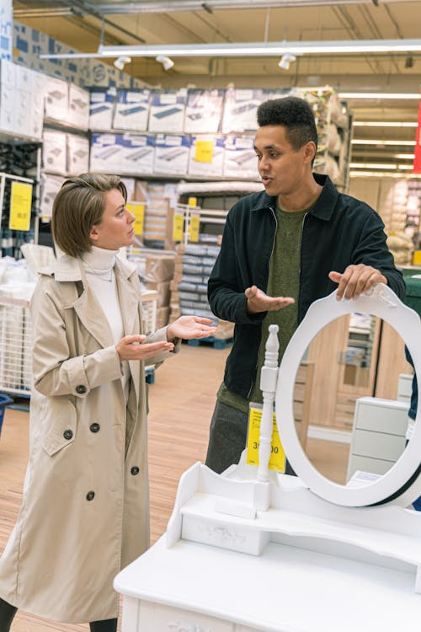
The nature of the market
Buying habits of customers
This includes tastes, preferences, likes and dislikes of customers. Customers also expect certain services like credit and personal attention and after sales service etc. All these factors greatly influence the choice of distribution channel.
https://www.pexels.com/photo/man-in-green-crew-neck-shirt-holding-white-hose-5486124/

Slide 26
THE NATURE OF MIDDLEMEN
Cost of distribution
Cost of distribution through middlemen is one of the main considerations to be taken into account by the manufacturer. Higher cost of distribution will result in the increased cost of product.
Availability of desired middlemen
Sometimes desired middlemen may not be available for the distribution of goods. They may be busy in dealing with the competitive products.

Slide 27
The nature of middlemen
Financial Soundness
In appointing middleman, the manufacturer must take into consideration the financial stability and reputation of the middleman. A financially sound middleman can provide credit facilities to customers and make prompt payment to the manufacturer.
Unsuitable marketing policies for middlemen
The marketing policies of the manufacturer may not be welcomed by the middlemen for the terms and conditions may not favour the middlemen

Slide 28
The nature and size of the manufacturing unit
The nature and size of manufacturing unit has a great impact on the selection of a distribution channel.
Manufacturer reputation: Reputed and financially sound manufacturing concerns can easily engage middlemen as compared to lesser reputed and newly established units
Experience of the undertaking: Industrial undertakings having ample marketing ability and experience can effectively manage their distribution activities themselves.

Slide 29

The nature and size of the manufacturing unit
Services provided by the manufacturers: The selection of marketing intermediaries is also influenced by various services provided by the manufacturer. These services include extensive advertisement for the product, after sales services and facilities of credit.
https://www.pexels.com/photo/man-standing-beside-man-holding-gray-club-1325735/

Slide 30
The nature of middlemen
Government Regulations and policies
Government policies and regulations also influence the choice of distribution channels. The government may impose certain restrictions on the wholesale trade of a particular product aid to takeover the distribution of certain products
Competition
The nature and extent of competition prevalent in a industry is another detrimental consideration in selecting a distribution channel. Different manufactures producing similar products may employ the same channels of distribution.

Slide 31
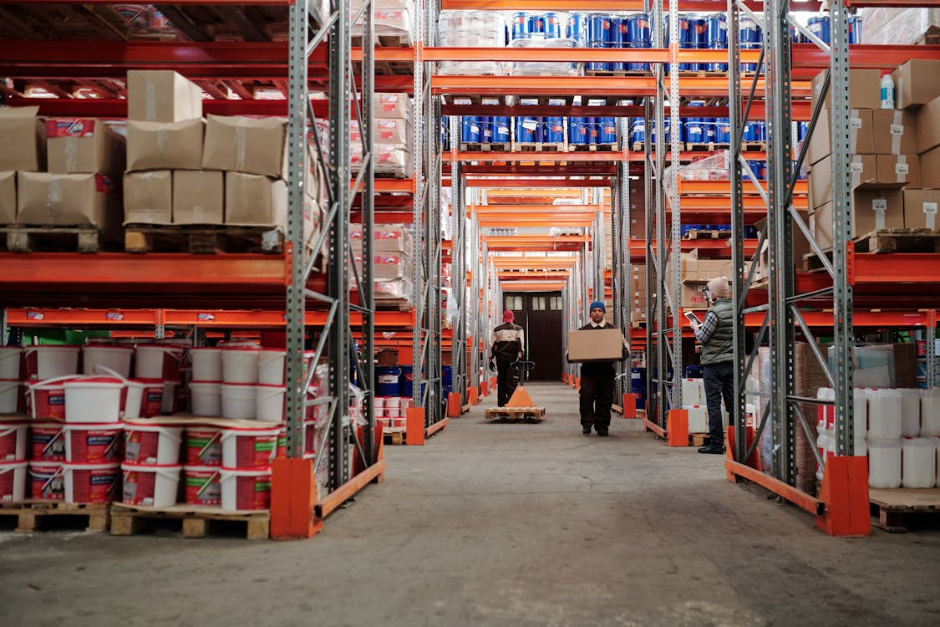
Key aspect of a middleman
There are many functions like assembling, warehousing, transporting etc are performed by the middlemen
We can eliminate the middlemen, but we cannot eliminate their functions. It means someone has to perform the functions. The marketing functions cannot be eliminated.
https://www.pexels.com/photo/workers-in-warehouse-4483862/

Slide 32
References
Fundamentals of marketing, Marilyn, A, S, John, D, Routledge (Taylor and Francis) London New York,2007
Principles of marketing. Rashmi. R. Das. https://ddceutkal.ac.in/Downloads/UG_SLM/Commerce/Principle_Marketing.pdf
Marketing Fundamentals, University of New South Wales, Spoonfeedme

Slide 33
References
Principles of Marketing, Pearson. 17th edition, Kotler P. and Armstrong G,2017
Essentials of Marketing 17th Edition, William Perreault, Joseph Cannon, E. Jerome McCarthy , McGraw-Hill Education,2021
Role of packaging in marketing product and organization. Dileep Kumar (2006). Hensard University Toru Orua
Packing and Packaging .S Natarajan, M. Govindarajan,V Kumar. Government Arts College, Coimbatore

Slide 34
References
Marketing, Polese, Francesco, and Evert Gummesson, ProQuest Ebook Central, http://ebookcentral.proquest.com/lib/aunke -ebooks / detail. action? docID =4856363,2017
Rashmi R Das .Principles of Management (http://ddceutkal.ac.in/Dowload/UG.SLM/Commerce/Principle-Marketing.pdf
Chahat Azam .Concept of products. https://dspmuranchi.ac.in/pdf/Blog/1)%20PRODUCT%20CONCEPT.pdf.Faculty of Commerce DSPMU.

Slide 35
References
Baglandesh Open University .New Product Development . http://www.ebookbou.edu.bd/Books/Text/SOB/MBA/mba_3313/Unit-06.pdf
Brand Management .Madhu S Kamar (2015)Knowledge Management and Research Organization .
Government Arts College, Coimbatore. https://gacbe.ac.in/pdf/ematerial/18MCO14E-U4.pdf

Slide 36
References
Tima Miroshnichenko (2020). https://www.pexels.com/photo/man-checking-the-paper-while-carrying-the-packages-6169052/
Artem Podrez (2020). https://www.pexels.com/photo/man-and-woman-checking-the-packages-5025635/
Tima Miroshnichenko (2020). https://www.pexels.com/photo/man-in-blue-t-shirt-standing-beside-white-van-6169591/

Slide 37
References
Tima Miroshnichenko (2020).https://www.pexels.com/photo/man-in-white-shirt-standing-beside-woman-in-white-shirt-6169641/
Tima Miroshnichenko (2020). https://www.pexels.com/photo/delivery-man-in-ppe-carrying-a-box-6170453/
Antoni Shkraba (2020). https://www.pexels.com/photo/man-in-green-crew-neck-shirt-holding-white-hose-5486124/
Jpwell(2018). https://www.pexels.com/photo/man-standing-beside-man-holding-gray-club-1325735/

Slide 38
References
Tiger Lily (2020). https://www.pexels.com/photo/workers-in-warehouse-4483862/

