Slide 1


PRINCIPLES OF PURCHASING
Week 1
Introduction to purchasing
Samson Ndonye

Slide 2
Lecture Learning outcomes
Explain the function and objectives of purchasing
Explain the purchasing procedures
Describe how the organization can do proactive purchasing

Slide 3
Introduction to principles of purchasing
Procurement is the process of obtaining goods or services in any way, including borrowing, leasing and even force or pillage (Lysons and Farrington, 2007).
Purchasing can be defined as a process of acquiring goods, services, or works in return for a price.

Slide 4
Introduction---
The major type of activities under purchasing function entail:
Coordination with user departments to identify purchase needs,
Identification of potential suppliers,
Conduct of market studies/survey for important materials,
Negotiation with potential suppliers,

Slide 5
Introduction cont--
Analysis of proposals,
selection of suppliers,
Issuance of purchase orders,
Administration of contracts and resolution of related problems
Maintenance of a variety of purchasing records.

Slide 6

Purchasing activities
Purchasing activities involve buying decisions to ensure that: the right goods are in the right place, at the right time, at the right price, at the right quality and at the right quantity

Slide 7
Six R’s of purchasing
The right goods: In regard to this, the buyer specifies exactly what the organization requires rather than simply buying from catalogue or what is on offer
The right place: In making the buying decisions it is important to provide detailed instructions on how, when and where deliveries are to be made
The right time: This is an attribute of ensuring that the ordered item reaches the company at the stipulated time to facilitate efficient supply chain operations
The right price: Achieving the right price is an important task since this will affect the purchaser’s cost structure and ultimately the margin achieved
The right quality: The customer either specifies quality or expects the supplier to do so

Slide 8

Six R’s of purchasing
The right quantity: This entail fully supply of the ordered items

Slide 9
What are the Objectives of Purchasing department?
Maintaining continuity of supply: The purchasing function must ensure the continuous availability of material, supplies and equipments to maintain production schedule or to avoid disruption in production
Maintenance standards quality: The purchasing function must ensure that the material purchased must be of required quality in order to produce the goods according to specifications and to maintain quality standards
Avoidance of duplication, waste and obsolescence: The purchasing authority must have the accurate knowledge of the items in hand and the requirements of materials for a particular period in order to have proper decision in view of long range and short range plans

Slide 10
What are the Objectives of Purchasing department?
Maintenance of company's competitive position: The purchasing authority must constantly examine his specifications for the purchase of right material
Maintenance of company's good image: The purchasing agent must create a good image in the minds of suppliers
Developing alternative sources of supply: Alternative sources of supply should be exposed for increasing the bargaining power of the buyer and minimizing the cost of purchases

Slide 11
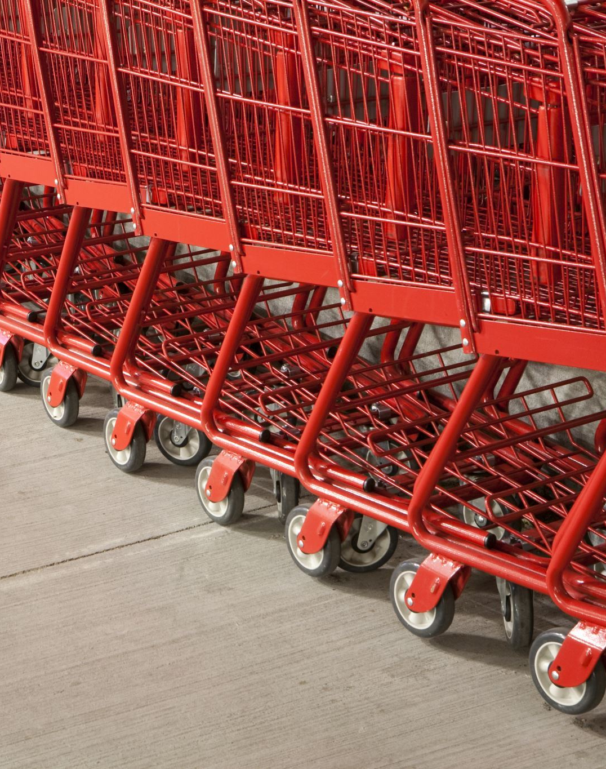
Purchasing procedures

Slide 12
Purchasing procedures
Apart from pre-purchase activities such as participation in the preparation of specification and budget decisions, purchasing has traditionally involved three main phases, each involving specific documents and considerable clerical activity.
The identification phase:
This involves the notification of the need to purchase by either:
A requisition issued by the stores department
A bill of materials (BOM) issued by the drawing office or production control department
Requirement from user departments.

Slide 13
Procurement procedures
The ordering phase:
On the receipt of the requisition or bill of materials, the buyer will check them for accuracy, conformity to specifications and purchase records to ensure whether the purchase is a re-buy or a new buy request.
If it is a re-buy request previously purchased from satisfactory supplier at an acceptable price, a repeat order may be issued.

Slide 14
Procurement procedures- New product case..
Enquiries will be sent to possible suppliers accompanied by additional documents e.g. drawings, specifications which will enable the suppliers to quote.
Quotations will be received in response to the enquiries and compared with respect to price, quality, delivery, tool costs and terms of business.

Slide 15
Procurement procedures- New product case..cont
When quantities are sub-station and quality/delivery are of great importance, further negotiation with suppliers including an evaluation of their capacity to undertake the order may be required.
A purchase order will be issued to the vendor. The quotation should be amended thoroughly in line with the negotiation between the buyer and the supplier.
An order acknowledgement should be required from the vendor which should be examined by the buyer to ensure that the order has been accepted on the terms and conditions agreed.

Slide 16
Purchasing procedures-The post-ordering phase:
It may be necessary to progress the order to ensure that delivery dates are met or to expedite delivery of overdue orders.
The supplier will issue an advice note, notifying the buyer that goods have been dispatched or are ready for collection.
On receipt, the goods will be checked for quantity by the stores, matters of quality or specifications will be examined by the inspection department.

Slide 17
Purchasing procedures-The post-ordering phase
An invoice for the value of goods will be received from the supplier.
The purchasing department will pay special attention to the legitimacy of any variations from the quoted price and if satisfactory, the invoice will be passed to accounts department for payment.
On completion, the order will be transferred to a completed orders file.

Slide 18
Buying strategies for small orders, emergency orders, and bulk purchases
It is estimated that about 60% of the purchasing and accounts payable transactions often represent only 5% of the total value of purchase expenditure.
Low value orders therefore both increase costs and hamper both purchasing and accounting productivity.
A low cost system is therefore required for the efficient handling of low value purchases

Slide 19
Strategies for small orders
Telephone orders: The buyer passes all the requirements via the telephone conversation to the supplier and provides an order number
Procurement cards: These are similar to consumer credit cards and involve a provider such as master cards, visa etc
Petty cash purchases: Items bought are paid for at once from petty cash
Standing orders: Entail submission of an invoice of agreed intervals
Blanket orders: Encompass all orders for a range of items placed with one supplier for a specified period

Slide 20
Proactive procurement
Proactive procurement can be defined as a strategic way based on advocating for control of all overall acquisition of goods/services for a company rather than reactive way of approaching buying activities.
It puts emphasis on long range relationship negotiation activities, expanding the supplier’s and material’s total cost, instead of doing it in repeated demands and stock reposition, early purchase involvement, purchase specifications

Slide 21
Proactive procurement procedures look in to the following
Making sure of purchasing continuity to keep effective relationships with existent sources, developing other supply alternatives, or attending the emergent or planned necessities, selecting the best suppliers
Keeping solid and cooperative relationships with the other organizational functions, supplying necessary information, and advising to make sure of the effective operation of the entire organization
Developing the training of employees, and the adoption of procedures organization to make sure to reach the previous goals
Keeping a balance between quality and value, obtaining products and services in the

Slide 22

Proactive procurement procedures look in to the following
Surveying market tendencies
Developing methods to negotiate purchasing conditions to deal with suppliers that look for mutual benefit by means of superior economic performance
Developing and keeping good relationships with the suppliers, besides developing potential suppliers
Emitting and controlling purchasing solicitation

Slide 23
Purchasing records:
Purchasing records are concerned with the storage of information.
This information can be filled manually or through computer system.
Computerization enables vast amounts of information to be stored, obviates duplication and ensures efficient retrieval of data.
A part from files of requisitions, purchase orders and other original documents, purchase records may include the following:

Slide 24
Purchasing records include the following:
Supplier index providing details of address, telephone, supplier’s items etc.
Supplier rating; details of supplier performance relating to price, quality, delivery etc.
Supplier visits records
Supplier database list
Supplier conference records

Slide 25
Other Purchasing records includes:
Price trends of crucial items
Records of materials issued to sub-contractors
The period for which records providing evidence should be kept depends on the type of the contract i.e.
Simple contracts may warrant the records be barred after six years from the date when the action accrued. Complex contracts may take up to twelve years from the date when the action accrued.

Slide 26
Procurement Best Practices: Six Key Practices
Clear Requirements Definition: Establishing well-defined requirements is essential for effective procurement.
Competitive Bidding: Implementing a competitive bidding process helps in obtaining the best value for money

Slide 27
Best practices
Transparent Evaluation Criteria: Clearly defined evaluation criteria should be used to assess bids objectively
Effective Vendor Management: Building strong relationships with vendors through effective management practices can lead to improved performance and reliability

Slide 28
Best practices
Regular Audits and Reviews: Conducting regular audits and reviews of procurement processes helps in identifying and rectifying inefficiencies or compliance issues
Ethical Standards and Integrity: Upholding high ethical standards is fundamental to a trustworthy procurement process

Slide 29
Lecture summary
In conclusion, purchasing involves obtaining goods or services through various methods, including purchasing, leasing, or borrowing
The purchasing process includes coordinating with departments, identifying suppliers, negotiating, and managing contracts
Key purchasing activities focus on ensuring the right goods are bought at the right place, time, price, quality, and quantity, known as the six R’s

Slide 30
Lecture summary continuation
Objectives of the purchasing department include maintaining supply continuity of goods and services, quality, and avoiding waste
The process is divided into identification, ordering, and post-ordering phases
Finally, the proactive procurement emphasizes on long-term supplier relationships and efficient cost management

Slide 31
Revision Question
What are the six R’s of purchasing, and why are they important in the purchasing process?
Describe the three main phases of purchasing procedures
List and explain at least three objectives of the purchasing department
What are some buying strategies used for handling small orders, emergency orders, and bulk purchases?
Explain the concept of proactive procurement

Slide 32
Reference
Purchasing and supply management; Lyson, K. Farrington, B. 7Th Edition, Pearson Education Limited, Harlow, (2007) page 1.

Slide 33
End

