Slide 1

Principles of Purchasing
Lecture 4
Quality Management in Purchasing
Lecturer: Samson Ndonye

Slide 2
Lecture Learning outcomes
At the end of the lecture, you will be able to:
Explain the conceptual framework of quality in purchasing
-Understand the quality management dimensions in purchasing
- Describe the implementation of total quality management in purchasing

Slide 3
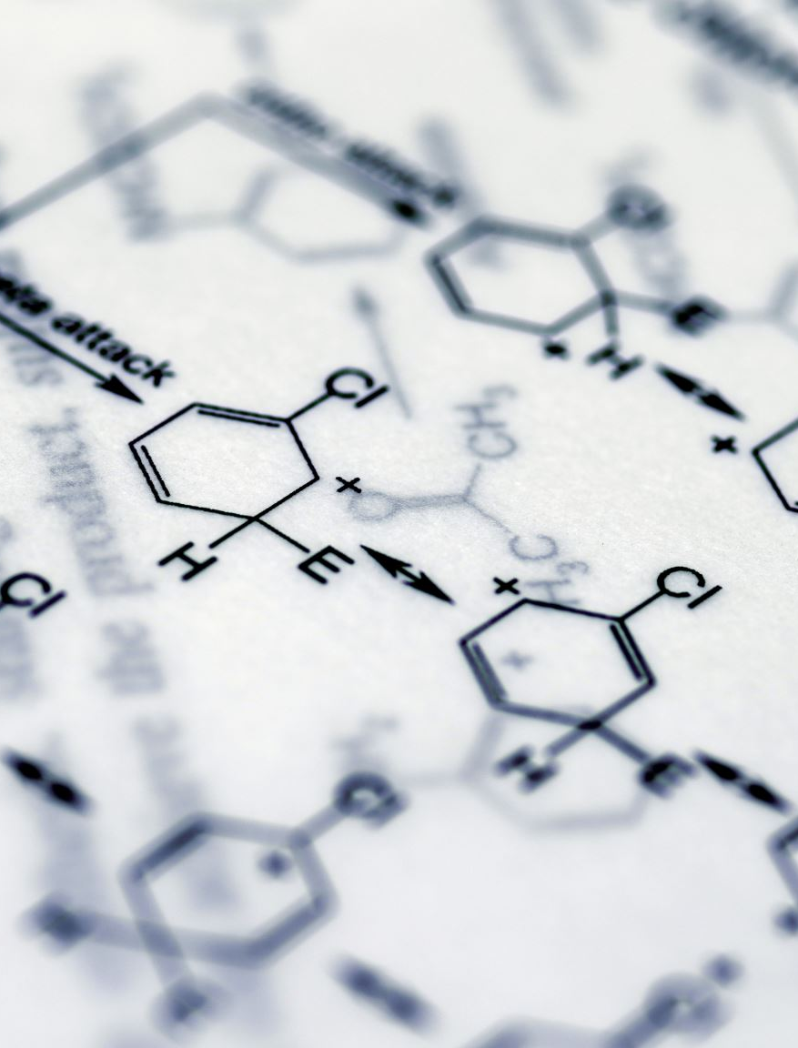
Introduction
Quality is the totality of features and characteristics of a product that bears on the ability to satisfy stated or implied needs.
Features and characteristic of product ‘ implies the ability to identify what quality aspects can be measured, or controlled, or constitute an acceptable quality level (AQL)
The ability to satisfy given needs relates to the value of the product or service to the customer including economic value as well as safety, reliability, maintainability and other relevant features.

Slide 4

Five approaches of quality
The transcendent approach: quality is absolute and universally recognisable
The product-based approach: quality is precise and measurable variable
The use-based approach: quality is defined in terms of fitness for use or how well the product fulfils its intended functions
The manufacturing-based approach: quality is conformance to specifications i.e. targets and tolerances determined by product designers
The value-based approach: quality is defined in terms of cost and prices
Performance: The product’s operating characteristics
Reliability: The probability of a product surviving over a specified period of time under stated conditions of use
Serviceability: the speed, accessibility and ease of repairing the item or having it repaired

Slide 5
Eight dimensions of quality
Conformance: The degree to which delivered products meet the pre-determined standards
Durability: Measures the projected use available from the product over its intended operating cycle before it deteriorates
Features: ‘The secondary characteristics which supplement the product the product’s basic functioning
Aesthetics: personal judgements of how a product looks, feels, sounds, tastes or smells
Perceived quality: Closely identified with the reputation of the producer

Slide 6
Eight dimensions of quality:
Performance: The product’s operating characteristics
Reliability: The probability of a product surviving over a specified period of time under stated conditions of use.
Serviceability: the speed, accessibility and ease of repairing the item or having it repaired.

Slide 7

Quality control and quality management-ISO 9000, 2000, TQM
Quality control: Is concerned with defect detection and correction
Quality assurance: Differs from quality control and is defined as all those planned and systematic activities implemented within the quality system and demonstrated as needed to provide adequate confidence that an entity will fulfil requirements for quality

Slide 8

Quality assurance includes all activities connected with the attainment of quality such as:
Design, including proving and testing
Specification, which must be clear and unambiguous
Assessment of supplier to ensure that they can perform
Motivation of all concerned parties
Education and training of supplier’s staff
Inspection and testing
Feedback to ensure that all measures are effective
Reduction of errors and enhancement of quality
Problem prevention rather than detection and correction
Reduction in product or service costs

Slide 9

Quality control/Assurance objectives:
Improved productivity
Improved employee involvement, motivation, job satisfaction and commitment
Improved teamwork and working relationships
Development of employee problem-solving ability
Reduction of errors and enhancement of quality
Problem prevention rather than detection and correction
Reduction in product or service costs

Slide 10
Advantages of quality control and assurance to both buying and supplying organisation
Minimum possible rejection and wider acceptance of the supply is made possible by the supplier’s effective quality control system
Minimum inspection time and effort help the vendor as well as the purchase in delivery and receiving the supply at a lower cost
Prospect of zero defects increase
Scraps are minimised and wastage is reduced due to good quality control system
Goodwill of both vendor and purchaser is enhanced as there are fewer difficult and problems in regard to quality products
Sometimes inspection at the purchaser’s end is eliminated if vendor quality certificate and statistical date regarding the quality of the goods supplied is enclosed
Quality consciousness is developed resulting in benefit to all concerned

Slide 11

Advantages of quality control and assurance to both buying and supplying organisation
Accumulation of obsolete material is reduced to the minimum
It results in reduction of lock-up capital due to decrease in inventory

Slide 12

Total quality management
TQM is defined as a way of managing an organisation so that every job, every process is carried out right, first time and every time
This mean each stage of process is carried out right, first time and every time
TQM is also defined as an integrative management concept of continually improving the quality of delivered goods and services through the participation of all levels and functions of the organisation

Slide 13

TQM principles
A focus on product improvement from the customer’s view point
A recognition that personal at all levels share responsibility for product quality
  Provision of leadership from the top
  Creation of quality culture dedicated to continuous improvement
  Team-work- i.e. quality improvement teams and quality cycles
  Adequate resource allocation
  Quality training of employees
  Measurement and use of statistical concepts
  Quality feedback
  Employee recognition

Slide 14
TQM principles
Recognition of the importance of implementing a system to provide information to managers about quality processes which enable them to plan, control and evaluate performance

Slide 15

Issues in managing quality in purchasing and supply chain
-Most of the issues are in Specification and standardization variety reduction, managing service quality and value analysis
A specification for an item has been defined as ‘a statement of the attributes of a product or service.
It is basically a description of an item, its dimensions, analysis, performance or other relevant characteristics in sufficient detail to ensure that it will be suitable in all aspects for the purpose for which it is intended.

Slide 16
Approaches to specification
The idea of performance specification is that a clear indication of the purpose, function, application and performance expected of the supplied material or service is communicated and the supplier is allowed or encouraged to provide an appropriate product
Conformance specifications apply in situations where the buying organisation lays down clear and unambiguous requirements that must be met

Slide 17
Additional methods of specification
Use of brand or trade name: This will be applicable under the following circumstances
  When manufacturing process is secrete or covered by a patent
  When manufacturing process of the vendor call a high degree of skill that cannot be exactly defined in a specification
  When only small quantities are bought so that the preparation of the specifications by the buyer is impracticable

Slide 18
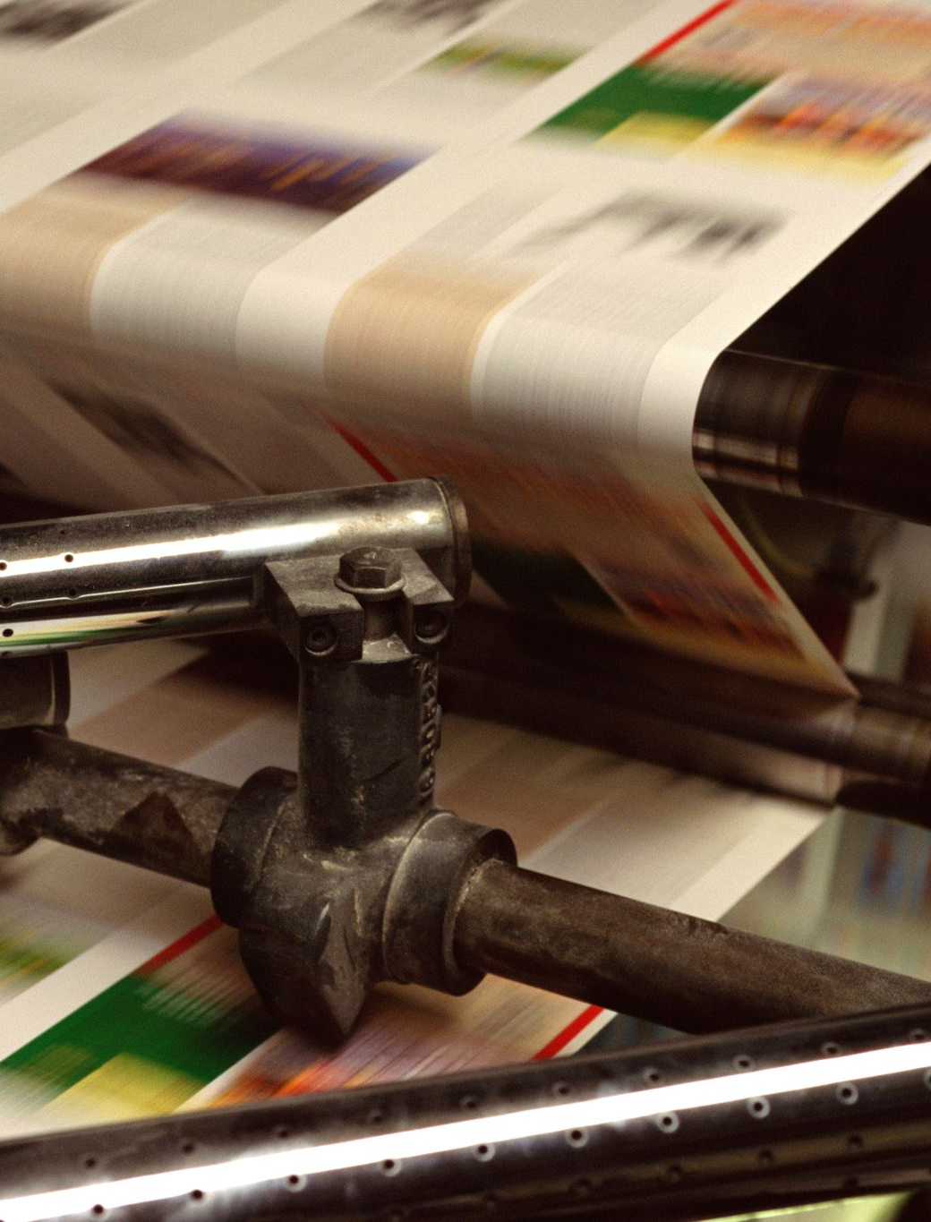
Additional methods of specification
By sample: The sample can be provided either by buyer or seller and is useful method of specification in relation to printing and some raw materials
  The bulk must correspond with the sample in quality
  The buyer must have a reasonable opportunity of comparing the bulky with the sample
  The goods must be free from any defect making their quality unsatisfactory which a reasonable examination of the sample would not reveal

Slide 19
Additional methods of specification
Function and fit specification: with this approach the function and the way the item is going to fit in the whole system is described. This is common in the computer and automobile industry where earlier supplier involvement (ESI) is essential.
Markets grades - grading is a method of determining quality of commodities. Grading is restricted to natural commodities, e.g., hides, cotton, tobacco etc.

Slide 20
Additional methods of specification
Combination of methods- many products cannot be adequately described by a single method as such many or a combination of methods may be used.
Descriptive - These describe the physical features of a requirement. Such description may include measurements such as height, breadth and length or quantified in weights such as kilograms or volume as litre. Usually, descriptive specifications give a mental picture and sometimes include colour.

Slide 21
The value of specifications
All commodities specified will be suitable for their intended purpose when put in place
Materials is of a consistent quality at all times
The inspection or testing to be applied to goods purchased is notified in advance to the inspection section and to suppliers
In respect of the purchase of the specified items, all suppliers will have the same date on which to base the quotations
Avoid over-specification: This may lead to goods becoming more expensive and also may be difficult to find a manufacturer willing to quote
Avoid under-specification since this may lead to inferior goods and services
In order to be practicable, pay attention to convenience in handling and storage

Slide 22
The value of specifications
If there is to be inspection after delivery, the specifications ought to state what tests are to be applied
If any special marking or packing is wanted, include the relevant instructions in the specifications

Slide 23
Preparation of specifications
Avoid over-specification: This may lead to goods becoming more expensive and also may be difficult to find a manufacturer willing to quote
Avoid under-specification since this may lead to inferior goods and services
In order to be practicable, pay attention to convenience in handling and storage
If there is to be inspection after delivery, the specifications ought to state what tests are to be applied
If any special marking or packing is wanted, include the relevant instructions in the specifications.

Slide 24
Standardization-
This is the process of agreeing and adopting generic specification or descriptions of the items required
There is accurate comparison of quotation since all prospective suppliers are quoting for the same thing
Clear specification helps to achieve reliability and reduce costs
Less dependability on specialist suppliers and greater scope for negotiation
Facilitation of international sourcing by reference to ISO standards
Reduction in error and conflicts thus increasing supplier goodwill
Quality is easier to monitor because visual inspection is easier and use of tried or tested items means that defects are less likely to occur
It gives clear specification and removal of any uncertainty as to what is required on part of both buyer and the supplier

Slide 25
Advantages of standardization
There is accurate comparison of quotation since all prospective suppliers are quoting for the same thing
Clear specification helps to achieve reliability and reduce costs
Less dependability on specialist suppliers and greater scope for negotiation
Facilitation of international sourcing by reference to ISO standards
Reduction in error and conflicts thus increasing supplier goodwill
Quality is easier to monitor because visual inspection is easier and use of tried or tested items means that defects are less likely to occur
It gives clear specification and removal of any uncertainty as to what is required on part of both buyer and the supplier

Slide 26
Advantages of standardization
Save time and money by eliminating the need to prepare specifications each time and reducing the need for explanatory telephone calls
Easier communication and less room for misunderstanding and disputes between buyers and users
Save inventory and cost through variety reduction
Ensure specifications are observed
Ensure new specifications are suitably revised and approved
Ensure old specifications are reviewed, replaced, amended or even eliminated if they are not necessary

Slide 27

Variety reduction
This is the process of reducing the number of varieties stocked to a controlled workable minimum

Slide 28

Procedure for variety reduction
The use or users for which each item is intended
Which items have similar characteristics and can be used as substitutes for each other
What range of sizes is essential
Which items can be eliminated
What specifications are necessary for retained items

Slide 29

Reasons that lead to variety reduction
Lack of specification when procuring items
Where there are many suppliers of the same item
Different sizes of containers or packages for items
Lack of guidelines on how to use stocked items
When there are varieties of the same item

Slide 30
Advantages of variety reduction
Reduction of stock holding cost
Release of money tied up in stocks
Easier specification while ordering
Narrow range of inventory which leads to reduction in administrative cost
Reduced supplier-base: facilitates the building of long-term relationship and supplier development.

Slide 31
Managing service quality
Service quality is about ensuring customers, both internal and external, get what they want.
As the technology brings markets, people and products ever closer, it is the single most effective and sustainable means of differentiation between competing companies.
Focus should be on
Customer focus
Customer alignment
Linking the customer to results
Voice of the customer

Slide 32
Conclusion
In conclusion, understanding the concepts of quality management is essential for any organization aiming to meet customer needs and improve overall performance
Quality is not just about meeting specifications; it encompasses a range of features and characteristics that contribute to customer satisfaction
The various approaches to quality—transcendent, product-based, use-based, manufacturing-based, and value-based—offer distinct perspectives on how to evaluate and enhance quality

Slide 33
Revision questions
How is quality defined in the context of quality management, and what are the implications of features and characteristics of a product in satisfying customer needs?
List and describe the five approaches to quality management
Identify and explain the eight dimensions of quality
What are the key differences between quality control and quality assurance?
What are the main principles of Total Quality Management?

Slide 34
End

