Slide 1

Principles of Purchasing
Week 7
Strategy in purchasing
Lecturer: Samson Ndonye

Slide 2
Lecture Learning outcomes
At the end of the lecture, you will be able to:
1. Understand the strategic sourcing process
2.Evaluate the market dynamics and supplier relationship
3. Apply performance measurement in purchasing

Slide 3
Introduction
-Strategic Purchasing/sourcing is a concept that was popularized by major consultancy companies in the late 1980’s 1990’s and is now considered a standard purchasing strategy used by many blue-chip companies.
-Strategic sourcing is the process of taking advantage of purchasing opportunities by continually reviewing current needs against purchasing opportunities.

Slide 4
Introduction-There are several processes within the strategic sourcing/purchasing process-
Evaluation of the company’s current purchasing cycles
Evaluation of what is currently available in the supply market
A review of the cost benefits analysis of using other suppliers
A review of potential vendors
An update of the current procurement strategy
Negotiations with potential vendors to ensure that they meet the new procurement strategy and cost benefit analysis
Implementation of the new vendor relationship
On a continuous process, review and update the strategic sourcing

Slide 5


ROLE OF STRATEGIC SOURCING
Strategic sourcing is one of the key methods that purchasing departments are using to lower costs and improve quality.
Strategic sourcing involves analyzing what products the company buys in the highest volume, reviewing the marketplace for those products, understanding the economics and usage of the supplier of those products.

Slide 6
ROLE OF STRATEGIC SOURCING-During this process, the team conducting the analysis should ask these questions
Why do we buy this product or service?
What do we use it for?
What market conditions do suppliers operate under?
What profit margin do suppliers seek to obtain?
What is the total price of purchasing from a particular vendor ?
Where is the good or service produced?
What does the production process look like?

Slide 7
If the supplier is willing to partner the following areas should be analysed
commitment to continuous improvement
Cost-competitive
Cost-conscious
Customer-oriented
Encourages employee involvement
Flexible
Financially stable
Abe to provide technical assistance

Slide 8
Establishing a Good Strategic Sourcing Methodology
The first step to a good strategic sourcing methodology is, unsurprisingly, to define the goals for the company. Beginning with the end system in mind is critical to developing a working program.
The second step is track and analyze internal spending. This can be done by aggregating data from current procurement and accounting systems or by the implementation of e procurement throughout the company.

Slide 9
Establishing a Good Strategic Sourcing Methodology
The third step involves the leadership team developing commodity strategies using:
Best Price Evaluation,
Volume Concentration,
Product Specification Improvement,
Joint Process Improvement,
Relationship Restructuring and
Global Sourcing.

Slide 10
Establishing a Good Strategic Sourcing Methodology
The fourth step; once the strategy is in place, the actual mechanics of strategic sourcing can begin.
The fifth step; Finally, awarding the contract is just the beginning. The buying company continues to communicate expectations, performance, supplier performance, and establishes both awards and penalties for various levels of service.
Once the contracts are in place, a good strategic sourcing methodology demands that analysis continue on each contract.

Slide 11

Ten Golden Rules of Strategic Sourcing

Slide 12
Establishing a Good Strategic Sourcing Methodology
Avoid a piecemeal approach: Leverage sourcing as an integral component of your overall business strategy.
Be strategic: Ensure that your service delivery model is not only aligned with, but will also drive forward, the enterprise’s ambitions.
Take a holistic, enterprise-wide approach: This will maximise economies of scale, avoid duplication and ensure continuity of standards.

Slide 13
Establishing a Good Strategic Sourcing Methodology
Sourcing is not synonymous with outsourcing: Review your present operating model and create a roadmap for future requirements that considers all of your options both internal and external, while balancing value, risk and speed.
Sourcing is an ongoing process, not an isolated decision: By deploying flexible services from wherever they are best provided, you can quickly and effectively respond to changing market conditions.
View service providers as partners: By keeping service providers informed of business goals and constraints as they evolve, and by structuring the relationship so that it is beneficial to both sides, your partners can innovate and transform in order to provide long-term value.

Slide 14
Establishing a Good Strategic Sourcing Methodology
Ensure buy-in: Executive sponsorship, centralised management and company-wide support a vital for success.
Identify the changes necessary to move to the new model: Communicate a compelling vision of the future that conveys the competitive advantage for the company and the opportunities for employees.
Service Management & Governance: Develop a corporate Service Management & Governance function with the skills and systems needed to drive effective sourcing strategy, execution and management.
Seek independent advice: Develop an informed perspective on your current operating costs and performance vis-à-vis the market and the future potential of your target operating model.

Slide 15
Example of purchasing strategies

Slide 16
Bulk Purchasing
Reduced Ordering Frequency leading to fewer orders hence lower administrative costs
Improved Supplier Relationships due to large consistent orders which foster better supplier terms

Slide 17
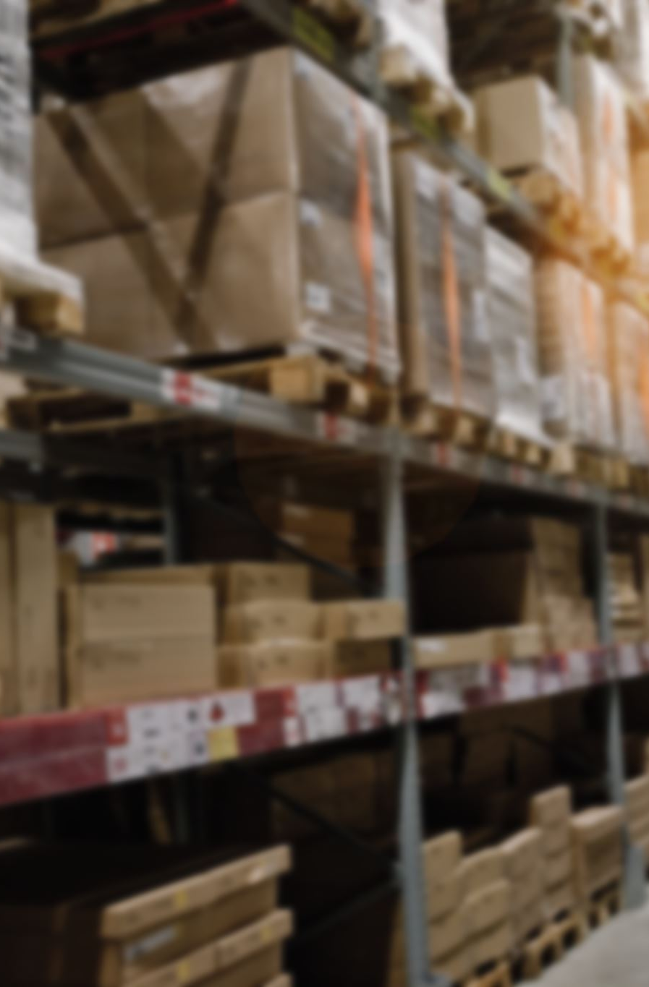
Vendor Managed Inventory
The supplier manages the inventory levels for the organization, replenishing stock as needed, which reduces the buyer’s need to monitor stock levels closely

Slide 18

Outsourcing
Contracting external suppliers for services or goods instead of producing them in-house, allowing the organization to focus on core activities

Slide 19

Strategic Partnerships
Forming long-term relationships with key suppliers to secure a consistent supply, often with negotiated pricing and quality assurances

Slide 20

Global Sourcing
Procuring materials or products from international suppliers to reduce costs or improve quality

Slide 21

Green Purchasing
Prioritizing environmentally friendly or sustainable products, often to support the organization’s corporate social responsibility goals

Slide 22

Consignment Purchasing
Having goods delivered and stored on the company’s site, with payment made only once items are used or sold, helping to reduce inventory costs

Slide 23

Competitive Bidding
Using requests for proposals or requests for quotations to solicit bids from multiple suppliers, encouraging competition to achieve better terms

Slide 24

E-procurement
Using digital platforms to automate and streamline purchasing processes, which can reduce procurement cycle times and improve supplier selection

Slide 25

Supplier Consolidation
Reducing the number of suppliers to a select few strategic partners, improving volume discounts and simplifying management.

Slide 26
Just in time (JIT)
Just-In-Time Purchasing
  Just-in-time manufacturing became one of the biggest trends in all facets of industry in the 1990s
  JIT companies maintain only enough inventory to manufacture the products they need in the very near future
  The benefits of this system include reduced inventory, improved quality, reduced lead time, reduced scrap and rework, and reduced equipment downtime
  Traditional purchasing meant building a supplier list over time by constantly adding new suppliers, spreading purchases around, and maintaining higher inventory levels in case demand for a product soared or quality from a supplier dipped suddenly

Slide 27

PURCHASING PERFORMANCE MEASUREMENT SYSTEMS
The fundamental objective of a purchasing and supply chain performance measurement system is to aid in strategy implementation through formal systematic approach to monitoring and evaluating purchasing activities

Slide 28
History of performance measurement systems
Performance measurement system have evolved over time, from quality being the largest concern in the Japanese industries during the 70s, while western companies were more concerned over service and return on investment
During the 80s a new era for measurements had its beginning and companies started to focus more on quality, time, cost and flexibility
The focus then shifted during the 90's when scholars started to criticize traditional financial measurements and started to focus more on effectiveness and efficiency of actions
From there on several different non-financial factors such as quality, customer satisfaction, cycle time and innovations became leading indicators to measure financial performance

Slide 29

History of performance measurement systems
And in recent years, environmental impact and social sustainability have gained importance, this has led to the evolvement of performance measurement systems

Slide 30
Performance measure as signaling device
Management can use performance measures as a means of signalling and influencing the actions of the people who are responsible for performing tasks
Performance measures may send conflicting signals to buyers, with both measures often disconnected from both corporate and supply strategy
Performance measures must be carefully designed to suit the needs of the organization in order to avoid resources being allocated in sub-optimal way
A well system should support and encourage performance in the areas which are critical to firms’ success

Slide 31
Cascading performance measure
Effective performance measurement system should cascade the high level corporate strategy down into the lowest levels of the organizations signalling expectations and desired behaviours to employees
The aim is to create an alignment between the corporate strategy, supply strategy, goals and objectives, performance measures and ultimately the actions of the individual responsible for carrying the work
For purchasing to contribute to the success of the organization, it is vital that it derives its strategy from corporate
Purchasing therefore requires a clear alignment with the broader corporate thrust

Slide 32
Benefits of measurements
Decision making
Communication
Visibility

Slide 33
Problems with measurement
Conflicting messages
Collection of inappropriate information
Lack of congruency

Slide 34
Key performance measurement concept
Efficiency
Effectiveness
Cost based measures
Financial and non-financial measurements
Identify stakeholders
Gaining buy-in

Slide 35
Conclusion
In conclusion, strategic sourcing is a vital approach in modern procurement, focusing on optimizing cost and quality through well-planned supplier relationships
It offers a structured methodology that integrates purchasing with business goals, allowing companies to leverage supplier capabilities effectively
This cohesive approach to sourcing empowers companies to adapt swiftly to market changes, maintain competitive advantage, and sustain long-term growth

Slide 36
Revision questions
What is strategic sourcing, and how did it become a widely adopted concept in business procurement?
Identify and describe the key steps involved in the strategic sourcing process
What role do supplier characteristics play in successful strategic sourcing, and which traits are most valued in supplier partnerships?
Outline the ten golden rules of strategic sourcing and discuss their impact on effective purchasing strategies
What are some challenges associated with purchasing performance measurement systems, and how do these systems add value to an organization?

