Slide 1

Principles of Purchasing
Week 10
Global sourcing
Lecturer: Samson Ndonye

Slide 2

Lecture Learning outcomes
At the end of the lecture, you will be able to:
1. Explain how international sourcing strategies are applied
2. Understand the risks and cost associated with global procurement
3. Understand how to evaluate and execute import procedure and documentation requirements

Slide 3

Introduction
In a global economy, international purchasing is a term used to describe the process of sourcing goods and services around the world to satisfy diversified needs of organization’s objectives
International purchasing emerged initially as a reactive approach designed to reduce production costs in an effort to neutralize the threat of foreign competition
Today, world class firms have shifted the focus of their international sourcing efforts to that of a proactive strategy that pursues a sustainable competitive advantage

Slide 4
Reasons for sourcing internationally
Competitiveness of overseas sources e.g. lower prices, improved deliveries, better quality etc
Need for manufacturing flexibility
Stringent quality standards
Ever changing technology
The buyer may prefer to buy from foreign source which offers products which have features which are not available domestically
Insufficient domestic capacity to meet demand to ensure continuity of suppliers owing to shortages or strikes
Reciprocal trading and counter trade owing to policy reasons
Innovation or variety of style

Slide 5
Successful elements in sourcing abroad
Top management support
Development of efficient communication skills and system
Establishment of long term relationships with overseas suppliers
Vast knowledge of diverse culture and opportunities across the globe
Good understanding of international rules under INCOTERMS
Knowledge of foreign business practices
Obtaining expert assistance
Use of third part logistics services

Slide 6
Benefits of international/global sourcing
Access to lower-priced goods
Enhanced competitive position
Access to higher-quality goods
Access to worldwide technology
Better delivery performance
Better customer service
Increased number of suppliers
Helps meet countertrade obligations

Slide 7

Difficulties in buying abroad
Fluctuations in currency exchange rates
Knowledge of foreign business practice
JIT sourcing requirements
Finding qualified foreign sources
Legal difficulties in case of a dispute
Duty and customs regulations
Nationalistic attitudes and behaviour
Logistics support for longer supply links
Understanding the political environment

Slide 8
Factors to consider when planning international purchasing
1. INTERNATIONAL RISKS
Financial factors such as currency uncertainty, financial policy uncertainty and financial effect of economic performance
Economic factors such as performers of economic indicators etc
Political factors such as radical changes in government composition or policies
Operational environmental factors such as the legal structure of the country of export, the rules and procedures governing international trade

Slide 9

Logistical barriers
Long distances mean increased transport costs and long delivery times, hampering the supplier in rendering a service

Slide 10

Customs regulations and duties
Import duties can disrupt prepared cost estimates at very short notice; political motives in the importing country can hamper purchases on specific foreign markets etc

Slide 11

Nationalism
Local source preference is a factor that influences the development of an international purchasing policy and strategy

Slide 12
Sources of information about overseas suppliers
Professional contacts: Professional contact of the purchasing staff can facilitate an evaluation of specific suppliers capability
Trade journals: Trade journals are published regularly by different industries in various countries and provide vital information on suppliers
Directories: Directories are good sources of information and are often printed by an organised industry in a particular country
Trading companies: Japan frequently uses this marketing channel which provides advantages of convenience, efficiency and assurance of supply to international buyers
Import brokers: They offer a buying and forwarding service in exporting country and often become very knowledgeable about the products

Slide 13

Characteristics of international purchasing mode
Increased purchasing scope
Increased purchasing risk:
Decreased purchasing price:
The need for a systematic criterion in supplier selection:
Stable purchasing channels

Slide 14

DRIVERS OF INTERNATIONAL PURCHASING
Materials are not available domestically
-Due to reasons of geography and technology, some domestic manufacturers may be unavailable to supply specific materials. Moreover, probably they are incapable of meeting the required delivery time or supplying some materials due to their limited technical capabilities.

Slide 15

DRIVERS OF INTERNATIONAL PURCHASING
Unsatisfactory quality of domestic products
-The quality of products obtained from the domestic market may not meet the requirements of buyers. The quality of domestic goods may not be sufficient for the manufacturers to sell their products to international markets where higher standards may apply. In addition to the quality of the goods themselves, maybe the supplier cannot provide satisfactory warranties or after-sales services to the manufacturers.

Slide 16

DRIVERS OF INTERNATIONAL PURCHASING
Price
-Especially in developed countries, the materials or products supplied by domestic suppliers may be too expensive, and they can obtain the same goods with a cheaper price elsewhere around the world.

Slide 17
DRIVERS OF INTERNATIONAL PURCHASING
Technology
-Especially in developing countries, some enterprises may have no choice but to source internationally; otherwise they cannot get access to world-class levels of technology.

Slide 18
Basic Benefits of international purchasing
Access to fresh research, design or specialized intellectual capital
Availability of new technology and capacity
Plans to sell or service locally
Proximity to raw materials
Superior quality

Slide 19

Risks from international purchasing
Security Risks: Many developing countries identified for low cost global sourcing are subject to political uncertainty or even internal political turmoil
Cost Risk: Because of the different cultures and different time zones, there can be other hidden costs when a company adopts global sourcing
Quality Risks: Global sourcing can lead to quality problems that, if not managed well, can damage the company's brand and result in a huge financial penalty
Intellectual Property Risk: The proprietary knowledge regarding design, engineering, materials and other elements can be exposed to the light of day easily

Slide 20
IMPORT PROCEDURES
The import procedure can be summarized into four parts as follows
Before placing the order for the goods
Ordering the goods
Before Goods Arrive
Once Goods Arrive

Slide 21
Before placing the order for the goods
Ensure you have an import license, if required
If it is food, drugs or chemical substance obtain permit, where necessary
For agricultural products
obtain plant import permit
establish the phytosanitary requirements
Establish the Kenyan standard for the product you are importing

Slide 22
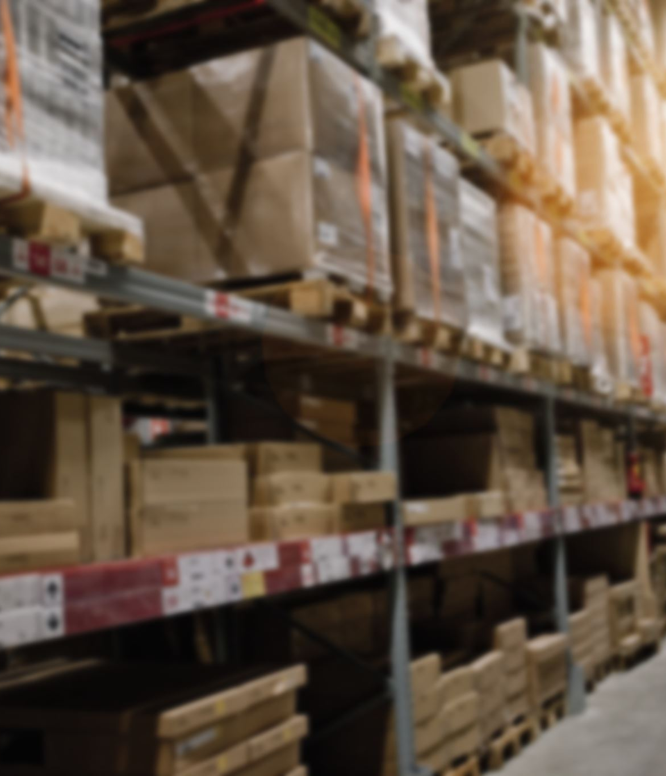
Before placing the order for the goods
*Determine the goods you need to import in respect of
  Description
  Quality
  Specifications
  Quantity
  * Send out information to the identified supplier clearly stating the following
    Description of the goods
    Technical specifications
    Quantity
    Price

Slide 23
Before placing the order for the goods
Determine the goods you need to import in respect of
    Delivery period
    Regulatory requirements e.g quality standards, health and safety standards
    Check to ensure that the goods are not prohibited or restricted from importation
    Check to determine whether the goods are exempted from duty
    Check to determine whether the goods attract countervailing and/or anti-dumping duties
    Determine the cost of the goods to be imported
    Organize for funding either internally or externally
    Consult your bank and obtain advice on how to deal with the supplier

Slide 24

Ordering the goods
Discuss with the selected supplier and agree on terms and enter into a contract
  Advise your supplier on the bank you will use
  Make payment arrangements according to the contract

Slide 25
Before Goods Arrive
Obtain the documents that your bank requires. Normally they will be:
  Commercial invoice
  Packing list
  Bill of lading/Airway bill
  Certificate of conformity
Appoint a clearing agent. The clearing agent assists the importer to clear all the customs duty on behalf of the importer.
The clearing agent computes customs duty, port charges and transport charges required and advises you.

Slide 26
Before Goods Arrive
The clearing agent makes arrangement for transport of the goods to your premises
The clearing agent prepares the customs declaration entry electronically, pays duty at the bank and lodges the supporting documents with Customs
Ensure the relevant quality certificates for the goods are available.
The Clearing agent clears with the Port Health Office,

Slide 27

Once Goods Arrive
Customs processes the documents
Release order is issued
Authentication of relevant compliance certificates and release of goods
Port charges are paid and goods are released to importer or clearing agent
Goods are collected and transported
Goods are received at your premises

Slide 28

IMPORT DOCUMENTATION
Supplier’s invoice
The supplier will provide the importer with the invoice for the goods sold to you. The invoice provides the details of the goods such as description of the goods, price and quantity.
ii. Packing list
Packing list provides the details of the contents of a particular package. It is also provided by the supplier.

Slide 29
IMPORT DOCUMENTATION
Bill of lading / airway bill
This is the document evidencing a contract of carriage of goods between a shipper and a carrier of goods (ship or airline). The supplier will send the document to you after s/he has passed the goods onto the carrier for shipping and they have acknowledged receipt.
Import Declaration Form (IDF Form C-61)
Issued by the KRA Customs Services offices and is required for all imports. You will need to pay a processing fee of Kshs 5,000 minimum or 2.75 percent of the CIF value. The IDF is completed by the clearing agent who enters information such as the importers and exporter’s names and contacts, invoice details, description and quantity of the goods.

Slide 30

IMPORT DOCUMENTATION
Declaration of customs value (Form C- 52)
Issued by the Customs Services Department. As an importer, you are required to complete it and sign it to show that you have declared the true and accurate value of the imported goods.
vi. Certificates of compliance
This is processed as required by the different authorities such as KEBS. Examples include certificate of conformity, certificate of analysis and phytosanitary certificate. These are issued by the competent authorities in the supplier’s country after inspecting the goods. The supplier will then send you the relevant certificate to show that the goods comply with the local requirements.
vii. Release Order
Release order is issued by the port authority. This document allows the goods to be released to you or to your agent’s custody after verification and payment of the storage and other charges that may have accrued.

Slide 31
IMPORT COSTS
There are several costs incurred while importing goods into the country. These may include;
i) Purchase price
This is the cost incurred on purchase of the goods. It is the cost indicated by the purchase invoice.
ii) Freight
This is the cost of transporting goods from the place of origin to the port or place of destination.
.

Slide 32
IMPORT COSTS
iii) Insurance
This is the cost of insuring the goods while on transit to the importer. Most of the time is paid by the supplier
iv) Customs duty and taxes
This refers to the tariffs paid to the revenue authority while importing goods.ie custom duty
v) Port charges
Local transport
Clearing agent fee

Slide 33
Conclusion
In conclusion, international purchasing has evolved from a reactive cost-cutting tool into a proactive strategy for gaining a competitive edge
Effective international purchasing relies on top management support, efficient communication, and solid supplier relationships, though challenges include exchange rate volatility, legal complexities, and logistical barriers
To mitigate risks such as political instability and quality issues, firms must follow systematic supplier selection and comply with import procedures and documentation requirements

Slide 34

Revision questions
Define international purchasing and explain how its strategic importance has evolved in a global economy
Identify and discuss three primary reasons organizations choose to source internationally. Give examples for each reason.
What are the main risks associated with international purchasing, and how can companies mitigate these risks?
Outline the basic import procedures before ordering, during ordering, and after goods arrive, highlighting the importance of each step
Explain the types of documentation required in a typical import clearing transaction and their significance in the import process

Slide 35
END

