Slide 1
Biometrics
Lecture 2
Design of a biometrics system
Lecturer: Dr. Joshua Okemwa

Slide 2
Expected learning outcomes
At the end of the lecture you will be able to:
Understand the nature of biometrics operation
Discuss the module composition of biometric system.
Evaluate the mode of operation of biometric system.

Slide 3
Areas of focus
The main areas of focus in this presentation include:
Biometric System
Modes of Operation
Modules
Types of Biometric Recognition

Slide 4
Biometric Systems
A biometric system is a pattern recognition system that operates by:
Acquiring biometric data: It captures physical or behavioural traits of an individual, such as fingerprints, facial features, iris patterns, voice, or gait.
Feature extraction: It processes the captured data to extract distinctive features that can uniquely identify the individual.

Slide 5
cont.…
A biometric system is a pattern recognition system that operates by:
Comparison: The extracted biometric features are then compared against stored biometric templates in a database to check for a match.
Decision-making: Based on the comparison, the system either verifies or identifies the individual, allowing or denying access, depending on the application.

Slide 6
operational mode
There are two modes of operation.
Verification Mode
Identification Mode.
Depending on the Application Context, Biometric System can work either on Verification Mode or in Identification Mode.

Slide 7
Explanation
1. Verification Mode (1:1 Matching):
Purpose: To confirm a person's identity by comparing their biometric data to a pre-enrolled template.
Use Case: Authentication (e.g., unlocking a smartphone with a fingerprint or face).

Slide 8
Explanation
1. Verification Mode (1:1 Matching):
Process:
The system captures the user's biometric data (e.g., fingerprint or face).
It compares this input to a stored template associated with the user's claimed identity.
The system checks for a match and either grants or denies access based on whether the biometric data matches the stored template.

Slide 9
Explanation
2. Identification Mode (1: Many Matching):
Purpose: To identify an individual from a large database of biometric templates without the user claiming an identity.
Use Case: Security checkpoints, law enforcement (e.g., searching a database for criminal suspects).

Slide 10
Explanation
Process:
  The system captures the individual's biometric data.
  It compares the data to all the templates in the system's database.
  It identifies the person by finding the best match or reports a failure if no match is found.

Slide 11
Why Biometrics is Required?
With increasing use of Information Technology in the field of banking, science, medication, etc., there is an immense need to protect the systems and data from unauthorized users.
Biometrics is used for authenticating and authorizing a person.

Slide 12
Cont…
Authentication (Identification)
This process tries to find out answer of question, “Are you the same who you are claiming to be?”, or, “Do I know you?” This is one-to-many matching and comparison of a person’s biometrics with the whole database.

Slide 13
Cont…
Verification
This is the one-to-one process of matching where live sample entered by the candidate is compared with a previously stored template in the database. If both are matching with more than 70% agreeable similarity, then the verification is successful.

Slide 14
Cont…
Authorization
It is the process of assigning access rights to the authenticated or verified users. It tries to find out the answer for the question, “Are you eligible to have certain rights to access this resource?”

Slide 15
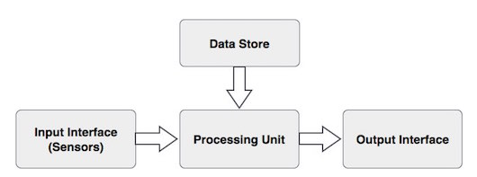
Basic Components of a Biometric System

Slide 16
Explanation
Input Interface (Sensors)
It is the sensing component of a biometrics system that converts human biological data into digital form.
For example,
An optical sensor in case of fingerprint systems.
A microphone in case of voice recognition systems.

Slide 17
Cont…
Input Interface (Sensors)
Function: Provides interaction between the user and the system, allowing the user to input biometric data and receive feedback (e.g., a fingerprint scanner or a camera).
Examples: A mobile app interface for unlocking a phone or a kiosk at an airport.

Slide 18
Explanation
Database Store
The database stores the enrolled sample, which is recalled to perform a match at the time of authentication.
For identification, there can be any memory from Random Access Memory (RAM), flash EPROM, or a data server.
For verification, a removable storage element like a contact or contactless smart card is used.

Slide 19
Explanation
Output Interface
The output interface communicates the decision of the biometric system to enable the access to the user.
This can be a simple serial communication protocol RS232, or the higher bandwidth USB protocol. It is widely used for simple, point-to-point communication between computers and devices like modems, printers, and other peripherals.
It could also be TCP/IP protocol, Radio Frequency Identification (RFID), Bluetooth, or one of the many cellular protocols.

Slide 20
Explanation
Processing Unit
The processing component is a microprocessor, Digital Signal Processor (DSP), or computer that processes the data captured from the sensors.
The processing of the biometric sample involves:
Sample image enhancement
Sample image normalization
Feature extraction
Comparison of the biometric sample with all stored samples in database.

Slide 21
Working of a Biometric System
There are four general steps a biometric system takes to perform identification and verification −
1. Acquire live sample from candidate. (using sensors)
2. Extract prominent features from sample. (using processing unit)
3. Compare live sample with samples stored in database. (using algorithms)
4. Present the decision. (Accept or reject the candidate.)

Slide 22
Cont…
The biometric sample is acquired from candidate user. The prominent features are extracted from the sample and it is then compared with all the samples stored in the database. When the input sample matches with one of the samples in the database, the biometric system allows the person to access the resources; otherwise prohibits.

Slide 23
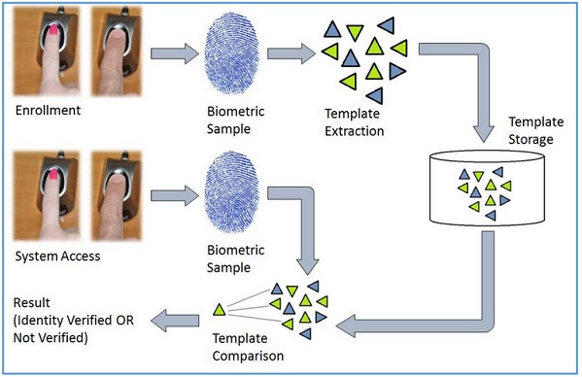
Diagram
Source: tutorialspoint.com

Slide 24
Biometrics Terminologies
Biometric Template − It is a digital reference of the distinct characteristics that are extracted from a biometric sample.
Candidate/Subject − A person who enters his biometric sample.
Closed-Set Identification − The person is known to be existing in the database.

Slide 25
Cont.…
Enrollment − It is when a candidate uses a biometric system for the first time, it records the basic information such as name, address, etc. and then records the candidate’s biometric trait.
False Acceptance Rate (FAR) − It is the measure of possibility that a biometric system will incorrectly identify an unauthorized user as a valid user.
FAR =Number of False Acceptances / Number of Identification Attempts
A biometric system providing low FAR ensures high security.

Slide 26
Cont.…
False Reject Rate (FRR) − It is the measure of possibility that the biometric system will incorrectly reject an authorized user as an invalid user.
FRR =Number of False Rejections / Number of Identification Attempts
Open-Set Identification − The person is not guaranteed to be existing in the database.
Task − It is when the biometric system searches the database for matching sample.

Slide 27
Modules needed to build a biometric system
To build a biometric system, several essential hardware and software modules are required to ensure it functions correctly.
Sensor module
Feature Extraction module
Matcher Module
System Database Module

Slide 28
Explanation
Sensor Module- It captures the Biometric data of an Individual. An example can be a Fingerprint Sensor.
Feature Extraction Module- Here the obtained biometric data of an Individual is processed to extract features. Example can be the Local ridge feature extraction from a Fingerprint.

Slide 29
Cont.…
Matcher Module- Here the features extracted during the above phase are matched against the templates stored in the database.
System Database Module- Used to Store Biometric templates of the users enrolled. The enrollment module is responsible for Enrolling Individuals to the database.

Slide 30
Review Questions
Discuss the two modes of Biometric system operations
Using a block diagram describe the following processes
  Enrollment phase
  Identification phase
  Verification phase
State the FOUR major modules of a biometric system
Explain the role of each module that you mentioned in above
A biometric system is basically a pattern matching system T/F

Slide 31
References
Li, S. Z., & Jain, A. K. (Eds.). (2020). Encyclopedia of biometrics (2nd ed.). Springer.
www. Tutorialspoint.com
Rocha, A., & Conci, A. (2023). Biometric systems: Security, privacy, and applications. Springer. https://doi.org/10.1007/978-3-031-12511-4

