Slide 1
Biometrics
Lecture 3
Fingerprints
Lecturer: Dr. Joshua Okemwa

Slide 2
Expected learning outcomes
At the end of the lecture you will be able to:
Understand biometrics modalities
Discuss various biometric fingerprint patterns
Evaluate the merits and demerits of fingerprint biometric system

Slide 3
Areas of focus
The main areas of focus in this presentation include:
Biometric Modalities
Types of Biometric Modalities
Fingerprint Patterns
Fingerprint matching techniques
Merits and Demerits for fingerprint recognition system

Slide 4
Biometrics Modalities
Biometric modalities refer to the different types of human physiological and behavioral traits that can be used for identification and authentication in biometric systems.
The category of a biometric system depending upon the type of human trait it takes as input.
The biometrics is largely statistical. The more the data available from sample, the more the system is likely to be unique and reliable.

Slide 5
Cont.…
It can work on various modalities pertaining to measurements of individual’s body and features, and behavioral patterns.
These modalities are employed based on their uniqueness, permanence, and ease of measurement, and they vary in terms of accuracy, security, and usability.

Slide 6
Types of Biometric Modalities
Here’s an overview of key biometric modalities, fall under three types:
  Physiological
  Behavioral
  Combination of physiological and behavioral modality

Slide 7
Cont.…
Physiological Modality | Behavioral Modality | Combination of Both Modalities
This modality pertains to the shape and size of the body. | This modality is related to change in human behavior over time. | This modality includes both traits, where the traits are depending upon physical as well as behavioral changes.
For example − Fingerprint Recognition Hand Geometry Recognition system Facial Recognition System Iris Recognition System Hand Geometry Recognition System Retinal Scanning System DNA Recognition System | For example − Gait (the way one walks) Rhythm of typing keys Signature | For example − Voice Recognition It depends on health, size, and shape of vocal cord, nasal cavities, mouth cavity, shape of lips, etc., and the emotional status, age, illness (behavior) of a person.

Slide 8
Cont.…
Physiological Modality | Behavioral Modality | Combination of Both Modalities
This modality pertains to the shape and size of the body. | This modality is related to change in human behavior over time. | This modality includes both traits, where the traits are depending upon physical as well as behavioral changes.
For example − Fingerprint Recognition Hand Geometry Recognition system Facial Recognition System Iris Recognition System Hand Geometry Recognition System Retinal Scanning System DNA Recognition System | For example − Gait (the way one walks) Rhythm of typing keys Signature | For example − Voice Recognition It depends on health, size, and shape of vocal cord, nasal cavities, mouth cavity, shape of lips, etc., and the emotional status, age, illness (behavior) of a person.

Slide 9
FINGERPRINTS
It is the most known and widely used biometrics solution to authenticate people on biometric systems.
It identifies individuals based on the unique patterns of ridges and valleys present on their fingertips.
This method leverages the distinctiveness of fingerprints, which remain largely unchanged throughout a person's lifetime, making it a reliable and secure biometric modality.

Slide 10
Cont.…
Every person has a unique fingerprint which is composed of ridges, grooves, and direction of the lines. There are three basic patterns of ridges namely, arch, loop, and whorl. The uniqueness of fingerprint is determined by these features as well as minutiae features such as bifurcation and spots (ridge endings).

Slide 11
Fingerprint Patterns
Fingerprint patterns are the unique configurations of ridges and valleys found on a person's fingertips. These patterns are used in fingerprint recognition systems to identify individuals. There are three primary types of fingerprint patterns
Arch Pattern
Overview: Arch patterns are the simplest and least common type of fingerprint pattern, appearing in about 5% of the population.

Slide 12
Cont.…
Characteristics: Ridges flow from one side of the finger to the other without forming any significant loops or whorls.
Subtypes:
Plain Arch: The ridges enter from one side of the finger, rise slightly in the middle, and exit on the opposite side, creating a gentle wave-like appearance.
Tented Arch: Similar to the plain arch, but with a more pronounced spike or angle in the center, resembling a tent.

Slide 13
Cont.…
ii. Loop Pattern
Overview: Loop patterns are the most common, occurring in about 60-70% of the population.
Characteristics: The ridges enter from one side of the finger, curve around, and exit on the same side. Loops always have at least one delta (a triangular region where ridge patterns diverge).

Slide 14
Cont.…
Subtypes:
  Ulnar Loop: The ridges flow toward the little finger (ulna bone side). If looking at a right hand, the ridges loop toward the right, and for the left hand, they loop toward the left.
  Radial Loop: The ridges flow toward the thumb (radius bone side). This pattern is less common than the ulnar loop.

Slide 15
Cont.…
iii. Whorl Pattern
Overview: Whorl patterns are more complex and appear in about 25-30% of the population.
Characteristics: Ridges form circular or spiral patterns, often containing two deltas.

Slide 16
Cont.…
Subtypes:
Plain Whorl: The simplest form of whorl, with ridges forming a symmetrical circular or spiral pattern. There are two deltas, one on each side of the pattern.
Central Pocket Loop Whorl: Similar to a plain whorl, but the circular pattern is tighter and not as symmetrical. It also has two deltas, but the core of the whorl is closer to one of the deltas.

Slide 17
Cont.…
Subtypes:
Double Loop Whorl: Consists of two distinct loop formations that twist around each other, often resembling the shape of the letter "S". This pattern also has two deltas.
Accidental Whorl: A combination of two or more pattern types (usually a mix of loops, arches, and whorls) that doesn’t fit clearly into any of the other categories. There are typically three or more deltas.

Slide 18
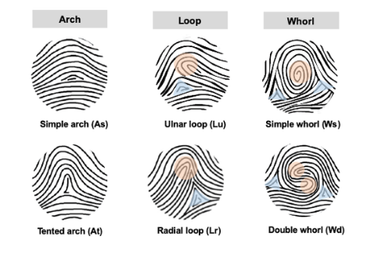
Diagram
Source:eurekalert.org

Slide 19
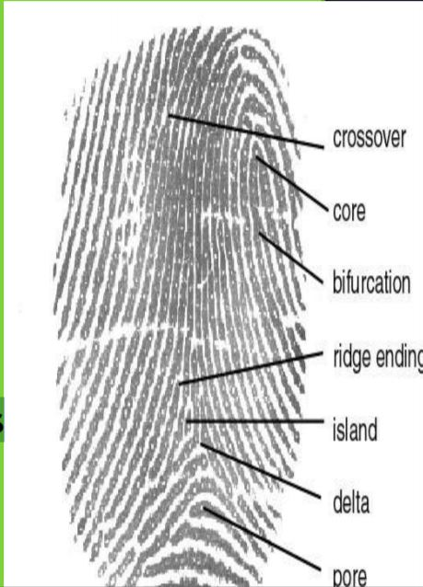
Fingerprint Patterns
Crossover: two ridges cross each other Core: centre
Bifurcation: ridge separates
Ridge ending: end point
Island: small ridge b/w two
spaces
Delta: space between ridges
Pore: human pore
Source:mdpi.com

Slide 20

Fingerprint matching techniques
Fingerprint matching techniques are of three types
i. Minutiae Based Techniques − In these minutiae (precise) points are found and then mapped to their relative position on finger. There are some difficulties such as if image is of low quality, then it is difficult to find minutiae points correctly. Another difficulty is, it considers local position of ridges and furrows; not global.

Slide 21
Cont.…
Fingerprint matching techniques are of three types
ii. Correlation Based Method − (finding relationship) It uses richer gray scale information. It overcomes problems of minutiae-based method, by being able to work with bad quality data. But it has some of its own problems like localization of points.
iii. Pattern Based (Image Based) Matching − Pattern based algorithms compare the basic fingerprint patterns (arch, whorl, and loop) between a stored template and a candidate fingerprint.

Slide 22
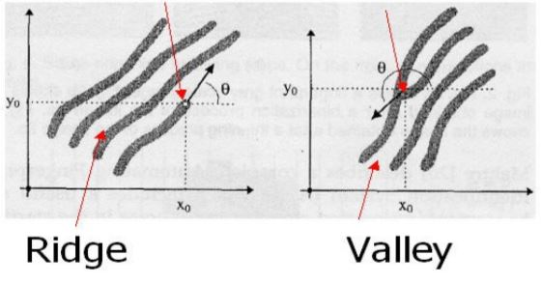
Cont.…
Source:semanticscholar.org
The two most prominent local ridge characteristics, called minutiae, are
1) ridge ending and
2) ridge bifurcation.
A ridge ending is defined as the point where a ridge ends abruptly.
A ridge bifurcation is defined as the point where a ridge forks or diverges into branch ridges

Slide 23
Fingerprint recognition problem
The fingerprint recognition problem can be grouped into two sub-domains:
Fingerprint verification :
Fingerprint verification is to verify the authenticity of one person by his fingerprint.
Fingerprint identification:
Fingerprint identification is to specify one person’s identity by his fingerprint(s).

Slide 24
Fingerprint recognition system
A fingerprint recognition system is a biometric technology that identifies and verifies a person by analyzing the unique patterns in their fingerprints.
This system captures a fingerprint, extracts its distinguishing features, and compares them to previously stored fingerprint data for authentication or identification purposes.
Fingerprint recognition system operates in three stages:
      Fingerprint acquiring device
      Minutia extraction and
      Minutia matching

Slide 25
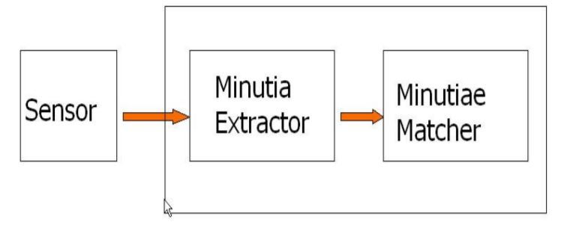
Diagram
Source: slideshare.net

Slide 26
Explanation
Fingerprint Acquiring Device:
  This device captures the fingerprint image. Common types include optical, capacitive, and ultrasonic sensors. Optical sensors use light to create an image of the fingerprint, while capacitive sensors measure electrical signals, and ultrasonic sensors use sound waves to capture the fingerprint’s details.

Slide 27
Cont.…
2. Minutia Extraction:
Minutiae are the unique features of a fingerprint, such as ridge endings and bifurcations. The extraction process involves several steps:
  Preprocessing: Enhancing the fingerprint image by denoising, binarization, thinning, and dilation.
  Detection: Identifying and marking the minutiae points.

Slide 28
Cont..
3.Minutia Matching:
This step involves comparing the extracted minutiae from the captured fingerprint with those stored in a database. The matching process typically uses algorithms to calculate the similarity between the minutiae sets.

Slide 29
Types of Fingerprint Sensors
Optical Sensors: Capture an image of the fingerprint using light. These are common in smartphones but can be affected by dirty or wet fingers.
Capacitive Sensors: Measure the electrical conductivity of the finger ridges and valleys, creating a more accurate and resistant-to-spoofing fingerprint image.
Ultrasonic Sensors: Use sound waves to capture the details of the fingerprint. These are highly accurate and can capture prints even through dirt or moisture.

Slide 30
Merits of Finger Recognition System
It is the most contemporary method.
It is most economical method.
It is highly reliable and secure.
It works on a small template size, which speeds up the verifying process.
It consumes less memory space.

Slide 31
Demerits of Finger Recognition System
Scars, cuts or absence of finger can hinder the recognition process.
The systems can be fooled by using artificial finger made of wax.
It involves physical contact with the system.
They leave the pattern of finger behind at the time of entering sample.

Slide 32
Applications of Finger Recognition System
Verification of driver-license authenticity.
Checking validity of driving license.
Border Control/Visa Issuance.
Access control in organizations.

Slide 33
References
Maltoni, D., Maio, D., Jain, A. K., & Prabhakar, S. (2022). Handbook of fingerprint recognition (2nd ed.). Springer.
Jain, A. K., Flynn, P., & Ross, A. A. (2024). Guide to biometrics. Springer
Komarinski, P. (2005). Automated fingerprint identification systems (AFIS). Elsevier.

